Slide 1

Policy and Practice
Connecting Alternate Assessment
to Instruction and Licensure
Dynamic Learning Maps, Early Literacy and Math Screeners
Alt ELPA Screener and Summative

Slide 2

Welcome
Please post your questions in the Q&A
Slides will be posted on the DE website after the webinar
Policy & Practice Webinar Series & Recordings | Department of Education

Slide 3

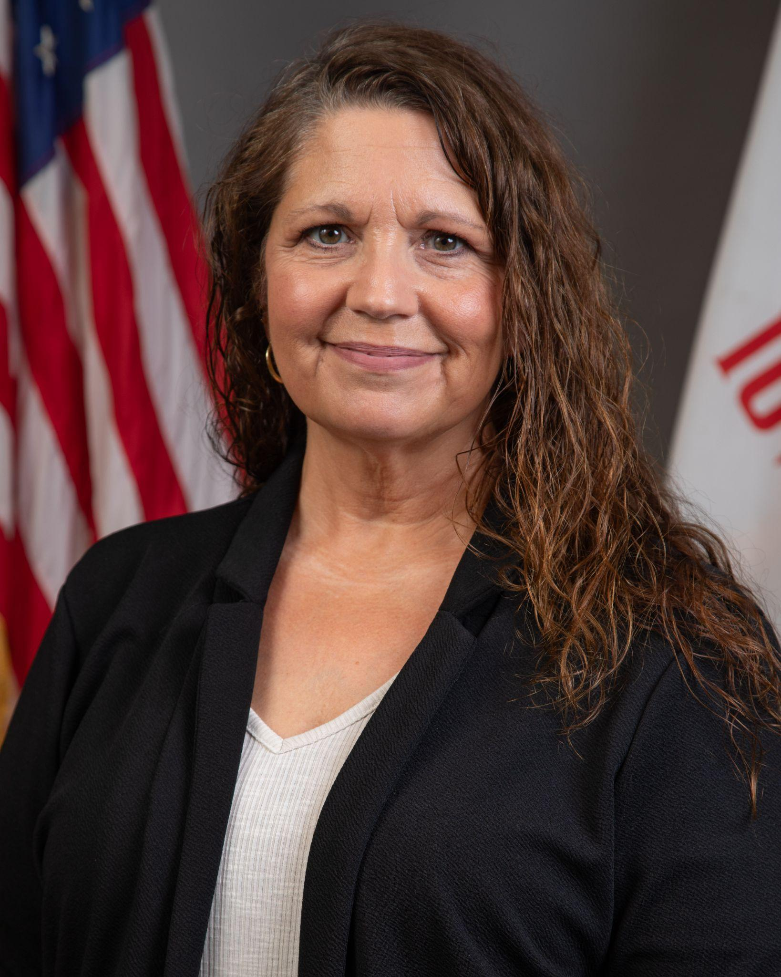

Today’s Presenters
Patrick Judkins
Keystone Regional Special Education Director
Division of Special Education
Jennifer Denne
EPC Alternate Assessment
Division of School Improvement
Mike Cavin
Executive Director
Bureau of Educational Examiners

Slide 4
Participants will understand:
Iowa Code and the purpose of Iowa’s Alternate Assessments
Criteria and considerations that must be discussed with the IEP team
How eligibility for participation in Iowa’s Alternate Assessments is determined
Licensure/endorsement requirements

Slide 5
Practice

Slide 6
Iowa Code In Relation To Alternate Assessment
Federal Requirement - IDEA
  All students with disabilities must participate in statewide or alternate assessments, as required by the Individuals with Disabilities Education Act (IDEA).
State Implementation - Iowa Administrative Code 281-41
  Iowa implements IDEA assessment requirements through Iowa Administrative Code 281-41.
Statewide Participation Limit - 1% Cap
  No more than 1% of all assessed students statewide may participate in the alternate assessment aligned to alternate academic achievement standards.
IEP Team Responsibility
  IEP teams must make individualized, data-based decisions regarding assessment participation in alignment with IDEA and Iowa Administrative Code 281-41.

Slide 7
Purpose of Iowa’s Alternate Assessments
Intended Population
  Iowa’s alternate assessments are designed for students with the most significant cognitive disabilities.
IEP Team Decision-Making
  Participation decisions are made by the IEP team and must be individualized and data based.
Exclusive Assessment Option
  If selected, the alternate assessment must be used for all assessed content areas.
Annual Review Requirement
  Participation decisions must be reviewed annually as part of the IEP process.
IDEA Alignment
  All decisions must be consistent with IDEA requirements and Iowa Administrative Code 281-41.

Slide 8
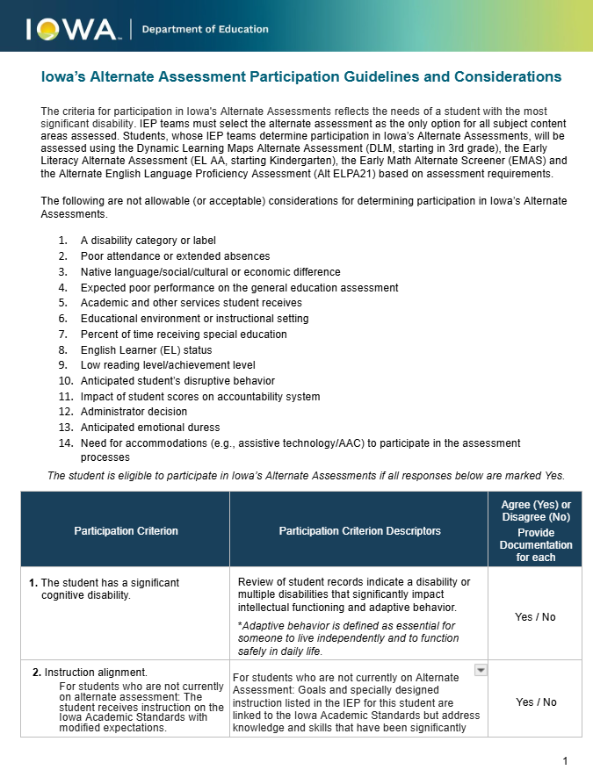
Iowa’s Alternate Assessment Participation Guidelines and Considerations
Excerpt from: Iowa’s Alternate Assessment Participation Guidelines and Considerations

Slide 9
Considerations That are NOT Allowable
Disability category or label
Poor attendance or extended absences
Native language, cultural, social or economic differences
Expected poor performance on general assessments
Academic and other services student receives
Educational environment or instructional setting
Percent of time in special education

Slide 10
Considerations That are NOT Allowable (Cont.)
English Learner (EL) status
Low reading or achievement levels
Anticipated student’s disruptive behavior
Impact of student scores on accountability system
Administrator decision
Anticipated emotional duress
Need for accommodations (including AAC or assistive technology)

Slide 11
Participation Criteria and Considerations
All three criteria must be applicable to the student in order to participate in the alternate assessment.
The student has a significant cognitive disability.
Instruction would be aligned to either the Iowa Academic Standards with modified expectations or the Essential Elements.
The student requires extensive direct individualized instruction and substantial supports to achieve measurable gains in the grade-and age- appropriate curriculum.
For better clarity, Iowa added four considerations that IEP teams should consider in answering the participation criteria: progress towards standards, accommodation, modifications and adaptive behavior.

Slide 12
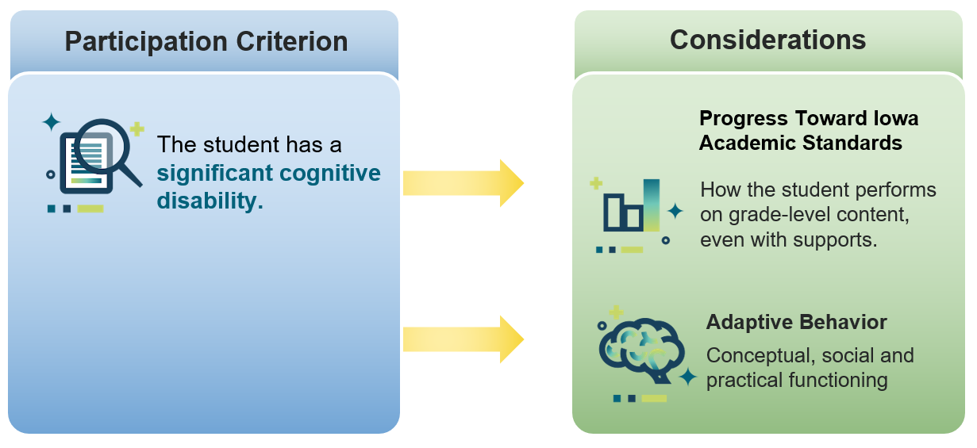
Participation Criterion 1
Most Significant Cognitive Disability

Slide 13
Criterion 1 - Data Based Decision
The IEP team must consider data that indicates a disability or multiple disabilities that significantly impact intellectual functioning and adaptive behavior.
Are there data sources to show that the student is not responding to instruction? (Consideration 1)
What are the adaptive behavior needs and concerns? How do they impact access to and progress towards the general education curriculum? (Consideration 4)

Slide 14
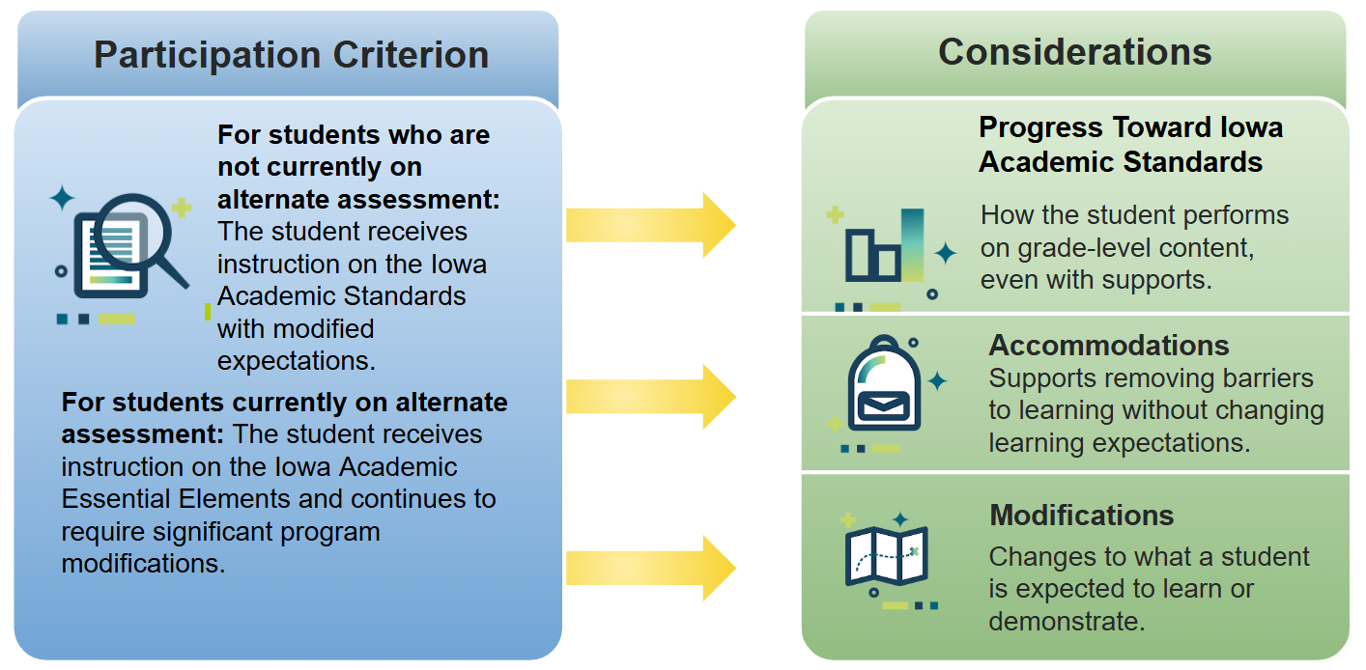
Participation Criterion 2

Slide 15
Criterion 2 - Data Based Decision
For students currently on alternate assessment and for those who may be eligible, the IEP team must consider data around the Iowa Academic Standards or the Essential Elements.
Are there data sources to show that the student is not responding to instruction? (Consideration 1)
Have considerable, highly individualized accommodations been provided and documented for access to core instruction? (Consideration 2)
Have considerable, highly individualized modifications been provided and documented for access to core instruction? (Consideration 3)

Slide 16
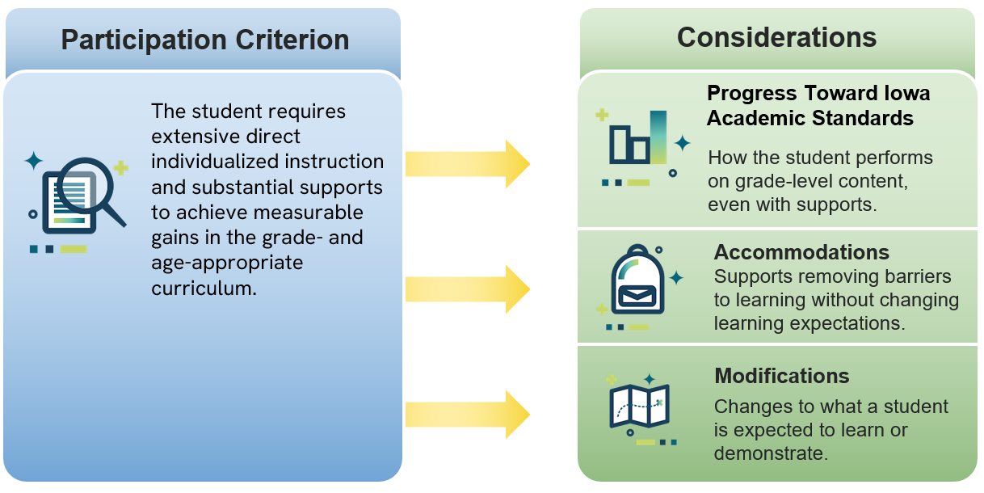
Participation Criterion 3

Slide 17
Criterion 3 - Data Based Decision
The IEP team must consider data supporting direct individualized instruction with substantial supports.
Are there data sources to show that the student is not responding to instruction? (Consideration 1)
Have considerable, highly individualized accommodations been provided and documented for access to core instruction? (Consideration 2)
Have considerable, highly individualized modifications been provided and documented for access to core instruction? (Consideration 3)

Slide 18
Eligibility
How is eligibility for Iowa’s alternate assessments determined?
No non-allowable considerations weigh in on the final determination
Through data-based conversations around the considerations 1-4, all 3 participation criterion are answered “Yes”
Evidence clearly supports participation in Iowa’s alternate assessment
An IEP team decision based on data that is reviewed at each annual IEP meeting

Slide 19
Key Takeaways for IEP Teams
Alternate assessment decisions are high-stakes and require careful documentation
Decisions must be:
  Individualized
  Data-driven
  Aligned to instruction
Participation decisions must be reviewed at least annually
The goal is meaningful access and appropriate challenge, not exclusion

Slide 20
Alternate Assessment

Slide 21
Alternate Assessment and Screeners
Iowa’s Alternate Screeners
Dynamic Learning Maps (DLM) - Alternate Assessment
Alternate to ISASP
Grades 3-11
English Language Arts, Math, Science
Instructionally Embedded
  Instruction and Assessment Cycle
  Two windows (fall and spring)
Early Literacy
Alternate to district universal screener
Grades K-6
Instructionally Embedded
Early Math (Beginning Fall 2026)
Alternate to district universal screener
Grades K-6
Instructionally Embedded
Alt ELPA
Alternate to ELPA 21
Grades K-12

Slide 22
Early Childhood Considerations
There is no alternate assessment for preschool because the required assessment, GOLD, can be used with all students.
If alternate assessment is being discussed during a preschool to kindergarten transition meeting…
  multiple data sources, including assessment information, should be considered
  if the data does NOT clearly support placing a student on alternate assessment, access to general education curriculum and standards is the recommendation

Slide 23
Alternate Assessment Resources
Dynamic Learning Maps Webpage
Dynamic Learning Maps Educator Portal
Iowa’s Alternate Assessment Google Site
  Information on DLM, Early Alternate Screeners and Alt ELPA
  For access please contact jennifer.denne@iowa.gov
ELPA21 Website

Slide 24
Alternate Assessment Data
Dynamic Learning Maps
Kite DLM Educator Portal
Early Alternate Screeners
ACHIEVE

Slide 25
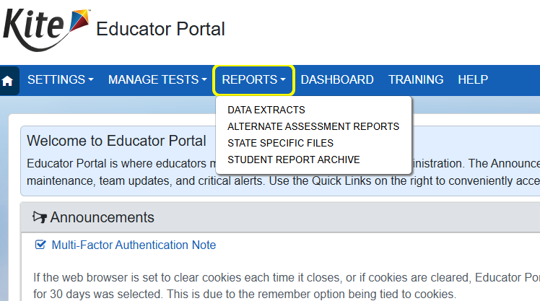
DLM Reports
Building administrators should have a Building Test Coordinator role or a Building User role to access DLM Reports.
To obtain access, contact your special education director or district alternate assessment lead.

Slide 26
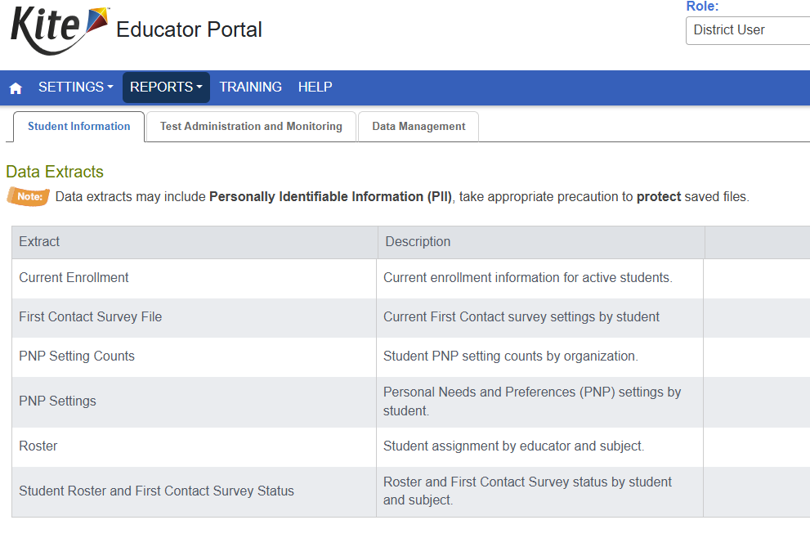
Reports Available

Slide 27
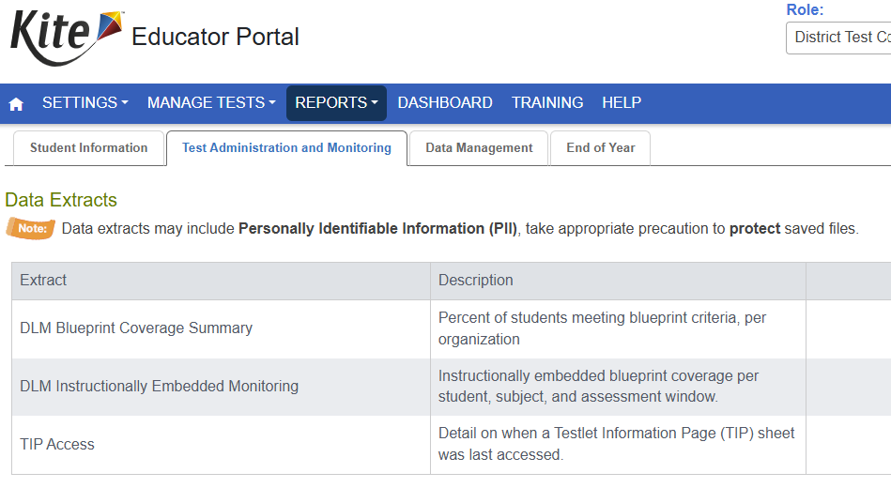
Reports Available

Slide 28
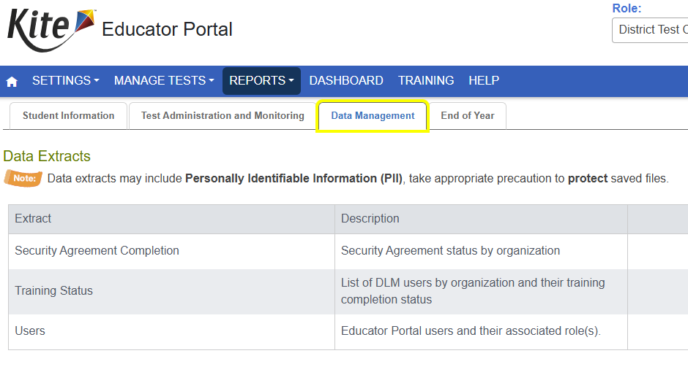
Reports Available

Slide 29
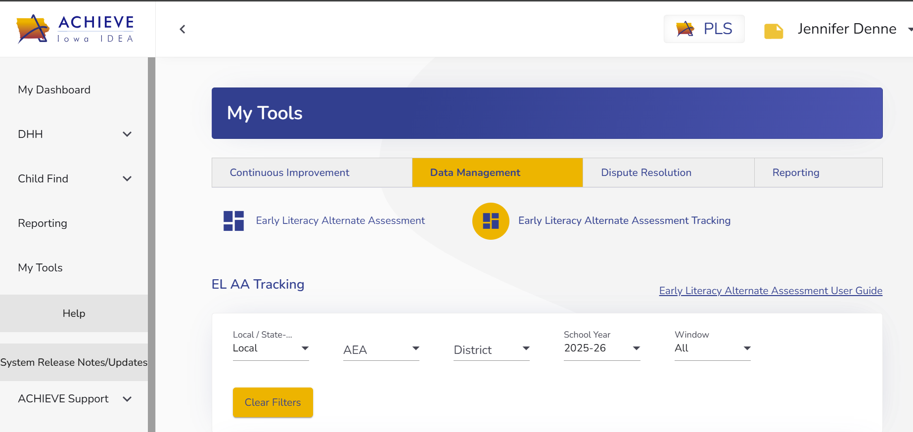
Screening Data
My Tools
  Data Management
    Early Literacy Alternate Assessment Tracking
      Select Data Filters

Slide 30
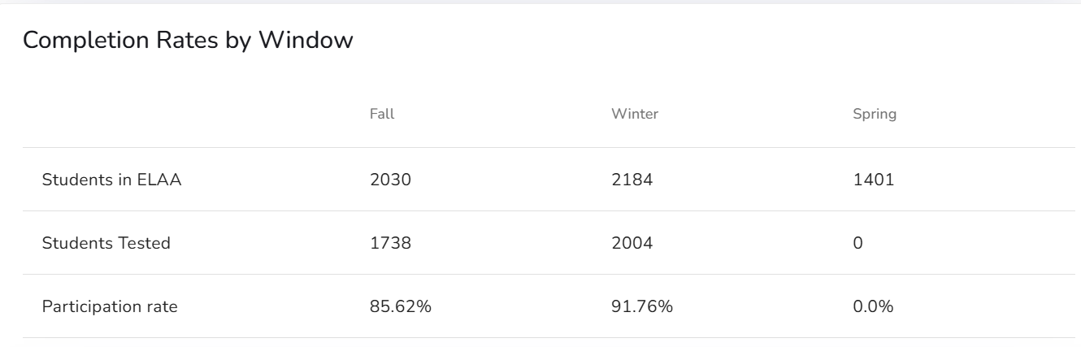
Dashboard Reports:
Percentage of Students Screened

Slide 31
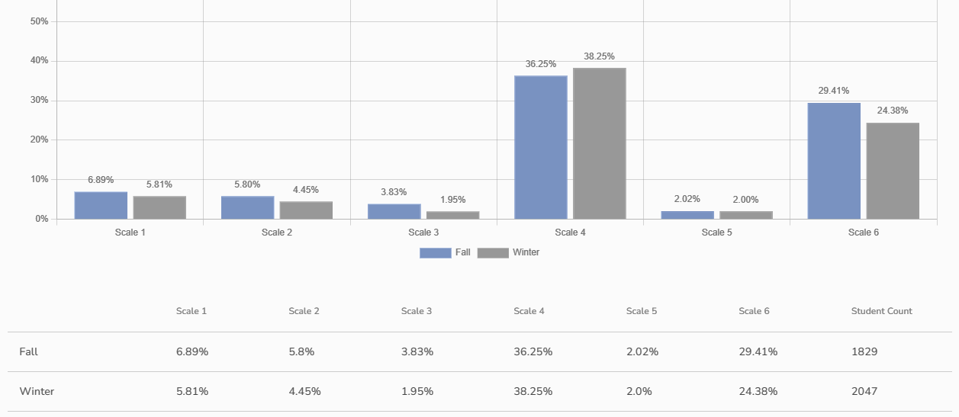
Dashboard Reports:
Percentage of Students who Met/Exceeded Benchmark by Scale

Slide 32
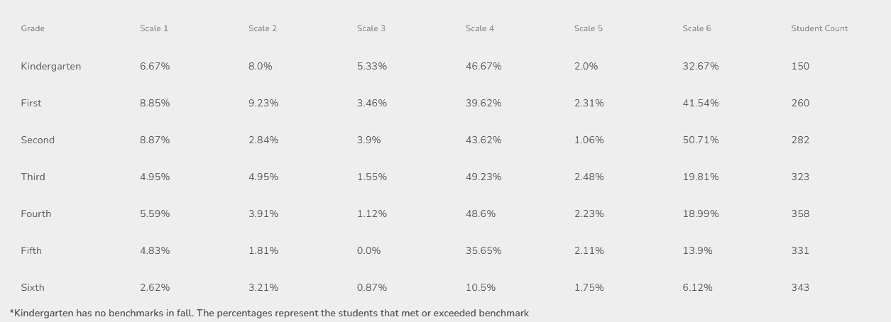
Dashboard Reports:
Percentage of Students Who Met or Exceeded Benchmarks by Scale and Grade

Slide 33
Policy

Slide 34
Iowa Teacher Licensure
Required Endorsements
Endorsement # 264 -
K-12 Instructional Strategist II:ID
Endorsement # 259 -
K-12 Instructional Strategist I and II: All
Endorsement 100 -
Pk-3 Including Special Education

Slide 35
Conditional Licensure
Executive Director Decision – less than 12 hours of special education coursework completed.
Class B – 12 hours or more of special education coursework completed.
Class E – a one year extension of a class B.

Slide 36
Substituting in an environment with students assessed under the Alternate Assessment.
•Any licensed teacher may substitute in any school setting at any grade level.
•Any educator holding a Substitute License may substitute in any school setting at any grade level.
•An educator holding a Substitute Authorization, may only sub for short periods of time (absent teacher).
•Licensed Paraeducator, with a Substitute Authorization, may sub for a short period of time, in the classroom they are assigned. Not in other areas without permission from the BoEE.

Slide 37
Licensure Questions
Geri McMahon
Geri.McMahon@iowa.gov
515-281-3437

Slide 38
Future Policy and Practice Webinars
Upcoming Topics and Dates (8:30 am - 9:30 am )
March 11, 2026: Extended School Year (ESY)
April 8, 2026: FAPE - Special Requests
May 13, 2026: Dispute Resolution
June 10, 2026: End of Year Program Evaluation (ACHIEVE) and Year-to-Year Data Comparison

Slide 39
Questions from the Field
Please type your questions into the Q & A.

Slide 40
Thank You!

