Slide 1


Empowering Iowa to Lead
Presentation on Iowa’s First-in-the-Nation
Unified Allocation Plan
Federal & Other Funds Appropriations Subcommittee
Feb. 5, 2026

Slide 2
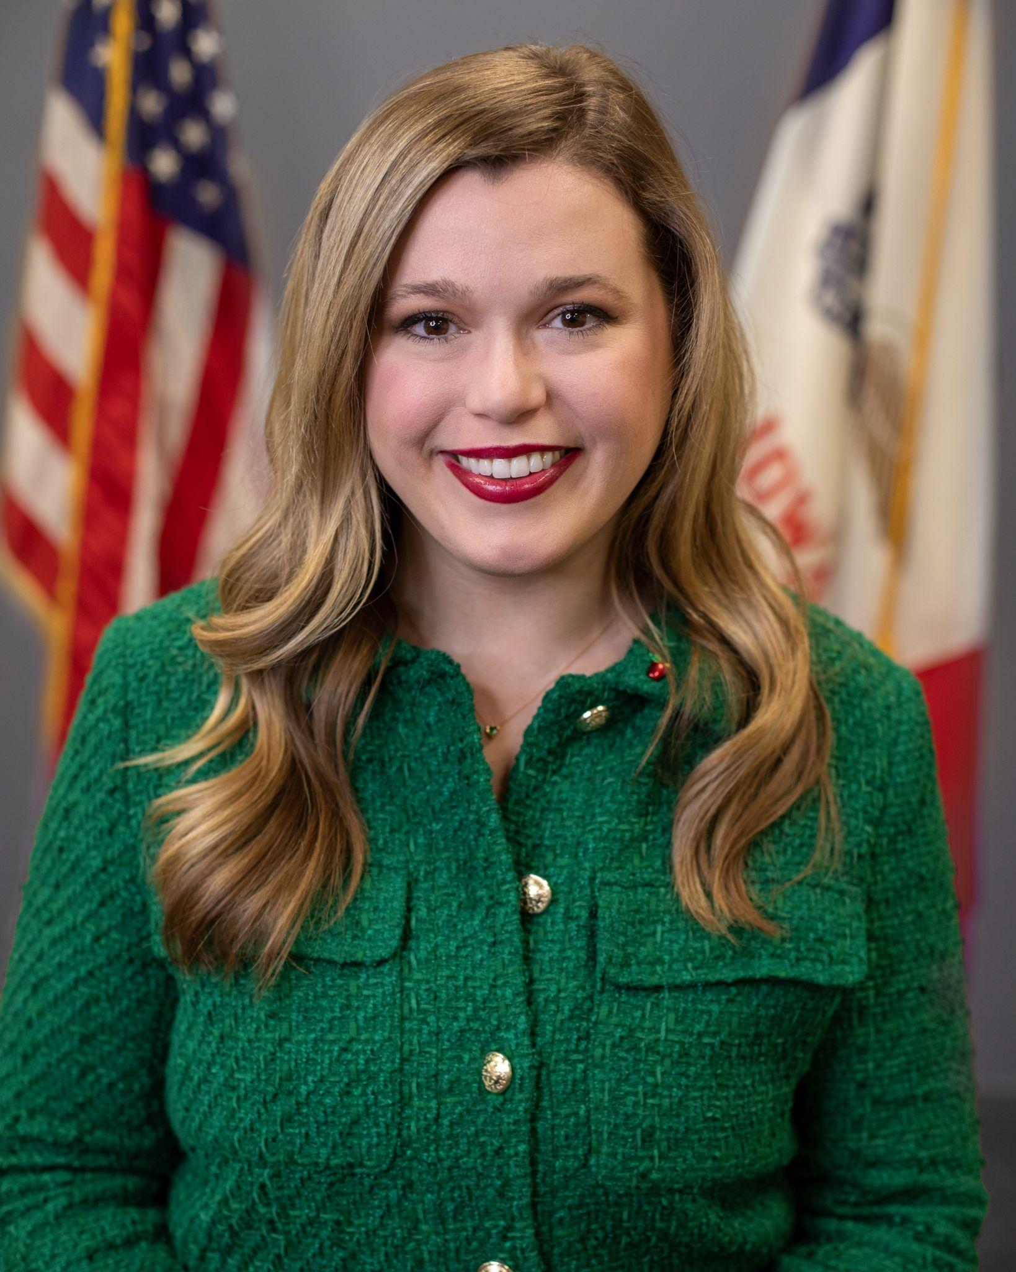
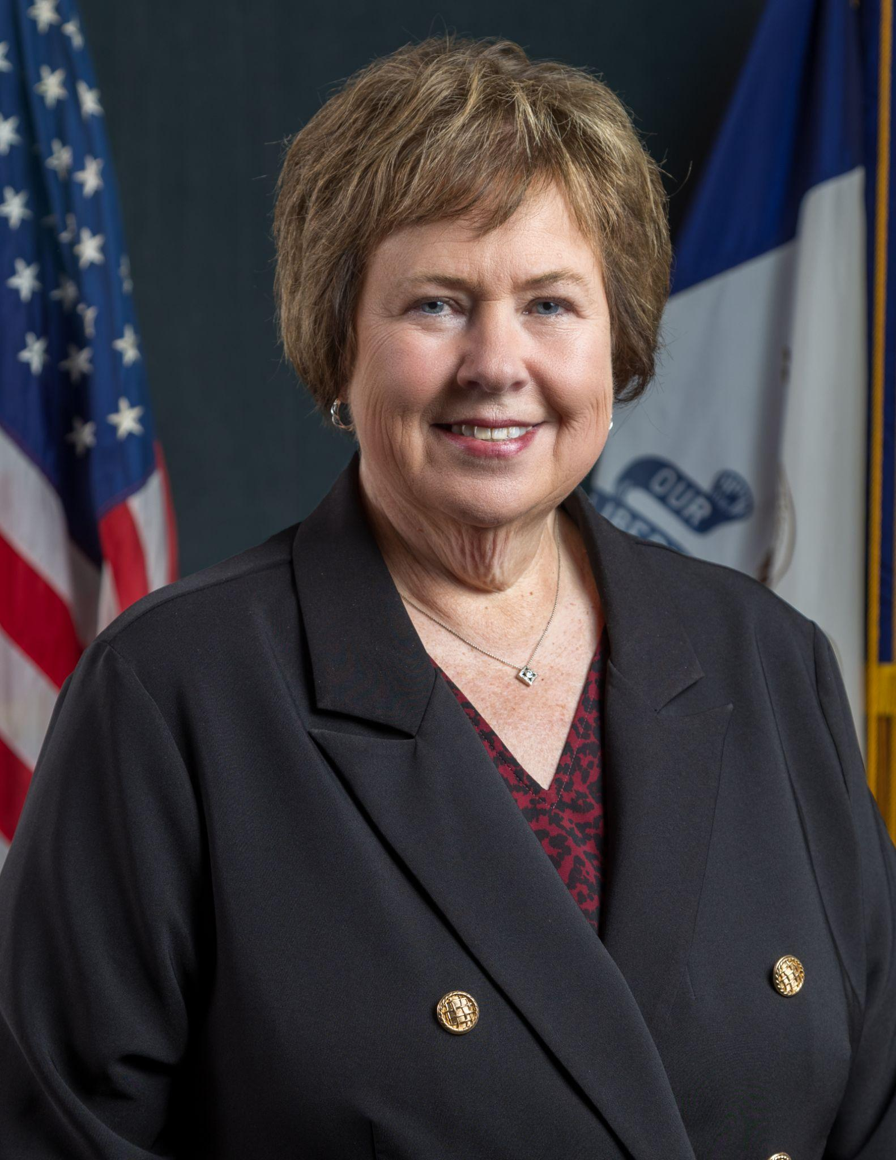
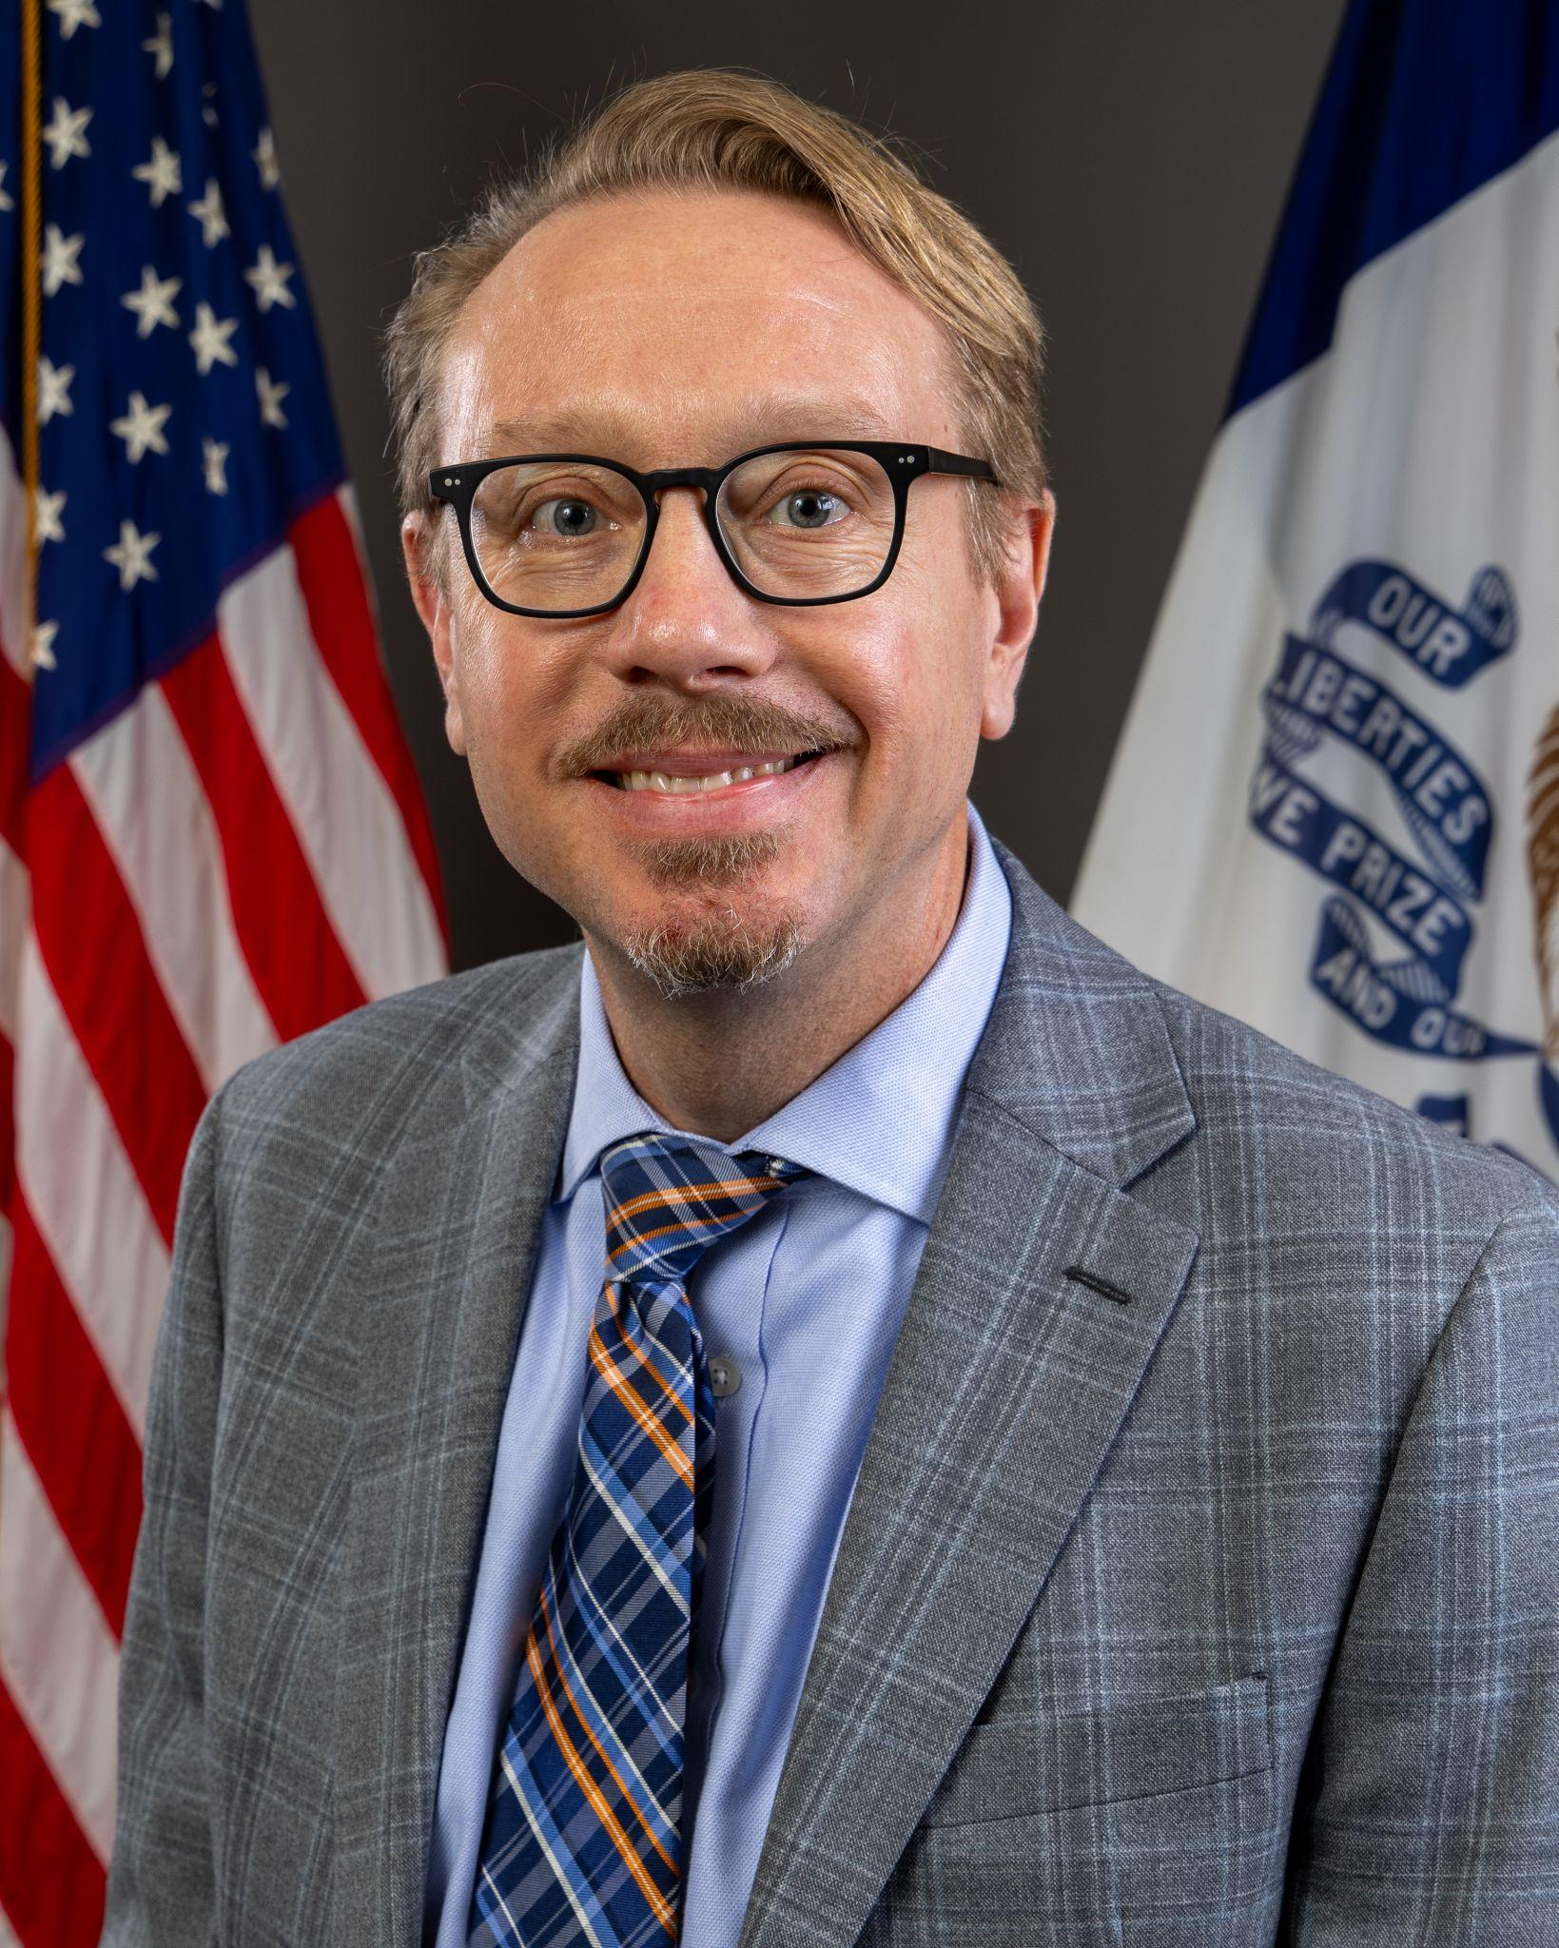
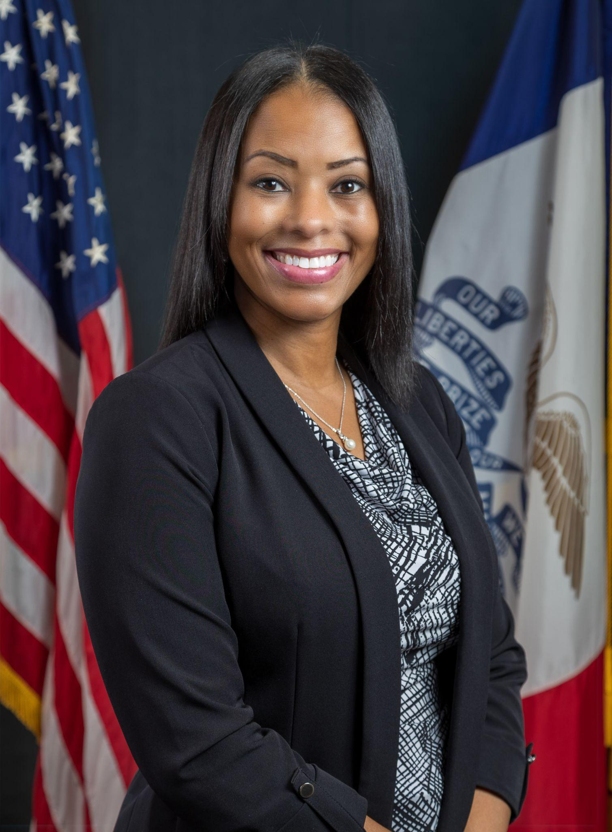
Our Presentation Team
McKENZIE SNOW
DIRECTOR
IOWA DEPARTMENT OF EDUCATION
TINA WAHLERT
DIVISION ADMINISTRATOR
PK-12 LEARNING
JAY PENNINGTON
DIVISION ADMINISTRATOR
TEACHER QUALITY & INNOVATION
JILLIAN DOTSON
BUREAU CHIEF
ESEA PROGRAMS
2

Slide 3
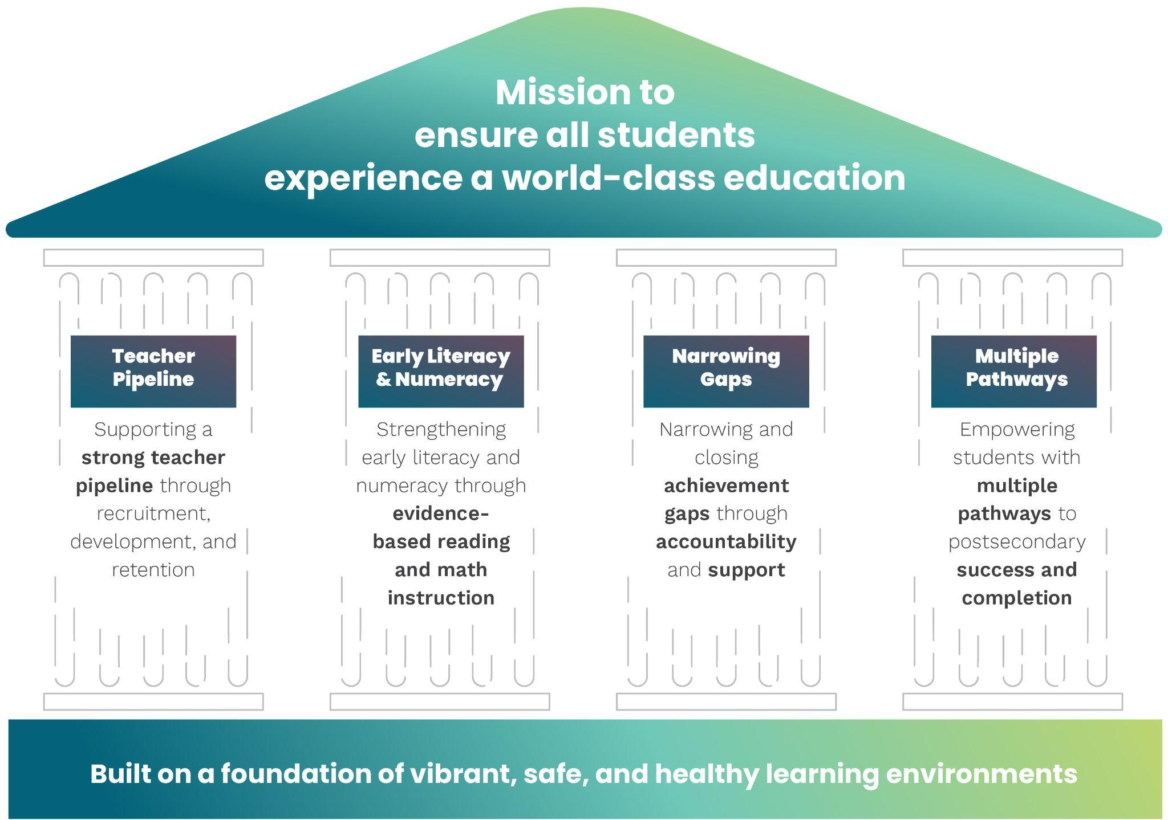
Our Bold Vision
3

Slide 4
Shaped by the experience and expertise of Iowans, our Unified Allocation Plan marks Iowa as the first state in the nation to receive a “Returning Education to the States” federal waiver approval.
Together, we’re refocusing federal resources on their true purpose – the success of all learners.
4

Slide 5
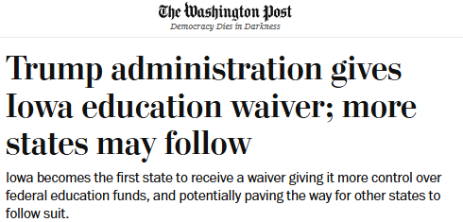
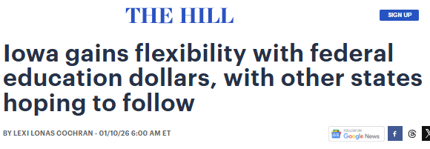
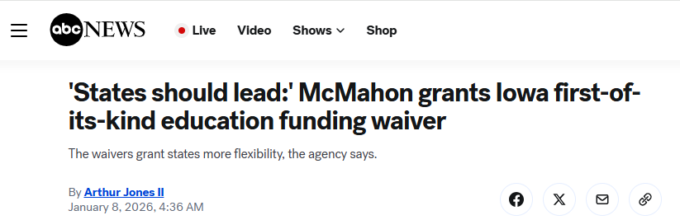
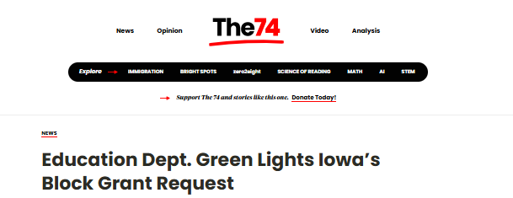
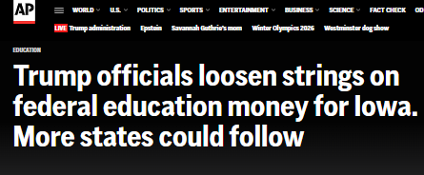
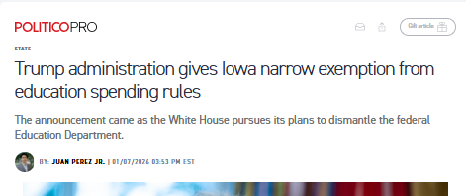
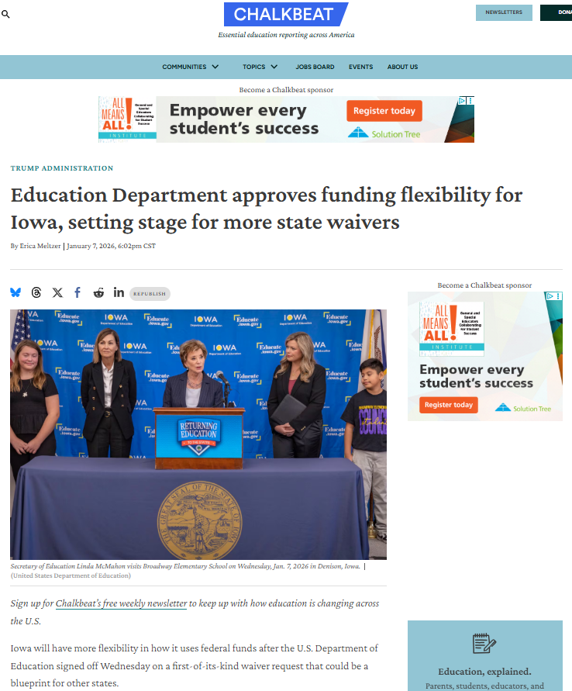
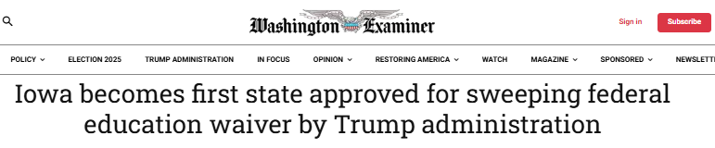
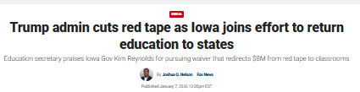

Slide 6
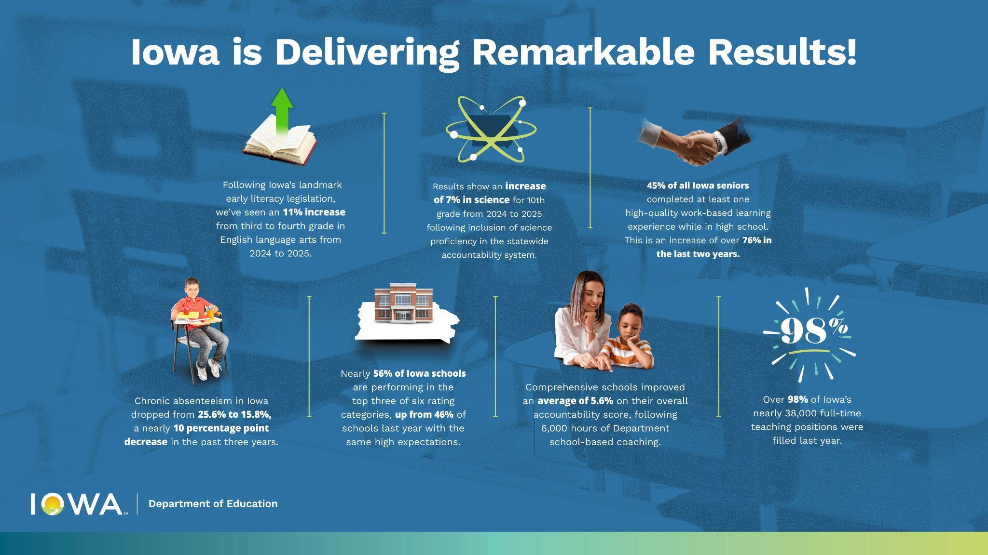
6

Slide 7
Early literacy is improving
Fourth graders showed an incredible 11 percentage point proficiency gain from third grade.
 | Literacy Changes Lives Act (2024) | Math Counts Act (2025)
Rigorous Academic Standards | Updated in 2024 and implemented beginning in the 2024-25 school year following 14 years without substantive review or revision | Updated in 2024 and implemented beginning in the 2024-25 school year following 14 years without any review or revision
High-Quality Instructional Materials | State purchasing list published with statewide contracts and negotiated pricing | State purchasing list published with statewide contracts and negotiated pricing
Early ID & Progress Monitoring | Universal screening 3x/year and monitoring of identified student progress at least biweekly | Universal screening 3x/year and monitoring of identified student progress at least biweekly
Strong Intervention Structures, including Personalized Academic Plans | K-6 Personalized Reading Plan required for all in-need students and embedded in State Early Warning System Statewide access to intelligent, personalized tutoring assistant, with 243 districts participating in performance-based contract | K-6 Personalized Math Plan required for all in-need students and embedded in State Early Warning System Statewide intervention supports include the Numeracy Project (K-8), SOAR (4-12), and Building Math Minds Tier ll and lll Interventions
Evidence-based PD | LETRS for 6,600 educators since 2023 | Building Math Minds for 1,265 educators since July 2025
High-Quality Teacher Preparation | Implementation of new TPP accreditation standards Self-assessment workbooks and targeted PD and TA to support TPPs aligning to revised standards Foundations of Reading test for teacher candidates | Implementation of new TPP accreditation standards Self-assessment workbooks and targeted PD and TA to support TPPs aligning to revised standards
Family-centered Resources | 10 decodables provided to nearly 38,000 first graders | Math Moments That Matter K-2 family support series
7

Slide 8

Science proficiency is improving.
Science proficiency was included in Iowa’s new, unified school accountability system for the first time during the 2024-25 school year.
In spring 2025, science proficiency increased across all tested grades by:
Grade 5: +4 percentage points
Grade 8: +5 percentage points
Grade 10: +7 percentage points
  New, rigorous academic standards
  HQIM-aligned professional learning and science kits
  Standards implementation professional learning
  School-based coaching and modeling

Slide 9

Overall school performance is improving.
Overall scores for the 2024-25 school year improved using the same high expectations as last year.
Nearly 56% of schools performed in the top 3 of 6 rating categories.
  +10 percentage points compared to 46% of schools last year.
41.9% of Iowa schools (528 schools out of 1,276 total) MOVED UP one or more rating categories.
  40.4% (510 schools) did not change rating
  categories.
  17.7% (223 schools) moved down one or more
  rating categories.

Slide 10
Overall school performance is improving.
Overall scores for the 2024-25 school year improved using the same high expectations as last year.
Nearly 56% of schools performed in the top 3 of 6 rating categories.
  +10 percentage points compared to 46% of schools last year.
41.9% of Iowa schools (528 schools out of 1,276 total) MOVED UP one or more rating categories.
  40.4% (510 schools) did not change rating categories.
  17.7% (223 schools) moved down one or more rating categories.

Slide 11
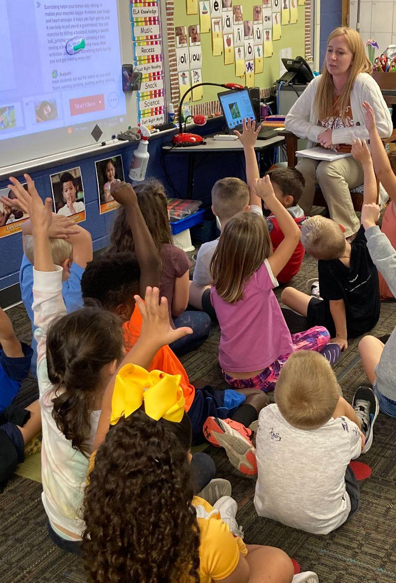
Schools in need of support are improving.
Comprehensive Schools Improved (identified lowest performing 5% of Title I schools)
The Department provided 6,000+ hours of school-based expert leadership support and classroom coaching and modeling in Iowa’s 35 Comprehensive schools, resulting in:
  32 of 35 Comprehensive schools improved, with a 5.4 average percentage point increase in overall accountability scores.
Targeted Schools Exited (identified based on the achievement gaps experienced by a student group)
The Department partnered with Iowa’s nine area education agencies to provide 1,000+ hours of consistent, school-based improvement supports in Iowa’s Targeted schools, resulting in:
  136 of 377 Targeted schools identified in 2024 exiting Targeted status by ensuring all students are supported in meeting high expectations.

Slide 12
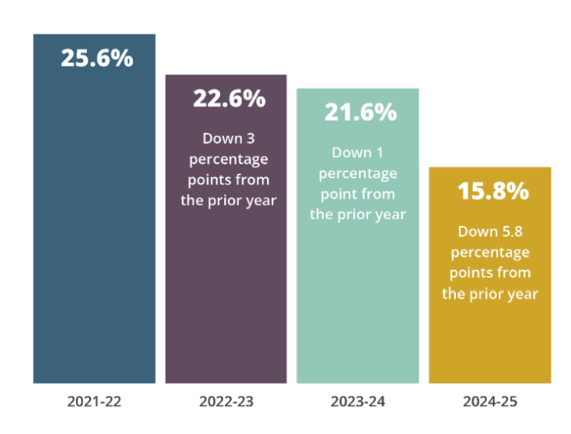
Attendance is improving.
The average percent of chronically absent K-12 public school students dropped 5.8 percentage points last year.
Over just the past three years, Iowa had a 9.8 percentage point decrease in chronic absenteeism.
Prioritized chronic absenteeism and attendance
growth in accountability system
2024 State Chronic Absenteeism Reduction Work Group
Statewide professional learning
Intensive supports for student engagement at schools in need
Early warning system for students at risk of becoming chronically absent
2024 legislation to support statewide family notices, engagement meetings, prevention plans, and county attorney partnerships

Slide 13
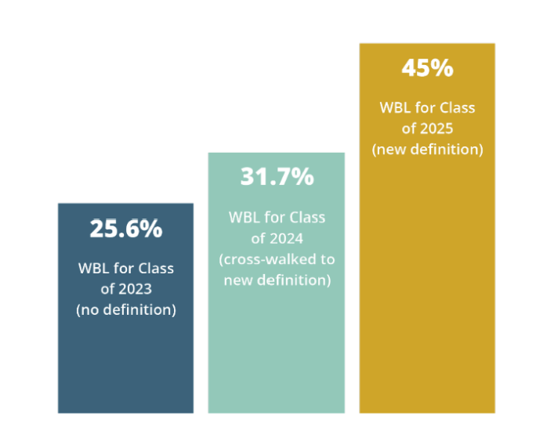
Work-based learning is growing.
45% of all high-school seniors, or 15,154 students, attained a WBL experience – a 19.5 percentage point increase and a 76% rate of increase over two years.
Prioritized WBL in Iowa’s accountability system
CTE Career Cluster Endorsement and WBL Authorization
Individual Career Academic Plans beginning in 8th grade
$3.5M in Credentials to Careers grants and $2.8M in STEM BEST grants
2024 legislation to recognize CTE courses for core credit and create a consistent, high-quality definition of WBL
2025 legislation to begin career exploration in 5th grade and celebrate IRC attainment with high school diploma seals

Slide 14
These remarkable results demonstrate the Department and Iowa’s districts and schools are well-positioned to employ the improved flexibility and accountability in our…
Unified Allocation Plan

Slide 15
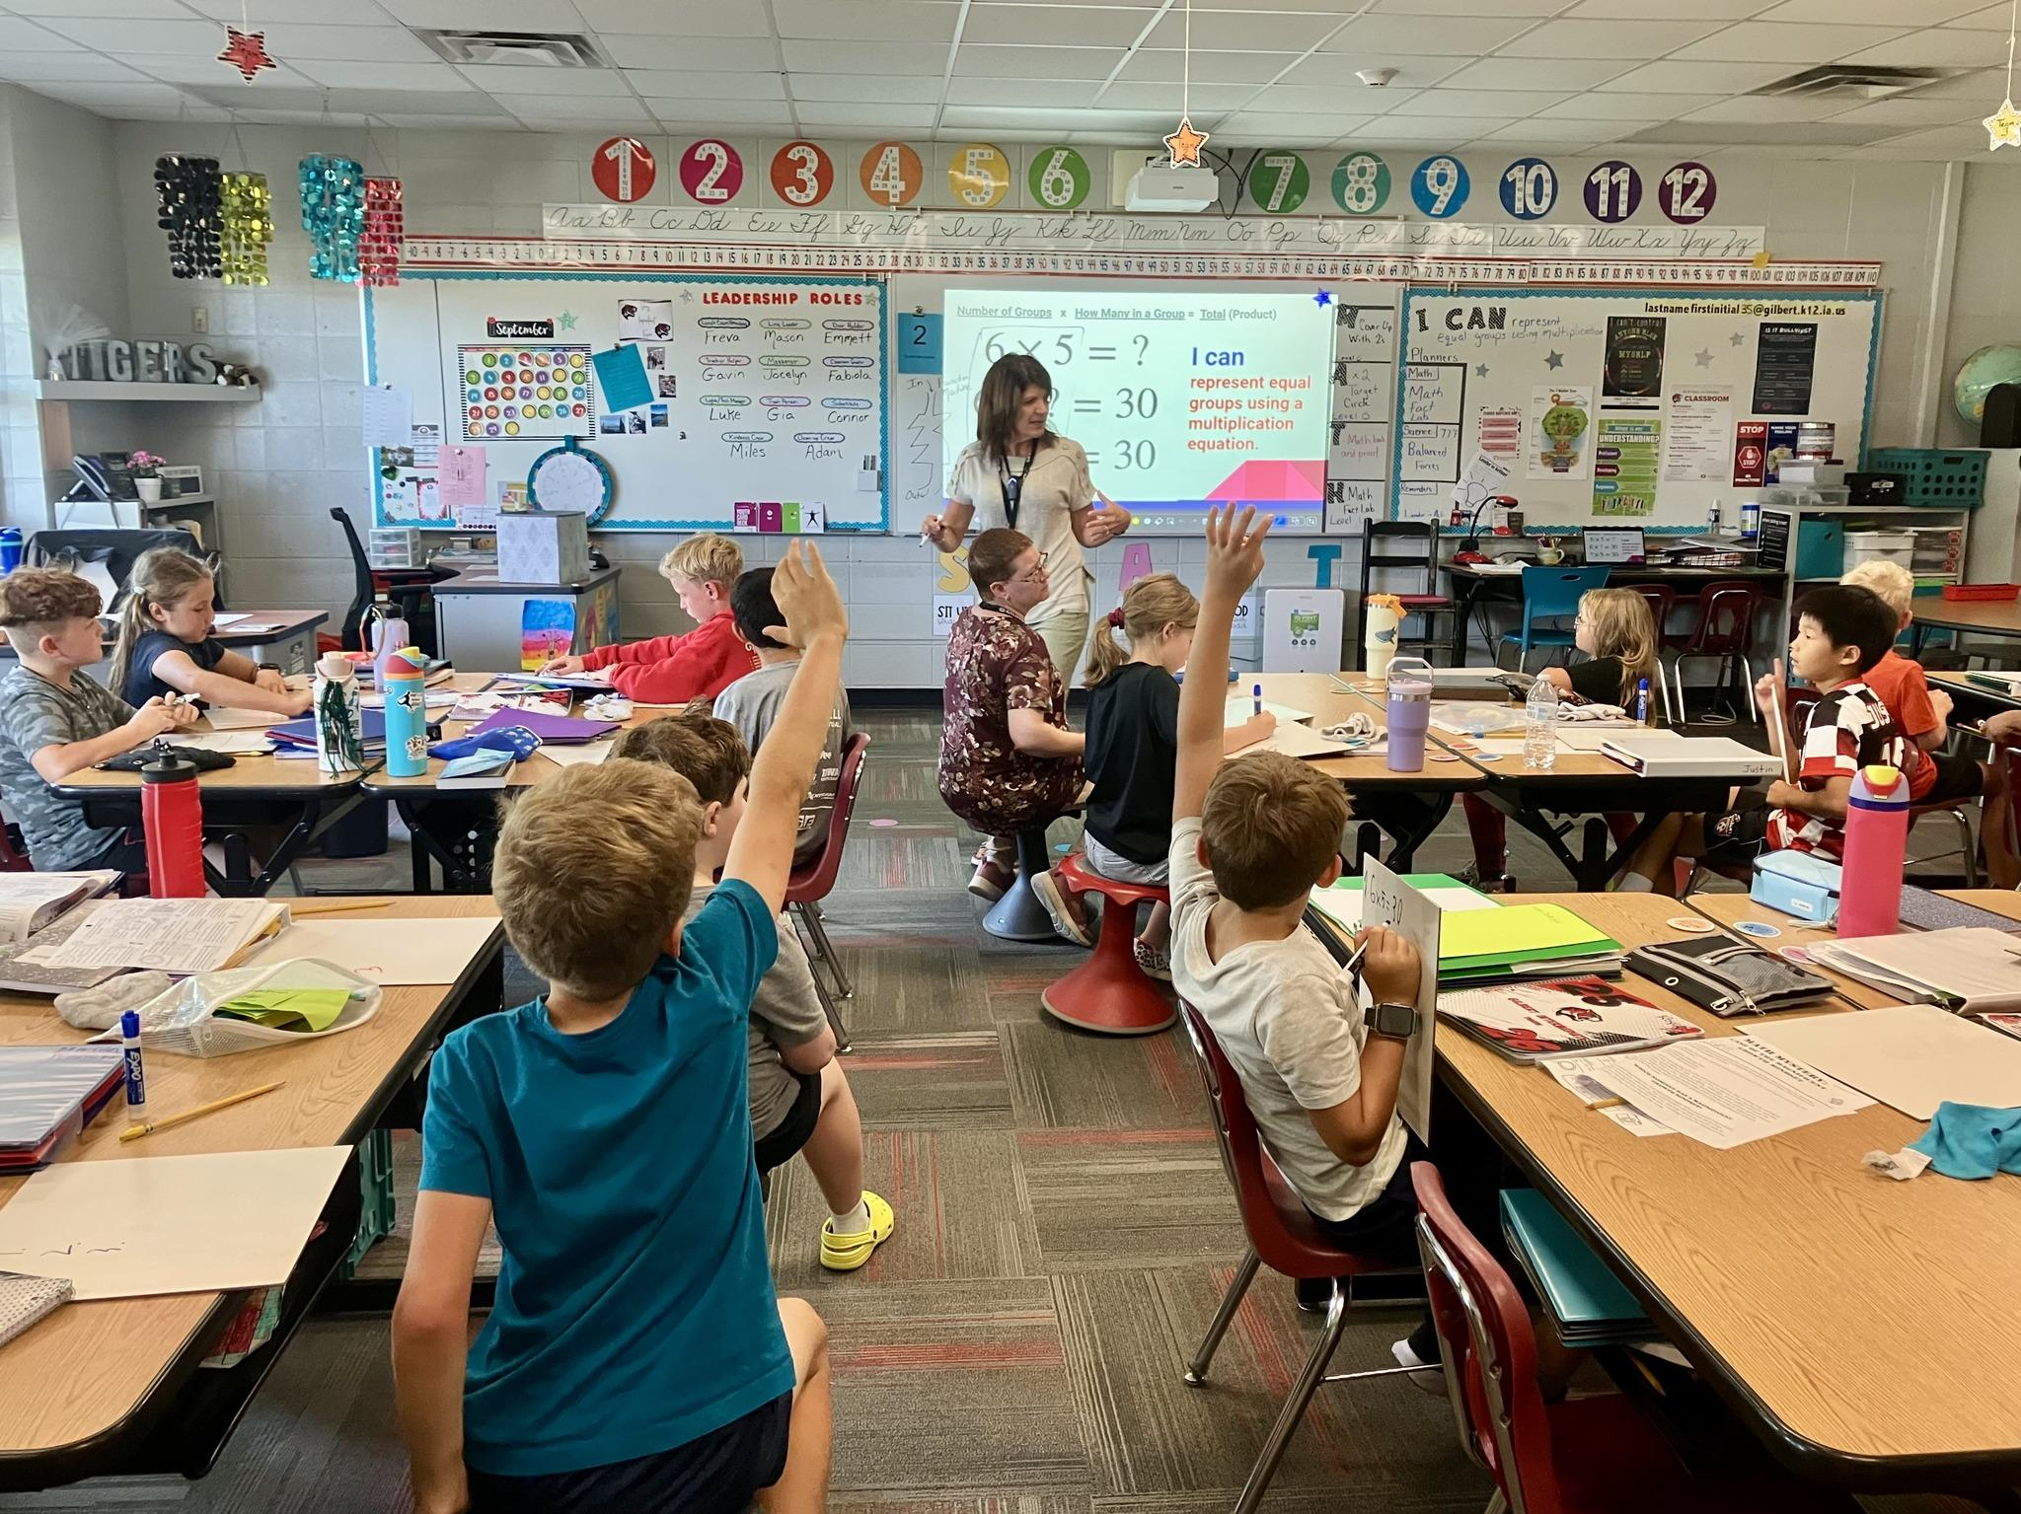
Informed by robust stakeholder feedback and ongoing consultation, our Unified Allocation Plan empowers Iowa to:
Ensuring Effective, Efficient Operations to Best Serve Iowans
Align ESEA programs to Iowa’s state and local education priorities
Redirect federal resources from compliance to the classroom
Bolster school improvement efforts informed by accountability and assessment
Support school districts’ focus on best serving students most in need of support

Slide 16


Slide 17
What they are saying in Iowa…
Ensuring Effective, Efficient Operations to Best Serve Iowans
Ankeny Community School District Superintendent Erick Pruitt: “Local school boards and district leaders know best how to meet the needs of their students and communities. Reducing unnecessary administrative burden and allowing local governance to guide decisions around how funds are spent can support more responsive and effective educational programs…”
Davenport Community School District Superintendent TJ Schneckloth: “... New consolidated applications will help districts improve outcomes for students and better target resources to the areas of greatest need by breaking down silos.”
College Community School District Superintendent Doug Wheeler: “Just as Iowa educators personalize instruction for every student, the UAP provides districts with the autonomy to do the same. This plan aims to transform vital federal funding into a strategic tool rather than a one-size fits all approach, allowing Districts to prioritize on their local context through flexibility and adjusting focus through streamlined reporting.”
UEN Executive Director, RSAI Professional Advocate, and ISFIS Partner Margaret Buckton: “Both rural and urban schools benefit from Iowa’s new Uniform Allocation Plan; relieved of excessive regulation, staff time and energy are freed up to refocus on students…..The Urban Education Network and the Rural School Advocates of Iowa appreciate the extraordinary work of the Iowa Department of Education staff and Director Snow in proposing the Plan, the U.S. Department of Education support and Gov. Reynolds’ passion for reducing regulation and trusting local leaders to know best what students need.”
Community Colleges For Iowa: “Today, the U.S. Department of Education (ED) approved Iowa’s Returning Education to the States Waiver, empowering state education officials to have more discretion over their federal education dollars.”

Slide 18
And across the Nation…
Ensuring Effective, Efficient Operations to Best Serve Iowans
American Enterprise Institute (AEI) Senior Fellow and Director, Education Policy Studies, Rick Hess: “For too long well-meaning rules and regulations have slowed state improvement efforts while siphoning up time and money. Today, Iowa and the US Department of Education deserve to be congratulated on stepping up and addressing this challenge. Here’s hoping that this is the first of many such announcements, and a commitment to reducing the outdated bureaucratic obligations that burden educators.”
Arkansas Secretary of Education, Jacob Olivia: “Anything that provides more flexibility for states to use federal funds to do good on behalf of students is a good thing. We look forward to submitting a waiver request in the coming weeks to better support Arkansas students and families as well.”
ExcelinEd Chairman of the Board, Jeb Bush: “Today, Iowa became the first state to gain approval of a plan to give the state more flexibility with funding while maintaining important federal assessment and accountability guardrails. When it comes to education policy, states know best what their students and families need, and states should be empowered to be responsive and nimble. I look forward to seeing how Iowa uses their flexibility and how further efforts to shift power from Washington back to the states will help students thrive.”
South Carolina State Superintendent of Education, Ellen Weaver: “... Iowa is offering a practical roadmap for how flexibility, accountability, and a focus on the fundamentals can work together. It’s a promising model South Carolina can learn from as we work to align resources, reduce red tape, and ensure every dollar drives academic achievement, character development, and citizenship readiness for every student.”

Slide 19
And across the Nation…
Ensuring Effective, Efficient Operations to Best Serve Iowans
American Enterprise Institute (AEI) Senior Fellow and Director, Education Policy Studies, Rick Hess: “For too long well-meaning rules and regulations have slowed state improvement efforts while siphoning up time and money. Today, Iowa and the US Department of Education deserve to be congratulated on stepping up and addressing this challenge. Here’s hoping that this is the first of many such announcements, and a commitment to reducing the outdated bureaucratic obligations that burden educators.”
Arkansas Secretary of Education, Jacob Olivia: “Anything that provides more flexibility for states to use federal funds to do good on behalf of students is a good thing. We look forward to submitting a waiver request in the coming weeks to better support Arkansas students and families as well.”
ExcelinEd Chairman of the Board, Jeb Bush: “Today, Iowa became the first state to gain approval of a plan to give the state more flexibility with funding while maintaining important federal assessment and accountability guardrails. When it comes to education policy, states know best what their students and families need, and states should be empowered to be responsive and nimble. I look forward to seeing how Iowa uses their flexibility and how further efforts to shift power from Washington back to the states will help students thrive.”
South Carolina State Superintendent of Education, Ellen Weaver: “... Iowa is offering a practical roadmap for how flexibility, accountability, and a focus on the fundamentals can work together. It’s a promising model South Carolina can learn from as we work to align resources, reduce red tape, and ensure every dollar drives academic achievement, character development, and citizenship readiness for every student.”

Slide 20
Federal approval of critical steps in Unified Allocation Plan allows Iowa to:
Operate a Block Grant for Federal State-Level ESEA Funds
Provide Targeted Local Flexibilities for School Districts
Advance Modernized Reporting and Administrative Alignment

Slide 21

Block Grant for Federal State-Level ESEA Funds
Iowa will consolidate 100% of existing federal state-level resources into a single state block grant. To have the greatest impact on student achievement and growth, this brings together state-level activities funds from four programs:
  Title II, Part A (Supporting Effective Instruction)
  Title III, Part A (English Language Learners)
  Title IV, Part A (Student Support and Academic Enrichment)
  Title IV, Part B (21st Century Community Learning Centers)
This block grant will total approximately $3.8 million for FFY 2024 and 2025 and about $9.5 million over the waiver period through FFY 2028 to support:
  Continued investments in evidence-based literacy professional learning
  New investments in professional learning to empower all teachers to best serve English learners offered statewide at no cost to schools or educators over the next four years

Slide 22

Block Grant for Federal State-Level ESEA Funds (cont.)
This state block grant does NOT:
  Create new funding, reduce funding, or generate savings
  Affect, reduce, or divert funds previously allocated to school districts or other subgrantees
It simply modernizes how federal state-level funds already appropriated may be flexibly administered and effectively used.

Slide 23
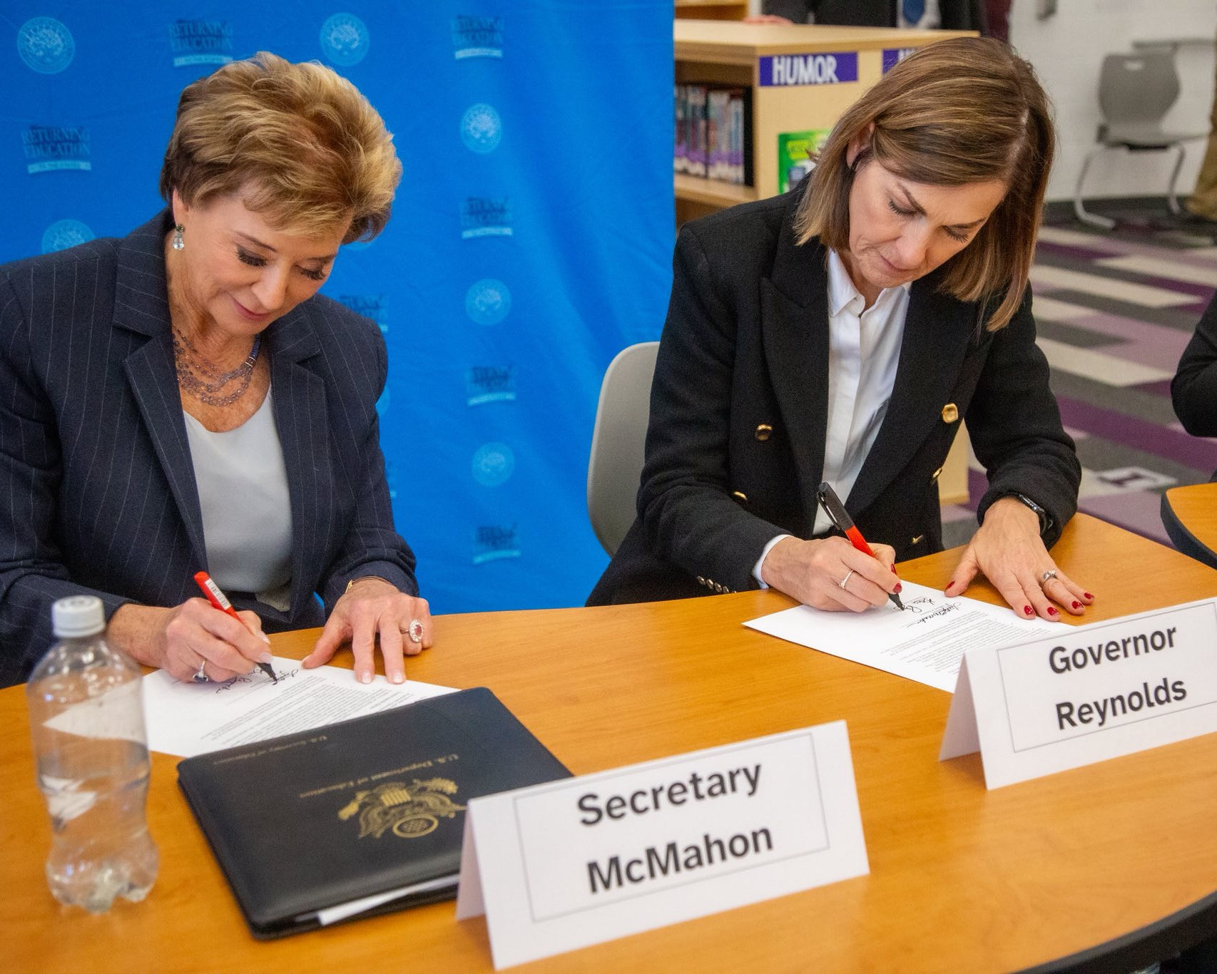
2. Targeted Local Flexibilities for School Districts
Iowa may approve school district requests to:
  Carry over up to 100 percent of Title I, Part A funds to support significant, evidence-based instructional investments; and
  Waive up to 100 percent of Title IV, Part A spending limitations, including requirements that larger grants allocate set percentages to well-rounded education, safe and healthy schools, and education technology.
Iowa also may approve state institutions’ requests to use up to 100% of Title I, Part D funds to support educational transitions for students in nontraditional home settings and justice-connected youth.

Slide 24

3. Modernized Reporting and Administrative Alignment
The U.S. Department of Education committed to advancing Iowa’s request to streamline programmatic and fiscal reporting as a model for the nation.
This will:
  Rightsize administrative workloads, reducing time and resources spent on duplicative administrative duties
  Continue to ensure transparency and accountability

Slide 25
Department’s ESEA Programs Team Time Distribution
(Compliance vs. Improving Achievement)
Ensuring Effective, Efficient Operations to Best Serve Iowans
Position | Approximate Current % Compliance | Approximate Current $ Compliance | Approximate New % Compliance | Approximate New $ Compliance | Approximate $ Reallocation to Achievement
Bureau Chief (1) | 70% | $130,898 | 30% | $56,099 | $74,799
ACs (2) | 75% | $244,237 | 25% | $81,412 | $162,825
EPCs (10) | 70% | $1,012,081 | 30% | $433,749 | $578,322
Total | 70-75% | $1,387,216 | 25-30% | $571,260 | $815,956

Slide 26
What is the potential impact of rightsizing administrative workloads?
Ensuring Effective, Efficient Operations to Best Serve Iowans
Iowa projects that, by rightsizing administrative workloads, it will allow nearly $8 million in time and resources to be redirected from compliance to the classroom over four years.
  Please recall that Iowa’s Unified Allocation Plan does not create new funding, reduce funding, or generate savings.
  Instead, it redirects – to the maximum extent possible – the use of federal funds at both the state and local levels to work that directly supports advancing student learning.
Note: School employee salary and benefit costs comprise an average of 73% of Iowa school district General Fund expenditures statewide.

Slide 27
What does this all mean?
Ensuring Effective, Efficient Operations to Best Serve Iowans
Stronger alignment to Iowa priorities, improving school improvement efforts and support for students most in need.
Sustained, high-quality support for educators, including statewide professional learning at no cost.
Greater flexibility for districts to plan multi-year, evidence-based investments while maintaining accountability.
More time and resources focused on students, not paperwork, by rightsizing administrative workloads.
Iowa helps lead the nation in modernizing how federal education funds are used to improve student outcomes.

Slide 28
What never changed?
Ensuring Effective, Efficient Operations to Best Serve Iowans
Iowa’s commitment to meaningful accountability achieved in its new, model Unified School Accountability System implemented for the first time during the 2024-25 school year that:
  Reflects high expectations for all students, with challenging academic standards to which our state summative assessment is aligned
  Prioritizes comprehensive, evidence-based school improvement supports, recognizing that the purpose of accountability is continuous improvement
Iowa’s commitment to ensuring the civil rights protections in ESEA, including school district requirements to provide specific services and supports to student groups
Iowa’s commitment to implement and monitor all statutory requirements, including allocation and distribution of funds, maintenance of effort, comparability, supplement not supplant, equitable participation, parental participation and involvement, etc.

Slide 29
What’s next?
Ensuring Effective, Efficient Operations to Best Serve Iowans
Iowa will implement the approved elements of its Unified Allocation Plan, demonstrating impact and continuing to build the case for broader flexibility.
  Implementation supports to school districts will include monthly ESEA Programs webinars and virtual office hours.
Iowa will continue to work with the U.S. Department of Education to:
  Streamline programmatic and fiscal reporting as a model for the nation, and
  Modernize administrative interpretations of “rank and serve” and “supplement, not supplant” statutory requirements.
Iowa will allow a school district and nonpublic school to choose – in meaningful consultation – to simplify the administration of equitable services to eligible nonpublic schools.
  This opt-in feature does not impact the equitable services proportionate share (amount of funds).
Iowa will continue to engage administrators, educators, families, communities, and policymakers to ensure these improvements – and future advancements – support accelerated learning for all students.

Slide 30
Questions & Discussion

