Slide 1
Labor Market
Labor Market
A deeper look at Iowa labor market information,
Adapting CTE programs to address employment gaps.
Creating versatile student talent pipelines
Building relationships with business and industry stakeholders.
February 3, 2026

Slide 2
Webinar Information
Webinar Information
Thank you for joining today’s CLNA webinar training presentation session #3
This webinar will be recorded and linked to the CLNA Landing Page
This slide deck will be available on the CLNA Landing Page
Chat, mics, and cameras have been disabled, please use the Q & A feature. In order to be considerate of everyone’s time, we are compiling questions received today and will provide follow up information that will be linked to the CLNA Landing Page.
All student-level data shared, discussed, or reported under this initiative are protected under the Family Educational Rights and Privacy Act (FERPA), 20 U.S.C. § 1232g, and its implementing regulations (34 CFR Part 99). Any data containing personally identifiable information (PII) from education records must be used solely for authorized educational purposes, may not be redisclosed to unauthorized parties, and must be handled in a manner that maintains confidentiality and data security. Only aggregate, de-identified, or summary data may be publicly disseminated.
All information and materials provided for this webinar and Spring 2024 CLNA work have been aggregated, de-identified, and/or summarized for public dissemination (FERPA/PII).

Slide 3
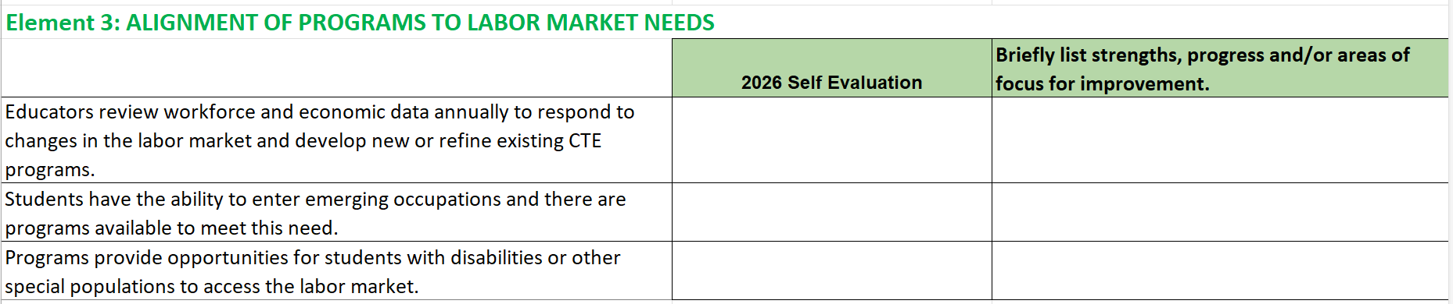
Element 3: Labor Market Alignment
Labor market resources to address Element Three:
3.1 Review openings and wages by program
3.2 Review emerging occupations related to current programs.
3.3 Review access for students with disabilities and special populations.

Slide 4
Iowa’s Labor Market: Overview
Current Labor Trends (2025 Data) Unemployment Rate in 2025: 3.5% 10,000+ Job openings, slower growth Long –Term Proections (2022 – 2032) BLS: 73,000 job openings over 10 years . | Occupational Projections (Two Year & 10 Year) Registered Nurses Heavy & Tractor-Trailer Truck Drivers Teaching Assistants Industry Employment Growth (2025 and 10 Year) Health Care & Social Assistance: +33,215 jobs Educational Services: +12,355 jobs Construction: +8,880 jobs
Iowa Workforce Development, 2025, Bureau of Labor Statistics (BLS), August-December, 2025)

Slide 5
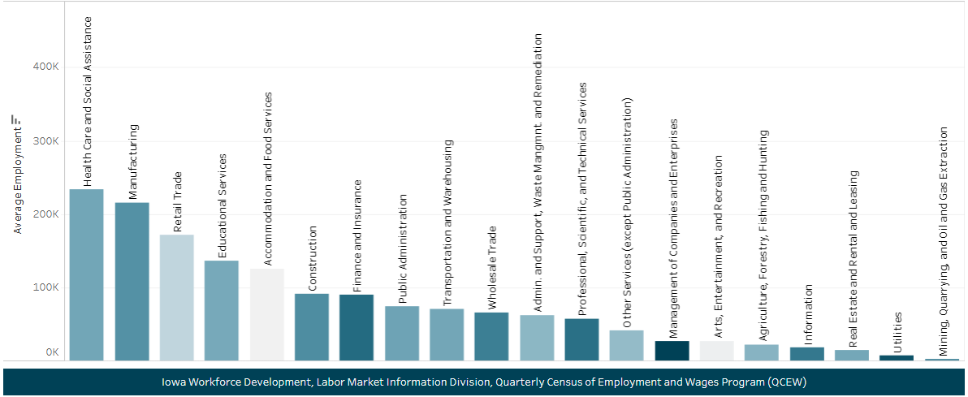
Iowa’s Labor Market, 2025

Slide 6
Artificial Intelligence Impact - 2024 Careers (in decline and replaced)
Entry-Level, Creative, Routine Service Roles Data entry, telemarketing, copywriting. Bank tellers, proofreaders, customer services reps White Collar and Entry Level Clerks, typists, payroll & bookkeeping Automated data processing systems Customer Service and Sales AI voice bots and chatbots Content Creation & Graphic Designers Iterative tasks & Generative AI (strategic, “meta-learning” roles less likely to be in decline) | White Collar and Entry Level Translation and medical transcription (20% in 2025) Entry Level technical writers Travel Agents AI Travel Advisors Computer Programmers Single Senior Engineer can do the work of 3-4 junior developers. AI Tools instantly generate basic functions faster and cheaper than human novices
Black
In Decline
Orange
Replaced with

Slide 7
2026 New Careers
Productivity will increase geometrically. Employees will gain”virtual co-workers” *New Job (SOC) Titles Cloud architects AI Ethics & Compliance Algorithm Auditors Agentic Specialists and Architects Machine Learning and AI Lifecycle Monitors AI Security and Simulation Ethical Hackers AI Human Workflow Specialists | Skills & human capital that AI cannot replace Innovation, judgment, creativity, grit, “meta-learning” (learning how to learn) New Credentials and Certification Certified AI Ethics Officer Certified AI Testing Professional Regulator Fluency and Risk Management Artificial Intelligence Governance Professional Certified Generative IA Cybersecurity
*Standard Occupational Titles updated every five years. Next release: Public input began in 2024, release year, 2027 for 2028. BLS (Robust versus Recent)

Slide 8
Labor Market: Educating for Success
AI is currently replacing 11.7 million of the U.S workforce in finance, healthcare, and professional services (MIT, Nov. 25, 2025)
Amazon plans to replace more than half a million jobs with robots and to automate 75 percent of its workforce (New York Times, October 21, 2025)
Goldman Sachs estimates that six to seven percent of current white collar jobs will be replaced by AI in 2026 (but AI will create jobs in other capacities)
AI will replace repetitive jobs
Estimated 44 percent of US jobs are repetitive manual.
Estimated 44 percent are repetitive cognitive
  Manual and cognitive include retail, call center, fast food, insurance, accounting, government, manufacturing (Andrew Yang 2020)

Slide 9
Labor Market: Educating for Success: Three Job Categories
Making (currently automating) – Production and manufacturing
Making/Thinking (in transition) Skilled Trades (except for installing, upgrading, repairing)
Caring (most secure) Human Services
  Childcare
  Elder care
  In Home Care
    Nurses, physical therapists, social workers, teachers
    Empathy business and the very essence of “human”
Substack, Robert Reich, August 19, 2025

Slide 10
Labor Market: Educating for Success: Characteristics
Characteristics of the people who will be affected
Autonomous vehicles:
  Currently there are one million CDL truck drivers with a current nationwide shortage of 180,000
  The characteristics of the persons that a disruption will affect
  94 percent of CDL drivers are male with an education level of high school and less than one year of college
  Plan for transitions

Slide 11
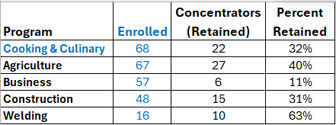
Element 3: Labor Market Alignment: Rolling Up Our Sleeves
3.1 Review openings and wages by program (School district with five CTE programs and 51 local course titles).
3.2 Review emerging occupations related to current programs.
3.3 Review access for students with disabilities and special populations.
Secondary - if Google Doc is open:
File (Left-Click) >> Download – (Left-Click) to MS Excel, MS Word, PDF, etc.
All folders, sub-folders, materials are view/read/download only.
Once “saved” locally, may optimize and utilize as one desires.
(DOWNLOAD FILE TO MS EXCEL ) District-level CTE Counts & Programs & Course Information

Slide 12
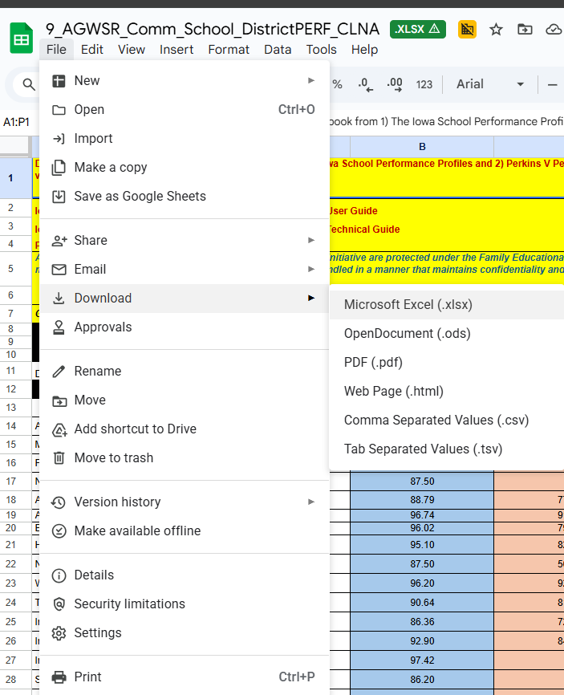
Saving file locally if “open”
Secondary - if Google Doc is open:
File (Left-Click) >> Download – (Left-Click) to MS Excel, MS Word, PDF, etc.
All folders, sub-folders, materials are view/read/download only.
Once “saved” locally, may optimize and utilize as one desires.
(DOWNLOAD FILE TO MS EXCEL ) District-level CTE Counts & Programs & Course Information
Review 23-24 DIST-PROGRAMS-COURSES File
Review Column J “Local Course Titles
CC - if Google Doc is open:
File (Left-Click) >> Download – (Left-Click) to MS Excel, MS Word, PDF, etc.
All folders, sub-folders, materials are view/read/download only.
Once “saved” locally, may optimize and utilize as one desires with local institutional research (IR) tools & data already provided by the Community College MIS Team:
(HOME) Iowa Student Outcomes
(CC) Iowa Perkins V & CTE Summary
(CC) Community College Profiles
(CC) Joint Enrollment
(CC) Annual Credit & Noncredit Enrollments
(CC) Education Outcomes
(CC) Iowa Online Condition of Community Colleges Reports
Workbook is a “one-stop-shop” containing all Perkins V reported data by CC from AY2023-2024, Perkins CAR 2024, approved March 2025.
#_CC_2324_CC_PERKINS_CLNA_ELEMENT_1

Slide 13
Element 3: Labor Market Alignment Making Your Case
  Prepare to make your case for FY 2027 and 2028 Perkins purchases
  Cooking and Culinary Arts
68 Enrolled
22 Retained (Concentrators)
32% Retention Rate
Review your school district’s or community college’s CTE programs.
  23-24 DIST-PROGRAMS-COURSES File
  Cooking and Culinary Arts (one of five CTE programs)
Compile current local course titles.
  Column J “Local Course Titles
    Bake Shop I & II
    Iron Chef
    Nutrition I & II
    Restaurant Management I & II

Slide 14

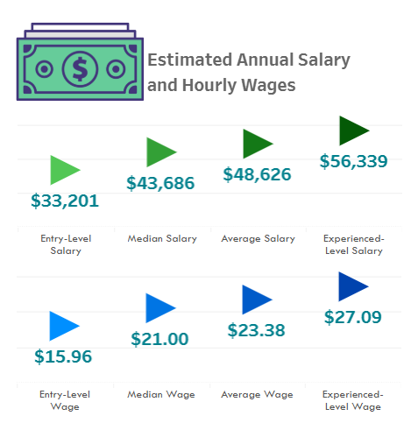
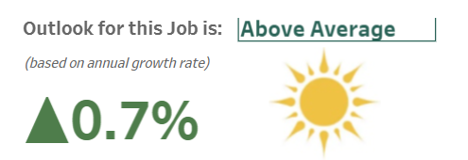
Element 3: Review Career Explorer
Use Iowa Workforce Development Iowa’s Career Explorer, Occupational Projections, and *AI resources for New and Emerging careers in Culinary.Iowa’s Career Explorer (Use State of Iowa)
*Standard Occupational Titles updated every five years. Next release: Public input began in 2024, release year, 2027 for 2028, BLS, Robust versus Recent

Slide 15
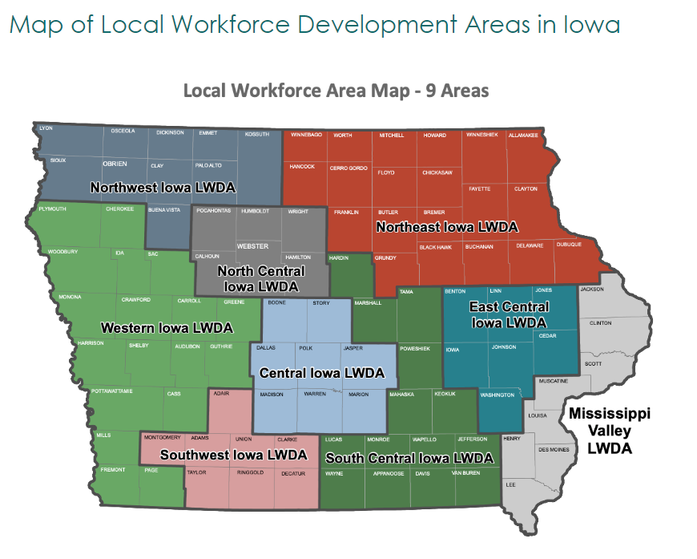
Element 3: Occupational Projections
Iowa Workforce Development Occupational Projections Data Visualizations Tool - Culinary

Slide 16
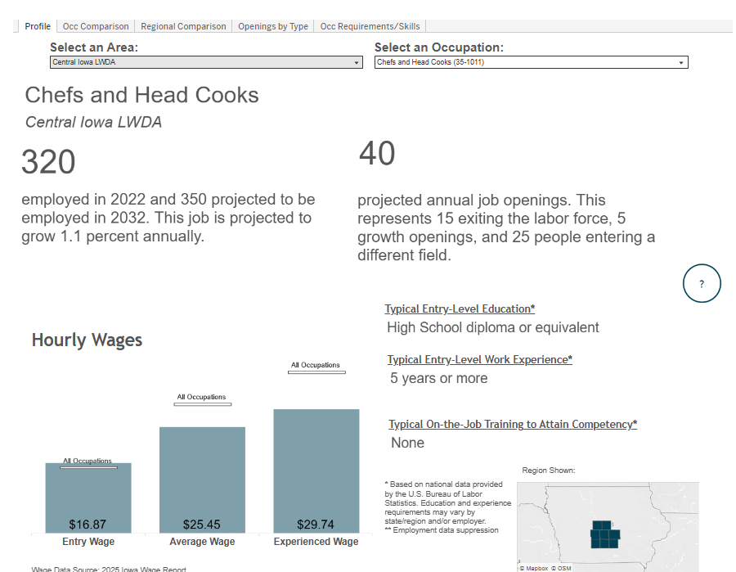
Element 3: Labor Market Alignment Occupational Projections
Iowa Workforce Development Occupational Projections Culinary by Region
onetonline

Slide 17
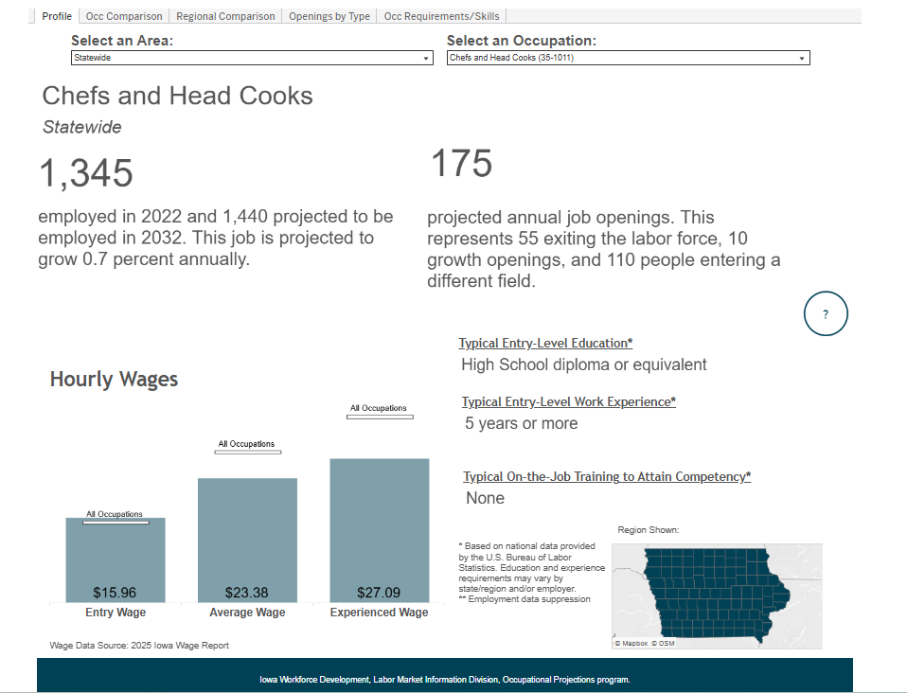
Element 3: Labor Market Alignment Occupational Projetions
Iowa Workforce Development Occupational Projections Culinary Statewide

Slide 18
Element 3: Labor Market Alignment Two- and Five-Year
  Once instructors have labor market information for local course titles, convene as a group to determine CTE Program Labor Market Two Year and Five-Year Outcomes
  What does an FY 2027 culinary budget look like after a review of future culinary coursework?
  What do local course titles look like after a labor market review of each CTE program?
  How will your institution share data with, and solicit feedback from, business, industry, and stakeholders?
  How will wage and labor market information be shared with students and parents?
  How will the 2027 budget reflect a need-based budget?
Transform culinary from manual to virtual reality and AI simulation (similar to correctional budgets).
Simulated knife skills & cooking techniques
High pressure, hazardous environments will transition to safe, controlled settings
Instant, data driven feedback
Cooking techniques, recipe adjustments, replacing the need for an instructor to personally monitor every student’s dish.
Menu Engineering and Digital Creativity
Automated Inventory and Waste Management Software
AI System Supervision

Slide 19
Element 3: Labor Market:
Using Labor Market Information to Guide CTE Program Size, Scope and Quality
  Iowa’s Career Explorer
  Occupational Projections (by Region)
  Lightcast Projections (Landing Page)
More details coming soon - Cale
Dates and registration will be shared on the Iowa CLNA Landing Page as they are finalized.
Stay connected for the 4th (FY 2027 Perkins Budget Form)
March 2nd 10:00-11:00
New Resource: Perkins Activity Two, CLNA Element Four
CTE Related In and Out-of-State Conference List: cte@iowa.gov
Conference Name & Description, Date/Month, Content Area
Date & Time TBD – Aligning Purchases with Perkins Activities (1-6) with CLNA Elements (1-6)

Slide 20
Iowa Workforce Data: Emerging Careers & Additional Resources
Licensed Occupations (115 in Iowa)
Top 25 Job Postings in Iowa
Iowa Registered Apprenticeships
Lightcast Projections (179 SOC Titles)
Iowa: 2026 Emerging Careers
Nurse Practitioners
Wind Turbine Service Technicians
Information Security Analysts
Data Scientists
Medical/Health Services Managers
Physical Therapy Assistants
Occupational Therapy Assistants
Physician Assistants
Home Health Aides

Slide 21




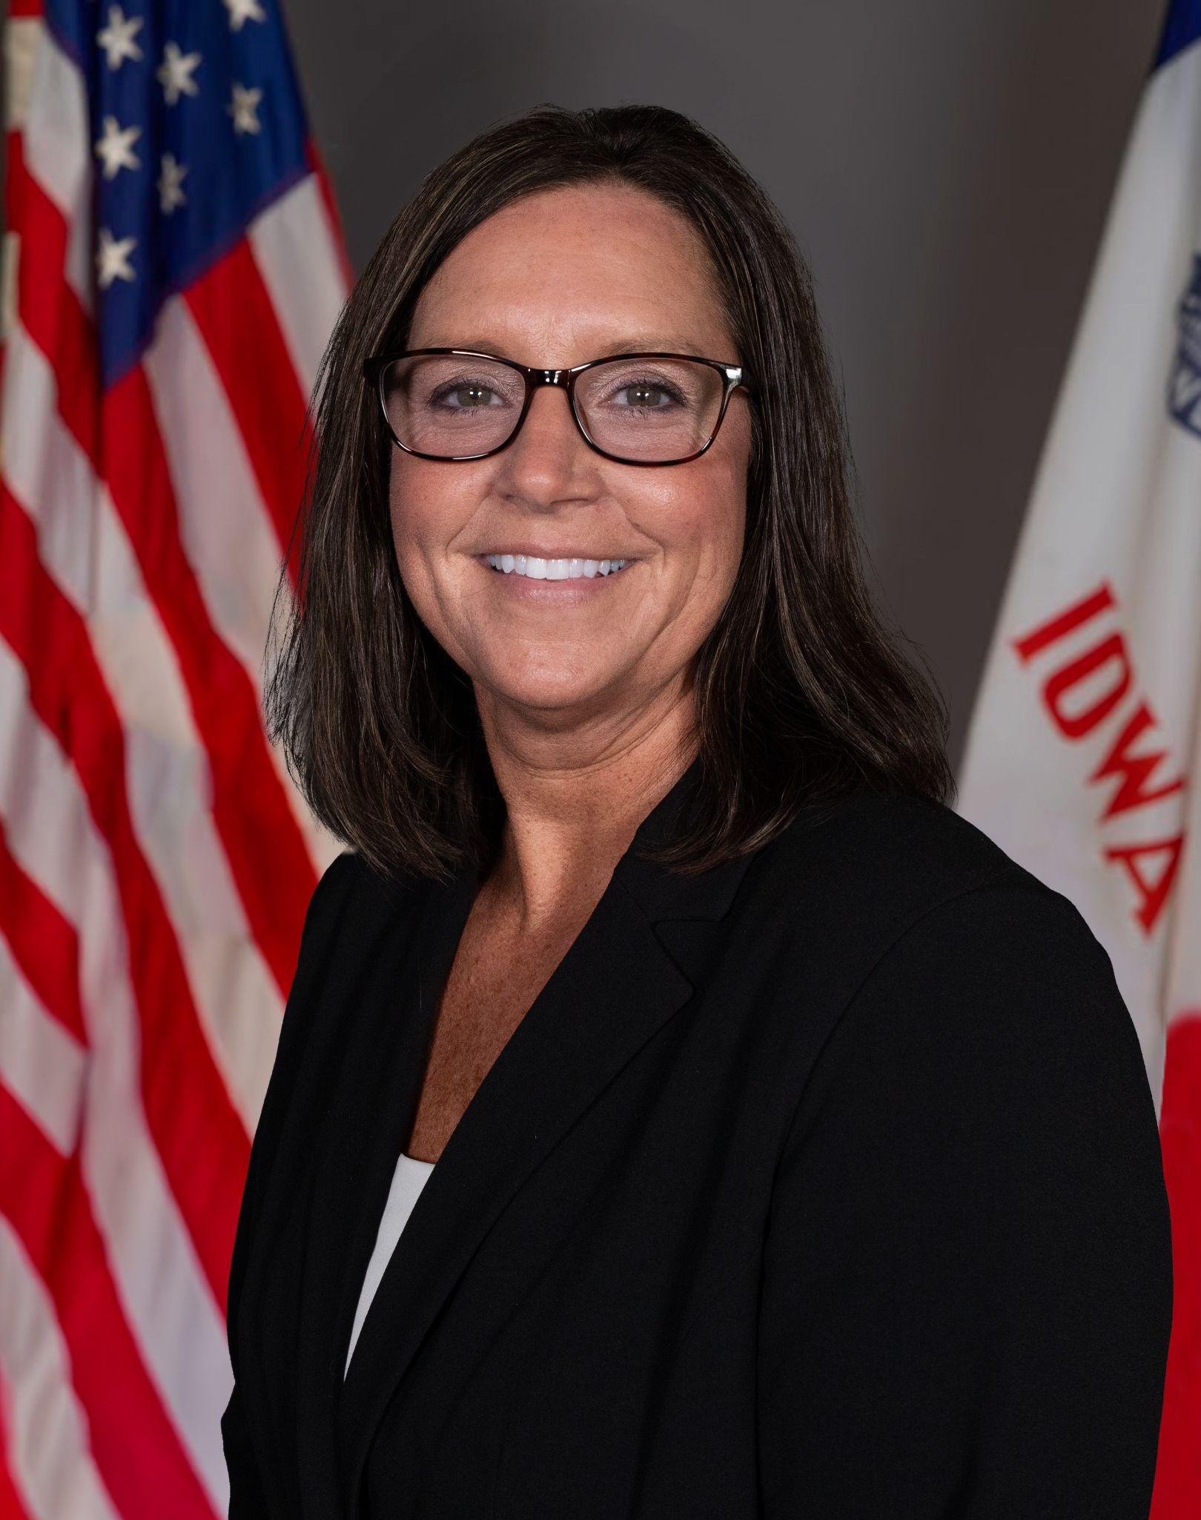

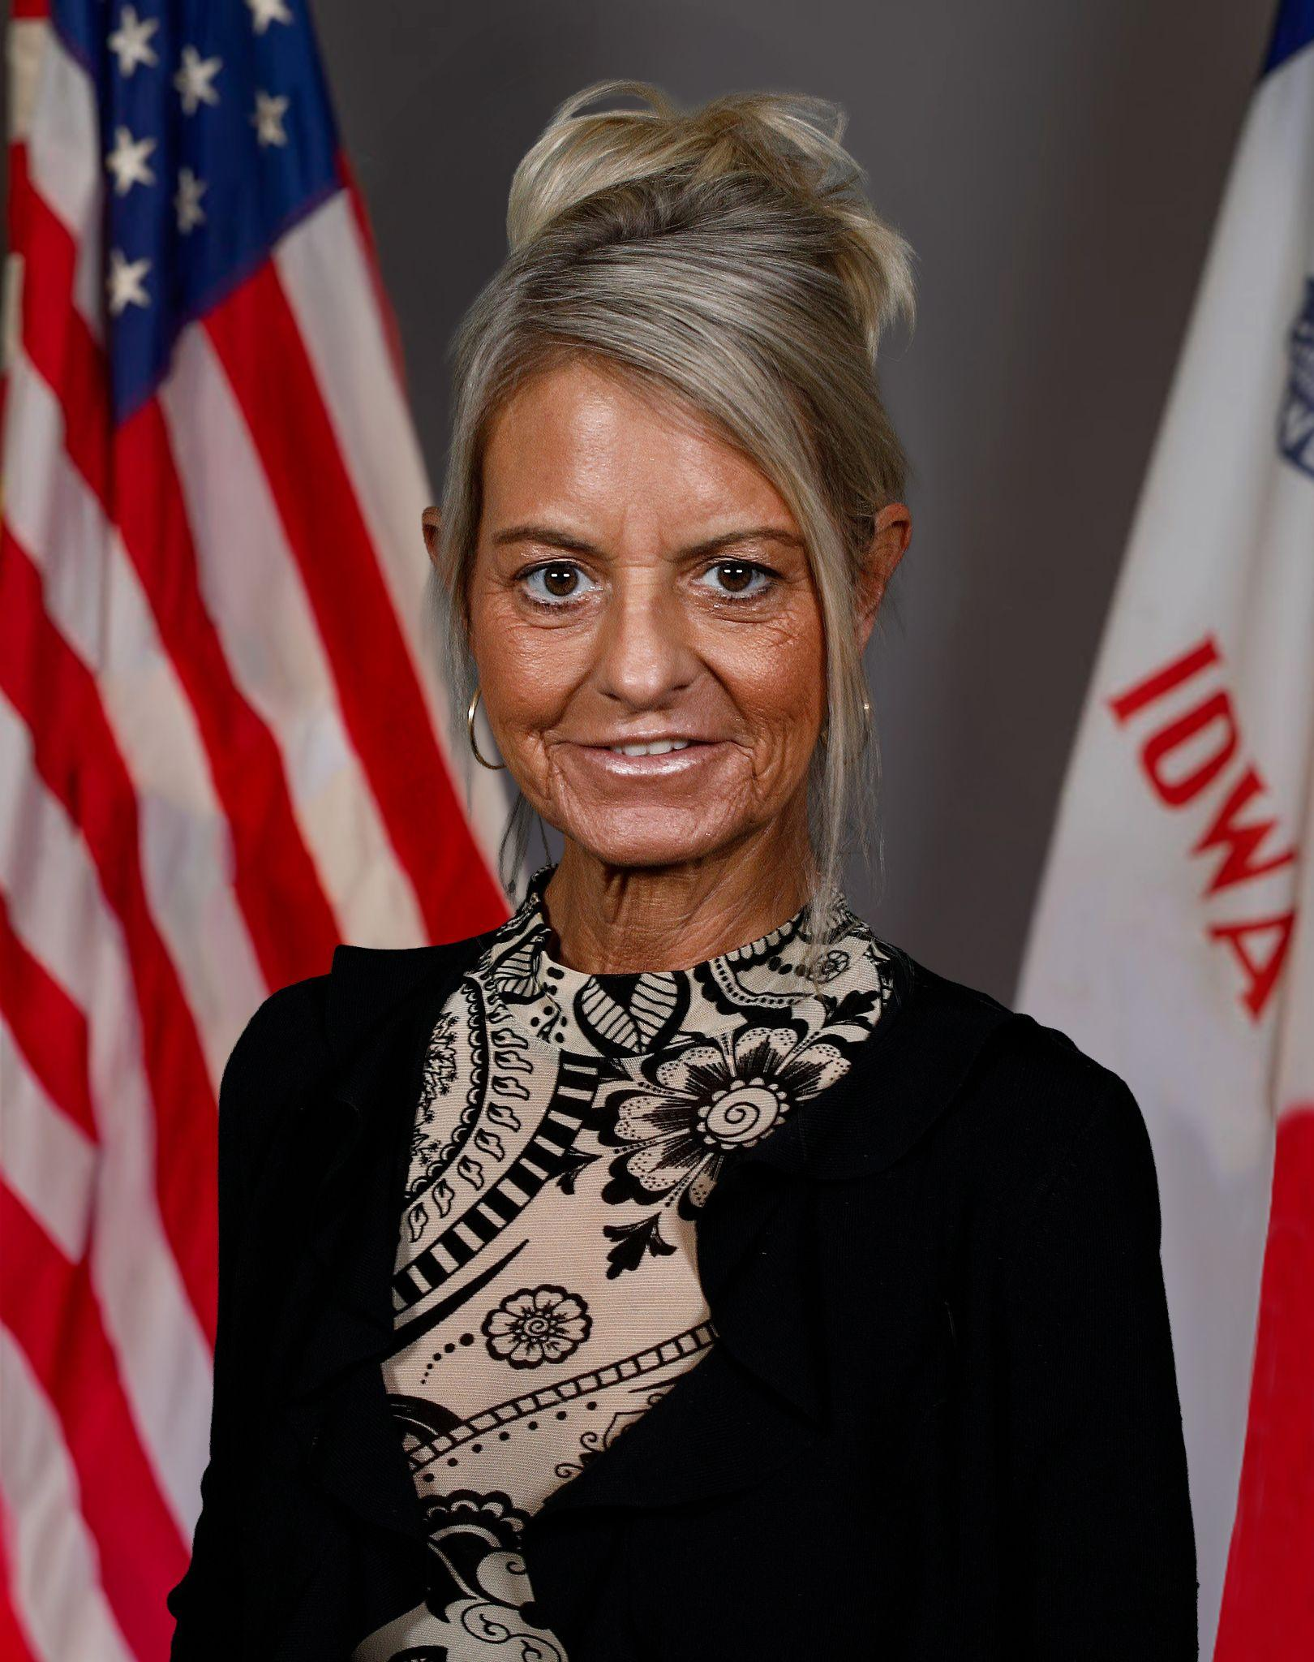
Contact Information
Cale Hutchings
Bureau Chief - CTE
cale.hutchings@iowa.gov
515-975-8193
Heather Meissen, PhD
Administrative Consultant - CTE
heather.meissen@iowa.gov
515-326-5378
Jodie Smith
Consultant - WBL/IRCs
jodie.smith@iowa.gov
515-419-5190
Alan Spencer
Consultant - Ag Ed
alan.spencer@iowa.gov
515-720-8863
Shelly Duwa
Consultant - Business Ed and CTSOs
shelly.duwa@iowa.gov
515-971-0669
Jeffrey Fletcher, PhD, MPA
Consultant - Perkins, IowaGrants
jeffrey.fletcher@iowa.gov
515-321-7309
Amy Vybiral
Consultant - Perkins Budgets and Claims
amy.vybiral@iowa.gov
515- 339-4520

Slide 22
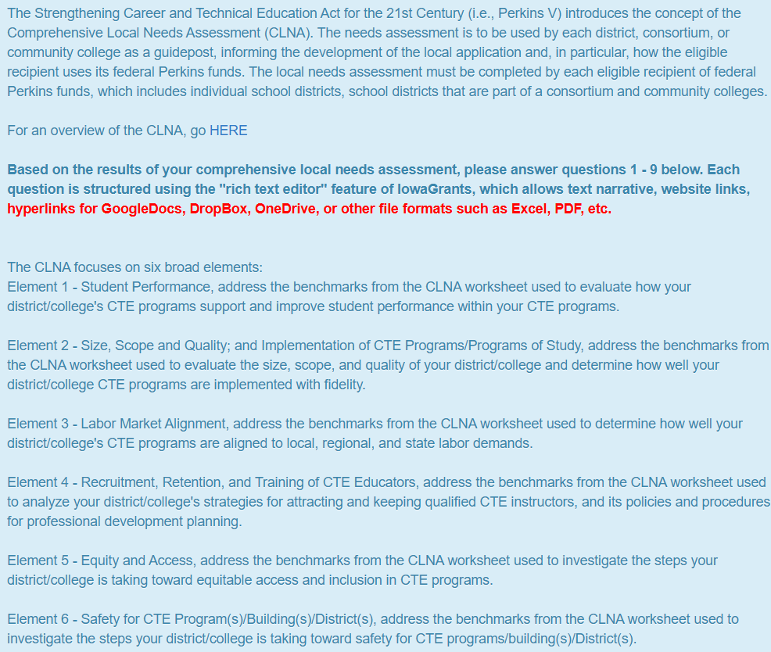
(Preview) IowaGrants CLNA Outcomes/Questions Application Form
The nine required narrative elements (often framed as the “9 questions” in local Perkins V CLNA-linked applications) are specified in Section 134(b) of the Strengthening Career and Technical Education for the 21st Century Act (Perkins V).
These elements define the statutory contents of the Perkins V local application that all eligible recipients must address when submitting a biennial application informed by the Comprehensive Local Needs Assessment (CLNA).
Applicable to all 50 U.S. states and certain U.S. territories receiving the Perkins V (the Strengthening Career and Technical Education for the 21st Century Act)
Federal Basic State Grant funding for career and technical education (CTE)

Slide 23
(Preview) IowaGrants CLNA Outcomes/Questions Application Form 1-5
Based on the completion of the CLNA process, please answer the following questions:
1. Provide a summary of the results of the comprehensive needs assessment.
2. Provide information on the CTE course offerings and activities to be provided with Perkins funds, including all state-approved plans of study.
3. Describe how your school district will, in collaboration with local workforce development partners, provide a series of career exploration and career guidance activities.
4. Provide a description of how the district or consortia will improve the academic and technical skills of students participating in CTE programs.
5. Utilizing available student performance and labor market data, provide a description of how the district or consortia will provide activities to prepare special populations for high-skill, high-wage, or in-demand occupations; prepare CTE participants for non-traditional fields; provide equal access for special populations to CTE courses, programs, and programs of study; and ensure that members of special populations will not be discriminated against.

Slide 24
(Preview) IowaGrants CLNA Outcomes/Questions Application Form 6-9
Based on the completion of the CLNA process, please answer the following questions:
6. Provide a description of the work-based learning opportunities for students participating in CTE programs and how the district or consortia will work with representatives from business and industry to develop or expand work-based learning.
7. Provide a description of how the district or consortia will provide students participating in CTE the opportunity to gain postsecondary credit while still attending high school.
8. Provide a description of how the district or consortia supports the recruitment, preparation, retention, and training, including professional development of teachers, faculty, administrators, counselors, and specialized instructional support personnel.
9. Provide a description of how the district or consortia will address disparities or gaps in performance between groups of students in each of the plan years, and if no meaningful progress has been achieved prior to the third program year, a description of the additional actions that will be taken to eliminate these disparities or gaps.

