Slide 1
Student Performance
Student Performance
A deeper look at Perkins performance data, programs, courses, enrollments:
How to interpret gaps, and how to turn findings into clear local priorities
January, 27 2026

Slide 2
Webinar Information
Thank you for joining today’s CLNA webinar training presentation session #2
This webinar will be recorded and linked to the CLNA Landing Page
This slide deck will be available on the CLNA Landing Page
Chat, mics, and cameras have been disabled, please use the Q & A feature. In order to be considerate of everyone’s time, we are compiling questions received today and will provide follow up information that will be linked to the CLNA Landing Page.
All student-level data shared, discussed, or reported under this initiative are protected under the Family Educational Rights and Privacy Act (FERPA), 20 U.S.C. § 1232g, and its implementing regulations (34 CFR Part 99). Any data containing personally identifiable information (PII) from education records must be used solely for authorized educational purposes, may not be redisclosed to unauthorized parties, and must be handled in a manner that maintains confidentiality and data security. Only aggregate, de-identified, or summary data may be publicly disseminated.
All information and materials provided for this webinar and Spring 2024 CLNA work have been aggregated, de-identified, and/or summarized for public dissemination (FERPA/PII).

Slide 3
From data & information to outcomes
Data/Information →
Dialogue →
Decisions/Strategies →
Dollars =
Outcomes/Programming
“The CLNA is the process that connects evidence and stakeholder voice to local priorities, state Perkins plans, and measurable improvement.”
- CLNA Webinar #1, 1/15/26, C. Hutchings

Slide 4
Big-picture questions to guide the work, always…
What is our overall vision for CTE in our district/consortium/community college area?
What are our top priorities over the next two years?
Which programs are strongest—and which need to be transformed, redesigned/modernized, or retired?
Where are employer needs immediate vs. longer-term pipeline needs?

Slide 5
Big-picture questions to guide the work, always…
(continued)
Which performance indicators show the biggest gaps? Which learner groups are most impacted?
What can we address now? What will need to be prioritized in the future?
Which program elements are strongest (career advising, WBL, dual-credit, wrap-around services/supports)? Which are weakest?
What strategies will we use to retain and train CTE professionals?

Slide 6
PERKINS V SEC. 113. [20 U.S.C. 2323] ACCOUNTABILITY
Secondary - Concentrators A secondary student who has earned (2.0) or more units within a career and technical education program (CTE). 1S1 - Four-year graduation rate 2S1 - Academic proficiency in Reading/Language Arts 2S2 - Academic proficiency in Mathematics 2S3 - Academic proficiency in Science 3S1 - Postsecondary placement 4S1 - Non-traditional program concentration 5S3 - Participated in work-based learning | Postsecondary - Concentrators A postsecondary student who has earned at least twelve (12.0) credits within a career and technical education program (CTE) or program of study; or completed such a program if the program encompasses fewer than (12.0) credits or the equivalent in total. 1P1 - Postsecondary retention and Placement 2P1 - Credential, Certificate, or Diploma 3P1 - Non-traditional program concentration

Slide 7
Not “Apples-to-Apples”: Federal Perkins V & ESSA/ISPP (Secondary)
Iowa School Performance Profiles is an online tool showing how public schools performed on required measures. The website was developed to meet both federal and state requirements for publishing online school report cards: The federal Every Student Succeeds Act and House File 215, adopted by Iowa lawmakers in 2013.
Secondary CTE Concentrator = A secondary student who has earned (2.0) or more units within a career and technical education program (CTE).
Perkins V Measures Read through the Perkins V Resources & Definitions PDF in the "Spring 2026 Resource Folder" | ESSA/ISSP Measure - All students “Every Student Succeed Act” Read through the user guide & technical guide for more information and details
1S1: FOUR-YEAR GRADUATION RATE (“cohort”) - In the reporting year…The % of CTE concentrators who graduate high school, as measured by the four-year adjusted cohort graduation rate (defined in section 8101 of the Elementary and Secondary Education Act of 1965). Performance = The % of CTE Concentrators who graduate high-school | “With the statewide identification system and Student Reporting in Iowa (SRI) data, Iowa can follow the same group of students over several years and implement the first-time freshman cohort rates (students who repeated their 9th grade year are not included in the cohort).” (p. 16)
2S1: ACADEMIC PROFICIENCY IN ENGLISH-LANGUAGE ARTS - In the reporting year…CTE concentrator proficiency in the challenging State academic standards adopted by the State under section 1111(b)(1) of the Elementary and Secondary Education Act of 1965, as measured by the academic assessments in reading/language arts as described in section 1111(b)(2) of such Act. | “Proficiency rates are calculated for English language arts (ELA), mathematics and science separately (grades 3-11 for ELA/mathematics, grades 5, 8 and 10 for science). (p. 19)
2S2: ACADEMIC PROFICIENCY IN MATHEMATICS - In the reporting year… CTE concentrator proficiency in the challenging State academic standards adopted by the State under section 1111(b)(1) of the Elementary and Secondary Education Act of 1965, as measured by the academic assessments in mathematics as described in section 1111(b)(2) of such Act. | “Proficiency rates are calculated for English language arts (ELA), mathematics and science separately (grades 3-11 for ELA/mathematics, grades 5, 8 and 10 for science). (p. 19)
2S3: ACADEMIC PROFICIENCY IN SCIENCE - In the reporting year… CTE concentrator proficiency in the challenging State academic standards adopted by the State under section 1111(b)(1) of the Elementary and Secondary Education Act of 1965, as measured by the academic assessments in science as described in section 1111(b)(2) of such Act (grade 10). | “Proficiency rates are calculated for English language arts (ELA), mathematics and science separately (grades 3-11 for ELA/mathematics, grades 5, 8 and 10 for science). (p. 19)
3S1: POSTSECONDARY PLACEMENT - Performance = The % of CTE Concentrators who are in postsecondary education or advanced training, military service, community service, or are employed. | “Percent of HS graduates who enrolled in postsecondary education within one year of HS graduation. The three most recently available combined graduating classes are included in the data on this page. The source of this data is the Enrollment Demographics report on the Iowa Postsecondary Readiness Reports (PRR) website.” (p. 24)
4S1: NONTRADITIONAL PROGRAM CONCENTRATION - In the reporting year…The % of CTE concentrators in career and technical education programs and programs of study that lead to non-traditional fields. Performance = The percentage of CTE Concentrators in CTE programs that lead to non-traditional fields. | No comparison: Unique to the Federal Perkins V Act.
5S3: PARTICIPATED IN WORK-BASED LEARNING - In the reporting year…The % of CTE concentrators graduating from high school having participated in work-based learning. Performance = The % of CTE Concentrators graduating from high school having participated in work-based learning. | Graduated or dropouts - “Students are counted as having had a work-based learning experience while in high school if they had a work-based learning experience…” (p. 18)
Notes:
Non-binary reporting

Slide 8
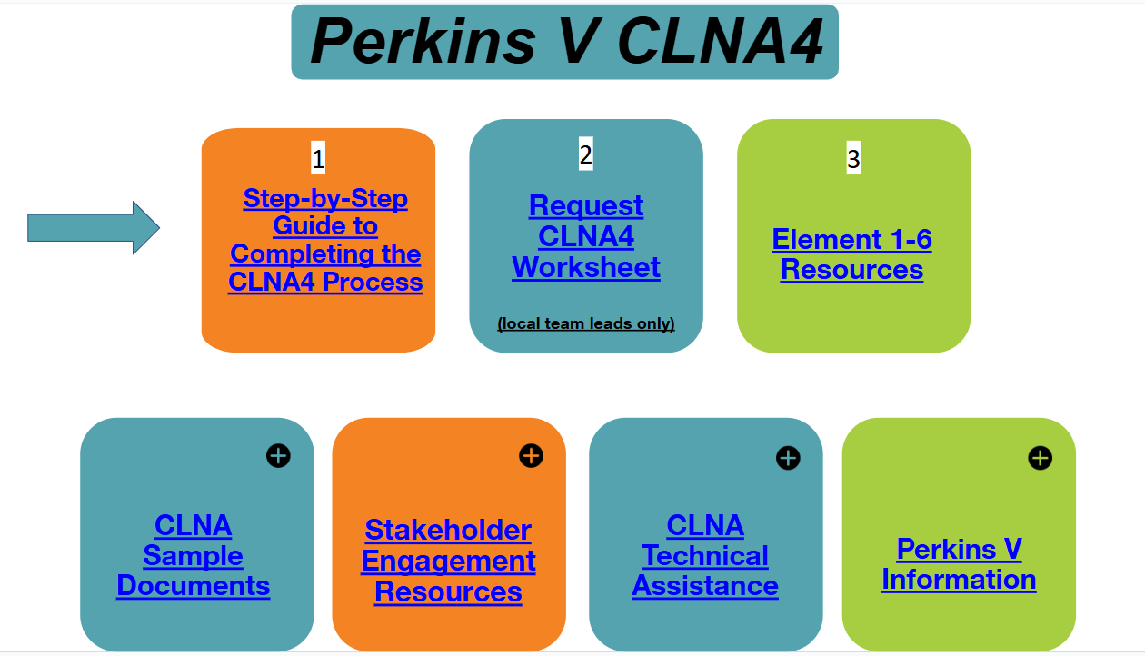

https://tinyurl.com/IowaCLNA4
The CLNA Landing Page
Element 1:
EVALUATION OF STUDENT PERFORMANCE
Element 2:
EVALUATION OF SIZE, SCOPE, AND QUALITY; AND PROGRESS TOWARD IMPLEMENTING CTE PROGRAMS/PROGRAMS OF STUDY
Element 3: EVALUATION OF LABOR MARKET ALIGNMENT
Element 4:
EVALUATION OF RECRUITMENT, RETENTION, AND TRAINING OF CTE EDUCATORS
Element 5:
EVALUATION OF PROGRESS TOWARD IMPROVING EQUITY AND ACCESS
Element 6:
EVALUATION OF SAFETY FOR CTE PROGRAM(S)/BUILDING(S)/DISTRICT(S)

Slide 9
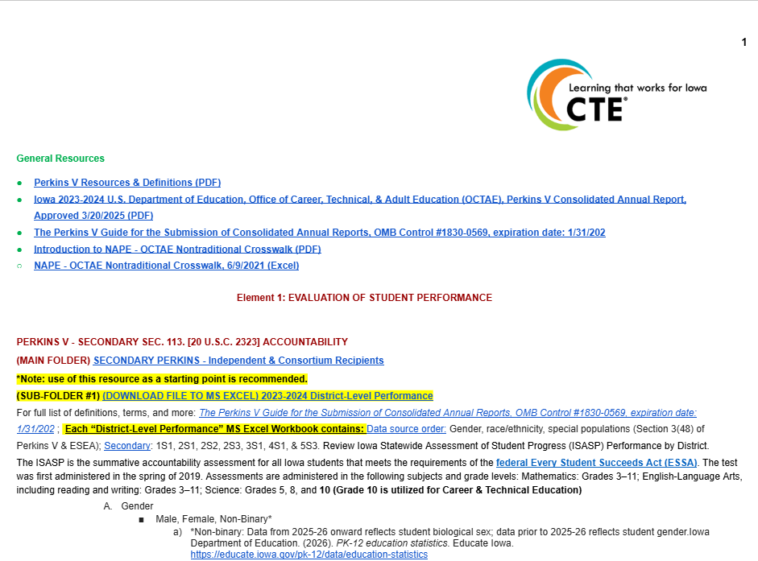
Spring 2026 Element 1 Resource - Screenshot #1

Slide 10
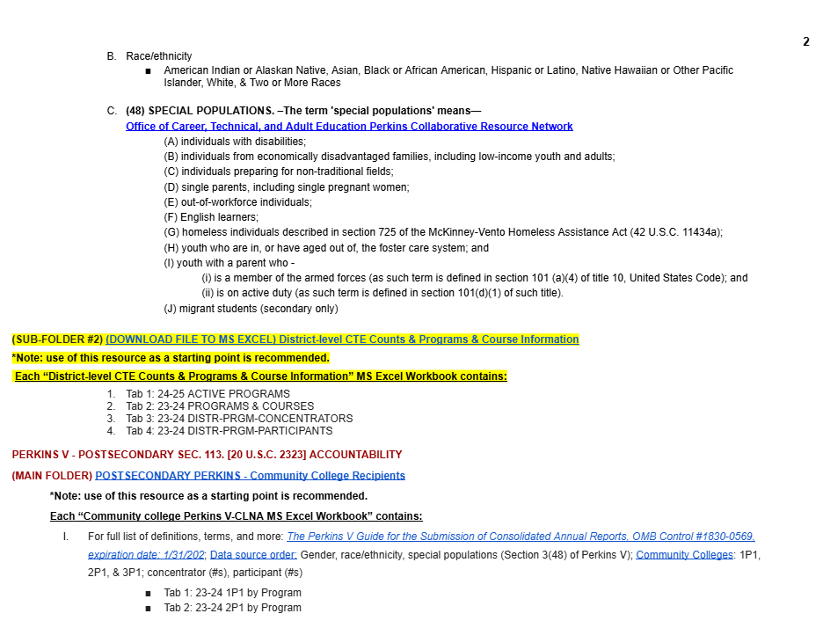
Spring 2026 Element 1 Resource - Screenshot #2

Slide 11
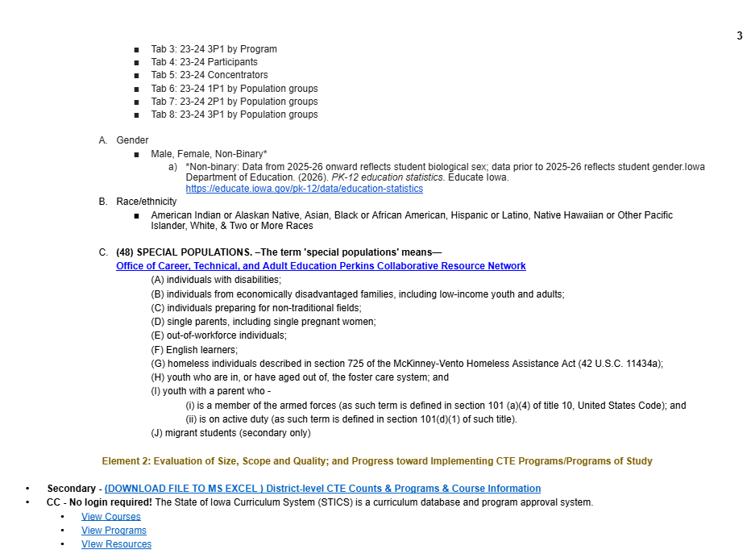
Spring 2026 Element 1 Resource - #3

Slide 12
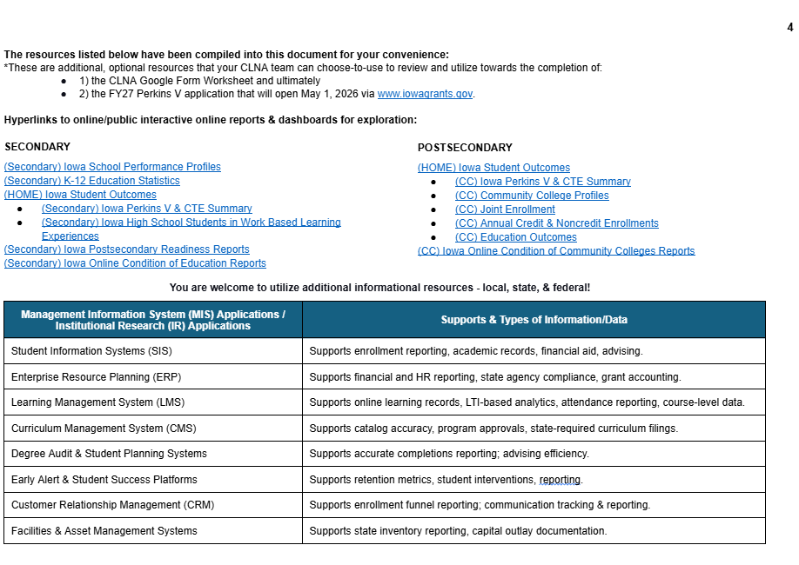
Spring 2026 Element 1 Resource - #4

Slide 13
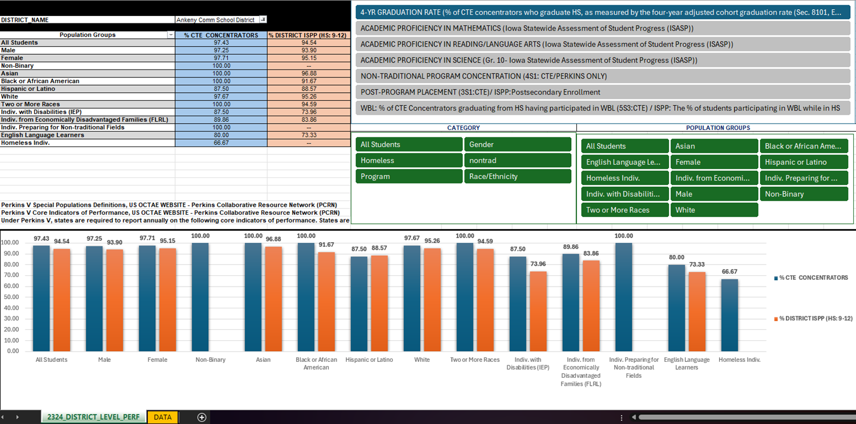
Spring 2026 Resource Folder Notes - #5
Each secondary MS Excel Workbook (N=2) and CC MS Excel Workbook (N=1) contains multiple tabs, and the data is organized in tabular format to aid local use flexibility and contains only “district-level” or “CC-level” 2023-2024 Perkins V CAR (3/2025 approved)/CTE information to help keep this work focused and not overwhelming because this is a “biennial” process.
Notes about the 2023-2024 District-Level Performance MS Workbook Excel file:
It contains (2) worksheets - 1) A data worksheet and 2) a worksheet that contains the PivotTable and PivotChart (they are connected to each other); both “Pivots” are connected to the “data worksheet of district-level information” labeled “data”
On the PivotTable & PivotChart worksheet, the slicers/buttons are interactive and using them will dynamically auto update and refresh both the PivotTable and PivotTable. Depending on internet connection and computer/laptop or device, load times may vary

Slide 14
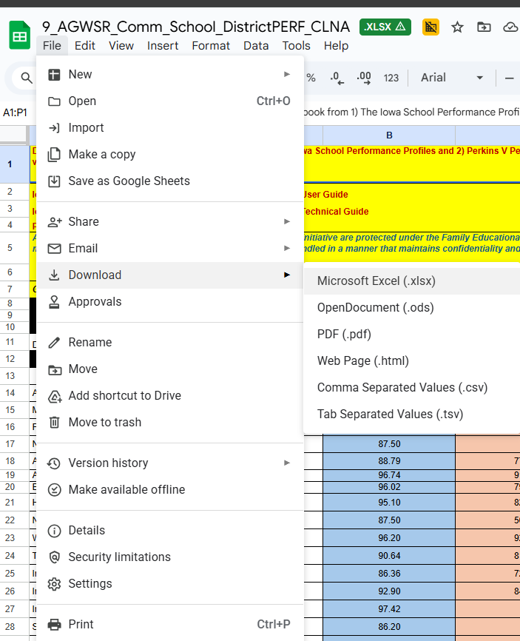
Saving file locally if “open”
Secondary - if Google Doc is open:
File (Left-Click) >> Download – (Left-Click) to MS Excel, MS Word, PDF, etc.
All folders, sub-folders, materials are view/read/download only.
Once “saved” locally, may optimize and utilize as one desires.
(DOWNLOAD FILE TO MS EXCEL ) District-level CTE Counts & Programs & Course Information
In particular, (DOWNLOAD FILE TO MS EXCEL) 2023-2024 District-Level Performance - This MS Excel workbook contains a PivotChart-PivotTable ‘combo’ unique to
Microsoft & not compatible with Google Docs.
CC - if Google Doc is open:
File (Left-Click) >> Download – (Left-Click) to MS Excel, MS Word, PDF, etc.
All folders, sub-folders, materials are view/read/download only.
Once “saved” locally, may optimize and utilize as one desires with local institutional research (IR) tools & data already provided by the Community College MIS Team:
(HOME) Iowa Student Outcomes
(CC) Iowa Perkins V & CTE Summary
(CC) Community College Profiles
(CC) Joint Enrollment
(CC) Annual Credit & Noncredit Enrollments
(CC) Education Outcomes
(CC) Iowa Online Condition of Community Colleges Reports
Workbook is a “one-stop-shop” containing all Perkins V reported data by CC from AY2023-2024, Perkins CAR 2024, approved March 2025.
#_CC_2324_CC_PERKINS_CLNA_ELEMENT_1

Slide 15
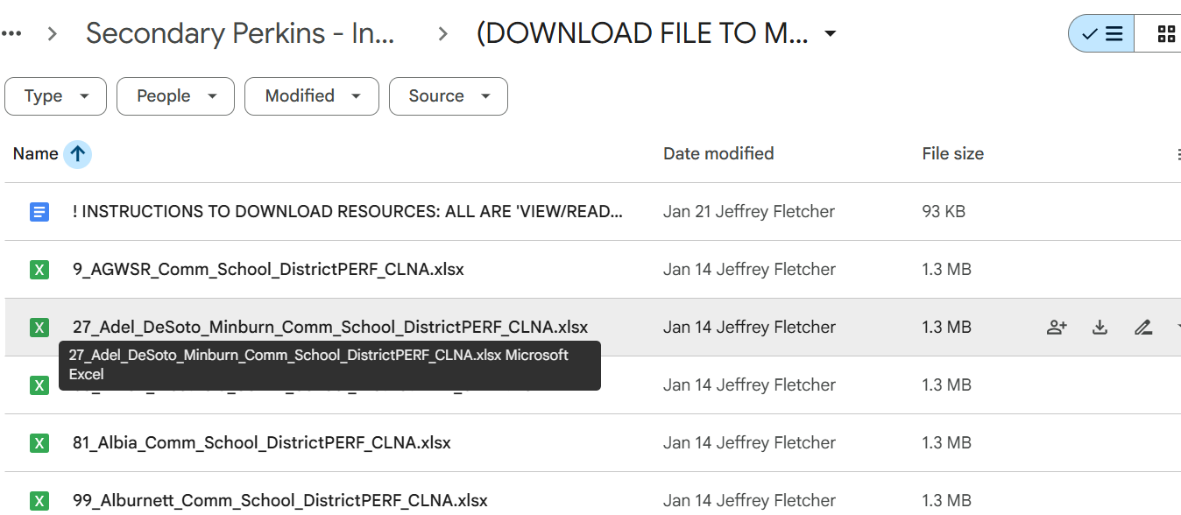
Saving file locally if “not open” - #1
Find your Google Sheet

Slide 16
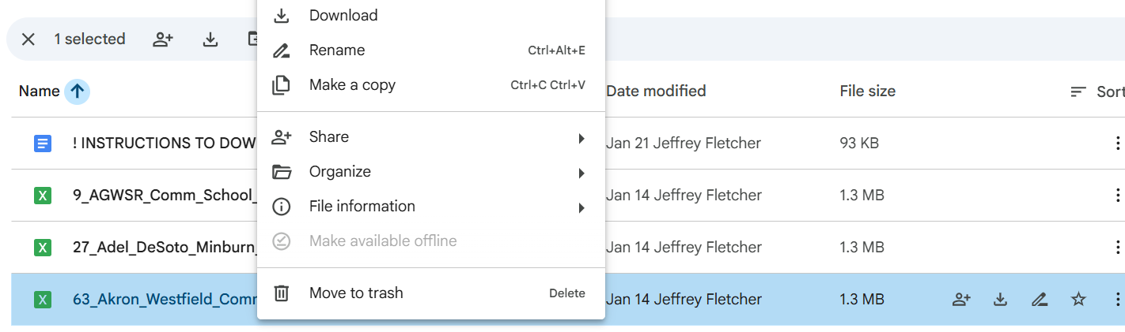
Saving file locally if “not open” - #2
Right click to download into Excel

Slide 17
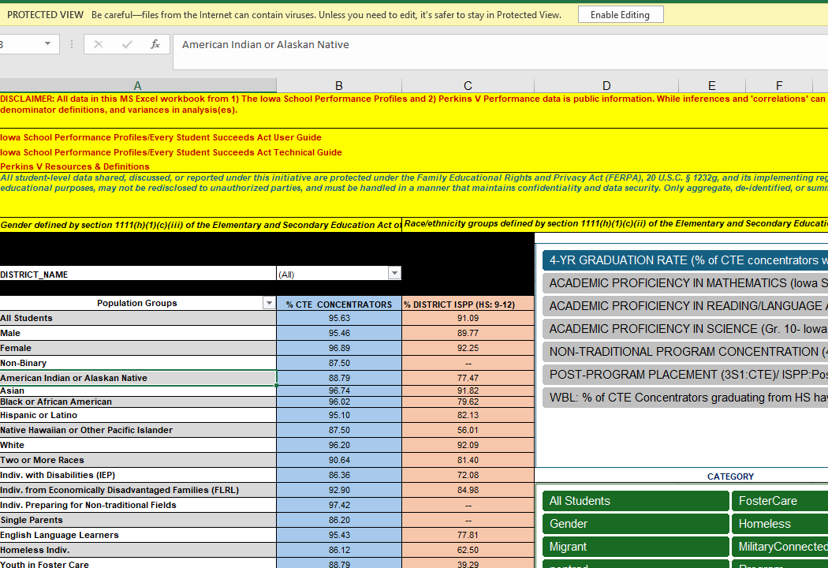
Element 1 Graduation Rate (1S1)
Enable Editing
Review ISASP & CTE Performance Indicators via:
“2324_District_level_PEF“ worksheet
  PivotTable
  PivotChart
“Data” worksheet
Blue = CTE Concentrator (%)
Orange - Non-CTE Student (%)
Tables will auto-refresh/populate based on user selections across three slicers:
Indicators of performance (blue)
Category (green)
Pop.Groups (green)

Slide 18
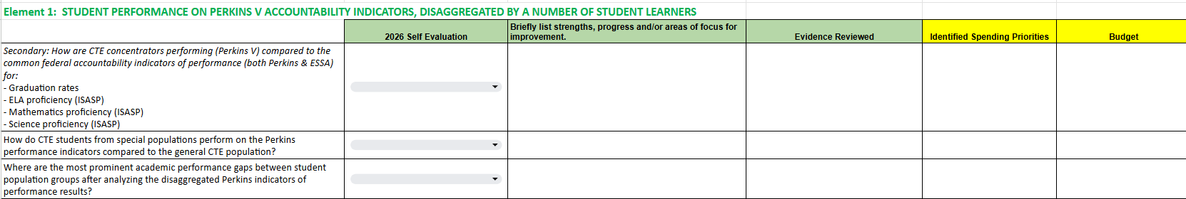
Element 1: Student Performance
Element 1: Evaluation of Student Performance
Secondary - (DOWNLOAD FILE TO MS EXCEL) 2023-2024 District-Level Performance
Question 1.1: Toggle through Grad Rate, ELA, Math, Science, Postsecondary Placement, Non-Trad (CTE Students only, Non-Trad data not collected for non-CTE students), Work-based learning. Compare and contrast CTE concentrator performance with non-CTE student performance.
Question 1.2: Note instances in which special populations within CTE concentrators did not outperform CTE students and add a statement about implementing an academic or coding intervention.
Question 1.3: Note any performance gaps between CTE concentrators and non-CTE students and formulate an academic or coding/reporting intervention.

Slide 19
Element 1 Graduation Rate (1S1): Slide #2
Enable Editing
Review ISASP & CTE Performance Indicators via:
“2324_District_level_PEF“ worksheet
  PivotTable
  PivotChart
“Data” worksheet
Blue = CTE Concentrator (%)
Orange - Non-CTE Student (%)
Tables will auto-refresh/populate based on user selections across three slicers:
Indicators of performance (blue)
Category (green)
Pop.Groups (green)

Slide 20
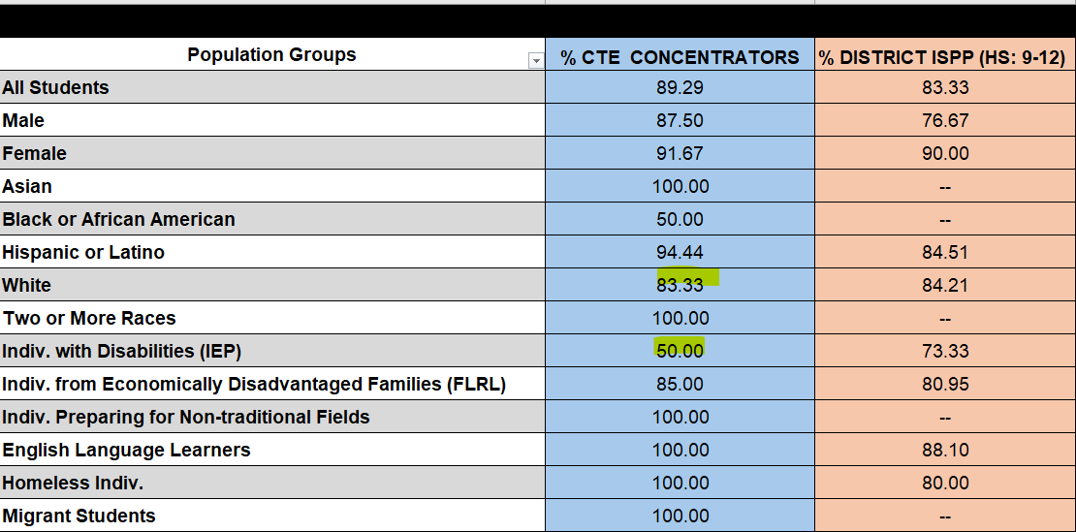
Element 1 Graduation Rate (1S1): Slide #3
1S1 Grad Rate: White & IEP academic interventions for FY 2027 (CLNA Row 9)
Strengths (Column C): CTE Concentrator Grad rates (1S1) exceed non-CTE student graduation rates in all populations except White and Students with Disabilities (IEP)
Evidence Reviewed (Column D):Iowa School Performance Profiles.
Spending Priorities: Identify remediation strategies to increase grad rates for all and specifically for White and Students with Disabilities (IEP).

Slide 21
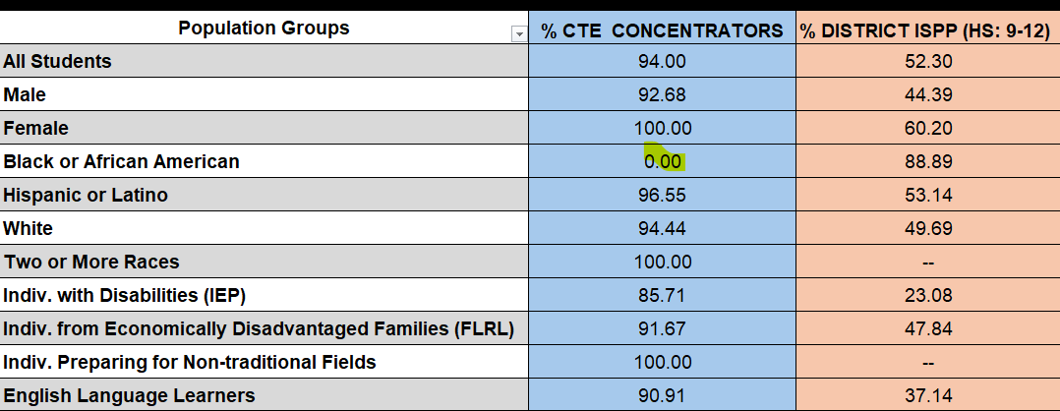
Element 1 Postsecondary Placement (3S1)
3S1 Postsecondary placement (employment, training, college). (CLNA Row 9)
Strengths (Column C): CTE Concentrators exceed all non-CTE student placement in workforce and postsecondary enrollment by 85 percent or higher.
Focus: Black or AA opportunities for 3S1
Evidence Reviewed (Column D):Iowa School Performance Profiles.
Spending Priorities: Postsecondary opportunities for our black student population.
Non-CTE ELA, Math, Science=0

Slide 22
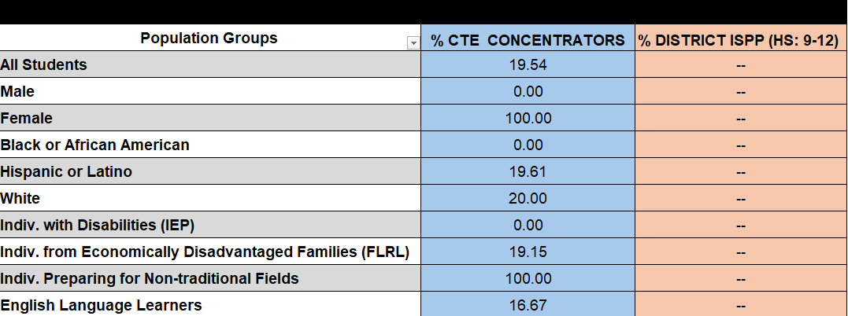
Element 1 Non-traditional (4S1)
4S1 *Non-traditional program concentration (CLNA Row 9)
Strengths (Column C):
Focus for Improvement: Provide non-traditional career outreach to males and females in all population groups
Evidence Reviewed (Column D):Iowa School Performance Profiles.
Spending Priorities :
*Male/female make up less than 25% of the workforce in a given occupation.Data not collected for non-CTE students.

Slide 23
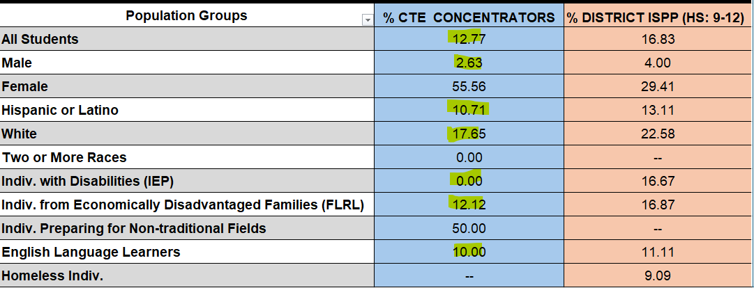
Element 1 Work-based learning (5S3)
5S3 Work-based learning (CLNA Row 9)
Focus: (Column C): Work-based learning for CTE concentrators was minimal with only 50 percent of females participating and all other populations groups participating in far lower percentage rates.
Evidence Reviewed (Column D):Iowa School Performance Profiles.
Spending Priorities District will reach out to the Department WBL consultant for coding and academic strategies to improve outcomes for students. Coding? Opportunities? Both?

Slide 24
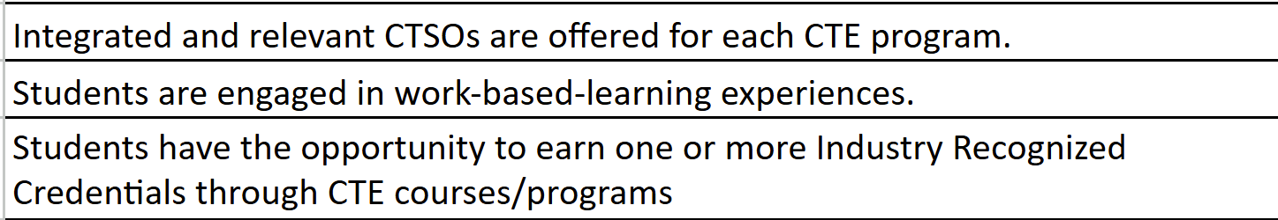
Element 2 Size, Scope, and Quality
CTE Programs/Programs of Study: Questions three, four, and five
  (DOWNLOAD FILE TO MS EXCEL ) District-level CTE Counts & Programs & Course Information
  CTSOs
  Work-based Learning
  Industry Recognized Credentials

Slide 25
Element 1 School District Performance Eval rows 10 & 11
Special Population prominent gaps and performance compared to the general CTE population. (CLNA Rows 10 & 11)
Grad rate: White and IEP
Postsecondary placement (workforce and post high school training); Exceeds in all population groups.
Work-based learning: All special population groups demonstrate performance gaps and low WBL participation.
Evidence Reviewed (Column D):Iowa School Performance Profiles.
Spending Priorities District will reach out to the Department WBL consultant for coding and academic strategies to improve outcomes for students.
Priorities: Expand Non-traditional opportunities for all males in healthcare and females in STEM.

Slide 26
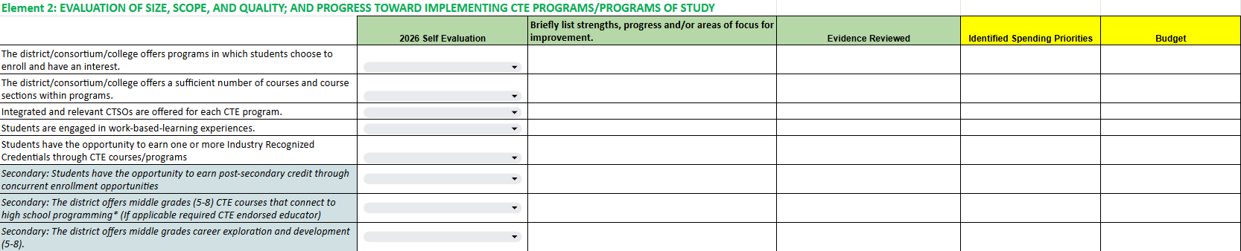
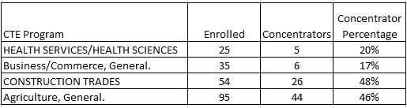
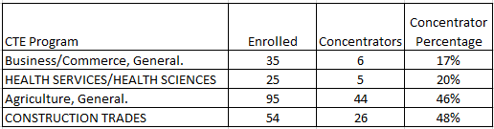
Element 2: Size Scope and Quality
Element 2: Evaluation of Size, Scope, and Quality
(DOWNLOAD FILE TO MS EXCEL ) District-level CTE Counts & Programs & Course Information
Question 2.1: Review programs and courses by calculation the number of CTE Concentrators by CTE Program.
    Review the percentage of concentrators in each program Column I Concentrators Worksheet Divided by Column I in Participants Worksheet).
    Data sort by the highest number enrolled.
    Data Sort by the highest percentage retained (concentrator status).
Sort by Enrolled (Ag General). Sort by highest percentage of concentrators (Construction Trades).
Use concentrator data to assist with Element 2, questions one and two. May also be useful for Element three.

Slide 27
Element 3: Labor Market Information
Element 2: Labor Market Information
(DOWNLOAD FILE TO MS EXCEL ) District-level CTE Counts & Programs & Course Information
Question 2.2: Have instructors review their CTE programs and local course titles.
  Instructors: Make your case for why your funding requests meet regional labor market needs, stakeholder input, business and industry needs, and student and parent input.
  Iowa’s Career Explorer
  Occupational Projections (by Region)
Sort by Enrolled (Ag General). Sort by highest percentage of concentrators (Construction Trades)
Use concentrator data to assist with Element 2, questions one and two. May also be useful for Element three.

Slide 28
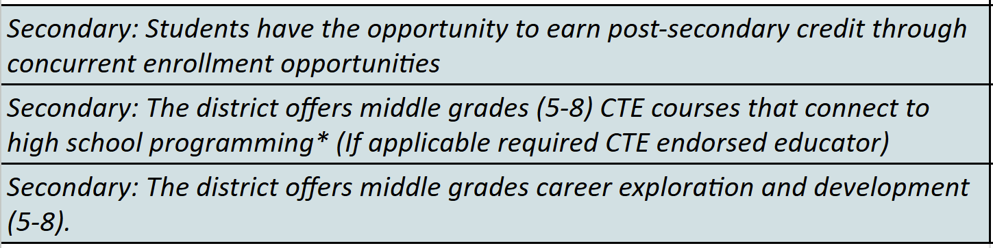
CTE Programs/Programs of Study: Middle School Optional
Prior approval and CTE Licensed instructors are required.
(DOWNLOAD FILE TO MS EXCEL ) District-level CTE Counts & Programs & Course Information
Element 2 Size, Scope, and Quality

Slide 29
Element 3: Labor Market
Using Labor Market Information to Guide CTE Program Size, Scope and Quality
Iowa and U.S. Labor Market Outlook (2027-2028 and Five year trends)
Artificial Intelligence (AI) Influence on Labor Market Information
Top 15 High-Wage, High-Demand Careers (Certificate, Diploma, 2-Year Degree)
Labor Market Outlook for the most common 180 Local Secondary & Postsecondary Course Titles
  Iowa’s Career Explorer
  Occupational Projections (by Region)
More details coming soon - Cale
Dates and registration will be shared on the Iowa CLNA Landing Page as they are finalized.
Stay connected for the 3rd (Labor Market)
February 3, 2:30 - 3:30
Date & Time TBD - 4th Webinar will concern Budget Prior approval and CLNA Alignment

Slide 30
Districts within consortia can and will have earlier due dates due to multi-CLNA coordination by consortium leaders.
Timeline
Date | Task
March 1 | Prior Approval Budget Template Distributed to Perkins Contacts
March 31 | Budget templates Due (Prior purchase approvals reviewed between April 1-April 30)
May 1 | Perkins Application Opens in IowaGrants* (Approved budgets are uploaded into Perkins application)
June 30 | Perkins Application Due in IowaGrants (The CLNA must be completed before you complete your application)

Slide 31
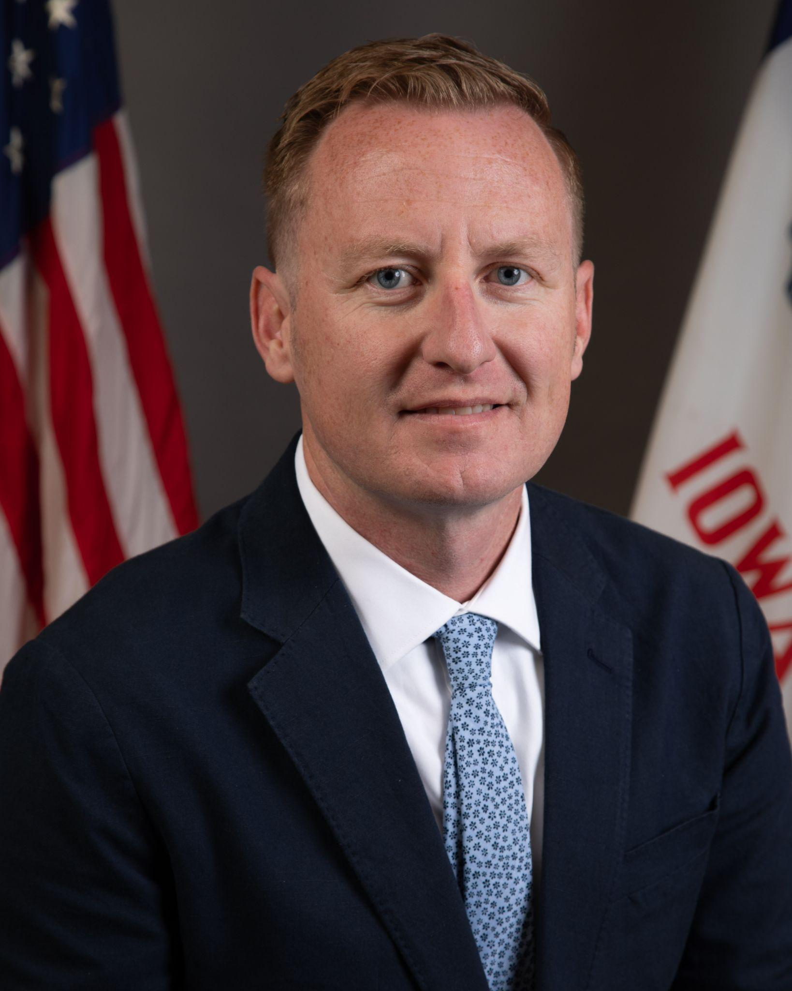

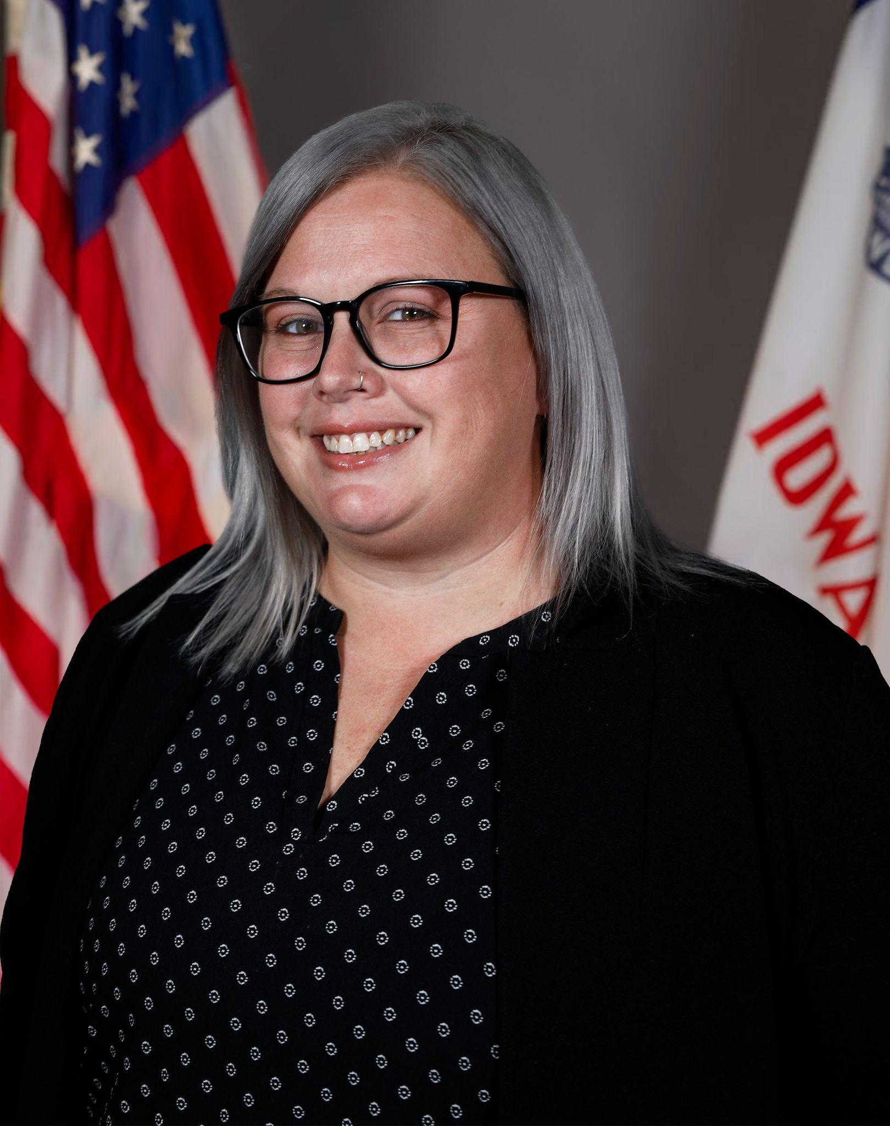

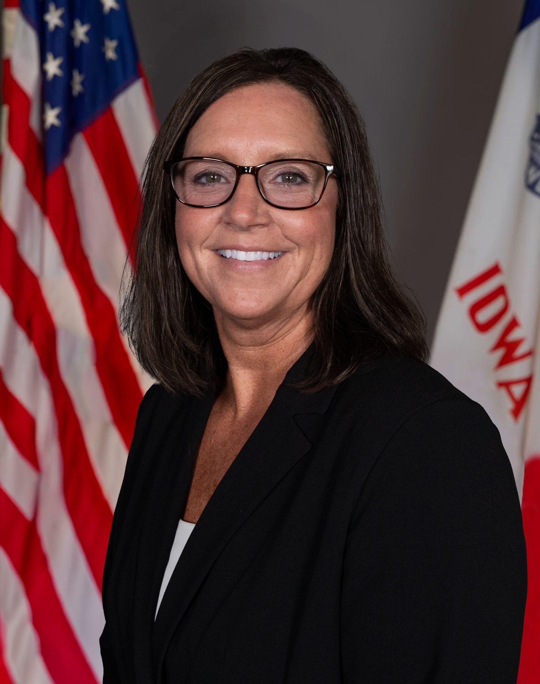

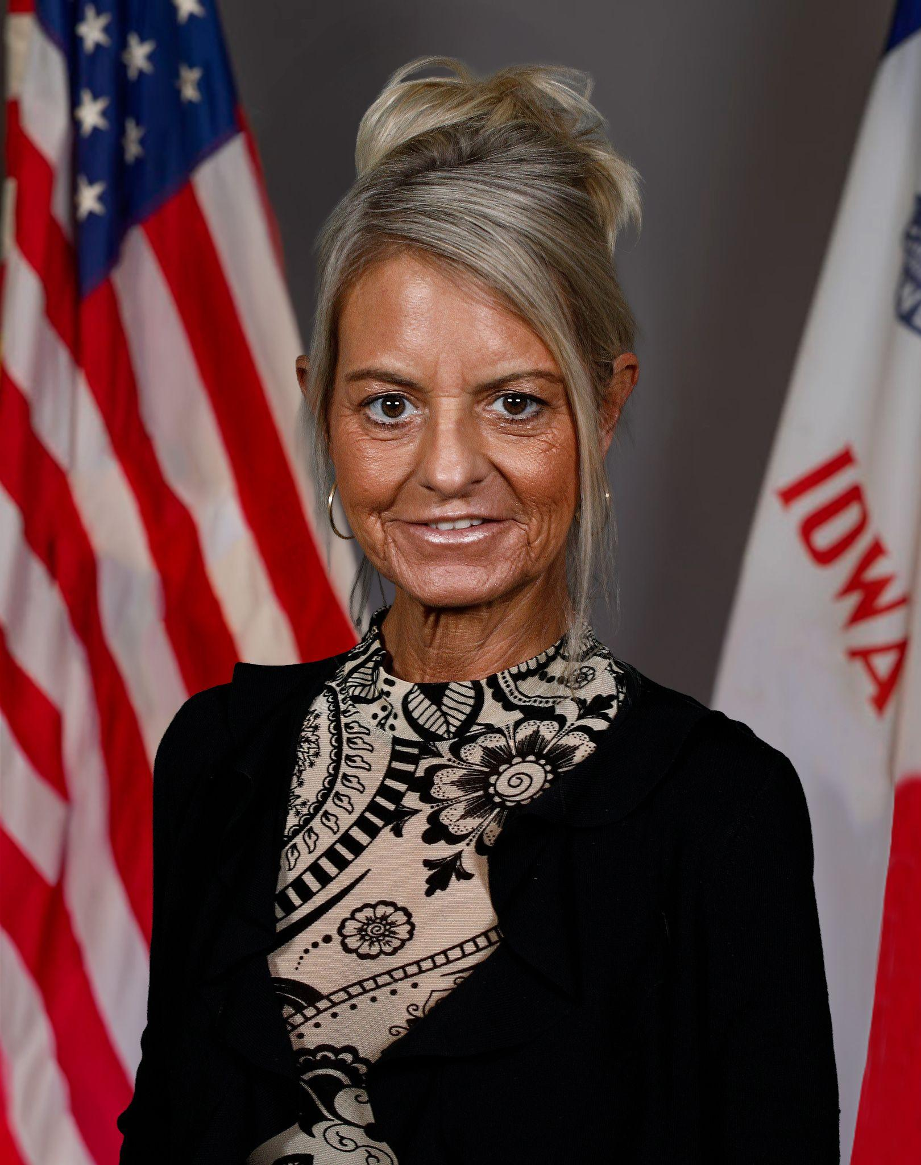
Contact Information
Cale Hutchings
Bureau Chief - CTE
cale.hutchings@iowa.gov
515-975-8193
Heather Meissen, PhD
Administrative Consultant - CTE
heather.meissen@iowa.gov
515-326-5378
Jodie Smith
Consultant - WBL/IRCs
jodie.smith@iowa.gov
515-419-5190
Alan Spencer
Consultant - Ag Ed
alan.spencer@iowa.gov
515-720-8863
Shelly Duwa
Consultant - Business Ed and CTSOs
shelly.duwa@iowa.gov
515-971-0669
Jeffrey Fletcher, PhD, MPA
Consultant - Perkins, IowaGrants
jeffrey.fletcher@iowa.gov
515-321-7309
Amy Vybiral
Consultant - Perkins Budgets and Claims
amy.vybiral@iowa.gov
515- 339-4520

Slide 32
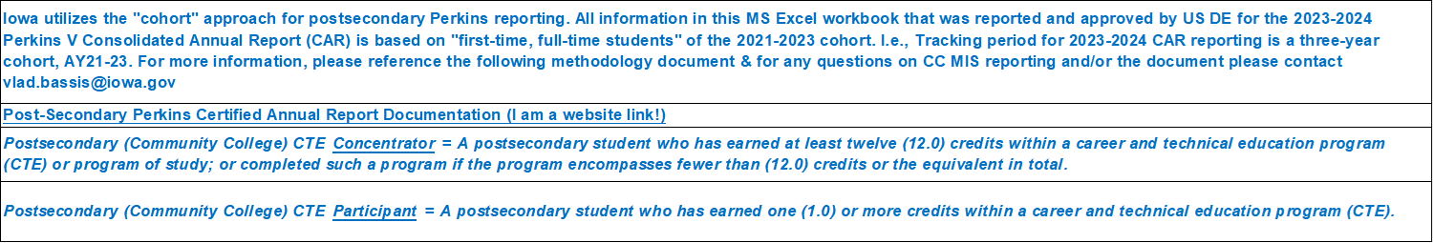
PERKINS V SEC. 113. [20 U.S.C. 2323] ACCOUNTABILITY - #2
SECONDARY PERKINS V SEC. 113. [20 U.S.C. 2323] ACCOUNTABILITY
POSTSECONDARY PERKINS V SEC. 113. [20 U.S.C. 2323] ACCOUNTABILITY

Slide 33
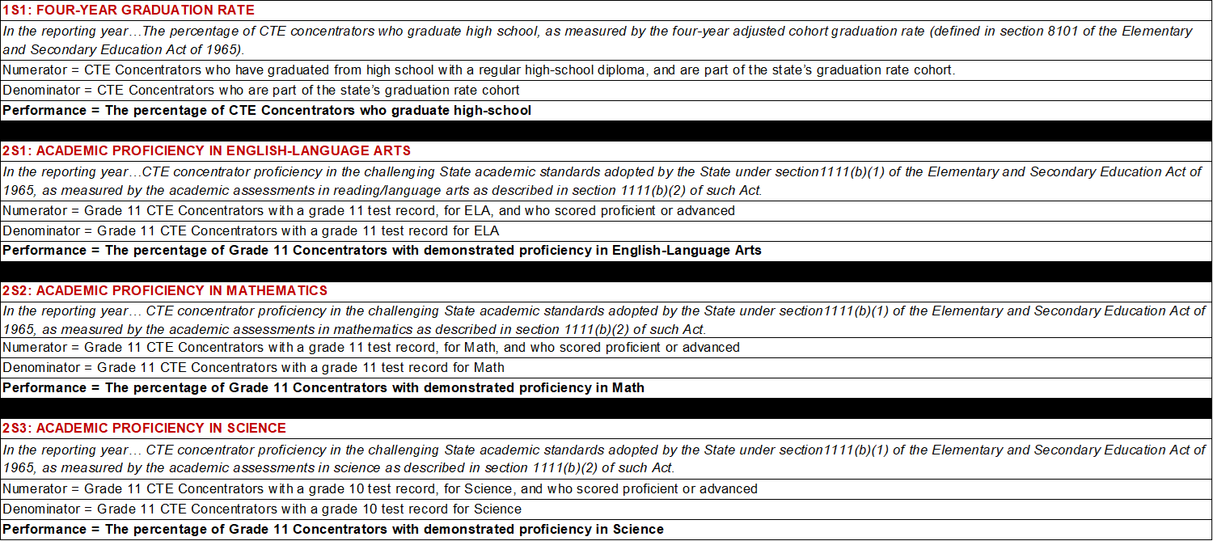
PERKINS V SEC. 113. [20 U.S.C. 2323] ACCOUNTABILITY - #3
SECONDARY PERKINS V SEC. 113. [20 U.S.C. 2323] ACCOUNTABILITY

Slide 34
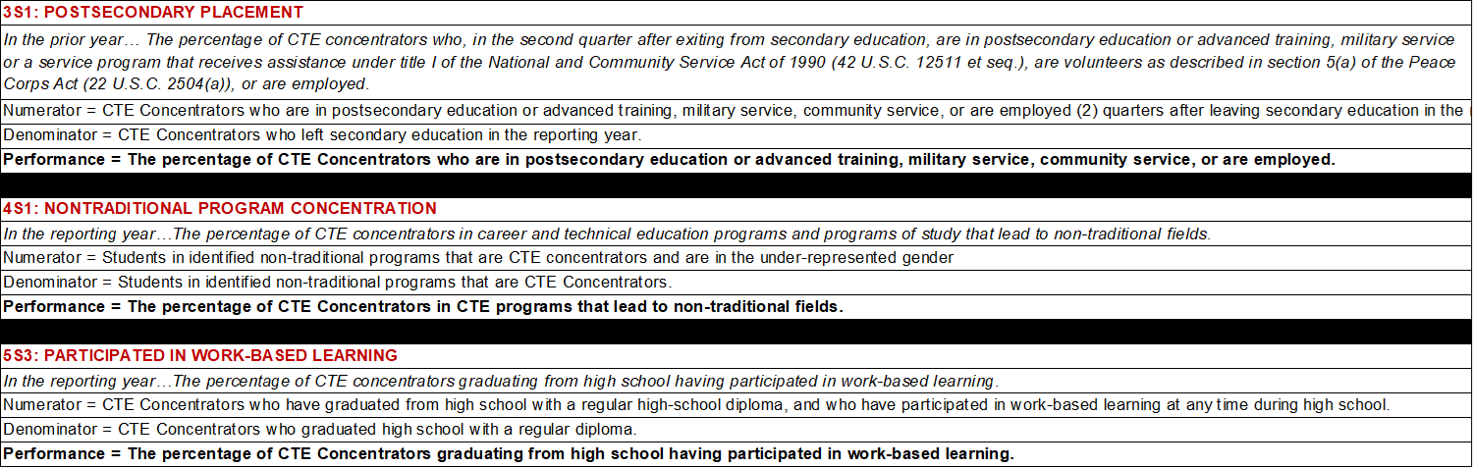
PERKINS V SEC. 113. [20 U.S.C. 2323] ACCOUNTABILITY - #4
SECONDARY PERKINS V SEC. 113. [20 U.S.C. 2323] ACCOUNTABILITY

Slide 35
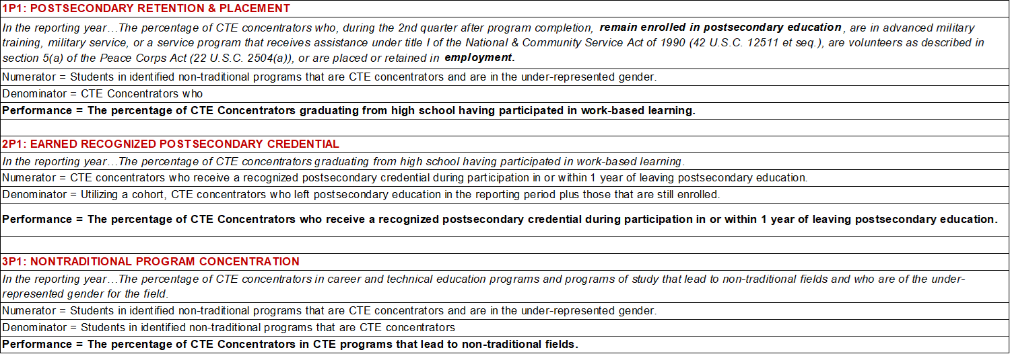
PERKINS V SEC. 113. [20 U.S.C. 2323] ACCOUNTABILITY - #5
POSTSECONDARY PERKINS V SEC. 113. [20 U.S.C. 2323] ACCOUNTABILITY

Slide 36
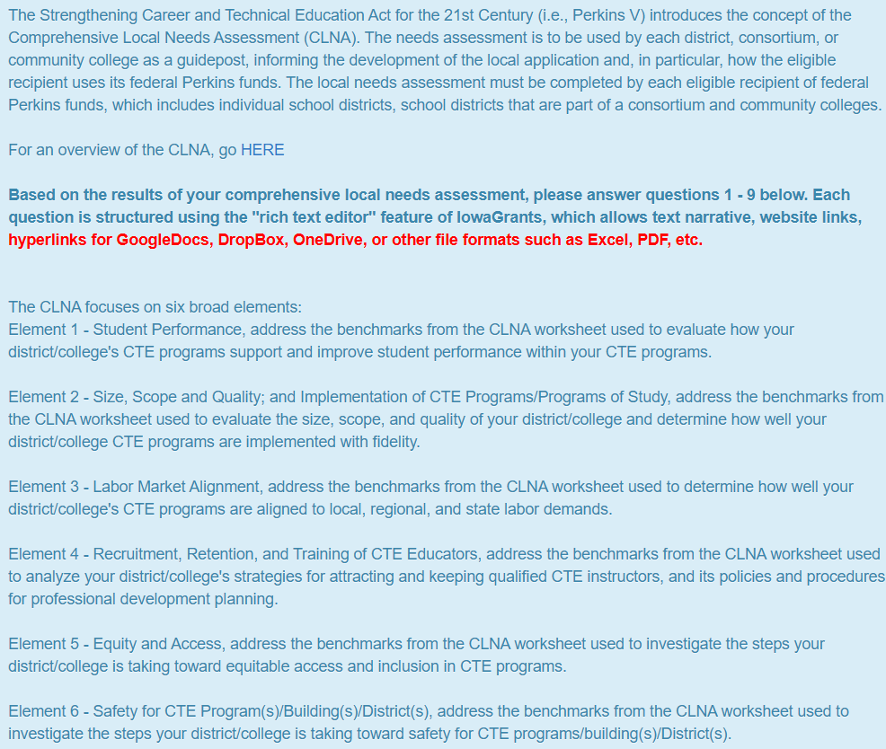
(Preview) IowaGrants CLNA Outcomes/Questions Application Form
The nine required narrative elements (often framed as the “9 questions” in local Perkins V CLNA-linked applications) are specified in Section 134(b) of the Strengthening Career and Technical Education for the 21st Century Act (Perkins V).
These elements define the statutory contents of the Perkins V local application that all eligible recipients must address when submitting a biennial application informed by the Comprehensive Local Needs Assessment (CLNA).
Applicable to all 50 U.S. states and certain U.S. territories receiving the Perkins V (the Strengthening Career and Technical Education for the 21st Century Act)
Federal Basic State Grant funding for career and technical education (CTE)

Slide 37
(Preview) IowaGrants CLNA Outcomes/Questions Application Form:
Slide #2
Based on the completion of the CLNA process, please answer the following questions:
1. Provide a summary of the results of the comprehensive needs assessment.
2. Provide information on the CTE course offerings and activities to be provided with Perkins funds, including all state-approved plans of study.
3. Describe how your school district will, in collaboration with local workforce development partners, provide a series of career exploration and career guidance activities.
4. Provide a description of how the district or consortia will improve the academic and technical skills of students participating in CTE programs.
5. Utilizing available student performance and labor market data, provide a description of how the district or consortia will provide activities to prepare special populations for high-skill, high-wage, or in-demand occupations; prepare CTE participants for non-traditional fields; provide equal access for special populations to CTE courses, programs, and programs of study; and ensure that members of special populations will not be discriminated against.

Slide 38
(Preview) IowaGrants CLNA Outcomes/Questions Application Form:
Slide #3
Based on the completion of the CLNA process, please answer the following questions:
6. Provide a description of the work-based learning opportunities for students participating in CTE programs and how the district or consortia will work with representatives from business and industry to develop or expand work-based learning.
7. Provide a description of how the district or consortia will provide students participating in CTE the opportunity to gain postsecondary credit while still attending high school.
8. Provide a description of how the district or consortia supports the recruitment, preparation, retention, and training, including professional development of teachers, faculty, administrators, counselors, and specialized instructional support personnel.
9. Provide a description of how the district or consortia will address disparities or gaps in performance between groups of students in each of the plan years, and if no meaningful progress has been achieved prior to the third program year, a description of the additional actions that will be taken to eliminate these disparities or gaps.

