Slide 1
Allowable Uses of Funds
Title III, Part A—English Learners and Immigrant Students
Bureau of ESEA Programs
Rachel Pettigrew

Slide 2
Overview
The purpose of today’s webinar is to provide school districts, area education agencies (AEAs), and accredited nonpublic schools with Title III, Part A - English Learners and Immigrant Students Program allowable activities requirements.
Ensure federal programs are effectively implemented according to federal guidance

Slide 3
Purpose
(ESEA § 3102) slide 1
To help ensure that English learners (ELs), including immigrant children and youth, attain English proficiency and develop high levels of academic achievement in English;
To assist all ELs, including immigrant children and youth, to achieve at high levels in academic subjects so that all ELs can meet the same challenging State academic standards that all children are expected to meet;
To assist teachers (including preschool teachers), principals and other school leaders, State educational agencies, local educational agencies, and schools in establishing, implementing, and sustaining effective language instruction educational programs (LIEPs) designed to assist in teaching ELs, including immigrant children and youth;

Slide 4
Purpose
(ESEA § 3102) slide 2
To assist teachers (including preschool teachers), principals and other school leaders, State educational agencies, and local educational agencies to develop and enhance their capacity to provide effective instructional programs designed to prepare ELs, including immigrant children and youth, to enter all-English instructional settings; and
To promote parental, family, and community participation in LIEPs for the parents, families, and communities of ELs.

Slide 5
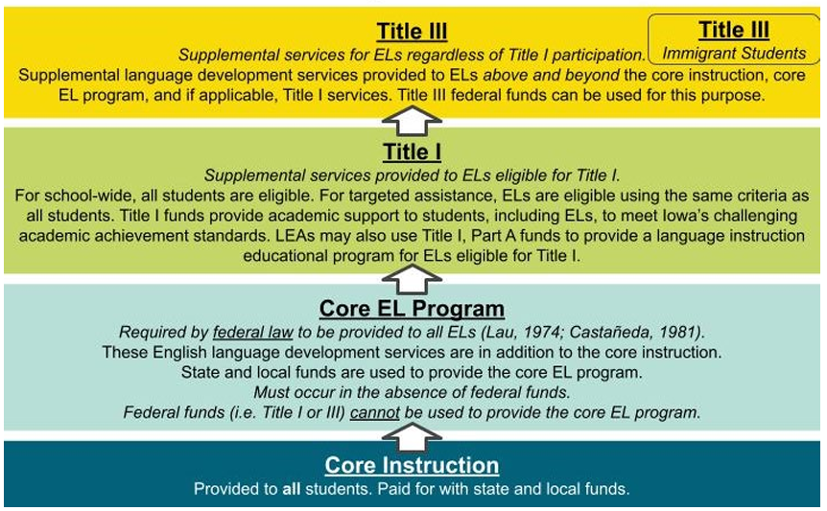
Funding Distinctions

Slide 6
Purposes of Title III Subgrants (ESEA § 3115(a))
In carrying out activities with Title III-A funds, the eligible entity shall use effective approaches and methodologies for teaching ELs and immigrant children and youth for the following purposes:
Developing and implementing new LIEPS and academic content instructional programs for ELs and immigrant children and youth, including early childhood education programs, elementary school programs, and secondary school programs.
Carrying out highly focused, innovative, locally designed activities to expand or enhance existing LIEPs and academic content instructional programs for ELs and immigrant children and youth.
Implementing, within an individual school, schoolwide programs for restructuring, reforming, and upgrading all relevant programs, activities, and operations relating to LIEPs and academic content instruction for ELs and immigrant children and youth.
Implementing, within the entire jurisdiction of a local educational agency (LEA), agency-wide programs for restructuring, reforming, and upgrading all relevant programs, activities, and operations relating to LIEPs and academic content instruction for ELs and immigrant children and youth.

Slide 7
Required Activity #1
(ESEA § 3115(c))
Increase the English language proficiency of ELs by providing effective LIEPs that meet the needs of ELs and demonstrate success in increasing—
  English language proficiency; and
  student academic achievement;

Slide 8
Required Activity #2
(ESEA § 3115(c))
Provide effective professional development to classroom teachers (including teachers in classroom settings that are not the settings of LIEPs), principals and other school leaders, administrators, and other school or community-based organizational personnel, that is—
  designed to improve the instruction and assessment of ELs;
  designed to enhance the ability of such teachers, principals, and other school leaders to understand and implement curricula, assessment practices and measures, and instructional strategies for ELs;
  effective in increasing children’s English language proficiency or substantially increasing the subject matter knowledge, teaching knowledge, and teaching skills of such teachers; and
  of sufficient intensity and duration (which shall not include activities such as 1-day or short-term workshops and conferences) to have a positive and lasting impact on the teachers’ performance in the classroom, except that this subparagraph shall not apply to an activity that is one component of a long-term, comprehensive professional development plan established by a teacher and the teacher’s supervisor based on an assessment of the needs of the teacher, the supervisor, the students of the teacher, and any local educational agency employing the teacher, as appropriate;

Slide 9
Required Activity #3
(ESEA § 3115(c))
Provide and implement other effective activities and strategies that enhance or supplement LIEPs for ELs, which—
  shall include parent, family, and community engagement activities; and
  may include strategies that serve to coordinate and align related programs.

Slide 10
Alignment of Title III Activities to Needs Assessed
Needs Assessment Assess the needs of: | Required Activities Coordinate or provide:
English learners (ELs) in order to demonstrate success in increasing— English language proficiency; and student academic achievement. | Effective strategies, materials, and activities for second language acquisition and academic achievement of ELs.
Classroom teachers, principals and other school leaders, administrators, and other school or community-based organizational personnel serving ELs. | Ongoing, supplemental EL professional development activities led by a qualified PD provider with EL expertise.
EL parent, family, and community engagement. | Supplemental EL family and community engagement opportunities.
and
Notes:
Iowa Administrative Code rule 281-60.2(3)
b.5 All district instructional staff and area education agency (AEA) staff responsible for implementing the educational and instructional models defined in rule 281—60.1(280) receive such professional development as may be necessary to implement those educational and instructional models.
Such professional development is delivered in accordance with 281—Chapter 83, including qualification of providers. In determining whether providers meet the standards in 281—Chapter 83, the following nonexhaustive factors may be considered, as they are relevant to the particular professional development to be provided:
1. ESL endorsement or equivalent;
2. Five years of ESL teaching experience; or
3. A graduate degree in teaching English to speakers of other languages or in a related field.

Slide 11
Supplement Not Supplant (ESEA § 3115(g))
Use “CARE” Not to Supplant
Civil Rights | Is it required under Civil Rights?
All students | Is it offered to all students?
Regulations | Is it required by federal, state, or local regulations?
Existed Previously | Did it exist previously through other federal, state, or local funds?
If the answer is “yes,” it is not an allowable use of Title III funds.

Slide 12
Authorized Activities of Title III - English Learners
(ESEA § 3115(d)) Items 1 through 3
Upgrading program objectives and effective instructional strategies.
Improving the instructional program for English learners by identifying, acquiring, and upgrading curricula, instructional materials, educational software, and assessment procedures.
Providing to English learners—
  tutorials and academic or career and technical education; and
  intensified instruction, which may include materials in a language that the student can understand, interpreters, and translators.

Slide 13
Authorized Activities of Title III - English Learners
(ESEA § 3115(d)) Items 4 through 6
Developing and implementing effective preschool, elementary school, or secondary school language instruction educational programs that are coordinated with other relevant programs and services.
Improving the English language proficiency and academic achievement of English learners.
Providing community participation programs, family literacy services, and parent and family outreach and training activities to English learners and their families—
  to improve the English language skills of English learners; and
  to assist parents and families in helping their children to improve their academic achievement and becoming active participants in the education of their children.

Slide 14
Authorized Activities of Title III - English Learners
(ESEA § 3115(d)) Items 7 through 9
Improving the instruction of English learners, which may include English learners with a disability, by providing for—
  the acquisition or development of educational technology or instructional materials;
  access to, and participation in, electronic networks for materials, training, and communication; and
  incorporation of the resources described in subparagraphs (A) and (B) into curricula and programs, such as those funded under this subpart.
Offering early college high school or dual or concurrent enrollment programs or courses designed to help English learners achieve success in postsecondary education.
Carrying out other activities that are consistent with the purposes of this section.

Slide 15
Title III - Immigrant Students (ESEA §§ 3202(5); 3114(d); 3115(e))
The term ‘‘immigrant children and youth’’ means individuals who—
are aged 3 through 21;
were not born in any State; and
have not been attending one or more schools in any one or more States for more than 3 full academic years.
The Department awards subgrants to eligible entities in Iowa that have experienced a significant increase, as compared to the average of the 2 preceding fiscal years, in the percentage or number of immigrant children and youth, who have enrolled, during the fiscal year for which the subgrant is made, in public and nonpublic elementary schools and secondary schools in the geographic areas under the jurisdiction of, or served by, such entities.
Eligible entities shall use Title III-Immigrant Students funds to pay for activities that provide enhanced instructional opportunities for immigrant children and youth.
Notes:
Note: The term “State” means each of the 50 States, the District of Columbia, and Puerto Rico.

Slide 16
Authorized Activities of Title III - Immigrant Students
(ESEA § 3115(e)) Items 1 through 4
Family literacy, parent and family outreach, and training activities designed to assist parents and families to become active participants in the education of their children;
Recruitment of, and support for, personnel, including teachers and paraprofessionals who have been specifically trained, or are being trained, to provide services to immigrant children and youth;
Provision of tutorials, mentoring, and academic or career counseling for immigrant children and youth;
Identification, development, and acquisition of curricular materials, educational software, and technologies to be used in the program carried out with awarded funds;

Slide 17
Authorized Activities of Title III - Immigrant Students
(ESEA § 3115(e)) Items 5 through 7
Basic instructional services that are directly attributable to the presence of immigrant children and youth in the local educational agency involved, including the payment of costs of providing additional classroom supplies, costs of transportation, or such other costs as are directly attributable to such additional basic instructional services;
Other instructional services that are designed to assist immigrant children and youth to achieve in elementary schools and secondary schools in the United States, such as programs of introduction to the educational system and civics education; and
Activities, coordinated with community-based organizations, institutions of higher education, private sector entities, or other entities with expertise in working with immigrants, to assist parents and families of immigrant children and youth by offering comprehensive community services.

Slide 18
Title III Allowability: Examples
Generally Allowable Activities to Fund with Title III
Tutoring ELs (before school, after school, evenings, weekends, summer, beyond contract hours, tutoring agency) Supplementing materials for ELs (developing instructional scaffolds, accommodated resources, interpretation supports for students, student licenses for supplemental computer programs) Staffing supplemental positions (EL paraeducators, bilingual family liaisons, SLIFE mental health specialists, cultural community ambassadors) Facilitating EL family and community engagement opportunities (EL home visits, EL family literacy events, bilingual FAFSA nights) Facilitating effective EL PD activities aligned to assessed needs of educators that are sustained (not stand-alone, one-day, or short term workshops), intensive, collaborative, job-embedded, data-driven, and classroom-focused (ESEA § 8101(42)) Aligning related services (systems to improve processes for LIEP data management and reporting) Implementing additional or new LIEPs (EL preschool programs, newcomer mental health services, night classes) Ensuring Title III activities are reasonable (2 CFR 200.404), necessary (2 CFR 200.403), and allocable (2 CFR 200.405)

Slide 19
Title III Allowability: Non-Examples
Generally NOT Allowable Uses of Title III Funds
Funding LIEP obligations to fulfill State requirements (staffing EL teachers, ESL endorsements, ELPA21) Interpreting information provided to all families (staffing interpreters for registration, parent-teacher conferences, IEP meetings) Changing funding streams for anything that was funded through a different funding stream previously (staffing bilingual family liaisons who were previously paid from general funds) Split-funding items or activities provided to all students (Chromebooks, summer school) Attending PD that does not meet the ESEA definition of effective (stand-alone, one-day, or short term workshops or conferences) Providing full meals, candy, or alcohol (snacks and light refreshments are generally allowable for students and parents participating in an allowable Title III activity) Purchasing furniture (filing cabinets, desks, curtains, or other materials not connected with providing supplemental services) Direct administrative costs beyond 2% of the current year’s Title III allocation (ESEA § 3115(b))

Slide 20
Contact Information
Rachel Pettigrew
Education Program Consultant
rachel.pettigrew@iowa.gov
515-380-5115

