Slide 1
Iowa Foundations of Reading Test (FORT)
First-Year Results & Program Support Plan
Office of Educator Quality
Prepared for Iowa State Board of Education
January 15, 2026

Slide 2

Purpose of Today’s Presentation
Understand first-year FORT results
Review program support plan
Discuss implications for continuous improvement
Receive and implement the Board’s feedback

Slide 3
2025 Foundations Of Reading Test Results
Foundations of Reading test (FORT) report results
Candidates who were tested between January 2, 2025 to July 31, 2025
The recommended national passing score, set by the Iowa Department of Education is 240
The report includes:
Percentage of candidates at each institution with passing scores
Number of test takers and services or opportunities for students to retake the test for each institution
As of August 1, 2025, the Iowa overall passage rate was 46%.

Slide 4
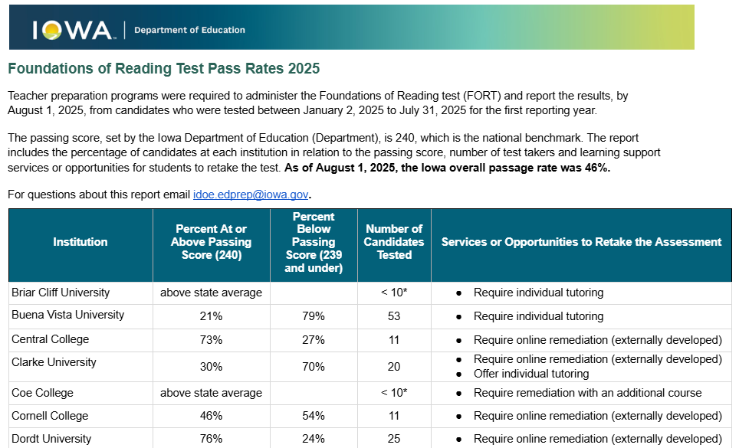
Overview of State Report

Slide 5
Why Foundations of Reading Matters
Reading is foundational to student success
Teachers need strong preparation in evidence-based reading instruction
FORT assessment is one shared tool utilized by all programs to provide insight into preparation, this test is one data point among many
How We are Using the Data
Diagnostic to inform continuous improvement (use assessment data responsibly, transparently, and in context)
Focused on shared goals, support for programs and building systems
Support consistent preparation across all pathways
Ensure all Iowa students benefit from well-prepared teachers

Slide 6
Program Results by Support Level
Intensive ≤35%
Targeted: 36–46%
Standard: >46%
Programs at or below 35%
5 Programs
Buena Vista
Clarke
Loras
UNI
William Penn
Programs at or between
36% to 46%
3 Programs
Cornell
ISU
Upper Iowa
Programs above the State Average (46%)
19 Programs
Notes:
Either this slide or next- remove one

Slide 7
Program Passage Rates
Briar Cliff (above state average)* | Graceland (above state average)* | Simpson (75%)
Buena Vista (21%) | Grand View (above state average)* | St. Ambrose (75%)
Central College (73%) | Grinnell** | University of Dubuque (55%)
Clarke (30%) | Iowa State University (40%) | University of Iowa (53%)
Coe (above state average)* | Loras (27%) | UNI (35%)
Cornell (46%) | Luther (56%) | Upper Iowa (39%)
Dordt (76%) | Morningside (65%) | Viterbo**
Drake (above state average)* | Mounty Mercy (above state average)* | Waldorf (above state average)*
Emmaus (above state average)* | Northwestern (50%) | Wartburg (above state average)*
Faith Baptist Bible College (100%) | RAPIL** | William Penn (30%)
BOLD - Intensive Support Level
ITALICS - Targeted Support Level
* Programs with less than 10 test takers only above or below the state average listed without passage rate to protect personally identifiable information
** Not required to report

Slide 8
Accountability and Support Level
Support Level | Criteria | Activities
Intensive | Programs at or below 35% | Same as Targeted Data Analysis | Reflection | Action Plan (shared with the Department) Curriculum review with revision action steps and implementation plan (independent reviewer(s) selected competitively) Review of faculty qualification | Required participating in LETRS PD In addition to Targeted Approved remediation course and interventions (build a model remediation course based on different competencies) Required participation in monthly peer-group training and monitoring
Targeted | At or between 46% to 36% | Same as Intensive Data Analysis | Reflection | Action Plan (shared with the Department) Curriculum review with revision action steps and implementation plan (independent reviewer(s) selected competitively) Review of faculty qualification | Required participating in LETRS PD Less restrictive than Intensive Remediation course/resources review
Standard | Above State Average (46%) | Strongly recommended below 70% pass rate (or those with fewer than 10 candidates to engage) Data Analysis | Reflection | Action Plan

Slide 9
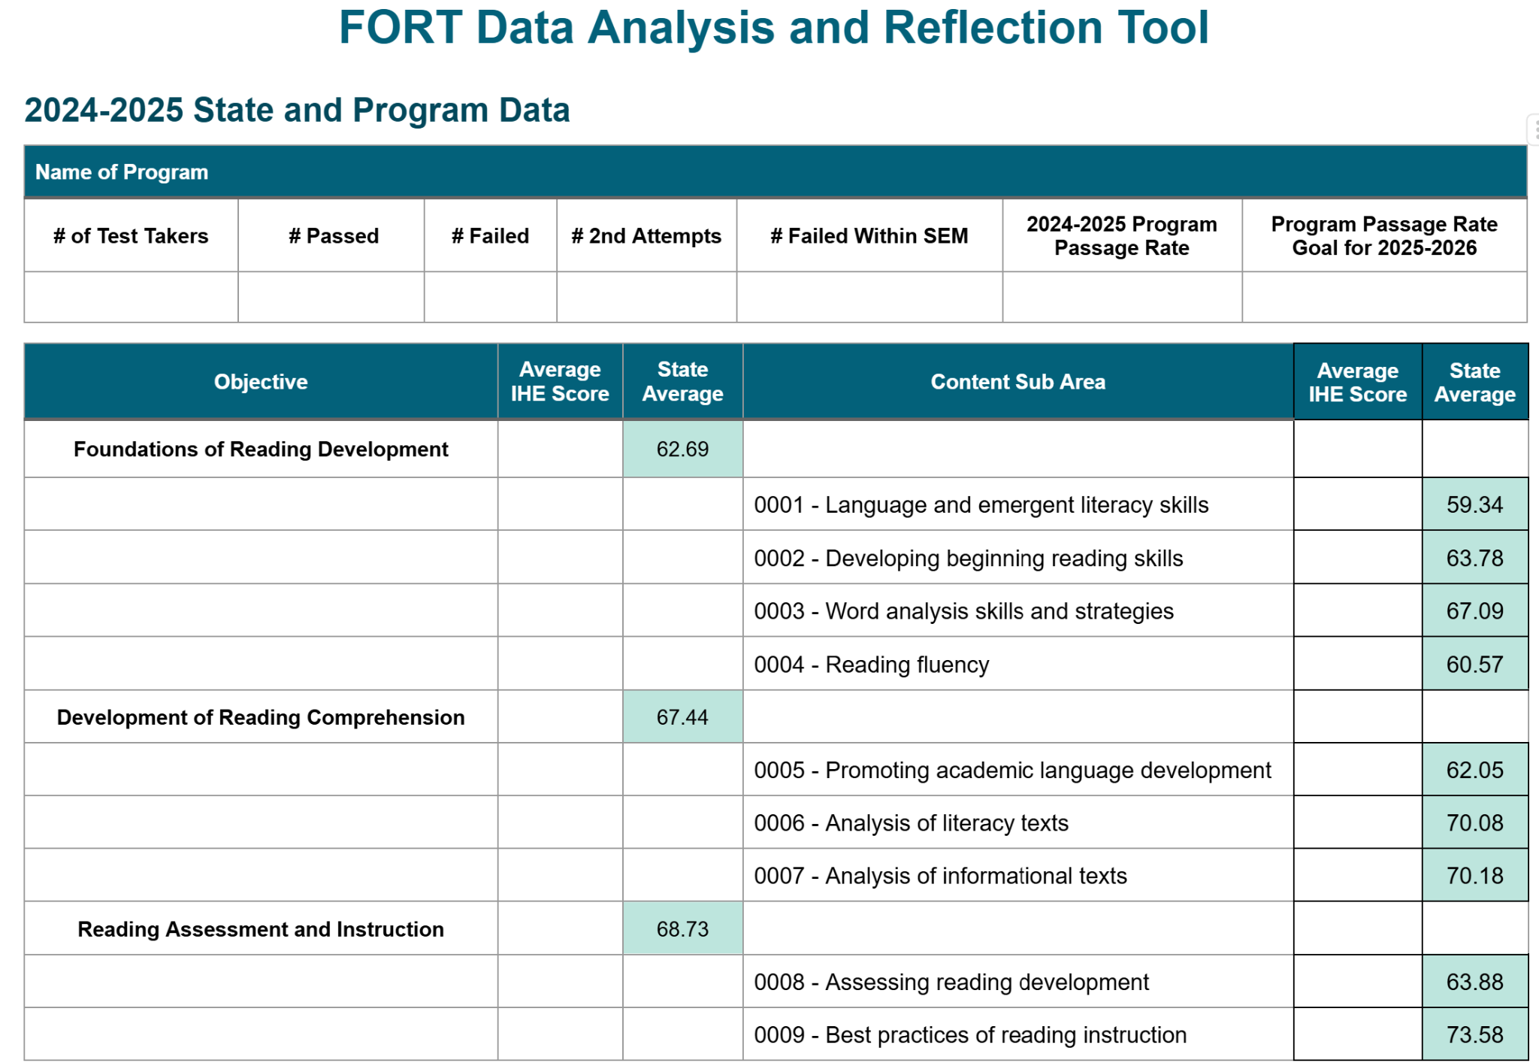
Data Analysis Tool

Slide 10
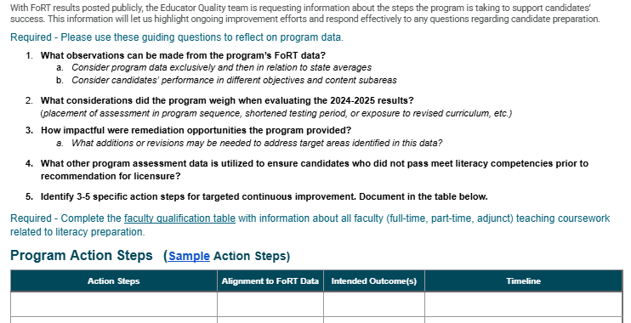
Reflection Tool

Slide 11
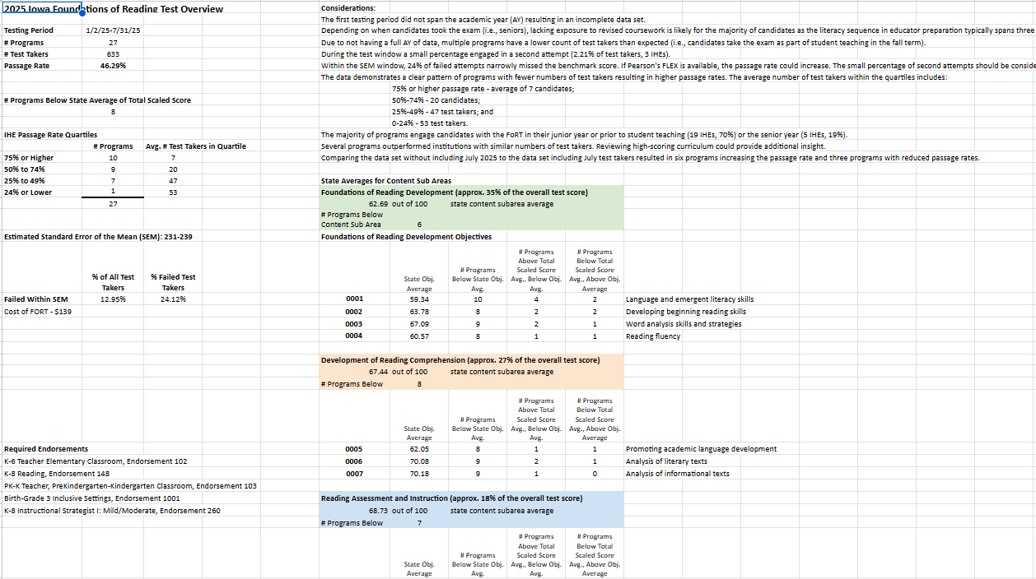
Example of Reports Shared With Each Program

Slide 12
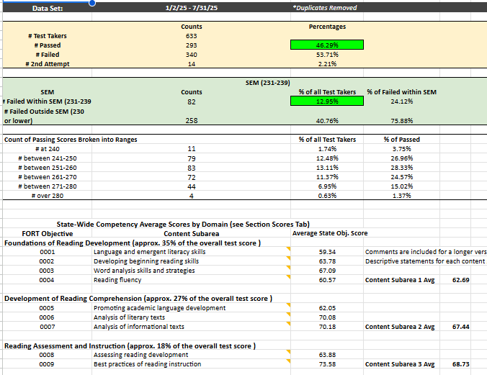
Example of Reports Shared With Each Program

Slide 13
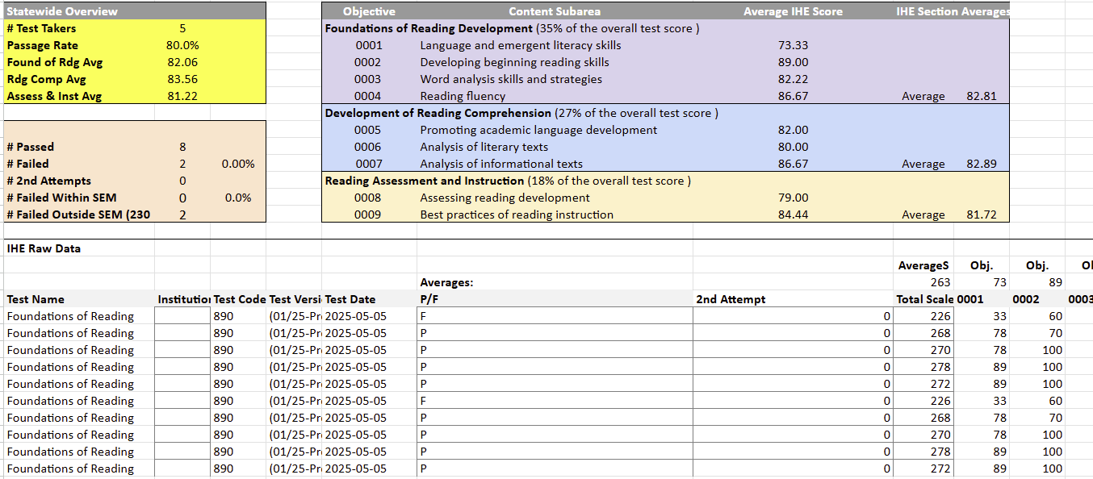
Example of Reports Shared With Each Program

Slide 14
Next Steps and Expectations
Communication sent to programs
Webinar to support programs in data analysis and diving deep into aligning action steps with the objectives
  Review state level results
  Overview of FORT Accountability and Support Plan
Programs will submit required documents for review to Educator Quality Team
Continuous improvement plan
  Data analysis, reflection and action plan
  Curriculum review with revision action steps and implementation plan
  Review of faculty qualifications and any recent training
  Requiring representation in peer-group training and regular monitoring report

