Slide 1
Allowable Uses of Funds
Title I, Part C—Education of Migratory Children
Bureau of ESEA Programs
Rachel Pettigrew

Slide 2
Overview
The purpose of today’s webinar is
to provide school districts, area education agencies (AEAs), and accredited nonpublic schools with information on Title I, Part C - Education of Migratory Children Program allowable activities; and
to ensure federal programs are effectively implemented according to federal guidance.

Slide 3
Purpose
(ESEA § 1301)
To assist states in supporting high-quality and comprehensive educational programs and services during the school year and, as applicable, during summer or intersession periods, that address the unique educational needs of migratory children.
To ensure that migratory children who move among the states are not penalized in any manner by disparities among the states in curriculum, graduation requirements, and challenging State academic standards.
To ensure that migratory children receive full and appropriate opportunities to meet the same challenging state academic standards that all children are expected to meet.
To help migratory children overcome educational disruption, cultural and language barriers, social isolation, various health-related problems, and other factors that inhibit the ability of such children to succeed in school.
To help migratory children benefit from State and local systemic reforms.

Slide 4
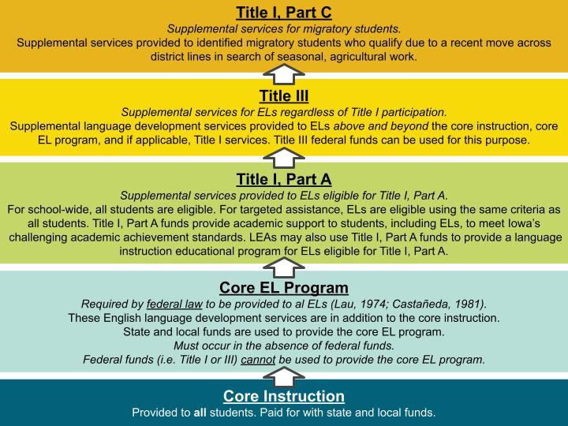
Funding Distinctions

Slide 5
Migratory
Child
(ESEA § 1309(3))
The term “migratory child” means a child or youth who made a qualifying move in the preceding
36 months—
as a migratory agricultural worker or a migratory fisher; or
with, or to join, a parent or spouse who is a migratory agricultural worker or a migratory fisher.

Slide 6
Priority for Services (PFS)
(ESEA § 1304(d))
In providing services with Title I, Part C funds, each recipient of such funds shall give priority to migratory children who have made a qualifying move within the previous 1-year period and who—
are failing, or most at risk of failing, to meet the challenging State academic standards; or
have dropped out of school.

Slide 7
Continuation of Services (COS)
(ESEA § 1304(e))
Notwithstanding any other provision of this part—
a child who ceases to be a migratory child during a school term shall be eligible for services until the end of such term;
a child who is no longer a migratory child may continue to receive services for 1 additional school year, but only if comparable services are not available through other programs; and
students who were eligible for services in secondary school may continue to be served through credit accrual programs until graduation.

Slide 8
Comprehensive Needs Assessment and
Service Delivery Plan (ESEA § 1306)
Comprehensive Needs Assessment
Service Delivery Plan
Title I, Part C funds must be used to address unique educational needs of migratory children as identified in the Comprehensive Needs Assessment.
Comprehensive Needs Assessment
(June 2023)
Authorized activities of Title I, Part C must align with the Iowa’s Service Delivery Plan, which is aligned to the Comprehensive Needs Assessment.
Service Delivery Plan
(January 2024)

Slide 9
Iowa’s Service
Goal Areas
School Readiness
English Language Arts and Mathematics
High School Graduation and Services
to Out-of-School Youth (OSY)
Non-Instructional Support Services

Slide 10
Goal Area 1: School Readiness
Strategy 1.1a | Coordinate/provide parents of migratory children before school age with information and strategies on child development.
Strategy 1.1b | Coordinate/provide parents of migratory children before school age with access to local preschool resources.
Strategy 1.2 | Coordinate with local preschool/childcare programs to ensure migratory children before school age receive instructional services.
Strategy 1.3 | Coordinate/provide instructional and support services to migratory children before school age to support school readiness / transition to kindergarten.

Slide 11
Goal Area 2: English Language Arts and Mathematics
Strategy 2.1 | Coordinate/provide needs-based supplemental instruction in ELA and math to migratory students in grades K-12 during the regular school year.
Strategy 2.2 | Coordinate/provide needs-based supplemental instruction in ELA and math to migratory students in grades K-12 during the summer.

Slide 12
Goal Area 3: High School Graduation / Services to OSY
Strategy 3.1 | Coordinate/partner/ provide supportive systems for migratory high school students to obtain credits for prompt high school graduation.
Strategy 3.2 | Coordinate/partner/ provide migratory high school students and OSY with culturally relevant information, services, and access to college/career readiness and postsecondary education.
Strategy 3.3 | Coordinate/partner/ provide instructional and support services to migratory OSY.
Strategy 3.4 | Coordinate/partner/ provide migratory high school students and OSY with needs-based culturally relevant summer services.

Slide 13
Goal Area 4: Non-Instructional Support Services
Strategy 4.1 | Coordinate/provide needs-based non-instructional support services to migratory children, youth, and families.
Strategy 4.2 | Coordinate/provide targeted professional development (PD) to staff who serve migratory children, youth, and families.
Strategy 4.3 | Coordinate/provide migratory families with strategies to help them support their children.
Strategy 4.4 | Coordinate/provide culturally responsive support and resources to migratory children and youth to build awareness and nurture their social-emotional well-being.

Slide 14
Contact Information
Rachel Pettigrew
Education Program Consultant
rachel.pettigrew@iowa.gov
515-380-5115

