Slide 1
Allowable Uses of Funds
Determining Allowability
Bureau of ESEA Programs
Isbelia Arzola

Slide 2
Purpose
The purpose of today’s webinar is to provide school districts, area education agencies (AEAs), and accredited nonpublic schools with information on cross-programs federal requirements to determine allowability of services.

Slide 3
Overview
Determining Allowability of Activities and Services
McKinney-Vento Homeless Assistance Act
Title V, Part B, Subpart 2—Rural and Low-Income School Program
Title IV, Part B—Nita M. Lowrey 21st Century Community Learning Centers
Title IV, Part A—Student Support and Academic Enrichment
Title III, Part A—English Learners and Immigrant Students
Title II, Part A—Supporting Effective Instruction
Title I, Part D, Subpart 2—Neglected, Delinquent, and At-Risk Local Programs
Title I, Part C—Education of Migratory Children
Title I, Part A—Improving Basic Programs Operated by LEAs

Slide 4
Determining Allowability of Activities and Services
Across Programs Requirements

Slide 5
Reasonable, Necessary, Allocable
Reasonable | Necessary | Allocable
Consistent with current market value and prudent business practices (2 CFR 200.404) | Required to carry out the intent and purpose of the federal program.(2 CFR 200.403) | A cost is allocable to a particular Federal award or other cost objective if the services involved are chargeable or are able to be assigned to that Federal program in accordance with relative benefits received (2 CFR 200.405)
Notes:
Reasonable: Follow the restraints/requirements of: sound business practices, arm's length bargaining, state and local laws, the Federal program’s conditions and requirements
Must be comparable to the same service by another provider in the geographic area
Must meet the standards of acting with good stewardship of public funds
Must not deviate from established practices and policies
Does the program really need this?
Is the expense targeted to valid programmatic or administrative need?
Is it in the Title IIA program’s plan?
Is this the minimum amount needed to be spent to meet the needs of students and teachers?
Does the LEA have the capacity to use what is being purchased, provided or done?
Did the LEA pay a fair rate?
Is this the same rate the other Federal programs are paying?
Is it sustainable?
Are there competing initiatives?
If the LEA is asked to defend this purchase, would the LEA be able to?
Necessary: Recommendation - Analyze whether the operation of the program fails without it
Is this cost necessary for the performance of the subgrant or program?
Is the purchase/service driven by need or data?
Does this cost support the purpose of the subgrant?
Allocable - Is the amount for service to be charged to the program commensurate with the benefit received?
Is the service consistent with the purpose of the program?

Slide 6
Supplement Not Supplant (Section 2301)
Supplement | Supplant
Using federal funds to enhance, expand, increase, or extend the programs and services offered with other federal, state, and/or local funds | Using federal funds to fund (in total or in part) a program or service that is required to be provided or was previously funded by other federal, state, and/or local funds.
Notes:
In the event of the unavailability of and ESEA program funds, would this activity be otherwise funded in another capacity (federal, state, local funds)?
Is the proposed activity required by laws?
Are the ESEA Program funds being used to provide services that the LEA provided with, non-federal funds in prior years?
If the answer to either of these questions is yes, then the use of funds is not supplementary to core services required by other federal, state, or local laws. (20 USC Section 6691)
What portion of the activity is supplemental?

Slide 7
Professional Development (ESEA § 8101(42))
It requires the Activity to be BOTH
An integral part of school and LEA strategies for providing educators (including teachers, principals, other school leaders, specialized instructional support personnel, paraprofessionals, and, as applicable, early childhood educators) with the knowledge and skills necessary to enable children to succeed in a well-rounded education and to meet the challenging State academic standards; AND
Sustained (not stand-alone, one-day, or short term workshops), intensive, collaborative, job embedded, data-driven, AND classroom-focused
Notes:
Explain CONFERENCES
ESEA section 8101(42) All professional development must meet the definition provided in the law.
Specifically, professional development services and programs must meet the definition of “professional development,” which requires
that the activity be both—
Does the activity meet all parts of the definition of professional development?
Are eligible staff considered and included?
You may be asked to provide the comprehensive professional development plan.

Slide 8
Evidence Based (Section 8101(21))
Demonstrates a statistically significant effect on improving student outcomes or other relevant outcomes based on ⎯
Type of evidence | Definition
I - Strong evidence | Supported by one or more well-designed and well-implemented experimental study
II - Moderate evidence | Supported by one or more well-designed and well-implemented quasi-experimental study
III - Promising evidence | Supported by one or more well-designed and well-implemented correlational study with statistical controls for selection bias
Demonstrates a rationale based on high quality research findings or positive evaluation that such activity, strategy, or intervention is likely to improve student outcomes or other relevant outcomes
Notes:
Funds should be used to support an activity, strategy or intervention described in section 8101(21) A:
(i) demonstrates a statistically significant effect on improving student outcomes or other relevant outcomes based on ⎯
(I) strong evidence from at least one well-designed and well-implemented experimental study;
(II) moderate evidence from at least one well-designed and well-implemented quasi-experimental study;
(III) promising evidence from at least one well-designed and well-implemented correlational study with statistical controls for selection bias
ii) (I) demonstrates a rationale based on high quality research findings or positive evaluation that such activity, strategy, or intervention is likely to improve student outcomes or other relevant outcomes
Evidence-based interventions are practices or programs that have evidence to show they are effective at producing results and improving outcomes when implemented. The kind of evidence described in ESSA has generally been produced through formal studies and research. Under ESSA, there are four tiers, or levels, of evidence: Tier 1 – Strong Evidence: highest level of evidence o supported by one or more well-designed and well-implemented randomized control experimental studies o intervention leads to favorable results Tier 2 – Moderate Evidence: o supported by one or more well-designed and well-implemented quasi-experimental studies o controlled experiment was conducted with a treatment group o intervention shows statistically significant and positive effect on the outcome Tier 3 – Promising Evidence: not as strong as evidence in an experiment o supported by one or more well-designed and well-implemented correlational studies (with statistical controls for selection bias). o formal study if a relationship exists between intervention and a given outcome o intervention shows a statistically significant and positive effect on the outcome Tier 4 – Demonstrates a Rationale: o practices that have a well-defined logic model or theory of action o supported by research in the field o some efforts are underway by a state, district, or outside research organization to determine the effectiveness o no formal evidence exists to prove interventions are successful

Slide 9
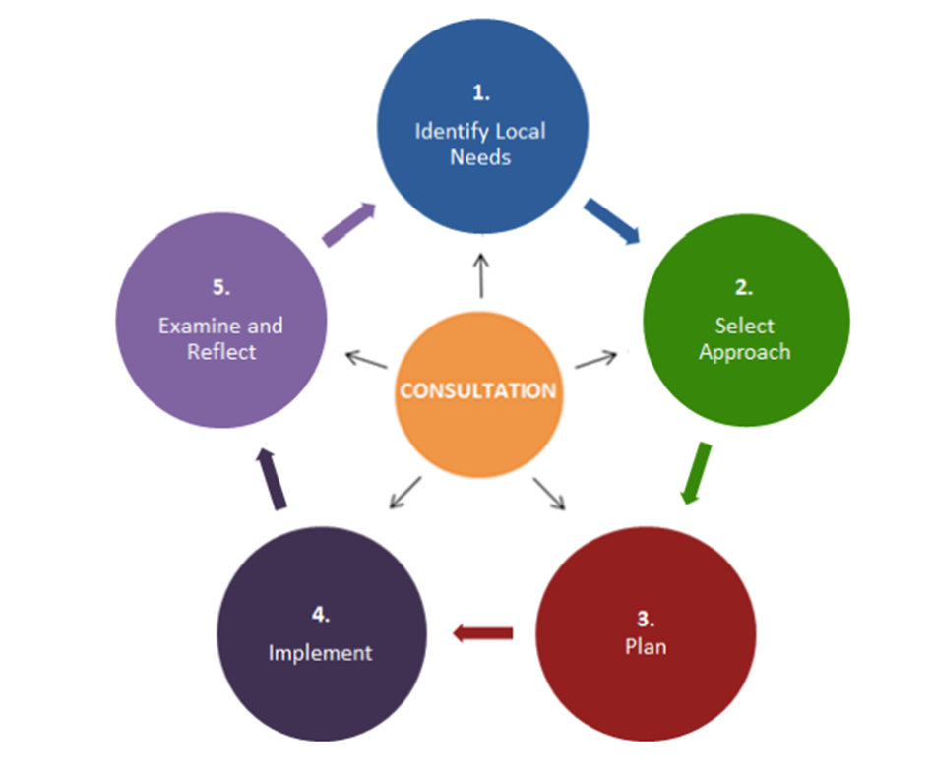
Cyclical Framework
Notes:
In general, interventions are more likely to result in sustained, improved outcomes for students if: 1) Chosen interventions align with identified local needs; 2) The evidence base and the local capacity are considered when selecting a strategy; 3) There is a robust implementation plan; 4) Adequate resources are provided so the implementation is well-supported; 5) Information is gathered regularly to examine the strategy and to reflect on and inform next steps. This framework is designed to help decision-makers make more effective investments and to make the use of evidence, research, and data part of the decision-making process.

Slide 10
Assessment of Needs
Was there an assessment of needs conducted?
What does the data show?
What are the needs of teachers to become effective?
How were the needs of students identified?

Slide 11
Consultation Process
Stakeholders
Nonpublic Schools Equitable Services (ESEA §§ 1117(a)(1) & 8501(a)(1))
Does the subgrantee conduct a meaningful consultation with all stakeholders (e.g. teachers, principals, and other school leaders) as required by each program to mee the purpose of the program?
What is the result of the consultation process with stakeholders?
Provides nonpublic officials with adequate notice of consultation to ensure those involved will be well-prepared with the necessary information and data for decision-making
Focuses on specific student and teacher needs (e.g., uses data to drive the consultation process to determine the services to be provided); and
Provides ample time and a genuine opportunity for all parties to express their views.
Consultation process should be ongoing, not a one-time meeting.
Consultation process should be ongoing, not a one-time meeting

Slide 12
Food or Drinks - Considerations
Can Federal funds be used for food, beverages, or snacks at an event?
Regular meetings
Networking sessions
Light refreshments vs. meals
Remote meetings
Can federal funds be used for family engagement events? If so, what are the provisions?
Entertainment
Working lunch
When hosting a Meeting or Conference
Can indirect cost funds be used to pay for food and beverages?

Slide 13
Contact Information
Bureau Chief
Jillian Dotson, jillian.dotson@iowa.gov
Administrative Consultants
Isbelia Arzola, isbelia.arzola@iowa.gov
Jina Brincks, jina.brincks@iowa.gov
ESEA Ombudsman and Title IV, Part A
Luke Markway, luke.markway@iowa.gov
McKinney-Vento Homeless Education
Tyler Navin, tyler.navin@iowa.gov
Title V, Part B
Teresa Garcia, teresa.garcia@iowa.gov
Education of Students in Foster Care and Title I, Part D
Scot Aden, scot.aden@iowa.gov
Title I, Part A
Veronica Andersen, veronica.andersen@iowa.gov
Title I, Part C and Title III, Part A
Rachel Pettigrew, rachel.pettigrew@iowa.gov
Title II, Part A
Amy Hensley, amy.hensley@iowa.gov
Title IV, Part B
Joe Collins, joe.collins@iowa.gov

