Slide 1

Behavior and Discipline

Slide 2

Welcome
Please post your questions in the Q&A
Slides will be posted on the DE website after the webinar
Policy & Practice Webinar Series & Recordings | Department of Education

Slide 3
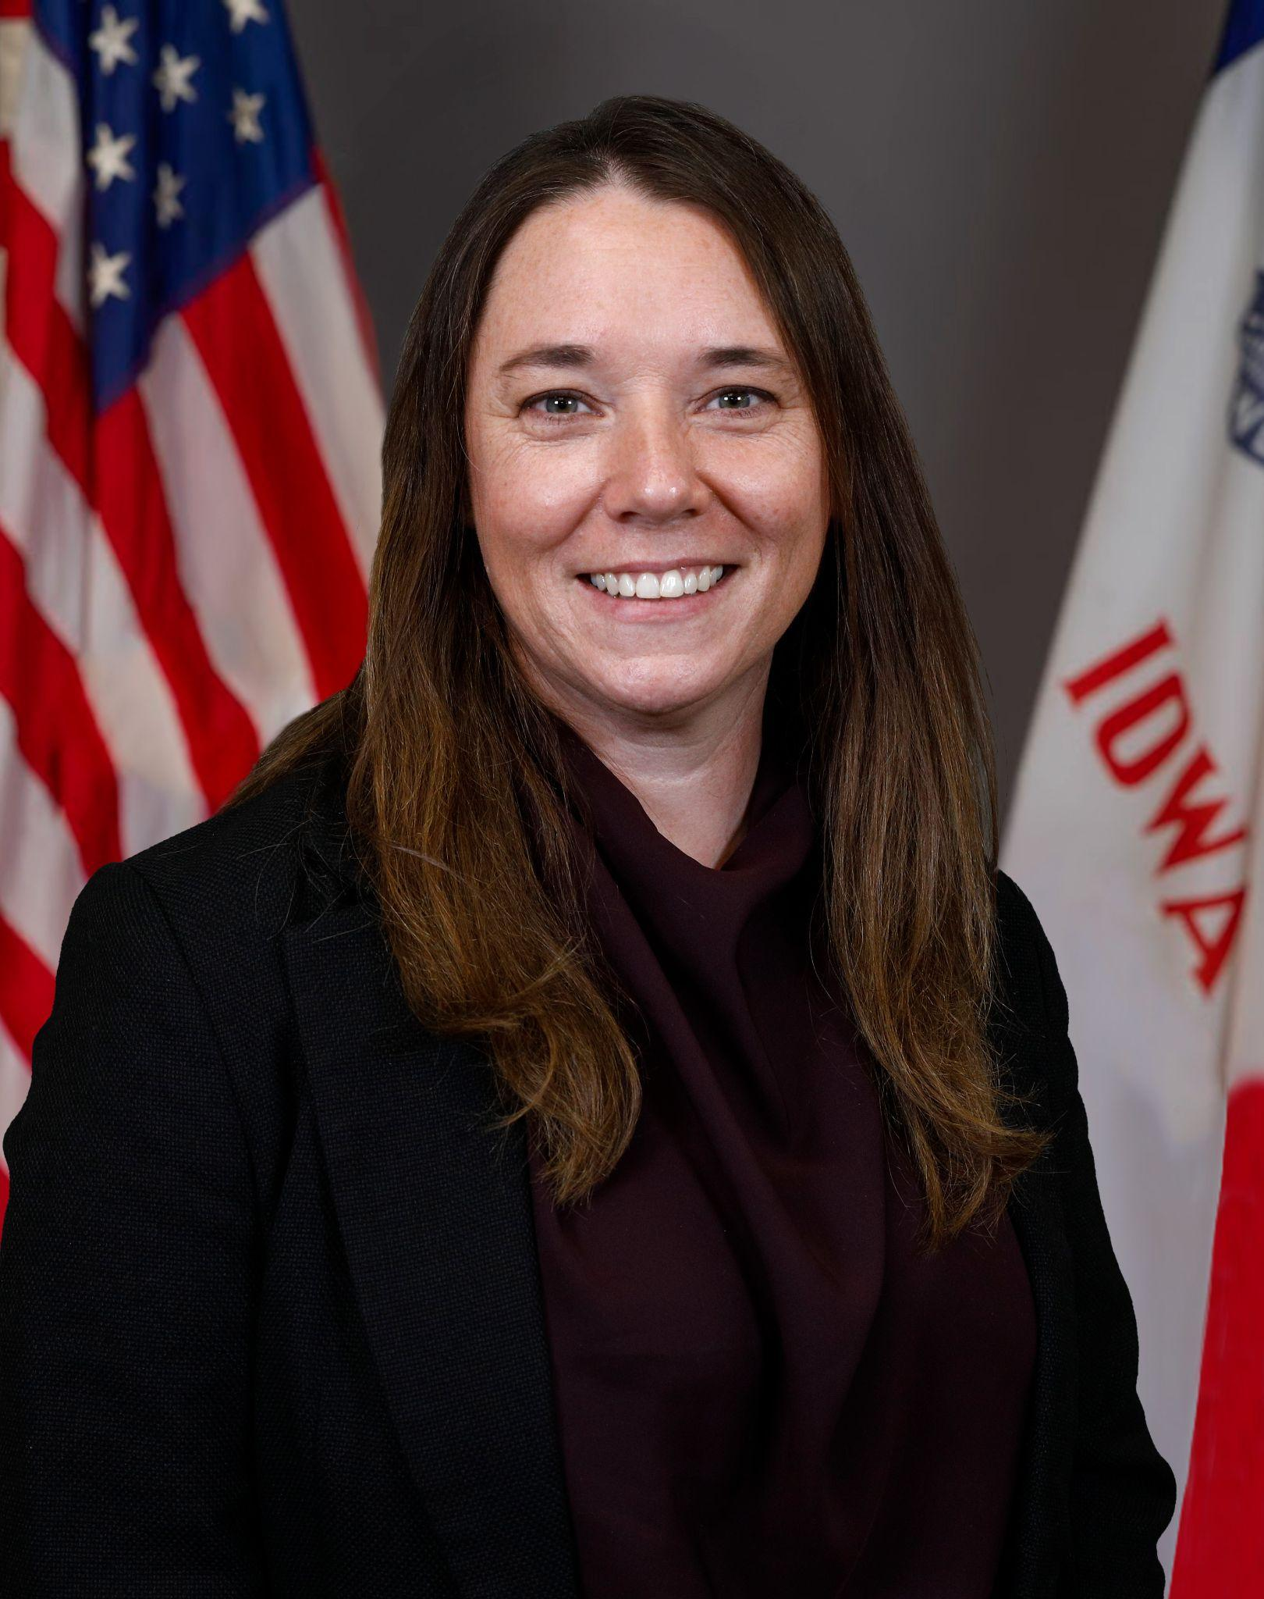
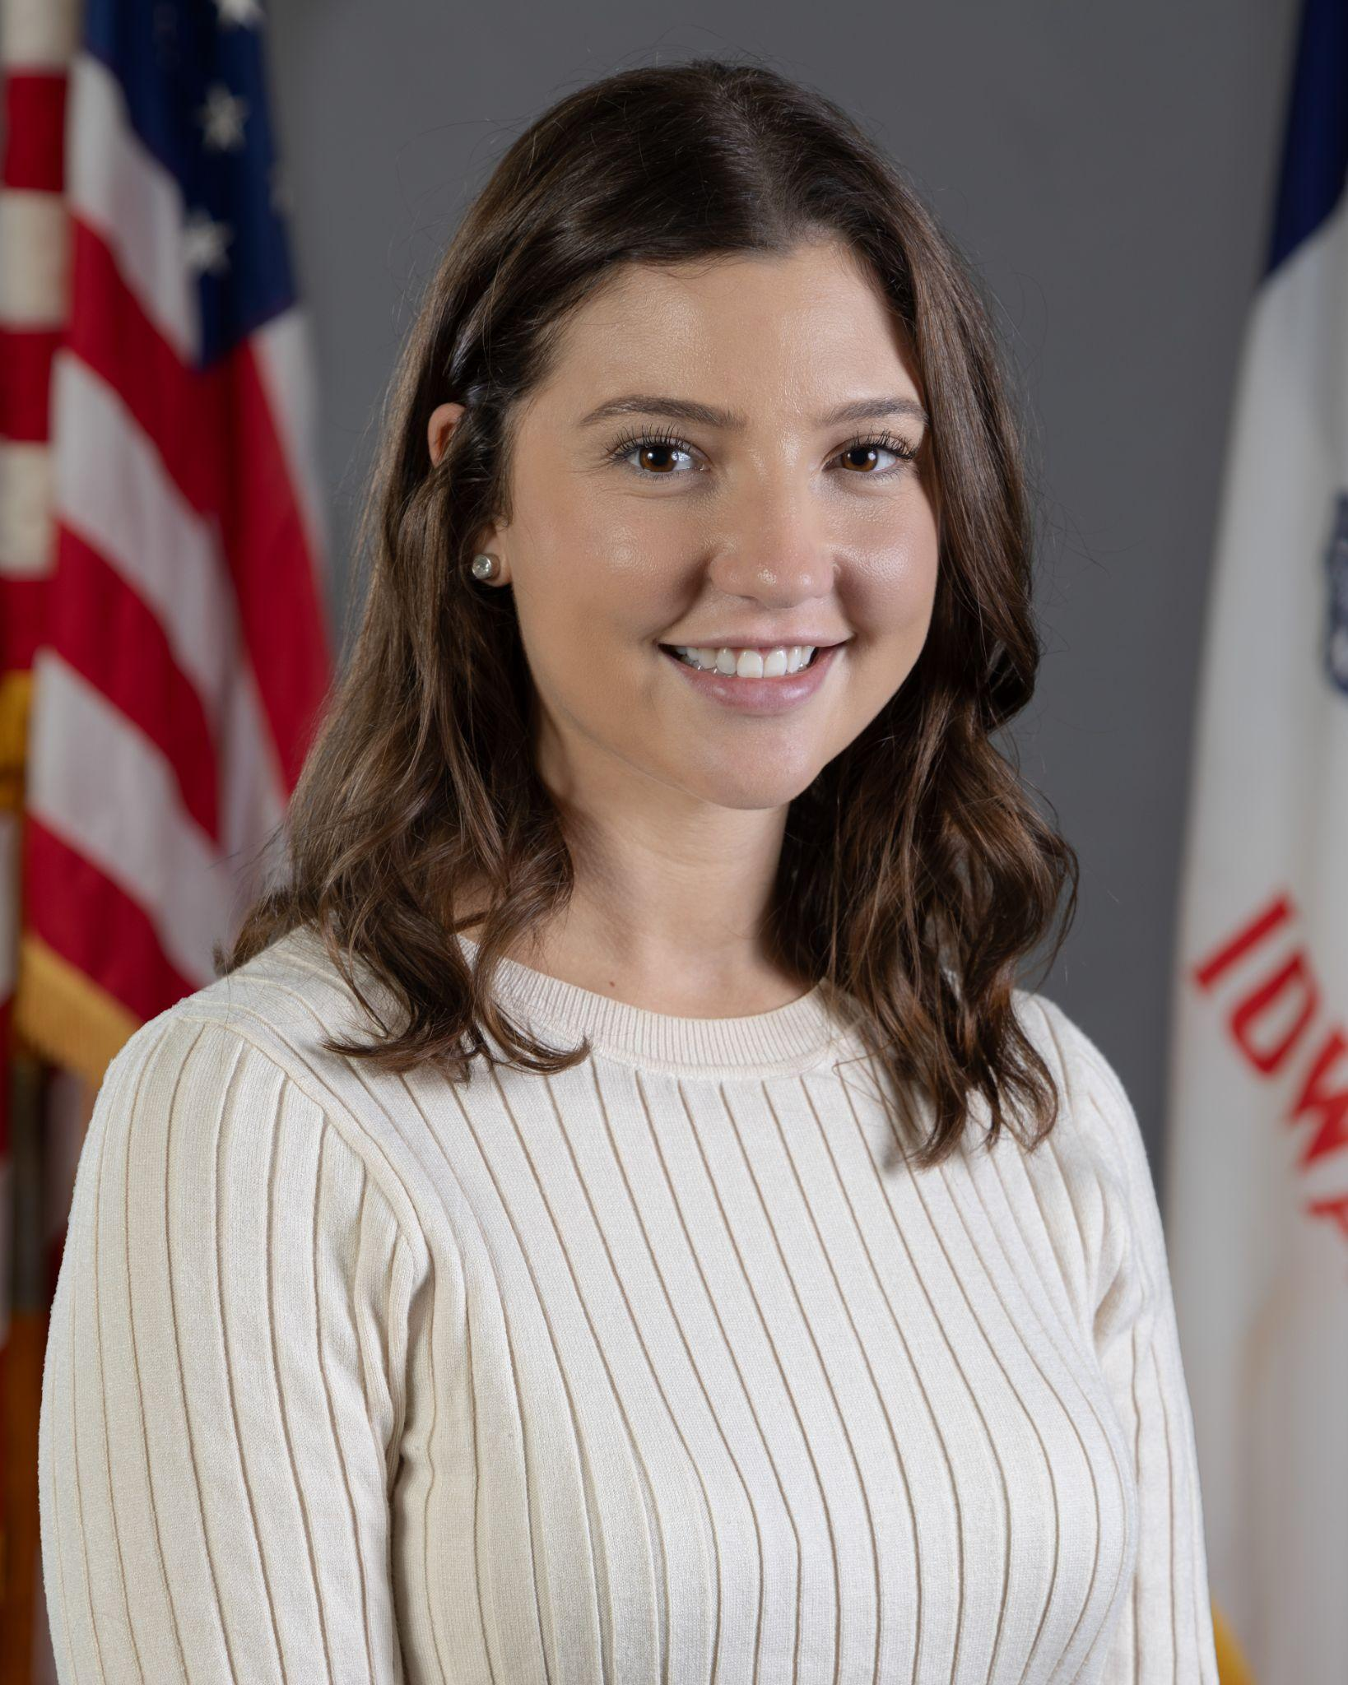
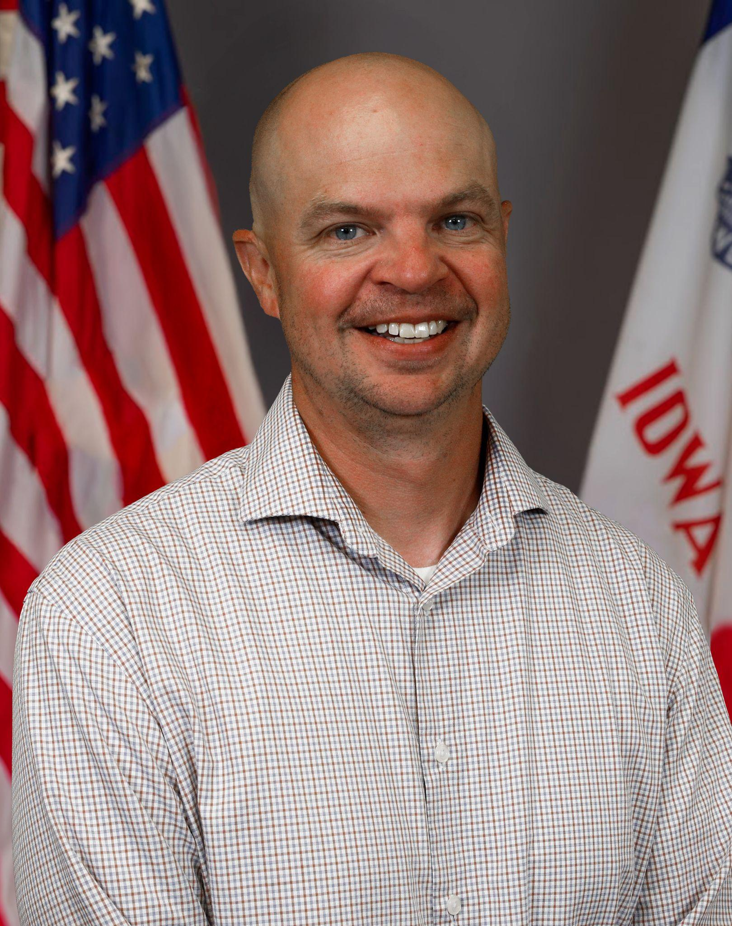

Today’s Presenters
Name: Leisa Breitfelder
Title: Division Administrator
Division of Special Education
Name: Rachel Bosovich
Title: Legal Counsel
Division of Special Education
Name: Patrick Judkins
Title: Regional Special Education Director (KAEA)
Division of Special Education
Name: Matt Cretsinger
Title: Regional Special Education Director (HAEA)
Division of Special Education

Slide 4
OSEP Citation:
The Office of Special Education Programs (OSEP) recently cited Iowa for concerns related to removals of students with disabilities.
  Specifically, when a student is unilaterally sent home or removed from instruction due to behavior, but the removal is not documented as a suspension.
When these incidents are not recorded as removals, districts risk:
  Underreporting disciplinary removals
  Lack of appropriate protections for the student under IDEA
  Compliance issues at both district and state levels
Iowa’s Commitment: protect student rights, provide appropriate support, and maintain full compliance with IDEA requirements.

Slide 5
Participants will:
IDEA Disciplinary Procedures & Protections
Increase depth of knowledge on common language and definitions
Recognize what is an informal removal compared to other disciplinary actions
Understand district roles and responsibilities around discipline and removals
Know how to fulfil the obligations of IDEA’s disciplinary protections

Slide 6
Common Terms + Definitions

Slide 7
Establishing Clarity
It is essential that we have shared clarity around the common terms and definitions found within Iowa Administrative Code (IAC)-Chapter 281-41 (“Chapter 41”).
This ensures that all parties have a clear understanding of the language used and continue development of their knowledge and application of IDEA’s Disciplinary Protections and Procedures.

Slide 8
Defining Discipline
“Discipline” is intended to mean the consequences a school imposes on a child who violates a school’s code of student conduct or rules as determined by school personnel.

Slide 9
What is a Removal?
A removal occurs whenever a child is removed from their current educational placement for behavior-related or disciplinary reasons.

Slide 10
What is an Informal Removal
Informal removal means “action taken by school personnel in response to a child’s behavior that . . . removes the child with a disability from class or school without invoking IDEAs disciplinary procedures.” Questions and Answers: Addressing the Needs of Children with Disabilities and IDEA's Discipline Provisions, 81 IDELR 138 (OSEP 2022).
An informal removal is a REMOVAL the school has incorrectly documented (or not documented at all).
Common examples of informal removals include:
administratively placed on shortened school day
administratively placed on virtual learning
requesting to pick child up from school
requesting the child stay home until an IEP team meeting can be convened

Slide 11
Providing Clarity
In-School Suspension
Out-of-School Suspension

Slide 12
Important to note…
Examples and scenarios discussed in the next section do not include strategies, supports and services a student receives as part of their IEP and as determined by the IEP team

Slide 13
In-School Suspension (ISS)

Slide 14
ISS
ISS: The administrative removal of a student from regular classes or activities for disciplinary reasons to a setting where the student continues to remain under the supervision of school personnel.
ISS is a removal unless the answer to all three of the following questions is YES:
Will the child be able to appropriately participate in the general education curriculum?
Will the child be able to receive the services specified in the child’s IEP?
Will the child be able to participate with children without disabilities to the extent provided in the child’s current placement?
Answer the third question “yes” if the in-school suspension environment is equally available to children with and without disabilities.

Slide 15
Common Undocumented ISS Examples
Sitting in the office for an extended period of time without receiving services
Moving a student to a separate space not articulated in their IEP for all or extended periods of the day away from their peers.
    special education classroom
    hallway
    office to sit
    sensory room

Slide 16
Out-of-School Suspension (OSS)

Slide 17
Out-of-School Suspension (OSS)
An out-of-school suspension is an administrative removal of a student from regular classes or activities for disciplinary reasons
NOTE: Saturday school does not count as an out-of-school suspension

Slide 18
Common Undocumented OSS Examples
Requiring a student to leave school early
Calling family members to pick a student up early
Suggesting to the family the student be kept home tomorrow
Requiring a student to participate in a virtual learning program from home when other students are receiving in-person instruction
Shortened school day (outside of an IEP team decision)

Slide 19
Documentation
Hours: Do you count each class period as a suspension? Commonly seen in the secondary setting that follows a class schedule.
Half Day: Do you document between an am and/or pm suspension? What are your cut off times?
Full Day: Do you mark each instance as a day that counts towards the 10 days of suspension?
Informal Removal: How do you know if a staff member is sending a student outside the classroom for disciplinary reasons?

Slide 20
Student Discipline Involving Transportation
A student’s suspension from the bus is a REMOVAL if transportation is a service included in the student’s IEP, unless the district provides alternate transportation.
This is the case even if the child otherwise gets to school.

Slide 21
IDEA Disciplinary Protections

Slide 22
Triggering Protections
The first 10 days of removals = services only required to the extent they are provided to similarly removed general education students
Any removals after the first 10 days = IDEA disciplinary protections apply

Slide 23
Change in Placement
A change in placement occurs when:
The child is removed from their current educational placement for more than 10 consecutive school days; OR
The child is removed from their current educational placement for more than 10 cumulative school days and the removals constitute a pattern.

Slide 24
Change in Placement - Pattern of Removals
Determining the existence of a pattern:
The series of removals total more than 10 school days in a school year;
The child’s behavior is substantially similar to the child’s behavior in previous incidents that resulted in the series of removals; and
Additional factors, such as the length of each removal, the total amount of time the child has been removed, and the proximity of the removals to one another.
No bright line rule on substantial similarity - Must be determined on a case-by-case basis.
Not limited to behaviors considered by the IEP team or included in the IEP.

Slide 25
Change in Placement - Rights Triggered
A change in placement triggers:
Notice
  Written notice
  Procedural safeguards notice
These must be provided the day the school decides to impose a removal that constitutes a change in placement:
Manifestation Determination
Services

Slide 26
Services during Removals
On Day 11 - Services must always be provided
Removals that are not changes in placement:
Removals that are changes in placement:
School personnel, in consultation with at least one of the child’s teachers, determine the extent to which services are needed for the child to continue to have access to a FAPE while removed.
The IEP team, not school personnel, determines the services to be provided to enable the child to have access to a FAPE and the location of those services.
Receive, as appropriate, an FBA and behavior intervention services/ modifications.

Slide 27
10-Day Rules
The ten-day rule under general education discipline (removals of greater than ten days require certain procedural safeguards)
The ten-day rule for services (first ten school days of disciplinary removal = no services unless general education students receive services; subsequent removals = services)
The ten-day rule for consecutive days of disciplinary removal (more than ten consecutive school days of removal = change in placement)
The ten-day rule for cumulative days of disciplinary removal (more than ten cumulative school days of removal = change in placement if the removals constitute a pattern)
The ten-day rule for conducting manifestation determinations (within ten school days of decision to impose disciplinary change in placement)

Slide 28
Next Steps
Conversations:
    Share this learning with others
    Documenting informal removals
Update any processes and procedures
Review Student Handbooks for ISS and OSS
Student Absence Coding
Complete Assurance Survey by Feb. 27

Slide 29
Future Policy and Practice Webinars
Upcoming Topics and Dates (8:30 am - 9:30 am)
February, 11, 2026: Connecting Alternate Assessment (DLM) to Instruction & Licensure
March 11, 2026: Extended School Year (ESY)
April 8, 2026: FAPE - Special Requests
May 13, 2026: Dispute Resolution
June 10, 2026: End of Year Program Evaluation (ACHIEVE) and Year-to-Year Data Comparison

Slide 30
Thank You!

