Slide 1
Equitable Services for Nonpublic Students and Teachers
ESEA Programs
Luke Markway
ESEA Programs Ombudsman

Slide 2
Presentation order
ESEA Programs - Specific Requirements
  Title I, Part A—Improving Basic Programs Operated by LEAs
  Title I, Part C—Education of Migratory Children
  Title II, Part A - Supporting Effective Instruction
  Title III, Part A - English Language Acquisition, Language Enhancement, and Academic Achievement
  Title IV, Part A - Student Support and Academic Enrichment Grants
  Title IV, Part B - Nita M. Lowey 21st Century Community Learning Centers (21st CCLC)
Presentation Goals
Equitable Services
Consultation Process and Procedures
Consultation Agreements
Transferability
LEA and AEA Considerations and Requirements
Role of the Ombudsman
Complaint Process

Slide 3
Presentation Goals
To provide guidance on fulfilling equitable services requirements for eligible nonpublic school students, their teachers, and, where applicable, other educational personnel and their families.
To clarify the most common equitable services inquiries of eligible ESEA programs

Slide 4
Equitable Services
Title I, Part A of the ESEA - Providing Equitable Services to Eligible Private School Children, Teachers, and Families
Title VIII, Part F of the ESEA - Equitable Services for Eligible Private School Children, Teachers, and Other Educational Personnel

Slide 5
Consultation Process and Procedures
Initial Consultation Process
  Beginning of January through March 15th
  The consultation should occur throughout the year
Nonpublic Consultation Agreement
  March 15 - Equitable Services participation is due.
  October 1 - Final consultation agreement due for the current school year.
  Confirmation of agreement

Slide 6
Consultation Process: Required Topics
How the students’ needs will be identified
January
December
February
How and when the agency will make decisions about the delivery of services through a contract with potential third-party providers
What services will be offered
How, where, and by whom the services will be provided
November
March
Providing services directly, other government agency, or another independent third-party entity
Timely and meaningful consultation (ESEA §§ 1117(a)(1) & 8501(a)(1)) must:
Continue throughout the implementation and assessment of the services.
Occur before the LEA or AEA makes any decision that affects the opportunities to participate of eligible nonpublic school students, teachers, and other educational personnel.
How the services will be academically assessed and how the results of that assessment will be used to improve those services
October
April
Amount of funds available for services (SEA determines the amount for services)
The size and scope of the equitable services to be provided to the eligible nonpublic school students
The method or sources of data that are used to determine the number of students from low-income families in participating school attendance areas who attend nonpublic schools (Title IA only)
September
May
Pooling of funds
August
June
July
*Results of consultation must be recorded in the CASA nonpublic consultation agreement.

Slide 7
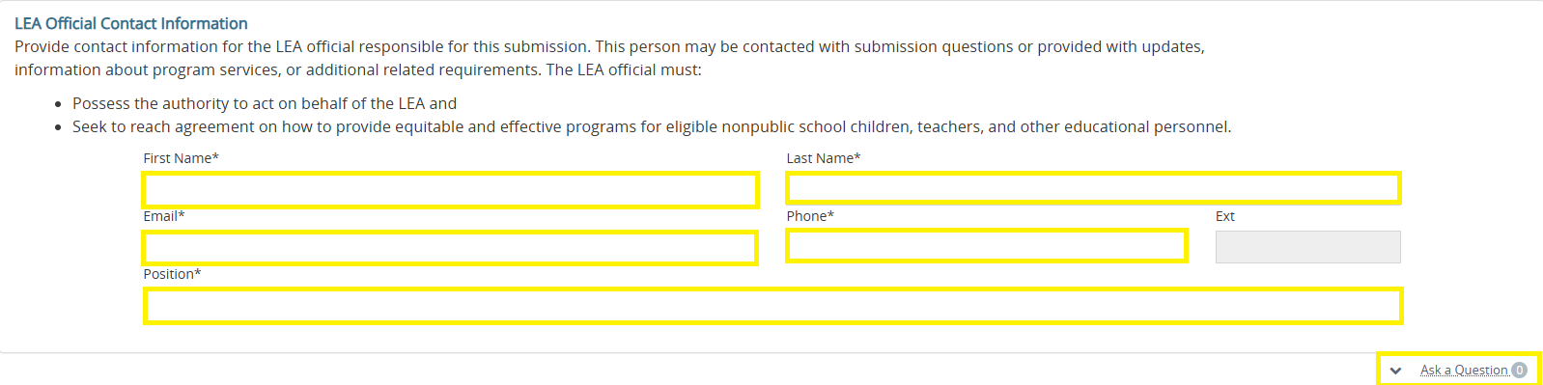
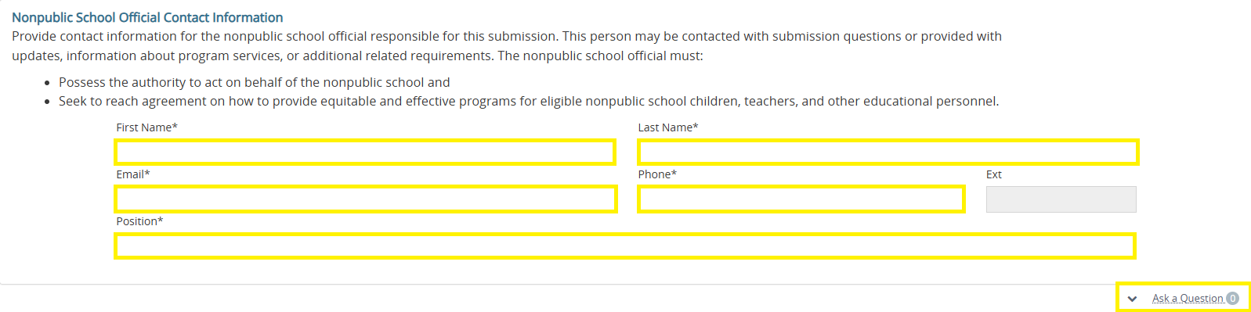
Consultation Agreement (Contact Information)

Slide 8
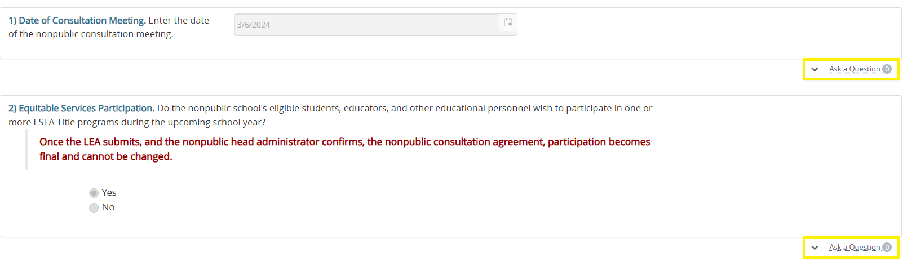
Consultation Agreement (Date of Consultation Meeting and Equitable Services Participation)

Slide 9
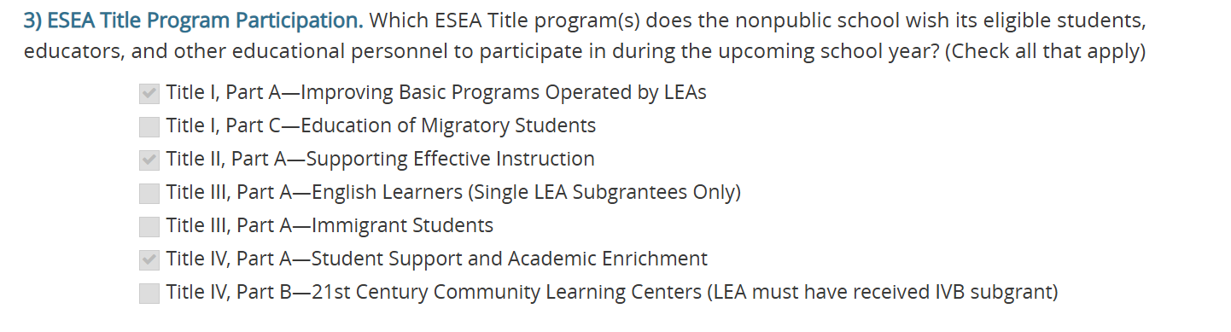
Consultation Agreement (ESEA Title Program Participation)

Slide 10
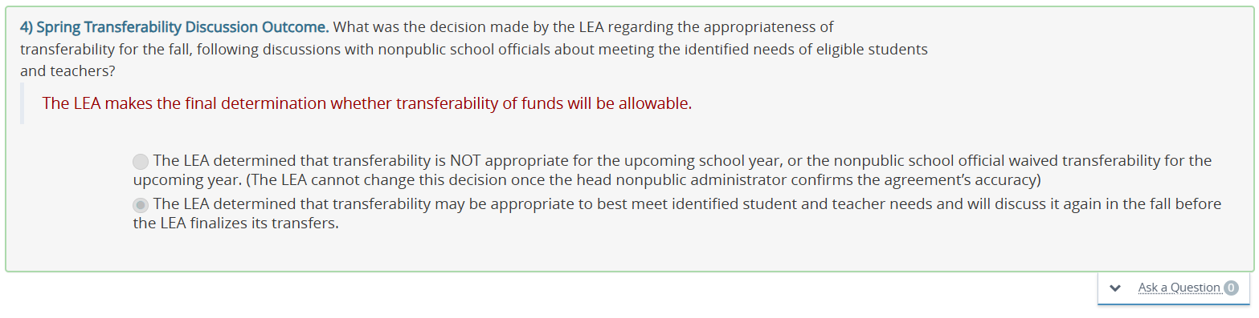
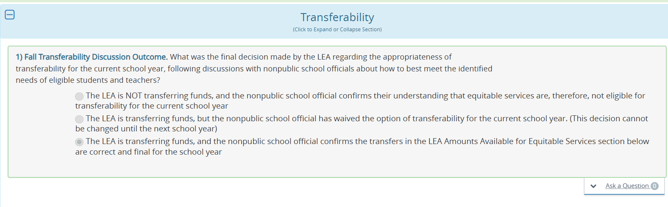
Consultation Agreement (Spring and Fall Transferability Discussion Outcomes)

Slide 11
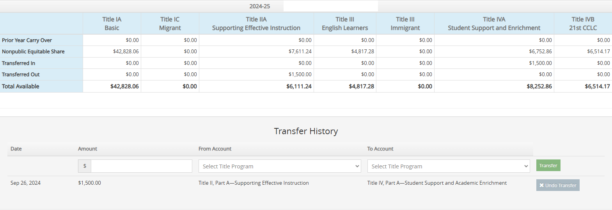
Transferability
  March 15 - Spring transferability discussion with nonpublic schools
  October - Transfers completion (public and nonpublic)
    Allocations and Transfers cannot be finalized until the consultation agreement status is submitted and confirmed by the nonpublic school

Slide 12
Professional Development
1
An integral part of school and LEA strategies for providing educators with the knowledge and skills necessary to enable children to succeed in a well-rounded education and to meet the challenging State academic standards;
(ESEA § 8101(42))
AND
2
Sustained (not stand-alone, one-day, or short term workshops), intensive, collaborative, job-embedded, data-driven, AND classroom-focused

Slide 13
LEA and AEA Considerations and Requirements
  Secular, neutral, and non-ideological
  Meets the specific needs of the nonpublic students, teachers, and/or families (as applicable)
  Supplement and not supplant services the nonpublic school already offers
  Same Program – Different Allowability (e.g., Title IIA equitable share cannot pay for teachers to reduce class sizes)
  Reasonable and necessary
  Allocable to the Title program
  Consistent with SEA/LEA policies and procedures
  Incurred within the approved budget period

Slide 14
Role of the Ombudsman
An ombudsman
Serves as an SEA’s primary point of contact for addressing questions and concerns from private school officials and LEAs regarding the provision of ESEA equitable services
Monitors and enforces the equitable services requirements under Title VIII and Title I, Part A (ESEA section 8501(a)(3)(B))

Slide 15
Complaint Process
Dispute Resolution
Public school district and nonpublic school must try to resolve the issue themselves
Nonpublic school official should contact the ESEA Program Consultant
The ESEA program consultant will discuss the issue with both the nonpublic school and public school district officials
If concern is not resolved, the nonpublic school official can file a complaint with the ESEA Programs ombudsperson
The ESEA Programs ombudsperson will review the complaint
The ESEA Programs ombudsperson must contact all parties
A written response must be issued no later than 30 days from the date of submission of the complaint
A summary of all complaint resolutions must be available

Slide 16
ESEA Programs Webinars
  Title I, Part A—Improving Basic Programs Operated by LEAs
  Title I, Part C—Education of Migratory Children
  Title II, Part A - Supporting Effective Instruction
  Title III, Part A - English Language Acquisition, Language Enhancement, and Academic Achievement
  Title IV, Part A - Student Support and Academic Enrichment Grants
  Title IV, Part B - Nita M. Lowey 21st Century Community Learning Centers (21st CCLC)

Slide 17
ESEA Programs Specific Requirements
Title I, Part A - Improving Basic Programs Operated by LEAs
Veronica Andersen

Slide 18
Title I, Part A—Improving Basic Programs Operated by LEAs
The purpose of Title I, Part A is to provide all children significant opportunity to receive a fair, equitable, and high-quality education and to close educational achievement gaps. (ESEA section 1001).
Each LEA that receives Title I, Part A funds identifies public school attendance areas and schools that have high concentrations of children from low-income families as eligible to participate in Title I, Part A programs. (ESEA section 1113).

Slide 19
Eligibility for Services
&
Allowable Activities
Allowable Activities may include:
Supplemental instructional intervention services provided by public school employees or third-party contractors such as literacy, math and social emotional learner supplemental supports
To be eligible for Title I, Part A services, a nonpublic school student must:
Reside in a participating Title I, Part A public school attendance area
Be identified by the LEA as low achieving on the basis of multiple, educationally related, objective criteria.
(ESEA sections 1115(c)(1)(B) and 1117(a)(1)).
Expanded learning time, including before- and after-school programs
Tutoring or summer school programs
Mentoring or counseling programs
Computer-assisted instruction & software
Professional development for teachers supporting identified students (subject to federal regulations for PD)
Parent Training Activities

Slide 20
Most Common Questions & Clarifications
The ESEA requires an accurate count of children from low-income families who attend public and nonpublic schools and reside in participating Title I, Part A public school attendance areas in order to allocate the proportional share.
How are equitable shares generated?
Title I, Part A funds to provide equitable services must:
Supplement, and in no case supplant, the services that would, in the absence of Title I, Part A services, be available to participating nonpublic school children.
Meet the identified educational needs of participating nonpublic school children and not to meet the needs of the nonpublic school or the general needs of children in the nonpublic school.
No. Simply providing a nonpublic school with instructional supplies does not meet the LEA’s obligation to provide equitable services because it is neither a proper Title I, Part A program implemented by the LEA nor does it meet the requirement that services be equitable. (ESEA section 1117(a)(1)(A), (a)(3)(A)).
Can the LEA just provide instructional supplies?
Can a nonpublic teacher provide these services?
All service providers must be independent of the nonpublic school, and the provider's contract must be under the control and supervision of the LEA (34 CFR 200.64(b)(3)).

Slide 21
Most Common Questions & Clarifications
Consultation
Students that generate Title I, Part A funds for nonpublic school services and students who are eligible to receive Title I, Part A services may not always be the same.
Who receives services?
An LEA must engage in ongoing nonpublic consultation and provide Title I, Part A services to eligible nonpublic school students, teachers, and families (ESEA § 1117).
Nonpublic schools may decline to participate in equitable services.
An LEA, in consultation with appropriate nonpublic school officials, determines the appropriate Title I, Part A services based on the academic needs of the eligible nonpublic school students. (ESEA section 1117(a)(1)(A); 34 C.F.R. § 299.64(b)(2)(i)).
Who determines services?
Family Engagement Requirements
Participating Title I, Part A schools must include parents of participating students attending nonpublic schools in informational meetings, activities and the development of school-parent compacts.

Slide 22
Most Common Questions & Clarifications Responsibility
34 C.F.R. § 200.62(b)(1)(i) defines, in part, Title I, Part A eligible nonpublic school students as those who reside in a participating Title I, Part A public school attendance area of an LEA, regardless of whether the nonpublic school they attend is located in the LEA.
1
When an eligible student resides in a participating Title I, Part A public school attendance area in one LEA and attends a nonpublic school in another LEA, which LEA is responsible for serving the student?
3 Considerations Apply
The LEA in which a student resides is responsible for providing services to the student, but it may arrange to have services provided by the LEA in which the nonpublic school is located and reimburse that LEA for costs.
2
The resident LEA, may not know the whereabouts of students who reside within its boundaries but attend a nonpublic school outside the LEA. Thus, nonpublic school officials need to notify the resident LEA about the presence of eligible students who reside outside the boundaries of the LEA.
3

Slide 23
ESEA Programs Specific Requirements
Title I, Part C - Education of Migratory Children
Rachel Pettigrew

Slide 24
Title I, Part C—Education of Migratory Children
The purpose of Title I, Part C is to ensure that migratory children who move among the states are not penalized in any manner and to help them overcome educational disruption, cultural and language barriers, social isolation, various health-related problems, and other factors that inhibit the ability of such children to succeed in school (ESEA § 1301).

Slide 25
Allowable Activities
Supplemental Instructional Services
Academic instruction;
Transfer of student records within and across States;
Counseling and career education services;
Allowable activities of Title I, Part C must align with Iowa’s Service Delivery Plan (ESEA § 1306) to address the unique needs of eligible migratory children in the following four goal areas:
School Readiness
ELA and Mathematics
High School Graduation and Services to Out-of-School Youth (OSY)
Non-instructional Support
Supplemental Non-instructional Services
Health, nutrition, and social services;
Professional development for educators of migratory children;
Supplemental Family Engagement Services
Parental involvement activities; and
Advocacy and outreach to migratory children and their families.

Slide 26
Most Common Questions
What is the national Certificate of Eligibility?
The national Certificate of Eligibility (COE) is completed for eligible migratory children by Iowa’s MEP staff, approved by the State, and emailed securely to the LEA’s migratory liaison.
A migratory child is defined as a child or youth, from birth to age 21, who made a qualifying move in the preceding 36 months as a migratory agricultural worker or migratory fisher; or with, or to join, a parent or spouse who is a migratory agricultural worker or migratory fisher (ESEA § 1309(3)).
The designated migratory liaison at each of Iowa’s LEAs refers potentially eligible migratory children to Iowa’s Migratory Education Program (MEP) using Iowa’s MEP Parent Form.
Can migratory children receive free lunch?
Yes, if the nonpublic school participates in the National School Lunch Program (NSLP), eligible migratory children with COEs on file can receive free school meals.
Iowa has 15 LEAs receiving Title I, Part C subgrants. Equitable shares are included in the 15 subgrants in order to provide MEP services to eligible migratory children attending nonpublic schools within the boundaries of the 15 LEAs.
Who manages Title I, Part C equitable services?

Slide 27
ESEA Programs Specific Requirements
Title II, Part A - Supporting Effective Instruction
Amy Hensley

Slide 28
Title II, Part A - Supporting Effective Instruction
The purpose of the Title II, Part A program is to increase student achievement through greater access to high quality instruction and highly effective teachers, principals, and other school leaders through the offerings of evidence-based professional development that is determined by need. (ESEA section 2001)

Slide 29
Allowable Activities
PD
Conducting a needs assessment will help determine the specific professional development for a school. Each school is unique in their specific needs, and so the type of activities will vary from school to school.
The LEA and the nonpublic school officials must consult on how to provide equitable and effective professional development activities and/or programs for eligible nonpublic school teachers, principals, and other school leaders (ESEA section 8501(c)(1)).
Supplemental professional development opportunities are evidence-based practices, focused on areas such as instructional strategies, core academic content knowledge, and leadership skills.
Some specific activities selected by schools allow training to implement formative assessments, training to identify and support gifted and talented students, and supporting instructional services provided by effective school library programs.

Slide 30
Some Considerations to Inform Decision Making
The Law
All professional development must meet the definition provided in the law. Specifically, professional development services and programs must meet the definition of “professional development,” which requires that the activity be both—
Does the professional development meet the definition as outlined in the law?
Is the professional development evidence-based?
Is the professional development reasonable and necessary?
Does the professional development supplement, and not supplant, professional development that would have otherwise been provided?
1.
An integral part of school and LEA strategies for providing educators (including teachers, principals, other school leaders, specialized instructional support personnel, paraprofessionals, and, as applicable, early childhood educators) with the knowledge and skills necessary to enable children to succeed in a well-rounded education and to meet the challenging State academic standards;
2.
Sustained (not stand-alone, one-day, or short term workshops), intensive, collaborative, job embedded, data-driven, and classroom-focused (ESEA § 8101(42)).

Slide 31
Most Common Questions
PD
Can the equitable share be used for teacher stipends?
Yes. Teachers may be paid a stipend to participate in professional development that occur outside of contract time. However, Title II, Part A funds cannot pay for any portion of an educator’s salary and/or benefits.
The most frequently selected allowable activity is “Provide high-quality, personalized professional development for educators focused on improving teaching, student learning, technology integration, and community engagement.”
Does the school get reimbursed for the service?
No. The LEA pays the service provider directly. The nonpublic schools are not reimbursed.
Can student supplies be paid for with Title II-A equitable share?
No. Supplies in Title II-A are for teachers and school leaders who are participating in a Title II-A funded professional development that requires specific supplies.

Slide 32
ESEA Programs Specific Requirements
Title III, Part A - English Language Acquisition, Language Enhancement, and Academic Achievement
Rachel Pettigrew

Slide 33
Title III, Part A - English Language Acquisition, Language Enhancement, and Academic Achievement
The purpose of Title III, Part A is to ensure English learners (ELs), including immigrant children and youth, attain English proficiency and develop high levels of academic achievement in English (ESEA § 3102).

Slide 34
Allowable Activities
Equitable Services
1. Effective language instruction educational programs (LIEPs)
Tutoring for ELs before, during, or after school hours.
Supplemental instructional materials and supplies
There are three required activities of Title III, Part A (ESEA § 3115(c)) which must supplement, not supplant core services for ELs.
Subgrantees of Title III, Part A must engage in all three required activities.
Title III equitable services must align with at least one of the three required activities.
Title III, Part A has two allocation funding streams:
Title III, Part A - English Learners
Title III, Part A - Immigrant Students
2. Effective EL professional development
Professional development for private school teachers of ELs.
Administration of an ELP assessment for identification of ELs, including the provision of test materials, teacher training, and stipends to teachers to administer assessments.
3. EL parent, family, and community engagement activities
Family literacy services and family outreach and training activities to support the education of ELs in private schools.
Summer school programs to provide English language instruction for ELs.

Slide 35
Most Common Questions
LIEP
How should Title III equitable share be used?
Title III equitable share for services must be used to address needs of English learners and immigrant students. Therefore, a needs assessment should be the first step in identifying needs systematically.
All accredited nonpublic schools must ensure EL students are provided core LIEP services under
Iowa Administrative Code 281.60.
Supplemental EL funding
(both state and federal)
is allocated based on student enrollment data as well as data reported to the State by LEAs and nonpublic schools in SRI and BEDs.
Title III must supplement, not supplant core LIEP services for ELs.
For additional information, see the Department’s Serving Nonpublic School English Learners Guidance
Who manages Title III funding?
Both LEAs and AEAs receive allocations for Title III, Part A - English Learners, which must be at least $10,000 (ESEA § 3114(b)).
LEAs alone receive subgrants for Title III, Part A - Immigrant Students, based on greatest increase in immigrant student counts.
Can Title III cover ELPA21?
Equitable shares may be utilized to pay for required ELP assessments for nonpublic school students who are not dually enrolled in the LEA for core LIEP services and are therefore not generating the state’s EL weighted funds.

Slide 36
ESEA Programs Specific Requirements
Title IV, Part A - Student Support and Academic Enrichment Grants
Luke Markway

Slide 37
Title IV, Part A - Student Support and Academic Enrichment Grants
The purpose of the SSAE program is to improve students’ academic achievement by increasing the capacity of the Iowa Department of Education (Department), school LEAs, and local communities to improve in the three content areas:
● Well-rounded education for all students (ESEA § 4107);
● School conditions for student learning to create a healthy and safe school environment (safe and healthy students; ESEA § 4108); and
● Access to personalized learning experiences supported by technology and professional development for the effective use of technology and data (ESEA § 4109).

Slide 38
Allowable Activities
3 content areas
Well Rounded Education (ESEA § 4107):
Science, technology, engineering and mathematics (STEM)
College and career counseling
Accelerated learning programs, including dual or concurrent enrollment and Advanced Placement or International Baccalaureate
Allowable uses of funds under each of the three content areas may include (but are not limited to):
● Direct services for students,
● Professional development for educators,
● Salaries of personnel to carry out the identified supplemental programs and services, and
● Supplemental educational resources and equipment.
Safe and healthy Students (ESEA § 4108):
Healthy, active lifestyle education
Mentoring and school counseling
Schoolwide positive behavioral interventions
Effective use of technology (ESEA § 4109):
Technological capacity and infrastructure (15% cap)
Specialized or rigorous academic technological courses and curricula, including digital learning and assistive technologies
Innovative blended learning projects

Slide 39
Most Common Questions
$30,000 or more
Does the nonpublic school need to meet the same requirements?
No, the nonpublic school does not need to meet the same requirements for each content area. The equitable share amount used in each section will contribute to the LEA’s content area amount.
Based on the comprehensive needs assessment results, the LEA with a total amount available of $30,000 or more must use:
● At least 20% of funds for activities to support well-rounded educational opportunities;
● At least 20% of funds for activities to support safe and healthy students; and
● A portion of funds for activities to support effective use of technology.
If the LEA has a Total Available amount of less than $30,000, it must only meet one of the content area requirements.
Any supplies or equipment purchased with the equitable share to support an activity is owned by the public school. The property will need to be returned when the nonpublic school is done using it.
Supplies or equipment purchased with equitable share?
Can the LEA transfer the equitable share to other programs?
After meaningful consultation with the nonpublic school, the LEA may transfer the equitable share to another program as determined by the needs assessment. This can only happen if the LEA transferred funds to or from the same programs.

Slide 40
ESEA Programs Specific Requirements
Title IV, Part B - Nita M. Lowey 21st Century Community Learning Centers (21CCLC)
Joe Collins

Slide 41
Title IV, Part B - Nita M. Lowey 21st Century Community Learning Centers (21CCLC)
The purpose of 21CCLC funding is to provide academic enrichment and support during out-of-school hours (before school, after school and during breaks) to help students and their families in high-poverty areas to improve academic outcomes and overall well-being through a wide range of support and services.
Iowa 21CCLC funds are awarded for up to 5 years through an annual competitive grant process for LEAs and qualifying nonprofits, community-based organizations and other entities that serve eligible public school students.

Slide 42
Allowable Activities
Community Learning Centers
Academic Enrichment
Tutoring services, mentoring programs, expanded library hours, literacy supports and remedial education.
Well-rounded education activities, including credit recovery or attainment.
STEM, computer science, telecommunications and technology education programs.
The overarching goal is to establish or expand community learning centers during non-school hours that provide students with opportunities and supportive services necessary to help them achieve academically and develop socially, emotionally, physically and behaviorally.
A broad array of services and activities are allowed, both within a center and during site visits or field trips, including, but not limited to the following three generalized areas of focus.
Health & Wellness
Programs that promote nutritional education and physical fitness.
Drug and violence prevention and counseling programs.
Parenting skills programs that promote parental involvement and family literacy.
Specialized Programs
Programs supporting English Language Learners (ELL), students with disabilities and students who have been truant, suspended, or expelled.
Career exploration and work-based learning opportunities, such as internships, service learning, and entrepreneurial programs.
Programs that explore the arts, music and culture within a community.

Slide 43
Most Common Questions
Nonpublic schools
Can a nonpublic school receive funds?
Yes. Nonpublic schools can apply for and directly receive 21CCLC funds. They must, however, provide a majority of program services/activities to students from a qualifying public school district.
As a federal education funding program, it is important to keep in mind that the goal is to provide support and services for qualifying public school students. Nonpublic school students can benefit from this program and related services, but it must be in coordination with qualifying public schools and students at all times.
Yes. Every entity that receives funds must consult with local nonpublic schools both at initial application time and on an annual basis thereafter. As with other federal funding programs, proof of consultation is required and services offered, if requested and approved/allowable.
Are grantees required to consult with nonpublic schools?
How is eligibility determined for schools?
Funds must support a public school that has at least 40% of their student population eligible to receive Free and Reduced Lunch (FRL).

Slide 44
Resources
Federal Title IA Equitable Services Guidance
Federal Title VIII Equitable Services Guidance
ESEA Programs
ESSA Guidance and Allocations
Equitable Services for Nonpublic Schools
Equitable Services for Nonpublic Students and Teachers: Process and Procedures Guidance

Slide 45
Contact Information
Title I, Part A - Veronica Andersen, veronica.andersen@iowa.gov
Title I, Part C - Rachel Pettigrew, rachel.pettigrew@iowa.gov
ESEA Programs Ombudsman
Luke Markway
luke.markway@iowa.gov
Title II, Part A - Amy Hensley, amy.hensley@iowa.gov
Title III, Part A - Rachel Pettigrew, rachel.pettigrew@iowa.gov
Title IV, Part A - Luke Markway, luke.markway@iowa.gov
Title IV, Part B - Joe Collins, joe.collins@iowa.gov

