Slide 1
Generalization and Fading Plans
December 2025
Notes:
Welcome to the Generalization and Fading Plans Training/Webinar. The updates to the FBA and BIP sections in ACHIEVE in September 2025 resulted in the Iowa Department of Education receiving requests for training materials for how to create Generalization and Fading Plans. The training materials provided today will be uploaded to the Iowa Department of Education website in December 2025. The training provided today was created by Rose Cartee, Education Program Consultant for Specially Designed Instruction for Behavior and Autism, Marie Conklin, Regional Education Program Consultant, providing support to Central Rivers Area Education Agency, and Jessica Hernandez, Education Program Consultant for Child Find.

Slide 2
Agenda
Fading Plans
Generalization Plans
Application and Practice
Notes:
Housekeeping items for LEAs hosting this training:
Share PDF of slides
All materials that are reviewed today will be made available/were made available on the Iowa Department of Education webpage in December 2025.
The agenda for today includes:
An overview of fading plans and how to write them within the prevention strategy, replacement/appropriate behavior strategy, and behavior of concern response strategy sections of the BIP in ACHIEVE followed by an opportunity to practice writing fading plans. We will then provide an overview of generalization plans and how to incorporate them within the teaching strategy section of the BIP in ACHIEVE. This presentation will conclude with an in-depth case study example, with participants writing fading plans and generalization plan for hypothetical learners.

Slide 3
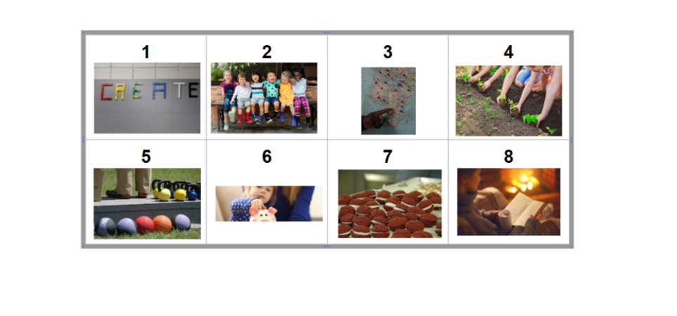
Which of these would be a reinforcer for you and why?
Notes:
Read the slide
Think about a time where the reinforcer you selected helped you get through a less desirable task. How often did you need it? At what point did you no longer need it?
Put in groups of 3-4 and have them share their answers

Slide 4
Learning Target and Success Criteria
Target: The learner will be able to write Fading Plans and Generalization Plans in Behavior Intervention Plans
Success Criteria:
  Describe a Fading Plan and Generalization Plan
  Determine when a Fading Plan and Generalization Plan are necessary
  Write Fading Plans for Preventative Strategies and Response Strategies
  Write Generalization Plans for Teaching Strategies
Notes:
At the end of today’s session, you will be able to write fading and generalization plans in BIPs. The success criteria we are looking for is:
Define a fading and generalization plan
Determine when a fading plan and generalization plan are necessary
Write fading plans for preventative and response strategies
Write generalization plans for teaching strategies

Slide 5
Why are Fading Plans and Generalization Plans necessary?
Fading Plans
Generalization Plans
Promote independence
Increase self management
Improve access to the general education classroom and peers
Move skills from acquisition to fluency
Ensure that a learner can use a skill in a variety of settings, in different contexts, with different materials, and with multiple people
Notes:
To begin, let’s start with the why - why are these plans necessary, and why were they moved within the IEP? Originally, fading and generalization were treated as separate questions in behavior intervention plans.
What we found, however, was that many plans didn’t truly address these components - fading and generalization were often overlooked or completed superficially. By moving them into the required components section, the goal isn’t to say that every plan must have a full fading or generalization plan. Rather, it ensures that the team has a conversation about whether those elements are needed - and if not, why?
When a student is ready, these plans should already be designed so that they can be implemented without delay. Now, before we go over the reasons for both fading and generalization plans, take a minute at your tables to discuss: How might you communicate this shift - and the importance of these plans - to teachers who may be struggling to see why this is necessary?
(Provide time for discussion 2-3 minutes, then read the slide)
Thank you for sharing your table thoughts. And yes, you are correct with your thinking, in that, without opportunities for learners to demonstrate new skills in real-life settings, SDI loses its purpose. For instruction to be truly meaningful, learners need to apply and experience success with these skills at home, at school, and in the community. Meaningful learning occurs only when skills are generalized across environments.

Slide 6
Fading Plans
Notes:
Strategies that are embedded with a learner’s Behavior Intervention Plan as part of their IEP are intended to teach the learner the necessary skills in order for them to make progress toward either a) reducing the amount of support a learner needs to be successful, or b) demonstrate such great success that they no longer require a BIP. When drafting a BIP, the IEP team should consider when and how they will fade the strategies that are listed in order for the learner to first demonstrate success and then maintain that success with less support. The purpose of the next few slides is to help guide IEP teams in identifying ways they can plan to begin fading BIP strategies.

Slide 7
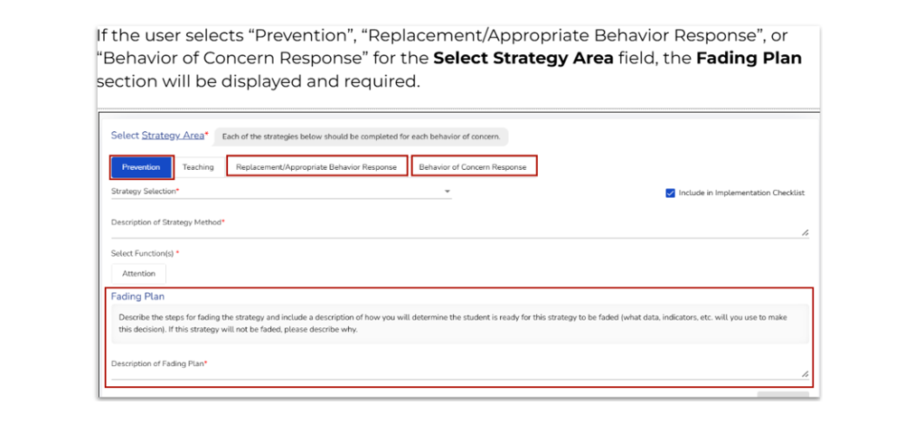
Fading Plan Definition
Gradually reducing a support, prompt, or reinforcer
Notes:
As mentioned in the Updates to the FBA & BIP Training Webinar, teams are now required to consider fading plans for three key areas - those include prevention strategies, replacement or appropriate behavior response strategies, and behavior of concern response strategies.
You’ll notice these areas are clearly marked in the strategies section with a red asterisk. That asterisk is your cue that a fading plan must be discussed - even if the team determines that fading isn’t needed right now, that decision and the rationale should still be documented.
This change ensures that every plan includes thoughtful consideration of how supports will be reduced over time and how learners will build independence.

Slide 8
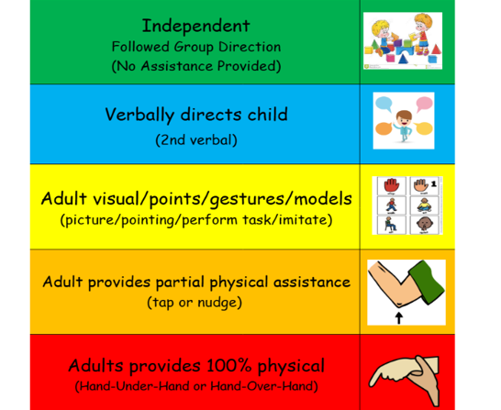
Fading Prompts
Notes:
Prompting is one of the most common supports we can fade over time. When developing a fading plan, it is important to think about how much prompting the learner currently needs and what steps can help them move toward greater independence.
For example, if a learner relies on an adult to provide a visual each time, could we shift to a verbal prompt that reminds the learner to reference their own checklist instead? Or, if multiple prompts are being given, can we reduce the number of prompts gradually while still maintaining success?
The goal is to identify and use the least intrusive prompt necessary for the learner to demonstrate the skill successfully. Over time, this helps build autonomy and ensures the skill doesn’t depend on constant adult support.

Slide 9
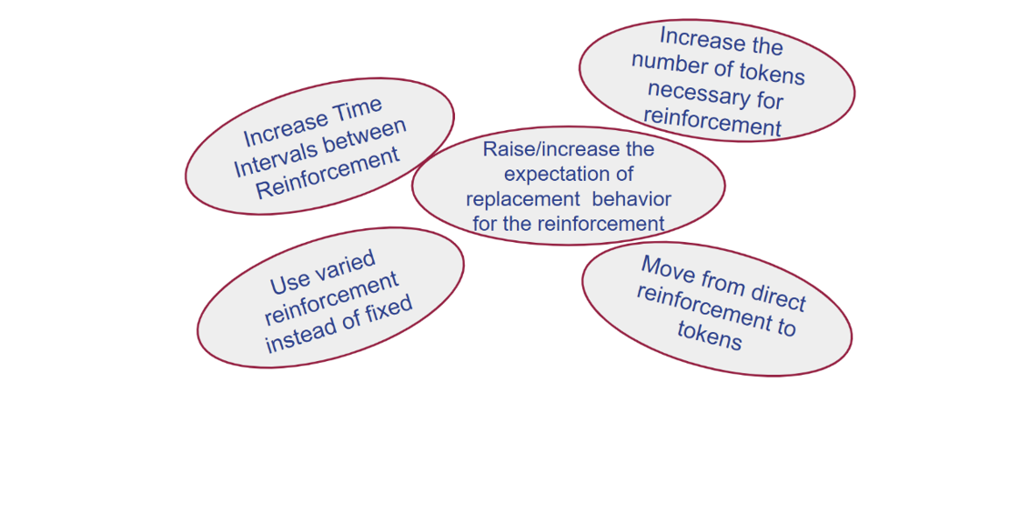
Fading Reinforcement
Notes:
Another component within the BIP that can be faded over time is reinforcement.
As you can see here, there are several ways to gradually reduce reinforcement while maintaining learner success. One approach is to move from direct reinforcement - where the learner demonstrates a behavior and immediately earns a reward - to a token economy system. By moving to a token economy system, the learner earns tokens for demonstrating the behavior over a period of time or after a set number of occurrences (e.g., problems solved), and then exchanges those token for reinforcement.
We can also fade reinforcement by increasing the amount of time between reinforcement opportunities or increasing the number of tokens needed before a reward is earned. Using varied reinforcement schedules make this transition easier, as learners are less likely to become dependent on a fixed pattern - for example, randomizing the number of tokens needed can allow you to increase the requirement gradually without the learner noticing.
Another effective way to fade reinforcement is to change the behavior being reinforced. For instance, if a learner was initially reinforced simply for staying in the classroom, the next step might be staying in a specific area of the classroom, or completing part of a task before earning reinforcement. Over time, the expectations can increase - perhaps moving from completing three problems to four, and so on.
The goal is always to promote independence and move toward behavior being maintained by natural reinforcement in the environment, not by constant external rewards.

Slide 10
Examples of Fading Plans: Prevention Strategies
Strategy | Fading Plan
When provided with academic tasks, S. will have the opportunity to earn punches on a punch card that can be exchanged for time with a preferred activity. When S. earns 5 punches, they may exchange the card for time with the iPad or other preferred activity. During writing tasks, which have proven to be more difficult, S. will earn punches by completing “chunked” assignments (e.g., one punch after writing 3 sentences, and another punch when S. has written the full 5 sentences required). | As S. learns self-management skills, they will have the same number of punches for all subjects. When S. is able to make it throughout writing without engaging in vocal disruption for 5 consecutive days, the number of punches will change to one punch when the writing task is complete.
S. will have preferential seating to increase attention and provide more opportunities for praise. | This strategy will not be faded at this time as it does not impact S’s access to LRE and can be provided in the general education setting.
Notes:
As mentioned earlier, when developing fading plans within the IEP, it may not always be appropriate to begin fading immediately. However, the team should still take time to consider what fading will look like when the learner is ready. In the examples shown here, you’ll see two different approaches:
In one example, the fading plan is contingent on the learner’s skill development and demonstration of specific behaviors
In the other, fading is not planned because doing so would not impact the learner’s access to LRE.
What is important is that the team has clearly considered and documented whether fading is appropriate, and if it isn’t right now, what it will look like in the future when it becomes appropriate.

Slide 11
Common Prevention Strategies
Strategies
Fading
Breaks
Noncontingent Free Time
Token System
First/Then Prompting
Visual Schedule
Paired Choices
Frequent Praise
Individualized Workspace
Notes:
Let’s review some common prevention strategies. Before we start, I’d like to gauge how many participants have written these into their plans?
Raise your hand if you’ve used breaks…. [continue down the strategies]
As you can see, many of us use these strategies, but likely have different processes for implementing them. In your group, think of students you currently work with and how each strategy is written in their plan. Choose some strategies to talk about in-depth and see if you can come up with fading strategies. You might even find that someone in your groups use of a strategy would be the logical next step for your own plan.
We’ll have __ minutes and then come back to share out ideas.
Facilitator Note: After coming back together from the breakout groups, ask for participants to share out ideas on how to fade these strategies, then add those strategies named in the bulleted list under “Fading”
Examples may include:
Breaks - can be faded by slowly decreasing the duration of the break (e.g., start with 3 minutes, then fade to 2 ½ minutes, then 2 minutes, then 1 ½ minutes); can be faded by slowly reducing the number of breaks a learner can request in a day (e.g., start with baseline of 7 break requests per day, reduce that to 6, then 5, then 4, etc until the number of breaks is similar to that of typical peers)
Noncontingent free time - can start with 3 designated “free time” periods per day, reduce that to two, then one. OR, begin to make the free time contingent on something, such as the absence of problem behavior during the period of time between free time periods
Token system - start with the learner being required to earn five tokens in order to gain access to a preferred activity, then increase to 6 tokens, 7 token, etc until they reach 10 tokens OR increase the effort/duration of a task in order to earn a token
First/Then Prompting - start with first/then prompting and then as the learner demonstrates mastery, move to a first/next/then sequence in which the learner would be required to complete two tasks before earning the “then” reinforcer then when the learner is engaging in a first/next/then sequence, move to a visual schedule that displays three activities and then reinforcer or a token system
Visual Schedule - Start with the learner’s day broken into 15- minute intervals/activities, then increase to 30- minutes, 45- minutes, etc. OR move from a picture-based schedule to pictures paired with written words, then just written words
Paired Choices - Start by providing the learner with 2 fail-safe choices for each activity, then fade to only providing choices for the most difficult times/activities, then fade to providing the learner with a “choice” card that can only be used X- number of times per day
Frequent Praise - Start by providing the learner with praise approximately every 60- seconds, then every 90- seconds, every 2- minutes, etc

Slide 12
Examples of Fading Plans: Appropriate/Replacement Behavior Response
Strategy | Fading Plan
When S. requests the use of their regulation routine, this will be honored. During this time, S. will request a regulation routine by showing the teacher a card or verbally requesting. S. will go to a predetermined designated space and use one of the strategies they have identified as effective. A timer will be set for 3 minutes. After 3 minutes, the adult will ask S. if they are ready to return. If S. is not ready to return, they may have 2 additional minutes. If S. is ready to return, they will return to class and work on the task they were completing. | S. currently completes their regulation routine in the Special Education setting. When S. has been able to complete their routine independently by setting their own timer and returning to class across 5 consecutive days, the time will be reduced to 2 minutes, with an additional 1 minute as needed. This process will be repeated until S. is able to engage in their routine for 1 initial minute plus 1 additional minute, absent of behavior targeted for reduction, across 5 consecutive school days. At that time, the team will meet to determine if this strategy is still necessary.
S. will have access to their regulation routine throughout their school day. They may request it at any time and this will be immediately honored. | When S. demonstrates the ability to access their regulation routine across 5 consecutive school days, absent of behavior targeted for reduction, the adult will embed a short wait (10- seconds) before honoring the request. Every 5 consecutive school that that S. is able to accept the delay to the request, the time will be increased by 10- seconds until S. is expected to wait for 60- seconds before leaving to engage in their regulation routine.
Notes:
Here are two examples of what fading plans might look like for appropriate or replacement behaviors. You’ll notice that these plans are contingent on student behavior, and that is completely appropriate. When writing fading plans, it is okay for the next step to depend on how consistently or independently a learner is demonstrating the target behavior. These examples show how fading can be built into the plan from the start so that we can be sure that we are always moving toward increased independence.

Slide 13
Common Appropriate/Replacement Behavior Response Strategies
Strategies
Fading
Frequent Praise
Rewards and/or Token Economy
Positive Calls Home
High Quality Attention
Visual Schedule
Access to Highly Preferred Items
Free Time
Immediately Honor Appropriate Requests
Notes:
As we just did with prevention strategies, we’ll do the same activity for appropriate behavior responses.
Let’s come back together to share out in ___ minutes
[Participants work in groups to come up with ideas for fading the example strategies, then share out with group and presenters enter ideas in the slide. ]
Examples may include:
Frequent Praise - Provide praise approximately every 15 minutes, fade to every 30 minutes, every 45 minutes, etc.
Rewards and/or token economy - Slowly increase the number of tokens a learner must earn in order to gain access to reinforcement; slowly move external rewards to intrinsic rewards
Positive calls home - Start with one phone call home per day, fade a phone call home being a choice of reward every other day, every three days, then once a week, then a note home, etc
High quality attention - Start with attention being delivered every 15 minutes, fade to 30 minutes, every 45 minutes, etc. Can also fade by providing high quality attention for 30- seconds, then 20- seconds, 15- seconds, 10- seconds, 5- seconds in order to fade the amount of attention being delivered
Access to highly preferred items - Start with continuous access to highly preferred items, then move to a first/then schedule of reinforcement, followed by a first/next/then schedule of reinforcement, followed by a visual schedule with pre-programmed times to access highly preferred items
Free time - Start with 5 minutes of free time, fade to 4 minutes, then 3 minutes, and finally 2 minutes
Immediately honor appropriate requests - Begin by immediately honoring appropriate requests, fade by slowly increasing a delay to the request (start with 30- seconds of wait time, followed by 60- seconds of wait time, then 2- minutes of wait time, etc)

Slide 14
Examples of Fading Plans: Behavior of Concern Response
Strategy | Fading Plan
When S. engages in Vocal Disruption the adults will use planned ignoring by refraining from commenting on the behavior of concern and/or disengaging when S. attempts to talk to adults about off-topic subjects. If S. asks about their work expectation, adults will write the expectations down on a dry erase board on S.’s desk. Adults will provide brief, neutral praise when S. begins engaging in their academic task/activity (e.g., “nice getting back to your learning”). | At this time, this strategy will not be faded as the FBA indicated that the hypothesized function for Vocal Disruption is Attention. By fading planned ignoring, the team may inadvertently reinforce the behavior of concern; therefore, planned ignoring will be used as a response strategy for adults supporting S. throughout behavioral episodes.
When S. elopes the classroom, an adult will walk them back to their classroom and read a social story about staying in the classroom before re-entering. | When S. is able to identify and explain the rules listed in their social story for staying in the classroom and why this is important, the social story will be discontinued (will no longer be read prior to re-entering) and the adult will remind S. of what their academic task/activity is that they need to be working on.
Notes:
Here are two examples of Behavior of concern response strategies. In the first example, LRE is not impacted by adults engaging in planned ignoring, and it is essential to continue withholding attention when the learner is engaging in the behavior targeted for reduction; therefore, it will not be faded at this time. With the second example, notice how the strategy will eventually be faded, but it is contingent on a specific behavior, so although this not be faded right away, there is a plan in place for when that time comes.

Slide 15
Common Behavior of Concern Response Strategies
Strategies
Fading
Planned Ignoring
Prompting Sequence
Remove Items from Workspace
Block/Redirect from Peers When Aggressive
Staff-Directed Breaks
Praise to Appropriate Peers
Notes:
Let’s take a look at how you might fade some common behavior of concern response strategies. Discuss in your groups how you might fade, or when you’ll know it’s an appropriate time to start fading.
We’ll come back in ___ minutes
[Participants work in groups to come up with ideas for fading the example strategies, then share out with group and presenters enter ideas in the slide. ]
Examples may include:
Planned ignoring - May not fade this as we do not want to inadvertently reinforce problem behavior
Prompting sequence - Move from physical prompts to gestural prompts, move from full physical prompts to partial physical prompts, move from gestural prompts to verbal prompts, verbal prompts to visual prompts, etc
Remove items from workspace - Begin by removing all items then fade to removing only items that could cause harm then only remove items that the learner is attempting to use as a weapon that could cause harm. May not be able to fade removing items
Block/redirect from peers when aggressive - May not need to fade this in order to prevent harm to others and/or impact the learner’s access to general education (LRE)
Staff-directed breaks - Staff provides prompting until learner takes break appropriately, begin to fade out the number or type of prompts (e.g., verbal prompting to visual prompting), fade to learner requesting a break
Praise to appropriate peers - May not need to fade this as it does not impact the learner’s access to general education (LRE)

Slide 16
Considerations For Writing A Fading Plan
If yes to the following, consider how you will plan to fade the current level of support:
Does the strategy require adult support?
Does the strategy require access to a more restrictive environment?
Has the student been using the reinforcer and demonstrating appropriate behavior for a significant amount of time?
Are there times where the learner will keep going if the reinforcer is not provided at the current rate?
Does the strategy need to be provided to reduce current challenging behaviors effectively?
If yes to the following, consider when you would think about fading the support:
Could fading the support right now lead to increased behaviors of concern?
Does the learner’s disability require continued use of the strategy at this time?
Would fading the support pose the risk of imminent danger to the learner or others?
Notes:
There are some considerations an IEP team will make when determining how or when to fade the supports listed in the learner’s BIP.
If the learner has supports listed in their IEP that require adult support, access to a more restrictive setting, or the learner has been demonstrating appropriate behavior either for long periods of time without access to reinforcement or if the learner is demonstrating periods of time where they demonstrate appropriate behavior at a different/longer rate than other times, the IEP team would consider how they can begin to fade the support being provided. As described earlier, this could include varying the amount of time between reinforcement, increasing time in the LRE, beginning to fade adult support at times the learner has consistently demonstrated success without relying on an adult to help them, and/or a strategy has proven to effectively reduce the current challenging behavior(s).
However, as we discussed earlier, there are certainly times when strategies would not be faded. These can include times such as when the learner needs access to a strategy because of their disability and no amount of instruction will change that. For instance, fading access to a wheelchair for a non-ambulatory learner or communication device when it is the learner’s only method of communication would not be appropriate as that would limit their ability to access instruction.

Slide 17
Generalization Plans
Notes:
Now that you have had an opportunity to practice writing fading plans for prevention strategies, appropriate/replacement behavior strategies, and behavior of concern responses, we are going to move into generalization plans.

Slide 18
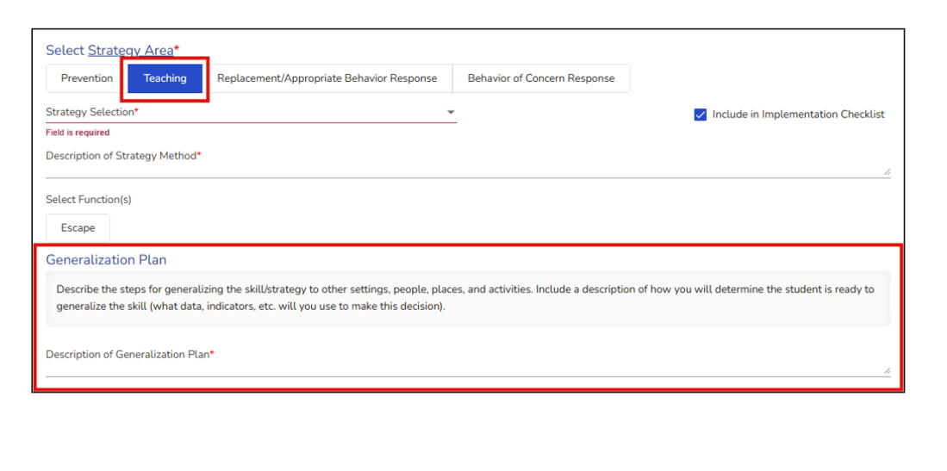
Generalization Plans in ACHIEVE
Notes:
Generalization plans are a new, required field for the Teaching Strategy section of the Behavior Intervention Plan in ACHIEVE. When the user selects, “teaching” as a strategy area, a prompt will be displayed asking the user to describe the steps for generalizing the skill/strategy to other settings, people, places, and activities.

Slide 19
What is Generalization?
The ability to transfer and apply acquired skills to new settings, materials, and individuals.
Notes:
Let’s begin by defining “generalization.”
Generalization, in simple terms, refers to the ability to apply learned skills across different settings, materials, and people. It moves beyond mere memorization or repetition, focusing instead on using those skills effectively in real-world contexts. When generalization occurs, individuals are able to apply the skill(s) to novel situations.
A key point in understanding generalization is realizing that it does not occur automatically. Some learners may have difficulty identifying similarities and differences between situations or may not apply skills beyond the specific settings where they were first learned. This underscores the importance of intentionally teaching and supporting generalization within specially designed instruction.
There are two main types of generalization. These include stimulus generalization and response generalization. The difference between these two types of generalization will be addressed in upcoming slides.

Slide 20
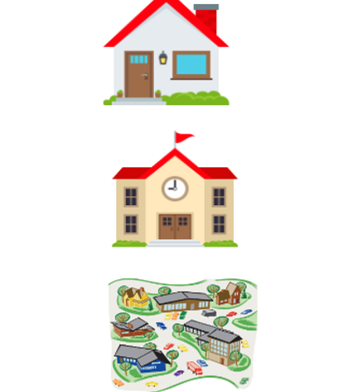
Why Plan For Generalization?
Transfers skills to daily life
Increases independence
Makes the skills more durable
Notes:
As we discussed at the beginning of the presentation, generalization is a vital component of SDI for a variety of reasons.
Generalization ensures that the skills learned during instruction are used in the learner’s everyday life. This is important because it promotes success at home, school, and in the community.
When a learner can generalize their skills, they are less reliant on others for help. This increased independence can lead to a greater sense of self-confidence and self-esteem.
As skills become generalized, they overall become more durable, meaning that the learner is less likely to lose the skill over time. This is important for long-term success.

Slide 21
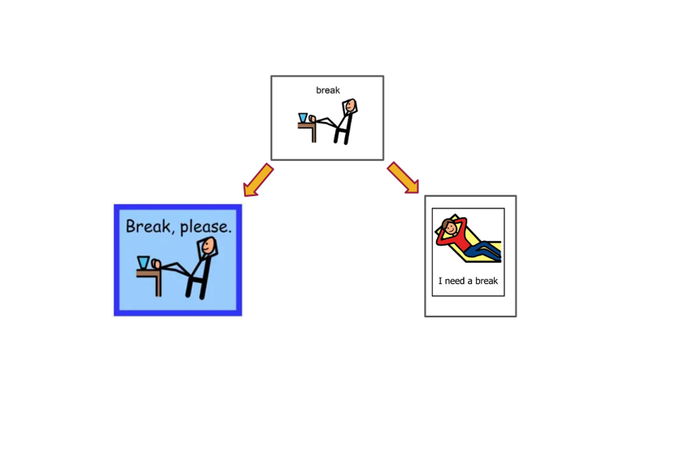
Stimulus Generalization
Notes:
Stimulus generalization happens when a learner uses a learned skill or behavior in response to things that are similar - but not exactly the same - as what they were originally taught with.
For example: If a learner is taught to greet their teacher by saying “hello,” and then later says “hello” to other adults or classmates, that is stimulus generalization. It means that the learner is recognizing that different people or situations are similar enough to use the same skill. In simple terms, it’s when learning “sticks” and carries over to new but related situations.
In the example displayed here, the learner was taught to request a break using the break card on the top. In this scenario, the learner observed similarities from the original break card they were taught to use with the ones displayed below. Because the learner received reinforcement, in the form of praise (“good job asking for a break”) paired with access to a break, the skill of requesting a break was generalized to new materials: the break cards displayed at the bottom.

Slide 22
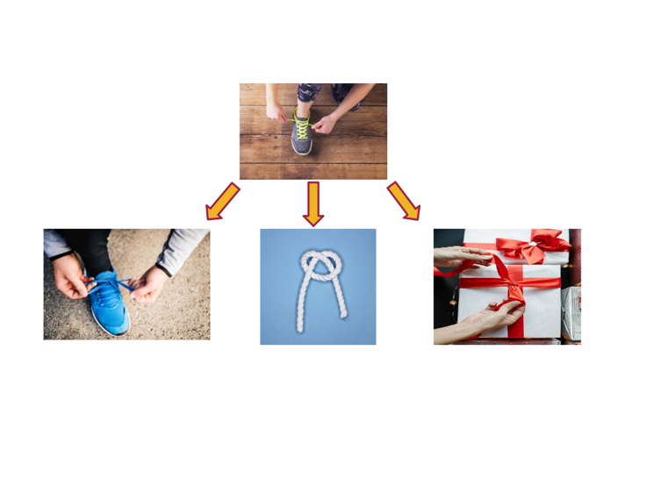
Response Generalization
Notes:
Response generalization, on the other hand, happens when a student uses different behaviors or responses that achieve the same outcome as the one they were originally taught.
If a learner is taught to ask for help by raising their hand, and later they start saying, “Can you help me?” or using a help card instead, that’s response generalization. The learner is showing they understand the purpose of the skill - asking for help - even though the way they do it has changed. In simple terms, response generalization means a learner can use different, but appropriate, ways to show what they know or get the same result.
The example displayed here shows that a learner was taught how to tie their shoes using gray shoes with green laces. Upon learning how to tie their shoes, the learner then generalized the skill to tying a different pair or shoes, tying a knot, and even tying a bow on a gift.

Slide 23
Generalizing Across Settings Examples
Teaching Strategy Description | Generalization Plan
Taking a Break: The learner will have access to a break card Velcroed on their desk. In P.E., it will be hung on the exterior door. The learner will first practice the skill in the Special Education classroom. | Mastery Criteria: 90% of break requests absent of problem behavior (as defined in their BIP) across 5 consecutive school days. Settings in Sequential Order: Special Education classroom, General Education classroom, P.E., Art, Music
Sharing/Turn-Taking: The learner will receive 1:1 explicit instruction on sharing/turn-taking and practice the skill with the Special Education Teacher in the Special Education classroom. | Mastery Criteria: 80% of appropriate sharing/turn-taking opportunities across 3 consecutive school days. Settings in Sequential Order: Special Education classroom, Small Group, Social Skills Group, Recess, P.E.
Accessing a Coping Strategy: The learner will have access to a personalized coping strategy box throughout their school day. When the learner requests a coping strategy, this request will receive immediate praise (e.g., “nice asking for a coping strategy!”) paired with access to the strategy box. | Mastery Criteria: 9/10 requests for a coping strategy absent of problem behavior (as defined in their BIP). Settings in Sequential Order: Social Skills Small Group, English class, Math class, Social Studies, Music, Home Economics
Notes:
This table displays how a teaching strategy, paired with the strategy description, will be generalized across settings. In these examples, the settings that have been identified for generalization are based upon here the learner has the most difficulty with demonstrating the targeted teaching strategy. Let’s take a look at the strategy description and generalization plans for each.
Taking a Break: The learner will practice taking a break in the Special Education classroom first. Once the learner is demonstrating Mastery Criteria, defined 90% of break requests, absent of problem behavior, across 5 consecutive school days, this skill will be practiced and reinforced in the General Education classroom. When mastery criteria is met in GenEd, it will be practiced and reinforced in P.E. Once mastery criteria is met in P.E., it will be generalized to Art, and finally Music.
Sharing/Turn-Taking: The learner will practice sharing/turn-taking one-on-one in the Special Education classroom. Once the learner is demonstrating Mastery Criteria, defined as 80% of appropriate sharing/turn-taking opportunities across 3 consecutive school days, this skill will be generalized in the following order, with mastery criteria needing to be met before moving on to the next area: Small Group, Social Skills Group, Recess, P.E.
Accessing a Coping Strategy: The learner will practice using a coping strategy first in Social Skills small group. Once the learner is requesting a coping strategy, absent of behavior targeted for reduction, in 9/10 opportunities, accessing a coping strategy will be practiced and reinforced in the following areas, using the same mastery criteria above before moving onto the next area: English class, Math class, Social Studies, Music, Home Economics

Slide 24
Generalizing Across Materials Examples
Teaching Strategy Description | Generalization Plan
Taking a Break: The learner will receive direct instruction on how to request a break by using: a break card, the ASL sign for “break,” and raising their hand and saying, “I need a break.” Once all strategies are taught, any one may be used by the learner and will result in a 2- minute break. | Mastery Criteria: 90% of break requests absent of problem behavior (as defined in their BIP) across 5 consecutive school days. Materials in Sequential Order: Break card, raising their hand and saying, “I need a break,” ASL sign for break.
Sharing/Turn-Taking: The learner will receive instruction on how to share/take turns by accessing Social Stories, using BST, and video modeling 1:1 with the Special Education Teacher and paraeducator, using their favorite toys: iPad, bubbles, and Barbies. | Mastery Criteria: 80% of appropriate sharing/turn-taking opportunities absent of problem behavior (as defined in their BIP) across 3 consecutive school days. Materials in Sequential Order: iPad, bubbles, Barbies. Once the learner demonstrates mastery with all three toys, the toys will be rotated to support continued generalization and maintenance.
Accessing a Coping Strategy: The learner will have access to a personalized coping strategy box with at least 4 items in the bin at all times. These items may include: putty, breathing exercises, stress ball, Squigs, etc. | Mastery Criteria: 9/10 requests for a coping strategy absent of problem behavior (as defined in their BIP) Materials in Sequential Order: Breathing exercises, stress ball, putty, Squigs. Once the learner demonstrates mastery of one coping strategy, an additional strategy will be taught and added to the bin.
Notes:
Similarly, generalization can occur across materials. Materials can be targeted one at a time, as the examples shown here describe, or they may be rotated throughout instruction in order to provide the learner with multiple opportunities to practice the targeted skill with a variety of materials.
(Read slide)

Slide 25
Generalizing Across Individuals Examples
Teaching Strategy Description | Generalization Plan
Taking a Break: The learner will be taught to request a break in all academic settings throughout the day, with all adults honoring the break by providing brief praise paired with immediate access to a 2- minute break. | Mastery Criteria: 90% of break requests absent of problem behavior (as defined in their BIP) across 5 consecutive school days. Individuals in Sequential Order: 1:1 with Special Education Teacher, in small group with paraeducator, in small group with General Education Teacher, with the P.E. Teacher, with the Art Teacher, with the Music Teacher.
Sharing/Turn-Taking: The learner will have the opportunity to practice sharing/turn-taking with the Special Education Teacher, paraeducator, 1:1 with a peer, and in a small group with up to 3 peers. | Mastery Criteria: 80% of appropriate sharing/turn-taking opportunities across 3 consecutive school days. Individuals in Sequential Order: Special Education Teacher, paraeducator, one peer, two peers, three peers. Upon demonstrating mastery with 3 peers, peers will be rotated weekly.
Accessing a Coping Strategy: The learner will practice using a coping strategy with adults the learner has identified as “trusted” adults, and with whom the learner has demonstrated frustrating situations with. | Mastery Criteria: 9/10 requests for a coping strategy absent of problem behavior (as defined in their BIP). Individuals in Sequential Order: Special Education Teacher, paraeducator, P.E. Teacher, Guidance Counselor
Notes:
Generalization can also occur when the learner is taught to use a targeted skill with multiple individuals. The examples shown here describe how and when a new individual will begin to use the skill with the learner.
(Read the slide)
It is important to note that, when developing a plan for generalization, mastery criteria is identified to guide when the learner should begin practicing the skill in a new setting, with materials, and with new individuals. While generalization may occur naturally for some learners, it is important to keep in mind that the skill being taught must be reinforced in new environments, in different settings, and with new individuals in order for the skill to be maintained.

Slide 26
Common Teaching Strategies
Strategies
Generalization
Self-Advocacy: Asking for Help or Breaks
Social Skills
Executive Skills Strategies
Play Skills
Coping Skills
Decision-Making
Expected/Unexpected Behaviors
Notes:
Let’s review some common teaching strategies to determine how they should/could be generalized. In your groups, discuss students you know with these types of strategies. We’ll have __ minutes and then come back to share out ideas.
[Participants work in groups to come up with ideas for generalizing the example strategies, then share out with group and presenters enter ideas in the slide. ]
Self-Advocacy - Start 1:1 w/ Special Education teacher, then begin to practice with paraeducator, generalize to GenEd classroom when fluent, then to other settings based on need
Social Skills - Start in a small group with familiar peers, rotate peers when fluent so that the learner can practice the skill with other individuals, generalize to Fun Friday/Recess, etc where other peers are present
Executive Skills Strategies - Start by color coding Math materials (e.g., red folder) then add science (e.g., yellow folder) then add literacy (e.g., green folder) in order to teach how to organize materials for each class
Play Skills - Start in small group with familiar peers, rotate peers when fluent so that the learner can practice the skill with other individuals, generalize to Fun Friday/Recess, etc where other peers are present OR practice in SpEd room, then generalize to Recess, then generalize to P.E., etc
Coping Skills - use in setting where strategy is taught, then to other locations when fluency is built, continue to add settings as student demonstrates mastery in current setting
Decision Making - practice 1:1 w/ Special Education teacher in SpEd room, then practice 1:1 w/ Gen Ed teacher in Gen Ed room, then generalize to 1:1 w/ paraeducator in the hallway
Expected/Unexpected Behaviors - use language of expected/unexpected behaviors with special education teacher, generalize to paraeducator, generalize to general education teacher, then Principal, P.E. teacher, Art teacher, etc

Slide 27
Considerations When Planning for Generalization in the School Setting
The immediacy of a skill that needs to be generalized
Caregiver and educational staff input
Access for the learner to have natural opportunities for reinforcement
Notes:
There are a number of considerations to take into account when planning for generalization. Although this is not an exhaustive list of every consideration an IEP team would need to make when determining which skill(s) to generalize and how to generalize the skill, this provides a guide of some things to consider when identifying which skill to generalize first.
Some skills may need to be generalized more quickly than others. For instance, if a learner is being taught to remain within arm’s reach of an adult when transitioning within the building, this instruction could have resulted from the learner eloping outside of the school building and parents reporting that the learner elopes within the community. A situation like this would require that the skill of remaining within close proximity of an adult be generalized as quickly as possible so that the learner quickly identifies that they must remain close to an adult at all times, and in all settings.
Caregiver and educational staff input are two important components to consider when creating a generalization plan. If a teacher or caregiver do not understand why the learner is being taught a particular skill, or if they believe that there is something more important for the learner to learn right away, there may be a lack of buy-in relative to the skill being taught and additional opportunities for reinforcement in new settings and with new individuals may be restricted as a result.
Generalization occurs best when the learner has multiple opportunities to access reinforcement for demonstrating a new skill. If there is limited access to opportunities for reinforcement, the skill may not prove to be durable over time; therefore, it might be more beneficial to create additional opportunities for more reinforcement by generalizing to new materials, as opposed to new contexts or new people. When a learner has natural opportunities for reinforcement to be provided for demonstrating a target skill, the likelihood of the skill being generalized increases.

Slide 28
In-Depth Case Study
Notes:
Now that we’ve reviewed the purpose of fading and generalization, things to consider, and examples of them, let’s use a case study to practice using fading and generalization in the context of a real plan.
As a whole-group, I’ll read through the plan, but you can follow along on your handout. Generalization Fading Case Study.pdf
[In case participants wonder how the case study was chosen]:
To find the sample case study, a report was ran to find BIPs across the state. A random number generator was also used to locate a student that corresponded to a line in the spreadsheet. The first student with only two behaviors of concern was chosen. Some of the specifics of the plan were changed at an attempt to maintain confidentiality.

Slide 29
Student X - 3rd Grade, 8 Years Old
Strengths and Skills: Student X is silly, caring, and curious with strengths in reading, being creative, and friendliness.
Preferences and Interests: Student X is interested in Roblox, Minecraft, going to the park, bowling, and playing games or watching TV with their parents.
Appropriate Behavior Statement: Student X is more likely to engage in appropriate behaviors when they are completing preferred tasks. They do a nice job of appropriate behaviors during read alouds, read to self time, and science.
Notes:
(Read the slide)

Slide 30
Behavior of Concern 1: Refusal/Non-Compliance
Refusal/Non-Compliance is defined as Student X verbally or physically protesting a given task or activity.
Examples include: Saying “no,” or “I don’t want to do that,” putting their head down on the desk, or turning away from staff.
Non-Examples include: Saying they won’t do a task, but still complying with the task, asking for help to complete a task, answering “no” to a question that is not a demand.
Hypothesis: When presented with non-preferred demands, Student X engages in refusal/non-compliance to escape the demand or to gain attention.
Goal: To interact respectfully and safely with adults and peers by scoring an average of 85% using a check-in/check-out rubric.
Notes:
(Read the slide)

Slide 31
Behavior of Concern 2: Disruption
Disruption is defined as Student X engaging in behaviors that interrupt or disturb an activity or task.
Examples include: Lying down during instruction or activities, yelling/screaming, blurting when the expectation is to raise hands, blurting comments not connected to the activity/lesson, throwing materials
Non-Examples include: Yelling when hurt or scared, lying down while on a break, throwing materials made to be thrown (e.g., in P.E., Recess), speaking loudly during unstructured times.
Hypothesis: When presented with non-preferred demands (structured activities, direct instruction), Student X engages in refusal/non-compliance to gain attention.
Goal: Combined with Refusal/Non-Compliance.
Notes:
(Read the slide)

Slide 32
Prevention Strategies
Multiple opportunities for choice embedded throughout the day
  Choices should be adult-facilitated and limited to two options
  Examples: allowing the learner to choose between writing utensils, deciding which work problem to complete first, and/or to sit or stand while completing the learning
Frequent reminders that the learner can ask for a break and which activities are coming up
Clear and predictable routines: classroom schedule check at the start of the day and advanced notice of changes in routine
Notes:
(Read the slide)

Slide 33
Prevention Continued
Timer and warning for transitions, including visual timer posted at the front of the classroom with multiple verbal reminders of how much time is left until the next transition
Assigned spot at the carpet and in lines
Allow time and space to comply with directions: provide firm directives, then walk away and only give one task/directive at a time
During writing: If Student X becomes upset, lower the demands and accept what is submitted as long as it is legible
Notes:
(Read the slide)

Slide 34
Teaching Strategies
Decision-Making: Help Student X understand decision-making among varying situations and the impact of choices on outcomes
Perspectives: Student X requires support in understanding others’ perspectives
Social Skills: Student X would benefit from being taught how to build positive relationships, engage in prosocial behaviors, and understanding friendships
  Social stories to support these skills
  Accepting positive feedback and compliments
Notes:
(Read the slide)

Slide 35
Response Strategies to Appropriate Behavior
Reinforcement System: Student X earns a sticker when they earn 80% of their check-in/check-out points for the morning and afternoon. Once Student X has five stickers, they may earn a reward.
When engaged in appropriate behaviors, provide indirect verbal praise on a frequent basis as part of a natural conversation
  E.g., “I like how everyone at the table is working”
Student X will meet with a teacher or associate before and after each content block to review their check-in/check-out sheet. The adult will provide positive feedback.
Notes:
(Read the slide)

Slide 36
Response Strategies to Behaviors of Concern
When appearing dysregulated, use visual, verbal, or physical cues (e.g., pointing) and provide space and time to follow directions
When engaged in refusal, give firm directives with choices embedded (e.g., finish this now, or later during ___)
  Work not completed will be placed in a make-up folder to be completed during a later independent work time, or the next morning
  Assignments will be prioritized by the classroom teacher
When engaged in Disruption, give a simple directive such as “you can take a break, but you still have to complete the work later” and provide space
Notes:
(Read the slide)

Slide 37
Fading of Strategies and Generalization Plan
Work in groups
  Using the handout
    Create fading plans for each prevention and response strategy
    Create a generalization plan for the teaching strategies
Share out your ideas
Notes:
Are there any questions or concerns before we begin the activity?
You will have ___ minutes to work as a group. Use the handout provided to jot down your thoughts.
Generalization Fading Case Study.pdf

Slide 38
Thank you!
Notes:
Thank you for your participation in today’s training. We hope that you have gained an understanding of how to effectively write fading plans and generalization plans in BIPs. Have a great afternoon!

