Slide 1

Unique Placements

Slide 2

Welcome
Please post your questions in the Q&A
Slides will be posted on the DE website after the webinar
Policy & Practice Webinar Series & Recordings | Department of Education

Slide 3
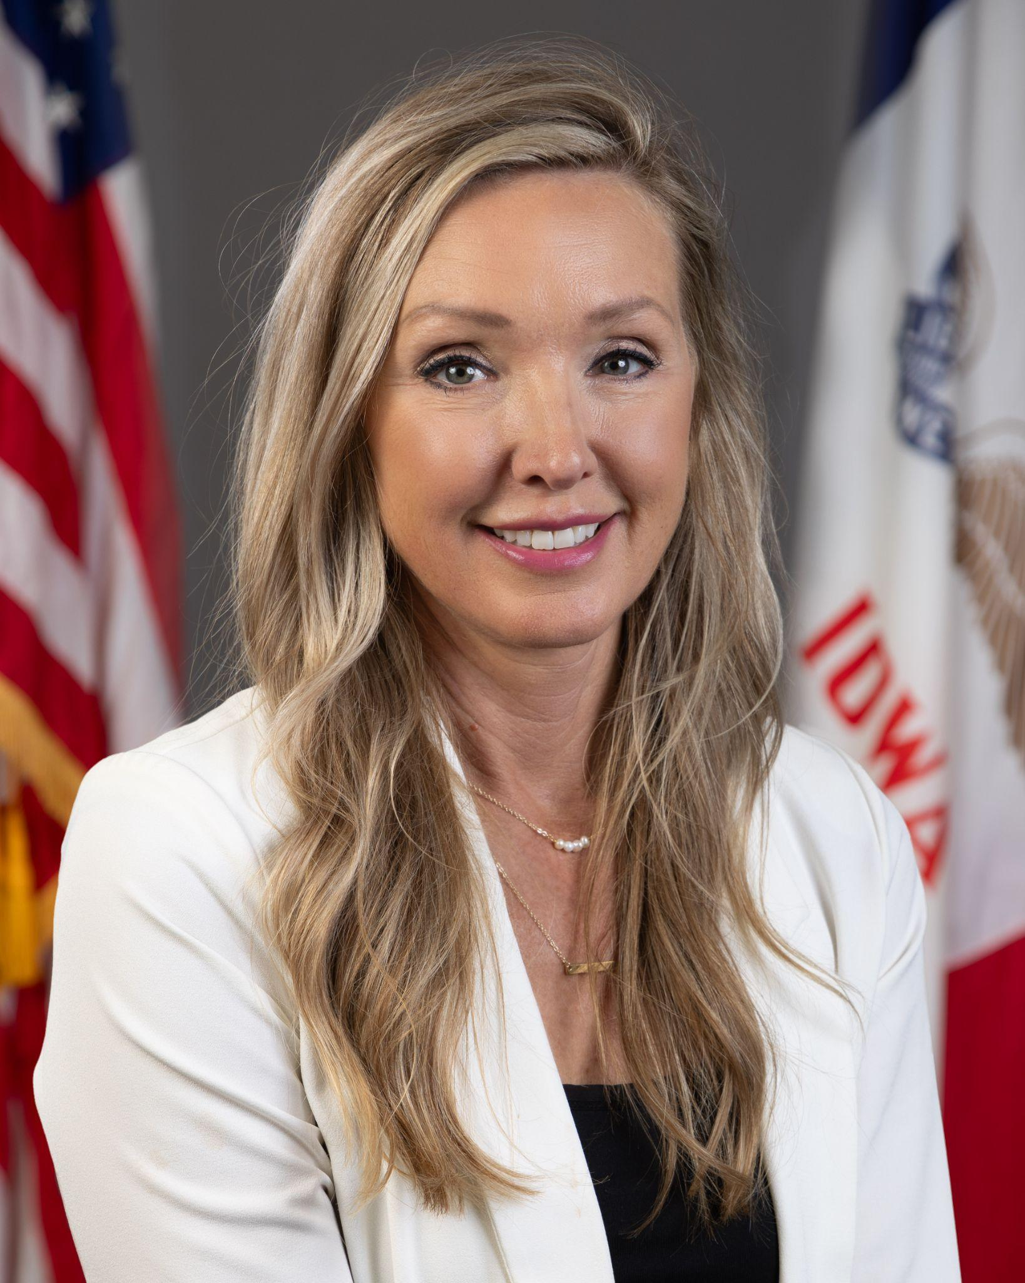

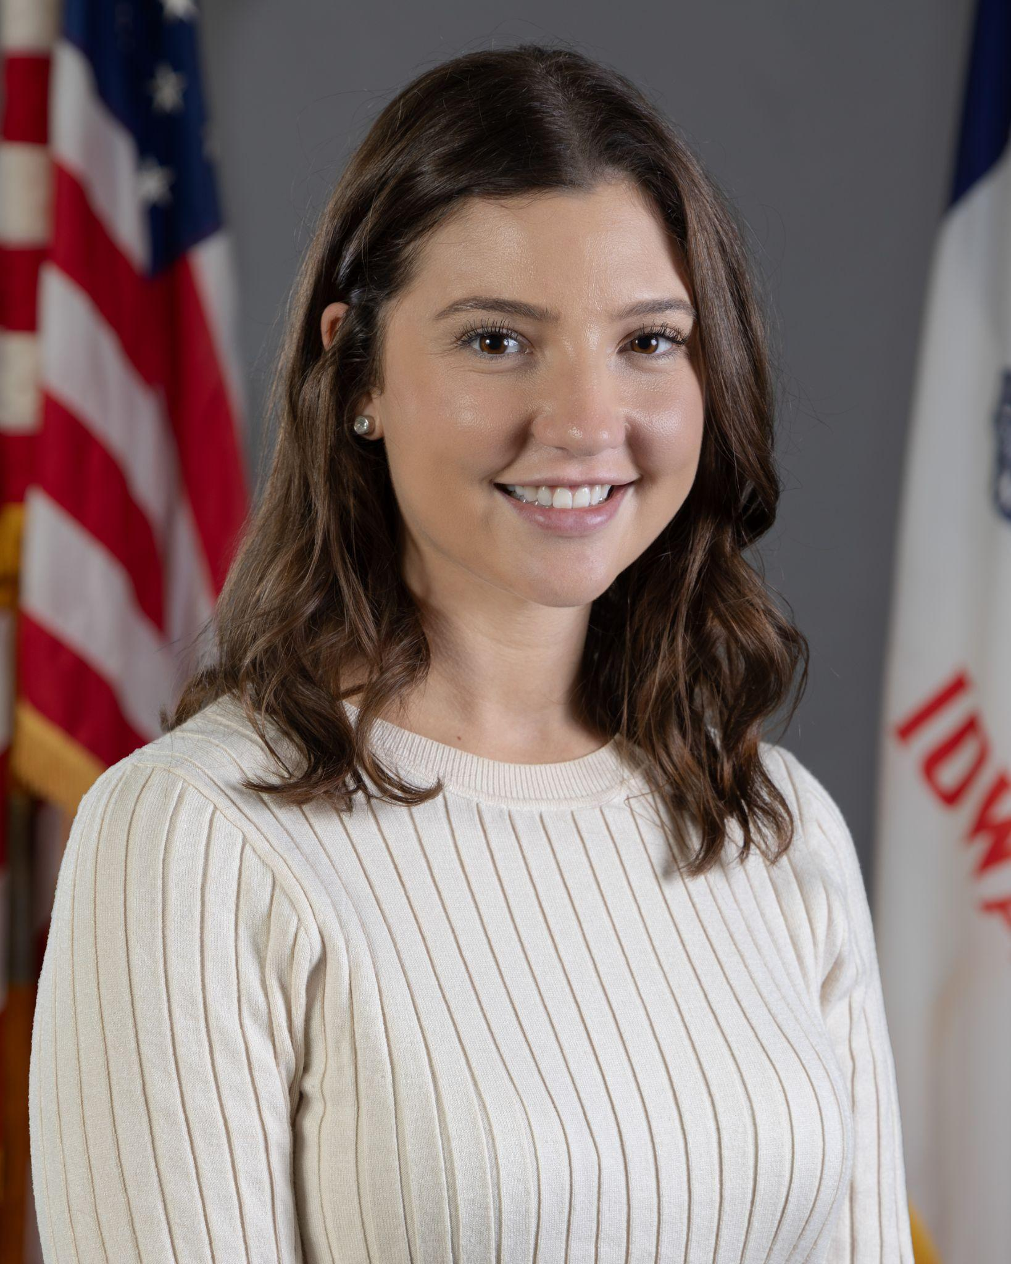

Today’s Presenters
Amy Thoms-Starr
Regional Director of Special Education- Central Rivers
Division of Special Education
Ivan Gentry
Regional Director of Special Education- Green Hills
Division of Special Education
Rachel Bosovich
Attorney II
Division of Special Education
Elisa Koler
Education Program Consultant
Division of Special Education
Education Program Consultants: Marie Conklin and Sara Reed

Slide 4
Participants will:
Understand each district’s responsibility to provide a FAPE in unique placements, including:
In-State State Agency Placements
Out-of-State IEP Team Placements
Out-of-State State Agency Placements

Slide 5
Terms to Know
SIS = Student Information System
*District of Residence = the school district where the parents are physically located
FAPE = Free and Appropriate Public Education
LRE = Least Restrictive Environment
HHS = Department of Health and Human Services
JCS = Juvenile Court Services
OOS = Out-of-State
State Operated Program = HHS education programs, State Training School and Independence Mental Health Institute
PMIC = Psychiatric Medical Institute for Children
*For purposes of this webinar, the district of residence is generally that in which the parent resides. However, please know that there can be many caveats to this and thus, again, we are speaking in generalities.

Slide 6
All educational placements must meet the standards set forth in Iowa’s Administrative Rules of Special Education
(IAC 281 Chapter 41)

Slide 7
In-State State Agency Placements

Slide 8
State-Initiated Placements in Iowa
Juvenile Home – Shelter under Chapter 63 provides a temporary home setting for children and youth awaiting a more permanent placement.
Juvenile Home – Juvenile Detention Center under Chapter 63 provides short term care for children and youth awaiting further adjudication.
The State Training School provides long term care for children and youth adjudicated delinquent by the Juvenile Courts, overseen by HHS.
Psychiatric Medical Institution for Children (PMIC) serves children and youth in need of treatment for mental health or psychiatric care.
  The Independence Mental Health Institute (IMHI) is a state-operated PMIC overseen by HHS.

Slide 9
Juvenile Homes: Home School vs. District of Residence
District of Residence = for billing purposes, typically the school district where the primary/biological parents are physically located.
Home School = for the purpose of serving learners in shelter or detention settings, the school where the learner most recently attended (which may be different from the learner’s District of Residence).

Slide 10
Shelter and Juvenile Detention: Enrollment & Coding
Learners in shelter and detention remain enrolled in their home school. The learner remains actively enrolled in their home school’s Student Information System (SIS).
If the learner was inadvertently exited from the SIS, the learner should be re-enrolled.
If coded correctly, the SIS will update the attending building in ACHIEVE.

Slide 11
Shelter and Juvenile Detention: IEP Management
The District of Residence continues to be the IEP facilitator in ACHIEVE.
The shelter or detention teacher becomes a “shared” user within ACHIEVE.
Whenever an IEP meeting is necessary, both parties will attend the meeting in order to collaborate and facilitate the IEP.
The shelter or detention teachers delivering the SDI are responsible for entering and/or communicating progress monitoring data to the ACHIEVE IEP facilitator.
It is ultimately the ACHIEVE IEP facilitator’s responsibility to ensure progress monitoring is entered within the ACHIEVE system.

Slide 12
PMIC: Enrollment & Coding
Learners in non-state operated PMICs are served by the local district.
The learner’s District of Residence is billed for both general education and special education costs.
Most PMICs do not have a separate building number; however, the ACHIEVE Data Team can assign a PMIC as a “Domicile” location for data reporting purposes.
This does not apply to State-operated PMICs such as Independence Mental Health Institute (IMHI) as the State-operated school has education responsibility

Slide 13
IMHI: Enrollment & Coding
Independence Mental Health Institute operates an on-site educational program.
  They may also contract with an AEA, approved charter or the district where the facility is located.
  Contact information for the current IMHI School Administrator is available on the HHS website.
Learners who are sent to IMHI for a 3-day evaluation are not considered “admitted” into the PMIC and should not be exited.
If coded correctly, the SIS will update the attending building in ACHIEVE.

Slide 14
State Training School: Enrollment & Coding
The State Training School operates its own school supported by HHS called “Midland Park High School.”
  The HHS website has the contact information for the current STS School Administrator.
If coded correctly, the SIS will update the attending building to Midland Park High School in ACHIEVE.

Slide 15
PMIC, IMHI & State Training School: IEP Management
The Special Education teacher serving the learners where the facility is located becomes the IEP Facilitator in ACHIEVE.
The District of Residence maintains the responsibility to ensure a FAPE is being provided and must continue to attend all IEP meetings.
The IEP Facilitator is responsible for entering and communicating progress monitoring data in ACHIEVE.
In-State AEA shelter/detention programs, PMICs and HHS-Operated Programs are not considered “Special Schools” for LRE purposes.

Slide 16
Progress Monitoring & Meaningful Participation
Being placed into one of these settings is NOT an extended absence. Progress monitoring should continue via collaboration between the District of Residence and the attending building/program.
Learners in these settings are NOT exempted from State Assessments (ISASP or DLM).
The majority of learners in these settings (70% in FY 2025) are in grades 9-12. Transition planning is crucial for these learners.

Slide 17
Out-of-State IEP Team Placements

Slide 18
Out of State Placement
IEP Teams may elect to send a learner to a residential setting or a day program outside of the Iowa state borders.
Day programs must be within a reasonable travel distance from the learner’s residence.
Residential placements may occur anywhere in the United States, providing the facility is approved by the DE to serve Iowa learners.
These placements are considered the most restrictive environments.

Slide 19
Learners should only go out of state when …
The closest available appropriate programming is across state lines (common in Sioux City, Council Bluffs and the Quad Cities).
The appropriate programming is not available in Iowa.
  There is NO appropriate programming at all in Iowa.
  Appropriate programs do not have availability (e.g. a long wait list).

Slide 20
Before making a placement decision …
The IEP team must first meet and write an IEP to appropriately address the learner’s needs as required to receive a FAPE. Once that IEP is written, the team can then determine the appropriate placement.
Prior to considering an out-of-state placement, the IEP team must consider all other appropriate educational programs on their continuum of services.
The IEP team should consider all other options in-state that are closer to the learner’s home.

Slide 21
The IEP team must …
Provide the parent(s) with prior written notice to inform the parent of the proposed placement.
The notice must document:
  The needs of the learner that require placement.
  The educational options within the continuum that the team explored, discussed and determined inappropriate.
Create a reintegration plan to prepare for the eligible individual’s transition back to a less restrictive setting.

Slide 22
Process for out-of-state placement (LEA)
IEP team meets to review data and identifies the least restrictive settings available to provide learner with a FAPE. This may include a determination that an OOS placement is the LRE.
Develop an IEP documenting the special education services and supports for the learner, as well as a reintegration plan to outline transition requirements needed for a return to services in Iowa.
  The IEP team will complete the Least Restrictive Environment section of the IEP, and then indicate that the learner will attend a special school.
Provide a prior written notice to inform parent(s) of the proposed out-of-state placement. The PWN must document the unique needs of the learner and all educational options the team explored, discussed and determined inappropriate.

Slide 23
Process for out-of-state placement (AEA)
The district will inform the AEA that an Out-of-State application is needed.
The AEA will complete an Out-of-State application on behalf of the individual in ACHIEVE and submit for Department of Education approval.
Upon approval, the learner will be placed in the out-of-state placement.

Slide 24
Identifying an appropriate setting
The IEP team chooses a setting that can administer the learner’s IEP with fidelity.
The Department of Education maintains a list of approved out-of-state facilities here.
If the IEP team identifies an appropriate setting that is not on the approved list, the facility can apply for approval using this form.
No facility that utilizes aversive/pain-based stimuli or prone restraint will be approved.

Slide 25
Parent Input
What if a parent approaches the IEP team about a placement outside of Iowa? Discuss as a team …
What challenges is the learner experiencing?
How are these challenges being addressed? How can a FAPE be provided in the current setting?
What interventions have been implemented? What data is there to support a higher level of care?
If the family proposes a placement in an IEP meeting and the team agrees that the placement is necessary to provide a FAPE, this is allowable.
If the team believes that they can provide a FAPE in the current setting,or with an in-state option, then the family may pursue placement on their own. The family may also exercise their dispute resolution rights in this scenario.

Slide 26
IEP Team OOS Placement: Funding and Coding
Special education costs are billed to the District of Residence.
The learner’s District of Residence for billing purposes continues to be the school district where the primary/biological parents are physically located.
The learner will remain active in the District of Residence SIS.
Do not exit these learners from ACHIEVE.
  ACHIEVE Exit Code MSK (Moved States, Known to be Continuing) does NOT apply to learners placed OOS by an IEP team.

Slide 27
Administering the IEP (Two Possibilities)
The Iowa IEP is implemented in the state where the facility is located. The Iowa team uploads or enters progress monitoring data into ACHIEVE; OR
The learner’s IEP is converted into another State’s IEP (typical with long-term stays). The Iowa team uploads evidence of progress monitoring into the “Documents” section of ACHIEVE.

Slide 28
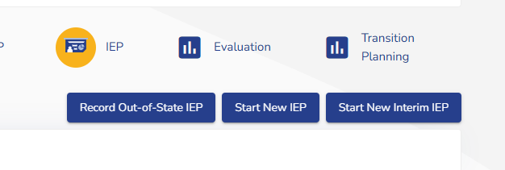
Recording Non-Iowa IEPs
When a learner has been out-of-state long enough to have a non-Iowa IEP (or never had an Iowa IEP in ACHIEVE), their IEP still needs to be recorded in ACHIEVE.
  Upload out-of-state IEP into ACHIEVE documentation stepper
An enhancement to record out-of-state IEPs for all learners will be available in 2026 (date TBD).
  The “Record Out-of-State IEP” button should only be used for learners with an approved Out-of-State Placement application.*
* or an approved Border Agreement
(Coming Soon)

Slide 29
Out-of-State State Agency Placements

Slide 30
Why are learners placed out of state by a State Agency?
The learner has significant behavioral or mental health needs that must be addressed in a specialized program.
A Juvenile Judge has ordered a child or youth to:
  Residential mental health treatment
  In-patient substance use treatment
  Specialized treatment for challenges such as an eating disorder or recovery from human trafficking

Slide 31
An IEP team does not have the authority to deny an HHS or JCS placement, even if they believe they can provide a FAPE

Slide 32
HHS and JCS Decisions
HHS and JCS make placement decisions based on the “best interest” of the child.
Any new facility must apply for approval, using the same form as facilities chosen by IEP teams.
HHS and JCS should reach out to the District of Residence when a learner is being placed out of state. The IEP team should convene to determine how a FAPE will be provided in this setting.
If there are issues communicating with HHS/JCS or an out-of-state facility, please contact the DE. If there are concerns about the provision of a FAPE in an out-of-state facility, please contact the DE.

Slide 33


HHS and JCS Out-of-State Placement Decisions
Approval by the Iowa Department of Education is required for contracts negotiated with other state agencies for the provision of special education services.

Slide 34
Process for HHS and JCS Placements
The referring agency (County Juvenile Court or County Department of Human Service) will send a copy of the court order placement to the District of Residence and AEA.
The AEA will then complete the Out-of-State application in ACHIEVE, and submit for Department of Education approval.
The Department provides a letter via ACHIEVE stating the approval/denial of the application.
An AEA designee will forward the copies of the approval or denial letter to the superintendent, and send a letter to the initial referring agency notifying the agency of their decision.
Placement occurs and an IEP team meeting is convened.

Slide 35
State Agency OOS Placement: Funding and Coding
Special education costs are billed to the District of Residence.
  HHS or JCS covers all residential costs.
  The learner’s District of Residence is billed for actual special education costs (rather than a daily rate).
The learner’s District of Residence for billing purposes continues to be the school district where the primary/biological parents are physically located.
Do not exit these learners from ACHIEVE.
  ACHIEVE Exit Code MSK (Moved States, Known to be Continuing) does NOT apply to learners placed OOS by a State agency.

Slide 36
Progress Monitoring & Meaningful Participation
Being placed into one of these settings is NOT an extended absence. Progress monitoring should continue via collaboration between the District of Residence and the attending building/program.
Learners in day programs are NOT exempted from State Assessments (ISASP or DLM).
IEP teams should plan carefully both for the learner’s eventual transition back to Iowa and their eventual transition to adulthood.

Slide 37
Legal Overview

Slide 38
The district of residence remains responsible for ensuring FAPE regardless of whether the child’s placement, in or out of state, was an IEP team placement or a placement by a state agency

Slide 39
Continuing FAPE Entitlement
This means the district has an ongoing obligation to:
monitor the student’s progress;
conduct evaluations as necessary;
make data driven decisions; and
review and revise the child’s IEP as necessary to address the child’s needs.
M.S. v. Los Angeles Unified School District, 913 F.3d 1119 (9th Cir. 2019): The district has an “independent obligation” to consider the student’s need for a residential placement regardless of whether the student had already been placed in a residential facility by a state agency.
R.S. v. Lower Merion Sch. Dist., 82 IDELR 202 (E.D. Pa. 2023): The failure to periodically review the student’s progress and changes in his needs while in an out-of-district placement

Slide 40
IEP team placements must be based on the child’s educationally related needs in accordance with the requirement of LRE

Slide 41
LRE
This means:
There is ongoing obligation to assess why the placement is necessary and the district should operate under the assumption that the student will be returning - portability test, what are we learning from this special placement
Districts should not place a student is a more restrictive environment just because it is requested by the parent
Child or family needs that do not adversely impact the child’s education performance are not valid reasons for an IEP/placement team placement
In re Richard U., 17 D.o.E. App. Dec. 20 (Iowa Dep’t of Educ. 1999): educational placement decisions may not be based on matters unrelated to the child’s ability to access a free appropriate public education (FAPE) and only the student’s IEP team is authorized to determine the educational placement the student requires.
Ashland Sch. Dist. v. R.J., 53 IDELR 176 (9th Cir. 2009) - denying placement in a residential facility when the need steamed from “risky” and “defiant” behaviors outside of school.
Edmonds Sch. Distri. v. A.T., 74 IDELR 218 (9th Cir. 2019) : to be appropriate, “residential placement must have been (1) necessary for [the student] to receive benefit from her education” and “(2) for educational purposes, rather than “a response to medical, social, or emotional problems . . . quite apart from the learning process.” (citations omitted)

Slide 42
Districts must continue to comply with procedures set out under the IDEA

Slide 43
Procedural Compliance
This means:
The necessary individuals are included in IEP team meetings, including the parent, the child, as appropriate, and a representative of facility
Educational decisions are documented in prior written notices and appropriately reflected in the IEP
Parents are provided with their procedural safeguards

Slide 44
Useful Links/Resources
Learner Reporting in Iowa | Department of Education
Addendum I: Service Provider and Type
Unique Settings (i3)

Slide 45
Questions from the Field
Please post your questions in the Q&A
Contact your RSED with any follow up questions
Slides will be posted on the DE website after the webinar
Policy & Practice Webinar Series & Recordings | Department of Education

Slide 46
Future Policy and Practice Webinars
Upcoming Topics and Dates (8:30 am - 9:30 am )
Jan. 14, 2026: Behavior and Discipline
Feb. 11, 2026: Connecting Alternate Assessment (DLM) to Instruction & Licensure
Mar. 11, 2026: Extended School Year (ESY)
April 8, 2026: FAPE - Special Requests
May 13, 2026: Dispute Resolution
June 10, 2026: End of Year Program Evaluation (ACHIEVE) and Year-to-Year Data Comparison

Slide 47
Thank You!

