Slide 1
Medicaid Updates
December 2, 2025
Notes:
Welcome - Leisa
Questions can be entered in the Q&A
Webinar is recorded and will be posted along with PPT on Iowa Department of Education School Based Medicaid website

Slide 2
Agenda
Behavior Log Requirements
Iowa Department of Health and Human Services (HHS) Audit
Audit File
Medicaid Exclusion and Sanction Checks
Local Education Agency (LEA) and Area Education Agency (AEA) Meetings
Financial Requirements
Other Information
Iowa Department of Education (Department) Consent Form
Sharing Medicaid File
Contacts
Notes:
Leisa

Slide 3
Behavior Log Requirements
Daily behavior logs are required to document the provider’s time spent supporting the learner as specified in the Individual Education Program (IEP)
Weekly behavior summaries are no longer required (effective immediately)
Updated paraprofessional documentation is coming soon
Notes:
Leisa
How this impacts school counselors and outside agencies requesting access to ACHIEVE
Impact on LEA and AEA staff

Slide 4
Compliance
Notes:
Leisa

Slide 5
HHS Audit
HHS had an audit conducted and found 45 districts were incorrectly billing transportation services
These districts will be notified by Iowa HHS Medicaid Program Integrity to complete a self audit with instructions
Self-Audit results will need to be submitted within 60 days to Iowa HHS
Notes:
Leisa
They were claiming entire routes (non eligible and eligible learners) and other things.
Leisa will notify the 45 districts impacted and additional directions will come from Iowa HHS

Slide 6
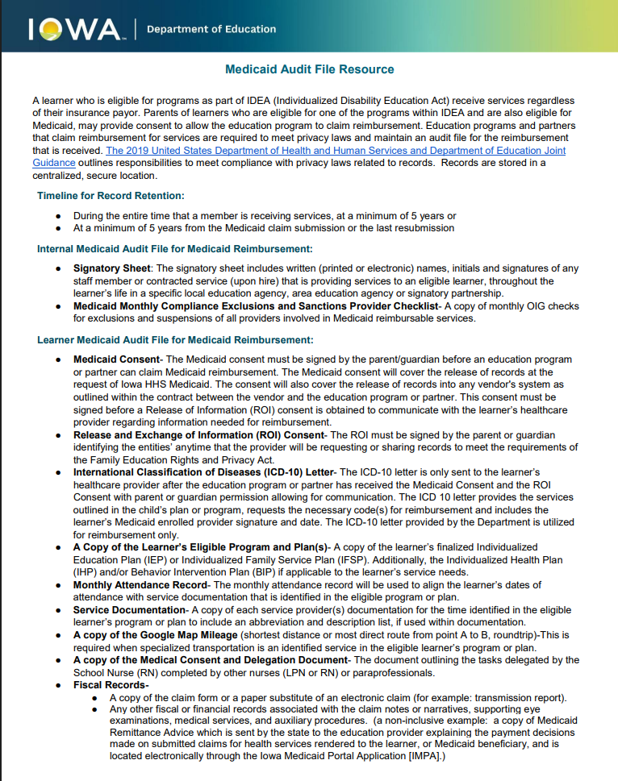
Audit File
New Medicaid Audit File Resource available on the School-Based Medicaid web page.
Obtaining an ICD 10 (International Classification of Diseases) code for LEA or AEA reimbursement is only required prior to requesting reimbursement or as required to align with changing provider services identified in the learner’s IEP
Notes:
Melissa

Slide 7
Medicaid Exclusion and Sanction Checks
This task is completed monthly by the LEA and AEA
A copy of the monthly Office of Inspector General (OIG) checks for exclusions and reinstatements of all providers involved in medicaid reimbursable services is kept in the audit file and released to Iowa HHS Medicaid if requested for program or audit requirements
Quarterly Reporting does NOT need to be sent to the Department
Resources:
Medicaid Monthly Compliance Exclusion and Sanctions Provider Template
Medicaid Monthly Compliance Exclusion and Sanctions Provider Tip Sheet
Notes:
Melissa

Slide 8
Financial Requirements
The Iowa Medicaid Portal Application (IMPA) system does not show the LEA or AEA amount of overpayment or underpayment via the invoice
Iowa HHS has the option for education agencies to make their payments electronically via an automated clearing house (ACH) deposit in agreement with the State of Iowa Treasurer’s Office and Wells Fargo (Sending a payment electronic is applied the same day and offers system-wide efficiency)
Once the LEA or AEA agree to send electronic payment, the contact below will send the Identifier number and the bank routing numbers for the individual entity
The LEA and AEA is required to use that identifier number for making payments
If you would like to set up the option to make payments electronically or find out if the LEA or AEA has an overpayment or underpayment, reach out directly to: mihneta.lisinovic@hhs.iowa.gov
Notes:
Melissa/Tashina?

Slide 9
Consent Q&A
Notes:
Shannon

Slide 10
Medicaid Consent Form
What is covered by the Medicaid Consent form?
  Both the one-page consent AND the existing Medicaid consents in ACHIEVE cover the following:
    eligibility determination,
    reimbursement of Medicaid eligible services,
    sharing records requested by Iowa HHS Medicaid, and
    release of records into a vendor's system (as outlined within the contract with the vendor and the LEA or AEA).
Note: FERPA regulations continue to require a separate release of information prior to requesting healthcare records from a child's provider for the purposes of reimbursement.
Notes:
Shannon

Slide 11
Medicaid Consent Form (con’t)
Can one Medicaid consent form be obtained to cover multiple agencies?
No, families must provide informed consent on behalf of each agency (AEA, CHSC, and/or LEA) prior to determining Medicaid eligibility and seeking reimbursement.
How often must Medicaid consent be obtained?
Prior to determining eligibility and seeking reimbursement for AEA and/or CHSC services provided to Early ACCESS learners.
Prior to determining eligibility and seeking reimbursement for AEA and/or LEA services provided to Special Education learners.
If the learner and family move and begin receiving services from a new agency (i.e., AEA, CHSC, or LEA), the new agency must obtain consent prior to determining eligibility and seeking reimbursement.
Notes:
Shannon

Slide 12
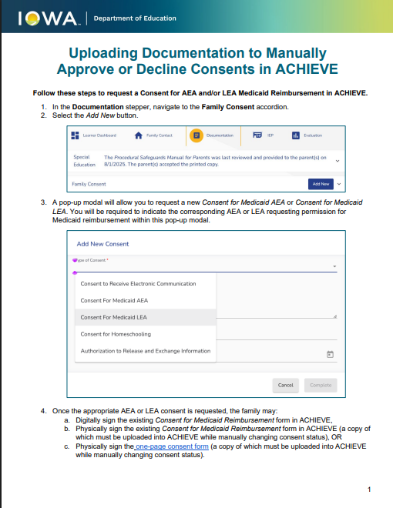
Medicaid Consent Status in ACHIEVE
To ensure learners are included on future Medicaid Eligibility reports in ACHIEVE, IFSP/IEP teams must:
Request the appropriate Consent for Medicaid Reimbursement in ACHIEVE and
Document the approval or declination of this consent.
Note: Only ACHIEVE case owners (i.e., IFSP Service Coordinators and IEP facilitators) may upload and manually change consent status.
Notes:
Shannon

Slide 13
Methods of Providing Informed Consent
Once the appropriate Consent for Medicaid Reimbursement has been requested in ACHIEVE, the family may:
Digitally sign the existing two-page consent form in ACHIEVE,
Physically sign the existing two-page consent form in ACHIEVE (a copy of which must be uploaded into ACHIEVE while manually changing consent status), OR
Physically sign the one-page consent form (a copy of which must be uploaded into ACHIEVE while manually changing consent status).
Note: If the family provides consent via option 2 or 3, case owners must manually upload a copy of the signed consent into ACHIEVE.
Notes:
Shannon

Slide 14
Previously Signed Medicaid Consent Forms
Families may have completed Medicaid Consent forms prior to launch of ACHIEVE.
Copies of these consent forms are required to be stored in the Medicaid Audit file.
ACHIEVE can only recognize consent statuses that have been electronically or manually approved or declined within the system.
In some cases, a copy of the signed consent was uploaded into the Documentation stepper. Unfortunately, this is not sufficient for inclusion in Medicaid Eligibility reports.
ACHIEVE will require an approved status for the appropriate Consent for Medicaid Reimbursement. All Medicaid consents received prior to the launch of ACHIEVE must be manually added by the case owner (IFSP Service Coordinator or IEP Facilitator).
Notes:
Shannon

Slide 15
Identifying Learners with Prior Medicaid Consent
SE-All IEPs Status Report in ACHIEVE
Column BG: AEA Medicaid Consent Approved (Yes/No)
Column BH: AEA Medicaid Consent Approved Date (most recent)
Column BI: AEA Medicaid Consent Declined (Yes/No)
Column BJ: LEA Medicaid Consent Approved (Yes/No)
Column BK: LEA Medicaid Consent Approved Date (most recent)
Column BL: LEA Medicaid Consent Declined (Yes/No)
Note: This report does not currently list the AEA or District of where the Medicaid consent form was approved or declined.
Notes:
Shannon

Slide 16
ACHIEVE Access for School Nurses
School nurses may require access to ACHIEVE to support development of Individualized Health Plans and Medicaid reimbursement processes.
Contact district Student Information System manager to initiate request for access
ACHIEVE Data Team will assign either a view-only or edit user role
  View-only: Allows users to view PDF documents
  Edit: Allows users to add/edit IEP information, including Individualized Health Plans
Notes:
Shannon

Slide 17
Next Steps
Notes:
Shannon

Slide 18
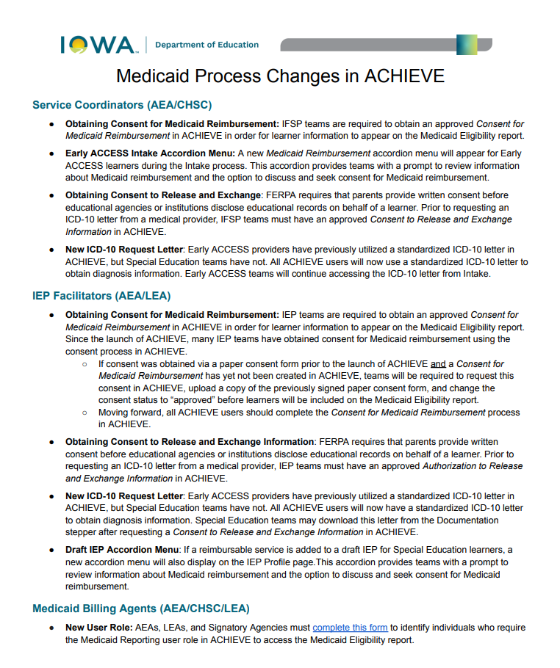
Medicaid Eligibility Information in ACHIEVE
IDOE and HHS staff meet December 3rd
  Determine next steps and timeline for release of Medicaid eligibility information to ACHIEVE and assignment of Medicaid Reporting roles
New ACHIEVE User Role:
AEAs, LEAs, and Signatory Agencies must complete this form to identify individuals who will require access the Medicaid Eligibility report in ACHIEVE
Details for Impacted Stakeholders
Notes:
Shannon
Note: If you have already signed up for the role, no need to do so again.

Slide 19
LEA and AEA Meetings
Quality Improvement Measure for LEA and AEA scheduled meetings
Issue: Prior meetings were not reaching all personnel involved with medicaid reimbursement at the LEA or AEA Level
Solution: A new meeting cadence will begin in 2026 with structured meetings that will:
  Alternate from LEA one month to AEA the next
  Provide coaching on process during the first half of the meeting
  Q and A during the second half of the meeting
  Registration will be required to attend
  Recorded meetings will be posted on the Medicaid site along with past meeting minutes
Notes:
Tashina - Discuss future school-based Medicaid website and explain that registration info will be housed here

Slide 20
Medicaid Reimbursement for BCBA Services
HHS has reviewed the role of BCBA’s and these services will soon be reimbursable.
HHS is creating additional guidance to ensure their state plan covers this service.
Notes:
Tashina

Slide 21
Contacts
Department of Education School Based Medicaid Contact
Department of Education ACHIEVE Medicaid Contacts
Position currently posted and open until December 16th
Interim: Melissa Walker: (515) 864-6701, melissa.walker@iowa.gov
Shannon Grundmeier: (515) 402-8742, shannon.grundmeier@iowa.gov
Lisa Lohman: (515) 210-9077, lisa.lohman@iowa.gov
Iowa Health and Human Services Medicaid Policy Contact
Tashina Hornaday: (515) 201-3553, tashina.hornaday@hhs.iowa.gov
Notes:
Leisa

Slide 22
Thank You!
Questions For Us

