Slide 1
ACHIEVE:
Progress Monitoring Enhancements

Slide 2
What’s Included in this Release
Enhancements include:
Goal Creation Enhancements
Progress Monitoring Redesign
Graphs and Data History Enhancements
Multiple Data Entry Enhancements
Service & LRE Section Alignment Updates
Scale Model & Comments Enhancements
IFSP Service Log and Documentation Enhancements
IEP View Page Updates (including restored View Graphs button)

Slide 3
What we will cover
We will walk through
Why the updates were needed
What changed in the system
How to use the new components
Where providers’ workflow shifts occur
What stays the same
What to look for when opening an IEP or IFSP after the release

Slide 4
Why These Changes
These enhancements improve:
Clarity for families and teams
Consistency across Iowa
Data integrity
Usability (less scrolling, fewer clicks)
Progress monitoring reliability

Slide 5
IEP Goal Creation: Updated Fields
New fields visible to providers:
Goal Nickname (Required)
Objective Nickname (Optional)
Standardized Mastery Fields:
  At/Above or At/Below
  Number of Data Points
  Goal Mastery Description
“Other” added to “Listed Assessment”
Helper text exists under several fields

Slide 6
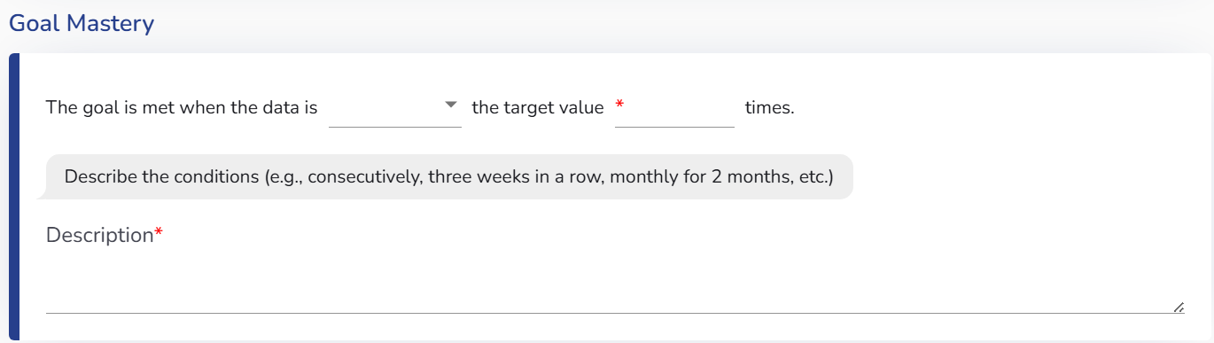
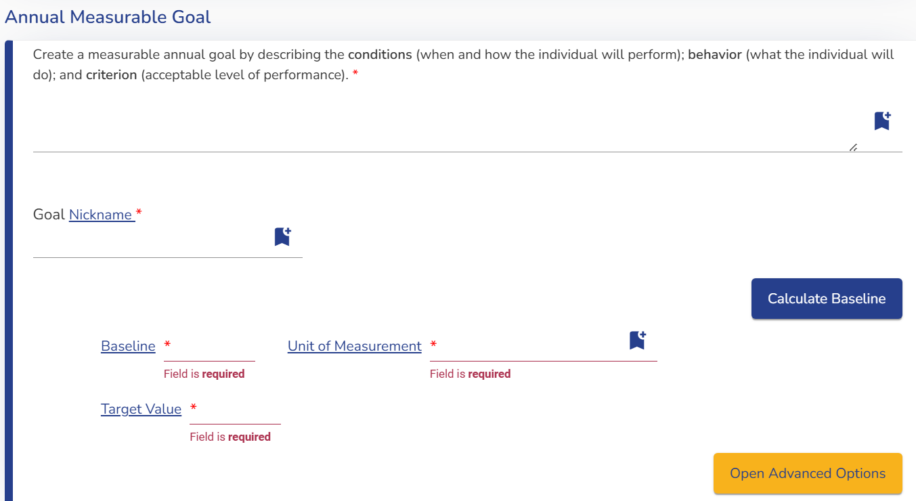
Goal, Objectives, and Mastery: What it looks like

Slide 7
What Goal Mastery Means
Goal Mastery = the specific, objective condition under which the goal is considered met.

Slide 8
Why Goal Mastery Changed
Previously:
Mastery statements varied across teams
Narrative descriptions lacked precision
Progress monitoring decisions differed
Families had difficulty understanding how mastery was determined

Slide 9
Not Decision-Making Rules
Mastery components:
Organize information
Increase clarity
Reduce interpretation

Slide 10
Deep Dive: What Goal Mastery Means
Teams must answer:
Are we increasing or decreasing something?
  Increase→ At/Above
  Decrease→At/Below
How many data points are required?
  Depends on the skill type
  Prevents “one good day” mastery
Under what conditions?
  Consecutively
  Independently
  Across Settings
  Within a timeframe

Slide 11
How do Teams Determine Data Points & Mastery Conditions
Teams consider:
Type of skill
  Discrete vs. complex
Variability of Performance
  Prevents “one good day” mastery
Frequency of Measurement
  Daily vs. weekly data collection
Teams consider:
Generalization needs
  Across people, setting, materials
Independence expectations
  With or without support
Functional use of the skill
  What mastery must look like in real life

Slide 12
Goal Mastery Examples (By Domain)
Academic (Fluency): At/Above 130 wcpm for 3 consecutive weeks.
Academic (Accuracy): At/Above 80% accuracy across 3 sessions.
Behavior: At/Below 2 incidents per week across 4 weeks.
Communication: At/Above 80% successful requests across 3 sessions without prompts.

Slide 13
Progress Monitoring: What it looks like
Providers will now see:
Cleaner accordion layout
Baseline, target, and mastery criteria grouped
Phase lines + comments aligned
Alternating color bands
Previously Entered data and Graph consolidated

Slide 14
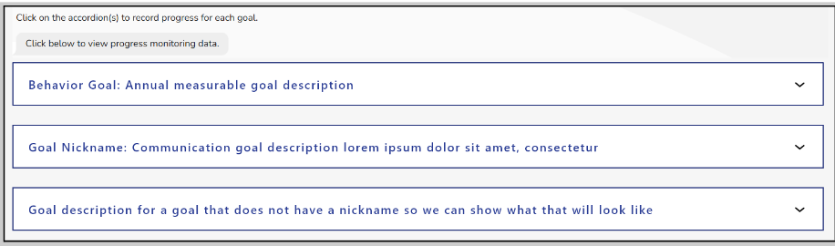
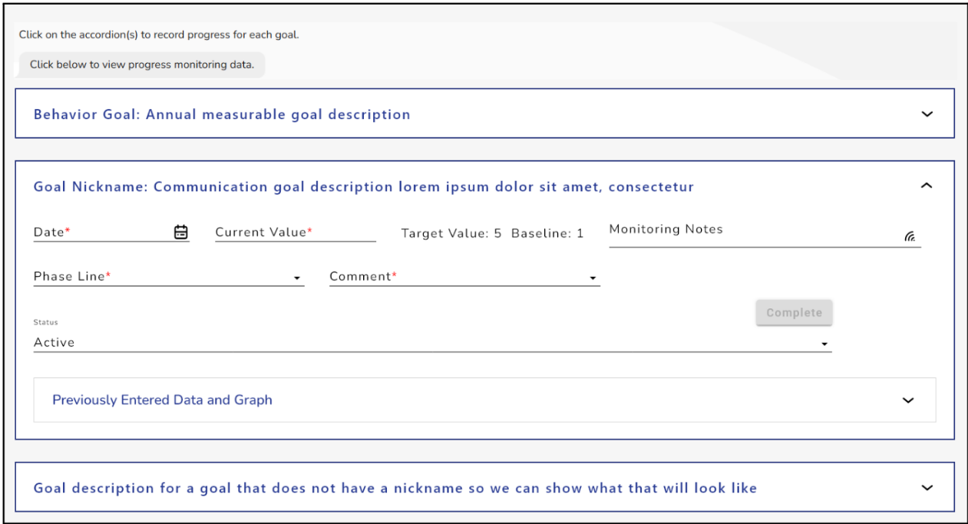
ACHIEVE Goal Enhancements

Slide 15
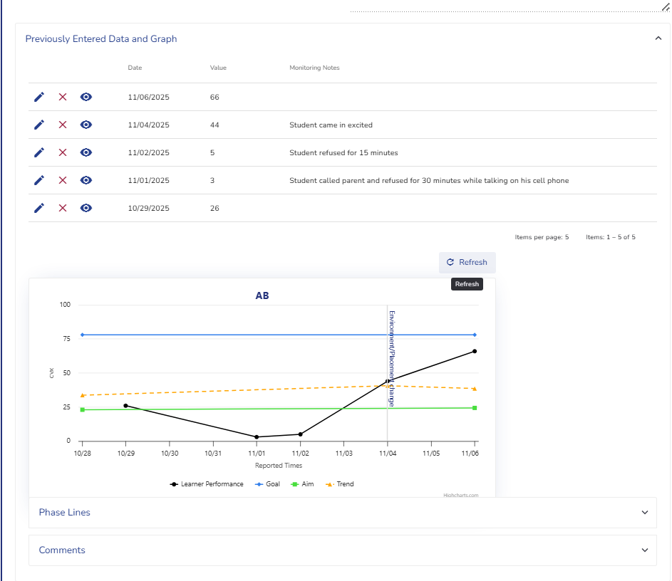
ACHIEVE Graph and Progress History

Slide 16
Progress Entry Enhancements
Updates include:
No longer required to enter a value for Phase Line and Comment
  Extended Absence Continued
  Refusal to Complete
Standardized options
Improved layout

Slide 17
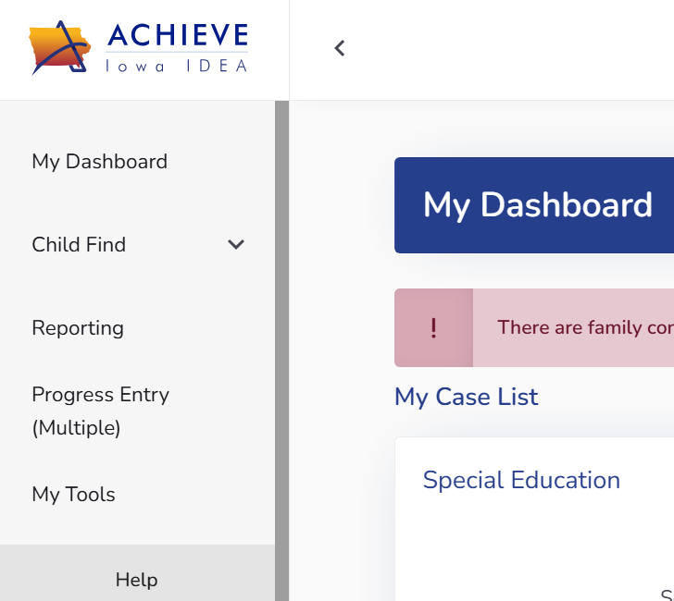
Multiple Data Entry Modal
Providers can now:
Enter multiple dates at once
Add multiple values
Add notes efficiently
Auto-generate additional data rows
View scale icons to open the goal’s scale model
Save each row individually
See last entered date for quick references
Click the Progress Entry Multiple

Slide 18

Multiple Data Entry Features

Slide 19
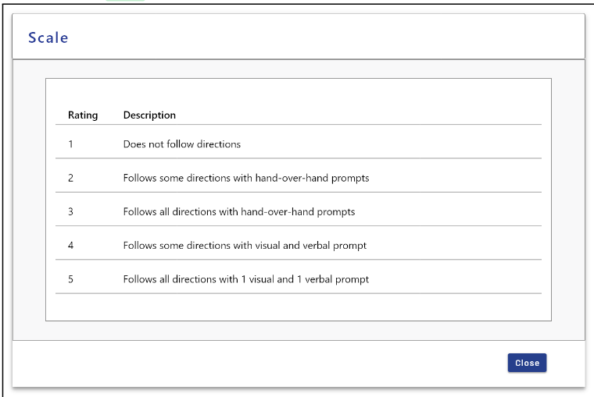
Scale Goals: Guardrails Added
ACHIEVE now prevents:
Entering values above a scale
Entering values below a scale
Scale descriptors shown in modal

Slide 20
Graphs and Data History
Providers will notice:
Goal Nickname used as graph title
Milestones shown on timeline
Full graph is now read-only
Data History now includes
  Baseline
  Target
  Monitoring criteria

Slide 21
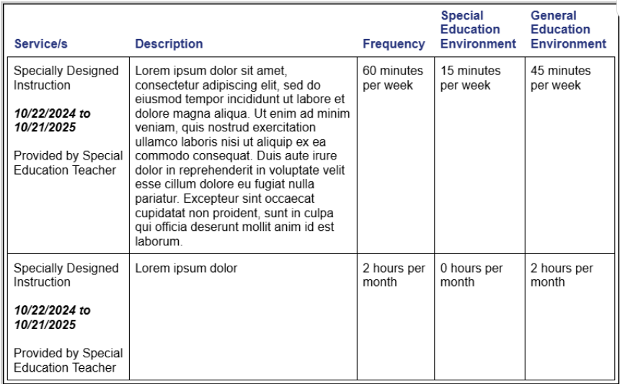
Services: Updated Layout
Changes include:
“Gen Ed Removal” renamed Special Education Environments
New General Education Environments column
Automatic environment minute calculations
Cleaner spacing and alignment

Slide 22
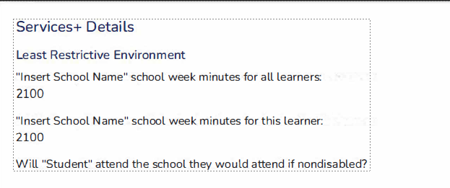
LRE: Updated View
Providers now see:
Updated layout
Updated static text
Revised output tables
New connections to service entries

Slide 23
IFSP: Service Log Updates
Changes include:
Entry through Quick Access only
View-only log entries display when opened from the main log
Editable entries available only through Quick Access
Cleaner, simpler display
Fewer clicks

Slide 24
Documentation Search Enhancements
Providers can now:
Search by title
Filter by document type (IEP, IFSP, PWN, Reports, Amendments, Meeting Notices)

Slide 25
Printed IEP Changes
Families will see:
Clearer mastery wording
Monitoring notes
Data Range
Revised Service tables
Cleaner formatting

Slide 26
Printed IFSP Changes
Families will see:
Updated service logs
Monitoring summaries
Updated title “Early Access/Special Education”
Cleaner formatting
Data ranges

Slide 27
Archive Enhancements: IEP and IFSP
ACHIEVE now automatically creates an archive version at exit
Archive includes all progress monitoring data through the exit date
Captures the plan and data as of that time
Ensures accurate records for transfers, audits, and compliance

Slide 28
Progress Monitoring Output Enhancements
Monitoring notes are now included in the printed output
Date range displayed to show which data points are included
Graphs now include a key explaining each line
Progress Reports titles now include the IEP/IFSP data range
More transparent, family-friendly and compliant reporting

Slide 29
Key Takeaways
These updates support:
Consistency
Clarity
Data integrity
Provider efficiency
Family Understanding
Accurate monitoring

Slide 30

Thank You

