Slide 1

Secondary Transition
November 12, 2025

Slide 2

Welcome
Please post your questions in the Q&A
Slides will be posted on the DE website after the webinar
Policy & Practice Webinar Series & Recordings | Department of Education

Slide 3
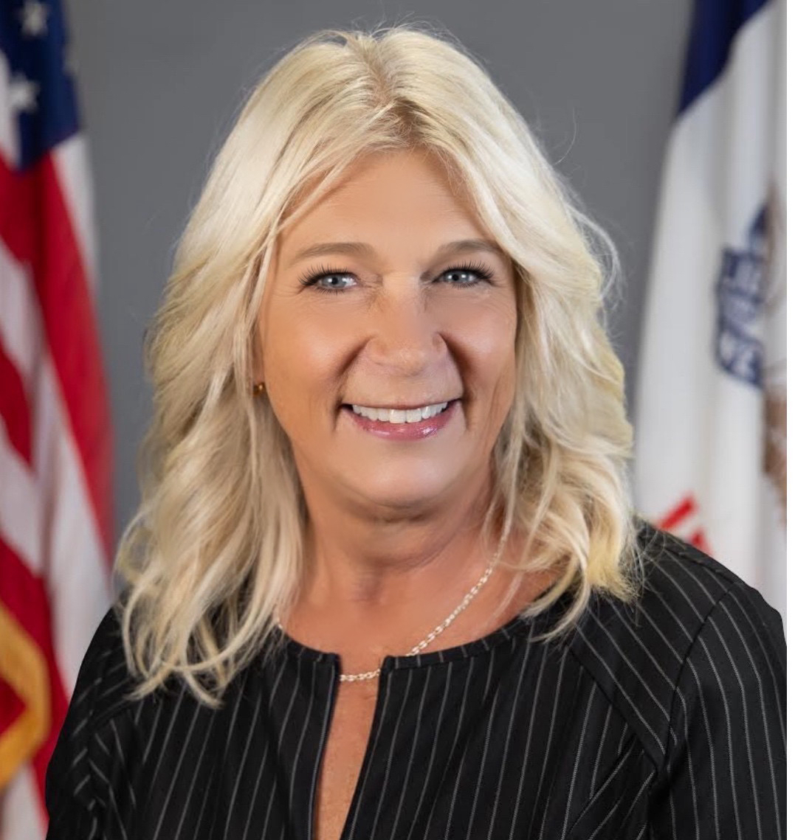
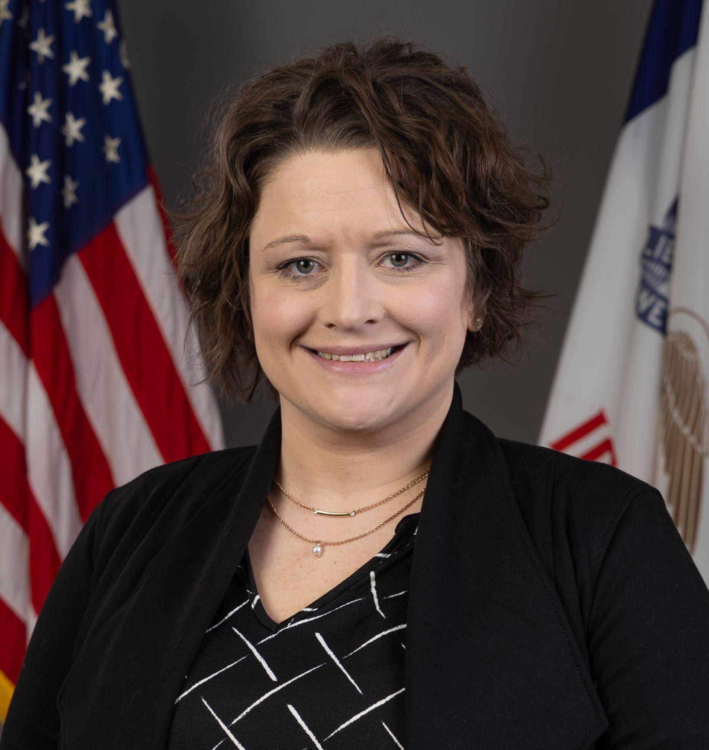
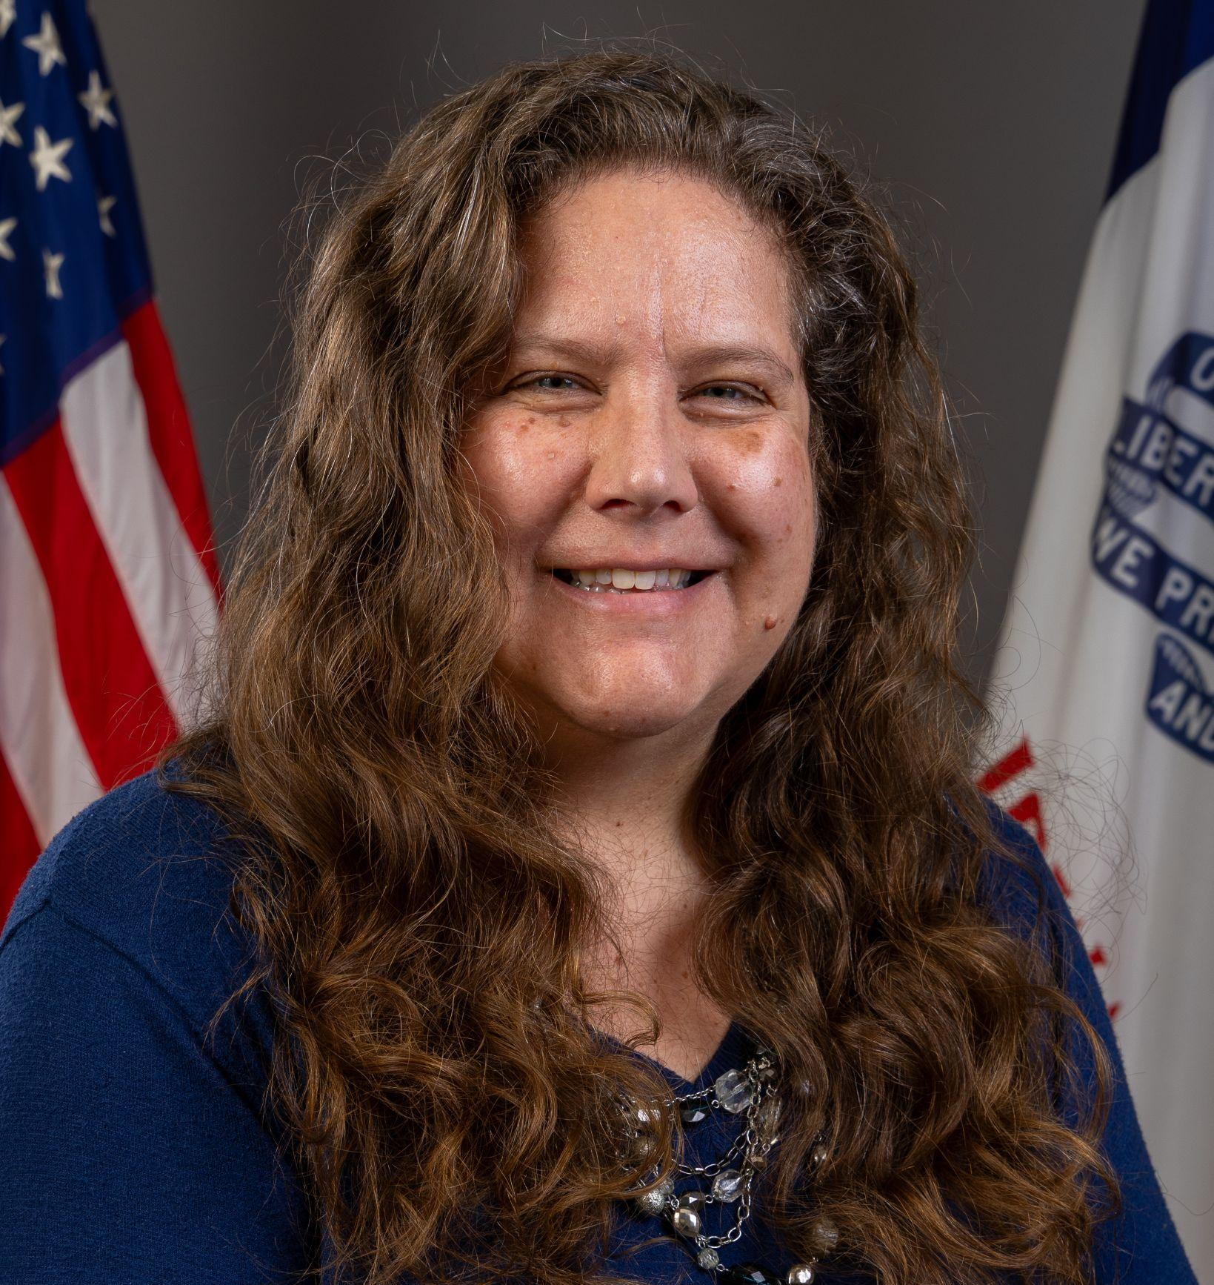
Today’s Presenters
Janel Lesan
Regional Special Education Director - Grant Wood/Interim Mississippi Bend
Division of Special Education
Kelsey Teeter
Secondary Special Education Program Consultant
Division of Special Education
Betsy Lin
Bureau Chief
Division of Special Education
Program Consultants: Jodi Johnson, Brittany Beverage, Tiffiny Poage, Mary Beilke, Dayna Willis-Champoux

Slide 4
Participants will:
Understand how district infrastructure related to Career and Academic Planning, CTE and WBL are predictors of postsecondary success for students with IEPs and how to create a system framework with existing resources
Learn how the IDEA and Indicators B13 and B14 are closely intertwined and applied in order to ensure high quality transition services, procedural compliance and improved outcomes
Familiarize themselves with recent trends and issues in the area of secondary transition at the state and national level

Slide 5
Indicator B14 - Statewide Postschool Outcomes
 | Enrolled in higher education within one year of leaving high school. | Competitively employed within one year of leaving high school. | Otherwise engaged within one year of leaving high school. | Not engaged in education or employment within one year of leaving high school.
IEP | 16% | 32% | 19% | 34%
No IEP | 55% | 19% | 9% | 11%
Averaged 3 years of data representing exit cohort years: 2020-21, 2021-22, 2022-23

Slide 6


System Connections: Creating a Strategic Framework with Key Predictors for Postsecondary Success

Slide 7
Creating a Strategic Framework to Enhance Outcomes
Identifying Gaps and Addressing System Needs
District Career and Academic Plan (DCAP)
Local School Plan (LSP)
Special Education Supports and Services
B14 Predictors to consider:
Interagency Collaboration is promising for education and employment outcomes
General Education Inclusion is a research-based predictor for education, employment, and independent living outcomes

Slide 8
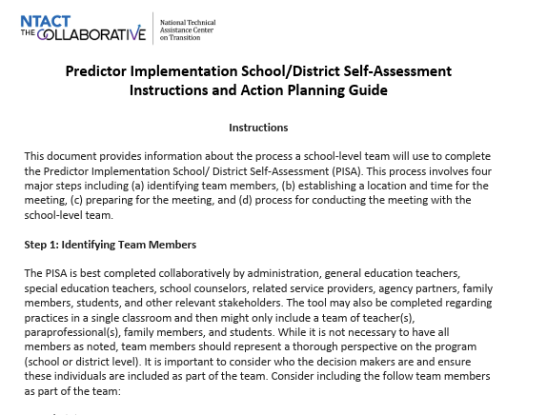
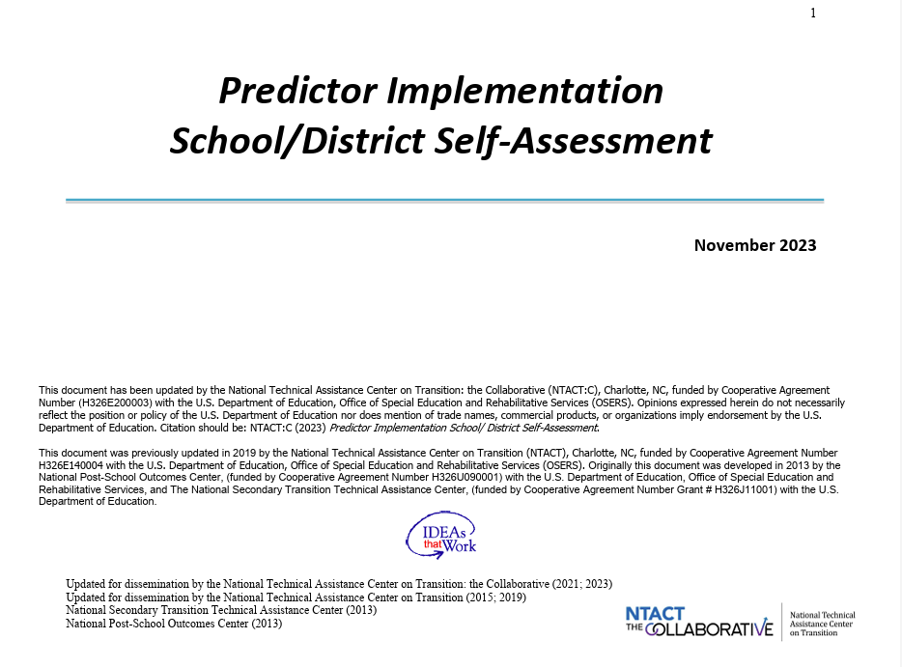
Resource: Predictor Implementation Self-Assessment (PISA)

Slide 9
Transition Services: Federal and State Regulations

Slide 10
Transition Services: Defined
  Designed to be within a results-oriented process that is focused on improving the academic and functional achievement of the child; and
  Facilitates the child’s movement from school to post-school activities, including postsecondary education, vocational education, integrated employment (including supported employment), continuing and adult education, adult services, independent living or community participation
281 Iowa Admin. Code r. 281.41.43; 34 C.F.R 300.43

Slide 11
Transition Services: The IEP
Beginning not later than the first IEP to be in effect when the child turns 14, or younger if determined appropriate by the IEP team, and updated annually, thereafter, the IEP must include:
Appropriate measurable postsecondary goals based upon age-appropriate transition assessments related to training, education, employment, and, where appropriate, independent living skills;
The transition services, including courses of study, needed to assist the child in reaching those goals.
281 Iowa Admin. Code r. 41.320(2); 34 C.F.R 300.320(b)

Slide 12
Transition Services: Individualized
Is based on the individual child’s needs, taking into account the child’s strengths, preferences and interests; and includes the following:
  Instruction;
  Related services;
  Community experiences;
  The development of employment and other post-school adult living objectives;
  If appropriate, acquisition of daily living skills and provision of a functional vocational evaluation.
281 Iowa Admin. Code r. 281.41.43; 34 C.F.R 300.43

Slide 13
Transition Services: IEP Team
If IEP meeting purpose includes consideration of postsecondary goals and the transition services needed:
The student must be invited that meeting
  If the student does not attend, other steps to ensure the student’s preferences and interests are considered
A representative of any participating agency that is likely to be responsible for providing or paying for transition services
  To the extent appropriate, and with the consent of the parents or a child who has reached the age of majority
281 Iowa Admin. Code r. 281.321(2); 34 C.F.R 300.321(b)

Slide 14
Compliance and Improved Outcomes

Slide 15

Indicator B13: Student Voice and Participation
The student was invited to the IEP meeting and the IEP includes the student’s strengths, interests and preferences.
Example B14 Predictors to consider:
Self Determination/Self Advocacy: Research-based for education and employment outcomes
Youth Autonomy/Decision Making: Research-based for education and employment outcomes

Slide 16
Indicator B13: Transition Services Provider Participation
A representative of each participating agency was invited to the IEP Team meeting with prior consent of the IDEA Parent or Student who has reached the age of majority.
Example B14 Predictors to consider:
Interagency Collaboration: Promising for education and employment outcomes
Student Support: Research-based for employment outcomes, Promising for education and independent living outcomes

Slide 17
Indicator B13: Postsecondary Expectations
Observable, measurable statements describing what the student will do after the completion of all secondary services (high school) in each postsecondary expectation area, aligned with transition assessment data.
Example B14 Predictors to consider:
Parent Expectations: Research-based for employment outcomes and promising for education outcomes
Self-Realization: Promising for employment and independent living outcomes

Slide 18
Indicator B13: Transition Assessment
Each postsecondary expectation area of Living, Learning and Working must be thoroughly assessed and used as the foundation of IEP development.
Example B14 Predictors to consider:
Career Exploration: Promising for education and employment outcomes
Goal-Setting: Research-based for education, employment and independent living outcomes

Slide 19
Indicator B13: Annual Goals
The annual goals represent relevant skills/behaviors which are well-aligned with the transition assessment information and are priorities for the student’s postsecondary expectations.
Example B14 Predictors to consider:
Goal-Setting: Research-based for education, employment and independent living outcomes

Slide 20
Indicator B13: Courses of Study, Activities, Services, and Supports
The course of study projects courses and activities, including linkages specific for the student to pursue the postsecondary expectations and there are courses, activities, services, supports and/or accommodations for every NEED identified in the IEP as a priority for the year.
Example B14 Predictors to consider:
Career Technical Education (CTE): Evidence-based for employment outcomes and research-based for education outcomes
Work-Based Learning (WBL): Research-based for education and employment outcomes

Slide 21
B14 Predictors: Supports
Provided in student’s Least Restrictive Environment (LRE)
  General education setting
  Community integrated setting
  Special Education setting
Consider and provide necessary supplemental aids and services
FAPE and Individualization: Provided in alignment with student’s strengths, interests, preferences, needs, and postsecondary expectations (PSEs)

Slide 22
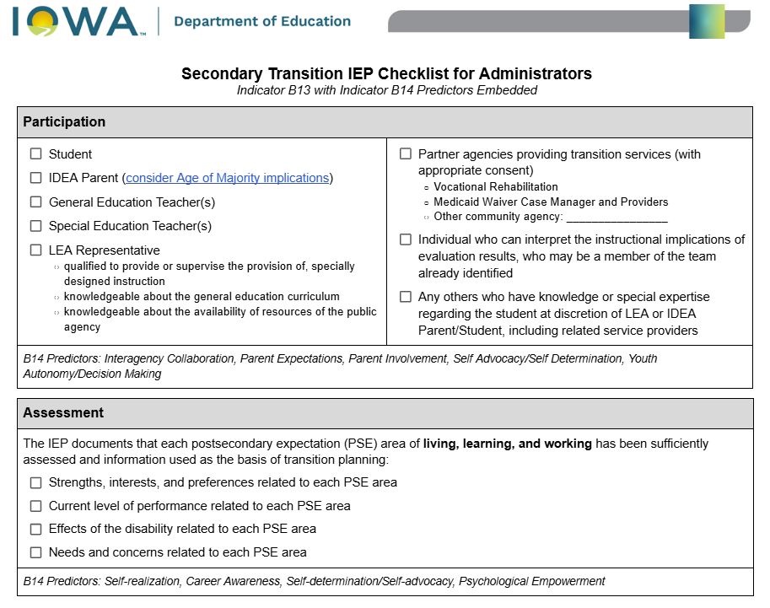
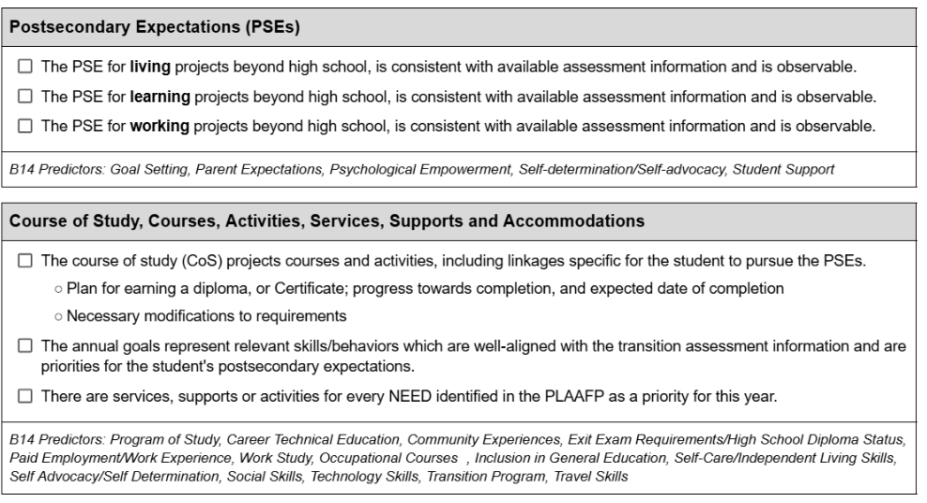
Resource: Administrator Checklist for Indicator B13 and B14

Slide 23
Before Graduating or Exiting
Analyze and triangulate the student’s data:
  Postsecondary Expectations
  Current levels academic achievement and functional performance
  Necessary skills, services, and support required for post-school success
If gaps exist, they must be addressed

Slide 24
Consideration of 4+ Services
4+ students may not be a graduate or issued a diploma until the completion of all IEP services
4+ students are secondary high school students of their resident district
District may also consider:
  Provide special education services internally
  Partner with their AEA to provide services
  Contract with another entity to provide the services
Placement vs. Location
Consideration of shortened school day

Slide 25
4+ and Postsecondary Education
4+ services are part of a district’s secondary program
A postsecondary course, if any, must be incidental to the transition services being provided
Courses, certificates, and degrees are not services
Transition may be achieved/completed without regard to any postsecondary education schedule
Department continues to conduct regular monitoring of 4+ services being provided by postsecondary education institutions
Additional guidance around 4+ services available on the Department’s Secondary Transition website

Slide 26
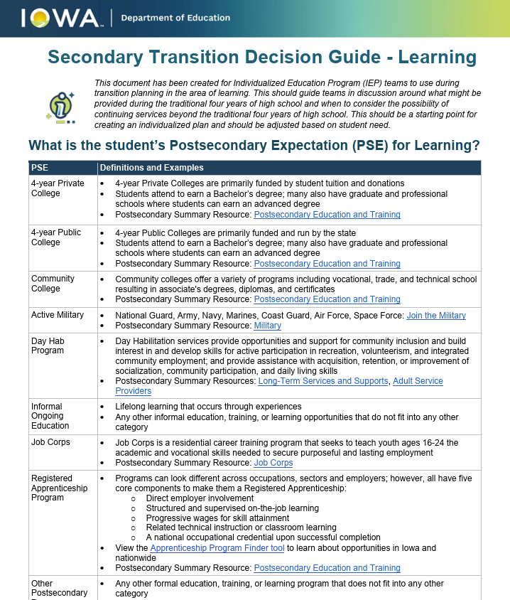
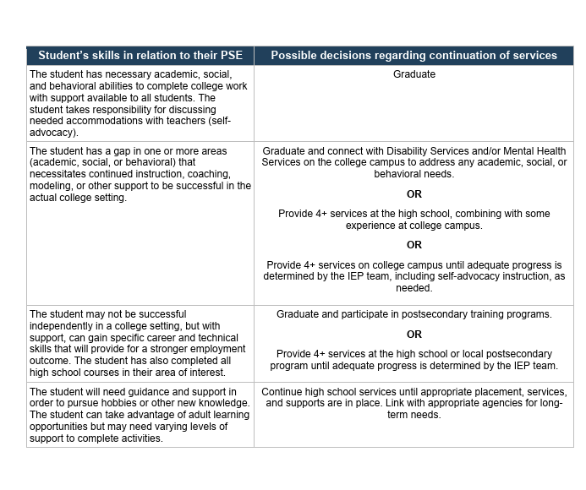
Resource: Secondary Transition Decision Making Guides

Slide 27
Recent Trends and Cases

Slide 28
Recent Iowa Focused Monitoring and State Complaint Findings
(Contracted 4+ Programs)
All IEPs within a single program contained the identical goals, rubrics, services, supports, and activities
Providing a program without a properly licensed special education teacher
Failure to enter into contractual agreements with the outside providers of special education services
Failure to offer and provide transportation to the location of off-site services

Slide 29
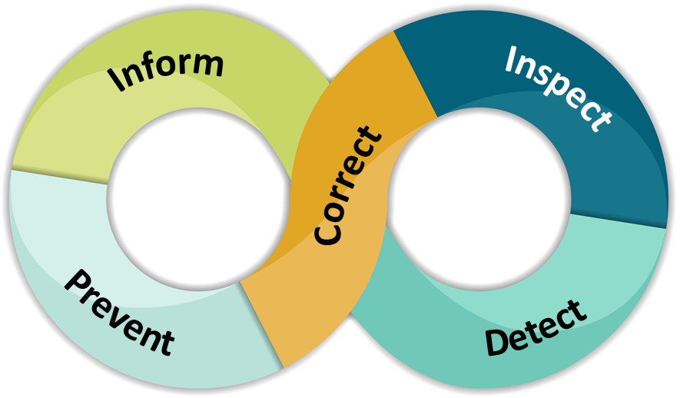
Recent Iowa Focused Monitoring and State Complaint Findings
(Secondary Transition)
Inappropriate and misaligned PSEs
Annual goals not aligned to address PSEs
Failure to provide objective, measurable PSEs that extend beyond high school
Failure to adequately identify and address skills as related to PSEs
WBL may have been provided in student’s LRE, however it was not in alignment with transition assessment results
Courses and Activities section does not plan or provide for any current or future needs, course of study not updated annually

Slide 30
Case Law:
Kass v Western Dubuque
(No. C21-1013-LTS-KEM 11/8/2022)
(District prevailed)
  4+ programming in the IEP provided for a school day of 3.25 hours with the following services: SDI, Work-Based Learning, and transportation.
  The District included the student’s Waiver Case Manager and Vocational Rehabilitation Counselor in IEP team discussions so as to arrange services in the community to address unmet transition needs
  Parent requested a full day of school for continued instruction in core academics and other general education courses.
  District took parent’s request into account, but ultimately rejected based on student having met all graduation requirements and only unmet transition needs in the area of employability and adaptive behavior.
  ALJ found that IEP goals, SDI and progress measures for those needs complied with IDEA.
  Parents appealed to the 8th Circuit, they affirmed ALJ’s decision

Slide 31

Questions from the Field

Slide 32
Thank You!

