Slide 1
Individuals with Disabilities Education Act: Differentiated Accountability
(IDEA-DA)
Overview
October 14, 2025

Slide 2
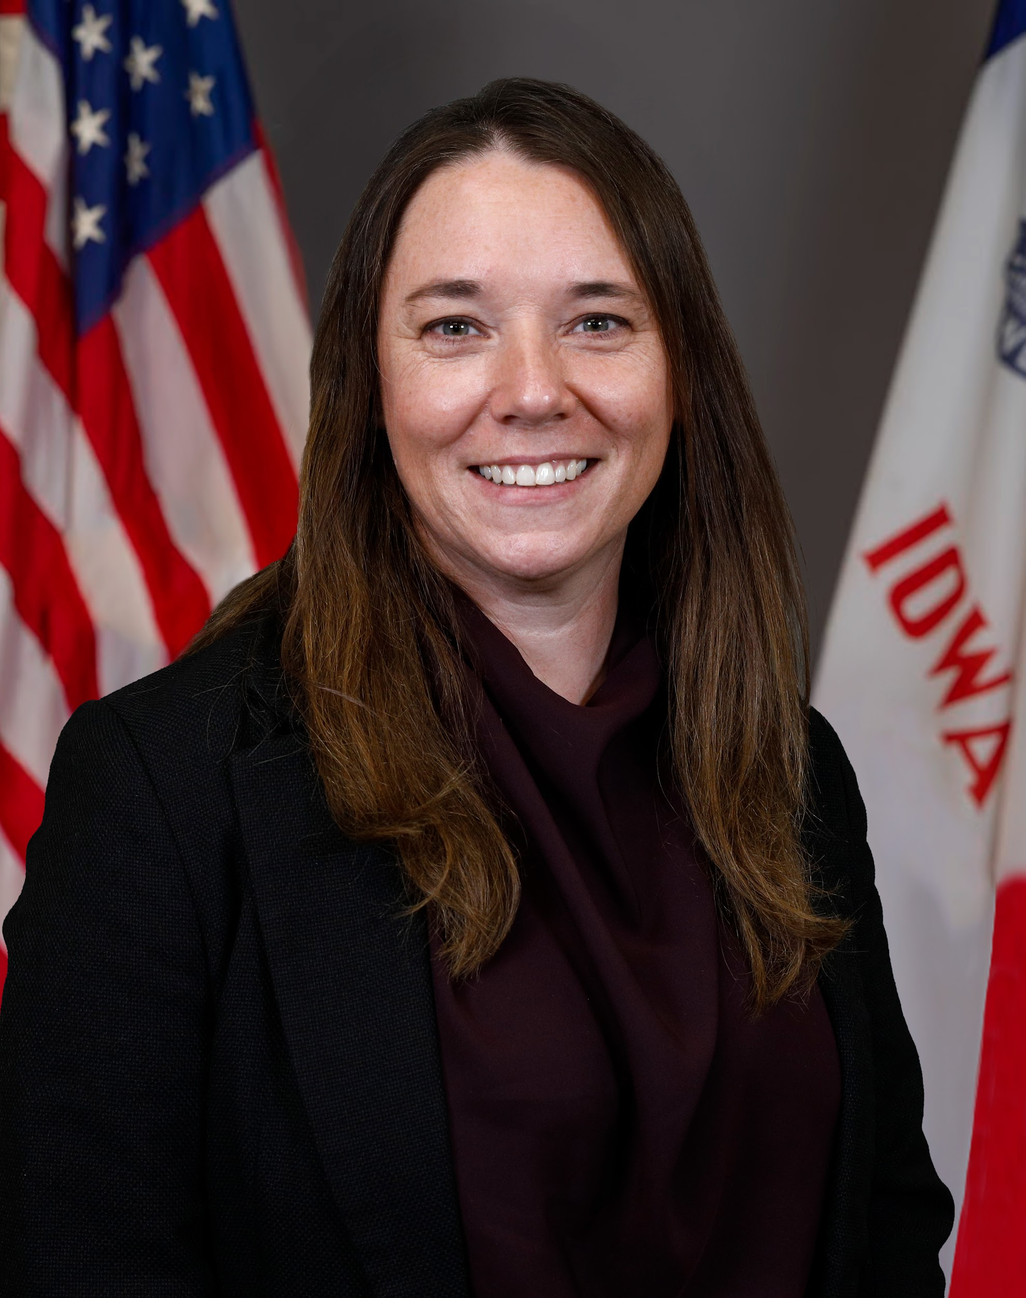
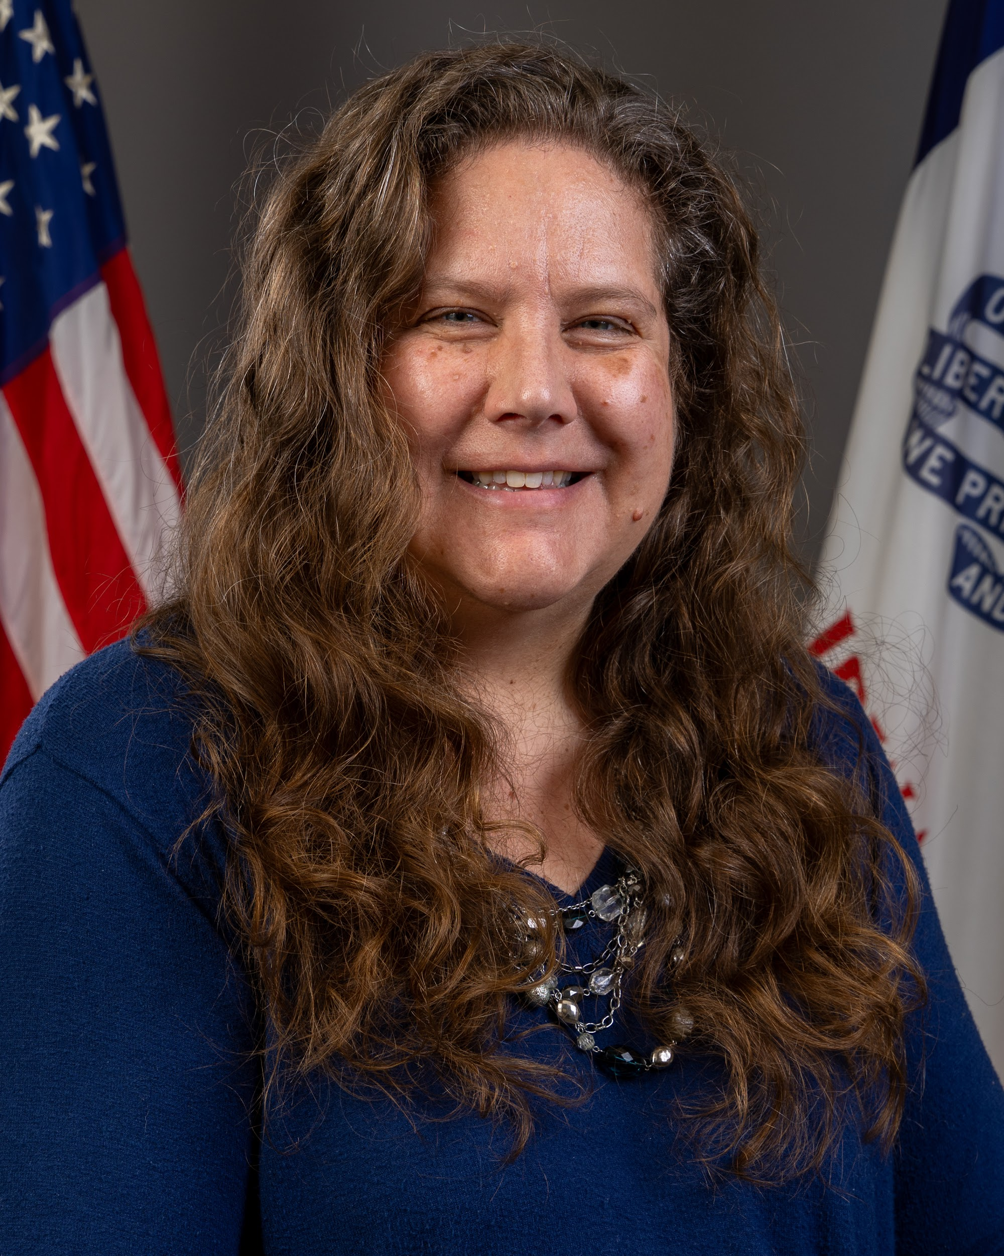
Today’s Presenters
Leisa Breitfelder
Division Administrator
Division of Special Education
Betsy Lin
Bureau Chief
Division of Special Education

Slide 3
Today’s topics
General Supervision
IDEA Differentiated Accountability Background
District Data
Support Levels
IDEA-DA Requirements and Timelines
Next Steps

Slide 4
General Supervision and IDEA-DA Background

Slide 5
General Supervision
One of the most important responsibilities of a state education agency (SEA) under the Individuals with Disabilities Education Act (IDEA) is to ensure that each local education agency (LEA) provides students with disabilities a free appropriate public education (FAPE) that responds to their unique needs and supports them to be successful in future educational, employment, and/or independent living pursuits (34 Code of Federal Regulations (CFR) § 300.1).
States must have in place a system of general supervision that monitors LEAs’ implementation of IDEA and provision of FAPE (34 C.F.R. § 300.600).
Iowa Administrative Code:
41.600(2) Primary focus of monitoring activity. The primary focus of the state’s monitoring activities must be on the following:
Improving educational results and functional outcomes for all children with disabilities; and
ensuring that public agencies meet the program requirements under Part B of the Act, with a particular emphasis on those requirements that are most closely related to improving educational results for children with disabilities.
Emphasis added

Slide 6
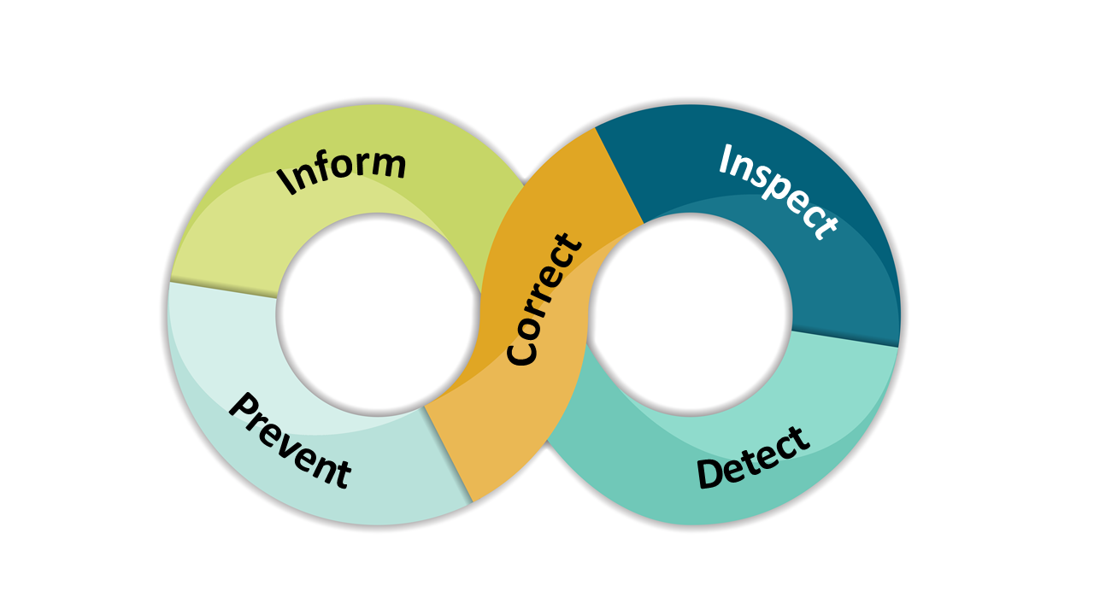
What is IDEA Differentiated Accountability?
IDEA Differentiated Accountability (DA) is Iowa’s accountability model designed to provide support for districts when and where they need it most.
Addresses IDEA requirements for primary focus on results AND provision of technical assistance in the monitoring system.
Nationally, often referenced as results-based accountability.
Designed to be a 3 Year continuous improvement cycle.

Slide 7
IDEA-DA Background
Task team began work in 2016 with representatives from districts, AEAs and DE
Developed an Implementation Support Rubric
  First partial implementation focused on B13 (% of IEPs that met secondary transition requirements of IDEA)
  Now: fully implementing the Implementation Support Rubric
  Data elements based on student results
First cycle of IDEA-DA occurred in school years 22-23, 23-24, and 24-25

Slide 8
IDEA-DA Focus Areas
Secondary Transition |  | Child Find |  | Academic Success |  | Social Emotional Behavior
Secondary Transition Outcomes Graduation Rates Drop-Out Rates Transition |  | Child Find Disproportionate Representation |  | Statewide Assessments Participation and Outcomes Early Childhood (3-5) Environments and LRE Preschool Outcomes School-Age (6-12) Environments and LRE |  | Suspension and Expulsion Preschool Social-Emotional Outcomes Attendance

Slide 9
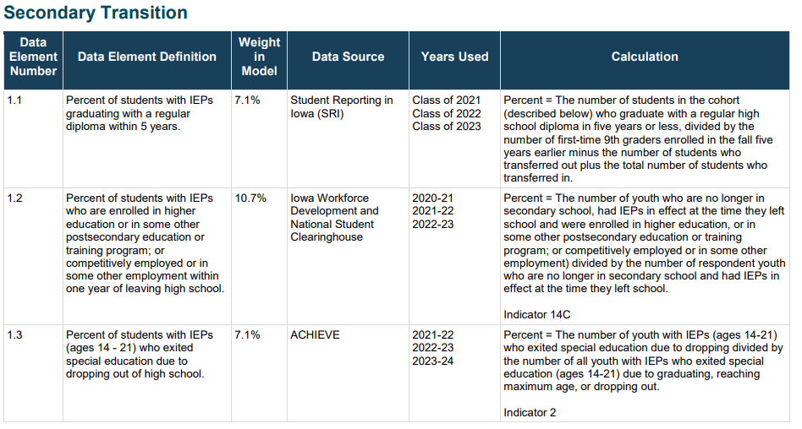
IDEA-DA Data Elements
Excerpt from IDEA-DA Data Elements

Slide 10
District Data

Slide 11
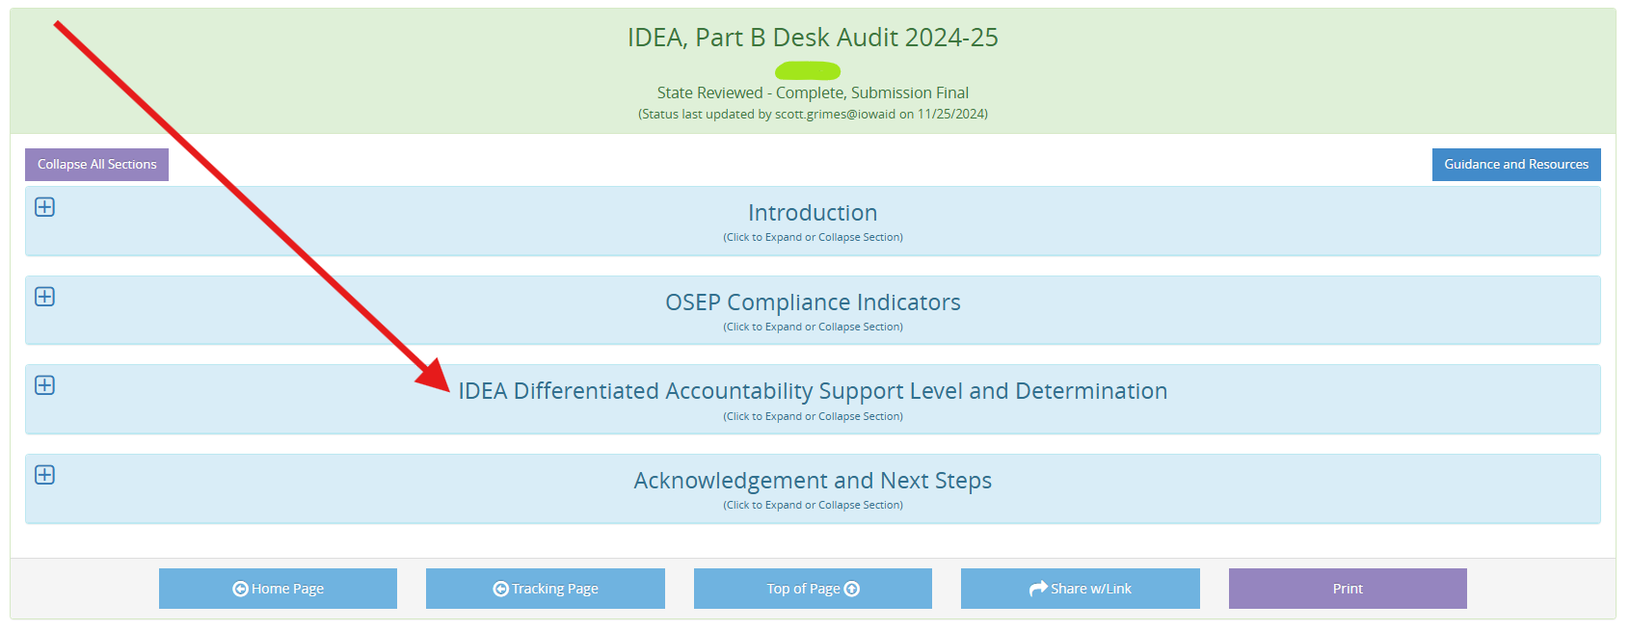
CASA: IDEA, Part B Desk Audit

Slide 12
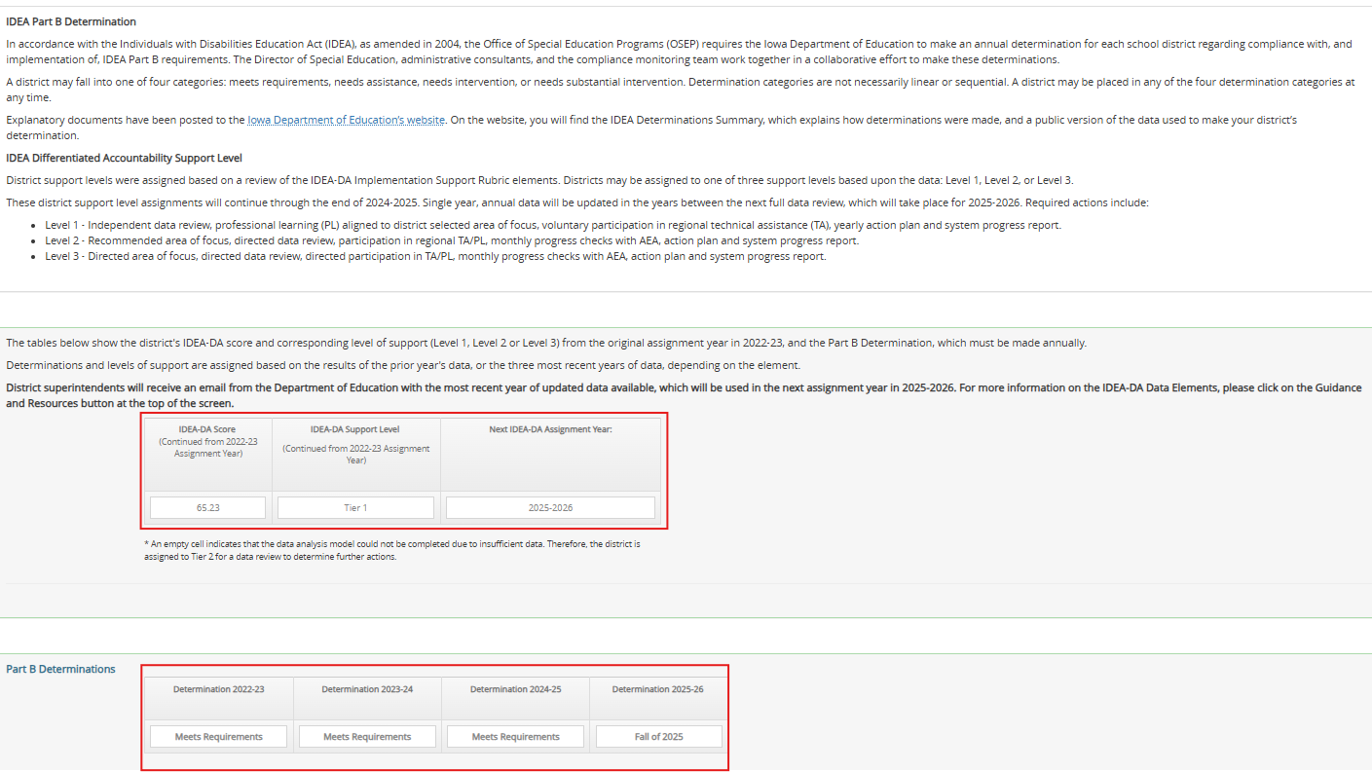
CASA: IDEA, Part B Desk Audit

Slide 13
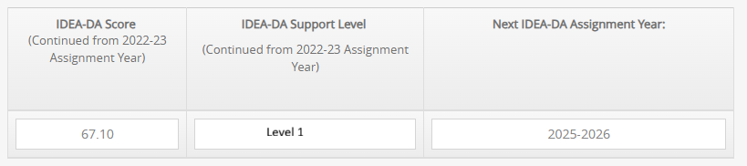
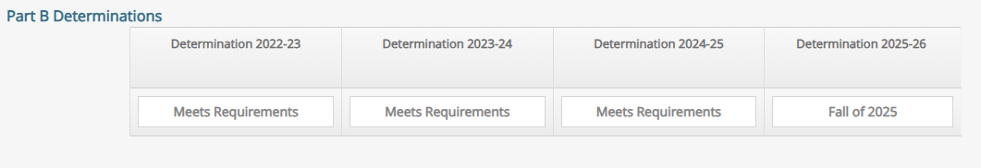
CASA: IDEA, Part B Desk Audit

Slide 14
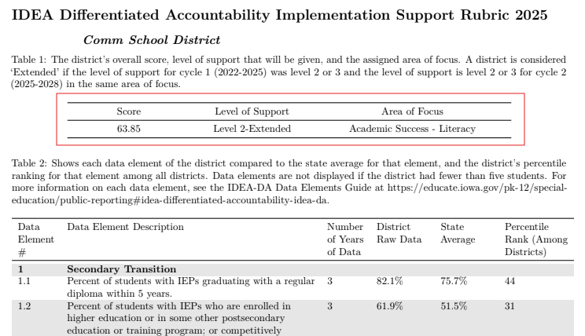
Implementation Support Rubric

Slide 15
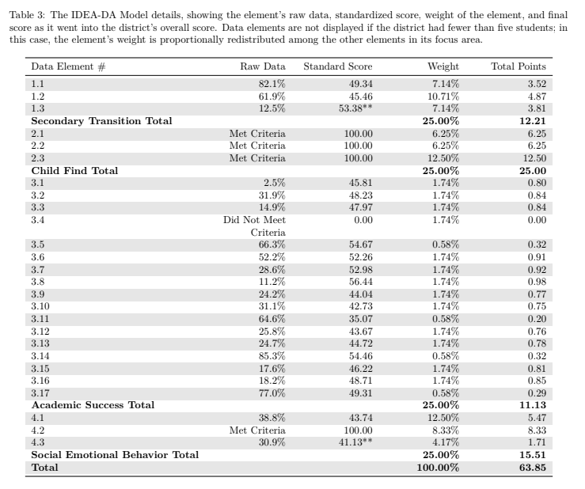
Implementation Support Rubric

Slide 16
Level of Support Assignment
Three levels of support
Lowest 10% identified as Level 3
Department identified cut-off for Level 2 based on a variety of factors
New in 2025-2026: Extended Districts
Second cycle of IDEA-DA
Addition of “Extended” to level of support
  Level 2 or 3 in the first cycle and continue to be Level 2 or 3 in the same Area of Focus for this second cycle.
Increased support and requirements

Slide 17
Results of Support Level Identification
Level of Support | Score Range | Number of Districts
Level 3 | 51.56-61.87 | 33 (including 17 Extended)
Level 2 | 62.10-65.20 | 78 (including 25 Extended)
Level 1 | 65.23-77.45 | 218

Slide 18
Area of Focus
Level 2 and Level 3 Districts receive an assigned Area of Focus (Academic Success-Literacy or Secondary Transition)
Districts in the lowest quartile with 1.2 and not 3.8 were assigned to secondary transition
Districts in the lowest quartile with 3.8 and not 1.2 were assigned to early literacy
Districts in the lowest quartile with both 1.2 and 3.8 were reviewed and assigned to an area based on a number of factors, including
  Identification of which element had a lower percentile rank
  Performance on other related elements
If results are mixed, Districts will do additional data review to determine area of focus
1.2 = Percent of students with IEPs who are enrolled in higher education or in some other postsecondary education or training program; or competitively employed or in some other employment within one year of leaving high school
3.8 = Percent of learners with an IEP who are below screening benchmark in the fall and then at/above in subsequent testing windows.

Slide 19
District Distribution across Areas of Focus

Slide 20
Change in Data: Cycle 1 to Cycle 2
 |  | Fall 2025 Support Level
 |  | Level 1 | Level 2 | Level 3
Fall 2022 Support Level | Level 1 | 173 | 42 | 13
 | Level 2 | 31 | 26 | 7
 | Level 3 | 14 | 6 | 13
 | New in 2025 | 0 | 4 | 0

Slide 21
IDEA-DA Requirements and Timelines

Slide 22
Differentiated Levels of Support
 | Level 1 | Level 2 | Level 3
Area of Focus | Select Area of Focus | Assigned Area of Focus
Data Review | Required, Data Review Protocol completed locally | Required, Data Review Protocol facilitated by DE
Implementation Plan | Required, Implementation Plan completed locally | Required, Implementation Plan facilitated by DE
Professional Learning | Participate in PL of choice, aligned to Area of Focus | Participate in required PL
Practice Coaching | Practice coaching recommended | Practice coaching 1x/ month | Practice coaching 2x/month
Systems Coaching | Not required | Bi-monthly check-in | Monthly check-in
Self-Assessments for Teachers and Coaches | FIT/CSA* Recommended | FIT/CSA* Required twice a year
Progress Report | Required at end of Years 2 and 3 | Required at end of Years 2 and 3
*FIT=Framework Implementation Tool, CSA=Coaching Self-Assessment

Slide 23
Area of Focus
Two Assigned Areas of Focus
Academic Success-Literacy or Secondary Transition
  L2/3 Districts assigned an area of focus
  “Additional Data Review Required”
  L1 Districts choose an area of focus
Additional Optional Areas of Focus
Academic Success-Mathematics
Social Emotional Behavior

Slide 24
Data Review
Data Review Protocol (DRP)
Required for ALL Districts
DRP tool in ACHIEVE, available November 2025
  Academic Success-Literacy
    K-6 Literacy, Preschool, and Significant Disabilities
  Secondary Transition
    Postsecondary Employment and Postsecondary Education
  Optional additional areas
    Social Emotional Behavior
      Learner Active Engagement and SDI Behavior
    Mathematics (not in ACHIEVE for 2025, data accessed locally)
L2/3 Districts-facilitated completion with the Department
L1 Districts-complete locally
Supporting materials will be available on IDEA-DA website
Deadline for completion: March 13, 2026

Slide 25
Implementation Plan
Required for ALL Districts
Tool in ACHIEVE, automatically uploaded to CASA upon completion
Aligned to the Area of Focus and focused on improving outcomes for learners eligible for special education
Can be revised and updated any time
L2/3 Districts: facilitated completion with the Department
L1 Districts: complete locally
Supporting materials will be available on IDEA-DA website
Deadline for completion: March 13, 2026

Slide 26
Professional Learning
Required for ALL Districts, described in the Implementation Plan
Aligned to the Area of Focus
  L2/3 Districts participate in state-approved professional learning, provided by approved Professional Learning Leads
  L1 Districts choose professional learning that will impact outcomes for learners with disabilities
Professional learning, including coaching, occurs across the three-year cycle

Slide 27
Practice Coaching
Practice coaching is coaching provided to teachers and providers, aligned to the area of focus and professional learning
  L3 Districts-practice coaching minimum of 2x/month
  L2 Districts-practice coaching minimum of 1x/month
  L1 Districts-practice coaching recommended, frequency determined locally
Supports for practice coaches
  Statewide SDI Practice Coach Network
  Communities of practice for content-specific coaching

Slide 28
Systems Coaching
Systems coaching is provided to District leadership to support the implementation plan
Provided by the Department’s Regional Division of Special Education
L3 Districts-required monthly
L2 Districts-required every other month
L1 Districts-not required

Slide 29
Self-
Assessments for Teachers and Coaches
SDI FIT (Framework Implementation Tool)
  Completed by teachers and providers participating in the professional development
  Available in ACHIEVE
  Self-assessment on the implementation of Iowa’s SDI Framework in the area of focus
SDI CSA (Coach Self-Assessment)
  Completed by coaches providing practice coaching to teachers
  Available in ACHIEVE
  Self-assessment on coaching Iowa’s SDI Framework in the area of focus
L2/3 Districts-required twice a year (fall and spring, starting in spring 2026)
L1 Districts-highly recommended

Slide 30
Progress Report
Required for ALL Districts
Completed at the end of Years 2 and 3
Annual reflection and reporting on actions and results in the Implementation Plan
Tool completed in ACHIEVE, automatically uploaded to CASA
Five Domains: Professional Learning, Coaching, Data-Driven Decisions, Leadership and the Implementation Plan

Slide 31
Extended Districts: Additional Requirements
Extended Needs Assessment and Observations
Completed before developing the Implementation Plan
Robust assessment of system strengths and needs, determine priorities within area of focus, and identify key supports needed
Systems Coaching
Minimum 1x/month
Additional intensification activities may include ongoing observations, fidelity checks, resource development and data analysis, as determined by the Regional Special Education Director
Practice Coaches
Required to attend monthly community of practice
Coaching provided individually to each teacher 2x/month
Complete coaching logs
Coaching log data reviewed during systems coaching sessions
SDI Administrator Network
Quarterly network meetings to collaborate and problem-solve

Slide 32
IDEA-DA Timelines for All Districts* (2025-2028)
 | 2025-26 |  |  |  |  |  |  |  | 2026-27 | 2027-2028
 | Oct. | Nov. | Dec. | Jan | Feb. | Mar. | Apr | May
IDEA-DA Support Levels Released
IDEA-DA Information Webinar
Data Review |  | Due March 13
Implementation Plan |  | Due March 13
Professional Learning and Coaching |  |  |  | May start as soon as 2026 |  |  |  |  | Required in SYs 26-27 and 27-28
Progress Report |  |  |  |  |  |  |  |  | Due June 30 in SYs 26-27 and 27-28
*see previous slides for additional timelines for Level 2 and 3 Districts, including Extended

Slide 33
Next Steps
Slides and Recording will be posted on the DE website
Questions will be reviewed and answers posted with the slides and recording
Level 2/3 Districts will work with their Regional Special Education Director to schedule data review and implementation planning sessions
  Extended sites will also work with the RSED to plan for their needs assessment and observations
Level 1 Districts will have access to materials to support the completion of the DRP and Implementation Plan on the IDEA-DA site (available in November)

