Slide 1

Assistive Technology (AT) &
Accessible Educational Materials (AEM)
Within the IEP

Slide 2

Welcome
Please post your questions in the Q&A
Slides will be posted on the DE website after the webinar
Policy & Practice Webinar Series & Recordings | Department of Education

Slide 3
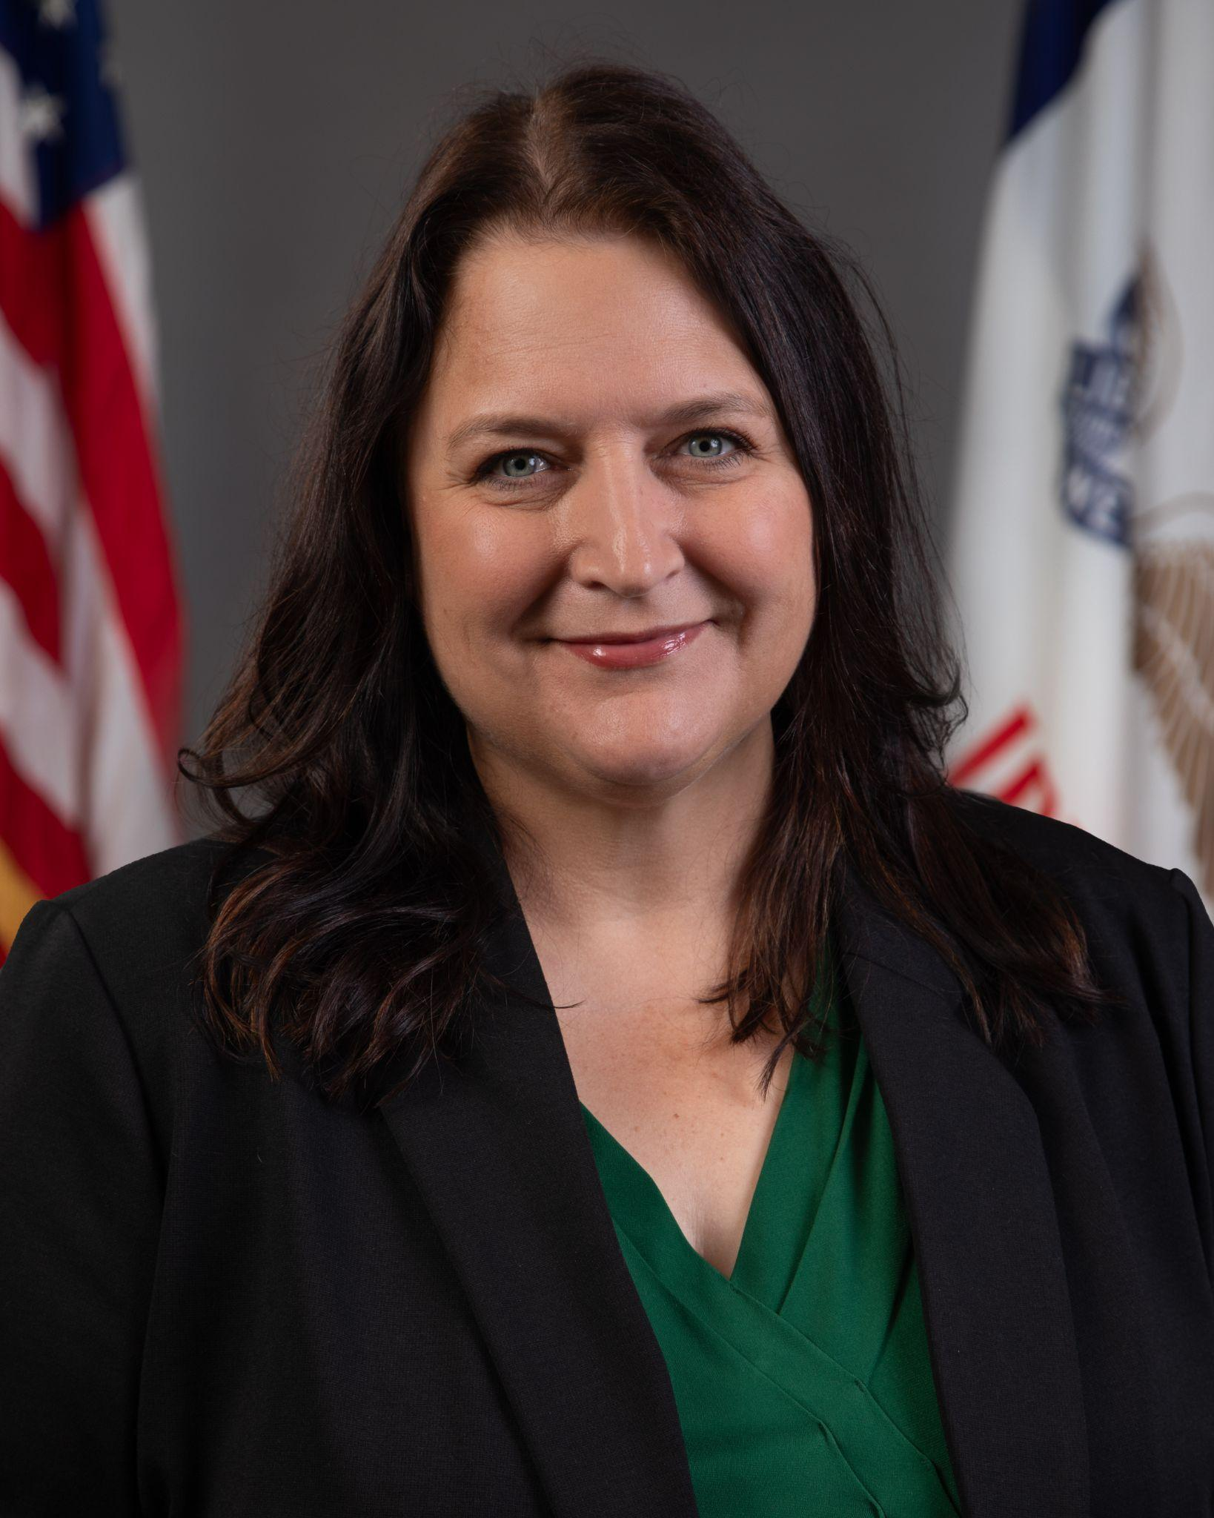

Today’s Presenters
MeLissa Lawson
Education Program Consultant
Division of Special Education
Ivan Gentry
Regional Special Education Director - Green Hills
Program Consultants: Jennifer Diers, Molly Pointer, Mary Beilke, Tori Carsrud, Dayna Willis-Champoux

Slide 4

Participants will:
Understand the definitions and implications of assistive technology (AT) and accessible educational materials (AEM) used within the Individualized Education Program (IEP)
Have an awareness of administrative policy guidance related to AT & AEM within the IEP
Understand the key components of AT & AEM to address within the IEP
Recognize various examples of AT & AEM across disciplines and domains
Know and be able to support staff in ensuring the proper documentation of AT & AEM within the IEP

Slide 5
Access and Participation

Slide 6

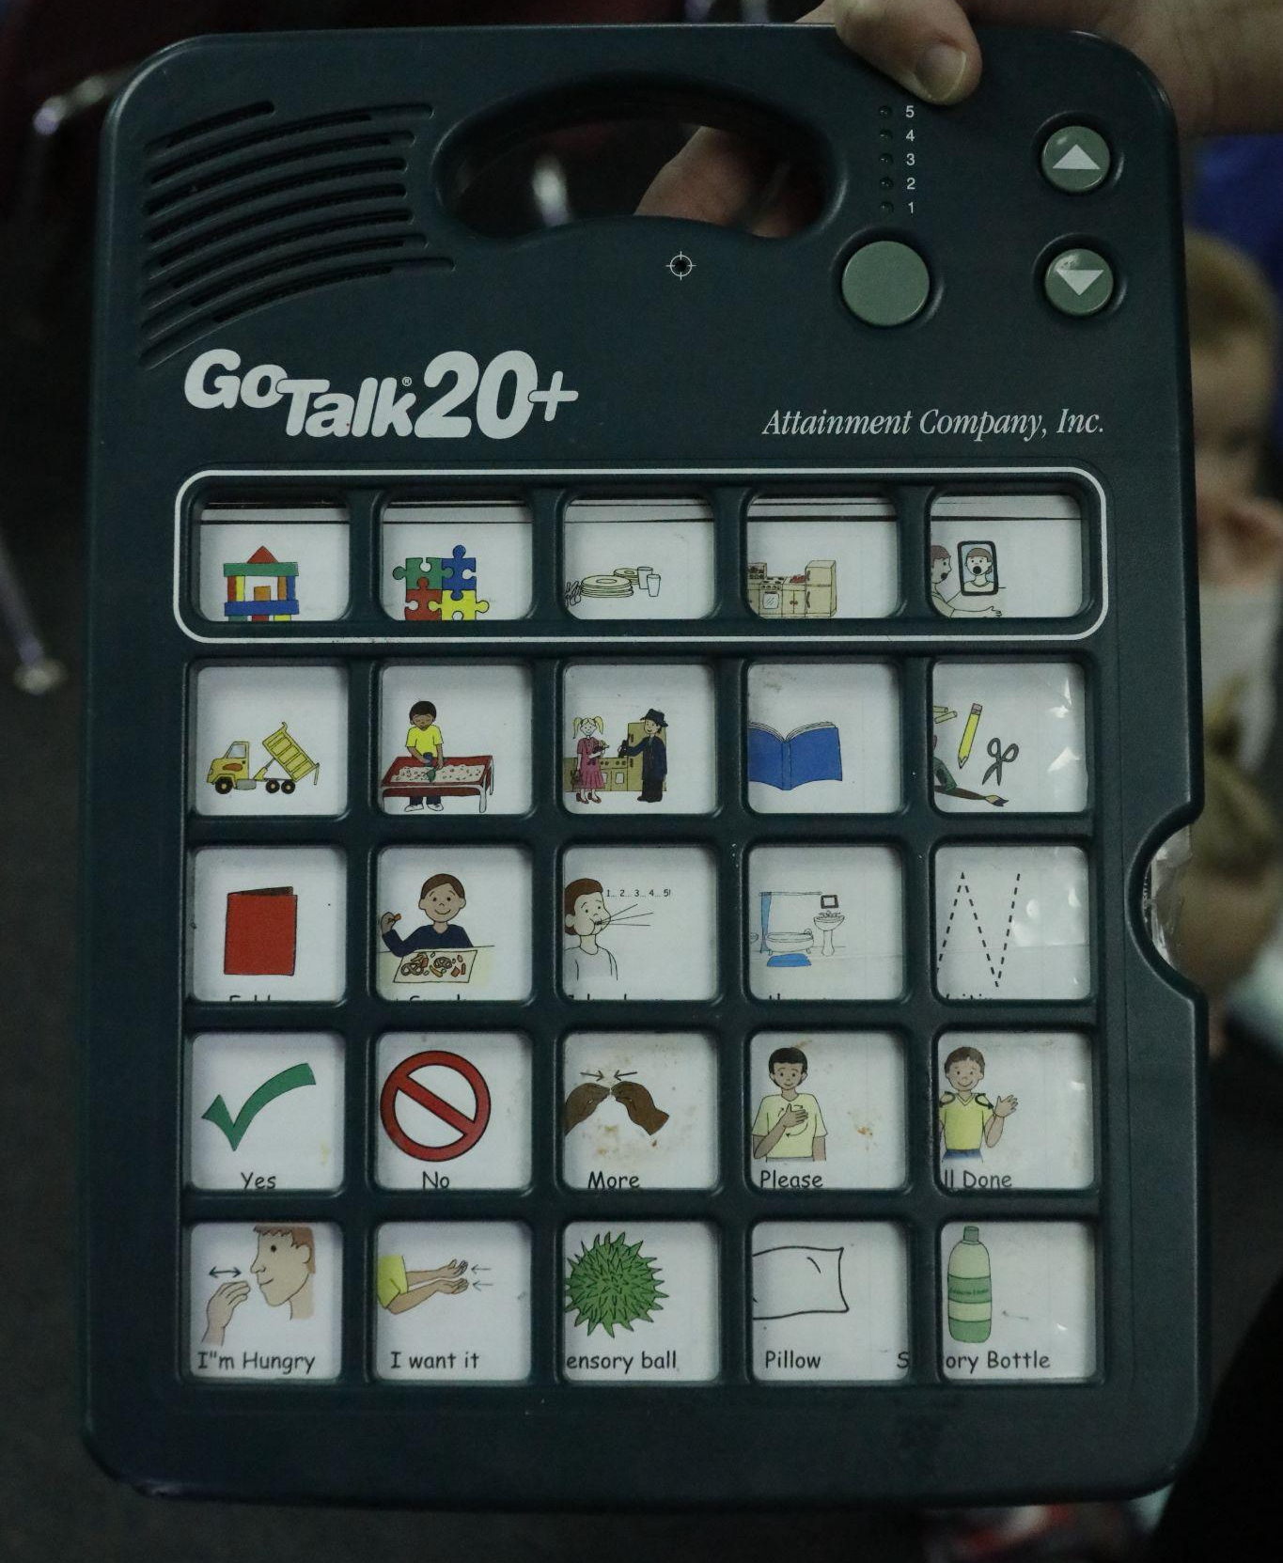
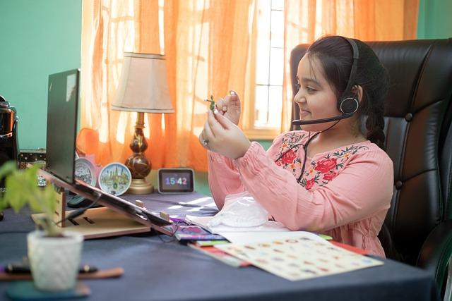
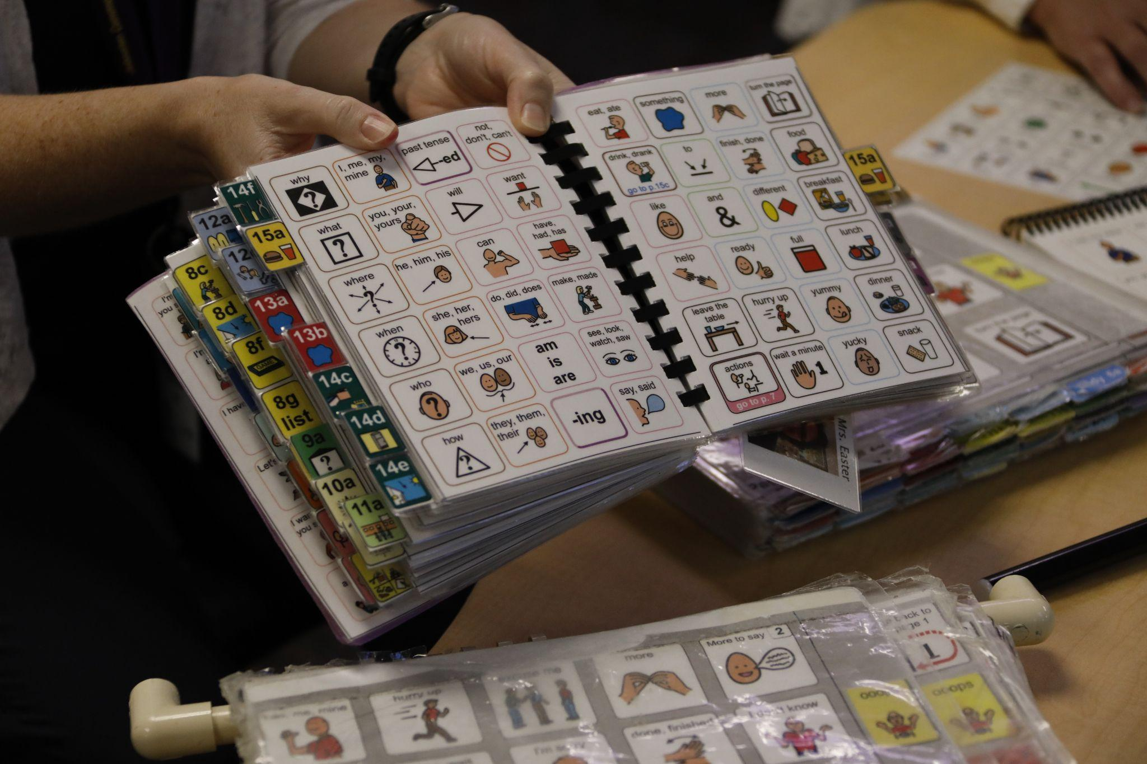

Examples of Assistive Technology (AT)
Assistive Technology supports learners in accessing and engaging with learning.

Slide 7
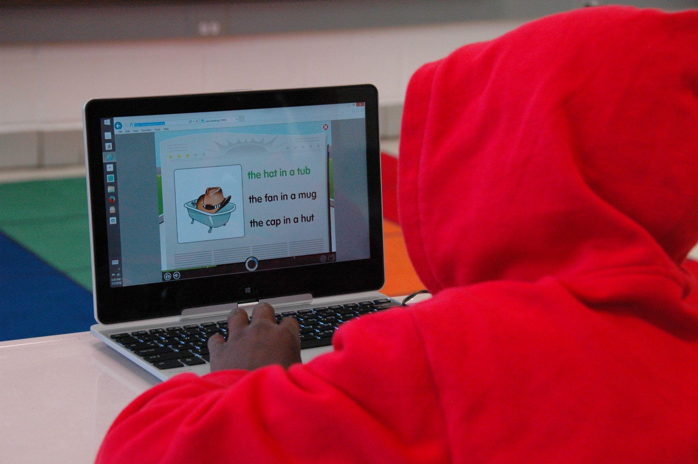
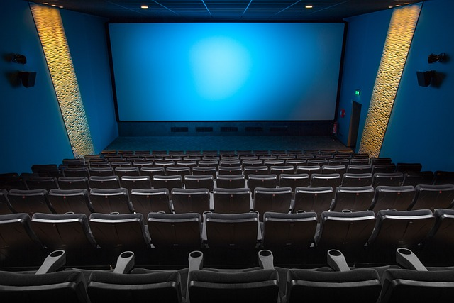

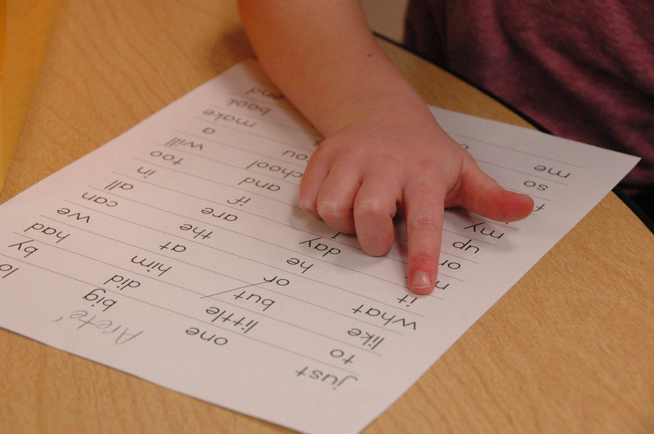
Examples of Accessible Educational Materials (AEM)
Closed Captioning
Accessible educational materials ensure content is usable for all learners.

Slide 8
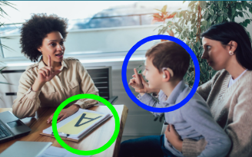
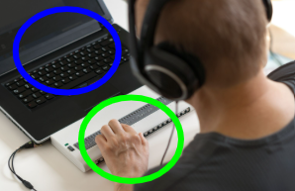

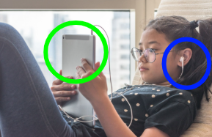
Examples of AT & AEM
Together, AT and AEM provide one option for fostering access, participation and personalized learning.

Slide 9
Policy
Assistive Technology Services, Devices & Supports
Accessible Educational Materials

Slide 10
Iowa Administrative Code (IAC)
281 — 41.324
41.324(1) Development of IEP.
b. Consideration of special factors. The IEP team must:
(5) Consider whether the child needs assistive technology devices and services, including accessible instructional materials
Development, Review & Revision of IEP

Slide 11

Iowa Administrative Code (IAC)
281 — 41.105
Assistive Technology
41.105(1) General. Each public agency must ensure that assistive technology devices or assistive technology services, or both, are made available to a child with a disability if required as a part of the child’s:
Special education;
Related services; or
Supplementary aids and services.
41.105(2) Use of assistive technology devices at home or in other settings. On a case-by-case basis, the use of school-purchased assistive technology devices in a child’s home or in other settings is required if the child’s IEP team determines that the child needs access to those devices in order to receive FAPE.

Slide 12
Iowa Administrative Code (IAC)
281 — 41.5
“Assistive technology device” means any item, piece of equipment, or product system, whether acquired commercially off the shelf, modified, or customized, that is used to increase, maintain, or improve the functional capabilities of a child with a disability. The term does not include a medical device that is surgically implanted or the replacement of such device.
Iowa Department of Education Assistive Technology

Slide 13

Assistive Technology (AT) Devices:
Communication device
Pencil grip
Slant board
Teacher microphone
Positioning support/adaptive seating
Wheelchairs
Text-to-Speech software
Word Prediction software
Speech-to-Text software

Slide 14
Iowa Administrative Code (IAC)
281 — 41.6
“Assistive technology service" means any service that directly assists a child with a disability in the selection, acquisition, or use of an assistive technology device. The term includes the following:
The evaluation of the needs of a child with a disability, including a functional evaluation of the child in the child’s customary environment;
Purchasing, leasing, or otherwise providing for the acquisition of assistive technology devices by children with disabilities;
Selecting, designing, fitting, customizing, adapting, applying, maintaining, repairing, or replacing assistive technology devices;
Coordinating and using other therapies, interventions, or services with assistive technology devices, such as those associated with existing education and rehabilitation plans and programs;
Training or technical assistance for a child with a disability or, if appropriate, that child’s family; and
Training or technical assistance for professionals (including individuals providing education or rehabilitation services), employers, or other individuals who provide services to, employ, or are otherwise substantially involved in the major life functions of that child.

Slide 15
Assistive Technology (AT) Services:
Repairing communication device
Routine checking of hearing aids
Coordinate with private service providers
Train student, family, and general education staff to use device
Evaluate student need for AT within work-based learning

Slide 16
Iowa Administrative Code (IAC)
281 — 41.172
Access to instructional materials
41.172(1) General. The state:
a. Adopts the National Instructional Materials Accessibility Standard (NIMAS) published in the Federal Register on July 19, 2006 (71 Fed. Reg. 41084), for the purposes of providing instructional materials to persons who are blind or visually impaired or other persons with print disabilities in a timely manner; and
b. Establishes the following definition of “timely manner” for purposes of this chapter: Providing instructional materials in accessible formats to children with disabilities in a “timely manner” means delivering those accessible instructional materials at the same time as other children receive instructional materials.
41.172(2) Public agencies. All public agencies must comply with rule.

Slide 17
Iowa Administrative Code (IAC)
281 — 41.210
Purchase of instructional materials
41.210(1) General. An AEA, an LEA, or any other public agency, when purchasing print instructional materials, must acquire those instructional materials for children who are blind or visually impaired or for other persons with print disabilities in a manner consistent with subrule 41.210(3) and ensure delivery of those materials in a timely manner to those children.
41.210(2) Rights and responsibilities of AEA or LEA. Nothing in this rule relieves the LEA or AEA or any other public agency of its responsibility to ensure that children with disabilities who need instructional materials in accessible formats, but who are not included under the definition of persons who are blind or visually impaired or other persons with print disabilities in paragraph 41.210(4)“a” or who need materials that cannot be produced from NIMAS files, receive those instructional materials in a timely manner.
Iowa Department of Education Accessible Educational Materials

Slide 18
Accessible Educational Materials (AEM):
Braille
Closed captioning
Digital content
Large print
Providing transcripts of audio content

Slide 19
Practice

Slide 20
Examples of AT Across Disciplines and Domains (1 of 4)
General | Teacher microphone Hearing aids Color-coded items/organizers Noise-reducing headphones Learning management systems (LMS) with accessibility tools
Literacy | Low-Tech: highlighter strips, reading guides or templates, color overlays Mid-Tech: audiobooks, electronic books with embedded talking dictionary High-Tech: text-to-speech software, digital books with built in read-aloud options, screen readers
Math | Low-Tech: number lines, tactile rulers, manipulatives Mid-Tech: talking calculators, digital timers, visual schedules, virtual manipulatives High-Tech: digital graphing calculators with or without auditory output, interactive whiteboards, math software with speech support
With the right tools, every student can succeed!

Slide 21
Examples of AT Across Disciplines and Domains (2 of 4)
Writing | Low-Tech: pencil grips, slant boards, adapted paper, graphic organizers Mid-Tech: electronic spell checkers, word prediction, portable word processors High-Tech: speech-to-text software, word processing with built in accessibility tools, alternative keyboards, writing support apps
Social Studies | Low-Tech: timelines with visuals, adapted maps, graphic organizers for historical events or concepts Mid-Tech: documentaries with closed captions, portable voice recorders High-Tech: interactive geography maps, digital timeline tools, virtual field trips to museums or historical sites
Science | Low-Tech: color-coded lab materials for sorting/organization, handheld magnifiers Mid-Tech: talking thermometers and calculators, microscopes with camera display High-Tech: interactive science simulations, virtual labs
With the right tools, every student can succeed!

Slide 22
Examples of AT Across Disciplines and Domains (3 of 4)
Music | Low-Tech: color-coded music sheets or instruments, adapted grips for drumsticks or mallets Mid-Tech: electronic keyboards with labeled keys, portable music players, digital metronomes with visual cues High-Tech: composition software, switch-adapted musical instruments, iPad music apps
Art | Low-Tech: adaptive paint brushes or scissors, templates or stencils, raised-line drawing paper, visual step-by-step guides Mid-Tech: battery-operated scissors or spinning paint tools, light boxes for tracing, adapted easels High-Tech: digital art tools with stylus or touch controls, switch-adapted pottery wheels, reality art apps for exploration and design
Physical Education (PE) | Low-Tech: bright colored or larger balls, tactile markers or floor guides, adapted handles for bats, rackets or jump ropes Mid-Tech: heart rate monitors with visual or auditory cues, electronic scoreboards or timers High-Tech: interactive video games for adaptive movement, virtual reality fitness apps, motion sensors with feedback
With the right tools, every student can succeed!

Slide 23
Examples of AT Across Disciplines and Domains (4 of 4)
Social Emotional Behavior & Executive Functioning | Low-Tech: visual schedules, first-then boards, sensory fidgets, paper planners Mid-Tech: timers with visual or auditory cues, reinforcement systems, calm-down music or location, digital calendars with or without alarms, smart pens High-Tech: behavior tracking apps, wearable tech for self-regulation, virtual reality for practicing coping strategies, task management apps, virtual assistants for reminders
Employability | Low-Tech: visual step-by-step instructions, check-off lists, communication board with work related words or phrases, ergonomic furniture (ex. standing desk), ramp/elevator Mid-Tech: portable magnifiers, single switch tools like staplers or paper shredders, digital voice recorders or voicemail transcription software, tactile graphics (Braille) High-Tech: on-site job coaching, text-to-speech software, training modules like iPrompts or Video Scheduler, wearable technology such as GPS or safety alerts
Communication | Low-Tech: communication boards or books, single-message voice output buttons Mid-Tech: speech-generating devices High-Tech: AAC devices, AAC apps, eye-gaze communication systems
Physical | Low-Tech: adapted seating, page turners or book holders, non-slip mats Mid-Tech: switch-adapted devices, portable magnifiers, hearing amplification systems High-Tech: eye-gaze or head-tracking systems, alternative mic or keyboards
With the right tools, every student can succeed!

Slide 24
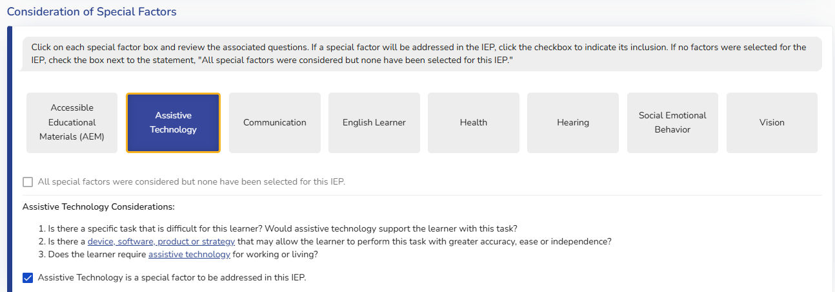
Assistive Technology Considerations:
Is there a specific task that is difficult for this learner? Would assistive technology support the learner with this task?
Is there a device, software, product or strategy that may allow the learner to perform this task with greater accuracy, ease or independence?
Does the learner require assistive technology for working or living?
Assistive Technology is a special factor to be addressed in this IEP.

Slide 25
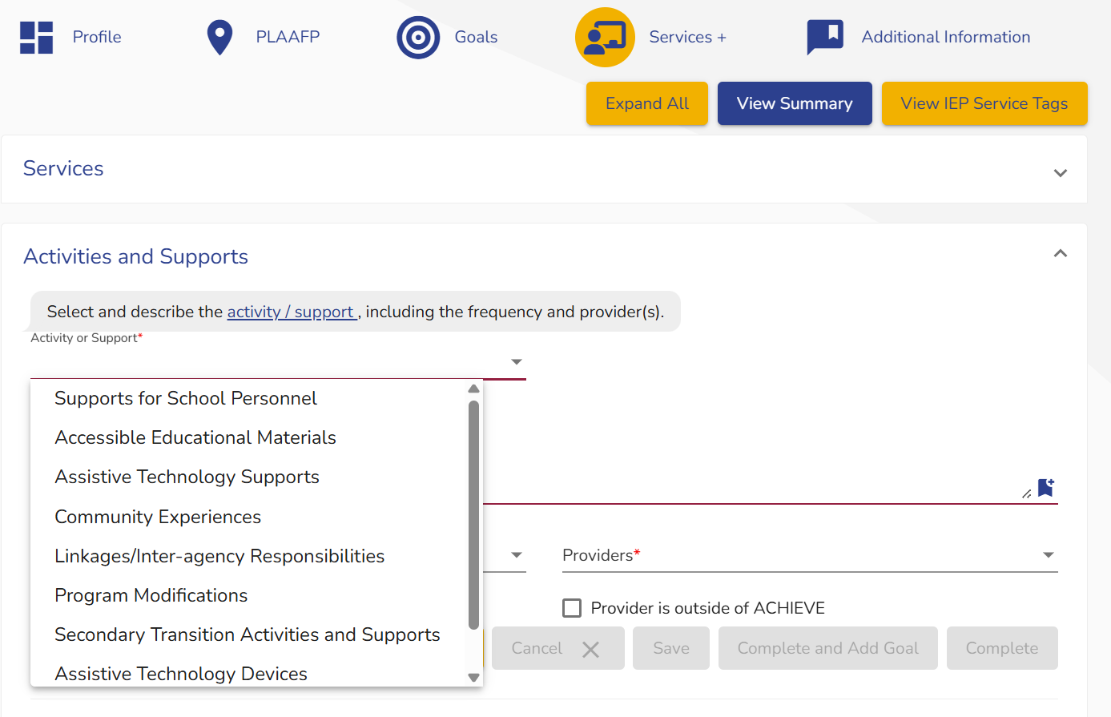

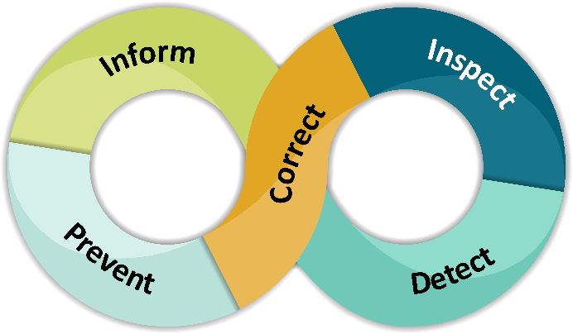
ACHIEVE Services+ - AT Devices & Supports

Slide 26
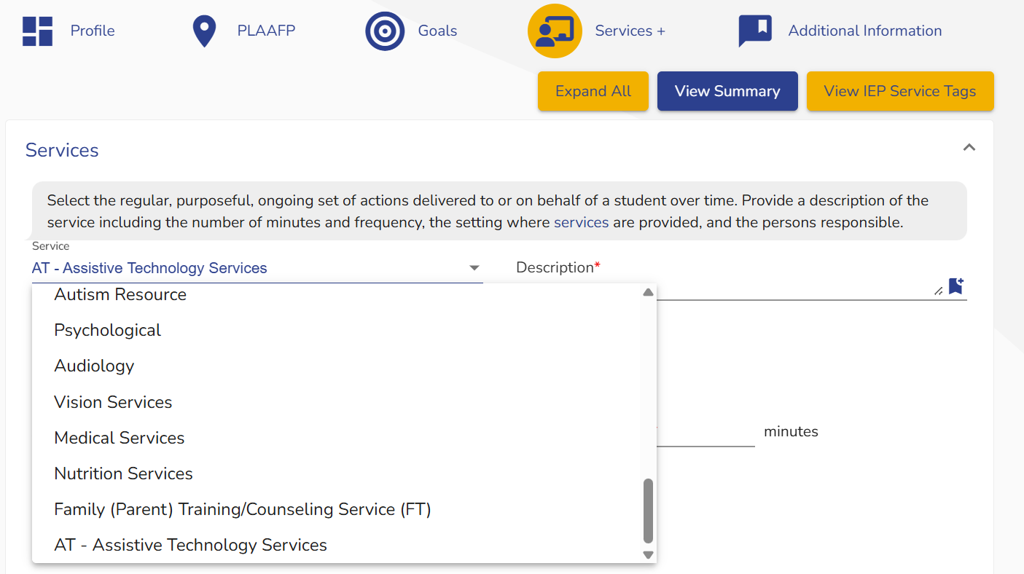
ACHIEVE Services+ - Assistive Technology Services

Slide 27
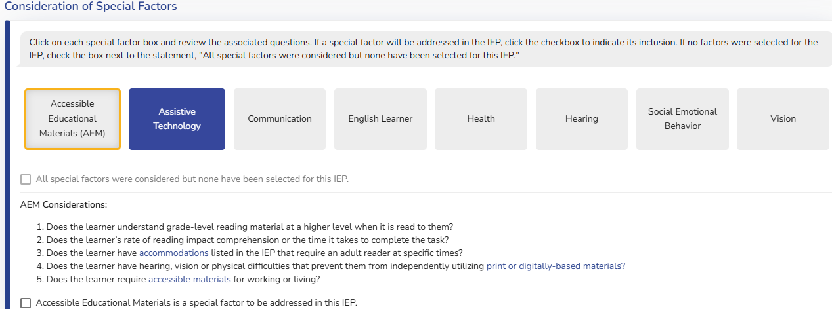
AEM Considerations:
Does the learner understand grade-level reading material at a higher level when it is read to them?
Does the learner’s rate of reading impact comprehension or the time it takes to complete the task?
Does the learner have accommodations listed in the IEP that require an adult reader at specific times?
Does the learner have hearing, vision or physical difficulties that prevent them from independently utilizing print or digitally-based materials?
Does the learner require accessible materials for working or living?
Accessible Educational Materials is a special factor to be addressed in this IEP.

Slide 28
ACHIEVE Services+: AEM

Slide 29
Administrator Think Abouts for AEM
Do the district’s curriculum adoption processes include assurances that the materials are accessible to the wide range of student needs and include the accessible formats that we discussed today? How about technology adoptions including learning management systems and instructional technology tools?
When staff are providing or creating supplemental materials for use in the classroom, do they have the knowledge and skills to ensure accessibility?
What are the district’s processes to obtain braille or digital formats when they are needed? If the district has a para that is producing braille materials, do they have the training and skills to produce quality materials?
Are the accessible materials being provided in a timely manner, meaning at the same time as peers, as required by law?

Slide 30
Useful Links / Resources
Assistive Technology FAQs
Myths & Facts Surrounding Assistive Technology Devices and Services
Assistive Technology Consideration Guide
SETT Consideration Tool (set up for copy)
Administrators’ Planner for Effective Technology Supervision and Leadership
Quality Indicators for the Provision and Use Accessible Digital Educational Materials

Slide 31
*Access for All
*the link above will take you to a recording titled: Access for All -Universal Protocol for Accommodations in Reading (uPar)
The Universal Protocol for Accommodations in Reading (uPar) identifies whether or not students benefit from a text reader to access grade level content.
  uPar Deployment Form
Read & Write software includes a text reader as well as additional reading and writing tools to support students in gaining access to grade level standards.
  Read & Write Implementation Plan
Train-the-trainer materials will be available.
  Access for All website

Slide 32
Questions from the Field
Please post your questions in the Q&A
Slides will be posted on the DE website after the webinar
Policy & Practice Webinar Series & Recordings | Department of Education

Slide 33
Future Policy and Practice Webinars
Upcoming Topics and Dates (8:30 am - 9:30 am )
Nov. 12, 2025: Secondary Transition (with Work-based Learning content) and Four Plus Programming
Dec. 10, 2025: Unique Placements (Out-of-State and Residential, PMIC)
Jan. 14, 2026: Behavior and Discipline
Feb. 11, 2026: Connecting Alternate Assessment (DLM) to Instruction & Licensure
March 11, 2026: Extended School Year (ESY)
April 8, 2026: FAPE - Special Requests
May 13, 2026: Dispute Resolution
June 10, 2026: End of Year Program Evaluation (ACHIEVE) and Year-to-Year Data Comparison

Slide 34
Thank You!

