Slide 1
LEA User Manager Training
August 8, 2024

Slide 2
Introducing Today’s Speakers
Shannon Grundmeier
Sue
Daker
Lisa Lohman

Slide 3
Background: General Supervision Tools
ACHIEVE General Supervision (Phase 2) Tools
What are they and what is their purpose?
  Continuous Improvement
  Data Collection
  Focused Monitoring
  Dispute Resolution
Where are they in ACHIEVE?
Who should have access to these tools?
Let’s take a peek!

Slide 4
ACHIEVE LEA User Manager
What is the purpose of the LEA User Manager?
What knowledge and skills does the LEA User Manager need to have to oversee this work?
What is the time commitment for the LEA User Manager to manage the roles and permissions?
What will the LEA User Manager be responsible for?
LEA User Manager Info

Slide 5

Q & A (1)

Slide 6
LEA User Manager - Start Date for Access
ACHIEVE Data Leads & Super Administrator
Assign LEA User Manager permission/location(s) to the following:
  Participants of this webinar
  Primary Contacts from CASA
  Complete this form to add new or request changes to existing staff who have previously been assigned the LEA User Manager role
Default location access of District for LEA User Manager, Primary Contact (unless specified differently).
Access will be assigned by end of the day, Thursday, August 15, 2024. If you do not already have access to ACHIEVE follow the directions on slide 8 prior to August 15th.
Notes:
Note: there can be more than one LEA User Manager per district (as needed per district decision). Additional staff must can be added via the link.

Slide 7
LEA User Manager - Contacts
LEA User Manager Primary Contacts & Additional Contacts
Add or remove additional LEA User Manager
Access will be assigned by end of the day, Thurs, August 15, 2024.
Users with LEA User Manager role can begin accessing the Administration/ User Management section once the setup is complete. It will be noted on this sheet (column I - labeled Access Assigned) when you have been setup in ACHIEVE.
Note: ACHIEVE Data Leads will continue to assign District staff the ELAA Reporting Role as well as Out-of-State Placement LEA Administrator for users right now (using the same process as before this training).
Notes:
Note: LEA User Manager Primary Contacts & Additional Contacts Sheets (broke down by AEA), column I will display date setup in ACHIEVE.

Slide 8
Access to ACHIEVE (1)
Step 1: EdPortal Account
Step 2: ACHIEVE User Role needs assigned in the District’s Student Information System (SIS)
Note: There is only one ACHIEVE user role in district’s SIS, which controls whether the user has access to ACHIEVE via EdPortal. It can be assigned at any active building in the district.
**If you do not have access to ACHIEVE currently, you will need to follow directions for step 1 & 2 prior to August 15th.**

Slide 9
Access to ACHIEVE (2)
EdPortal Account setup (step 1, slide 8)
ACHIEVE user role assigned in SIS (step 2, slide 8)
User setup in ACHIEVE with Permission(s)
  LEA User Managers - Assigns General Supervision Tools for the location requested
  ACHIEVE Super Admin or Data Leads - Assigns ‘LEA User Manager’ and all other ACHIEVE permission(s) and service(s). Note: ACHIEVE Data Leads will continue to add/update ELAA Reporting & Out-of-State Placement LEA Administrator permissions for users right now (using the same process as before this training).
Email address between EdPortal/SIS/ACHIEVE must be exact match
Notes:
In order to access ACHIEVE, all users (including LEA User Managers) need an EdPortal account, ACHIEVE User Role assigned in the District’s Student Information System (SIS), and an account in ACHIEVE that has the exact same email address as EdPortal and SIS system.

Slide 10
Tracking Staff to Assign
Keep track of staff to assign via the LEA Template - ACHIEVE GS Tools Access.
  Click on ‘make a copy’, update LEA in the document title with District name.
  Note: as other permissions (roles) are added in the future, a new tab will need to be manually added to your district’s sheet.
Determine with district leadership how the sheet above will be shared within the district (e.g., update access to edit) so that the appropriate staff can add information for the roles/locations to be assigned by the LEA User Manager.
Share the District sheet with ACHIEVE Data Leads after you have updated the title to include your District.
Notes:
As other General Supervision permissions (roles) are added to ACHIEVE, LEA User Managers will be notified.

Slide 11
Q & A (2)

Slide 12

Navigation of User Management (1)
Buttons are used to complete actions in ACHIEVE (blue buttons).
Carets show or hide other available options within a section; clicking on one shows any additional options or information available, and clicking on the caret again hides the options.

Slide 13


Navigation of User Management (2)
Drop-Down Menus are indicated by a filled caret. Clicking on one will open a drop-down menu with options specific to the field/task. Depending on the type of field the caret is connected to, making a selection could take you to another page (like the Settings) or fill in the field with the selected item. If multiple items can be selected from the drop-down menu, items chosen will have a blue background and an “X” indicating they can be removed from the field.
Quick Access Menus allow you to navigate from one section of the system to another with ease. Clicking on the menu icon brings up a list of options, and clicking on an option takes you directly to that section of ACHIEVE.

Slide 14

User Management Pagination
Pagination is located at the bottom of the User Management page. The display is ‘Items per page’ (caret will allow you to change the items per page) and the number of pages (arrows to the right will allow you to move back and forth between pages).

Slide 15
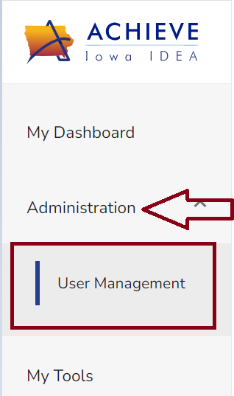
Administration/User Management (1)
LEA User Manager Role Assignment
  Assigned by ACHIEVE Super Admin or Data Lead
  Locationally defined (district OR individual buildings)
LEA User Manager will have access to Administration/User Management section (in the left navigation menu of ACHIEVE) to add new LEA staff (if applicable) and assign LEA staff within their locational setting for General Supervision User Roles.
Notes:
Note: The left nav may have other links based on other roles the LEA User Manager might have in ACHIEVE.

Slide 16

Administration/User Management (2)
LEA User Managers should not:
Add LEA staff to ACHIEVE if the user already exists in ACHIEVE (directions for ‘search’ on slide 17).
Add LEA staff solely for the purpose of access to the IFSP, IEP or any other ACHIEVE tool that is not included in the this document. Please reach out to the ACHIEVE Data Lead from your AEA for support.
Before selecting the ‘add new’ button, search active/inactive users to verify the user does not already exist in ACHIEVE.

Slide 17
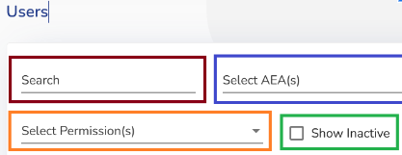
Search for Users (active/inactive) (1)
Search by: User First Name, Last Name, Email Address
  Note: Ensure the user does not already exist in ACHIEVE prior to clicking ‘Add New’ button.
Show Inactive - Displays inactive users, that can be reactivated (if the user has moved to your location).
Note: LEA User Managers will be able to view/edit ‘all’ users in ACHIEVE, but can only assign General Supervision User Roles for users within their locational assignment. It is important to search ‘all’ users prior to adding a new user to ACHIEVE to avoid duplication of users and conflicting user accounts.

Slide 18
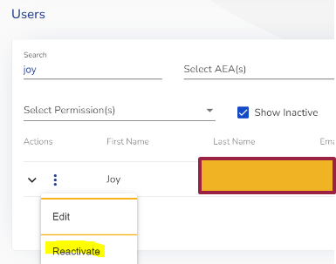
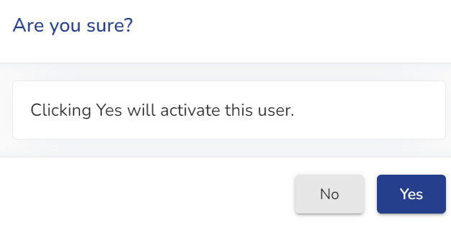
Search for Users (active/inactive) (2)
If the user already exists and is active, that record can be updated.
If the user is inactive, the account will need reactivated by selecting the ‘quick access menu’ to the left of the inactive users name.
  Search for user
  Select the ‘quick access menu’ left of users name
  Select ‘Reactivate’
  Are you sure? - select yes, if you are sure

Slide 19
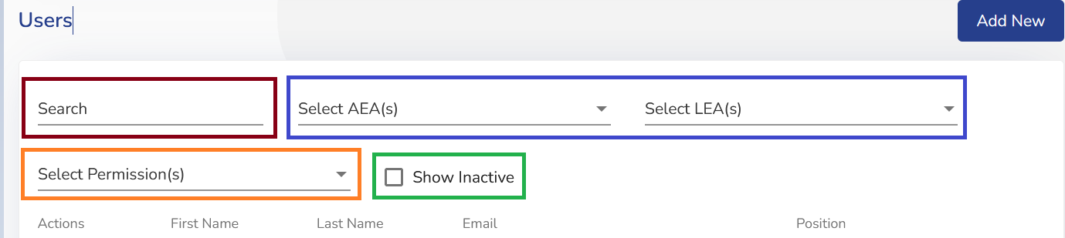
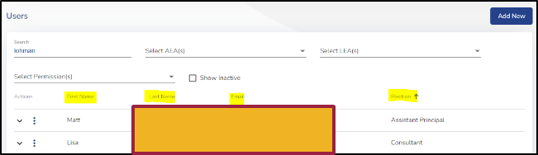
Filter Results
Filter by: AEA(s), LEA(s) - type first few letters to access specific AEA and/or LEA without having to scroll through the entire list.
Filter by: Permission(s) - to verify who has access to specific permission(s). This will be useful to verify if a user requesting access might already have access.
Sort: When a column (within table) is sortable by date or alphabet, you will see an arrow appear next to the column heading when you move your mouse over it. The up arrow means the column sorts in ascending order while the down arrow indicates descending. User management screen should be filtered down prior to sorting (smaller number of users).
Notes:
LEA User Managers would not need to filter by AEA.

Slide 20
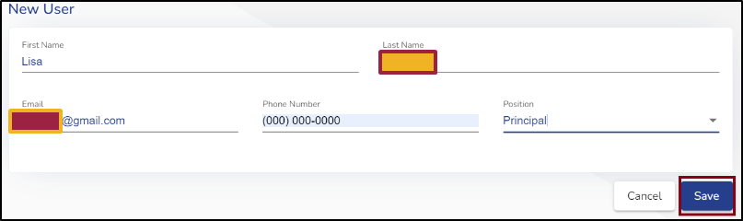
Add New Users
It is important to search all users prior to adding a new user to ACHIEVE
to avoid duplication of users and conflicting user accounts.
Add new users
  Enter: User’s name, phone number, email address, and position.
  Click ‘Save’ button
  After save is selected, use Search to locate the added user to assign permission(s) and location(s).
Notes:
Note: User information and location does not come over to ACHIEVE from Student Information Systems (SIS) and is required to save the user. If you try to add a user with the same email address as another user in ACHIEVE, you will not be able to save the record.

Slide 21
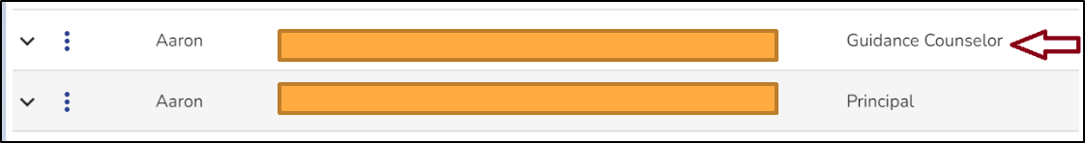
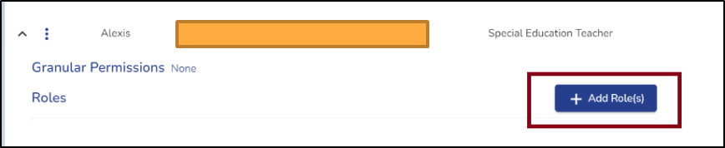
Add General Supervision (GS) Role(s)
After you have located the user (utilizing the search function), click anywhere within the user’s information to open the accordion. Select ‘Add Role(s)’.

Slide 22
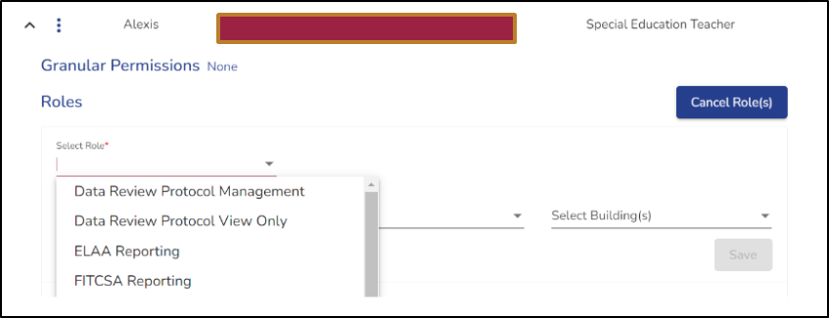
Assign General Supervision (GS) Role(s)
Choose the role that needs to be assigned.
Note: only General Supervision Roles will display in the drop-down menu to assign.

Slide 23
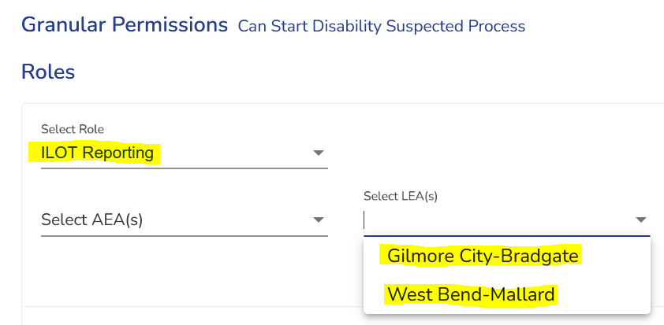
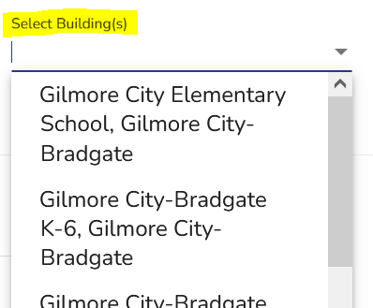


Assign General Supervision Role(s) Location
Select location (district and/or buildings) for the user; click ‘save’ to assign the role.
Cancel role button allows you to cancel prior to saving.
Note: only the location(s) assigned to the LEA User Manager will be available to assign locations to users.

Slide 24
General Supervision (GS) Role(s) (1)
Roles | Description | Location(s)
Data Review Protocol Management | Data Review Protocol (add/edit) | District
Data Review Protocol View Only | Data Review Protocol (view only) | District
ELAA Reporting Note: ACHIEVE Data Leads will continue to assign this role right now | Early Literacy Alternate Assessment (view only) | District or District/Building
FIT/CSA Access (no role needed, only an active user account) | Framework Implementation Tool/Coach Self Assessment (add/edit) | No Location is needed, only an active user account
FIT/CSA Reporting | Framework Implementation Tool/Coach Self Assessment (view only) | District or District/Building
Notes:
Note: Multiple locations can be added for a role.

Slide 25
General Supervision (GS) Role(s) (2)
Roles | Description | Location(s)
Implementation Plan Management | IDEA DA Implementation Plan (develop/edit) IDEA DA Implementation Plan (view only once plan is submitted) | District or District/Building
Implementation Plan Progress Monitoring | IDEA DA Implementation Plan (progress monitoring) | District or District/Building
Implementation Plan Reporting | IDEA DA Implementation Plan (excel reports only) | District or District/Building
ILOT Reporting | Iowa Literacy Observation Tool (view only) | District or District/Building
Notes:
Note: Multiple locations can be added for a role.

Slide 26
Q & A (3)

Slide 27
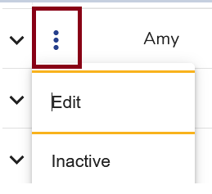
Quick Access Menu for User Record
Quick access menu is left of the user name.
Edit: Allows the user record to be edited if the user has changed locations, email address, name, phone number, or position.
Inactive: Allows the user record to be made inactive in the event the user leaves the agency or if the user was accidentally added.
  Do not ‘inactivate’ a user with assigned roles the LEA User Manager is unable to edit.
Note: If a user moves into your location from another location in Iowa and you are updating that record, please work with the other agency’s ACHIEVE Data Lead and/or LEA User Manager Primary Contact to ensure that they have removed access for their location.

Slide 28
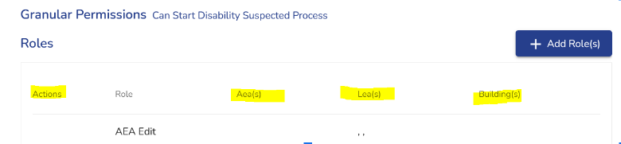
No Quick Access Menu for User Roles
LEA User Managers will only be able to edit/delete roles (via the quick access menu) within their locational assignment. There will be no quick access menu to the left of the role to edit/delete if the role location is outside the LEA User Managers locational assignment.
Note: It is important that when adding role(s) that you include the location(s) prior to saving the role, otherwise you will not be able to edit/delete that role. In this case, an ACHIEVE support ticket (slide 33) would be needed to add the location or edit/delete the role.
Notes:
Share example. Reach out to your ACHIEVE data lead if you have questions.

Slide 29
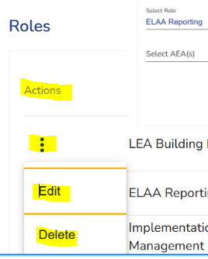
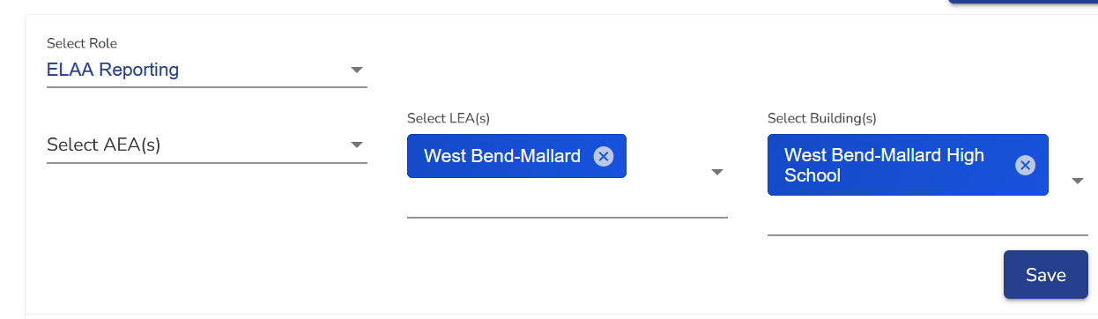
Edit/Delete Role within Locational Assignment
Quick access menu allows you to edit/delete role(s) and locations within your locational assignment. The ‘X’ to the right of the LEA/building allows you to remove the LEA and/or Building.
Edit: Allows update of location(s) and change in role (if applicable).

Slide 30
End of Year - Inactivating Users (1)
Users who are no longer employees of the location assigned to the LEA User Manager responsible for assigning access will need to make sure the user is inactivated in ACHIEVE.
Note: this has already been updated for districts for 24-25 school year, however there maybe some users that the ACHIEVE Data Leads are still working on.

Slide 31
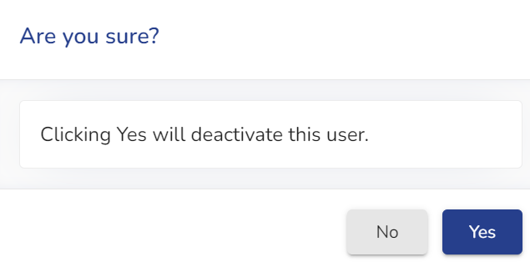
End of Year - Inactivating Users (2)
Inactive: Allows the user record to be made inactive in the event the user leaves the agency or if the user was accidentally added.
  Note: Do not ‘inactivate’ a user with assigned roles the LEA User Manager is unable to edit.
Search for user
Select the ‘quick access menu’ left of users name
Select ‘Inactivate’
Are you sure? - select yes, if you are sure
Notes:
If you accidently inactivate the incorrect user you have the option to reactivate via the quick access link.

Slide 32
End of Year - Inactivating Users (3)
If a user moves into your location from another location in Iowa and you are updating that record, please work with the other agency’s ACHIEVE Data Lead and/or LEA User Manager Primary Contact (column J) to ensure that they have removed access for their location.
Notes:
Report in the future for quick reference on who still has roles/permissions assigned that may have left the district.

Slide 33
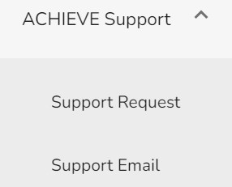
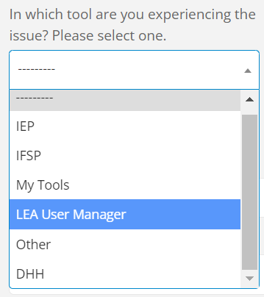
ACHIEVE Support Request (Tickets)
ACHIEVE Support Request located at the bottom of left nav. Prefer user choose ‘Support Request’ option so required information is included and the tickets are routed to the correct ACHIEVE Data Leads for support.
  Note: choose ‘LEA User Manager’ when submitting an ACHIEVE support request when related to user management/user roles addressed in this training.
Ticket Process (when received): ACHIEVE Data Lead will review ticket(s), if they are unable to resolve they will move it to ACHIEVE Super Admin to review and request ACHIEVE vendor to resolve (if applicable).

Slide 34
Q & A (4)

Slide 35
Additional Information
Recording/Materials will be posted on Iowa Department of Education website and shared with all registered participants.
ACHIEVE Summer Rollover - Detailed information regarding SIS updates and ACHIEVE.
ACHIEVE Support Team (Data Leads) Contacts by AEA
  Lisa Lohman, ACHIEVE Technical and Support Specialist, Super Administrator
  Email: lisa.lohman@iowa.gov
    Technical support
    Questions - staff move from one location to another
Notes:
User Guide will also be available.

Slide 36
Thank you!

