Slide 1

ACHIEVE - General Supervision
&
Prior Written Notice

Slide 2
ACHIEVE – General Supervision
&
Prior Written Notice

Slide 3

Welcome
Please post your questions in the Q&A
Slides will be posted on the DE website after the webinar
Policy & Practice Webinar Series & Recordings | Department of Education

Slide 4
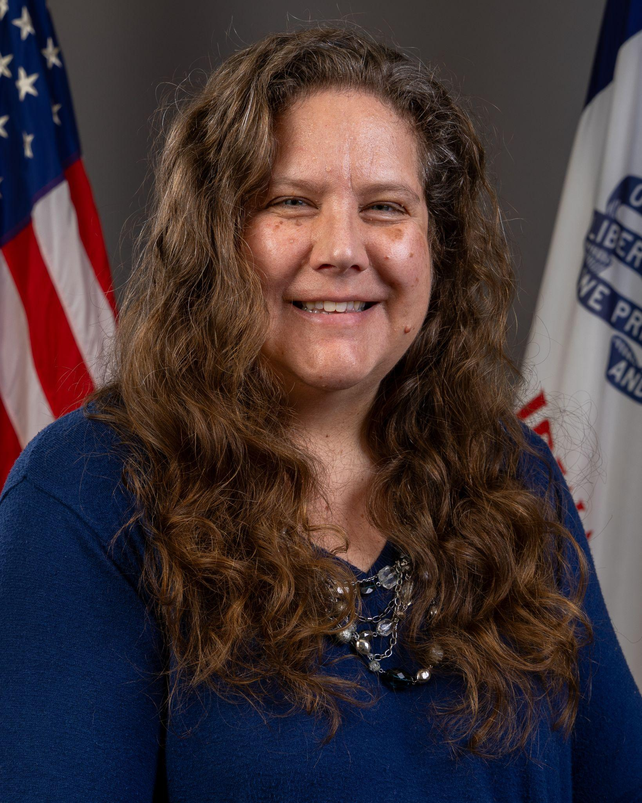
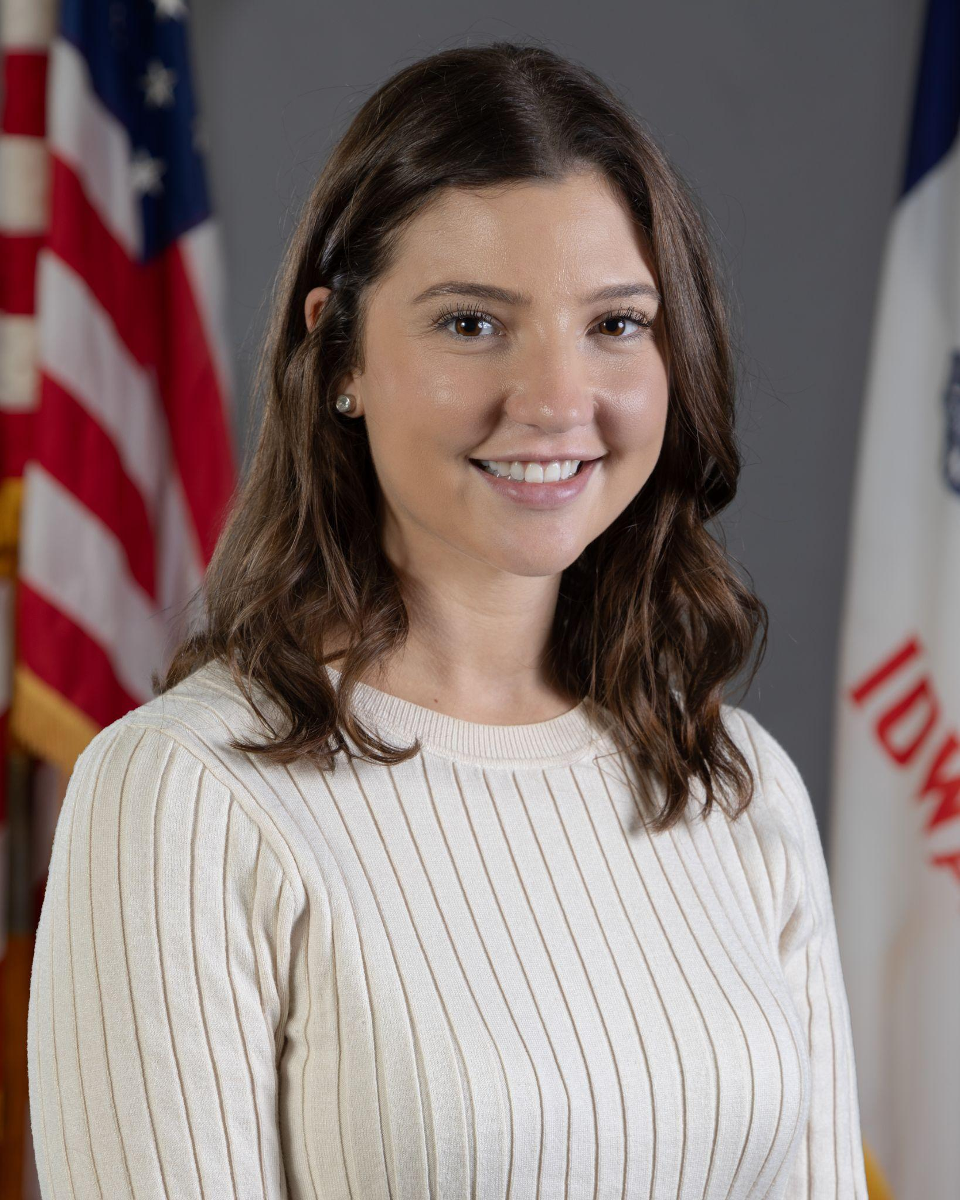
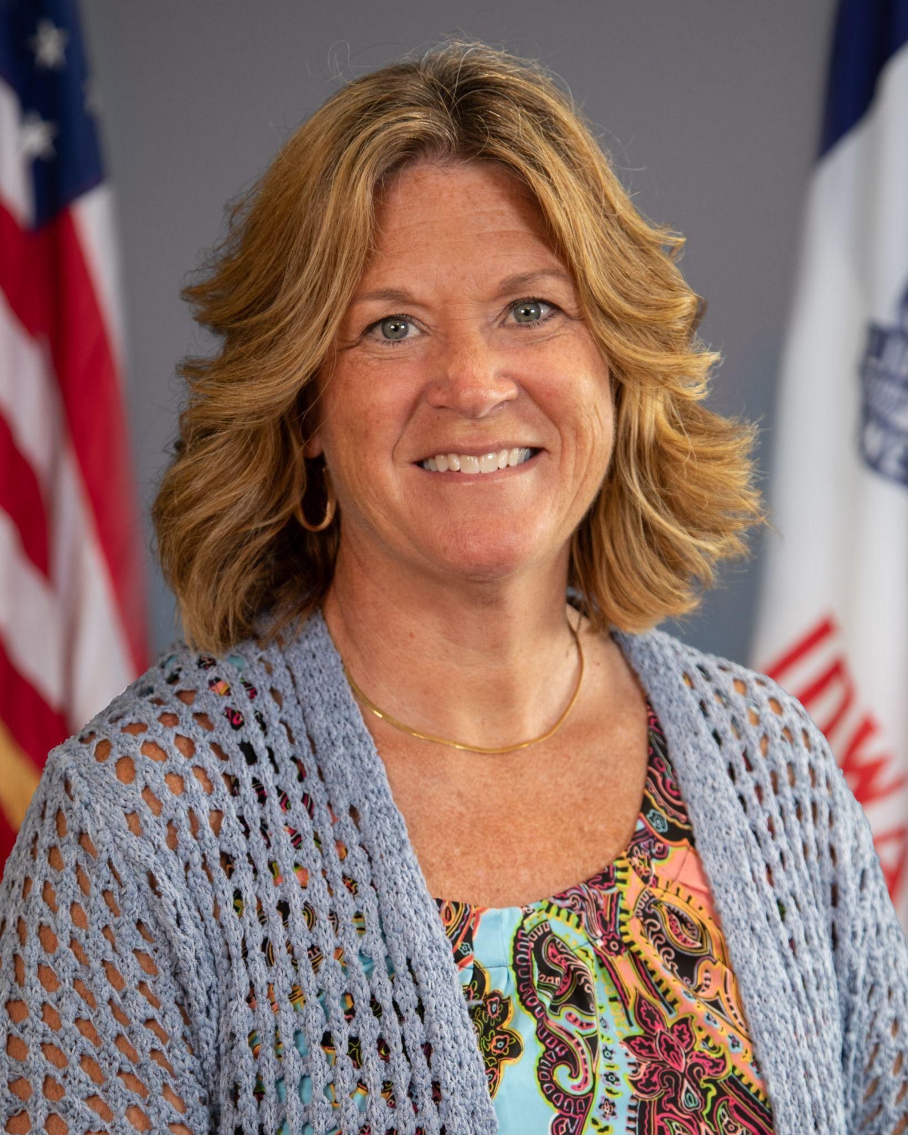
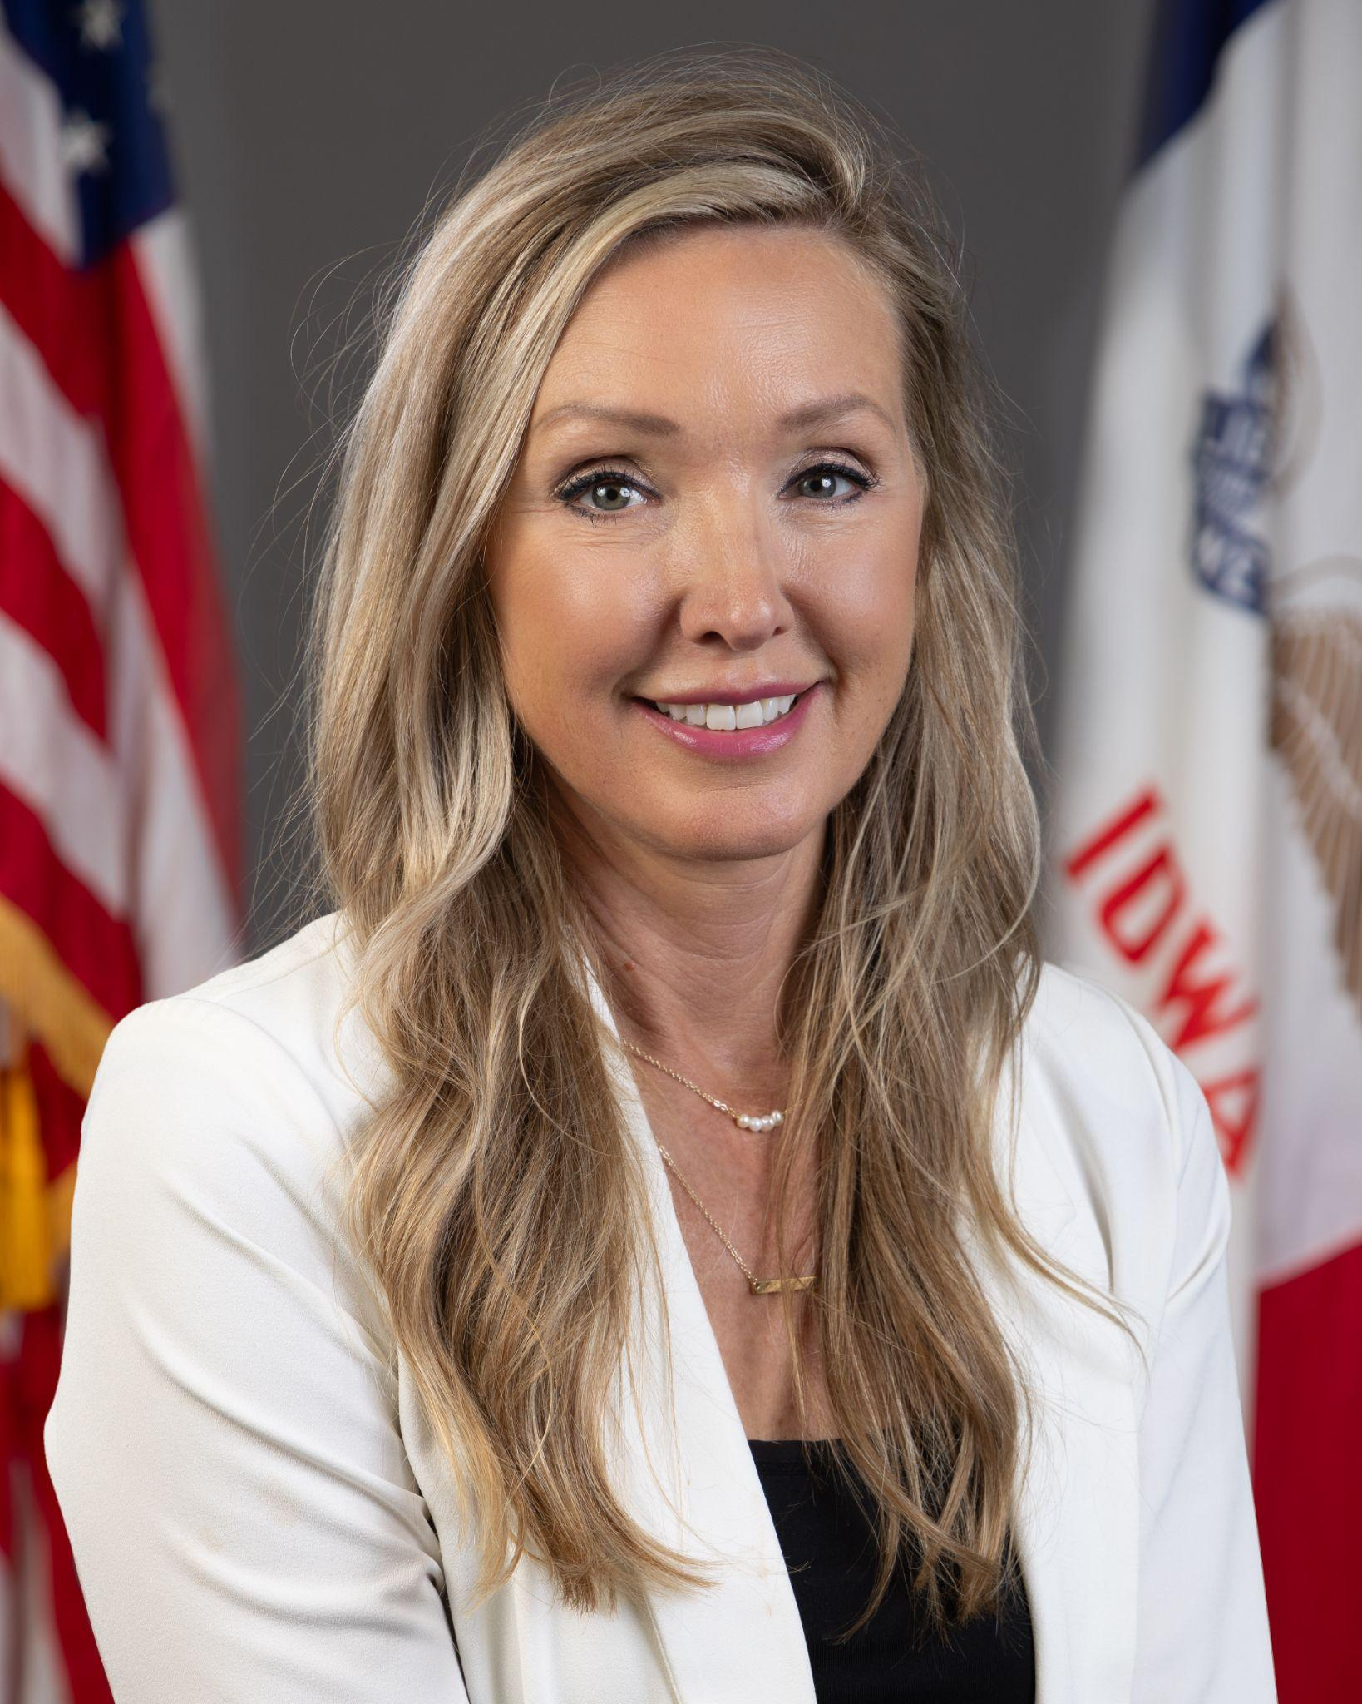
Today’s Presenters
Name: Betsy Lin
Title: Bureau Chief
Division of Special Education
Name: Rachel Bosovich
Title: Attorney II
Division of Special Education
Name: Molly Elston
Title: Regional Special Education Director-PLAEA
Name: Amy Thoms-Starr
Title: Regional Special Education Director-CRAEA
Program Consultants: Sara Reed, Stephanie McDonald, Michelle Harris, Jodi Johnson, Molly Pointer, Mary Beilke, Wendy Trotter

Slide 5
Participants will:
Understand how the five duties of general supervision relate to the work at the LEA/district level
Pull and use reports within ACHIEVE to provide general supervision for your building/district
Understand the purpose and content of a Prior Written Notice (PWN), specifically addressing LEA General Supervision Duties
Know and be able to explain to teachers when a PWN is required
Know and be able to support staff in ensuring the proper use of the PWN and coach teachers to improve the documentation of the PWN

Slide 6
IDEA and IAC Reference to General Supervision
Division VIII:
Monitoring, Enforcement, Confidentiality and Program Information
281—41.600(256B,34CFR300) State monitoring and enforcement.
41.600(1) General. The state must monitor the implementation of Part B of the Act and this chapter, enforce this chapter in accordance with rule 281—41.604(256B,34CFR300), and annually report on performance under Part B of the Act and this chapter
Iowa Administrative Code

Slide 7
Primary Focus of Monitoring Activities (IDEA)
41.600(2) Primary focus of monitoring activity. The primary focus of the state’s monitoring activities must be on the following:
Improving educational results and functional outcomes for all children with disabilities; and
ensuring that public agencies meet the program requirements under Part B of the Act, with a particular emphasis on those requirements that are most closely related to improving educational results for children with disabilities.
Iowa Administrative Code

Slide 8
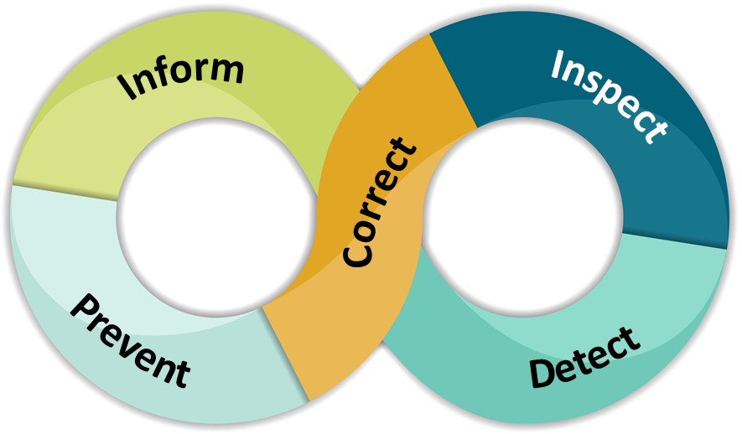
Iowa’s Duties of General Supervision

Slide 9

ACHIEVE & General Supervision

Slide 10
ACHIEVE Reports
The special education data found in these reports will help determine if there are concerns that should be addressed.
Using ACHIEVE reports on a regular basis will help identify areas that might be a focus of continuous improvement.
Why is it Important to Pull Reports
in ACHIEVE?

Slide 11
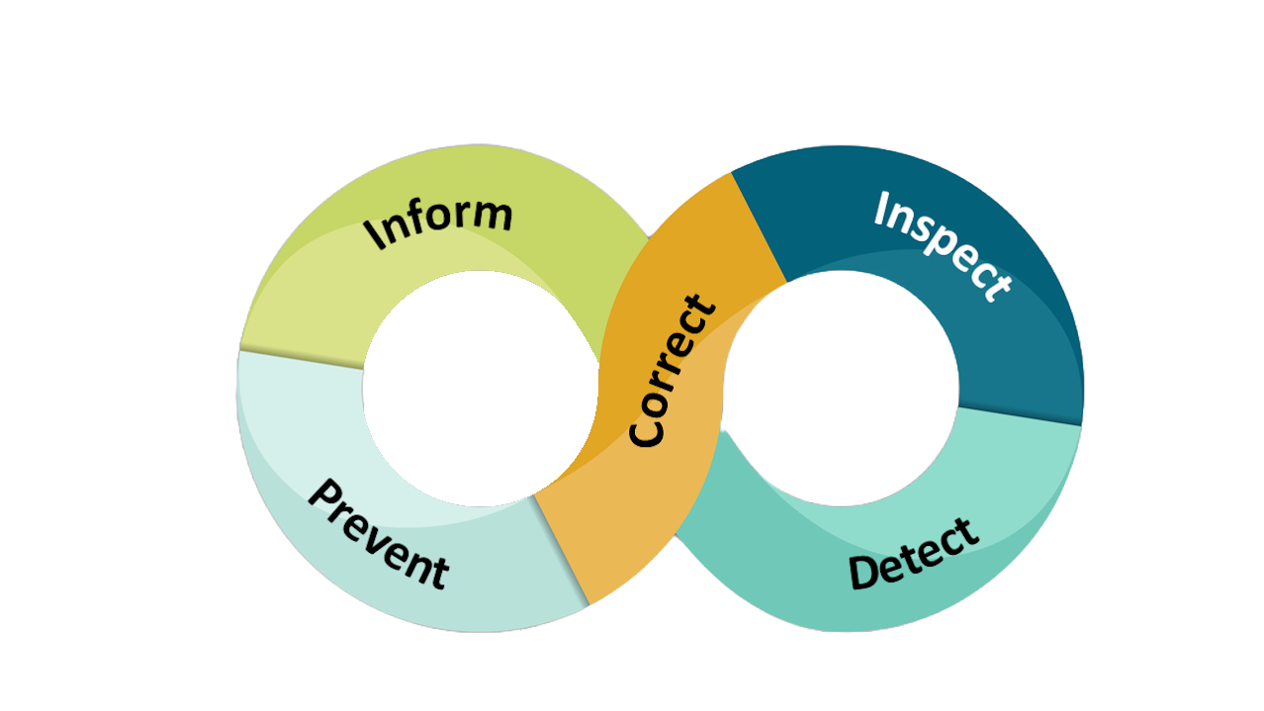
ACHIEVE Reports
Awareness /
Understanding
Deeper Dive
Create Consistency
Determine Concerns
Address Concerns

Slide 12
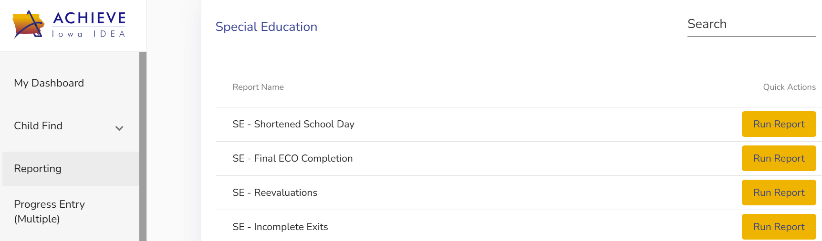
Accessing the Report - Overdue Plans
Where is the report?

Slide 13
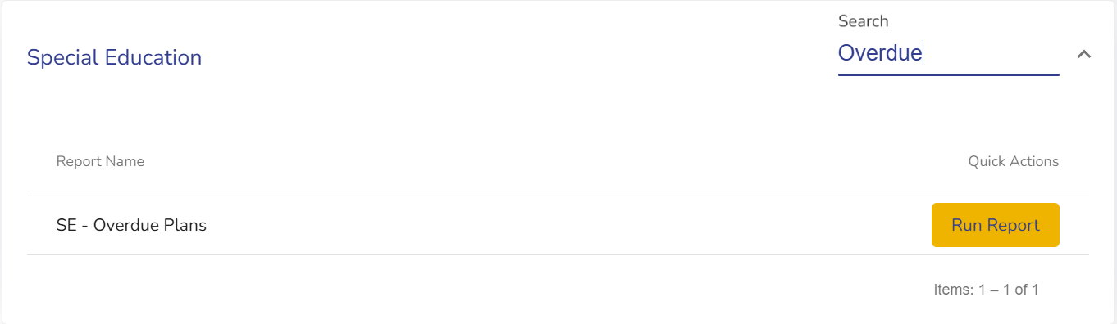
Accessing the Report - Overdue Plans
Where is the report?

Slide 14
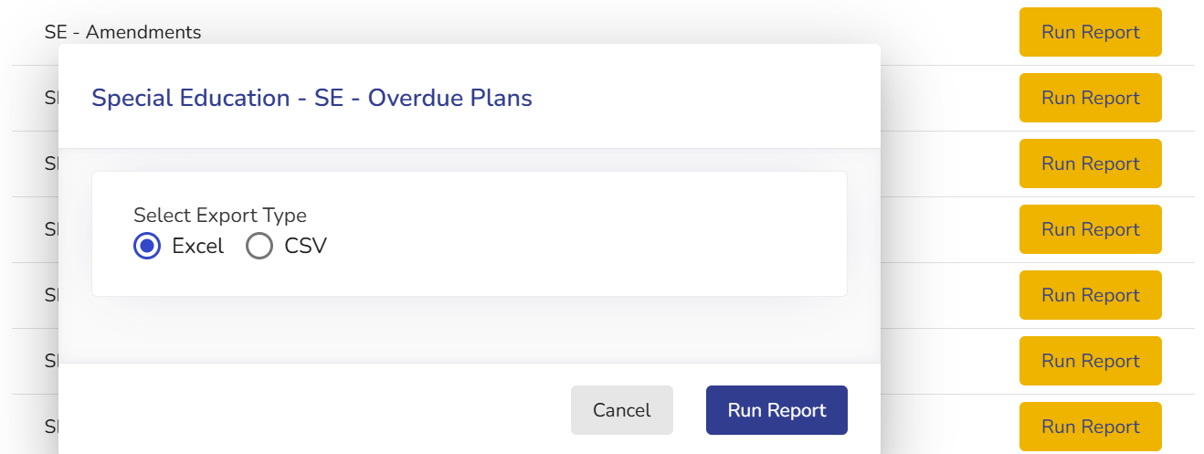
Accessing the Report - Overdue Plans
How do I generate the report?

Slide 15
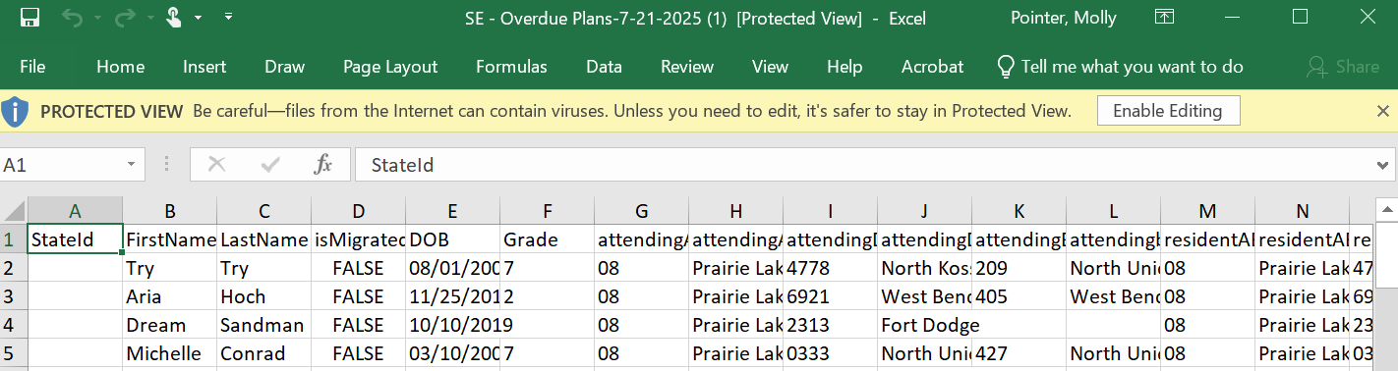
Accessing the Report - Overdue Plans
How do I generate the report?

Slide 16
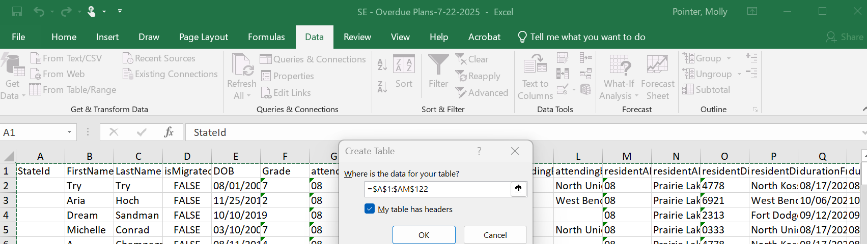
Accessing the Report - Overdue Plans
How can I sort the data?

Slide 17
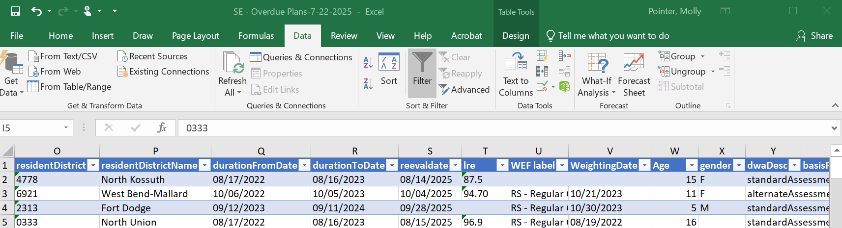
Accessing the Report - Overdue Plans
How can I sort the data?

Slide 18
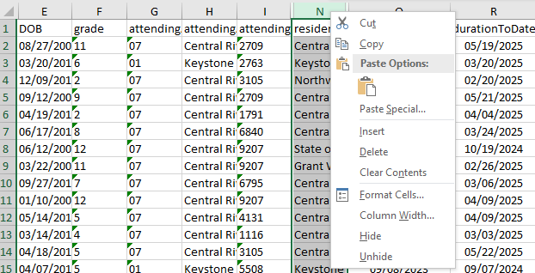
Sorting the Data - Overdue Plans
Hiding a column:
  Any column can be hidden by right clicking on the column letter and selecting “Hide.” This will allow you to focus only on the data you want to see.

Slide 19
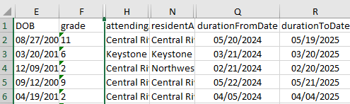
Analyzing the Data - Overdue Plans
What does the data tell us?
  Column Q documents the start date for an IEP and column R documents the end date
  Provides an awareness of overdue IEP plans
  Conversations should be held with the appropriate case manager and/or service provider(s)

Slide 20
How Often Should I Pull Reports?
An overdue IEP is considered a compliance violation under the Individuals with Disabilities Education Act (IDEA). It is best practice to have someone identified in your district that will pull this report monthly, and based on the data, have conversations with the appropriate staff.
Pulling and using reports on a regular basis will help detect areas of concern. This in turn will trigger other duties of concern, such as Inspect and Correct.

Slide 21
Policy
Understanding the legal requirement of Prior Written Notice

Slide 22

Inform
The duty to inform means ensuring teachers, providers, administrators, and any staff member who works with learners with disabilities and their families are aware of and understand the requirements of IDEA.
Outcome: Administrators will have increased knowledge and understanding of the requirements of a Prior Written Notice (PWN)

Slide 23






Locating the PWN
Click on the student’s name from your list, if the IEP has been shared with you
OR
Click location search under Child Find to get your building list of students
Click on the documentation stepper, open the documents list
Look at the dates on the right to find the one you’re looking for
The document will open in a new window

Slide 24
IA Admin Code
281—41.503
41.503(1) Notice
Written notice that meets the requirements of subrule 41.503
(2) must be given to the parents of a child with a disability within a reasonable time before the public agency:
Proposes to initiate or change the identification, evaluation, or educational placement of the child or the provision of FAPE to the child; or
Refuses to initiate or change the identification, evaluation, or educational placement of the child or the provision of FAPE to the child

Slide 25
IA Admin Code
281—41.503
41.503(2) Content of notice
The notice required under subrule 41.503(1) must include the following:
A description of the action proposed or refused by the agency;
An explanation of why the agency proposes or refuses to take the action;
A description of each evaluation procedure, assessment, record, or report the agency used as a basis for the proposed or refused action;
A statement that the parents of a child with a disability have protection under the procedural safeguards of this chapter and, if this notice is not an initial referral for evaluation, the means by which a copy of a description of the procedural safeguards can be obtained;
Sources for parents to contact to obtain assistance in understanding the provisions of this chapter;
A description of other options that the IEP team considered and the reasons why those options were rejected; and
A description of other factors that are relevant to the agency’s proposal or refusal.

Slide 26
IA Admin Code
281—41.503
41.503(3) Notice in understandable language.
The notice required under subrule 41.503
(1) must be written in language understandable to the general public, and must be provided in the native language of the parent or other mode of communication used by the parent, unless it is clearly not feasible to do so.
If the native language or other mode of communication of the parent is not a written language, the public agency must take steps to ensure the following:
(1) The notice is translated orally or by other means to the parent in the parent’s native language or other mode of communication;
(2) The parent understands the content of the notice; and
(3) There is written evidence that the requirements in subparagraphs 41.503(3)“b”(1) and (2) have been met.

Slide 27
What does a PWN include:
Sources used to develop the PWN
Description of the action proposed or refused
Explanation of why the agency proposes or refuses to take the action
Description of each evaluation procedure, assessment, record, or report the agency used as a basis for the proposed or refused action
Other options the school considered and the reason why those options were rejected
Other factors relevant to the school proposed/refused action
The date of implementation
Contact for questions
*A statement that the parents have protection under the due process provisions of special education and, if this notice is not an initial referral for evaluation, how the parent may obtain a copy of the description of the procedural safeguards.

Slide 28
When is a PWN Required in ACHIEVE
PWN Required
PWN Not Required
IEP team designs a new plan for a learner
  Amendments
Change in service provision and current needs for FAPE are articulated
  ESYS determination
Refusing an action, decision, consideration requested by the parent
Change in placement
  Consider disciplinary actions beyond 10 days
  Change in LRE
Exiting special education services - ALL reasons
Consent for Full and Individual Initial Evaluation and the Consent for/Notice of Reevaluation (Built in)
Consent for Initial Service (Built In)
Change in material or methodology
Change of qualified service provider
Change in location of service not controlled by school agency
  Court or HHS ordered placement
Change in location of service which does not change service or placement
  Classroom, Building, Teacher
*If in doubt, use a PWN. It is an equal protection for districts and family.

Slide 29
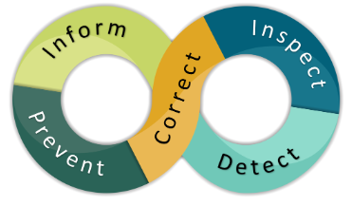
The Duty to Detect
The duty to detect includes processes for regularly analyzing data, coordinating intake of concerns, and using information from the other duties to screen for potential issues.
Outcome: Administrators will identify a process to detect issues with Prior Written Notices early, so that they can correct through learning, coaching, and monitoring.

Slide 30

Detect
During the IEP Meeting
Use the PWN prompts as you conclude the IEP meeting
Gain clarity and understanding of proposal or refusal
Timeline for implementation
  Timely
  Reasonable
Procedural Safeguards
After the IEP Meeting
Use the PWN to ensure accuracy and clarity of the schools action
Establish a method to review PWNs
Monitor timeliness
  Continue current services
  Finalize the IEP/Amendment-Implementation Date
Coaching and support for SE Teachers

Slide 31
The Duty to Inspect
The duty to inspect includes problem analysis and in-depth investigations to verify the existences of an issue or issues, determine their underlying causes, and assess the extent of the problem (e.g., whether it is specific to a student, classroom, building, etc.).
Outcome: Upon detection of concerns, administrators will have the skills and tools to analyze systemic problems that contribute to non-compliant use of the PWN and support correction within their building or district.

Slide 32
Inspect
What does the data tell me about the PWN components of Accuracy, Clarity, and Implementation?
Review: Historical concerns and/or patterns of behavior
Interview: What have teachers, parents, or other administrators shared with you in regard to concerns or needs?
Observations: During meetings, what have been common observed patterns?
Tasks: Pulling a broader sample size - What does a more comprehensive data set tell you?
Observations
Products
Conversations

Slide 33
Legal Lessons
Understanding the legal impact of PWN

Slide 34
Case Law
Triggers
RULE: Trigger is not limited to that which is requested or refused during an IEP team meeting
In re: Student with a Disability, 78 IDELR 267 (SEA KS 2021) : "That request could have been made in a staff meeting, an IEP team meeting, a phone conversation, an email, or a note and it would not change the analysis here.”
Content
RULE: The information required by 34 CFR 300.503 / IAC 281-41.503 is that which is always necessary regardless of the circumstances surrounding the proposal or refusal
Cincinnati Public Schools, 116 LRP 11536 (SEA OH 2016):
  description: “Annual IEP”
  explanation: “Annual IEP review is required by law”
  other options considered: “No other options were considered, annual review required by law."
  Description of each evaluation procedure, assessment used: “Progress monitoring and academic assessments.”
  Other factors relevant: "Input from the IEP team, including the parent/guardian and consideration of any outside evaluation."
Ask - Does this fulfill the purpose?

Slide 35
Caselaw
Accuracy
Rule: The PWN is noncompliant if it doesn’t accurately reflect what occurred
Westfall Local Schs., 123 LRP 14125 (SEA OH 03/20/2023): The PWN provided sufficient information but because the information was inaccurate, the PWN was noncompliant
Timing
“Reasonable time”
Letter to Chandler, 59 IDELR 110 (OSEP 2012), “enough time to fully consider the change and respond to the action before it is implemented.”
Rule: This should not be before the team meeting
Impact: Meaningful Participation, Predetermination, FAPE
Enumclaw Sch. Dist., 123 LRP 17953 (SEA WA 2023):
  District appropriately addressed the child's needs, materially implemented his IEP, and took appropriate steps to address bullying
  PWN failed to adequate explain team decisions which resulted in the parent being confused as to whether additional speech therapy interventions were going to be pursued and whether the team had made a decision regarding whether the student required either speech or occupational therapy
“We find that this formal requirement has an important purpose that is not merely technical, and we therefore believe it should be enforced rigorously.” Union Sch. Dist. v. Smith, 20 IDELR 987 (9th Cir. 1994).

Slide 36
Common Mistakes or Misunderstandings
Too vague of a description of proposed or refused action
Too vague of a description to understand the rationale for the proposed or refused action
Includes specific methodologies or staff by name
No other options were considered- there should always be options for the team to consider. Predetermination
Relevant Factors were not addressed- captures perspectives of all parties involved
Perspective of the author proposing or refusing an option
PWN is a district/school form that captures their refusal or proposal
Stay put- If the parent files prior to the implementation date
Unrealistic implementation date- reasonable time for parents to consider and reasonable time for districts to prepare for implementation
Ensuring it is provided to the parent(s) in their native language.

Slide 37
Administrative Resources
Additional Resources:
I3
ASK Request Form
ASK Info Sheet

Slide 38
Questions from the Field

Slide 39
Thank You!

