Slide 1
ACHIEVE FBA/BIP Updates
Coming September 2025
Notes:
Welcome to the ACHIEVE Functional Behavior Assessment and Behavior Intervention Plan Updates webinar/training! Based on input from the field over the last several years, the Department convened a small task team in the Spring of 2024 who identified a number of revisions to the Functional Behavior Assessment (FBA) and Behavior Intervention Plan (BIP) processes in ACHIEVE. This resulted in a year-long process to update the proposed changes in the system. This training outlines all of the notable changes to the FBA and BIP processes in ACHIEVE. These enhancements reflect the collaborative efforts of many professionals working to provide a streamlined FBA and BIP writing process for our schools.
The information provided today will be available on the Iowa Department of Education ACHIEVE website by August 31, 2025. Office hours will be available on a rotating, morning/afternoon basis for technical support. These hours will be posted on the Department of Education website.

Slide 2
Introducing Today’s Speakers
Rose Cartee, M.Ed., BCBA, LBA
Marie Conklin, M.Ed.
Notes:
The training information provided today has been developed by:
Rose Cartee, M.Ed., BCBA, LBA, Education Program Consultant for Specially Designed Instruction (Behavior & Autism), Iowa Department of Education
Marie Conklin, M.Ed. Regional Education Program Consultant, Iowa Department of Education, serving Central Rivers Area Education Agency.

Slide 3
Agenda
General Updates
Updates to the FBA
Updates to the BIP
Available training materials and resources
Notes:
Housekeeping items:
Today’s Webinar will begin with general updates within ACHIEVE, followed by updates to the FBA process. At the end of the FBA process updates, the slide deck will be paused and we will provide a live demonstration of those updates. We will then return back to the slide deck and provide information regarding updates to the BIP process, followed by a live demonstration of those updates. At the conclusion of the live demonstration, slides will be provided with additional information regarding training materials and resources.
Housekeeping items for LEAs/AEAs hosting this training:
Share PDF of slides
All materials that are reviewed today will be made available/were made available on the ACHIEVE webpage in mid August. Additional resources can be found on the Iowa Department of Education website, including a guide for team reference describing the changes, a Q&A guide to address frequently asked questions and a guide denoting what will occur if an FBA or BIP is in either “draft” or “amendment” status at the time of the launch. Open office hours with the Department of Education have been designated and are included in this slideshow if users need additional assistance during the first two weeks of the launch of the updates within the system.

Slide 4

When will the ACHIEVE FBA & BIP updates be released statewide?
Notes:
The FBA/BIP Updates are scheduled to be released on the evening of September 17, 2025
This is an important date to remember, because any Functional Behavior Assessment and/or Behavior Intervention Plan that are in “amending” or “draft” status at the time the system switches will be impacted. There will be additional information regarding the impact later in this training.

Slide 5
General Updates
It is STRONGLY encouraged to have all FBAs and BIPs finalized on or before the close of business day on September 17th.
Notes:
If an FBA or BIP is left in draft or amending form at the time of the system update, information that was pulled into the BIP from the FBA may be lost. In order to prevent the team from permanently losing information, teams are being strongly encouraged to either:
If possible, finalize any draft FBAs and/or draft BIPs before the changes take effect on September 18.
If finalizing the draft FBA and/or BIP is not a possibility, teams are highly encouraged to download and save the draft and/or copy the information to be used later and re-entered after the launch.
If the team is starting a new draft IEP before Sept. 18, consider waiting to update the Special Factors page until after Sept. 18 or consider meeting with the IEP team and finalizing the IEP before Sept. 18.

Slide 6
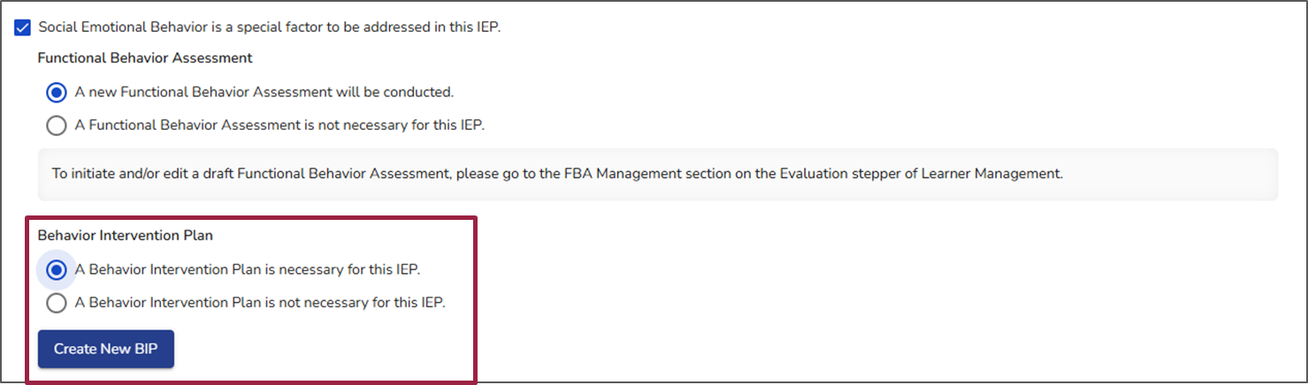
PLAAFP Update
Notes:
One of the latest enhancements added to ACHIEVE lets the team start drafting a Behavior Intervention Plan (BIP) while simultaneously conducting a Functional Behavior Assessment (FBA). If an IEP or a BIP are in Draft or Amendment status on 9/17 OR the next time a user starts a draft IEP with Behavior as a Special Factor, the following are the steps the team will follow to create a new BIP:
Navigate to the Special Factors page
Check the box indicating that social-emotional behavior is a Special Factor to be addressed in the IEP
Specify whether an FBA will be completed as part of the assessment
Once that is selected, the Behavior Intervention Plan menu, shown above, will allow the team to indicate if a BIP is needed for this IEP
If the team agrees that a BIP is necessary, a blue “Create New BIP” button will appear
Clicking on this button generates a draft BIP, enabling the team to begin working on it at the same time the FBA is underway
The image shown here displays what the PLAAFP page will look like when a team has chosen to create a draft FBA and a draft BIP simultaneously.

Slide 7
BIP Embedded in IEP
Notes:
The BIP will now be a part of the IEP process / IEP amendment process and will have its own stepper within the IEP. It is no longer a stand alone document, but rather an integral part of the IEP. Due to this change, the team will no longer be able to revise the BIP outside of the IEP processes. Instead, during the lifetime of the IEP, if the team wishes to make changes to the BIP, all steps for the typical IEP amendment process will need to be completed. However, before that decision is made, the team may complete a BIP review to determine next steps. Additional information regarding how to review and amend a BIP are included in this training.

Slide 8
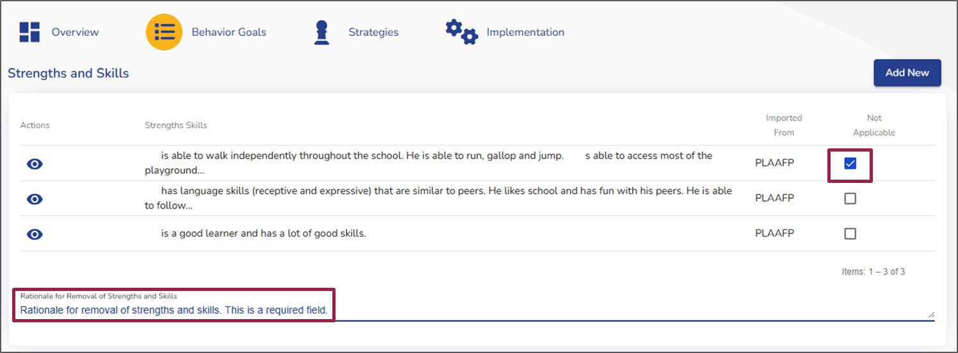
General Updates (BIP Changes)
Items imported from the FBA can be marked as “Not Applicable”
Some items marked “Not Applicable” will require a rationale
Notes:
Because the FBA and BIP are live and talk to one another as long as the FBA is in draft form, all relevant information from the FBA will automatically import into the BIP in ACHIEVE. The user will be able to select if an item is “Not Applicable” by selecting the corresponding checkbox for the designated item. For these items, a “Rationale” will be required. If a rationale is required, as indicated by a red asterisk, and the user does not input a rationale for marking the item “not applicable,” a new IDR will be generated within the BIP IDR section for that item.
If multiple lines are marked not applicable, the user will need to address the rationale for each one in the one rationale box.

Slide 9
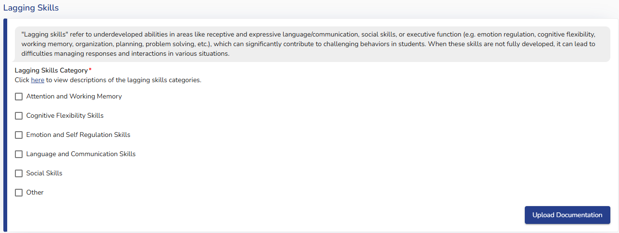
New Lagging Skills Section
Notes:
A new section in both the FBA and BIP has been added called Lagging Skills. "Lagging skills" refer to underdeveloped abilities in areas like receptive and expressive language/communication, social skills, or executive function (e.g. emotion regulation, cognitive flexibility, working memory, organization, planning, problem solving, etc.), which can significantly contribute to students displaying challenging behaviors. When these skills are not fully developed, it can lead to difficulties managing responses and interactions in various situations. This section has been added to the FBA to help the user better understand any skills the student may be lagging, and how that is impacting behavior, which can support the user with identifying appropriate replacement behaviors based on the current skill deficit(s).

Slide 10
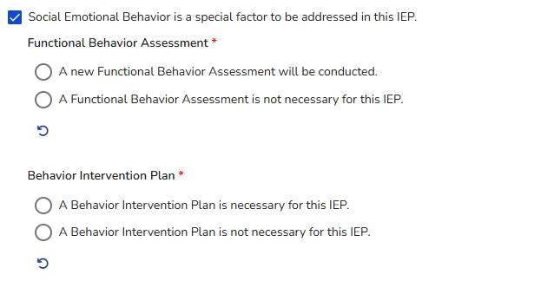
PLAAFP Display (No Finalized FBA)
Notes:
When a new IEP is created and “Social Emotional Behavior is a Special Factor to be addressed in this IEP” is selected in the PLAAFP section, the following options are displayed related to FBA and BIP.
If the learner does not currently have an FBA:
Two options will be available for the team to choose from.
A new Functional Behavior Assessment will be conducted.
A Functional Behavior Assessment is not necessary for this IEP.
Selecting either of the options will allow the team to indicate whether or not a Behavior Intervention Plan is necessary for this IEP.

Slide 11
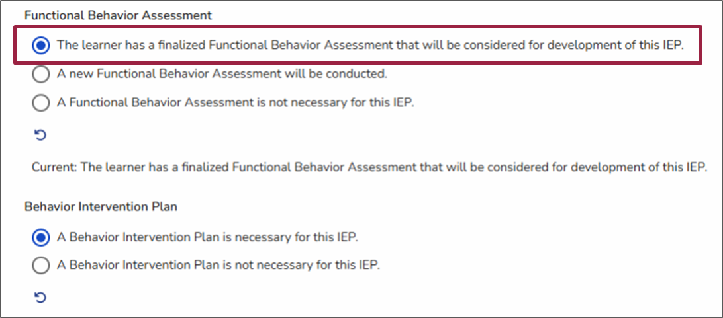
PLAAFP Display (Finalized FBA)
Notes:
If the learner does have an FBA finalized in ACHIEVE, three options will be available for the team to choose from:
The learner has a finalized Functional Behavior Assessment that will be considered for development of this IEP.
A new Functional Behavior Assessment will be conducted.
A Functional Behavior Assessment is not necessary for this IEP.
If the team selects the option that “The learner has a finalized Functional Behavior Assessment that will be considered for the development of this IEP”:
The draft Behavior Intervention Plan will begin pulling information from the most recently finalized FBA.
If the team selects the option that “A new Functional Behavior Assessment will be conducted”:
The draft Behavior Intervention Plan will begin pulling information from the draft FBA.

Slide 12
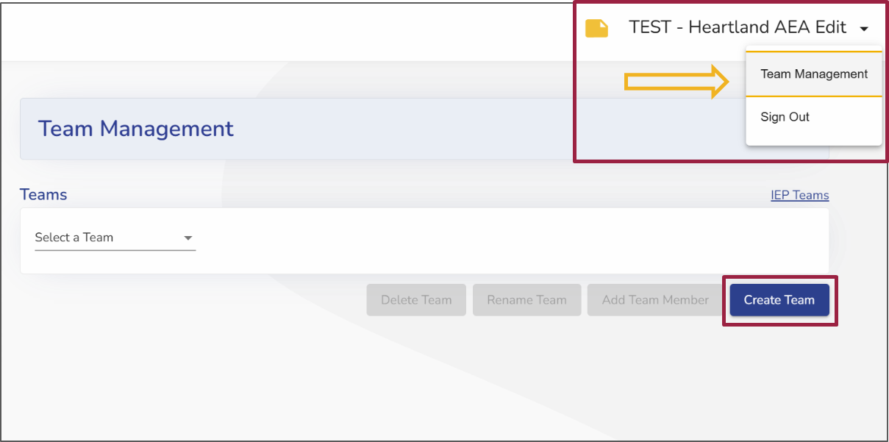
Creating A New Team
Notes:
For Webinar:
A tool that may be helpful in an FBA and BIP is creating a team for learners. This allows you to create teams in your IEP management system. These teams are unique to the user (not the student). This was created so you can quickly add a team without having to add each team member each time.
For Live:
To create a new team, the user will navigate to the login section of ACHIEVE and click on the carat next to their name to expand a box that will show “Team Management” and “Sign Out.” The user will click “Team Management” and the screen shown here will appear. The user will select the blue “Create Team” button shown with the red box around it.

Slide 13
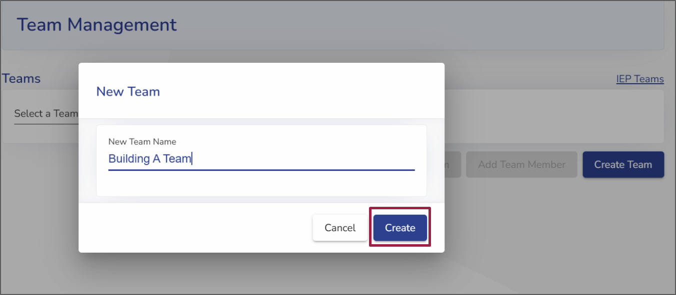
Naming A Team
Notes:
For Live: Once the user has entered a name for the team, the blue “Create” button will appear

Slide 14
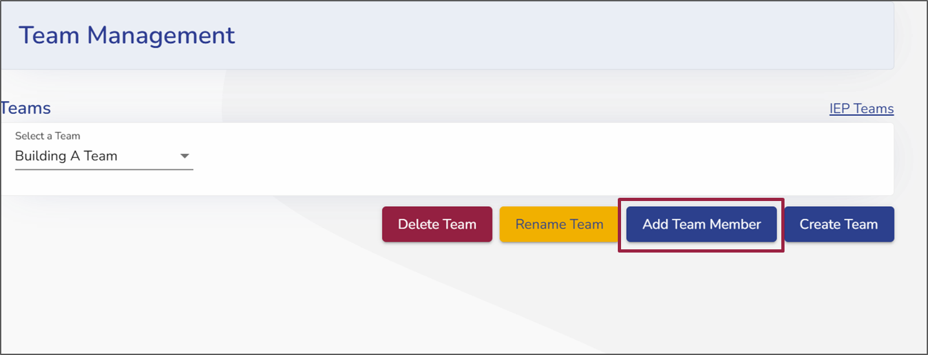
Adding Team Members
Notes:
For Live: After clicking “create,” the user will be directed to the “Team Management” page where they can delete the team, rename the team, add team members, or create a new team. The user will want to select “Add Team Member” by clicking on the corresponding blue box.

Slide 15
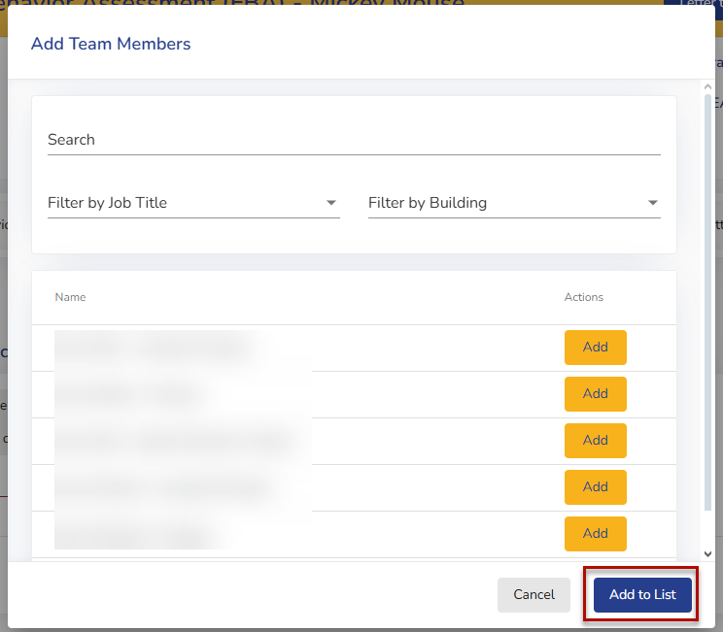
Adding Members to the List
Notes:
For Live: Once the user is done selecting team members, click the “Add to List” button and the team members who have been added can be seen in list form.

Slide 16
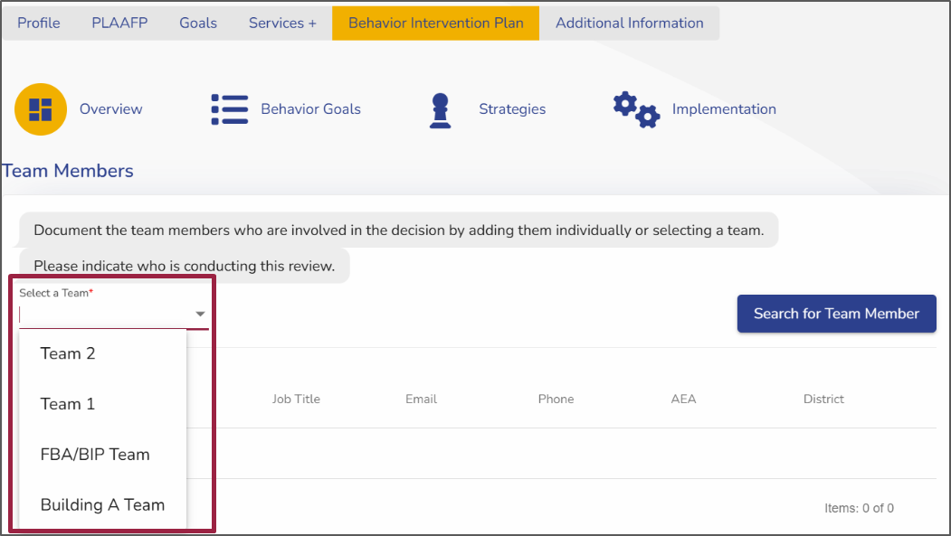
Selecting a Team
Notes:
For: Webinar The user can then select a team from the dropdown menu in the following sections: FBA, BIP, and BIP Review

Slide 17
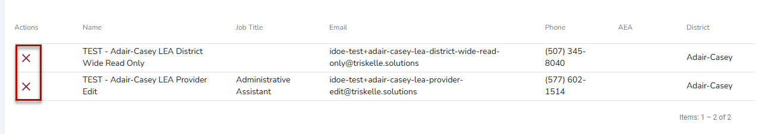
Removing Team Members From A Team
Notes:
For Live: Team members can be removed from the team by navigating to the Overview stepper and selecting the red “X” icon next to their name.

Slide 18
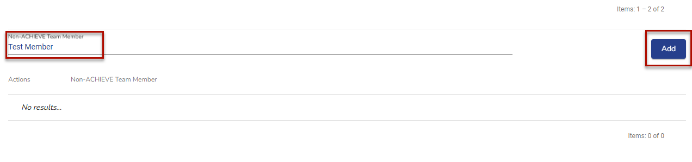
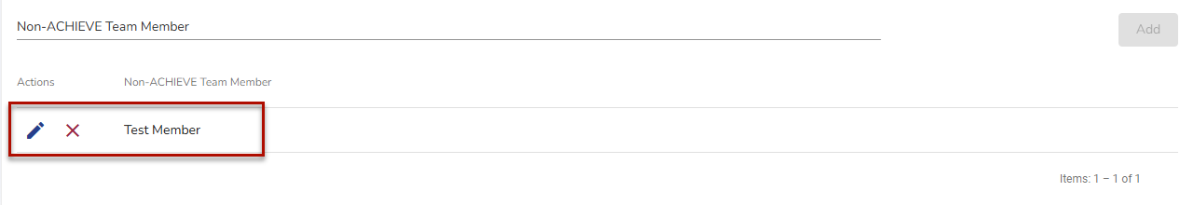
Managing Non-ACHIEVE Team Members
Adding
Deleting or Editing
Notes:
For Webinar: Non-ACHIEVE users can also be added as team members. In order to do this, the user will select, “Non-Achieve Team Member” and type their name. This will create another list of team members specific to non-ACHIEVE users.
For Live: Then select the “Add” button. This will create another list of team members specific to non-ACHIEVE users. As with ACHIEVE team members, a non-ACHIEVE team member can be removed by clicking on the red “X” icon next to their name. A non-ACHIEVE team member name can be edited clicking the blue pencil button next to their name.

Slide 19
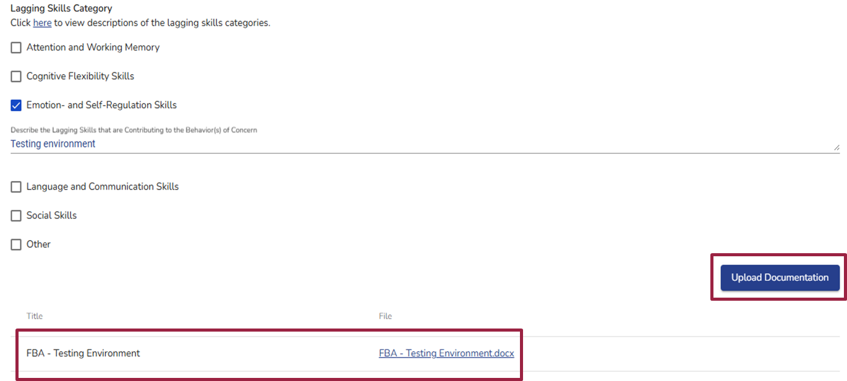
Uploading Documentation
Notes:
For Webinar:
The button labeled “Upload Evidence” has been renamed to “Upload Documentation” throughout ACHIEVE. When documentation from the FBA is added, this button will now generate the prefix “FBA” plus the name given to the documentation (e.g., FBA - Preference Inventory) and this documentation will be housed both within the FBA as well as the Documentation stepper. There will be a hyperlink for the user to have quick access to the uploaded FBA documentation.

Slide 20
Considerations
Status | Draft FBA | Draft FBA with previous finalized FBA | No Draft; No previous finalized FBA
Draft BIP | The BIP will pull over all the information from the FBA. The DRAFT BIP continues to reflect what is being written in the DRAFT FBA unless the DRAFT FBA record is deleted. There is a warning message displayed on each substepper under the BIP stepper of the IEP that states: “An FBA is currently in-progress. Content displayed on the BIP below is subject to change until this FBA is finalized.” | The information from the finalized FBA is removed from the DRAFT BIP. The information from the newly created DRAFT FBA is pulled over to the DRAFT BIP. The information in the DRAFT BIP continues to reflect what is being written in the DRAFT FBA unless the DRAFT FBA record is deleted. | No information in the DRAFT BIP continues to reflect what is being written in the DRAFT FBA unless the DRAFT FBA record is deleted.
FBA Created After Finalized BIP | The BIP stepper of the IEP View page will pull over all the information from the FBA. In this scenario, a warning message is displayed on the BIP View page that states: “An FBA is currently in-progress. Content displayed on the BIP View below is subject to change until this FBA is finalized.” There will be a button to the PDF output for the most recently finalized BIP directly following the warning message.
Notes:
For Webinar: There are several considerations to keep in mind when starting a new FBA or BIP as there are now several pieces of information pushing from the FBA to the BIP. The table displayed here reflects how a draft BIP will be impacted based on the status of the FBA. You will also notice if a BIP is finalized and an FBA is opened, it impacts the BIP view page, but not the BIP output.

Slide 21
Updates to the Functional Behavior Assessment (FBA)
Notes:
There have been multiple updates to the Functional Behavior Assessment in ACHIEVE. We will begin by presenting these updates through a slideshow, followed by a live demonstration of the changes.

Slide 22
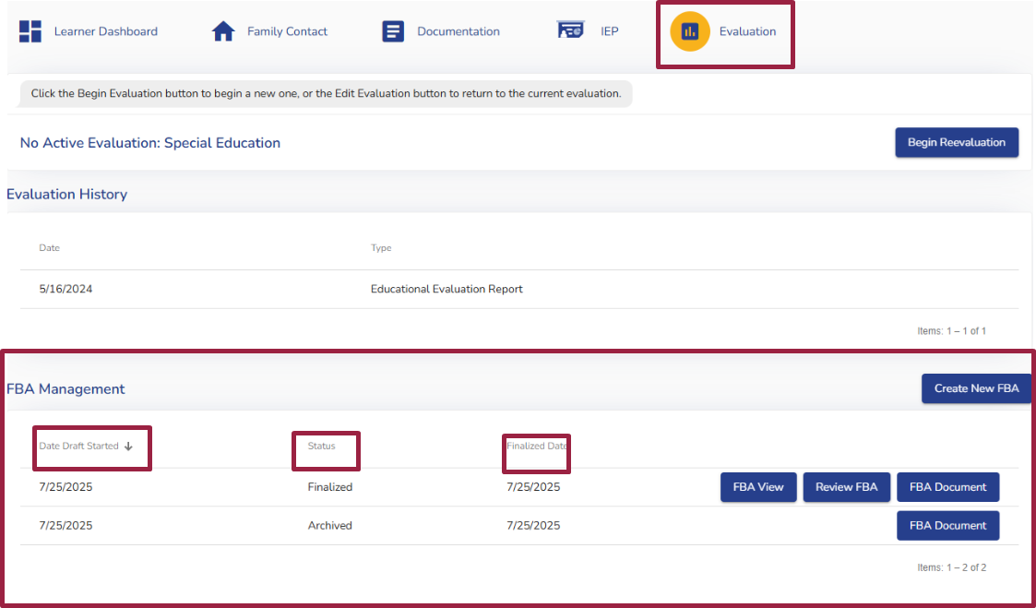
New FBA Management Section
Notes:
For Webinar:
In order to navigate to the new FBA Management section, the team will need to:
Go to the learner’s dashboard
Select the “Evaluation” stepper
Scroll to the “FBA Management” section
The FBA Management section will display a paginated table of all FBAs that have been completed for the learner, with sortable columns that will allow the team to sort by:
Date Draft Started, which will display the date that the FBA was created on
Status, which will display the current status of the FBA. These statuses will include:
Draft - denoting that an FBA is being drafted
Finalized - this status will appear for the most recently finalized FBA
Archived - this status will appear for all other FBAs that were finalized that are not the most recent FBA
And finally, the last sortable column is “Finalized Date” which will populate the date that each FBA was finalized.
The team should note that, if the table is empty as a result of no previous FBA having been completed in the ACHIEVE system, the display text will read, “No results.”

Slide 23
Confirmation Modals
Status | Finalized FBA | Draft FBA
Draft BIP | “There is currently a draft Behavior Intervention Plan (BIP). Creating a new draft Functional Behavior Assessment (FBA) will remove all existing data from the existing BIP steppers and replace it with the new FBA data. Do you wish to continue?” | There is currently a draft Behavior Intervention Plan (BIP). Creating a draft Functional Behavior Assessment (FBA) will populate the existing BIP steppers with any information added to the new FBA. Do you wish to continue?”
Finalized BIP | “There is currently an active Behavior Intervention Plan (BIP). Creating a new draft Functional Behavior Assessment (FBA) will remove all existing FBA data from the existing BIP view pages and replace it with the new FBA data. (This will not impact the current active BIP output). Do you wish to continue?” | “There is currently an active Behavior Intervention Plan (BIP). Creating a draft Functional Behavior Assessment (FBA) will populate the existing BIP view pages with any information added to the new FBA. (This will not impact the active BIP output.) Do you wish to continue?”
No BIP | “A finalized Functional Behavior Assessment (FBA) already exists. Are you sure you want to create a new FBA?” | No confirmation modal will be displayed
Notes:
For Webinar: New confirmation modals have been embedded within the FBA section of the IEP that will help guide the team through different scenarios. These are separated into two categories, based on whether or not there is a Finalized FBA in the IEP. Although these confirmation modals include clear, specific details about the impact that making a selection will have, it is important for the team to understand these in order to help prevent confusion.
This table outlines the different modals that appear based on the status of the FBA and the BIP.

Slide 24
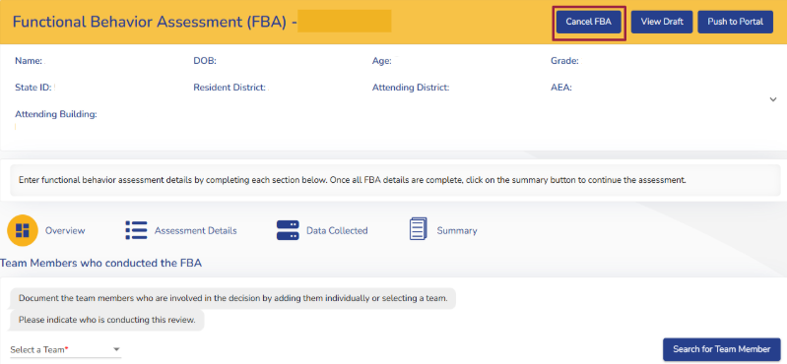
Canceling a Draft FBA
Notes:
For Webinar: If a team needs to cancel a draft FBA for any reason, a new “Cancel FBA” button is now available at the top of the page, to the left of the “View Draft” button. Before clicking “Cancel FBA,” the team should be certain about their decision, as any information entered into the FBA, including details already transferred to the Behavior Intervention Plan, will be permanently lost and cannot be recovered.
For Live: If a team member chooses to cancel a draft FBA, a warning message will be displayed asking “Are you sure?” and informing the team that the draft FBA will no longer be accessible and that all information pushed from the draft FBA to the draft BIP will also be removed.

Slide 25
Considerations for Canceling Draft FBA
FBA Status | Implications of Canceling Draft FBA
No FBA currently exists | Will delete current FBA and anything pushed over to current BIP.
FBA has been uploaded | Will delete current FBA and anything pushed over to current BIP.
Previous finalized FBA | Will delete current FBA and replace with most recently finalized FBA
Notes:
For Webinar: Information displayed in the BIP View Pages will be impacted based on the previous status of the most recent FBA as shown in the table. If there has never been an FBA done in ACHIEVE (which includes an uploaded FBA from another state or Legacy), there will be no information in the BIP. If there was a previous FBA in ACHIEVE, that information will be in the BIP.

Slide 26
Data Collected Stepper
RIOT Areas
Lagging Skills
ABC Data
Additional Data
Notes:
For Webinar:
The “data collected” stepper has been reorganized and a new section, Lagging Skills, has been added, and ABC Data and Additional Data Collected have been added to the “Data Collected” stepper

Slide 27
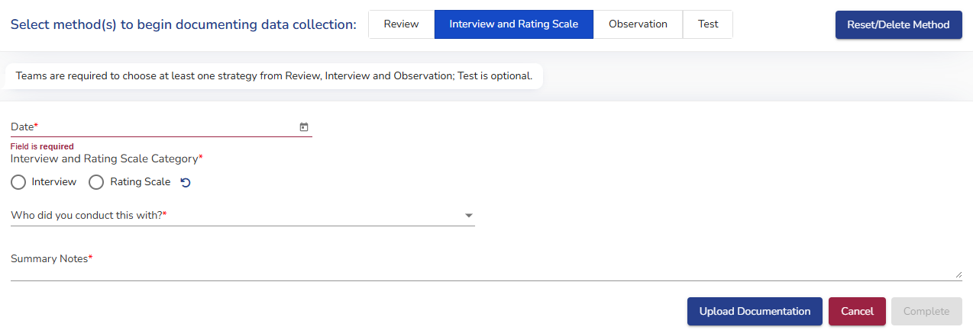
RIOT Data Collected: Interview and Rating Scale
Notes:
For Webinar: Updates have been made to the Interview and Rating Scale method for RIOT Data Collected. Now, users will need to select the "Interview and Rating Scale Category” of either: Interview or Rating Scale, and complete the corresponding required fields.
Once information is entered, the specific method selected will be reflected on the accordion label in the RIOT Data Collected section.

Slide 28
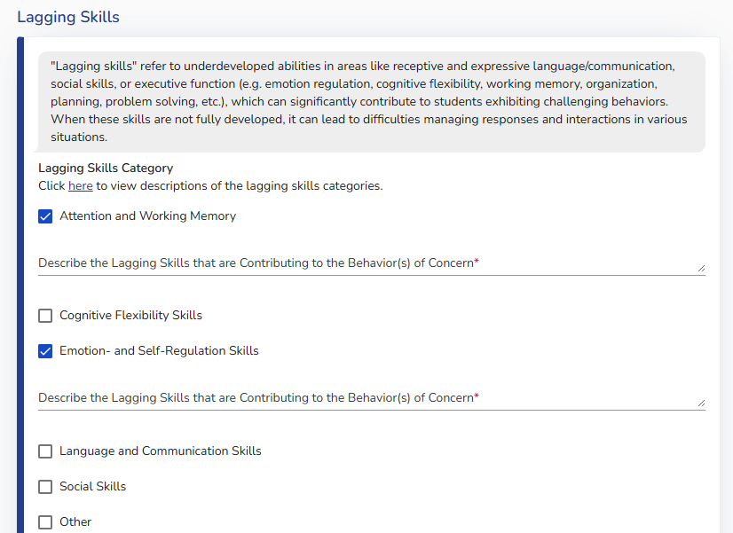
Lagging Skills in FBA
Notes:
For Webinar: As stated earlier, Lagging Skills is a new section added to the Data Collected Stepper. The lagging skills category in the FBA has a blue hyperlink, titled, “here” that will allow the user to view descriptions of the lagging skills categories in order to help support selecting the corresponding category within ACHIEVE.
When conducting a Functional Behavior Assessment, the team should consider which skill area(s) the learner is exhibiting delays in and how these specific deficits may be contributing to the challenging behavior. It is important for the team to provide detailed information about the lagging skills and their potential impact on behavior, as this insight will be valuable to the IEP team when developing the Behavior Intervention Plan.

Slide 29
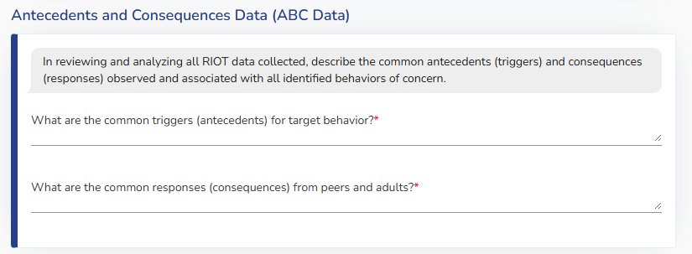
Antecedents and Consequences Data (ABC Data)
Notes:
For Webinar: Antecedents and Consequences Data (ABC Data) has been split from the previous “Summary of Data Collected” card.
Within the Antecedents and Consequences Data (ABC Data) stepper, two text fields are required fields that need to be completed:
What are the common triggers (antecedents) for target behavior?
What are the common responses (consequences) from peers and adults?

Slide 30
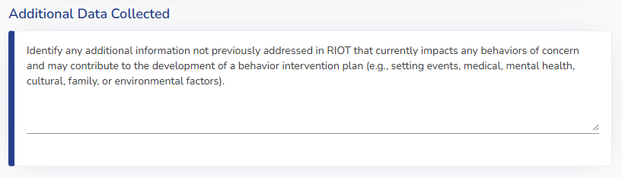
Additional Data Collected
Notes:
For Webinar: The next section, titled Additional Data Collected is accompanied by helper text to help the team with identifying, describing, and considering how ecological and/or environmental factors, such as medical, mental health, and setting events may be contributing to the behavior of concern.

Slide 31
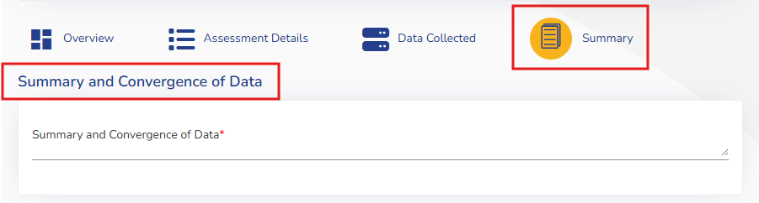
Summary Stepper
Notes:
For Webinar: The summary stepper is the final stepper within the FBA section of the IEP. The hypothesis statement is still housed within the summary stepper and has the same functionality as before, but there are two new sections that have been added:
Summary and Convergence of Data
Recommendations
The Summary and Convergence of Data section is a mandatory field with an expandable text box. The purpose of summarizing and converging the data is to provide the team the opportunity to summarize all the data collected for the FBA and describe general observations beyond specific instances of challenging behavior, allowing for broader insights and conclusions. This process is essential in helping identify key information that addresses why a learner is engaging in the behavior of concern. Understanding the purpose, or function, of the behavior will help guide the team in selecting the most appropriate intervention.
The Recommendations section is an optional section that has been added to allow for the evaluator to provide potential recommendations for the BIP based on the results of the FBA.

Slide 32
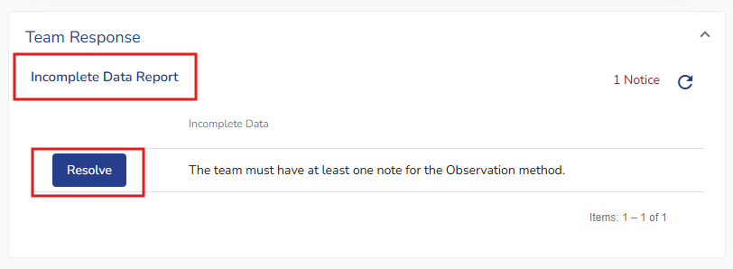
FBA Incomplete Data Report (IDR)
Notes:
For Webinar: Before the FBA can be finalized, an Incomplete Data Report (IDR) will reflect which items, if any, need to be complete. This functions the same as it did prior to the FBA and BIP Updates in ACHIEVE, but teams will want to be remember that the FBA must be finalized before the BIP/IEP can be finalized.

Slide 33
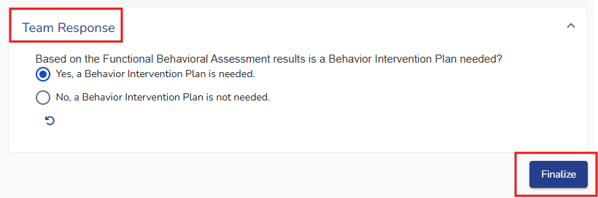
Finalizing the FBA
Notes:
For Webinar: Once all of the IDR items have been completed, the team will need to indicate whether, based on the results of the Functional Behavior Assessment, a Behavior Intervention Plan is required by selecting the corresponding button from the two options shown.

Slide 34
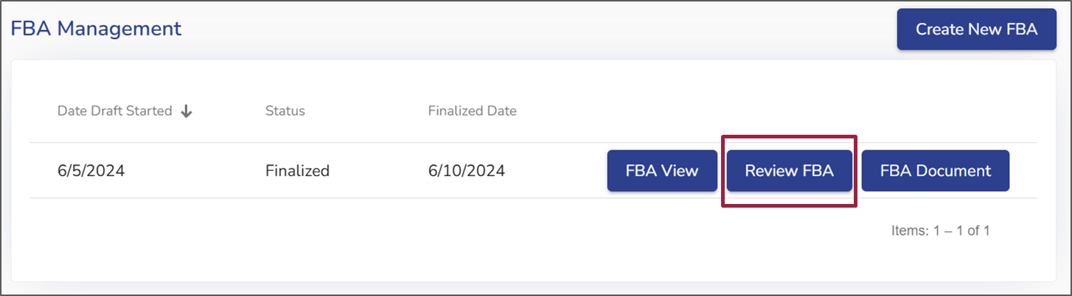
Beginning a Review of a Finalized FBA
Notes:
For Webinar: To perform an FBA review, the team will navigate to the “Evaluation” stepper for the learner. Once on the evaluation stepper, the team will select the “Review FBA” button for the FBA they want to review. A new section will appear labeled “Reviews.”

Slide 35
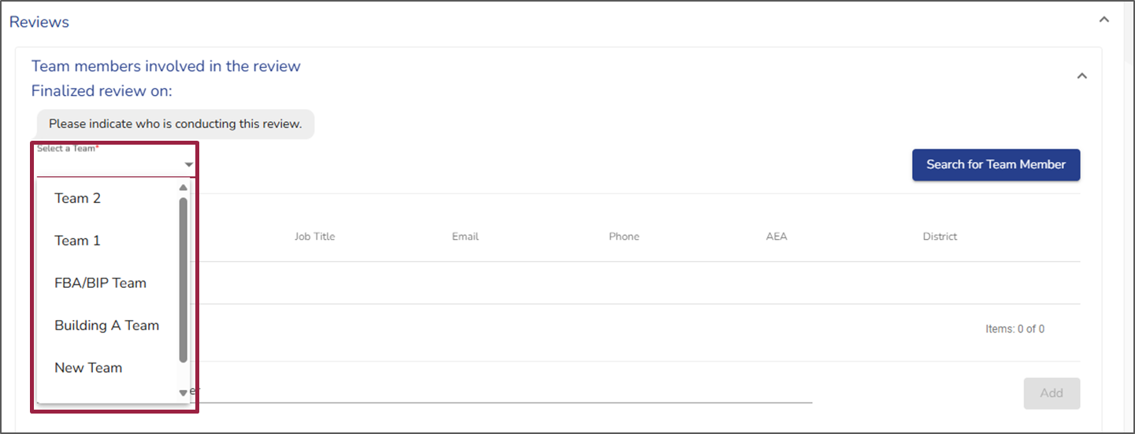
Selecting a Review Team
Notes:
For Live: Once on the “Reviews” page, the team will indicate who was involved in the FBA Review by either selecting a team or searching for team members.

Slide 36
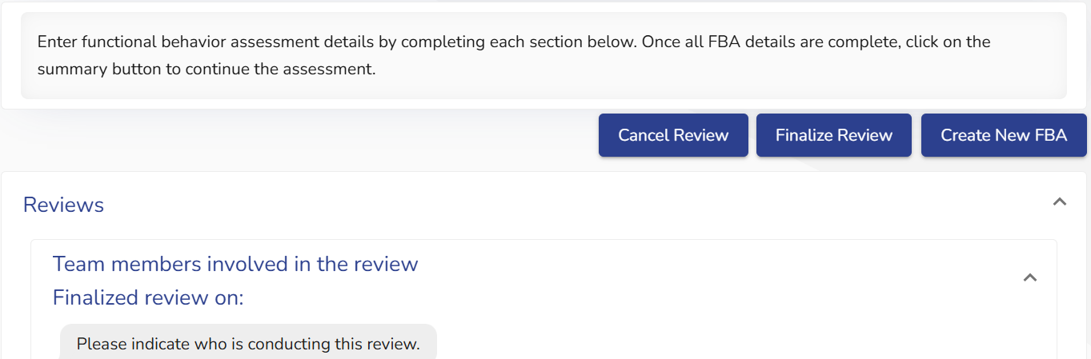
Reviewing a Finalized FBA
Notes:
For Webinar: After the team members have been selected, new blue buttons will appear above the “Reviews” section labeled, “Cancel Review,” “Finalize Review,” and “Create New FBA.” If a team chooses to Create a New FBA, the team will want to finalize the review first, then select Create New FBA.

Slide 37
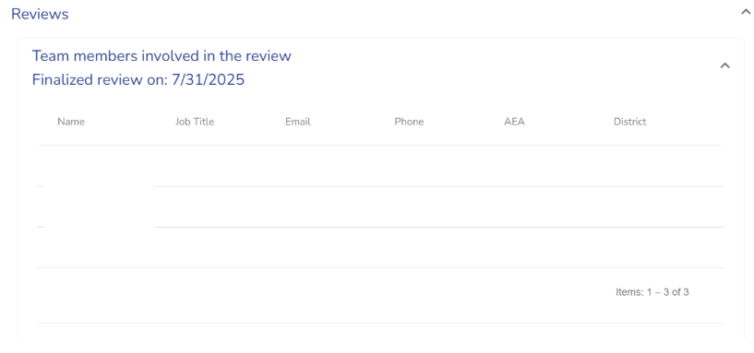
Finalizing an FBA Review
Notes:
For Webinar: Once the team has checked “Finalize Review,” under the “Reviews” section, a drop down menu will appear that, when selected, will display the date the review was finalized on as well as the names of the team members who were involved in the review.
At this point, we are now going to pause the slideshow and navigate to the ACHIEVE system to demonstrate the functionality of the updates to the FBA section of the IEP.
**Note for Admin hosting training**: You may choose to either do a live demonstration, show the live demonstration in the ACHIEVE FBA/BIP Updates Webinar, or opt out of doing a live demonstration

Slide 38
Updates to the Behavior Intervention Plan (BIP)
Notes:
Several changes have been made to the Behavior Intervention Plan section of the IEP. These changes will be reviewed during the next few slides.

Slide 39
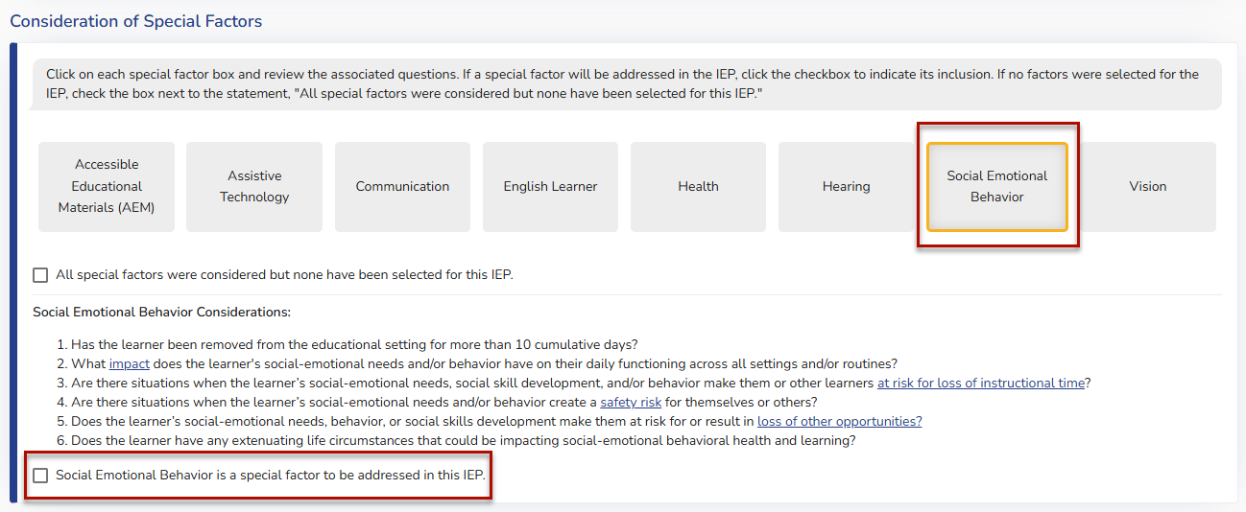
Starting a BIP
PLAAFP Stepper
Consideration of Special Factors
Social Emotional Behavior
“Social Emotional Behavior is a special factor to be addressed in this IEP”
Notes:
Webinar: The functionality for starting a Behavior Intervention Plan (BIP) is the same as it has been since the launch of ACHIEVE. The team will navigate to the PLAAFP stepper and select “consideration of special factors,” then select “social emotional behavior.” This will populate a checkbox that states, “Social Emotional Behavior is a special factor to be addressed in this IEP.”

Slide 40
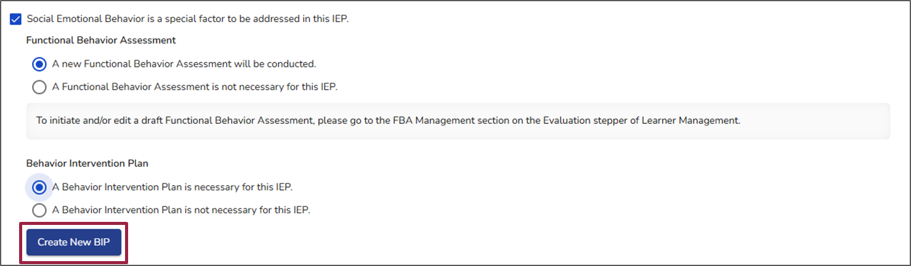
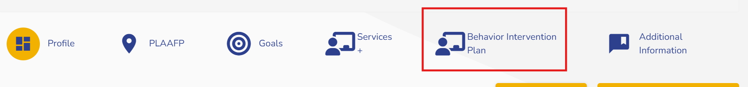
Creating new BIP
Notes:
For webinar: Once this box is checked, two radio buttons will appear for the user to select whether or not a BIP is required for the IEP, and upon selecting “A Behavior Intervention Plan is necessary for this IEP,” the blue “Create New BIP” button will appear. Clicking on the ”Create New BIP” button will then open/create a new Behavior Intervention Plan stepper in the IEP.
The new BIP Stepper will appear after the “Services” stepper and before the “Additional Information” stepper in the IEP, as shown below.

Slide 41
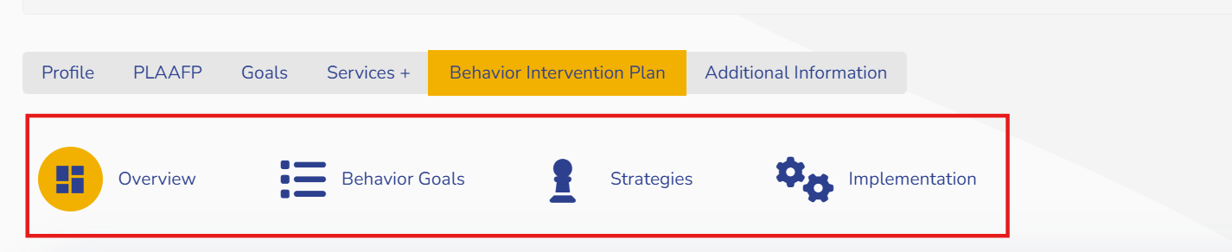
BIP Stepper
Notes:
For Webinar: Once a BIP is associated with an IEP, either through a new IEP or through the amendment process, the team will no longer be able to take any actions related to the BIP from the PLAAFP section. Instead, the team will need to navigate to the Behavior Intervention Plan stepper to take any actions. When this occurs, the user will receive helper text which states “A Behavior Intervention Plan has been initiated for this IEP. Any actions related to the Behavior Intervention Plan will be done on the Behavior Intervention Plan stepper,” reminding the user to navigate to the BIP stepper.
While drafting the Behavior Intervention Plan, either during a draft IEP or when creating a new BIP during an IEP amendment, when the user clicks to navigate to the Behavior Intervention Plan stepper, the Behavior Intervention Plan substeppers will be displayed.

Slide 42
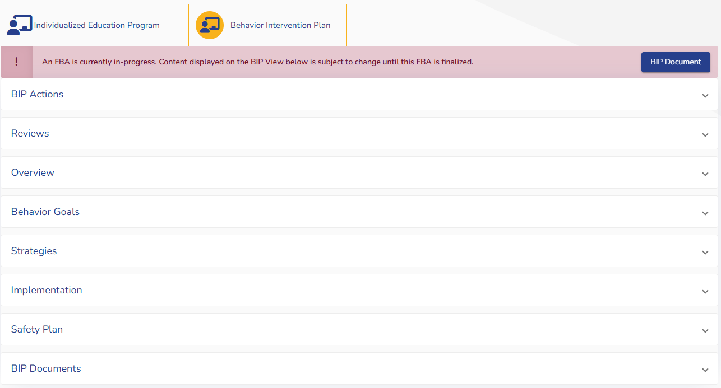
BIP Banner While FBA is Being Drafted
Notes:
For Webinar: The red warning banner shown here will be displayed when a finalized BIP exists in the learner’s IEP and the team has decided to complete a new FBA. Remember, the FBA and BIP talk to each other, so if there is a current FBA open, that information will transfer over immediately as it is completed.

Slide 43
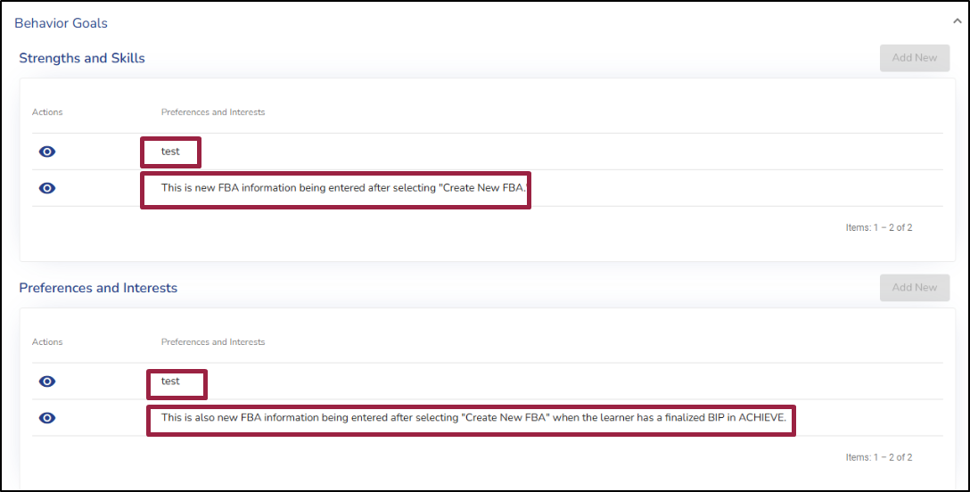
BIP View Screen
Notes:
For webinar: As teams are editing a draft FBA, those changes are automatically reflected on the BIP view screens, so it will be important for teams to be aware that those changes are happening simultaneously when both the draft FBA and draft BIP are open at the same time. If the BIP is finalized, but a new FBA is started, the information on the BIP view screens will be updated according to information from the draft FBA, but it will not impact the finalized BIP document (PDF document).
The image displayed here shows how the BIP view screens will be impacted. The information entered into Strengths and Skills and Preferences and Interests, noted here as “test” is information that is in the finalized BIP/IEP that was originally entered in the BIP. The information highlighted now is from a finalized FBA in ACHIEVE”. As previously mentioned, the information entered in the new FBA will be displayed on the BIP View Screen, but will not be displayed on the BIP Output (PDF document) that is associated with the IEP in the “Documentation” stepper.

Slide 44
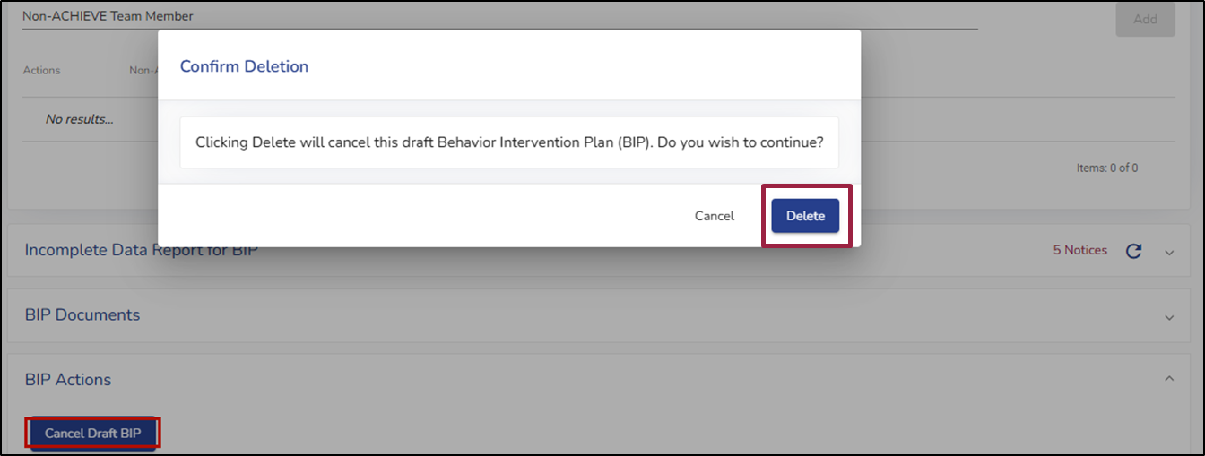
Canceling a Draft BIP
Notes:
For Webinar: When a BIP is in either draft or amendment status it can be deleted by selecting the “Cancel BIP” button. Selecting the “Cancel BIP” button will generate a warning message asking the user if they are sure they want to delete the draft BIP. Selecting “Delete” will delete all information that has been completed in the BIP section of the IEP. Once this selection is made, the information that was deleted will be inaccessible to the user.

Slide 45
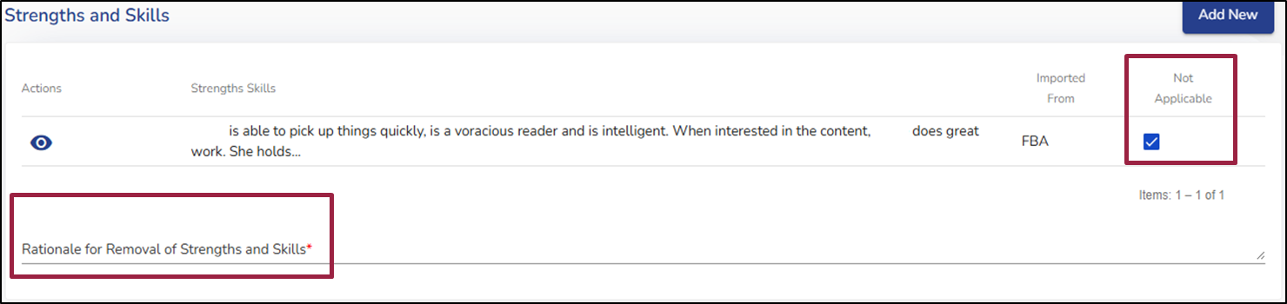
Marking Not Applicable
Notes:
For Webinar: As stated earlier, there will be information that pushes directly to the BIP from the PLAAFP and the FBA in the IEP goals section. The user can mark the information as not applicable, but will need to provide a rationale for why it will not be addressed in the BIP. If multiple items are marked not applicable in a section, the team must provide justification for each one in the box provided. This section now also includes the lagging skills that were identified in the FBA. The user can also add new to any section. These are the only changes in the IEP goals section.

Slide 46
Strategies
Prevention
Teaching
Replacement/Appropriate Behavior Response
Behavior of Concern Response
Lagging Skills
Notes:
For Webinar: There are several changes in the strategies section of the BIP. For every behavior function identified in the BIP, at least one Prevention, Teaching, Replacement/Appropriate Behavior Response and Behavior of Concern Response is required, same as before. One additional section in the strategies stepper includes providing how the identified lagging skills will be addressed.

Slide 47
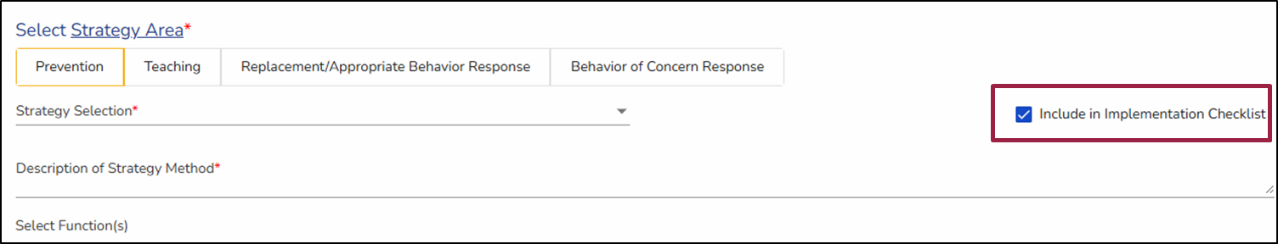
Implementation Checklist
Notes:
For Webinar: The new default setting for the Implementation Checklist is for all strategies to automatically populate into the checklist. If the team agrees that they do not want a strategy included in the checklist, the box next to “Include in Implementation Checklist” can be unchecked to remove the identified strategy.

Slide 48
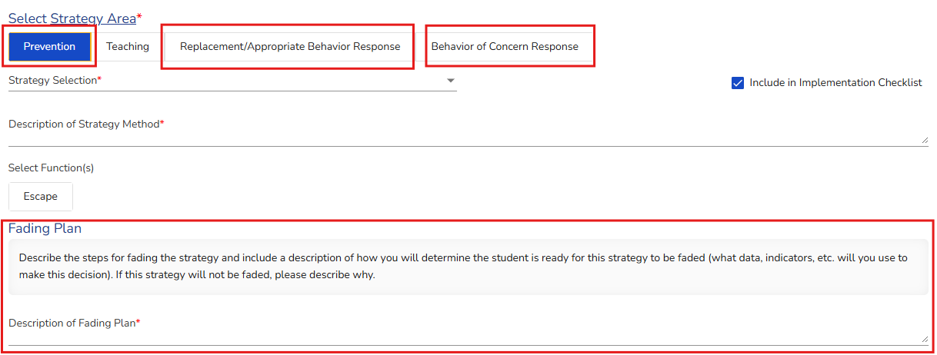
Fading Plan
Notes:
For Webinar: The Fading Plan as it previously functioned has been removed. Now, when adding a Prevention, Replacement/Appropriate Behavior Response, or Behavior of Concern Response, the user must add a Fading Plan for each of these strategies. The user will be prompted to provide a description of the Fading Plan, with helper text above that states, “Describe the steps for fading the strategy and include a description of how you will determine the student is ready for this strategy to be faded (what data, indicators, etc. will you use to make this decision). If this strategy will not be faded, please describe why.” This will allow the user to indicate, with a rationale, why they may decide not to fade a support at that time. This is a required field and will be denoted with a red asterisk.

Slide 49
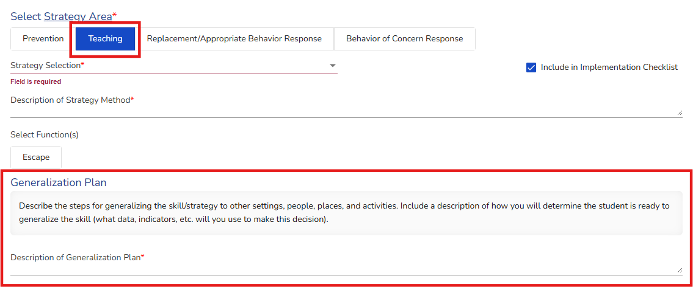
Generalization Plan
Notes:
For Webinar: Similarly, the Generalization Plan has been moved to an embedded question within the Teaching Strategy selection section, with the generalization questions only becoming available for the Teaching Strategy selection. The user will be prompted to provide a description of the Generalization Plan, with helper text above that states, “Describe the steps for generalizing the skill/strategy to other settings, people, places, and activities, as well as a description of how the user will determine that the student is ready to generalize the skill (what data, indicators, etc. will you use to make this decision).” This is a required field and will be denoted with a red asterisk.

Slide 50
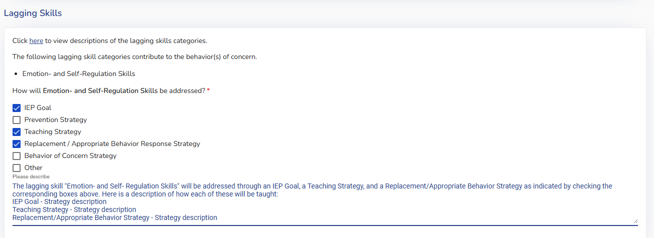
Lagging Skills in BIP
Notes:
For Webinar: The new section of Lagging Skills has been added to both the FBA and the BIP. In the Lagging Skills section of the BIP, the user must state which part of the IEP is being used to support the lagging skills. Multiple boxes may be checked if the team decides to address/teach the lagging skill in multiple ways. In the example shown, the team has decided to address the learner’s lagging skill area of “Emotion- and Self- Regulation Skills” through an IEP Goal, a Teaching Strategy, and a Replacement/Appropriate Behavior Response strategy. The team will describe in the expandable text box how each of the selected items will help support the acquisition of the lagging skill.

Slide 51
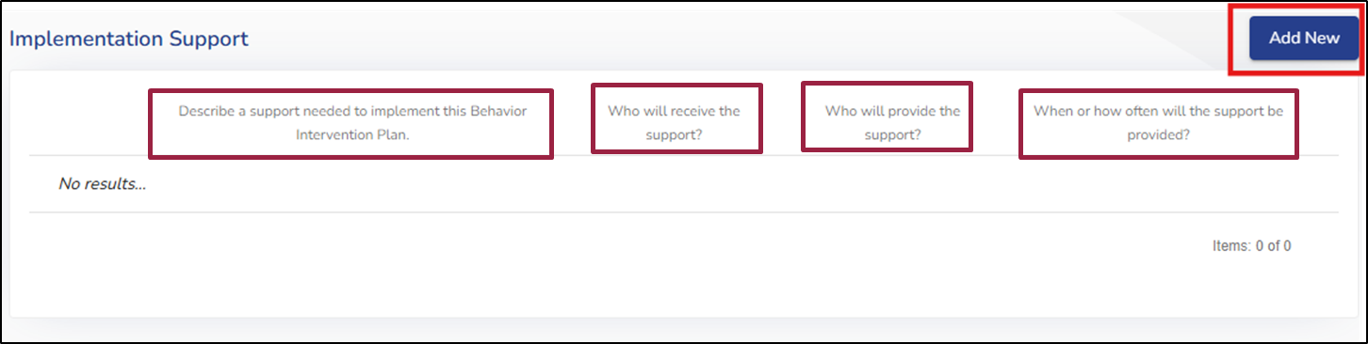
Adding Implementation Supports
Notes:
For Webinar: The Implementation Support card in the Implementation stepper has been updated to more accurately identify the type of support needed, the frequency of the support provided, and the team member responsible for providing support.
There are now four questions on the Implementation Support card:
Describe the support needed to implement this Behavior Intervention Plan.
Who will receive the support?
Who will provide the support?
When or how often will the support be provided?
For Live: Once the user selects Add New, they must add information for each of the four questions as denoted with a red asterisk. Each implementation support added will show in a table below which can be viewed, edited, and deleted as needed. The user will need to select the Add New button to add implementation support information for each type of support needed.

Slide 52
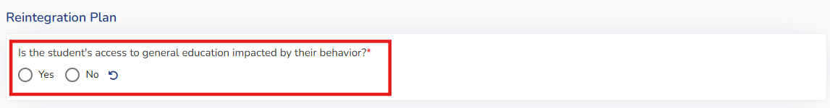
Reintegration Plan
Notes:
For Webinar: The Reintegration Plan has been modified slightly within the BIP. Now, a required field marked with a red asterisk, will prompt the user to answer either “yes” or “no” to the question: “Is the student’s access to general education impacted by their behavior?”
If the student is being removed as any part of their Behavior Intervention Plan OR behavior services such as SDI minutes, the user should mark yes and a reintegration plan should be created and implemented. This is to assure that the team is reviewing the least restrictive environment for a student on a regular basis and the student is not being removed for discipline reasons.
Access indicates removal for any reasons including, but not limited to Specially Designed Instruction, Prevention or Response strategies. For example, if the student has a preventative strategy of taking a break outside of the general education setting, the team would need a reintegration plan for how they will work towards that break occurring in the general education setting. The same would be true if a learner is spending half their day in a self contained setting due to behavior. The team would need to address what the plan is to work towards increasing their time in the general education setting. If the child is being removed from the general education setting as a result of their behavior, this should be marked yes, and a reintegration plan should be created and implemented to increase time in the LRE. The team will then be prompted to answer four additional questions for the Reintegration Plan, which will be reviewed on the next slide.
If the user responds “no,” then no additional questions are asked, and no further steps are required.

Slide 53
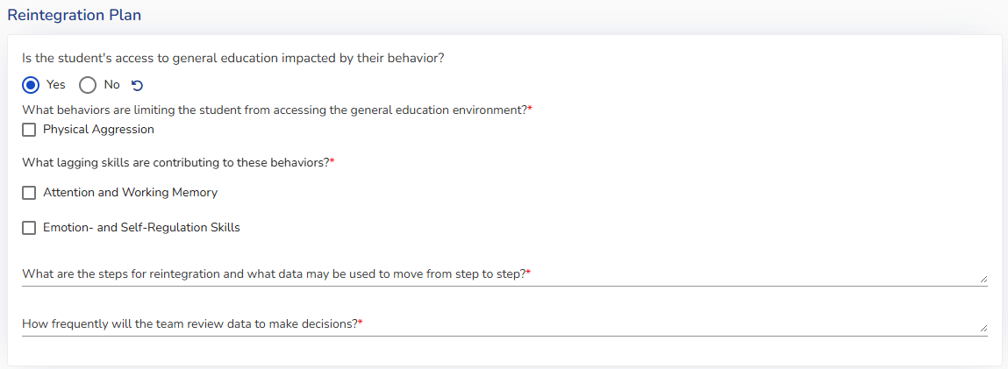
Reintegration Plan Questions
Notes:
For Webinar: If the user responds “yes,” then four additional required questions will populate. The purpose of these questions is to guide the team with using data-driven decision making for increasing a learner’s time in the least restrictive environment, and to ensure that the team is reviewing the LRE for a learner on a consistent basis.
For Live: If the user responds “yes,” then four additional required questions will populate:
What behaviors are limiting the student from accessing the general education environment?
All Behaviors of Concern listed in the FBA/BIP will automatically populate, and multiple behaviors can be selected from the list.
What lagging skills are contributing to these behaviors?
This will pull over the chosen categories from the Lagging Skills section of the BIP, and the team will choose the categories that apply. The team will then describe the specific lagging skill in a text box, and address how that specific skill is contributing to the target behavior(s).
What are the steps for reintegration and what data may be used to move from step to step?
In this section, the team should develop a plan to increase the learner’s time in the Least Restrictive Environment (LRE) when they begin demonstrating targeted skills or when previously limiting challenging behaviors have decreased to a level comparable to that of their typically developing peers. If similar behaviors are present among peers who do not receive special education services, the learner should not be required to completely eliminate those behaviors before returning to the general education setting.
How frequently will the team review data to make decisions?

Slide 54
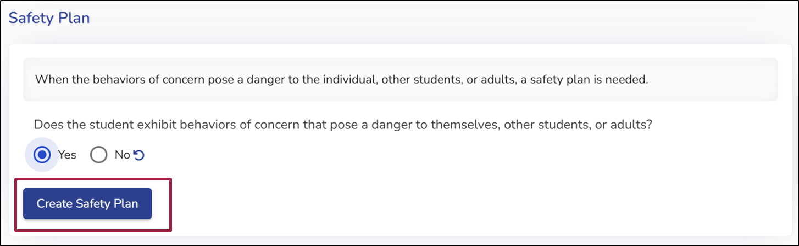
Safety Plan
Notes:
For webinar: The helper text and prompt for the Safety Plan has been changed to state, “When the behaviors of concern pose a danger to the individual, other students, or adults, a safety plan is needed”, and an additional question has been added that states: “Does the student exhibit behaviors of concern that pose a danger to themselves, other students, or adults?” This question requires a yes/no response via radio button selection.
If the user selects, “Yes”, a prompt will be provided to develop a safety plan via an added button that reads, “Create Safety Plan” which directs the user to the Safety Plan stepper. Once the user has navigated to the Safety Plan stepper, no additional changes have been made, and the ACHIEVE system will prompt the user to complete the Safety Plan section.
Next we will share how the review process has changed and how to amend a BIP and some of the changes with amending.

Slide 55
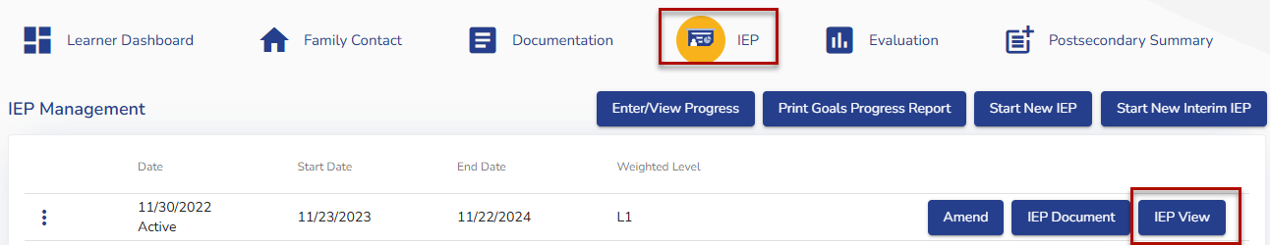

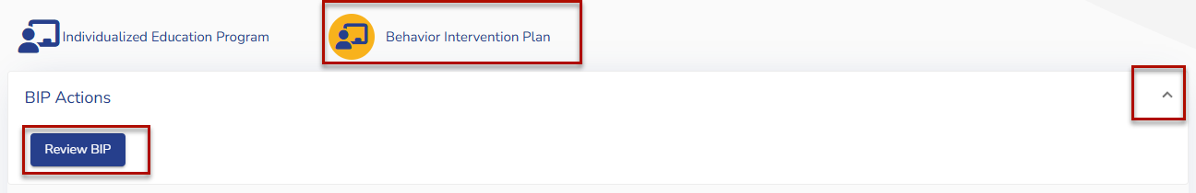

BIP Review
Notes:
For webinar: The team will no longer be able to revise the BIP outside of the IEP processes. Instead, during the lifetime of the IEP, if the team wishes to change the BIP, all steps for the normal IEP amendment process will need to be completed. However, before that decision is made, the team may complete a BIP review to determine next steps. The purpose of the BIP review is to determine if the BIP needs to be changed, to make the changes, an amendment will be required.
For Live: To perform a BIP review, to go the IEP stepper for the learner, and select “IEP View.” Then go to the Behavior Intervention Plan stepper. Here, the team will see a section labeled BIP Actions. Select that to find the “Review BIP” button.

Slide 56
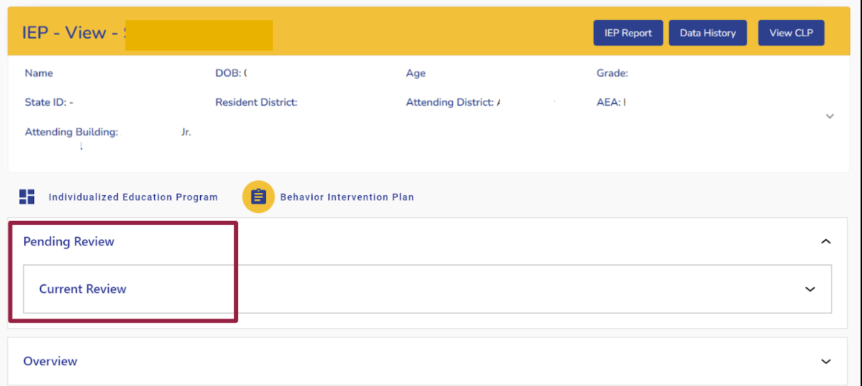
Current Review
Notes:
For live: When the team clicks “Review BIP,” both the “Review BIP” and “BIP Actions” accordions will be hidden. If this is the first review, the helper text in the “Reviews” accordion will change from “Reviews” to “Pending Review.” A “Current Review” accordion will be nested in the “Pending Review” accordion. Need to click on current review dropdown to navigate to review sections

Slide 57
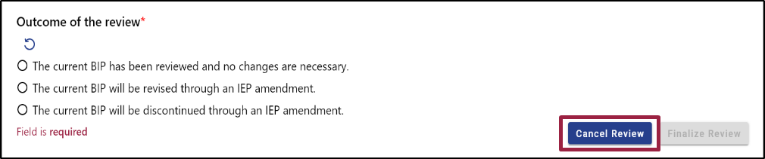
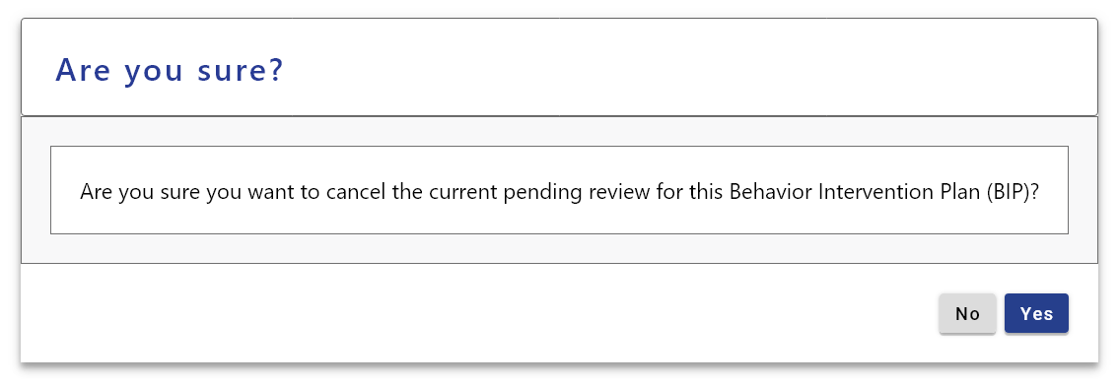
Canceling a BIP Review
Notes:
For Webinar: There is a “Cancel Review” button in the “Outcome of the review” section. If the team selects “cancel review,” they will receive a warning modal that states, “Are you sure you want to cancel the current pending review for this Behavior Intervention Plan (BIP)?” By selecting “yes,” the review is marked as “deleted” in the database, and the canceled review accordion will no longer be visible. The header for the reviews accordion will revert back to “Reviews” instead of “Pending Review.”

Slide 58
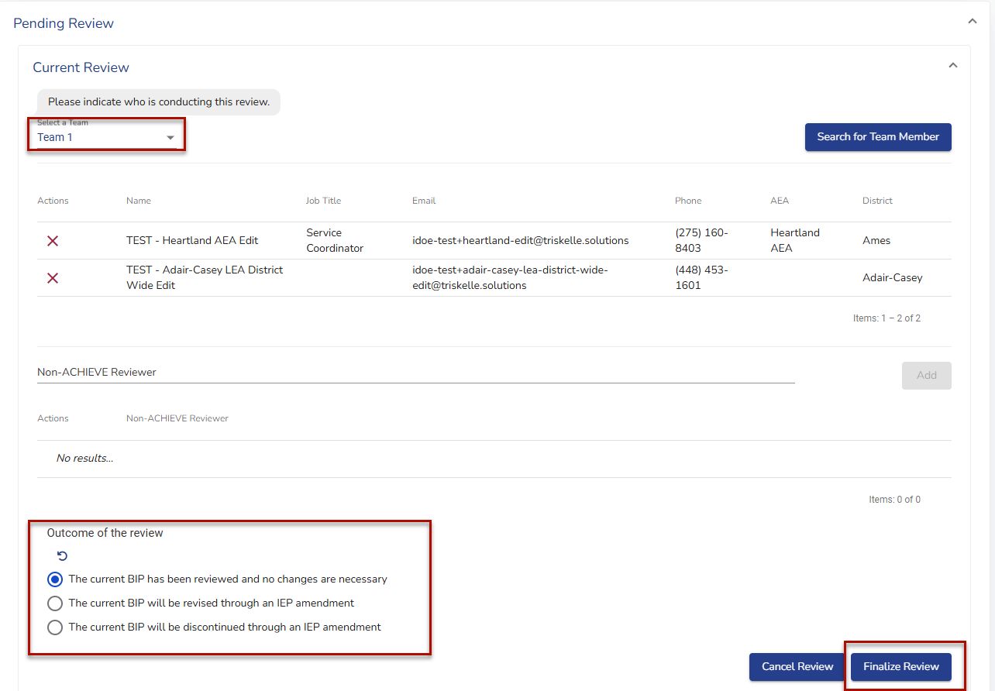
BIP Review Outcome
Notes:
For Webinar:
Opening the “Current Review” accordion will allow the team to pick team members who were involved in the review. This has the same functionality as explained earlier in the “Team Selection” part of this training.
Once a team is selected, a new required field will be created titled “Outcome of the Review.” The new Outcome options are:
The current BIP has been reviewed and no changes are necessary
The current BIP will be revised through an IEP amendment
The current BIP will be discontinued through an IEP amendment
Once the team has selected an option, they can click the “finalize review” button

Slide 59
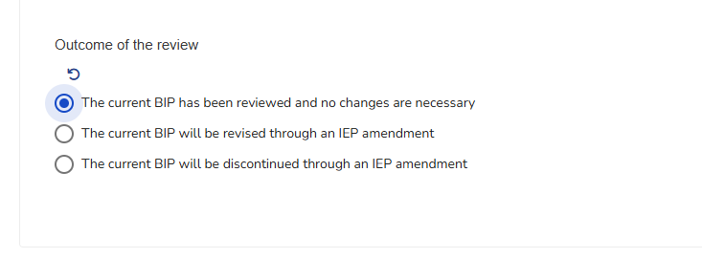

BIP Review Outcome (No Changes)
Notes:
For Webinar: If the team selects “The current BIP has been reviewed and no changes are necessary,” the team will be able to finalize the review and a date and time that the review was completed will appear.

Slide 60


BIP Review Outcomes (Revised)
Notes:
For Webinar: If the team selects The current BIP will be revised through an IEP amendment, the team will be able to finalize and it will show up in the reviews that it was complete.
Note: this is the only indicator that an Amendment needs to occur. Best practice would be to open an amendment as soon as this decision is made to ensure the amendment is complete.

Slide 61


BIP Review Outcomes (Discontinued)
Notes:
For Webinar: If the team selects The current BIP will be discontinued through an IEP amendment, the team will be able to finalize and it will show up in the reviews that it was complete.
Again Note: this is the only indicator that an Amendment needs to occur. Best practice would be to open an amendment as soon as this decision is made to ensure the amendment is complete.

Slide 62

Finalizing a BIP Review
Notes:
For Webinar: Once the team clicks, “Finalize Review” a modal will appear that states, “Are you sure? This will finalize the current review and prevent further changes from being made.”

Slide 63

Historical BIP Reviews
Notes:
For Webinar: Each time a Review is complete, the most recent review is added to the top in the review section.

Slide 64

BIP Review Decision
Notes:
For Live: When the user clicks on the carrot of a review, the review team will drop down and the Output (PDF) of the review decision from the Reviews section can be accessed.

Slide 65

BIP Actions Accordion
Notes:
For Webinar: The buttons embedded within the BIP Actions accordion will vary depending on the current status of the Behavior Intervention Plan (BIP) and the current status of the IEP.
During an IEP amendment (as shown here), the buttons available in the BIP Actions accordion will be Amend BIP, Discontinue BIP, and Create New BIP.
The Amend BIP button, allows the user to make changes to the current BIP
The discontinue BIP button should only be used if the team has agreed the student no longer needs a BIP, if the user click this option with the intention of writing a new BIP, the user will have finalize the current amendment and open a new amendment to start a new BIP.
The create New BIP button is used if the user wants to discontinue the current BIP AND create a new BIP.

Slide 66

Beginning an Amendment
Notes:
For Webinar: If the team decides the Behavior Intervention Plan needs to be amended, this can must be done through an IEP amendment. In order to do this, the team will navigate to the IEP page and open a new amendment.
The team will complete the required fields and then select, “Begin Amendment.” A warning message will appear notifying the team that an IEP amendment will be created and that they will be required to complete the full amendment process.

Slide 67

BIP Actions
Notes:
After clicking Begin Amendment, navigate to the BIP Stepper and expand the BIP Actions section. Select the Amend BIP button. Once selected, the Amend BIP button will be hidden and the Amend buttons on each section will be enabled.

Slide 68

BIP Options
Notes:
For Webinar: On the BIP Stepper, the team can amend each section of the BIP by selecting the Amend button in each corresponding section. The team also has the option to Discontinue the BIP or to Create a New BIP by expanding the BIP Actions section and selecting the corresponding action button.
If the team chooses to amend the BIP, click the blue Amend button on the section of the BIP the user would like to amend. If the button is greyed, that section has already been amended. To open another section, click the blue Amend button and amend each section as needed.
Most of the sections can be amended directly in the BIP with the exception of the “goals” section. This will be amended in the IEP and the team will select associated behavior goals in the BIP.

Slide 69

Amended Social Emotional Behavior Goals
Notes:
For webinar: During an IEP/BIP amendment, a Social Emotional Behavior goal can be changed, but this change occurs directly in the IEP under goals. When this change occurs, the updated functionality of ACHIEVE will now pull the new goal into the BIP goals.The previous goal will appear below the new goal in yellow, with the statement, “Amended on _____” and will also display what the previous goal was, and what the previous monitoring frequency was for the goal.
For the new goal to be added to the BIP, it must be done in the IEP and marked complete.

Slide 70

Adding a New SEB Goal with Current Goal
Notes:
For Webinar: Once the goal is complete, the user will return back to the Goal section of the BIP and the new goal will be available to choose. There are several options when updating goals and there will be different ways to indicate which goals are discontinuing, staying and being added.
In the first goal, labeled “testing environment”, the annual goal highlighted in red is the one originally written and currently linked to the BIP, but will be discontinued. This student had two behavior goals and the second goal remains highlighted in blue to indicate it will continue to be part of the BIP. The third and fourth goals, highlighted in green and labeled “demonstrating functionality” and “A goal to demonstrate the how goals will appear in ACHIEVE have been selected and will be added to the BIP.

Slide 71

BIP IDR
Notes:
For Webinar: The team will be responsible for resolving all of the related IDR items associated with the BIP in the BIP section of the IEP. Once all IDR items are complete for the BIP, the team will see that this section has updated to display “0 Notice” as seen in this image.

Slide 72

Finalizing a New or Amended BIP
Notes:
For Webinar: From the BIP stepper, the team will navigate back to the IEP and complete any IDR items listed for the IEP. When the IDR for the IEP reflects “0 Notice,” navigate to the IEP/Reports dropdown menu, click to expand the menu, then select “Finalize IEP.” When the team selects “Finalize IEP,” the BIP will be finalized at the same time.

Slide 73

Discontinuing a BIP
Notes:
For Webinar: There is an option to discontinue a BIP. This option should only be used if the team has decided the learner no longer needs a BIP. Choosing this option will end the current BIP and remove the BIP from the IEP menu. If the learner continues to need a BIP and minor changes are necessary, choose the amend buttons. If the BIP requires many changes, the team may choose to click Create New BIP which will discontinue the current BIP and start a new one.

Slide 74

Date of BIP Actions
Notes:
When a Behavior Intervention Plan has been written in an IEP, the Special Factors section on the PLAAFP page will display the date the BIP was finalized. If A BIP is amended or discontinued, the PLAAFP page will include bullet points with dates displaying when the BIP was amended or discontinued.
At this point, we are now going to pause the slideshow and navigate to the ACHIEVE system to demonstrate the functionality of the updates to the BIP section of the IEP.
At the conclusion of our demonstration, we will show the slide deck again and orient you to additional training resources and where those can be found on the Department’s website.
**Note for Admin hosting training**: You may choose to either do a live demonstration, show the live demonstration in the ACHIEVE FBA/BIP Updates Webinar, or opt out of doing a live demonstration

Slide 75
Training Resources
Training Materials will be available on the Department ACHIEVE webpage
  FBA/BIP User Guide
  Changes to the FBA and BIP Processes
  Transition Implications for IEP Teams
Notes:
Additional training resources can be found on the Iowa Department of Education website. These resources include:
A User Guide that has been created with coordinated efforts between the Department of Education and our vendor.
A step-by-step guide titled “Changes to the FBA and BIP Processes” with links to information and screenshots of each portion of the FBA and BIP that have been updated
A Considerations for IEP Teams document that provides guidance for FBAs and BIPs that are in draft status at the time of the launch

Slide 76

Open Office Hours
9/15, 9/17, 9/19, 9/23, 9/25 8:00am-10:00am via Zoom
Meeting ID: 820 8810 8163
Passcode: 042218
(515) 330-0582
rose.cartee@iowa.gov
9/16, 9/18, 9/22, 9/24, 9/26 2:00pm - 4:00pm via Zoom
Meeting ID: 838 2007 7149
Passcode: 797353
(515) 975-7769
marie.conklin@iowa.gov
Notes:
In order to support the transition to the updates to the FBA and BIP in ACHIEVE, the Task Team will be hosting open office hours for individuals to join an open Zoom, call the numbers listed here, or send an email request to the email addresses provided. These will occur the first two weeks of the launch and will alternate between morning and afternoon hours. The dates and times listed here provide users with the opportunity to connect with the Task Team in order to help users problem solve common errors. In the event we are unable to provide assistance during the call, we will follow up with the appropriate personnel and provide a response within 48 business hours.

Slide 77
Live Webinars
Wednesday, 9/17
2:00pm - 3:30pm
Wednesday, 10/15
3:00pm - 4:30pm
Zoom Link for Both Webinars
Webinar ID: 811 9803 7032
Passcode: 510645
Notes:
In order to support the transition to the updates to the FBA and BIP in ACHIEVE, the Task Team will be hosting open office hours for individuals to join an open Zoom, call the numbers listed here, or send an email request to the email addresses provided. These will occur the first two weeks of the launch and will alternate between morning and afternoon hours. The dates and times listed here provide users with the opportunity to connect with the Task Team in order to help users problem solve common errors. In the event we are unable to provide assistance during the call, we will follow up with the appropriate personnel and provide a response within 48 business hours.

Slide 78
Thank you!
Notes:
Thank you for viewing our Webinar/attending this training session. If you have any questions, please feel free to reach out to Rose Cartee at the Iowa Department of Education. Enjoy the rest of your day.

