Slide 1
Allowable Uses of
Special Education Funds
August 13, 2025

Slide 2
Panelist Introductions

Slide 3
Dr. Kassandra Cline
Bureau Chief
Bureau of School Business Operations

Slide 4
Bureau of School Business Operations (14)
Special education finance
  SpecialEducationFinance@iowa.gov
Transportation for students with specialized transportation needs
  Tom Simpson, state director for pupil transportation
    Tom.Simpson@iowa.gov
School Budget Review Committee
  Stephanie Edler, School Budget Review Committee Liaison
    Stephanie.Edler@iowa.gov
School finance
  Kassandra Cline, bureau chief
    Kassandra.Cline@iowa.gov

Slide 5
Leisa Breitfelder
Division Administrator
Special Education Division Central

Slide 6
Special Education Division Central
Bureau of Accountability, Data and Finance (11)
(Vacant)
Bureau of Student Evaluation, Instruction, and Supports (15)
Betsy Lin
Bureau of Early Access and Early Childhood (9)
Kimberly Villotti
Attorney for Complaints and Dispute Resolution (2)
Rachel Bosovich

Slide 7
Dr. Angelisa Fynaardt
Division Administrator
Special Education Division Regional

Slide 8
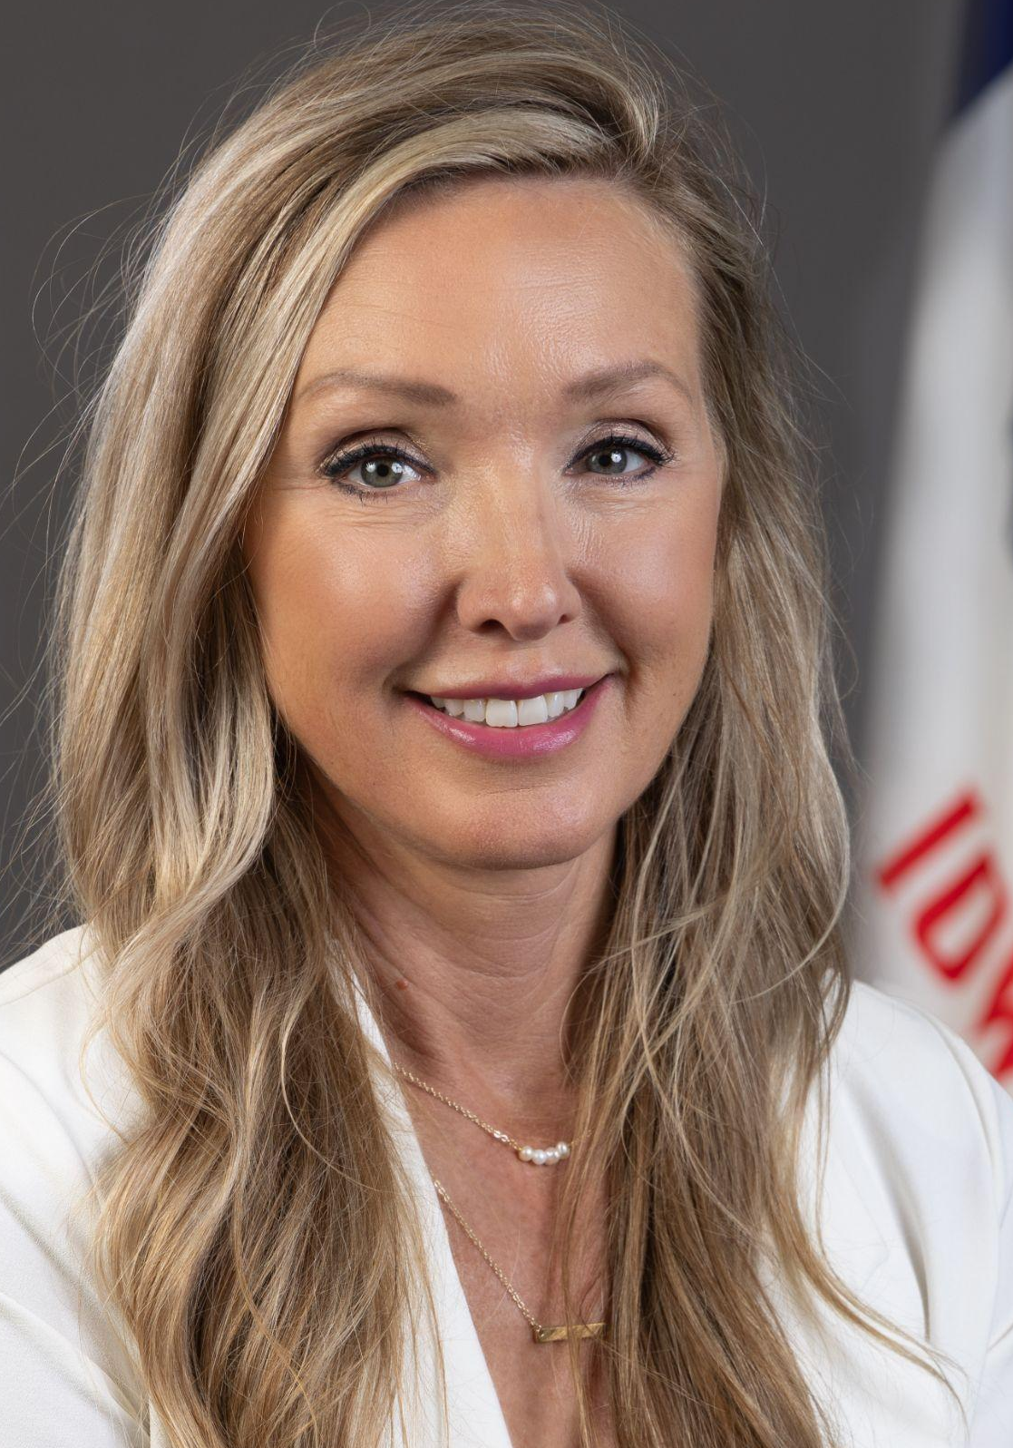
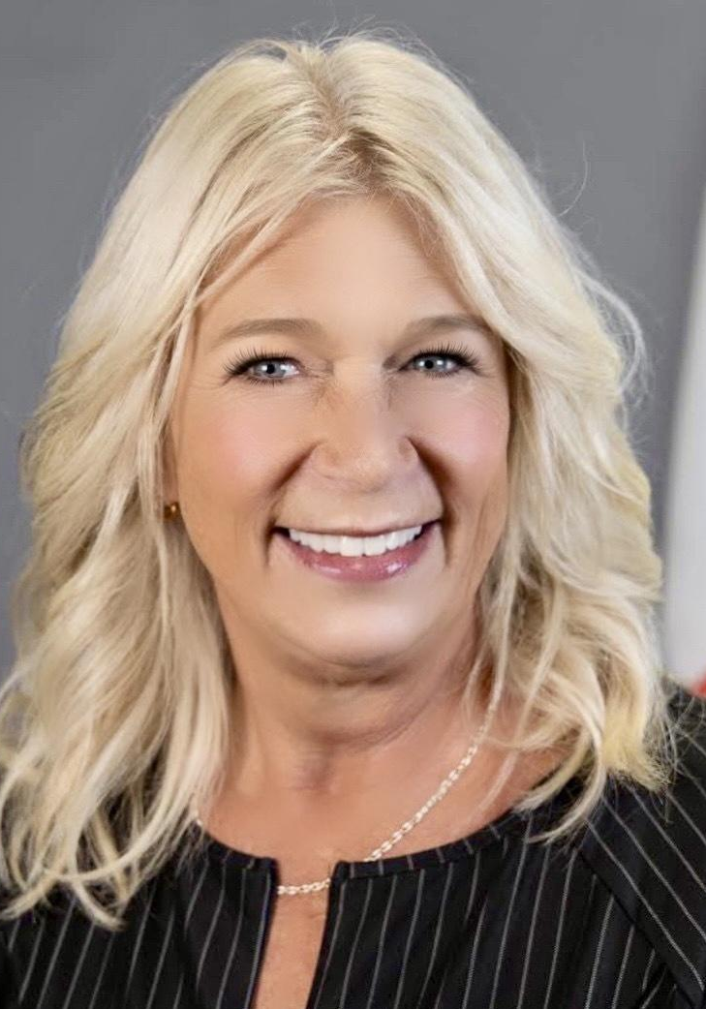
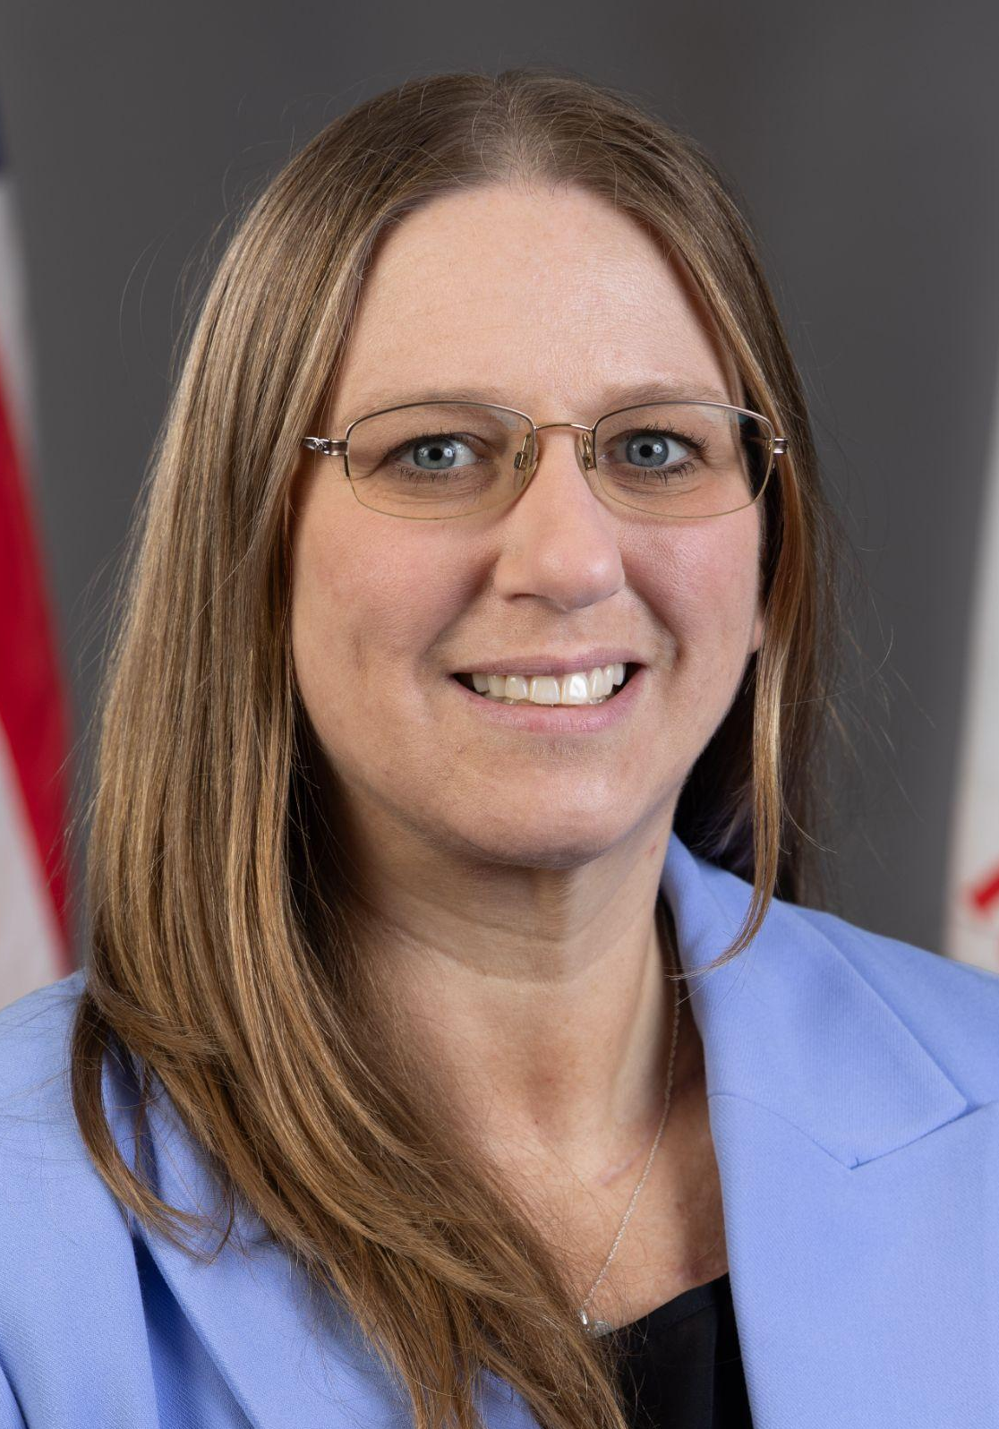
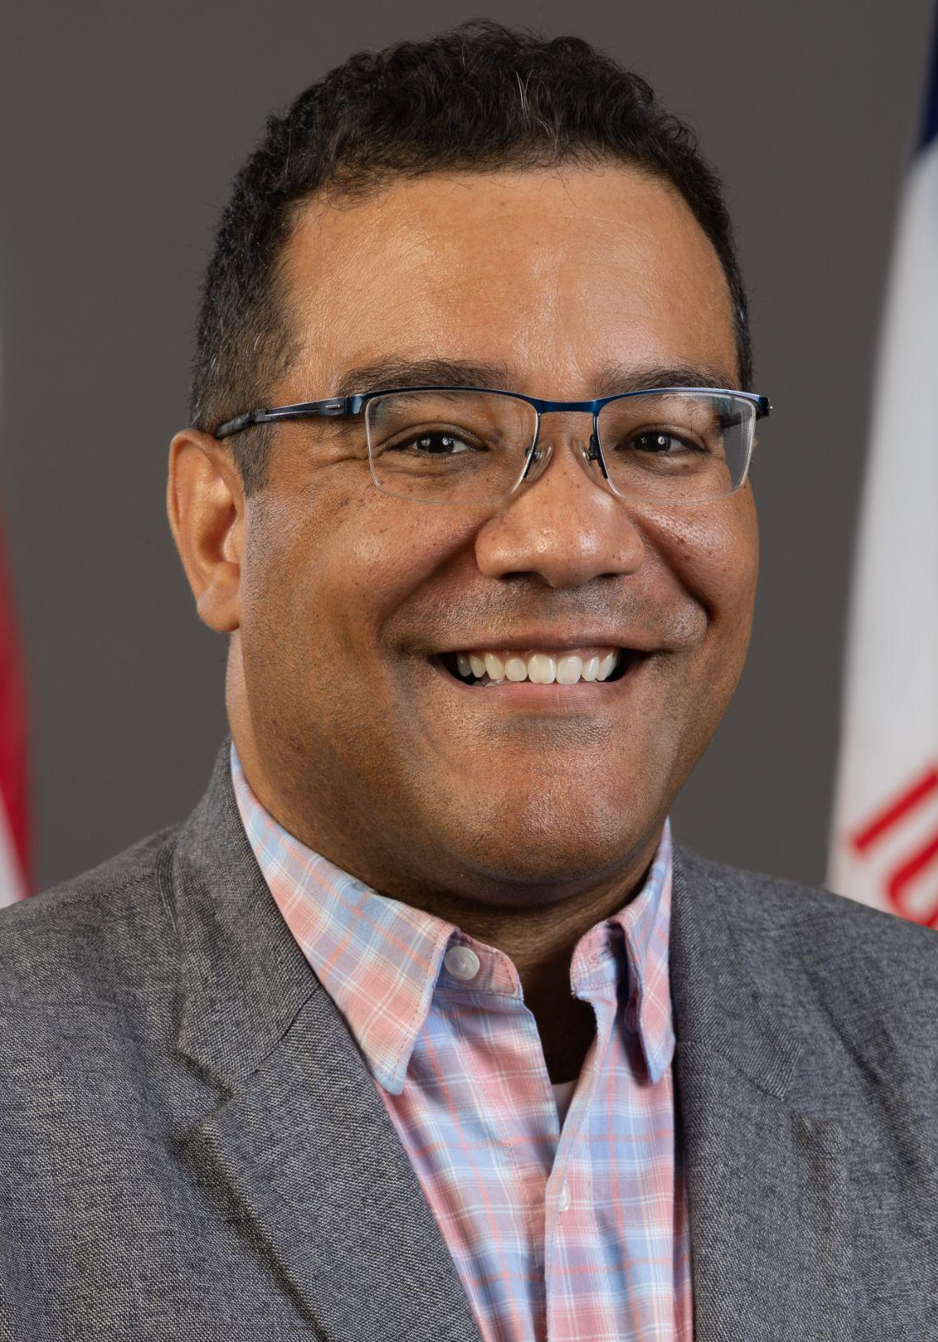
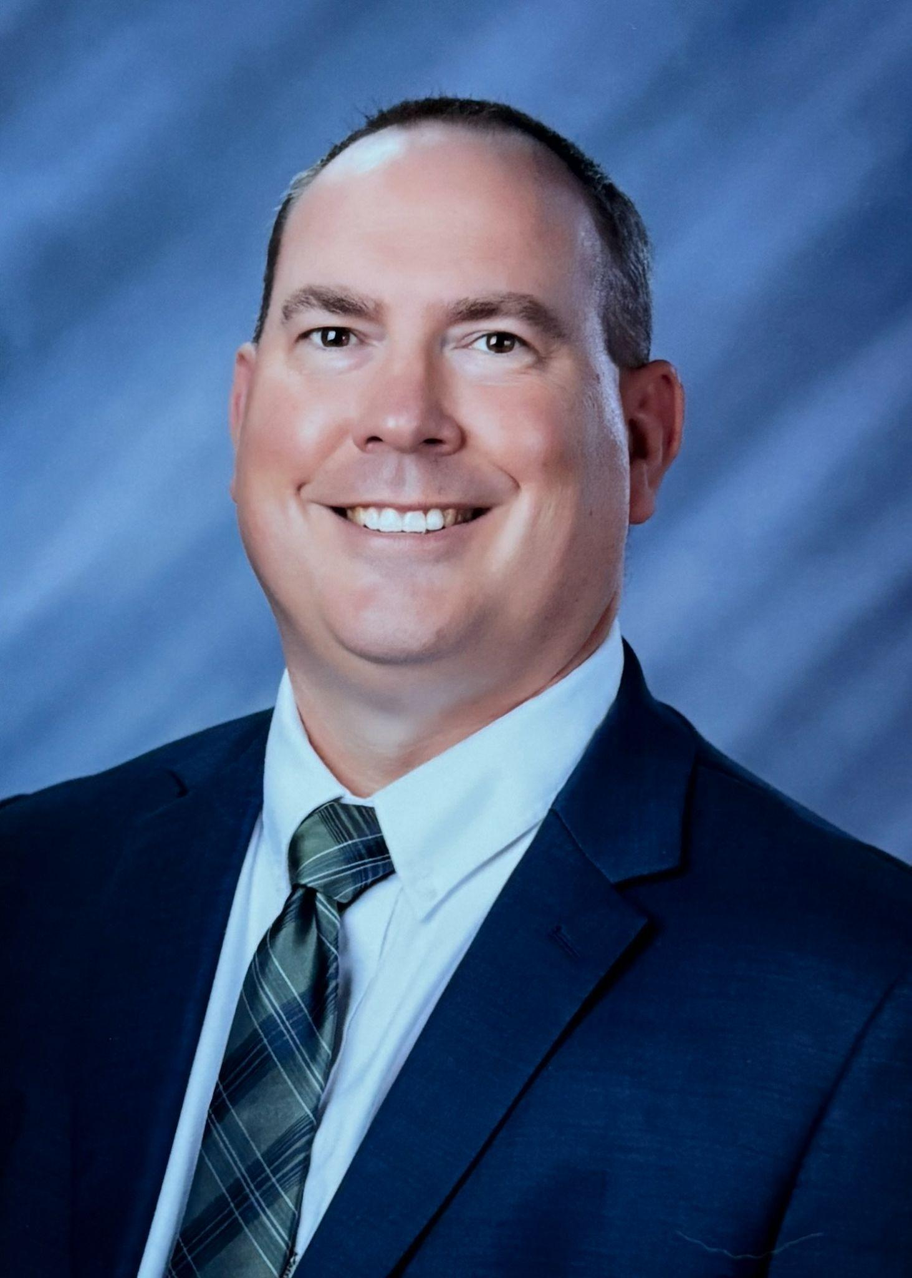
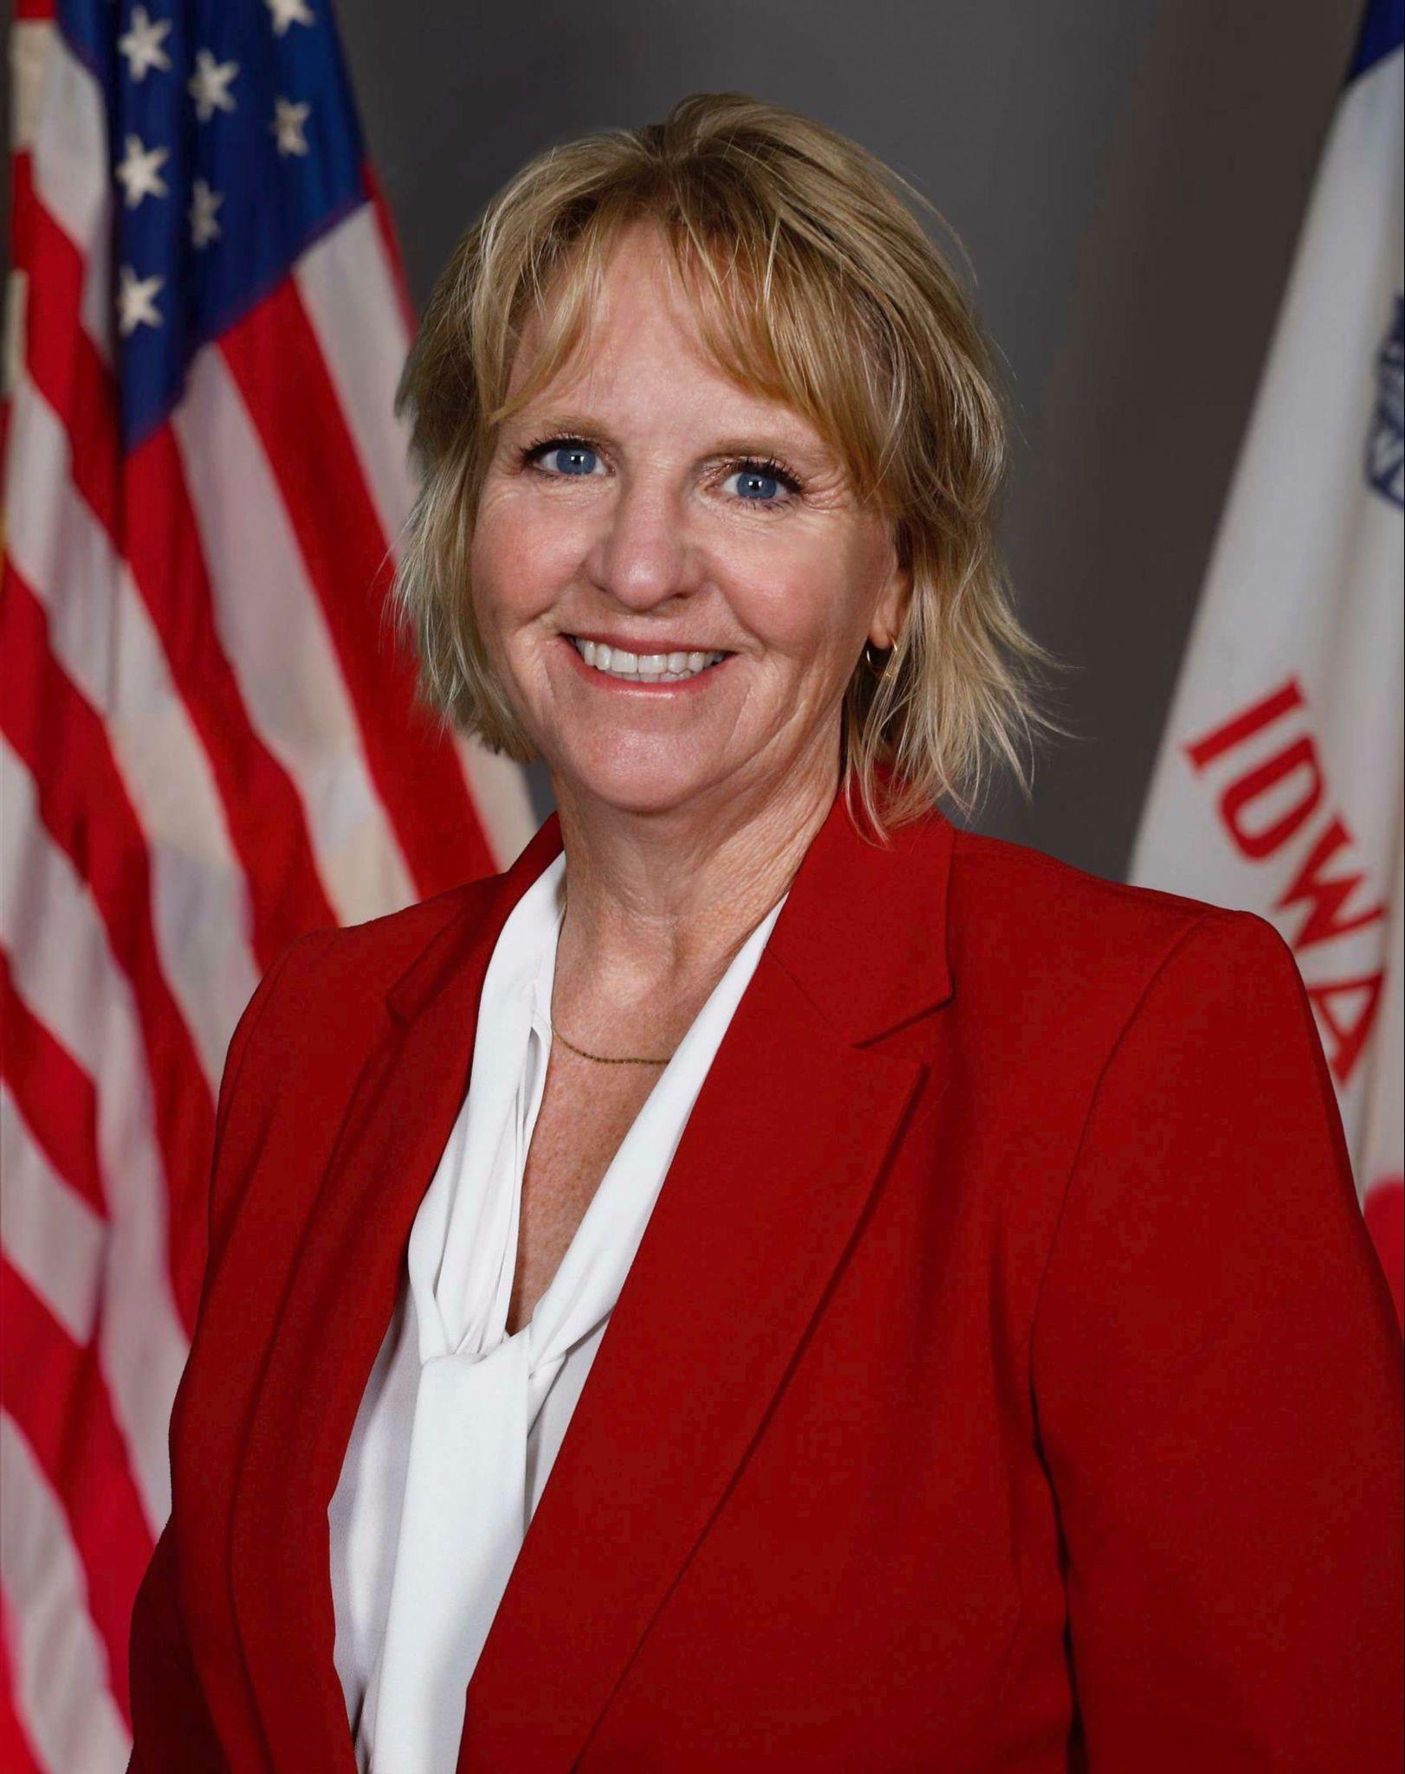
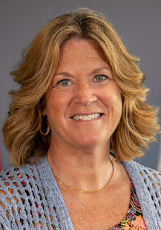
Regional Special Education Directors
Amy Thoms Starr, MAE/ASC
Central Rivers & Keystone AEAs
Regional Director - 3 Years
Special Education Consultant - 19 Years
Special Education Teacher- 5 Years
Janel Lesan, Ed.S.
Grant Wood AEA
AEA Regional Administrator - 22 years
LEA Director of Special Education - 3 years
AEA Special Education Consultant - 5 years
Special Education Teacher - 7 years
Angelisa Fynaardt, Ph.D.
Great Prairie AEA
AEA Special Education Director & Asst./Assoc. Administrator - 13 years
Regional Director - 1 year
Professional Learning Lead - 5 years
School Psychologist - 5 years
Ivan Gentry, Ed.S.
Green Hills AEA
AEA Special Education Director - 3 years
LEA Special Education Director or Coordinator - 5 years
Building Principal - 4 years
Special Education Teacher - 10 years
Matt Cretsinger, Ed.S.
Heartland AEA
LEA Special Services Director - 13 years
AEA Team Leader for Behavioral Supports - 2 years
Professional Learning Lead - 2 years
School Psychologist - 5 years
To be hired
Mississippi Bend AEA
Michelle Havenstrite, Ed.D.
Northwest AEA
Superintendent - 4 years
Principal/Curriculum Coordinator - 7 years
AEA Consultant - 15 years
Special Education Teacher - 6 years
Molly Elston, MAE
Prairie Lakes AEA
AEA Regional Director - 9 years
AEA Special Education Consultant - 3 years
Special Education Teacher - 15 years
Notes:
McKenzie
Leaders on this slide represent over 200 years of special education experience
AEA
-SE Director
-Regional Director
-SE Consultant
LEA
-SE Director
-Principals
-SE Teacher
-School Psych
-Paraeducators
Parents and families of SWDs

Slide 9
Special Education Regional Division
Primary Focus of Our Work
Support continuous improvement efforts in special education in order to close the achievement gap
Provide system coaching for IDEA-Differentiated Accountability & support the implementation of Specially Designed Instruction and continuous improvement work
Implement general supervision in the AEA and districts in the region
Monitor compliance in special education and support implementation or corrective action plans
Complete the special education count process in partnership with districts and the AEA
Assist with the compliant implementation of special education policies and procedures

Slide 10
Mr. Thomas Mayes
General Counsel

Slide 11
Goals
Understand how student reporting generates funding
Differentiate between special education programming and general education programming
Identify costs allowable to the special education program
Recognize costs appropriate to pay from special education support services funding
Locate related resources

Slide 12
Student Reporting

Slide 13
Count: Certified Enrollment
Iowa Code section 257.6(1) Actual enrollment.
Count date: October 1
Report due: October 15
Generates 1.0 weighting and categorical funding
  Teacher Salary Supplement (TSS)
  Teacher Leadership Compensation (TLC)
  Professional Development (PD)
  Early Intervention (EIC)
Note: Audit Adjustment allowed for errors

Slide 14
Count: Special Education
Iowa Code section 257.6(3) Additional enrollment because of special education.
Count date: Last Friday in October
Report due: November 15
Generates weighted funding
  Level 1: 0.72
  Level 2: 1.21
  Level 3: 2.74
Note: Audit adjustment is not allowed for errors.

Slide 15
Count: SESS
Special Education Support Services (SESS)
  Uses weighted enrollment = budget enrollment plus Level 1, 2, and 3 SE weights
Count Type | Student Count | Weighting | Total
Budget Enrollment | 515.9 | 1 | 515.9
SE Level 1 | 50 | .72 | 36.0
SE Level 2 | 20 | 1.21 | 24.2
SE Level 3 | 10 | 2.74 | 27.4
Total |  |  | 603.5

Slide 16
Best Practice: Stakeholder Collaboration
Best Practice: Coordinate proactive collaboration with stakeholders to ensure accurate reporting.
  District leadership
  Business office team
  Special education team
  Student reporting team

Slide 17
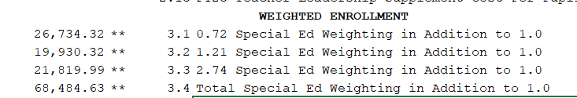
Weighted Funding: Funded
Department of Management (DOM)
  School Resources
  Aid & Levy
  Lines:
    3.1: 0.72 special education weighting in addition to 1.0
    3.2: 1.21 special education weighting in addition to 1.0
    3.3: 2.74 special education weighting in addition to 1.0

Slide 18
Special Education Program

Slide 19
Free and Appropriate Education
What is FAPE?

Slide 20
Specially Designed Instruction
What is specially designed instruction?

Slide 21
Allowable Uses of State and Local Special Education Program Funds

Slide 22
FY24 SE Expenditures & Revenues
Type | Amount | Explanation
Revenue | $1,214,093,797 | Weighted Funding, GPP, Medicaid, Part B
Expenditures | $1,420,687,415 | Services provided pursuant to an IEP – instructional, support, transportation
Special education deficit exceeded $200m in FY24.
Tip: Special education expenditure reviews occurring in FY26 for FY25.

Slide 23
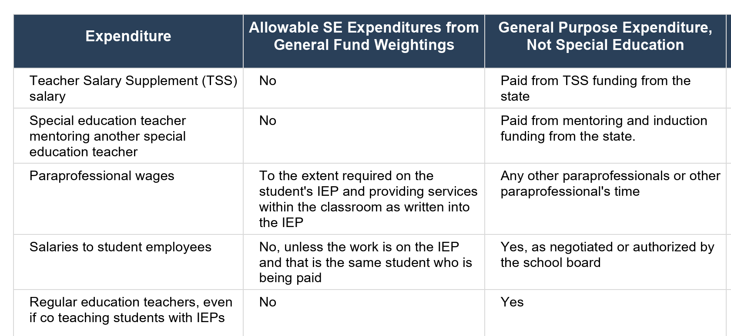
Resource
Chart of Allowable Special Education Costs
Extensive listing of expenditures, identified as allowable from:
  Special ed weightings
  General ed 1.0 funding
  Unallowed expenditure
Tip: Use crtl+F to search by key words

Slide 24
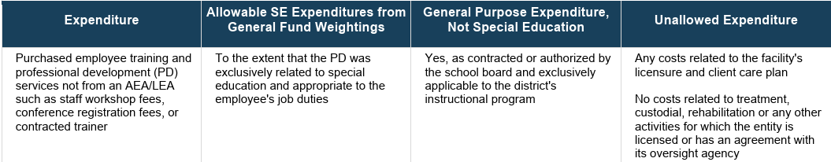
Recent Question: SE PD
Q: Can a district send staff to a special education conference for training and pay for it from special education funds?
A: Yes, you can pay for staff to attend a special education conference using special education weighted funds to the extent that the PD is exclusively related to special education and appropriate to the employee’s job duties. The following scenario is listed on the Chart of Allowable Special Education Costs on the Department’s Special Education Finance web page. You must if the staff training for particular staff members is called for in a student’s IEP.

Slide 25
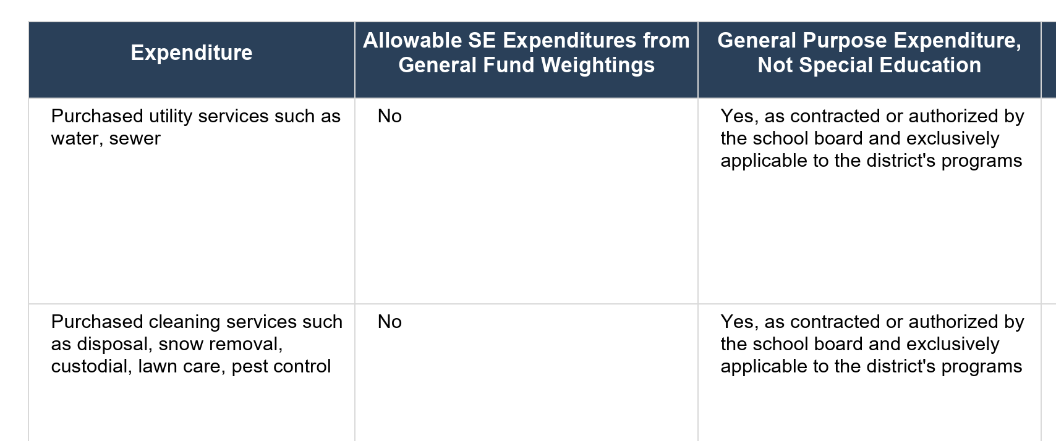
Lesson Learned: Utilities from SE
Q: Can a district pay for utility costs and custodial costs from the special education program?
A: No. The following scenario is listed on the Chart of Allowable Special Education Costs on the Department’s Special Education Finance web page.

Slide 26
Examples of Allowable Costs
Examples of costs necessary to implement an IEP
Special education teacher
Special education paraeducator
Screen reader
Specialized desk
Specially required chair
Large print textbooks
Examples of costs necessary to implement an IEP
Specialized transportation
Bus aide
Room amplification system
Hearing aids
Specialized curriculum
Interpreter

Slide 27
Question: SE Costs
Is every cost related to a special education student a special education cost?
No. Every student is a general education student first.
Authority: Iowa Code section 256B.9(1) (“above the costs of instruction of pupils in a regular curriculum”)

Slide 28
Examples of Unallowable Costs
All students are general education students first.
Only costs that are necessary to implement an IEP are allowable from special education sources.
Computer
  If your school is a 1:1, if the SE student is getting the same computer, it is a GE cost.
Curriculum
  If your school provides curriculum to all students in the same manner, it is a GE cost.
Transportation
  If the SE student is riding the same regular bus route in the same type of seat as their GE peers, the cost of the transportation is a GE cost.
Desks/Chairs
  If the SE student is sitting in the same desk using the same chair as a GE student, it is a GE cost.

Slide 29
Special Education Support Services

Slide 30
State Funded: Special Education Support Services
Special Education Support Services (SESS)
Iowa Administrative Code r. 281-41.409
  Support services. Support services are the specially designed instruction and activities that augment, supplement or support the educational program of eligible individuals. These services include special education consultant services, educational strategist services, audiology, occupational therapy, physical therapy, school psychology, school social work services, special education nursing services, and speech-language services. Support services are usually provided by the AEA but may be provided by contractual agreement, subject to the approval of the board, by another qualified agency.
How do districts differentiate between special education programming and special education support services?

Slide 31
SESS Funding
Up to FY25
  SESS funds were 100% retained by the AEAs.
Beginning FY26:
  90% special education support services budgeted with AEA
  10% retained by the district
    May be used to pay for services from the AEA
    May be used to pay for services from an entity other than an AEA
    May be spent on eligible district costs

Slide 32
Recent Question: SESS Allowable Uses (Cont.)
SESS Funds: Eligible District Costs
  Special education support services
  Special education program costs
Note: If a special education deficit balance is experienced, the district should not also have an SESS balance.

Slide 33
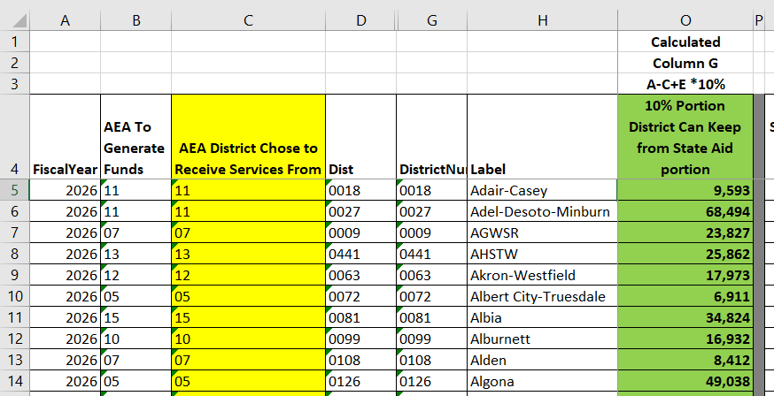
SESS – Locating Amounts
Location #1 – Annual Funding
  Department of Management’s School Resources web page
  File: AEA Enrollment and Cost Detail
  Tab: Special Education Breakdown

Slide 34
Recent Questions: SESS – Locating Amounts
Location #2 – Monthly Funding
  Department of Education State Payment Information web page
  Section: State Payment Information FY26
  Sub-section: LEA Monthly Payment Summaries
    Files will be posted monthly beginning in September

Slide 35
Resources
Web page: HF2612 Implementation
Resource HF2612 Implementation FAQ
Resource: AEA Special Education Funded Staff Involvement in General Education Interventions
Resource: Distribution and Use of State and Federal Special Education Allocations Beginning FY26

Slide 36
Recent Question: Paying for Special Education Director
Q: How can a district pay for a Special Education Director?
A: The district can use unobligated General Funds or, beginning in FY26, the district may use the 10% retained special education support services funding to pay for special education administrative costs.
Tip: Be sure to track time and effort for employees with split responsibilities to ensure funding aligns to duties.
Funding Example:
Employee Duties | Percent Duties | SESS | Unobligated General Fund
Special Ed Director | 30% | 30% | Up to 30%
Principal | 70% | 0% | 70%

Slide 37
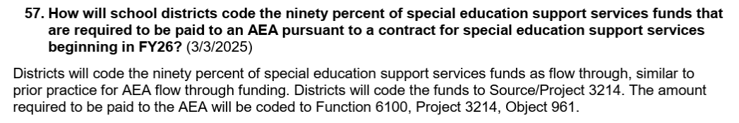
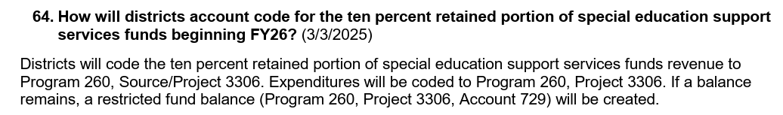
Recent Questions: SESS – Account Coding
Q: What is the account coding for the 10 SESS payments to the AEA?
Resource HF2612 Implementation FAQ

Slide 38
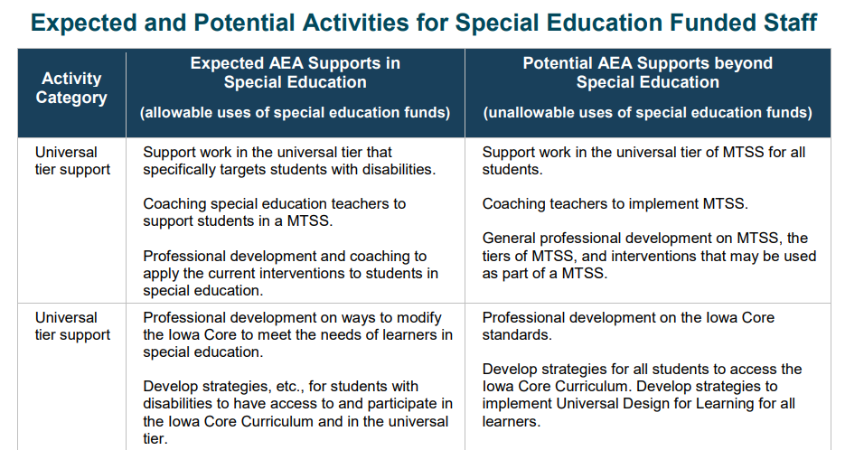
Resources
Resource: AEA Special Education Funded Staff Involvement in General Education Interventions

Slide 39
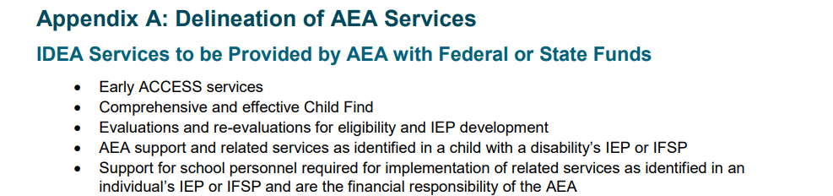
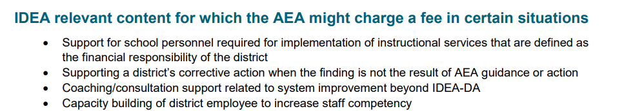
Resources: Delineation of Services
Resource: Distribution and Use of State and Federal Special Education Allocations Beginning FY26

Slide 40
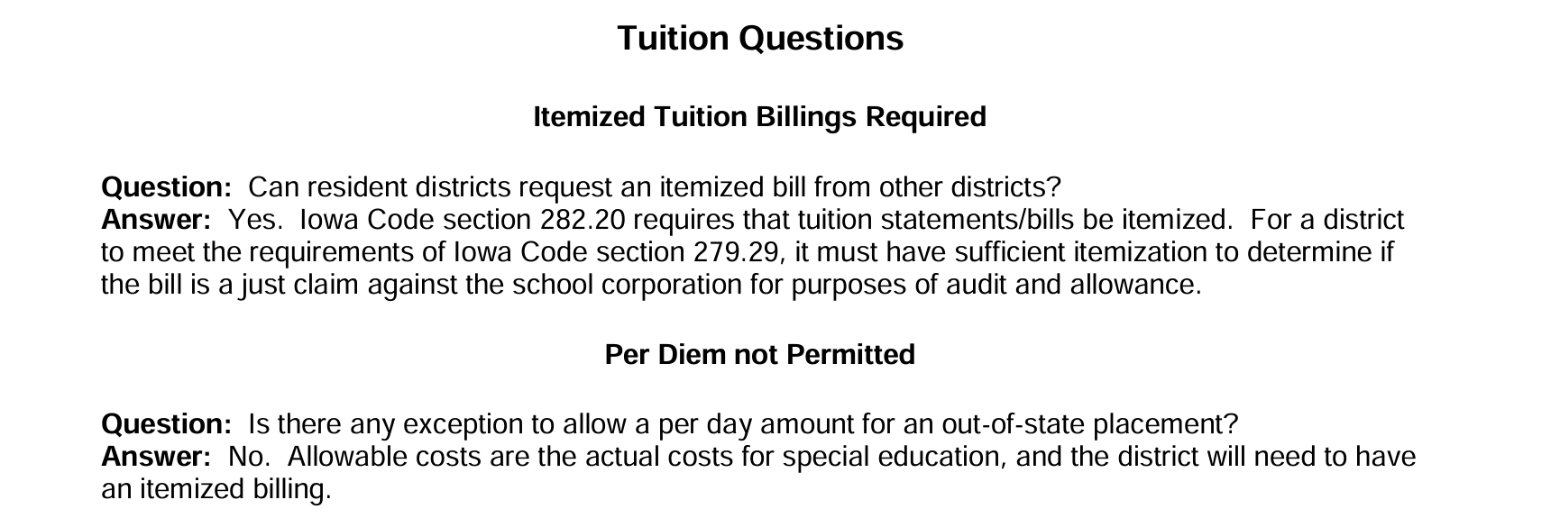
Resources: Permissive Uses
Resource: Permissive and nonpermissive uses of special education funds

Slide 41
Differentiating Programming

Slide 42
Differentiating Programs
It is critical to differentiate between general education programming, special education programming, or other programs to ensure funds used to support each program are allowable uses.
Example: a child without a reading goal in her IEP receives supports from Early Literacy Implementation under Iowa Code section 279.68. The child is not proficient in reading; however, the child’s lack of proficiency is not related to the child’s disability. This is not a special education cost.

Slide 43
Programming Examples
There are various programs throughout the day in which a student may be engaged for which costs may have different funding sources.
Examples:
Special education
SWVPP
Head Start
Childcare
Tuition-based preschool
Alternative school programming
EL programming
Title programming
TAG programming
Co-curricular/extracurricular programming

Slide 44
Recent Question: Verifying Appropriate Costs
What can be done throughout the year to ensure only allowable costs are charged to the special education program?
Proactive Check:
  Ensure staff who are coding and/or approving SE expenditures know how to verify it is an appropriate cost to the special education program, special education support services funding (i.e.,10% retained), or another source.
Reactive Check:
  Ensure there is a process to incrementally review expenditures coded to special education.
  Conduct throughout the year and at the end of the year to verify only allowable costs were charged and that district policy and processes for verification and approval were followed.

Slide 45
Time & Effort Documentation
Tracking Hourly Employees
Initial scheduled assignment
Identify students enrolled in classroom
Weekly or bi-weekly timecard
Lesson Learned: Ensure time and effort is tracked for hourly employees who stray from their regular schedule.
Example: 1:1 SE paraeducator whose assigned student doesn’t attend school that day.

Slide 46
Time & Effort Documentation
Documentation
Incorporate into official records
  Payroll records
  Position assignments
  Student records
Tips: Internal Controls
Support the process through a system of internal controls which provide reasonable assurance that charges are accurate, allowable, and properly allocated.
  Develop written procedures
  Verify incrementally and ongoing that written procedures are followed.
  Documentation should reflect implementation of process.

Slide 47
Differentiating Programs
  Identify all of the funding sources that could be used to fund costs related to a student that is involved in the programming below.
  Student is a level 2 special education student.
  Student is transported in the morning by the district.
  Student attends Head Start programming in the morning before breakfast.
  Student leaves to go to breakfast.
  Student spends the remainder of the morning in the SWVPP, during which the student has a one-on-one para to support behavioral challenges.
  Student leaves to go to lunch.
  Student spends the afternoon first engaged in receiving individualized writing supports to which the student is entitled to pursuant to the IEP.
  Student spends the remainder of the afternoon in childcare.
  Student is transported home by the district in the afternoon.

Slide 48
Apply Your Knowledge: Group Activity
  Identify all of the funding sources that could be used to fund costs related to a student that is involved in the programming below.
  Student is a level 2 special education student.
  Student is transported in the morning by the district.
  Student attends Head Start programming in the morning before breakfast.
  Student leaves to go to breakfast.
  Student spends the remainder of the morning in the SWVPP, during which the student has a one-on-one para to support behavioral challenges.
  Student leaves to go to lunch.
  Student spends the afternoon first engaged in receiving individualized writing supports to which the student is entitled to pursuant to the IEP.
  Student spends the remainder of the afternoon in childcare.
  Student is transported home by the district in the afternoon.
  Answers:
    Special education
    Child care tuition
    General state aid
    Head Start
    National School Lunch Program
    SWVPP

Slide 49
Recent Question: SE Teachers & TSS
  Are all teachers required to have a portion of their salary paid from TSS funds?
    Answer: No. School districts may choose to maximize the use of other funding sources to fund the single salary system, pursuant to Iowa Code section 284.3A.
      The negotiation process to determine final salaries is a process separate from identifying the funding source(s) that will pay for each teacher’s salary.
      For example, the salary of a TAG teacher may be fully funded by TAG funds and not include any funding from TSS.
      Iowa Administrative Code r. 281-98.24(1) limits the use of TSS funding to additional salary for teachers, including amounts necessary for the district to comply with statutory teacher salary minimums. Iowa Administrative Code r. 281-98.24(3) gives deference to local school board decisions regarding distribution methodology. School districts are encouraged to be mindful when using funding sources that could potentially create or increase a tax burden on local taxpayers (e.g., special education funding) in place of TSS funding.
Tip: The HF2612 FAQ is available on the Department’s HF2612 Implementation web page.

Slide 50
Other Recent Questions

Slide 51
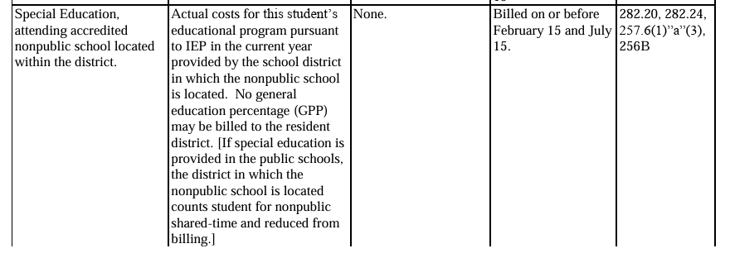
Recent Question: Students Attending Nonpublic Schools
Q: Who is responsible for fulfilling paraeducator support minutes written in an IEP for special education students attending a nonpublic school? Is the district only responsible to provide funding up to the amount generated through weighted funding?
A: Actual costs for this student’s educational program pursuant to the IEP of the current year is provided by the school district in which the nonpublic school is located.
Please see the information below from Chapter 4 of the Uniform Administrative Procedures manual.

Slide 52
Recent Question: ESPSS & SE Staff
Q: Do districts have to pay ESPSS funds to SE Staff?
A: No. Districts determine how to use the funds to supplement personnel wages.

Slide 53
Recent Question: Students Attending Charter Schools
Q: Who is responsible for SE Costs for students attending charters.
A: Charter schools are required to bill resident districts for actual costs incurred to provide special education services (Iowa Code § 256E.8(2)”b”)).
Q: Can the resident district be included in IEP meetings?
A: Yes, and they must be, because the resident district is expected to pay the actual costs of specially designed instruction. If the resident district does not appear, that is the resident district’s choice.
Q: How do students attending charter schools receive special education support services and who is responsible for the related costs?
A: Accessing special education support services from the AEA: The students at charter schools were included in the "count" of students that generated the Part B funding to AEAs and on the special education count of the resident district that generated the 90% state special education support services funding districts will pay to AEAs . Therefore, charter schools and students attending charter schools should have access to the same services being provided as part of the service agreement contract for school districts for no additional cost.

Slide 54
Contacts
Dr. Angelisa Fynaardt
Division Administrator
Special Education Division Regional
Angelisa.Fynaardt@iowa.gov
Mrs. Leisa Breitfelder
Division Administrator
Special Education Division Central
Leisa.Breitfelder@iowa.gov
Mr. Thomas Mayes
General Counsel
Thomas.Mayes@iowa.gov
Dr. Kassandra Cline
Bureau Chief
Bureau of School Business Operations
Kassandra.Cline@iowa.gov

Slide 55
Questions?

