Slide 1
Free Appropriate Public Education
(FAPE)
Special Education Policy & Practice Webinar Series
May 14, 2025

Slide 2
Welcome
Please post your questions in the Q&A.
Slides will be posted on the DE website after the webinar.
Policy & Practice Webinar Series & Recordings

Slide 3
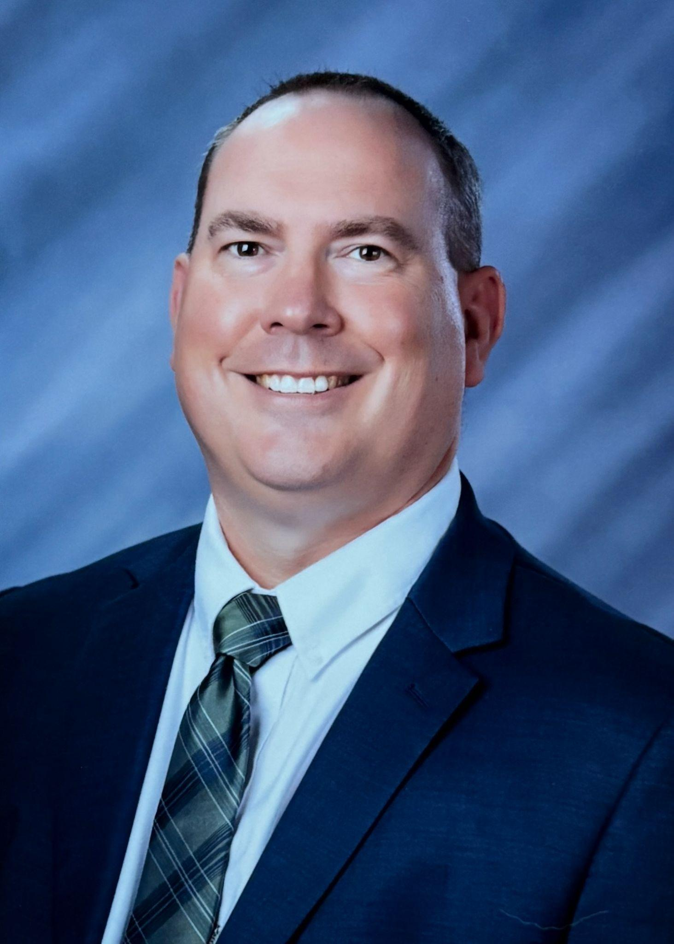
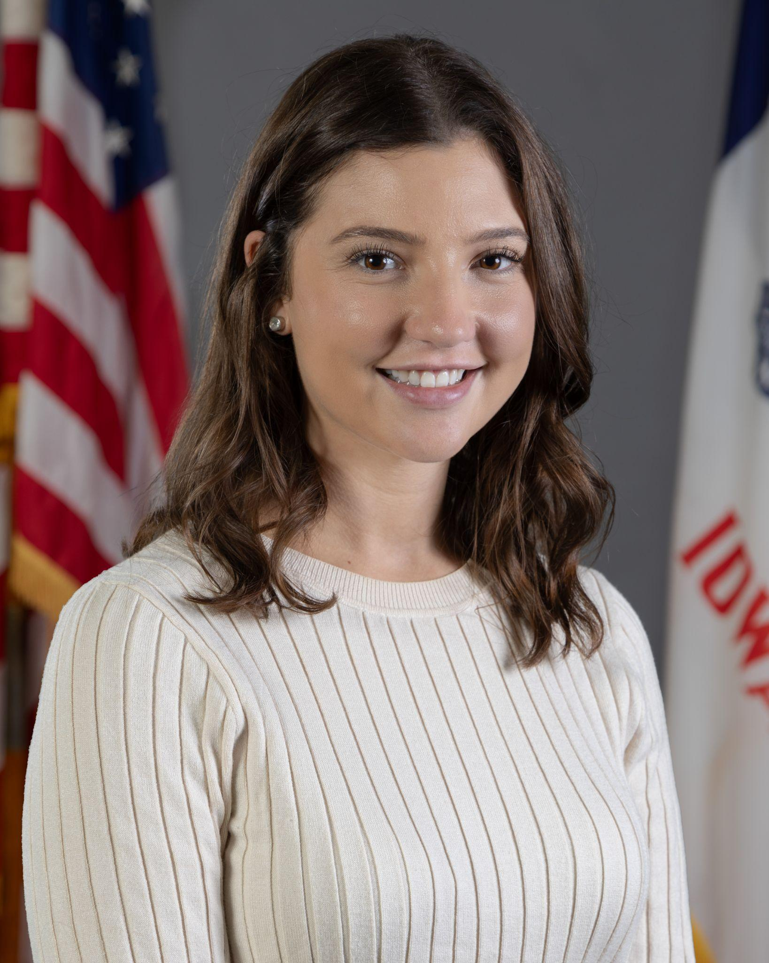
Today’s presenters
Matt Cretsinger
Regional Special Education Director – Heartland
Iowa Department of Education
Rachel Bosovich
Attorney II
Division of PK-12 Learning
Iowa Department of Education

Slide 4
Today’s objectives:
Overview of legal framework for FAPE
Key components of the “A” in FAPE
Tips for building leaders
Questions from the field

Slide 5
Free Appropriate Public Education
“FAPE”

Slide 6
FAPE Defined
FAPE means special education and related services that:
are provided at public expense, under public supervision and direction;
meet the SEA standards;
include an appropriate preschool, elementary, or secondary school education; and
are provided in conformity with an IEP that meets the requirements of 300.320 - 300.324 (41. 320- 41.324).
34 CFR 300.17; Iowa Administrative Code 281-41.17.

Slide 7
FAPE Standard - Rowley
Two U.S. Supreme Court Cases
Board of Education v. Rowley, 458 U.S. 176 (1982)
Appropriate Education ≠ Best Education
Rule: FAPE requires an IEP reasonably calculated to enable the child to receive an educational benefit
For students fully integrated, generally an IEP must be “reasonably calculated to enable the child to achieve passing marks and advance from grade to grade”

Slide 8
FAPE Standard - U.S. Supreme Court
Endrew F. v. Douglas County School District RE-1, 580 U.S. 386 (2017)
“FAPE requires markedly more than “merely more than de minimis” educational benefit”
Educational Benefit = Progress
Rowley stands: For students fully integrated, generally appropriate progress is grade level advancement.
Rule: FAPE requires an “IEP reasonably calculated to enable a child to make progress appropriate in light of the child’s circumstances.”

Slide 9
Endrew F. Continued
Rule: FAPE requires an “IEP reasonably calculated to enable a child to make progress appropriate in light of the child’s circumstances.”
Individually Tailored
to meet to child’s unique needs
Appropriately Ambitious
just as advancement from grade to grade is appropriately ambitious for most children in the regular education classroom
Challenging Objectives
the goals may differ, but every child should have the chance to meet challenging objectives

Slide 10
Assessing Appropriateness
Considerations:
Adequate Evaluation
Repetition of Goals
Response to Lack of Progress
Achievement of Goals and Objectives
Compliance with provisions governing IEP development process
Deference to school: School officials should be prepared to offer a “cogent and responsive explanation for their decisions.”
Snapshot rule: Requires IEPs be judged based on what was objectively reasonable at the time. It will not be judged based on hindsight.

Slide 11
Key Components of the
“A” in FAPE

Slide 12
Understanding Our “Why”
Why Are Special Education Services Needed?
Some learners face challenges to learning grade-level content because their disability changes how they:
Encode → Process → Retrieve
information in their brain
These challenges create skill deficits that interfere with their ability to fully access general education at the same pace as other learners.
Let’s discuss F.A.P.E. from the perspective of how do learners with disabilities receive equitable access to general education.

Slide 13
How Do Special Education Services Allow for Access?
Special education services support learners with disabilities through:
Remediating skill deficits through accelerated learning practices
Services focus on skills necessary to access the general education content / standards
Skill development (Specially Designed Instruction or SDI) should occur through the implementation of evidence based practices
Utilizing accommodations - program modifications - assistive technology to provide access to the general education content
Access to instruction
Access to the general education curriculum
Access to demonstrating knowledge on formative / summative assessments
Leader Takeaways:
Special education is a service, not a location. Be knowledgeable about your District Developed Service Delivery Plan (DDSDP)
An appropriately developed IEP provides access to core curriculum / instruction / assessments

Slide 14
Accessing General Education
Who Has Expertise In General Education
Curriculum? Instruction? Assessments?
Who Has Expertise In Special Education (Encode - Process - Retrieval)?
Grade level / content area standards?
Content scope and sequence?
Content formative assessments?
Content summative assessments?
Expected skills for the next grade level / content level?
Demonstration of mastery?
Instructional strategies?
Accommodations?
Program modifications?
Accessibility features through the use of assistive technology?
How a learner’s disability interacts with;
Curriculum?
Core instruction?
Formative/Summative assessments?
Leader Takeaway:
Appropriate access is provided when educators who have expertise in both areas come together. Missing either component lessens the likelihood that the learner will make appropriate educational progress.

Slide 15
Accessing General Education: Post Secondary Education
Role | Key Contributions to Appropriate Access
General Ed Teachers | Define academic expectations, Identify learning challenges, Recommend adaptations to core content, Define how content mastery is assessed
Special Ed Teachers | Aligning SDI with standards, Adapting instruction, Ensuring access via supports, Targeting specific post-secondary services
School Counselors | Guide college/career pathways, Advise on graduation planning, Connect learners with post-secondary education/vocational opportunities
Access for All | Ensure access to: Work-Based Learning, College/Career Pathways
Leader Takeaways:
Appropriately developed IEPs allow for learners with disabilities to access the necessary courses (course standards) to progress towards obtaining a diploma.
If it is available to a learner without a disability, how can it be accessible for a learner with a disability?

Slide 16
Key Indicators for Determining if a Learner’s IEP is “Appropriate”
A = Does it meet the INDIVIDUAL need of the student with a Disability?

Slide 17
Ensuring Learners’ IEPs are “Appropriate”
Conduct regular review of IEPs in your building
Pull a sample of IEPs from ACHIEVE and look for these key features:
Instruction
Collaboration
Accessibility through accommodations - program modifications - assistive technology
Related services and supports
Data driven decisions
Least restrictive environment

Slide 18
Ensuring Learners’ IEPs are “Appropriate”
Instruction
Look fors:
Is SDI individualized, specific, and aligned to the unique needs of the student?
Is SDI being delivered as documented in the IEP (frequency, setting)?
Is there intentional collaboration between general education, special education, the AEA, and pertinent outside providers?
A great resource to understand your district’s continuum of services is the District Developed Service Delivery Plan (DDSDP).

Slide 19
Ensuring Learners’ IEPs are “Appropriate”
Collaboration with the full IEP team Required IEP Team Members
Were the required members invited?
Did they attend or were they excused?
Did the team members, including families, have the opportunity to meaningfully participate?
Were decisions made as a team based on data and not predetermined before the meeting?
Did collaboration occur with the entire team to make decisions:
Transition age students are involved and invited?
AEA direct service providers involved and invited?
Community partners who are currently working with the learner involved and invited?
Community agencies that are being considered invited?
Did You Know?
Not only is the general education teacher a required participant, they are also one of the most important voices at the meeting!
IEP = access to core content / standards

Slide 20
Ensuring Learners’ IEPs are “Appropriate”
Accessibility through Accommodations / Program Modifications / Assistive Technology
Accommodations and Program Modifications:
Do all educators understand the accommodations, including how and when to use them?
Did all staff receive the necessary training to implement them?
What information is being collected that informs the IEP team these supports are working?
Assistive Technology and Accessibility Features:
Do all necessary educators understand how, and when, to use these features?
Do students have the AT tools (identified in the IEP) available, and are they being used as described?
Did staff and family receive the necessary training and support to use independently?
Is data is being collected and used to determine if these supports are working?

Slide 21
Ensuring Learners’ IEPs are “Appropriate”
Services and Supports
Were related services, such as Physical Therapy, Speech-Language services, Occupational Therapy, considered as part of the IEP development process?
Are the minutes of services clear (pull-out, push-in, etc)?
Is the description of the service written specifically and clearly enough that a substitute or new paraeducator could read and understand it?
Are the services and supports specific to the student?

Slide 22
Ensuring Learners’ IEPs are “Appropriate”
Data Driven Decisions
Are data driven decisions individualized to the student needs (not dictated by schedule, other, prep periods, recess, lunch duty)?
Is the progress monitoring data current and entered as specified in the IEP?
Are decisions regarding progress toward goals based on data?
Do IEP goals reflect changes in instruction when needed and the reason is clearly documented in the IEP?

Slide 23
Ensuring Learners’ IEPs are “Appropriate”
Least Restrictive Environment (LRE)
What data was used to determine the learner’s LRE?
Using data, is the student with general education peers as much as appropriate and the reason for removal from general education peers is clearly documented?
Is there evidence that accommodations, modifications and other supports have been explored before conversations regarding the movement to a more restrictive environment?

Slide 24
Questions from the Field

Slide 25
Thank You!!

