Slide 1
Least Restrictive Environment
(LRE)
Special Education Policy & Practice Webinar Series
April 9, 2025

Slide 2
Welcome
Please post your questions in the Q&A
Slides will be posted on the DE website after the webinar
Policy & Practice Webinar Series & Recordings

Slide 3
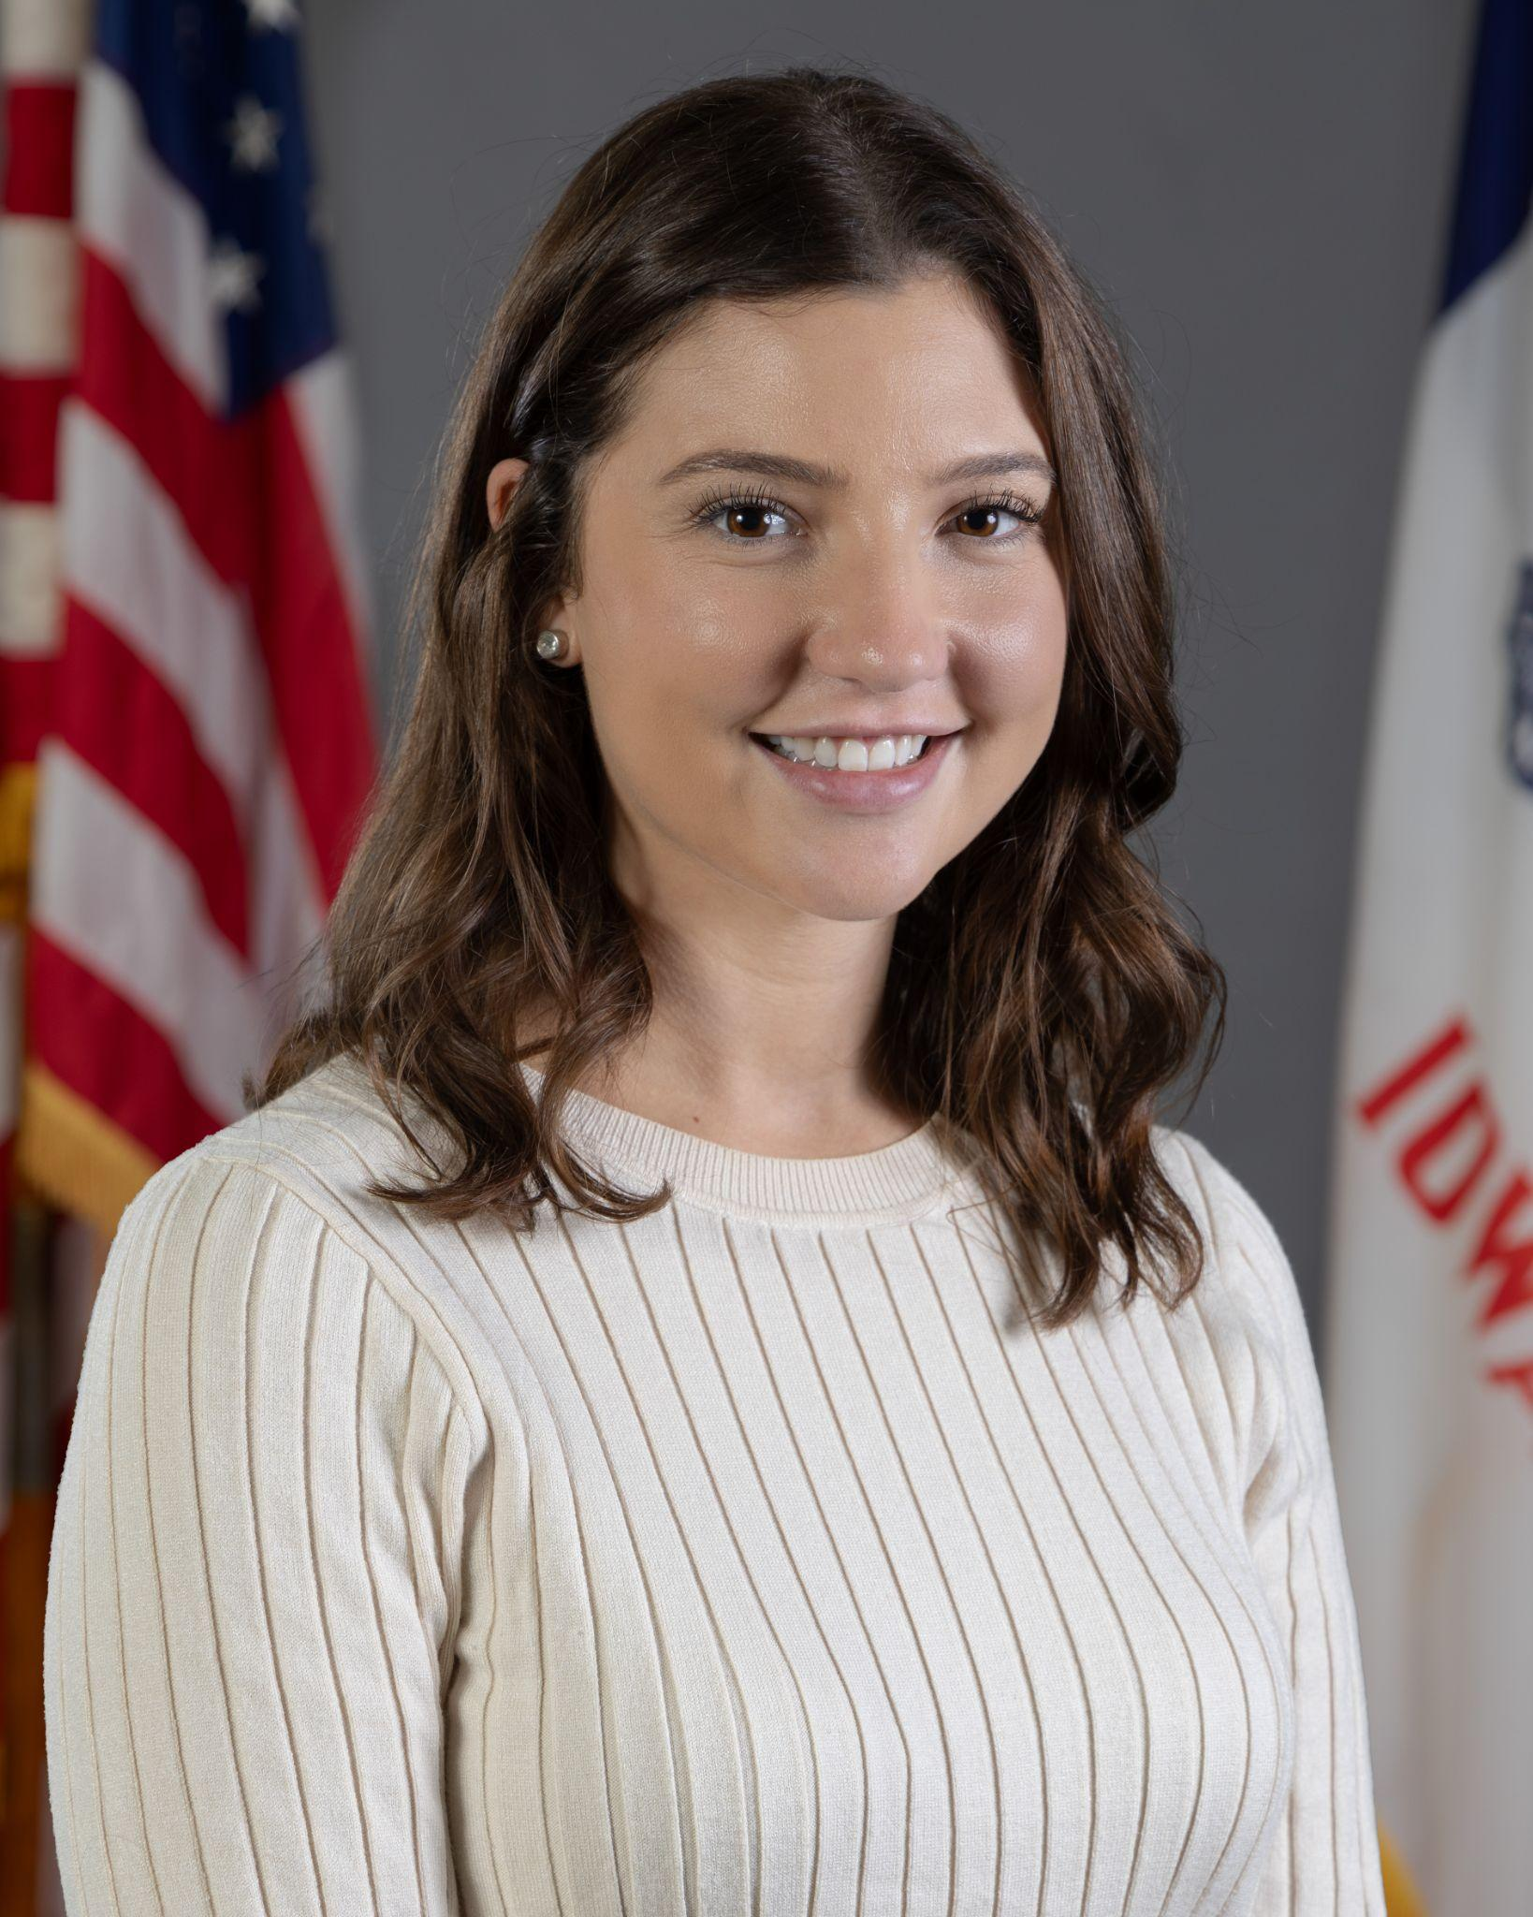
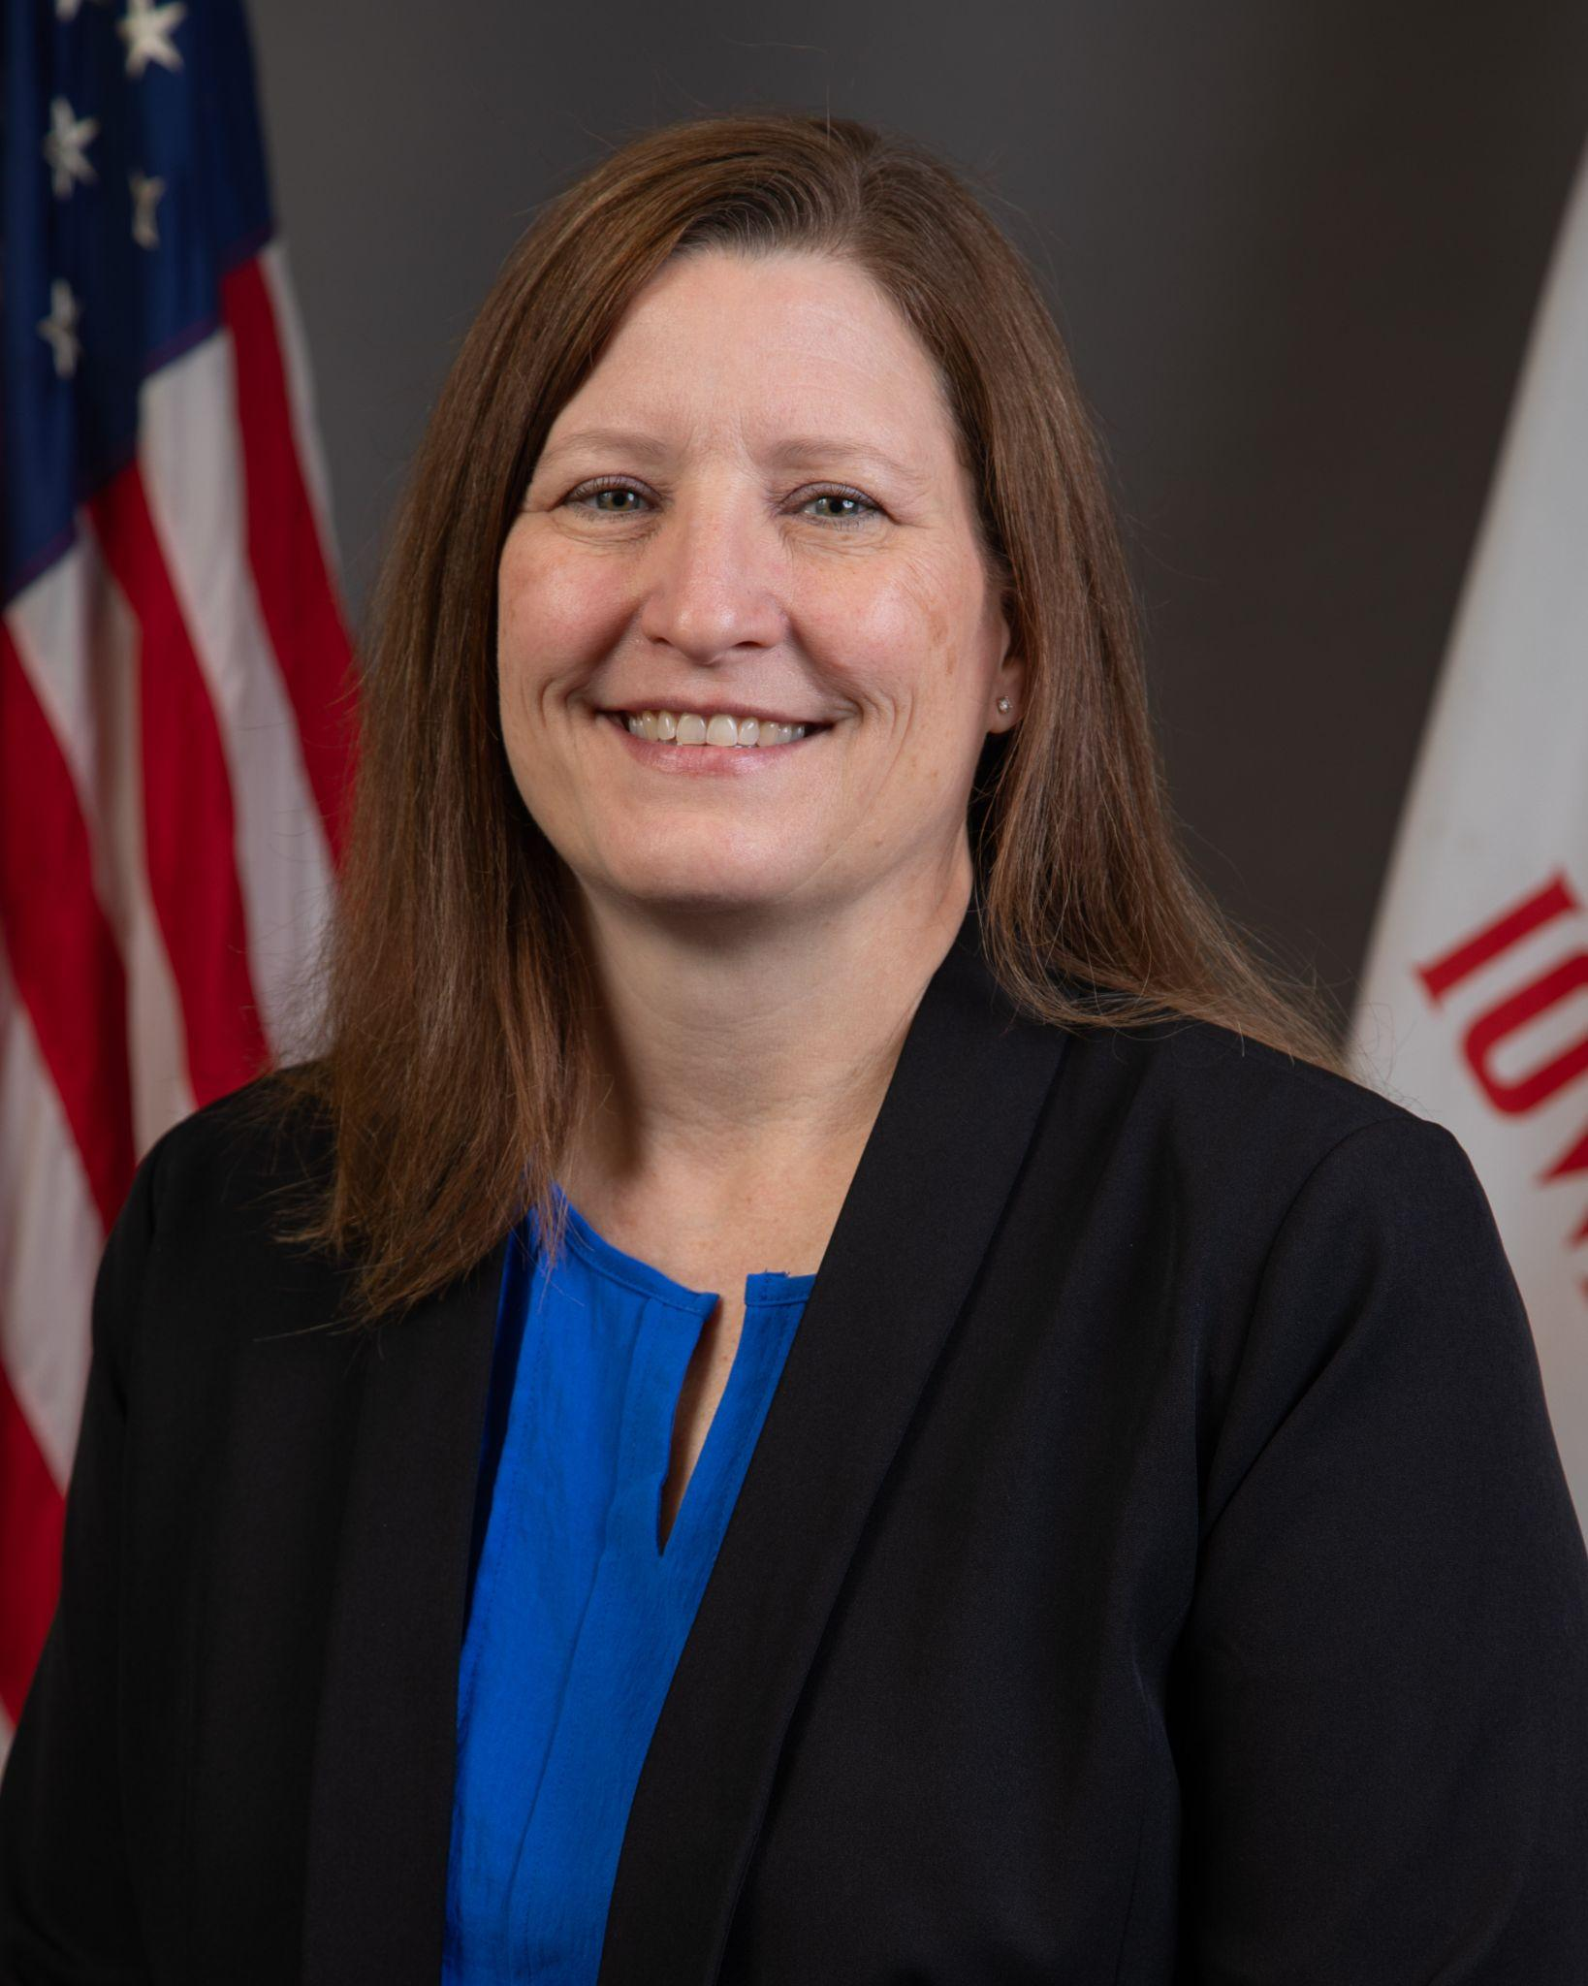
Today’s presenters
Rachel Bosovich
Attorney II
Division of PK-12 Learning
Janel Lesan
Regional Special Education Director-Mississippi Bend
Bureau of Special Education Regional Continuous Improvement & Compliance
Tiffiny Poage
Education Program Consultant
Bureau of Student Instruction, Evaluation & Services

Slide 4
Today’s objectives:
Understand the definition of Least Restrictive Environment (LRE)
Examine policies guiding LRE and the role of IEP teams in placement decisions
Review specific examples of services and placements that support students with IEPs in various educational settings
Address where LRE is documented on the IEP

Slide 5
Continuum of Alternative Placements

Slide 6
General Education Setting
In the general education environment
Services could be provided by the general education teacher or the special education teacher through co-teaching or consultation or collaboration with the general education teacher
Instruction is supported with specialized materials, equipment, instructional methods
Special education teachers may provide individual/small group instruction within the gen ed setting

Slide 7
Special Education Setting
Services are provided by a special education teacher/service provider
Under the direction of the appropriately licensed teacher, services may be provided by other professionals throughout the day
Instruction may be provided individually or in small-group
A child may attend only one class in the special education setting, multiple classes or all classes in the special education setting.

Slide 8
Special School Setting
Majority of the school day in a separate public or private facility
Designed, staffed, and resourced for the care and education of students with similar disability related needs

Slide 9
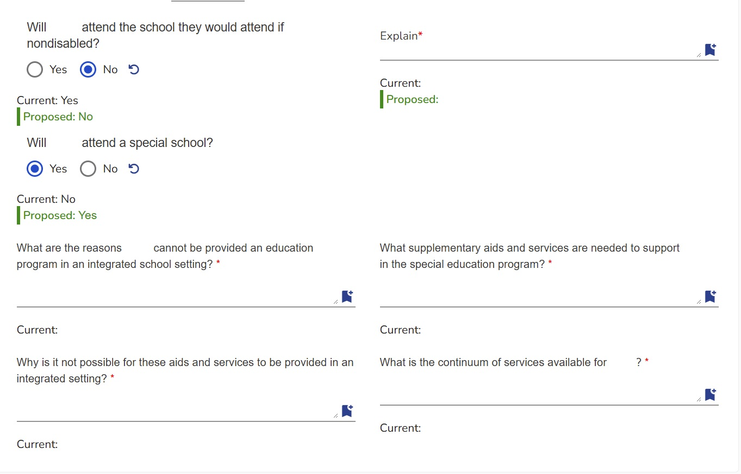
ACHIEVE:
Annual Considerations for
Special School Placement
1
2
3
4
5
7
6

Slide 10
Homebound Instruction Setting
Provided by homebound teacher
Services may include:
Consultation and collaboration with general and special education teachers
Convenient schedule for the student

Slide 11
Hospital and Institution Settings
Instruction in a hospital, public or private residential facility
Provided by an educational professional
Services may include consultation and collaboration with the general and special education teachers

Slide 12
Non-academic Settings
LRE applies to nonacademic settings too! (34 CFR 300.107)
Meals, recess, transportation, extracurricular activities
Teams must ensure that each child with a disability has the supplementary aids and services determined by the child's IEP team to be appropriate and necessary for the child to participate in nonacademic settings
Postsecondary Transition (Letter to Spitzer-Resnick, Swedeen, and Pugh, 59 IDELR 230 (OSEP 2012))
A postsecondary transition placement, including a work placement, is no different than any other educational placement
IEP team must look at whether there are steps it could take that would enable the student to work alongside nondisabled individuals.

Slide 13
Least Restrictive Environment (LRE)

Slide 14
Least Restrictive Environment
IAC 281—41.114(2)
To the maximum extent appropriate, children with disabilities, including children in public or private institutions or other care facilities, are educated with children who are nondisabled;
Special classes, separate schooling, or other removal of children with disabilities from the general education environment occurs only if the nature or severity of the disability is such that education in regular classes with the use of supplementary aids and services cannot be achieved satisfactorily.

Slide 15
When is LRE addressed?
The team will:
identify present levels of academic achievement and functional performance (PLAAFP).
develop measurable annual goals and determine effective progress monitoring strategies.
determine and describe all special education services, activities, and supports.
determine the least restrictive environment (LRE) and additional considerations.
determine how progress will be reported to parents.
Iowa Admin. Code r. 281—41.116(1)“b”(2); Letter to VanWart, 20 IDELR 1217 (OSEP 1993)

Slide 16
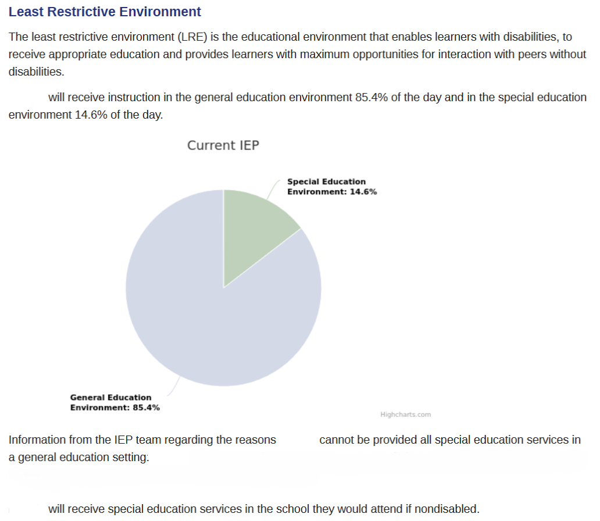
IEP Documentation

Slide 17
Legal Lessons:
Least Restrictive Environment (LRE)

Slide 18
8th Cir. Adopts Roncker LRE Test
A.W. v. Northwest R-1 Sch. Dist., 813 F.2d 158 (8th Cir. 1987)
Adopted LRE test articulated in Roncker v. Walter, 554 LRP 7707(6th Cir. 1982)
What services make the segregated placement superior? Can those services feasibly be provided in a non-segregated setting?
Pachl v. Seagren, 453 F.3d 1064 (8th Cir. 2006): feasibly = appropriately and satisfactorily
Are the marginal benefits received by the student from mainstreaming far outweighed by the benefits gained from the services that could not feasibly be provided in a non-segregated setting, or is the student a disruptive force in the non-segregated setting?
Is the cost of mainstreaming the student excessive?
CAUTION: while recognized as a factor, courts have not yet found cost as the basis for rejecting a more inclusive setting

Slide 19
LRE Decisions
Parent Input: LRE requirement applies even to parent proposed placements
Placement decisions must be made “by a group of persons, including the parents, and other persons knowledgeable about the child, the meaning of the evaluation data, and the placement options.” 34 CFR 300.116
Yeger v. East Ramapo Cent. Sch. Dist., 82 IDELR 24 (S.D.N.Y. 2022): parents wanted residential placement but therapeutic day program at the high school was the LRE.

Slide 20
LRE Decisions
Document!!!
H.L. v. Downington Area Sch. Dist., 624 Fed.Appx.64 (3rd Cir. 2015): “The issue was not what the IEP said or did not say for its own sake; the issue is whether there was evidence that a critical part of implementing the LRE mandate had been carried out . . .The failure to do so was a substantive shortcoming in the IEP.”
Boilerplate language and lack of information significantly undermine a district’s position and has led to systemic findings:
Yonkers (NY) Pub. Schs., 69 IDELR 18 (OCR 2016): 81 of 162 sampled IEPs provided same “boilerplate explanations”: “[student] requires special instruction in ... [an] environment with a smaller student-to-teacher ratio and minimal distractions in order to progress in achieving the learning standards.”; 100 out of 162 lacked documentation of attempted services in the regular education environment

Slide 21
LRE & FAPE
Do not lose sight of the obligation to provide FAPE:
Hartmann v. Loudoun County Bd. of Educ., 118 F.3d 996 (4th Cir. 1997):
Student served in general education environment with “extensive” accommodations, aids and services
Circuit court found "overwhelming" evidence that the student made minimal, if any, educational progress while attending the regular education placement.
“The mainstreaming provision represents recognition of the value of having disabled children interact with non-handicapped students. The fact that the provision only creates a presumption, however, reflects a congressional judgment that receipt of such social benefits is ultimately a goal subordinate to the requirement that disabled children receive educational benefit.”

Slide 22
LRE & FAPE
Where to start? Individualized Determination
A student need not start in the regular education classroom if that placement would not reasonably provide the student with FAPE
“There is no requirement that a disabled student first must fail in the regular classroom before a more restrictive placement can be considered.” Letter to Estavan, 25 IDELR 1211 (OSEP, 1997).
However, if is was reasonable to first try to meet the student’s needs in the general education setting the fact that those attempts end up being unsuccessful does not mean the district denied the student FAPE
“Snapshot rule”: Requires IEPs be judged based on what was objectively reasonable at the time. It will not be judged based on hindsight
K.E. v. Independent Sch. Dist. No. 15, 647 F.3d 795 (8th Cir. 2011)

Slide 23
Permissible Considerations
Benefit to student
Educational benefits are considered both academic and nonacademic in nature: social development, self-care, increased self esteem, language development, role modeling
Solorio v. Clovis Unified Sch. Dist., No. 17-16625 (9th Cir. 2019): The individual circumstances of the student need to be considered when determining how much weight to give these considerations
Impact on other students
Interference with learning of others
Significant time and attention
Disruptive behavior
Engages in dangerous conduct

Slide 24
Impermissible Considerations
Administrative concerns: lack of adequately trained staff, configuration of delivery system, availability of services and space, administrative convenience
Washoe County Sch. Dist., 115 LRP 3790 (SEA N 2015): changed services from being provided in co-taught setting to special education classroom to conform with new master schedule
Portland Sch. Dist. 1J (SEA OR 2022): student placed on home instruction due to inability to hire school nurse
Category or Severity of Disability
Letter to Autin, 58 IDELR 51 (OSERS 2012): establishment of “school for students with autism”

Slide 25
Key LRE Questions to Consider
What specific needs can and cannot be met in the general education environment?
What data supports the decision for a more restrictive or less restrictive environment?
Have all potential supplementary aids/services within the general education setting been thoroughly explored?
What strategies will be put in place to facilitate a smooth transition back to general education, if appropriate?
How will progress be monitored in the chosen setting?

Slide 26
What are the benefits of LRE?
There are several ways in which LRE may benefit children with special needs:
Access to a broader range of educational opportunities
Improved social skills and relationships
Increased independence and autonomy
Greater access to extracurricular activities
Improved self-esteem and confidence

Slide 27
Tools & Resources to
Support Administrators

Slide 28
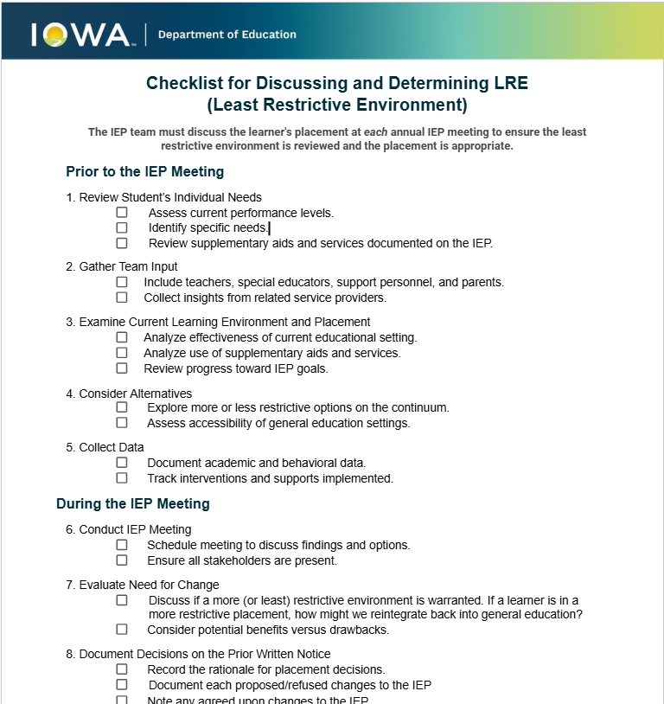
Checklist for Discussing and Determining LRE

Slide 29
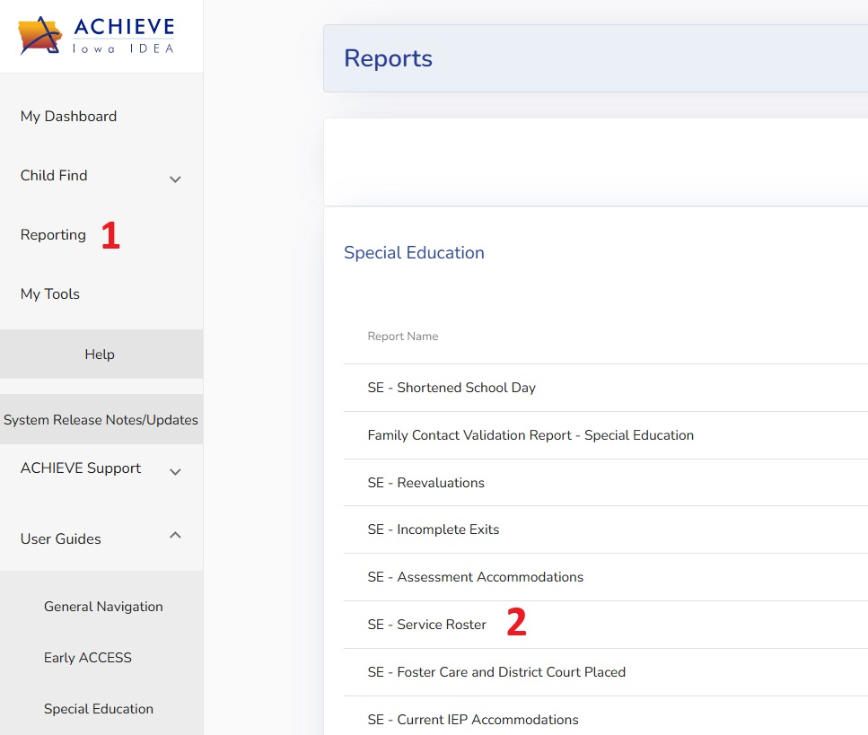
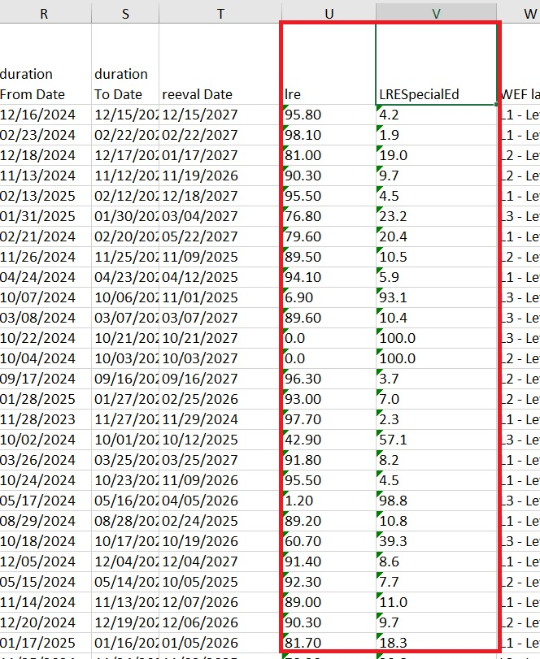
ACHIEVE REPORT:
Special Education - Service Roster

Slide 30
Guidance
&
Caselaw
OSEP Guidance
Letter to Trigg
Memo 95-9, 21 IDELR 1152
Caselaw
Roncker v. Walter, 554 LRP 7707(6th Cir. 1982)
**The Guidance and Caselaw shown above can be found at: Policy & Practice Webinar Series & Recordings

Slide 31
Questions from the Field

Slide 32
Thank You!

