Slide 1
Behind the Wheel Authorization Renewal A Step-by-Step Guide
Note: Chrome or Firefox work best with this system.

Slide 2
NOTE: This set of instructions does not include how to register for the online system. If you are new to the system, visit the Bureau of Educational Examiners website.

Slide 3
Log in with an existing account.
Use the email and password you used to set up your account previously.
If needed, a password reset can be sent to the username email originally used to set up the account.

Slide 4
Before You Begin…
Check the expiration date on your BOEE BTW Authorization - Your Authorization renewal date is one year from issuance, and may not line up with your DOT Recertification expiration date. Double check to make sure you are not renewing too early - or too late!
Verify Eligibility with DOT - Have you completed your annual recertification with the Department of Transportation? This does not need to be included in your renewal application with the BOEE, but it does need to be valid and on file with the DOT.
Check for Mandatory Reporter Certificate - Effective 2/26/2025, you only need to provide the Child Abuse Training Certificate in your renewal application. Depending on completion dates, you may need to upload certificates for the initial 2-hour training and the recertification.
Processing Times Can Vary - Depending on the time of year, renewal processing can take up to six (6) weeks to complete. Be sure you allow enough time for processing and error correction.

Slide 5
Click “New Application or Renew” to start your application.

Slide 6
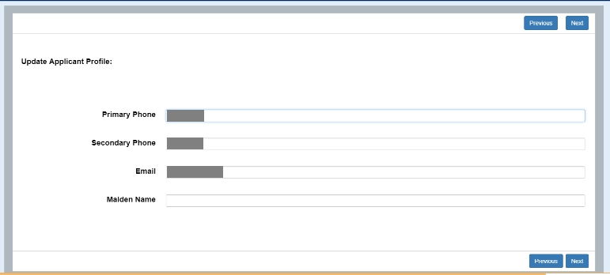
Verify your demographic information. If all is correct, click on the “Next” button. If your name is incorrect, you will have to temporarily agree to it for now, and you can request a change later within the application. If you need to make a change other than your name, click the “no” button and make the appropriate changes.

Slide 7
Select the “Renew Existing License” option.

Slide 8
Use the pull down menu to select your BTW Driving Instructor Authorization.

Slide 9
Use the pull down menu and select “Renew Behind the Wheel” for the Application Type.

Slide 10
If you have successfully chosen the correct application, click “next.”

Slide 11
Your application template has now been generated. Click “Finish” to move into document upload and payment of fees.

Slide 12
There are three separate steps to your application. Steps must be completed in order to advance your application to the next one.

Slide 13
Checklist Step
As you respond to each checklist question, click the “Save & Next” button and you will advance to the next section.

Slide 14
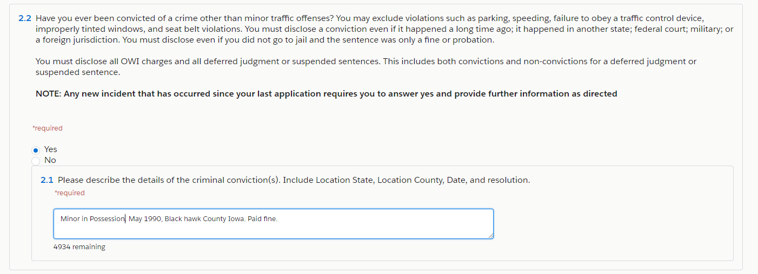
Checklist Step (cont.)
In some sections, your response may open another text box for you to provide more information. Many of these are freeform text boxes. Just type the information requested. In the case of past convictions, please list all and be specific. Failure to do so may delay the processing of your application.

Slide 15
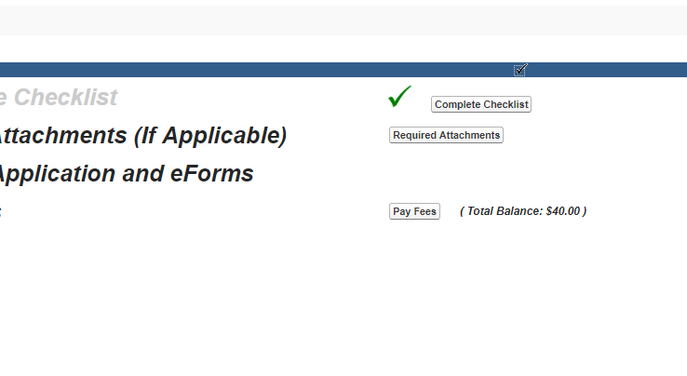
Attachment Step
Once you fully complete the checklist, you will click “Required Attachments” to upload relevant attachments (when applicable).

Slide 16
Attachment Step (cont.)
Upload your Mandatory Reporter Training Certificate.

Slide 17
The “Review Application” area is where the system will check to make sure you have all the required boxes checked and documents.

Slide 18
Pay Fees & Submit Application

Slide 19
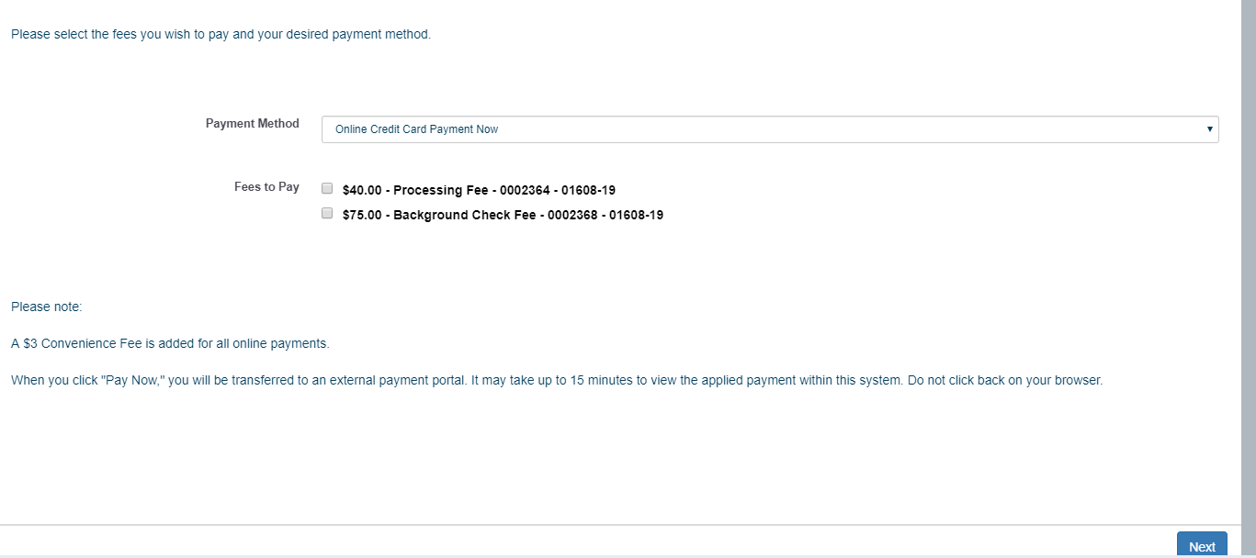
Payment
All fees for a specific application must be paid for the application to be submitted. The total payment amount will be $53.00:
$40.00 Processing Fee
$10.00 Background Check Fee
$3.00 Convenience Fee

Slide 20
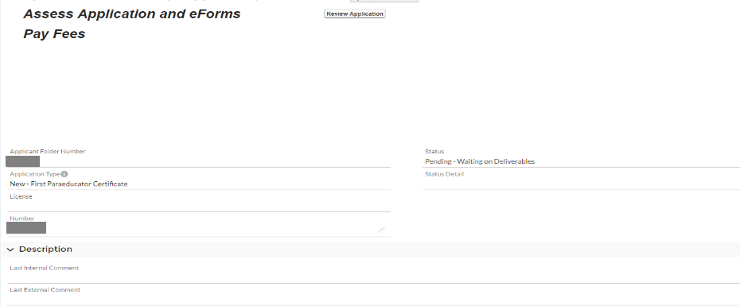
Once your fee is paid, you can check your application status.
If your application status is . . .
Pending - Internal Review - it has been submitted.
Pending - Waiting on Deliverables - you are missing attachments and need to upload additional information.

Slide 21
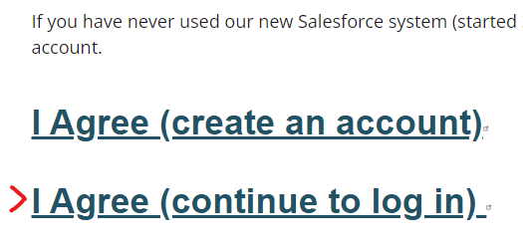
If you start your application, but do not complete it all in one sitting, you may leave and come back.

Slide 22
Click on the “My Applications” tab at the top of the page. Select your application (this number will be specific to your application).

