Slide 1

#6 FY 2026 Perkins Budget Prior Approval and Perkins Use of Funds
February 26, 2025
10:00 a.m. - 10:55 a.m.
Amy Vybiral, MS Ed.
Education Program Consultant
Bureau of Community Colleges and Postsecondary Readiness
515-339-4520
amy.vybiral@iowa.gov

Slide 2

Agenda
Timelines and Due Dates through June, 2025
  Wrap-up FY 2025
FY 2026
  Perkins Budget Template Amy Vybiral 515-339-4520
  Perkins Application Jeff Fletcher 515-321-7309

Slide 3
FY 2025 Housekeeping
Perkins Final Purchases and Claims
  April 15 - All Equipment, Supplies, Purchases. Completed and Claimed.
  June 30 - Purchased services & professional development (prior approval FY 2025)
  July 15 - Salaries, benefits, and stipends (CLNA, CTSOs, etc.).

Slide 4
Final FY 2025 Claims
Third Quarter Claim Due April 15, 2025
Final claims in July should be primarily for:
  Professional development - prior approval
  Final purchases to spend the allocation balance.
  Salaries and benefits (July 15 claim)
Spend Entire Allocation
  Request prior approval for individual purchases that exceed $5,000
  Items not on the approved budgets for FY 2025 but on the Allowable Costs (FY 2025)document may be purchased without prior approval.
  When in doubt email seek prior approval
  Salaries and benefits
  Unallowable Costs
    Standard technology and items that supplant.

Slide 5
Timelines for FY 2026
FY 2026 Perkins Budget Template
  Input from CTE instructors and staff
  Budget is determined by the 2025 CLNA Negotiated and Approved by April 30
  The approved budget is uploaded into the FY 2026 Perkins application.
    Amy Vybiral 515-339-4520
Perkins FY 2026 Perkins V Application (Released on or around May 1, 2025)
  Allocation tables embedded in the application.
  Due June 30, 2025
    Jeff Fletcher 515-321-7309

Slide 6
FY 2026
Focus on Accountability Indicators & State Plan Priorities
  Work-based learning (WBL)
  Industry Recognized Credentials (IRCs)
  Career and Technical Student Organizations (CTSOs)
Focus on Alignment of Perkins Activities and CLNA Elements in Perkins Statute
FY 2026 - Professional Development.
Focus on building content specific relationships with like minded career professionals and attending professional development opportunities that focus on instructional skill development expertise.
Perkins Activity | CLNA Element Number
Two Professional Development | Four Teacher Training and Retention
Five Implementation of CTE | Student Performance and Size Scope and Quality

Slide 7

Before we jump in…..
Budget Review Goals
Review 2026 Use of Funds and Unallowable Costs
10 minutes or less to review a budget
  Determine eligibility
  Calculate total
  Confirm 5% admin.
Allowable, Reasonable, Necessary, Prudent Person, Climate, your institutional funding sources.
Des Moines Register and Cedar Rapids Gazette.
Salaries - Eligible Job Duties?
Trucks, trailers, EVs, Prometheans and Interactive Whiteboards, Advertising for SPs
Item-by-item basis.
Federal, state, and local law (OMB, Office of the White House Compliance Supplement (Supplanting) - SL)

Slide 8
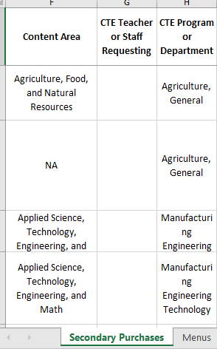
The Template 1
Populate the Menus and Also Refer to Perkins Activities

Slide 9
The Template 2
Key words in bold identify why items are eligible.
Curriculum must be “supplementary” to be eligible.
Stipends must be outside of an instructor’s contract or “off-contract.
  If Perkins funds a percentage of a total contract, a job description, time and effort, and percentage must be included.
“Vendor equipment and software training” must be specified so that other item eligibility can be determined (this is “in-house” so no mileage or meal reimbursement is eligible).
Include Accountability measures when possible.
Align Perkins Activities with CLNA Elements for every purchase.

Slide 10
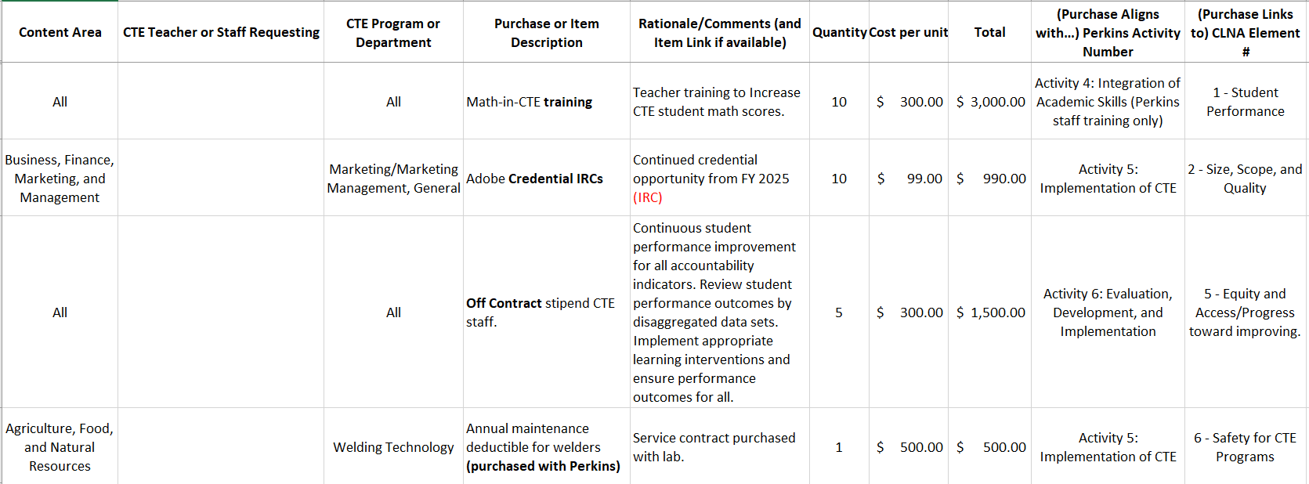
The Template 3
Key words in bold identify why items are eligible.
IRCs are a new accountability indicator.
Equity and Access statements should include review statements stating that learning interventions are for all students in the disaggregated data sets who are performing at less than 100%.
Stipends must be outside of an instructor’s contract or “off-contract.
  If Perkins funds a percentage of a total contract, a job description, time and effort, and percentage must be included.
Maintenance plans are eligible for items that were purchased with Perkins.
Align Perkins Activities with CLNA Elements for every purchase.

Slide 11
The Template 4
Key words in bold identify why items are eligible.
Red font = State Plan initiative. Institutional Membership (Bold) Quantity of one is eligible.
Equipment and supplies are most often aligned with size (increasing program capacity) or student performance.
Professional Development is most often aligned with teacher training and retention.
CTSOs are most often aligned with student performance.
Align Perkins Activities with CLNA Elements for every purchase.
A balance surplus is ok. The budget is an estimate monitored by the business office and Perkins contact.

Slide 12
2026 Allowable and Unallowable Costs
Technology and Supplanting List
Eligible | Ineligible
Stratasys, MakerBot, 3D, blueprint-large format | Ink-jet, Laser
Project Lead the Way (PLTW) equipment and supplies, if taught by a PLTW endorsed instructor. | Computers that replace standard computer labs
 | Furniture. All classroom furnishings are ineligible for reimbursement (supplanting). School district assumes responsibility for tables, chairs, desks (including mobile whiteboard desks and tables), benches, ergonomic workspaces, sectionals, end-tables, carpet, lamps, lighting, workstations and area rugs. Furniture will not be approved as “equipment.” Gifts, raffles and door prizes.
Seek prior approval for trailers | Vehicles such as automobiles, trucks, buses, airplanes, boats, golf carts, snowmobiles, motorcycles, heavy equipment, backhoes and skid loaders.
 | Advertising for special populations Interactive Panels, Promethean, i3TOUCH, Smart Whiteboards, Interactive Touch Panels.

Slide 13
Technology and Supplanting List
CTE students may not be excluded from purchases the institution makes for non-CTE students.
Ineligible
Transportation, food, document cameras (Elmos), ink-jet and laser printers, TVs, monitors, smart TVs, computers, computer monitors, projection equipment, storage (plastic bins, shelving, totes, storage racks, lockers), technology cables as independent purchases (HDMA, VGA, splitters, extension cords), utility carts, vacuums
Capital expenditures are any buildings, land or improvements that add value to the property, and are the responsibility of the school district general fund or another non-federal funding source. Permanent structural (including permanent greenhouses) and wiring upgrades, buildings, concrete slabs and land, accommodation upgrades, safety rails, ramps and guards are considered capital expenditures, and may not be purchased with Perkins federal funding per EDGAR e.C.F.R. 200.439.

Slide 14
Perkins Funding for New Job Positions
Keep Perkins Funding Eligible
Use Perkins for salaries when creating new positions to avoid future supplanting issues.
Salaried or Hourly, Off-contract, Stipend or Extra duty pay
  CTSO Advising positions for newly developed CTSOs
  CLNA development and evaluation
  Postsecondary Initiatives
  Strategic Partnerships
  Apprenticeships
  Research and Concentrator retention strategies
  Social media
  CTE mentorships
  Student led initiatives, entrepreneurship

Slide 15
Perkins Funding for New Job Positions
Can we use Perkins to pay someone to create a mentor and recruiting program for our CTE teachers?
CTE Recruiter, Mentor, and Trainer
Perkins Activity | CLNA Element
Activity Five - Implementation of CTE | Element Four Evaluation of Recruitment, Retention, and Training of CTE Educators
Subsection (G) efforts to recruit and retain career and technical education program teachers, faculty, school leaders, administrators, specialized instructional support personnel, career guidance and academic counselors, and paraprofessionals; | The district/college effectively recruits new CTE faculty, counselors and staff (host practicum and student teachers, grow-your-own initiative).
 | The district/college effectively recruits new CTE faculty, counselors and staff (host practicum and student teachers, grow-your-own initiative).
 | Regular, substantive and effective professional development is offered to CTE faculty, staff and counselors which supports the coordination with the Department and/or institutions of higher education, on recruitment, preparation, and retention of CTE faculty.
Notes:
We’ll find it in statute: Perkins Activities and CLNA Elements

Slide 16
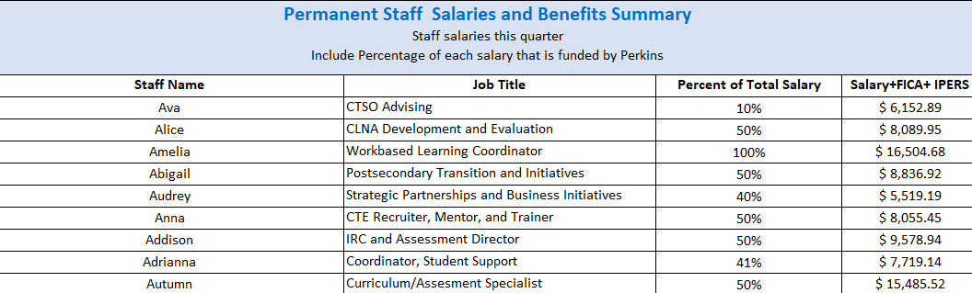
Perkins Funding for New Job Positions
Can we use Perkins to pay someone to create a mentor and recruiting program for our CTE teachers?
Percentages may decrease but never increase (supplanting).
Positions may be added as new job duties are created.

Slide 17
Next Steps
FY 2026 Allowable Costs (Draft)
2026 Budget Template
Slide Deck
Post recording on website

Slide 18

Questions
Amy Vybiral MS Ed
Consultant
amy.vybiral@iowa.gov
Rev.02/26/2025
Jeffrey Fletcher, PhD, MPA
Consultant
Jeffrey.Fletcher@iowa.gov
Rev.02/26/2025
Bureau of Community Colleges & Postsecondary Readiness
Grimes State Office Building
400 E 14th St
Des Moines, IA 50319-0146

