Slide 1
ACHIEVE Family Portal
Coming February 2025
Early ACCESS (IFSP) Administrators

Slide 2
ACHIEVE Family Portal Team
Dee
Waddell
Lisa
Lohman
Nancy
Hunt
Shannon
Grundmeier

Slide 3
Agenda
Overview of ACHIEVE Family Portal Functionality
ACHIEVE Family Portal Sandbox environment
How the ACHIEVE Family Portal impacts your role
Available training and communication materials
Notes:
Housekeeping items:
Share PDF of slides
Questions can be submitted using the Q&A feature. We will hold off on responding to questions until the end of the webinar.
Webinar is being recorded. All materials that we review today will be made available on the ACHIEVE webpage in early January.

Slide 4
ACHIEVE Family Portal Overview

Slide 5
When will the ACHIEVE Family Portal be released statewide?

Slide 6
Who can create an ACHIEVE Family Portal account?
Parents as defined by IDEA
Special Education
Learners (3-21)
Individuals who cannot create an ACHIEVE Family Portal account
Parent (Biological or Adoptive)
Relative acting as Parent
Legal Guardian
Court Designee
Power of Attorney
Surrogate
Prior to reaching Age of Majority/Date of Rights Transfer: Learners may be invited to create an account with view-only access by an IDEA Parent
Upon Age of Majority (18) or Date of Rights Transfer: Validated Learners are automatically invited if email address is stored in ACHIEVE
Parent (Other)
*Foster Parent
Relative
Friend
*Foster parents may be eligible if another IDEA Parent criterion is met.
Notes:
The Individuals with Disabilities Education Act defines who makes decisions about education for a child with a disability. Most often, biological or adoptive parents hold this right. In some cases, another person steps into the role. Decision makers, called IDEA Parents, may create an ACHIEVE Family Portal account. Learners who transition into special education may also be invited to create an account.

Slide 7
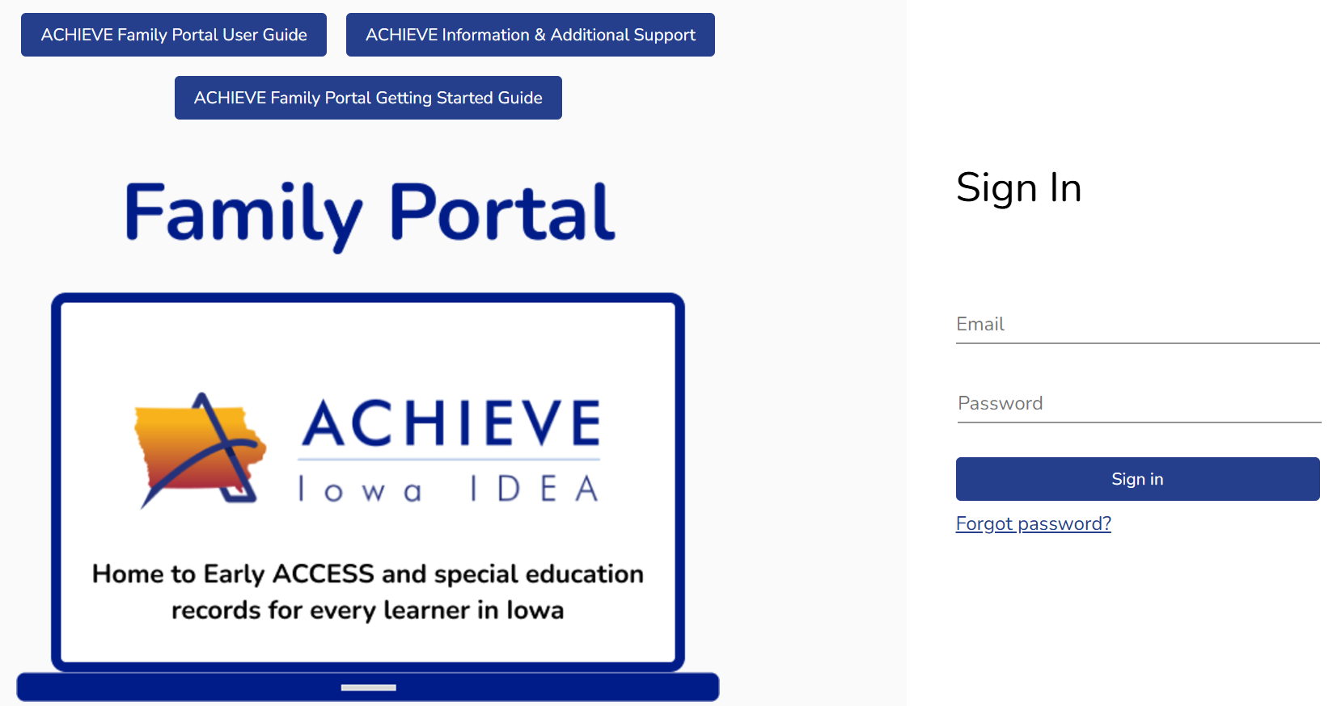
ACHIEVE Family Portal Sign In Page
Notes:
The ACHIEVE Family Portal is a web-based tool that requires users to log-in with a username (email address) and password. Account holders will be able to access the ACHIEVE Family Portal from any web-enabled device including computers, laptops, tablets, and smartphones.

Slide 8
Ways to the Access ACHIEVE Family Portal
Web-Enabled Devices
Computer
Laptop
Smartphone
Tablet
No Apps to Download
Notes:
The ACHIEVE Family Portal allows families to view records online at your convenience. Through their account, families can also keep track of progress to enhance collaboration with their child's team. It is easy to access information from any web browser on your computer, laptop, smartphone, or tablet. Don’t worry! You maintain the right to receive paper copies of records and attend meetings whether you create an account or not.

Slide 9
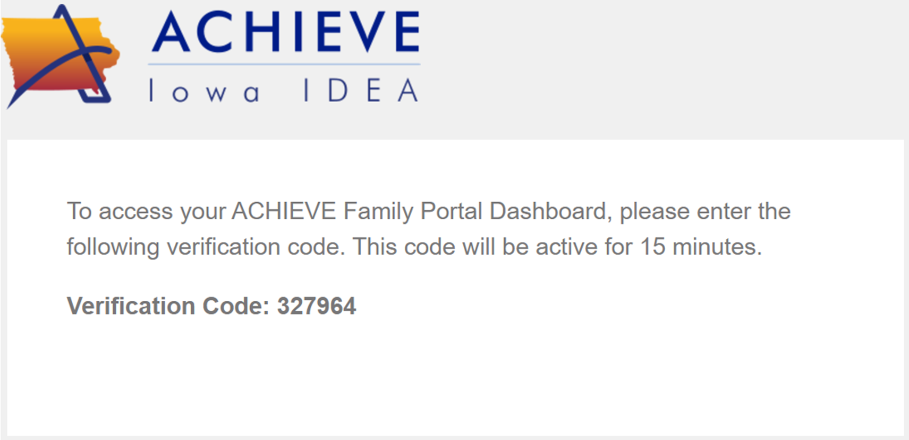
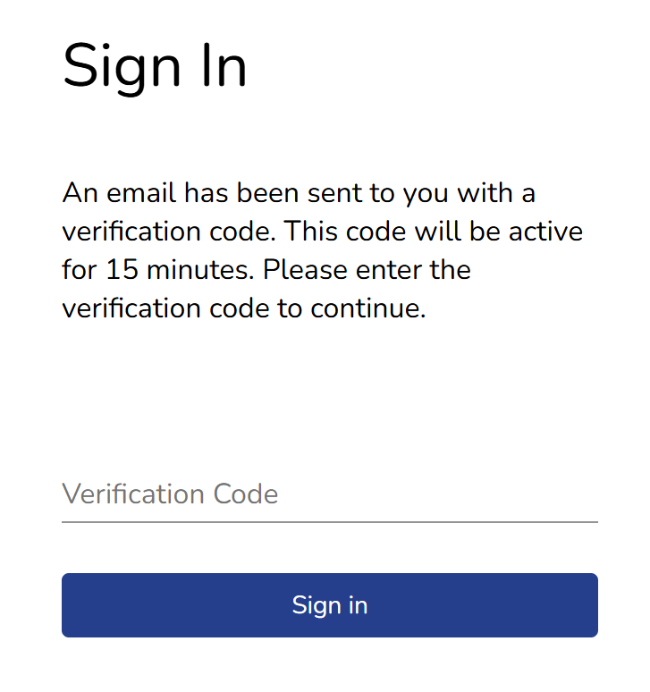
Multi-Factor Authentication
Notes:
For additional security, multi-factor authentication is also required. Account holders will receive an email with a randomly generated code to enter each time they log-in. After 30 minutes of inactivity, users will automatically be logged out.

Slide 10
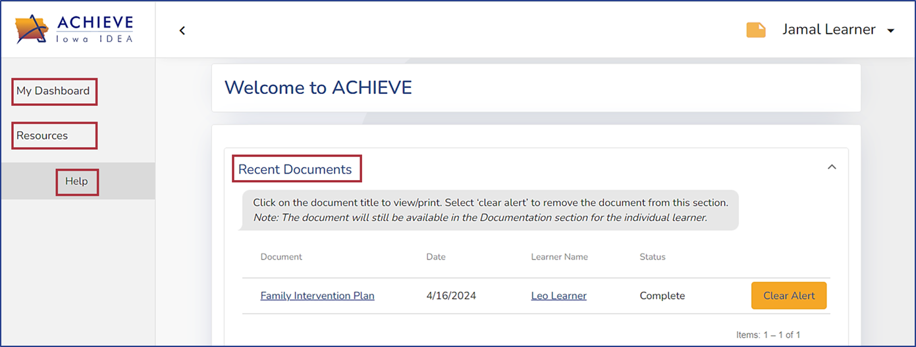
My Dashboard 1
My Dashboard
Resources
Help
Recent Documents
Notes:
Upon successfully logging in, the ACHIEVE Dashboard will be displayed. This page can always be accessed by selecting the My Dashboard link in the left navigation menu. Account holders will also have access to sections called Resources and Help.

Slide 11
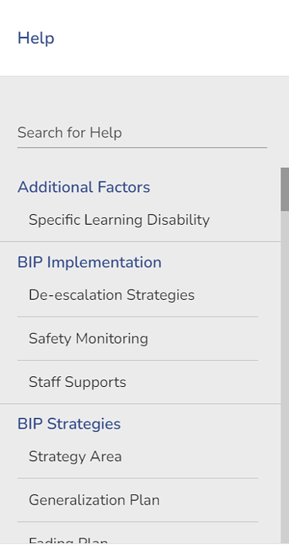
Resources and Help 2
Notes:
The Resources section includes links to the Iowa IDEA Information web page as well as Procedural Safeguards information. Early ACCESS families will also see a link to the Iowa Family Support Network web page. By selecting Help, account holders will have access to a searchable bank of education terminology. This feature aims to help families understand education jargon that may appear in their learner’s IFSP records.

Slide 12
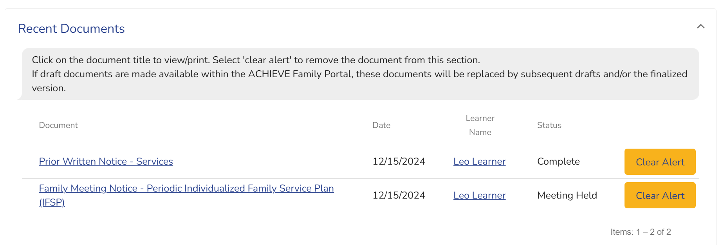
Recent Documents
Ability to Review
My Dashboard:
Recent Documents
IFSPs and related documents appear automatically when finalized
Draft IFSPs appear only if Push to Portal button is selected
Notes:
The first section that appears on the ACHIEVE Dashboard is called Recent Documents. This section functions similarly to Notifications in other applications. As new IFSP records are finalized or draft documents are pushed to the ACHIEVE Family Portal, a notification automatically appears in Recent Documents. Account holders may choose to clear these alerts as they wish. Once an alert is cleared, the notice will disappear from the dashboard, but the document can still be viewed elsewhere within the ACHIEVE Family Portal.

Slide 13
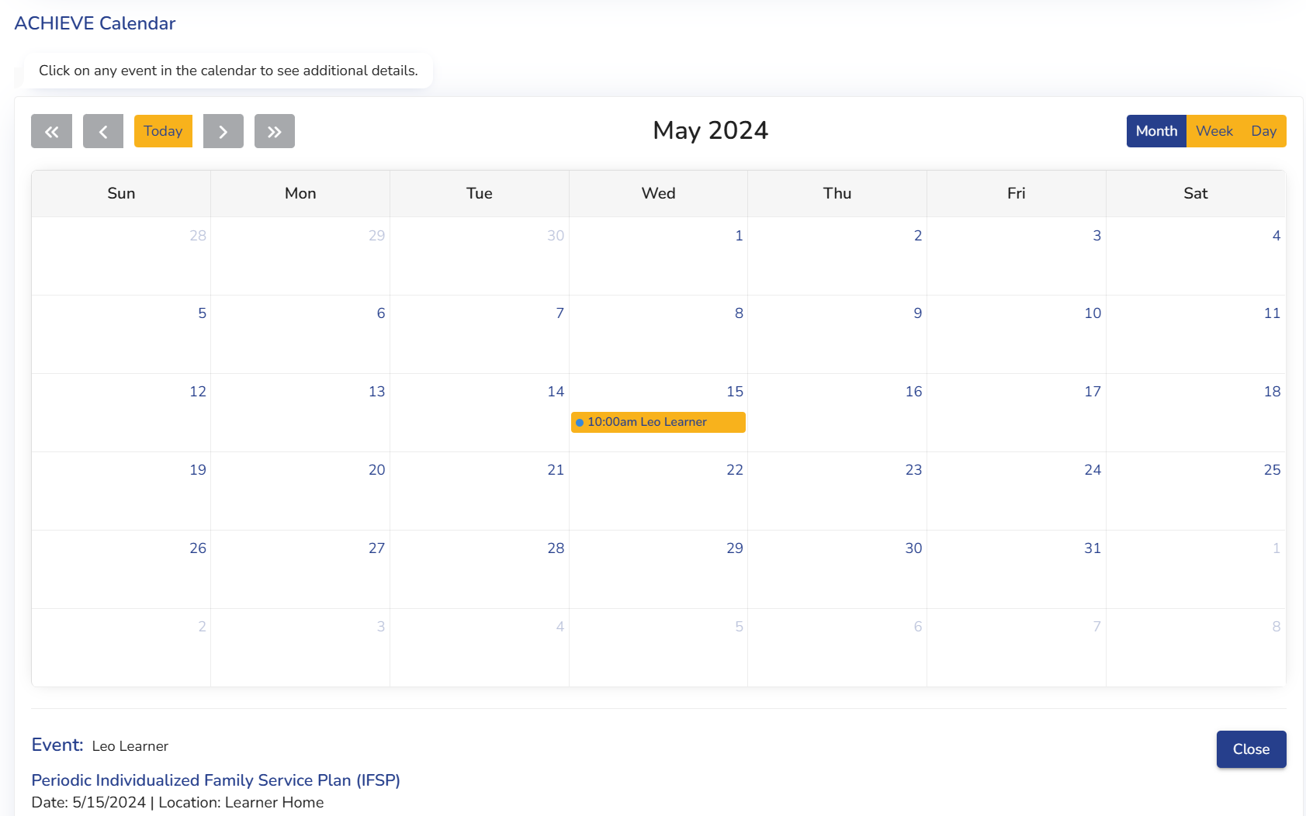
ACHIEVE Calendar2
Ability to Review
My Dashboard:
ACHIEVE Calendar
Displays scheduled meetings and deadlines
Notes:
The ACHIEVE Calendar displays upcoming deadlines and meetings scheduled with IFSP teams. Through this tool, account holders can also find meeting notices.

Slide 14
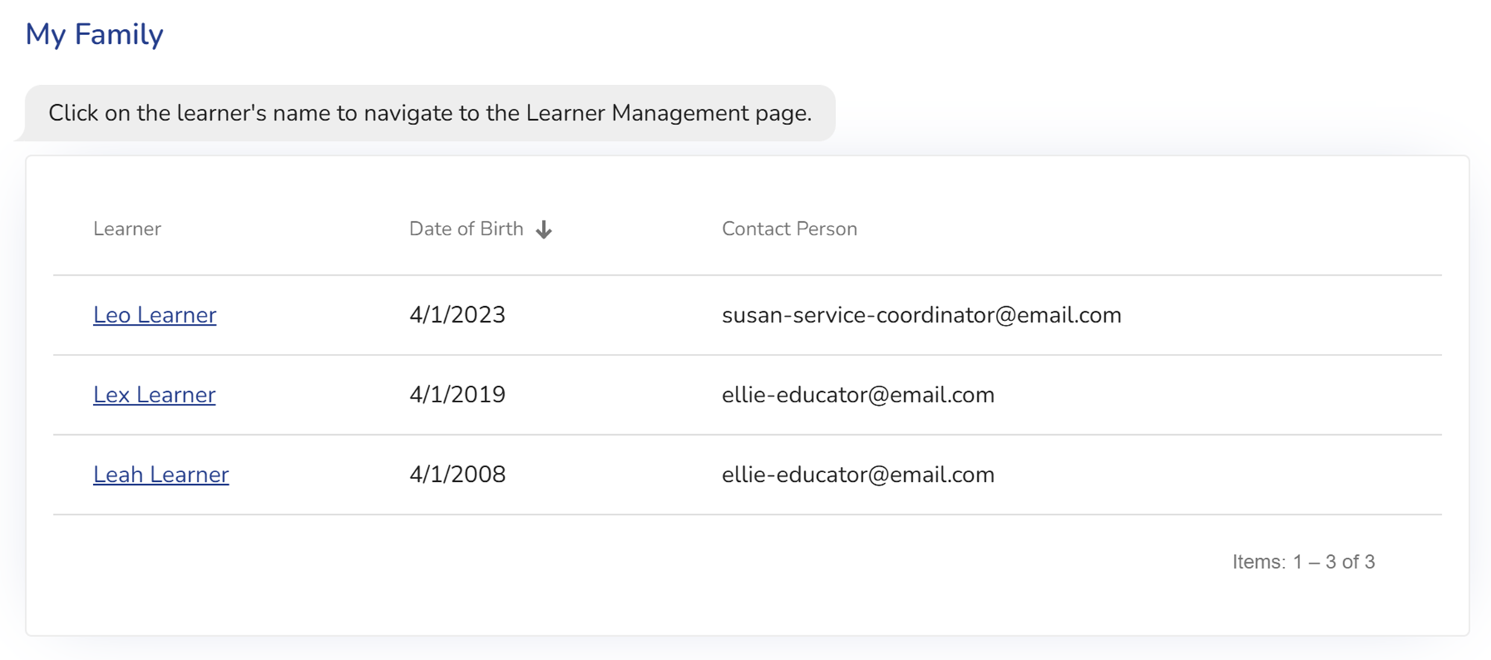
My Family
Ability to Review
My Dashboard:
My Family
IDEA Parents with more than one child receiving Early ACCESS or Special Education services may connect each learner to their ACHIEVE Family Portal account
Notes:
Another section on the Dashboard is called My Family. Here, account holders can view their child’s name and date of birth once they have successfully established a connection to their learner via the registration process. Families with more than one child receiving Early ACCESS or Special Education services will have the option to connect each child to the same account. Selecting on a learner’s name will open their Learner Dashboard, which will display the same information that is shown in ACHIEVE.

Slide 15
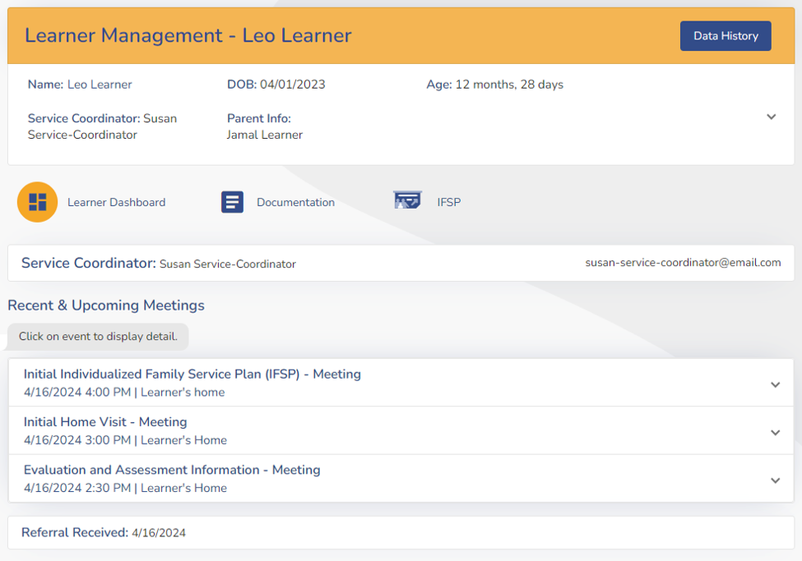
Early ACCESS (Birth-3) Learner Dashboard
Ability to Review
Learner Management:
Data History
Learner Dashboard
Documentation
IFSP
Transition Planning (when applicable)
Service Coordinator
Recent & Upcoming Meetings
Referral Received
Notes:
The Learner Dashboard will include learner-specific information and several navigational steppers including Documentation, IFSP, and Transition Summary when applicable. However, families will not have access to view the Family Contact stepper that is available to IFSP teams in ACHIEVE. This ensures that addresses and phone numbers of family contacts are not displayed in the ACHIEVE Family Portal. Families also will not have access to the Evaluation stepper.

Slide 16
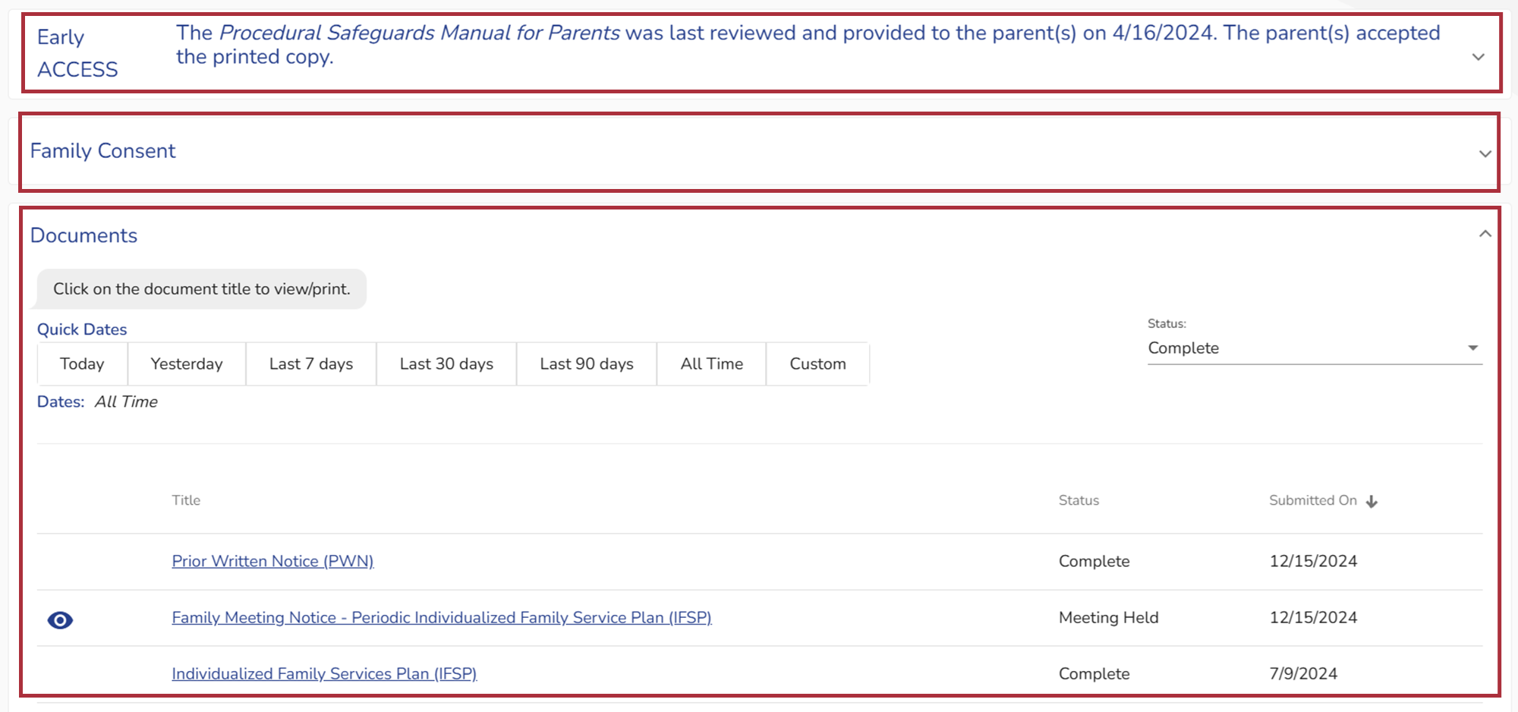
Review Documentation
Ability to Review
Learner Management:
Documentation Stepper
Procedural Safeguards
Family Consents
Finalized IFSP documents
Draft documents are not stored in ACHIEVE or the ACHIEVE Family Portal.
Notes:
The Documentation stepper mirrors the information that is available to IFSP teams in ACHIEVE. Families will have access to see when Procedural Safeguards were last provided, review, print, and/or electronically sign consent forms, and view copies of finalized documents.

Slide 17
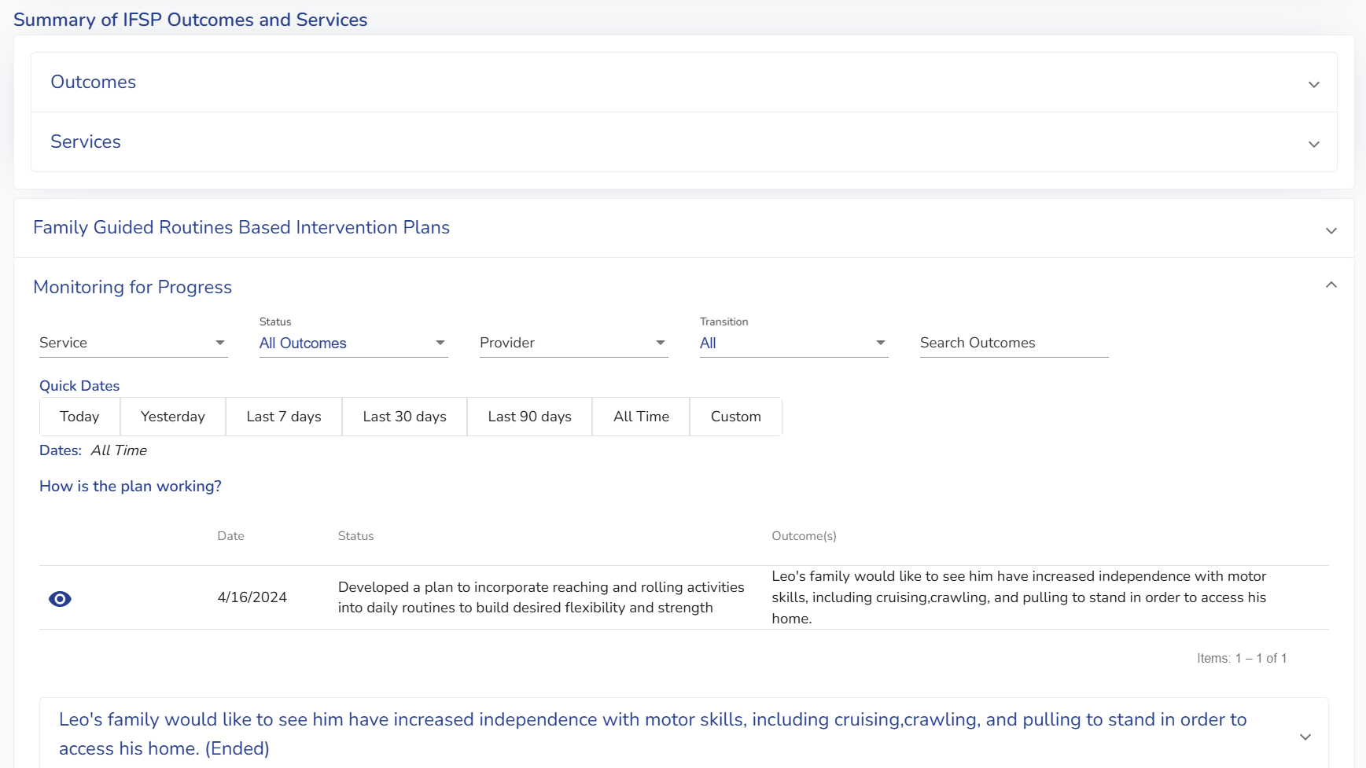
Review Data History 5
Ability to Review
Learner Management:
Data History
Provides real-time access to progress monitoring data entered in ACHIEVE including Family Guided Routines Based Intervention Plans
Notes:
Progress monitoring data entered into ACHIEVE becomes available to ACHIEVE Family Portal account holders in real-time. This exciting feature allows families to proactively monitor their child’s progress throughout the year.

Slide 18
Consents to Review and Sign6
Tasks to Complete
My Dashboard:
Consents to Review and Sign
Download/Print PDF Consent Forms
Electronically Sign Consent Forms
Notes:
In addition to reviewing information in the ACHIEVE Family Portal, families can complete several tasks as well. Returning to My Dashboard, families can quickly access consent forms that are requested by their IFSP team. By clicking on the linked consent form, families will be redirected to the Documentation stepper and will be able to view, print, and/or electronically sign the consent form. When families sign consent forms electronically, the the status of the consent changes to Approved in real-time.

Slide 19
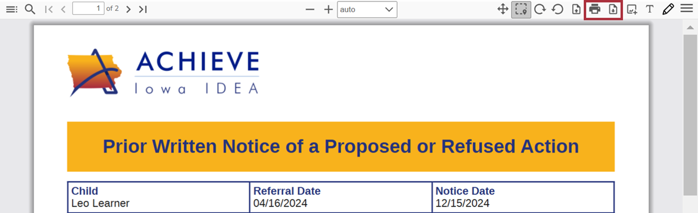
Documentation Tasks
Tasks to Complete
Learner Management:
Documentation
Download/Print PDF Consents and IFSP Documents
Notes:
On the Documentation stepper, families can download and print finalized PDF records at their convenience.

Slide 20
IFSP Tasks
Tasks to Complete
Learner Management:
IFSP
Immediate access to view and print finalized IFSPs via IFSP Document button
When an IFSP is finalized, a PDF copy is automatically shared with family within the ACHIEVE Family Portal and can be accessed from the IFSP navigational stepper.
A link to the finalized IFSP document can also be found in the following places:
Recent Documents (if the alert has not yet been cleared)
Documentation navigational stepper under Documents
Notes:
On the IFSP stepper, families can access their learner’s IFSP document once it has been finalized. When teams finalize IFSPs, a notification will appear on the Recent Documents section of the family member’s ACHIEVE Dashboard and IFSP Document button will also become enabled on the IFSP stepper. Please note: draft documents that are pushed to the portal will not appear here.

Slide 21
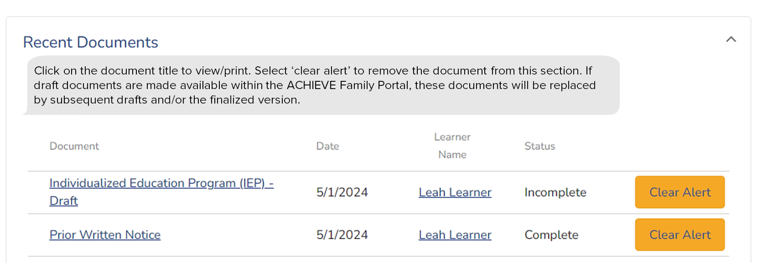
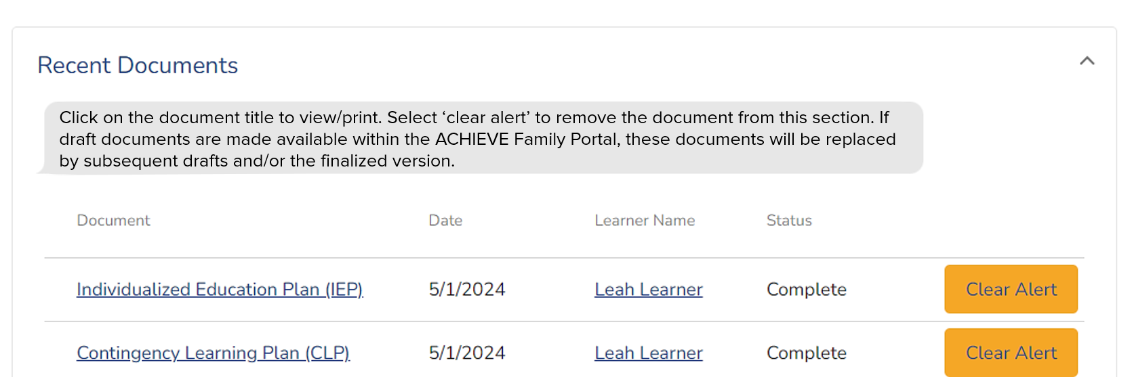
Draft vs. Finalized IFSP in Recent Documents
Notes:
Draft IFSP records that are pushed to the ACHIEVE Family Portal will only appear under the Recent Documents section of a family member’s ACHIEVE dashboard. Drafts can be pushed to the portal by the IFSP team as many times as you like. Each time a new draft is manually pushed, the previous draft will be removed and replaced by the new one. This ensures families always have access to the most recently pushed draft document. Likewise, when the team finalizes the IFSP, any previously pushed draft will be removed and replaced by the finalized PDF document.

Slide 22
ACHIEVE Family Portal Sandbox Environment

Slide 23
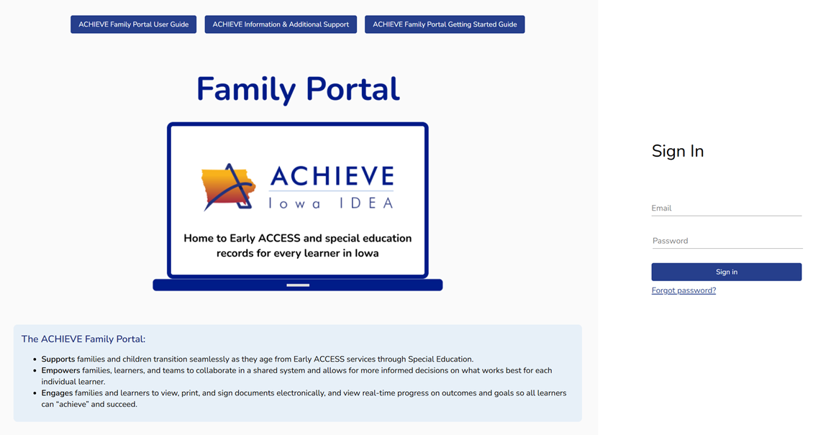
Training Environment for IFSP Teams
ACHIEVE Family Portal Sandbox Environment
Sample family login credentials will be provided to allow IFSP teams to learn more about the information provided in the ACHIEVE Family Portal

Slide 24
ACHIEVE Impacts for IFSP Team Members

Slide 25
Impacts for IFSP Team Members 1
ACHIEVE requirements before ACHIEVE Family Portal account creation
1

Slide 26
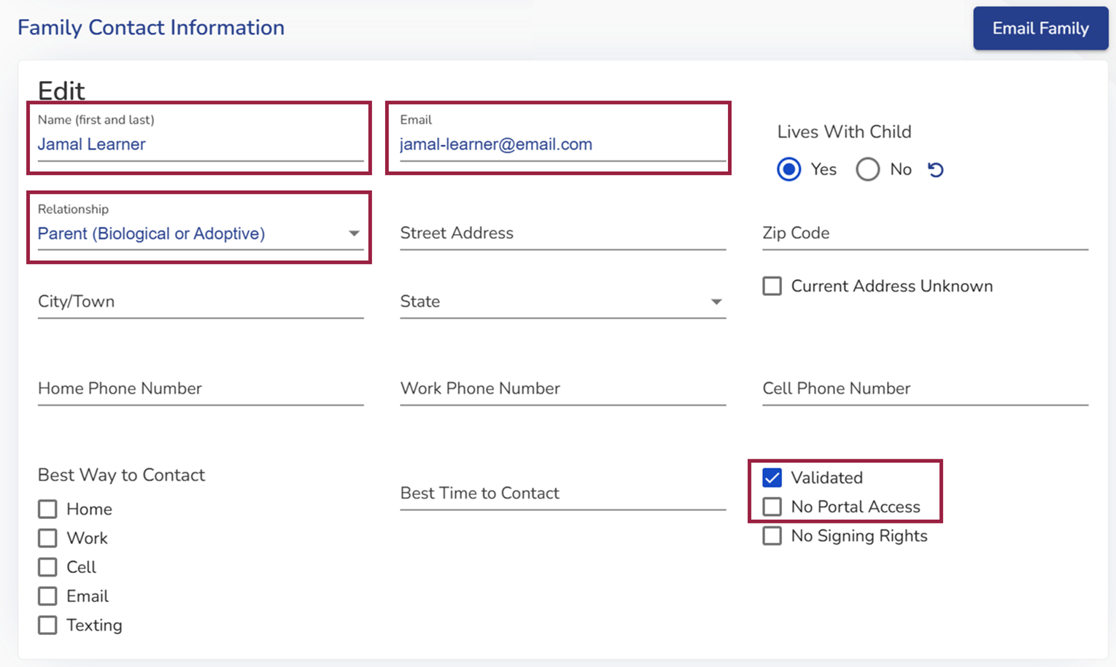
ACHIEVE Requirements to Create Account
ACHIEVE Requirements
Family contact meets requirements as an IDEA Parent.
Contact has provided a unique email address.
Validated checkbox must be selected.
No Portal Access must NOT be selected.
Learner must have an active/approved Consent for Services.
Notes:
Family contacts must meet several requirements before they become eligible to create an account in the ACHIEVE Family Portal. Many of these requirements rely upon completion of the family contact validation process in ACHIEVE. This process ensures IFSP teams serve as a gatekeeper to confidential records on behalf of special education learners.
First, IFSP teams must confirm that the family contact is an eligible decision-maker by selecting the appropriate relationship type in ACHIEVE. Only family contacts who meet requirements as an IDEA Parent will be eligible to create an account.
Family contacts must provide IFSP teams with a unique email address if they wish to create an account. This email address becomes the account holder’s username for the ACHIEVE Family Portal.
IFSP teams must review family contact information and make changes as needed. The Validated checkbox must be selected to enable the family member to create an account for the first time.
In some instances, biological or adoptive parents have their educational decision-making rights terminated. Selecting the No Portal Access checkbox prevents these contacts from receiving an invitation to create an ACHIEVE Family Portal account.
Once validation requirements are met, ACHIEVE also looks for an active/approved Consent for Early ACCESS Services on behalf of the learner before allowing the family contact to be invited to the portal.

Slide 27
Impacts for IFSP Team Members 2
Creating ACHIEVE Family Portal accounts
2

Slide 28
How Email Invitations Will Be Sent
ACHIEVE Process:
Once all 5 requirements are met, the Invite to Portal button becomes enabled.
IFSP Team may manually invite the IDEA Parent contact immediately by selecting this button. OR
Allow the nightly ACHIEVE process to automatically send invitations to newly eligible IDEA Parent contacts.

Slide 29
Invite to Portal Button
IDEA Parents
Button available after validation of email address in Family Contact Information
IFSP Service Coordinators
ACHIEVE Data Techs/Leads and Super Admins

Slide 30
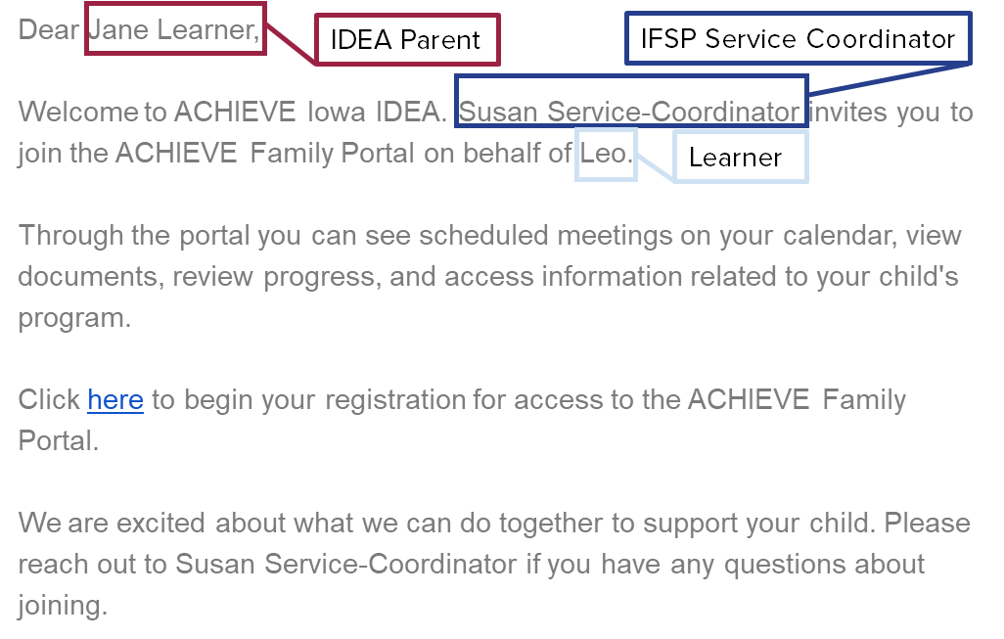
Invite to Portal Email
Notes:
ACHIEVE will generate an Invite to Portal email. This message will contain the family contact’s first and last name, the name of the IFSP Service Coordinator, and the first name of the learner.

Slide 31
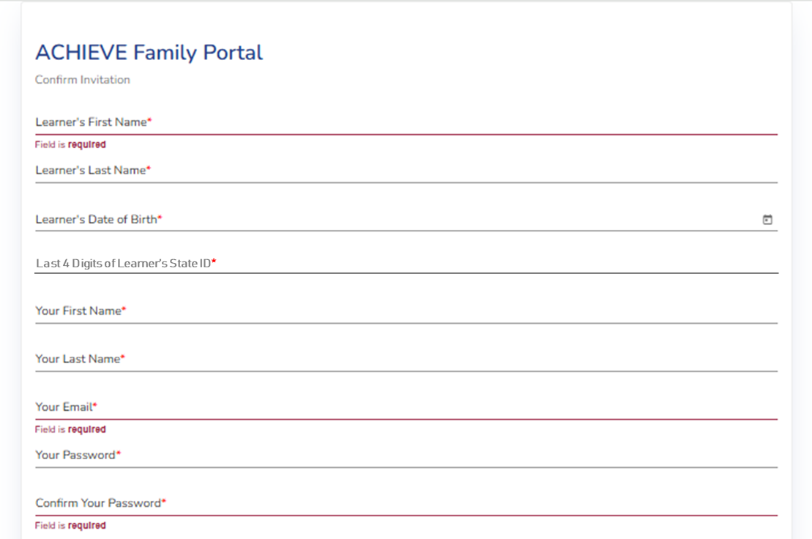
Establishing Connections to Learners
Connecting to ACHIEVE Data
IDEA Parents must validate data elements about their child to establish an initial connection to the learner’s ACHIEVE data.
IFSP teams must provide IDEA Parents with the last 4 digits of the learner’s State ID to support connections to Early ACCESS records.

Slide 32
Impacts for IFSP Team Members 3
Supporting ACHIEVE Family Portal Account Access
3

Slide 33
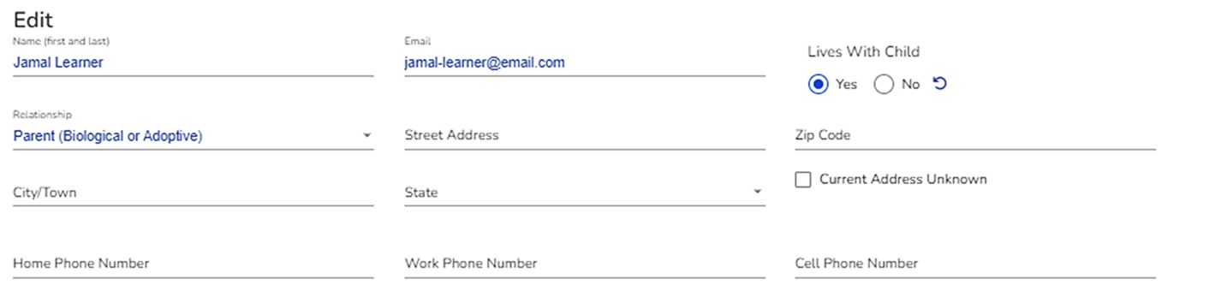
Family Contact Enhancements Coming Soon
Supporting Account Access
Additional Family Contact functionality to be released in February
Allows IFSP teams and Iowa Department of Education staff to update Family Portal usernames and assist with password reset, as needed
The Iowa Department of Education will be providing help desk support to address questions from family members as well as AEA/LEA staff. More details are forthcoming.

Slide 34
Impacts for IFSP Team Members 4
Pushing Draft Documents to ACHIEVE Family Portal
4

Slide 35
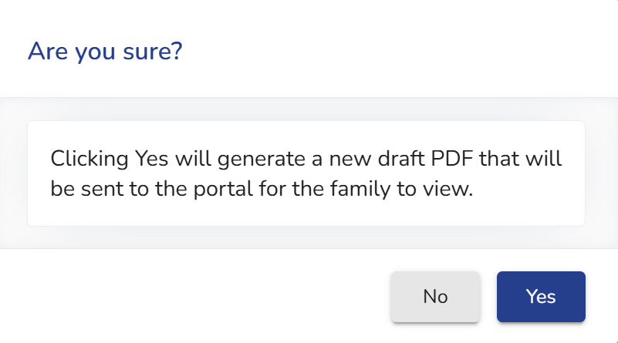
Sharing Draft Documents with Families
Draft Documents
IFSP teams may choose to share copies of draft documents with families via the Push to Portal button
IFSPs
IFSP Modifications
Draft PDF documents only appear in the ACHIEVE Family Portal if IFSP team members select the Push to Portal button.
If a second copy of a draft document is pushed to the portal, the original draft are removed/replaced.
When IFSP records are finalized, draft documents are removed/ replaced.
Draft documents are not stored in the Documentation stepper of ACHIEVE or the ACHIEVE Family Portal.

Slide 36
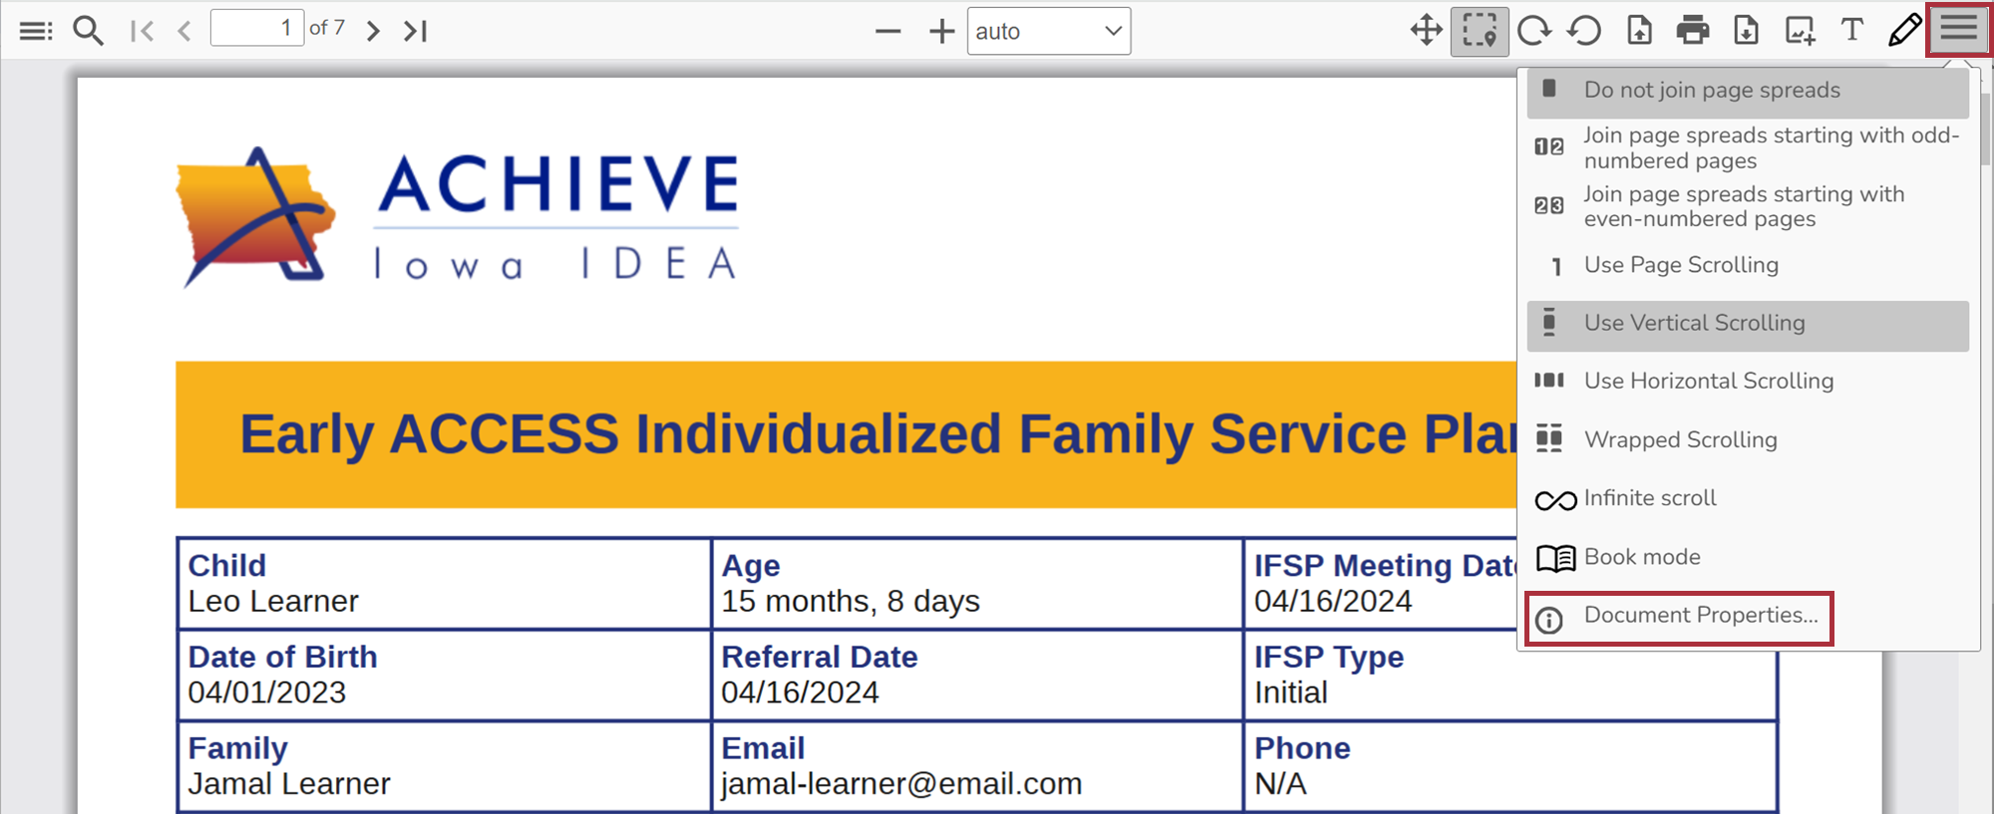
Identifying When Document Are Created
Timestamps
ACHIEVE and ACHIEVE Family Portal users can determine when PDF documents are created by reviewing Document Properties
The document creation date and time is displayed

Slide 37
Impacts for IFSP Team Members 5
Maintaining Privacy of Learner Records
5

Slide 38
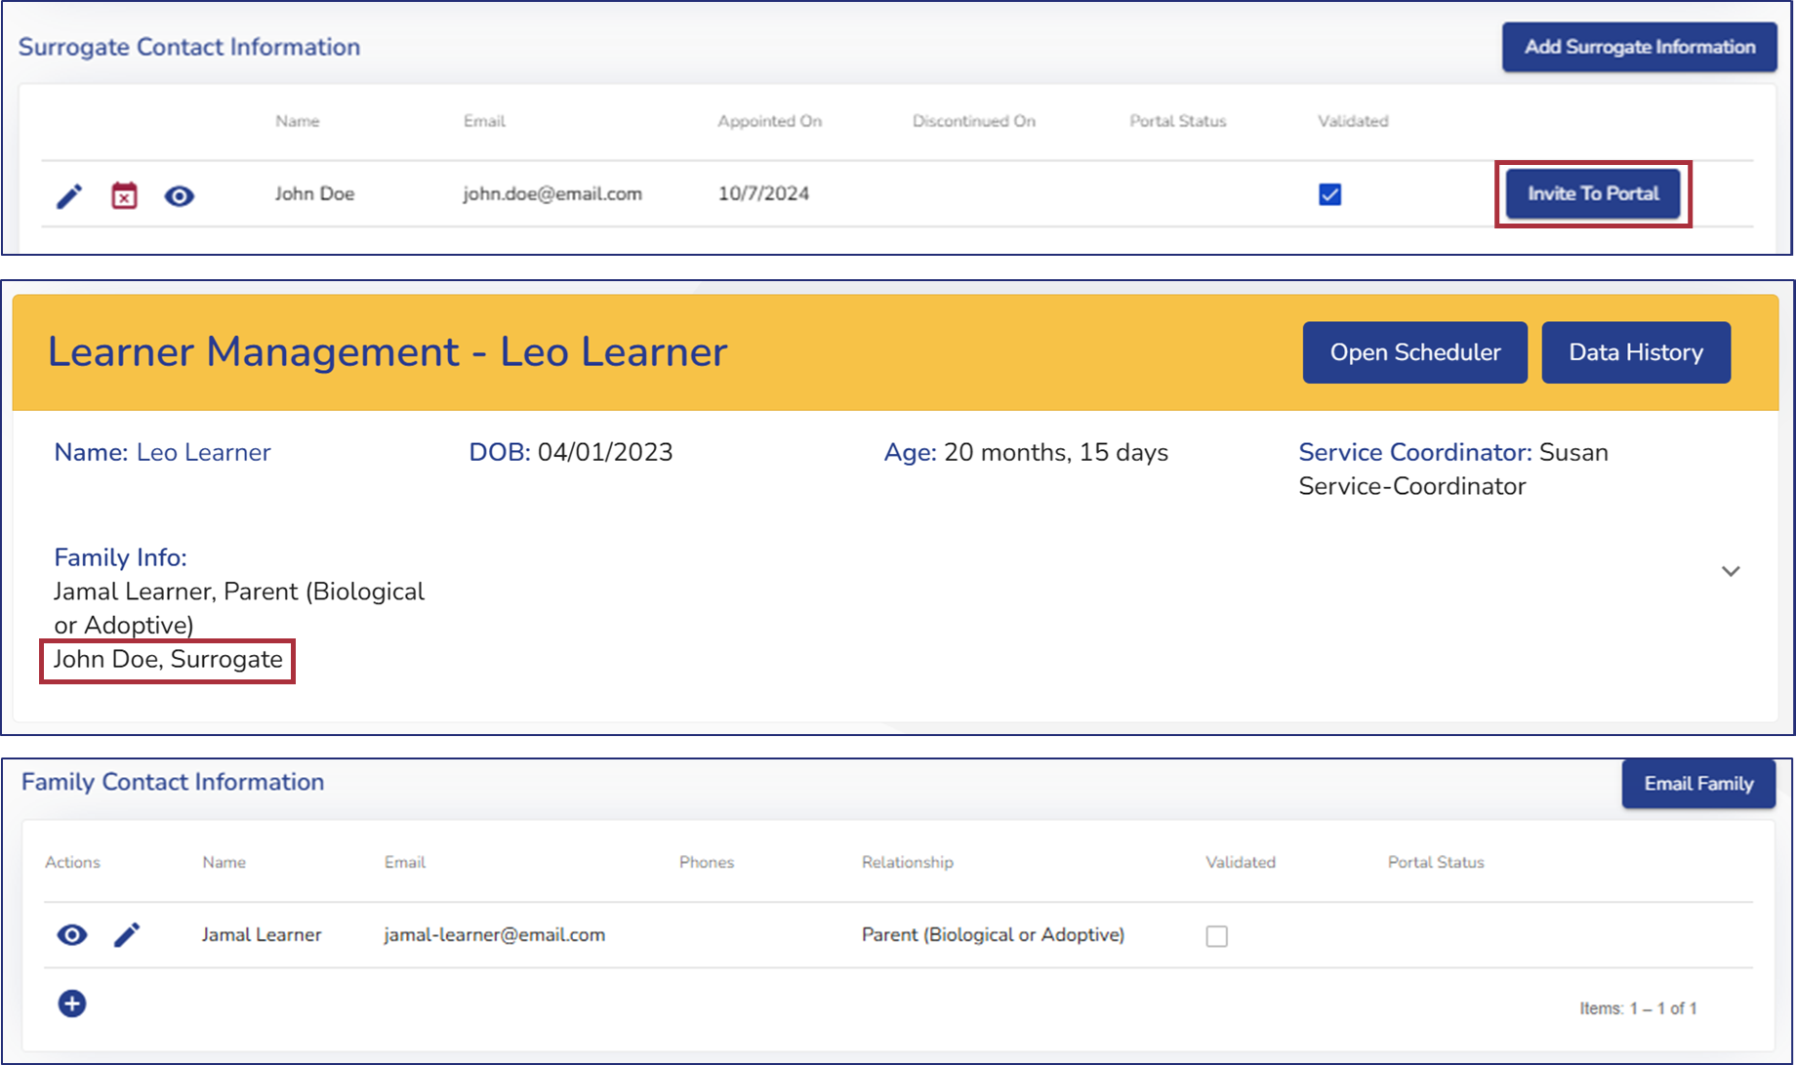
Surrogate Parent Information
Surrogate Parents
Only ACHIEVE users with permission to Add Surrogate Information can access the Invite to Portal button for Surrogate parents
IFSP teams will find Surrogate parent added to Learner Management header
Surrogate parent will not display in Family Contact Information

Slide 39
Privacy of Contact Information
Privacy Concerns
Address information of family contacts is not displayed on IFSP outputs or within the ACHIEVE Family Portal
Phone numbers will soon be replaced by IDEA Parent relationship type
The ability to restrict email addresses from appearing on outputs is coming Feb 2025

Slide 40
How will families communicate with IFSP teams?
In-Person
Phone
Email
Notes:
Families can use the ACHIEVE Family Portal to feel more informed, share in team decision-making, and support their child's progress. Families cannot make or request changes to records in the portal. However, they can download and print copies to discuss at meetings. IFSP teams then makes needed changes and provide updated copies.
The ACHIEVE Family Portal is not meant to replace personal connections with IFSP teams. Families will continue to contact your team members by phone, email, or in-person as they do today. IFSP meetings are still required at least once per year and upon request.

Slide 41
Training & Communication

Slide 42
Communication Toolkit
ACHIEVE Webpages
Communication Samples & Templates
Slidedeck for Parent Presentations
About ACHIEVE Family Portal Printable Flyer
ACHIEVE Family Portal Overview Video
Frequently Asked Questions (FAQ)
Notes:
For LEAs and AEAs- tools to communication about the launch to families

Slide 43
Training Materials for Families
ACHIEVE Family Portal Web Page https://educate.iowa.gov/ACHIEVE-Family-Portal
Guides
Quick Start Guide
User Guide
“How To” Guides
Frequently Asked Questions (FAQ)
Handouts
About the ACHIEVE Family Portal
IDEA Parent Guidelines
Language Translation Guide
Videos
About the ACHIEVE Family Portal
Early ACCESS Overview
Special Education Overview
Notes:
The following materials will be available for families as a resource to help them learn more about the functionality and benefits of the family portal, create an account, access their learner’s records and navigate the tools in the portal.

Slide 44
ACHIEVE Family Portal Launch Toolkit
Frequently Asked
Questions
Training Guides
Communication Materials
ACHIEVE Webpage
ACHIEVE Family Portal User Guide
ACHIEVE Family Portal Quick Start Guide
IDEA Parent Guidelines
Overview
Videos
Training Webinars

Slide 45
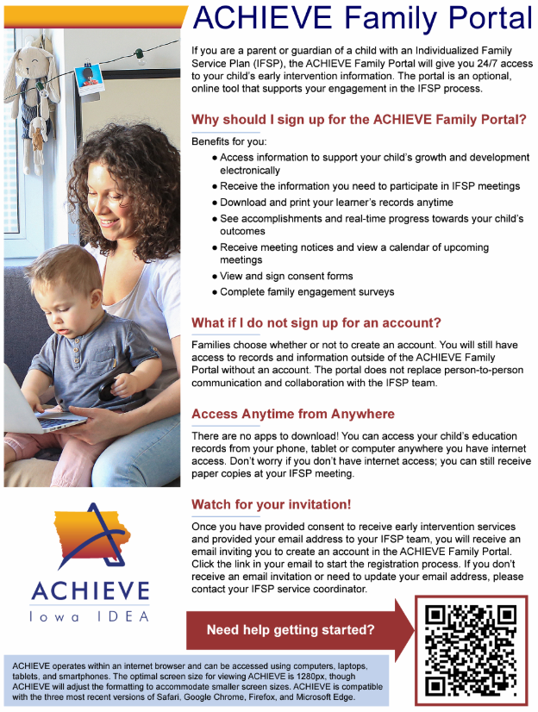
About the ACHIEVE Family Portal - Early ACCESS
Share with Families!
https://educate.iowa.gov/ACHIEVE-Family-Portal
Notes:
https://educate.iowa.gov/media/10763/download?inline

Slide 46
ACHIEVE Web Page
Training & Resources
ACHIEVE Family Portal Toolkit materials will be available on the Iowa Department of Education ACHIEVE webpage in early January 2025
https://educate.iowa.gov/pk-12/special-education/programs-services/achieve

Slide 47
Thank You!

