Slide 1
Work-Based Learning (WBL) Coding and Reporting Support Webinar
January 13, 2025
Notes:
Heather

Slide 2
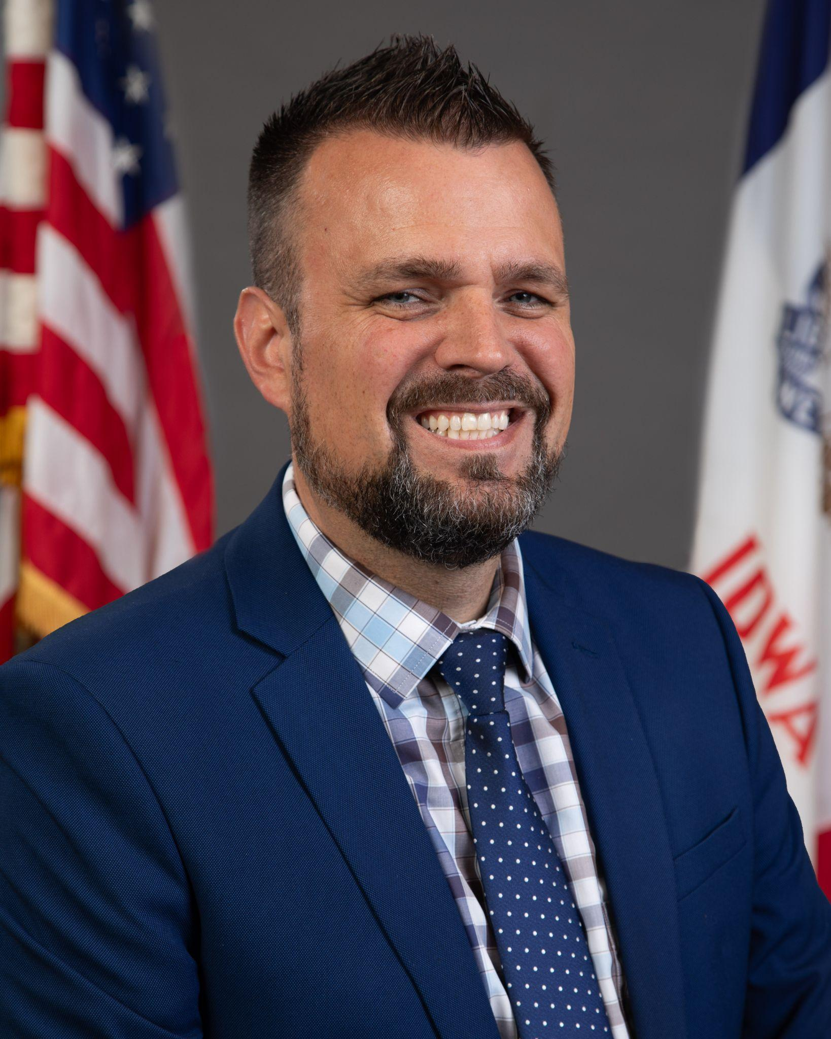
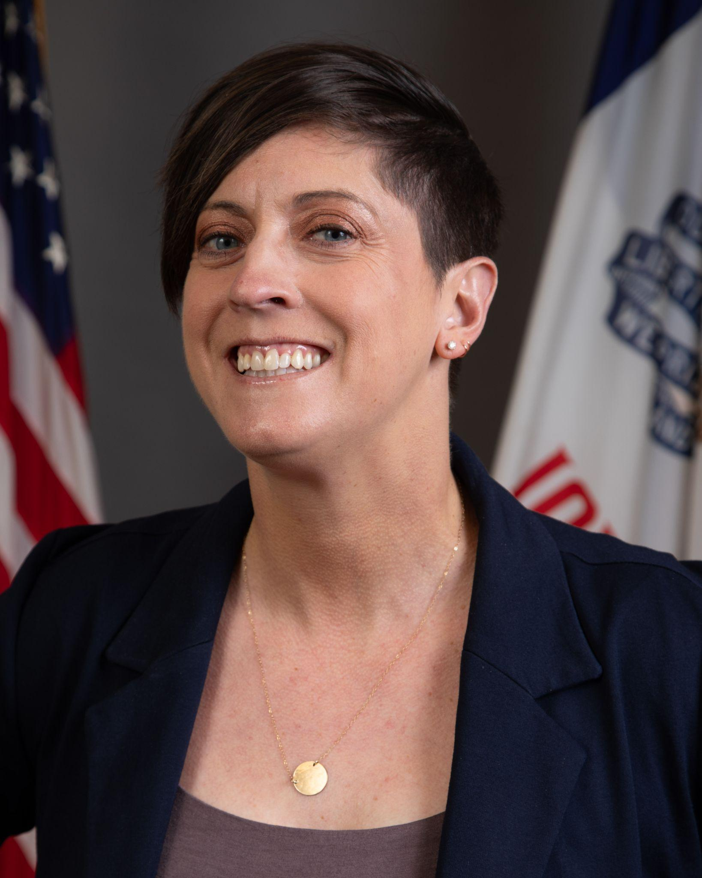
Presenters
Joe Collins
Education Program Consultant,
WBL & Health Science
Iowa Department of Education
joe.collins@iowa.gov
Rachel Kruse
Education Program Consultant,
Information and Analysis
Iowa Department of Education
rachel.kruse@iowa.gov
Jason Crowley
Administrative Consultant,
Information and Analysis
Iowa Department of Education
jason.crowley@iowa.gov
Heather Meissen
Administrative Consultant,
Career and Technical Education
Iowa Department of Education
heather.meissen@iowa.gov
Notes:
Heather
Panelists: Abby Tibbetts, Cale Hutchings, Erica Woods-Schmitz, Jeffrey Fletcher

Slide 3
Outline
Defining Career-Connected Learning (CCL)
Recommendations for Coding and Expanding Work-Based Learning (WBL)
Reporting WBL in the Student Information Systems (SIS) for SRI Reporting
Additional Resources to Consider
If you have any questions, please ask them in the chat. We will provide an FAQ after the meeting with answers to your questions.
This webinar is being recorded and will be shared after the webinar. It will also be posted to the Career-Connected Learning webpage at educate.iowa.gov/ccl.
Notes:
Heather

Slide 4
Terminology Changes
The passage of Senate File 2411 in May 2024 solidified the definition of “work-based learning” as being only those activities that involve direct interactions between industry and education stakeholders as:
sustained project-based learning in partnership with an employer
simulated work experiences aligned with industry-recognized credentials
high-quality pre-apprenticeships aligned to an apprenticeship
student learner programs
internships
apprenticeships
Most of these experiences will occur in a physical work environment, but some may be provided in a simulated or virtual environment in class or on campus.
Refer to the new Work-Based Learning Course Naming & Coding resource available at educate.iowa.gov/ccl for information on definitions and coding.
Notes:
Joe

Slide 5
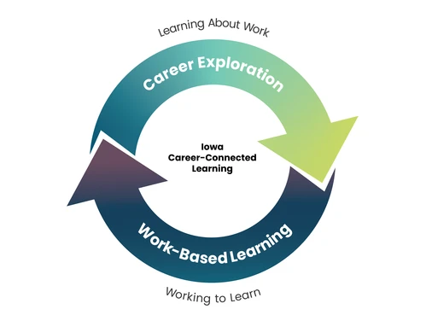
Career-Connected Learning
Career-Connected Learning = Career Exploration + Work-Based Learning
Career Exploration - activities that help students in learning about work
Work-Based Learning (WBL) - supports students in working to learn the knowledge and skills they need to succeed in the workplace and beyond
Career-Connected Learning Website
(educate.iowa.gov/ccl)
Notes:
Joe

Slide 6
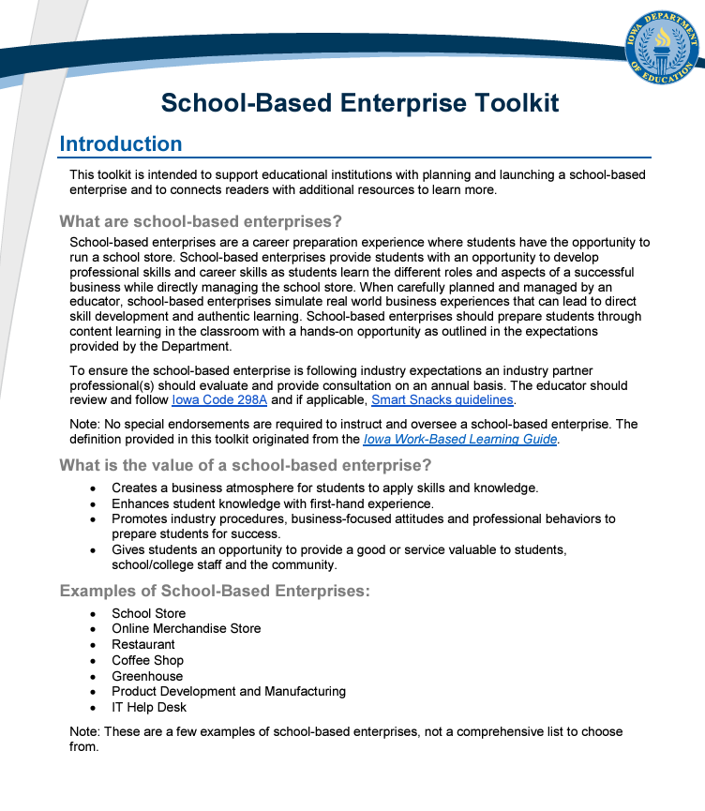
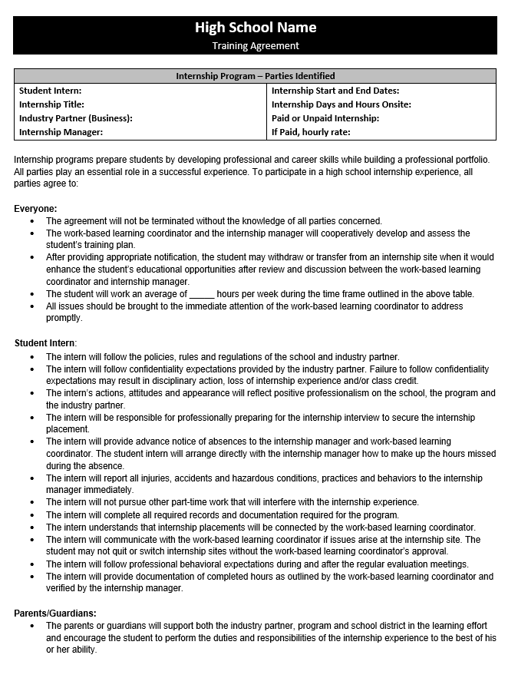
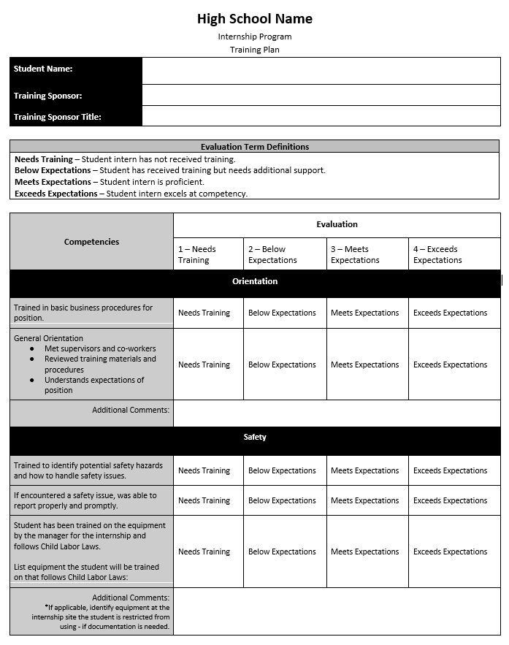
Overview of WBL Resources
Check out the guides, toolkits, templates and other resources available at educate.iowa.gov/ccl
Career Exploration
Authentic Project Experiences Toolkit - Informational Interview Toolkit
Career Immersion Experience Toolkit - Interactive Career Event Toolkit
Career-Based Service Learning Toolkit - Job Shadow Toolkit
Classroom Speaker Toolkit - Mock Interview Toolkit
Developing Professional Skills in CTE Toolkit - Professional Skills Workshop Toolkit
Entrepreneurship Toolkit - Worksite Exploratory Event Toolkit
Work-Based Learning
Internship Toolkit
School-Based Enterprise Toolkit
Sample Internship Training Plan
Sample Internship Training Agreement
WBL Self Assessment Tool
Expanding WBL for Schools
Notes:
Joe

Slide 7
Quick WBL Verification Check
While districts have flexibility on how they classify experiences, there are some specific considerations to keep in mind to ensure it should be considered “Work-Based Learning” and not “Career Exploration”. Note: CTE courses do not automatically count as WBL!
Are students actively working, not passively observing?
Students must be completing actual work duties that provide value to employers in a real or simulated environment. Some examples of roles played by students would include:
Project-Based Learning = Consultants
Simulated Work Experience = Worker for School Based Enterprise, completing work clinicals or practicum requirements, etc…
Internships, Student Learner Programs, Pre-Apprenticeships & Apprenticeships = Worker
Are employer partners directly involved and engaging with students?
Employer partners need to be directly involved and engaging with students to be considered WBL, not simply providing consultation on advisory councils, CTSOs, competitions, etc…
Projects, lab work or experiences that have been designed by or approved/vetted by employers or advisory councils do not automatically qualify.
Schools/districts, family businesses, entrepreneurs and others may qualify as “employers”.
Notes:
Joe

Slide 8
Three tips for counting/expanding WBL experiences #1
Tip #1: Embedded experiences count the same as dedicated WBL courses
Work-based learning activities or experiences that are part of a course (otherwise known as "embedding") are counted the same as dedicated WBL courses (e.g. internships or work-study) for the Iowa School Performance Profiles and other measures.
The staff, time and other resources necessary to offer dedicated WBL programs and courses can be a barrier for many schools, so consider embedding experiences into your current course offerings before building out larger scale programs and changes.
Some examples would be a student-led coffee shop that is part of a business course, internships that are part of an agriculture course or project-based learning activities as part of a construction course.
Notes:
Joe

Slide 9
Three tips for counting/expanding WBL experiences #2
Tip #2: All courses can qualify as work-based learning
There is no requirement that WBL must occur as part of a designated career and technical education (CTE) course or program of study. Every course can be counted as including WBL as long as it meets one of the state definitions.
A few examples might be project-based learning as part of a math class, a school-based enterprise as part of a science class or a student learner program as part of a government/social studies class.
Similar to the previous tip, expanding or implement quality CTE programs can be time and resource intensive, so consider adapting all of your current course offerings to be included as WBL in different ways.
Reminder: CTE courses, even those taught at a career academy or regional center, do not automatically count as WBL.
Notes:
Joe

Slide 10
Three tips for counting/expanding WBL experiences #3
Tip #3: Create an inventory of courses and survey staff for ideas or opportunities
Districts should consider building out an inventory of all courses and surveying staff to determine if qualifying WBL is already taking place or if some minor tweaks might be needed to be able to do so in some capacity.
Questions to consider might be:
Do you involve business and industry partners in your course/program?
If not, are you interested in doing so in the future?
Do you include project-based learning in your course/program?
If yes, are local business and industry partners involved?
If not, are you interested in doing so in the future?
Do your students conduct clinicals, practicum or other required work experience for your course/program or related credentials/licensure?
If no, has this interest been expressed by students or industry partners?
Do your students work towards an industry-recognized credential (IRC) as part of your course/program?
If no, has this interest been expressed by students or industry partners?
Are you interested in learning more about incorporating career exploration or work-based learning activities and experiences in your course/program?
Notes:
Joe

Slide 11
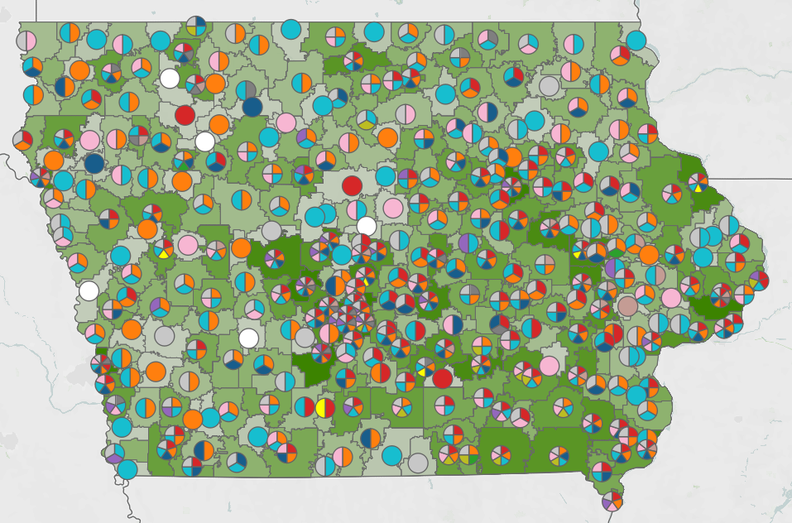
Iowa Student Outcomes WBL Dashboard
The interactive WBL dashboard at
www.iowastudentoutcomes.com/work-based-learning
showcases WBL participation at the district level and
has recently been updated to reflect 2023-2024 AY
data for the new state definition of the new definition of WBL.
District staff are encouraged to check the updated
information and conduct a thorough review of all
identified courses, as well as any that may be missing
or seemingly incorrect due to coding or reporting issues.
A new feedback form has also been added to the site to
request corrections, clarifications or other information. This is
being done to help ensure courses are being adequately
coded within district Student Information Systems (SIS) before
the transmission of Winter Student Reporting in Iowa (SRI)
data files by the end of this month (January 29th).
Notes:
Joe

Slide 12
WBL Data Collection Points
The WBL data will be collected in the Winter SRI data files that are due between December and January of each year (Deadline: January 29, 2025)
Although not required, consider using all three of the below data points in combination with one another to ensure accuracy:
School Courses for the Exchange of Data (SCED) Codes
Course Names (keywords; only used for map/internal DE use)
Embedded Work-Based Learning Indicator Codes
Secondary Career & Technical Education Reporting Application (SCTERA)
Student-level, only for “CTE concentrators” (earned 2.0 credits in specific CTE area)
Refer to current resources at educate.iowa.gov/ccl for updated guidance.
Course/ Content Area | Keyword(s) to Include in Course Title | SCED Code | Embedded Work-Based Learning Indicator
Internship for All Career Paths | “Internship” or “Intern” | 22998 | 15
Notes:
Joe

Slide 13
ESSA Postsecondary Readiness Indicator
Prior Indicators
Outcome Based
Phased in Indicators
ACT or SAT participation
ACT or SAT success
College-level coursework
CTE concentrators
% students that obtain college credit while in high school
% of students in a work-based learning (updated definition) experience
% students who obtain an industry recognized credential (IRC)
ESSA State Plan Information (pg. 47); General student reporting information
Notes:
Jason takes over

Slide 14
Postsecondary Readiness: Work-Based Learning
Reported in Fall 2024: Seniors from the 2022-23 school year who were in Iowa public schools for the four years leading up to that year
Work-Based Learning
Enrolled in a course in the Winter Student Reporting in Iowa (SRI) data collection that has a work-based learning School Courses for the Exchange of Data (SCED) course code
Enrolled in a course in the Winter SRI data collection that is tagged with an Embedded Work-Based Learning code on the approved list
Identified within the Secondary Career and Technical Education Reporting Application (SCTERA) as having participated in work-based learning at student-level
A school receives points toward its accountability index score proportional to the percentage of students participating in work-based learning; for example, if the school has 25% of students participating in work-based learning, it receives 25% * 50 possible points = 12.5 total points.
Notes:
Jason

Slide 15
Student Reporting in Iowa (SRI)
Student level data collection which includes all scheduled courses for a student.
Uses data from a district’s Student Information System (SIS)
Three times per year: Fall, Winter, and Spring
Winter collection is considered the ‘Curriculum’ collection
Winter SRI includes all scheduled courses for the year
Winter SRI should not be certified until courses for the entire year have been verified.
First Semester/First Trimester
Scheduled Course Enrollments
Winter SRI Data
2024-2025 Academic Year
Second Semester/ Second and Third Trimester
Scheduled Course Enrollments
Notes:
Rachel takes over

Slide 16
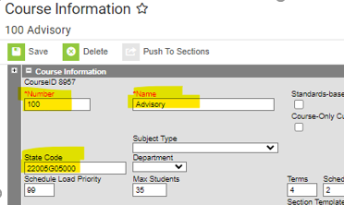
SCED Codes in Infinite Campus
Main Menu > Scheduling & Courses > Course Information (if no course is selected, you will need to Open Course Search and search for the course, hitting return will list all courses/sections)
Notes:
Rachel

Slide 17
SCED Codes in JMC
Schedules > Course > Edit Course Data > State Specific Course tab
Notes:
Rachel

Slide 18
SCED Codes in PowerSchool
School Management > Courses & Programs > Courses
Select a course
Under the Iowa State Report Information
Notes:
Rachel

Slide 19
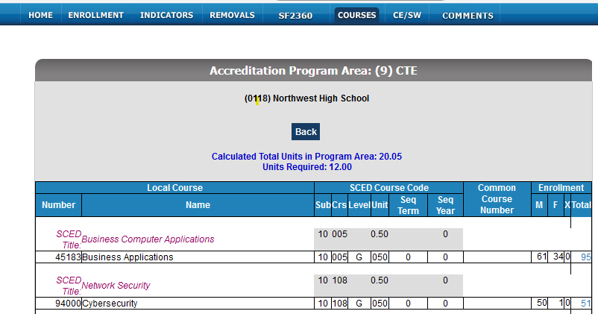
Curriculum Reports in Winter SRI for SCED Codes
Notes:
Rachel

Slide 20
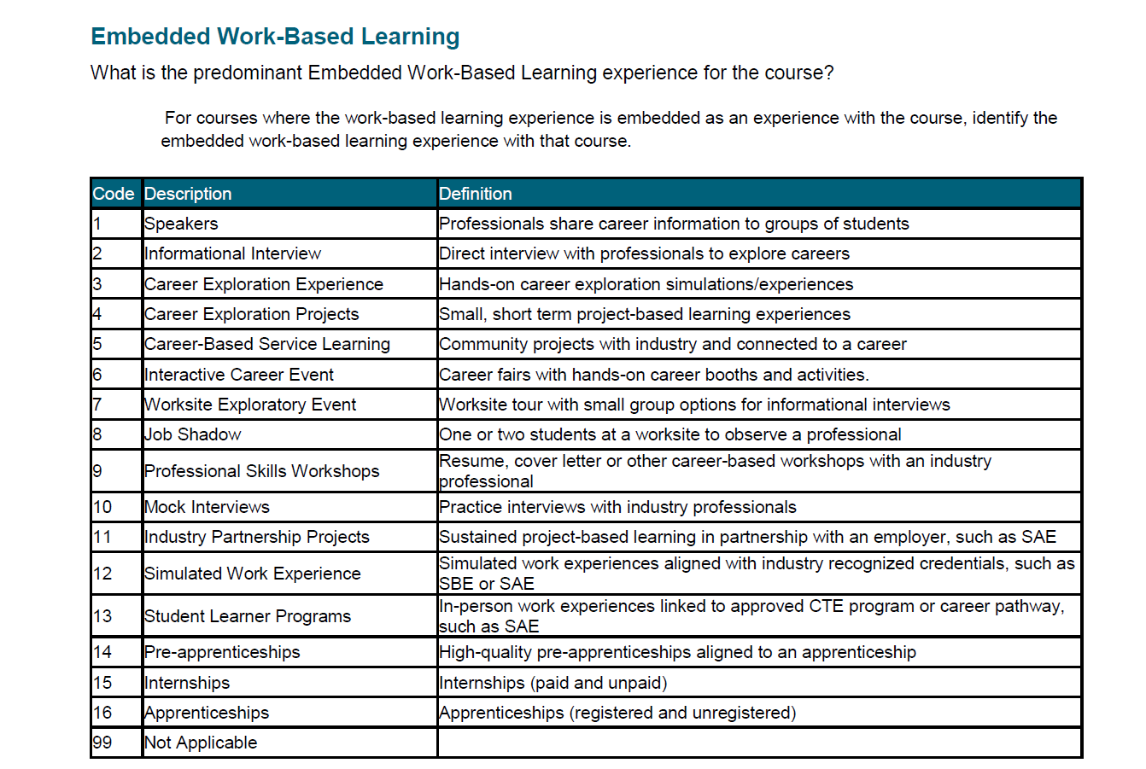
Embedded Work-Based Learning Indicator Data Dictionary page 111
WBL
Notes:
Rachel

Slide 21
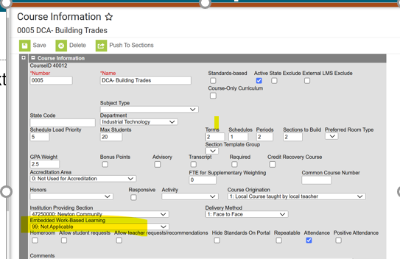
Embedded WBL – Infinite Campus
Search by Course/Section
Select Course
Course Information
Notes:
Rachel

Slide 22
Embedded WBL - JMC
Schedules > Course > Edit Course Data
State Specific Course tab
Notes:
Rachel

Slide 23
Embedded WBL - PowerSchool
School Management > Courses and Programs > Courses
Under the Iowa State Report Information section
Notes:
Rachel

Slide 24
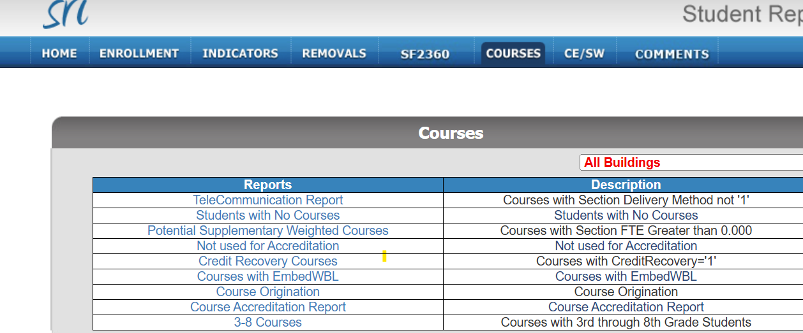
Report in Winter SRI Showing Courses with Embedded WBL
Notes:
Rachel

Slide 25
Stay in the Loop
Sign up for the following monthly newsletters to stay updated on important education news, trends and initiatives. Archived copies are also available on each site.
Work-Based Learning Coordinators
educate.iowa.gov/ccl
Superintendent & Education Leader Updates
educate.iowa.gov/pk-12/accreditation-program-approval/school-improvement/superintendent-education-leader-update
Notes:
Heather

Slide 26
Partner Spotlight: Iowa Workforce Development/Iowa Office of Apprenticeship
Our colleagues at Iowa Workforce Development have some great information and resources to consider at https://workforce.iowa.gov/opportunities/work-based-learning.
Schools and districts can fill out a WBL Interest Form to schedule a cross-agency meeting to review strategies and resources available to help with the planning, expansion, improvement or implementation of quality WBL programs or opportunities.
They also recently opened the Iowa Office of Apprenticeship with dedicated statewide teams that can help with pre-apprenticeship and apprenticeship program needs at https://workforce.iowa.gov/apprenticeship.
Notes:
Heather

Slide 27
Iowa Work-Based Learning Webinar Series
The Iowa Department of Education and Iowa Workforce Development are continuing a collaborative and informative series of webinars aimed at showcasing the many ways that Iowa schools and employers are building the workforce pipeline across our state. Special guests also include strategic partners like the Iowa Work-Based Learning Coordinators Association, Iowa Business Council and the Iowa Governor's STEM Advisory Council. Learn more, view previous session recordings and register for future sessions at https://workforce.iowa.gov/wbl-series.
Past Sessions:
10/01 - Work-Based Learning: Essential Tool for Preparing Students for Careers
10/21 - Jump-Start Careers: Apprenticeship, Pre-Apprenticeship and Industry-Recognized Credentials
11/19 - Iowa Business Council’s ‘Top Four' List of Professional Proficiencies
12/03 - Where to Find Funding and Other Resources for Work-Based Learning
Upcoming Sessions:
01/21 - A Deeper Dive into Starting and Expanding Work-Based Learning
02/11 - Using Labor Market Information to Drive Work-Based Learning Decisions
03/04 - Pre-Employment Transition Services (Pre-ETS) Work-Based Learning for Students with Disabilities
04/08 - Linking Perkins, CTSOs and Other Programs for Sustained Work-Based Learning
Notes:
Heather

Slide 28
WBL - Technical Assistance
Career Exploration, Project-Based Learning, Simulated Work Experiences with IRCs, Student Learner Programs & Internships
Heather Meissen, Iowa Department of Education
515-326-5378
heather.meissen@iowa.gov
Employer Connections, Pre-Apprenticeships & Apprenticeships
Kathy Leggett, Iowa Workforce Development
515-204-1378
kathy.leggett@iwd.iowa.gov
Notes:
Heather
We have a team of staff that works on WBL

