Slide 1
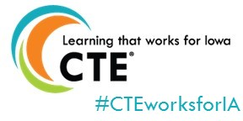
Student Reporting in Iowa (SRI) and Secondary CTE Reporting Application (SCTERA) “Connections” Webinar
Dr. Jeffrey Fletcher
Bureau of Community Colleges & Postsecondary Readiness
Iowa Department of Education
12/18/2025

Slide 2
Opening Remarks
This webinar is about the Winter SRI & SCTERA Data Collection/Reporting for Ch. 12 State Accreditation due January 29, 2025.
Ch. 12 Offer & Teach Accreditation Requirements around CTE programs & CTE courses
Extracting course/student data from district student information system (SIS) to SRI & SCTERA department databases.
SRI and SCTERA databases are utilized by Information Analysis Bureau for programmatic data processing for state and federal reporting (e.g., ESSA/ESEA, Perkins V).
More accurate/complete data collection lead to… More accurate/complete data processing down-the-road.
KEY STEPS:
District submits and uploads a 100% complete SRI file
District then completes SCTERA work of adding all CTE courses to program.
District then “certifies” SRI file to begin CH.12 accreditation review.

Slide 3
Opening Remarks
Questions about SRI data? SCED Codes? Sequencing? Other? – Please contact Rachel Kruse (Rachel.Kruse@iowa.gov)
Questions about SCTERA application? Complete a Google Form ticket via the home screen.
For dedicated SCTERA assistance, please utilize the SCTERA scheduling tool
For questions about courses & programs, please reference contact list below (or click on “DE Contacts” in SCTERA application):

Slide 4
Student Reporting in Iowa (SRI)
Student Reporting in Iowa (SRI), an EdInfo application in the Iowa Education Portal, is the Iowa Department of Education’s centralized initiative involving the transfer of individual student records from local districts to the state.
The mission of the project is to reduce data burden and encourage better decision-making by establishing and maintaining a cost effective method of accessing and transferring accurate and timely education information among school districts, postsecondary institutions, and the Iowa Department of Education.
Student Reporting in Iowa Tutorials

Slide 5
Student Reporting in Iowa (SRI)
SRI Contacts
Rachel Kruse, Rachel.kruse@iowa.gov, 515-281-4153
Margaret Hanson, Margaret.Hanson@iowa.gov, 515-281-3214
2024-2025 SRI Documentation
2024-2025 Student Reporting in Iowa Data Dictionary

Slide 6
Student Reporting in Iowa (SRI)
SCED Coding 101 – Introduces the user to SCED codes for secondary level courses. Examples of SCED codes are given, and the user has the opportunity to practice creating SCED codes.
National Center for Education Statistics – What is SCED?
Understanding the Accreditation Report – Explains the Curriculum Accreditation Report, which is found in Winter SRI. It describes the four main focus areas when checking for accuracy and common mistakes that are made.

Slide 7
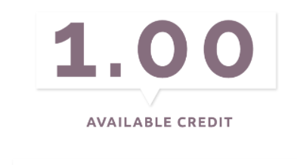
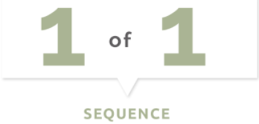
Student Reporting in Iowa (SRI)
Secondary (9-12) SCED Code Structure
Iowa has modified non-secondary in a slightly different style on the non-secondary courses. For non secondary courses, use “000” in place of the Carnegie Units, and the last two digits is the intended grade span instead of sequencing.
Coding Non Secondary Level Courses (13:57) - Describes how to link students to teachers at the non-secondary level. If courses are not scheduled, this webcast will instruct the user how to make the linkage in the SIS. For scheduled courses, the webcast will take the user through creating the SCED code for the course (Presentation Slides)

Slide 8
Student Reporting in Iowa (SRI)
SCED Course Code
9-12 courses used as placeholders for no credit, such as study hall or lunch, may contain a single ‘0’
All 9-12 courses should be assigned a course code generated from the coding manual, Secondary School Course Classification System: School Codes for the Exchange of Data (SCED) from the National Center for Educational Statistics, School Courses for the Exchange of Data (SCED) v12 as modified by the Iowa Department of Education and found on the State Reporting (SRI) website.
The 9-12 SCED course codes are 11 characters in length and have four components:
Course Description consisting of a two digit Subject Area and three digit Course Identifier
Course Level consisting of one alphabetic character in UPPERCASE
Carnegie Units expressed as a three digit number excluding the decimal point (e.g. 0.50 = 050)
A two digit sequence representing a count of the number of times you re-use the first 5 digits for courses with different content or used to indicate 1st term/2nd term of a year-long course

Slide 9
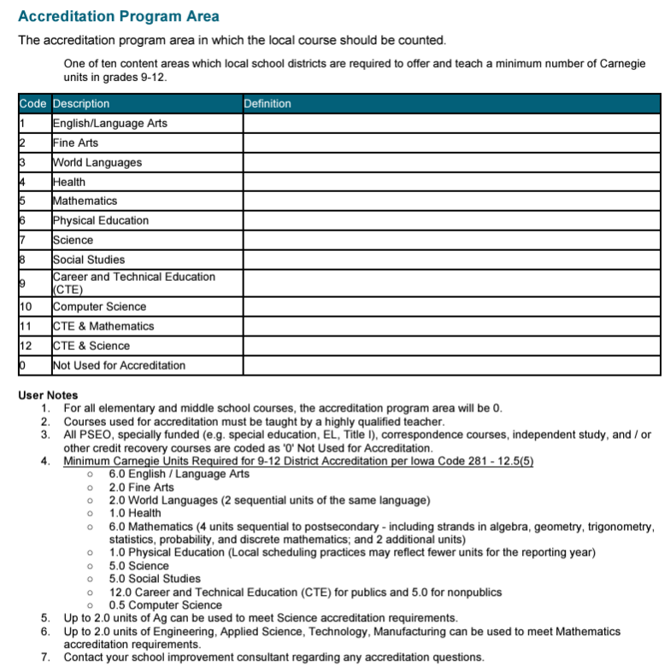
CRITICAL!!!
Accreditation Program Area, Code = ‘9’ or ’11’ or ’12’ for each SCED/Course that is Career & Technical Education (CTE)
*Under the right conditions, courses flagged with accreditation program area codes ’11’ or ’12’ will also “flow” into SCTERA.
‘11’ = Applied STEM for Math (up to 2.0 units)
‘12’ = Agricultural for Science (up to 2.0 units)
A critical step for information to “flow” into the IDE’s Secondary CTE Reporting Application (SCTERA) (SRI HANDBOOK, P. 109)
Reporting Assistance for HF 2465 (about new accreditation areas ’11’ & ‘12’)
Applied STEM for Math
Agricultural for Science

Slide 10
Student Reporting in Iowa
Reporting Assistance for HF 2465
Accreditation program area code ’11’ – CTE (ASTEM) & Mathematics ; ‘12’ – CTE (AG) & Science
An Act modifying provisions related to the curriculum provided to students enrolled in grades 9-12 by allowing instruction related to agriculture to meet a portion of the unit requirements related to science and allowing instruction related to ASTEM to meet a portion of the unit requirements related to mathematics.
Selecting Accreditation Area in Student Reporting in Iowa (SRI)
Districts opting to use a course with an Agriculture SCED code to also meet accreditation requirements in science, should set the Accreditation Program Area to '12' career and technical education (CTE) and Science on the course in their student information system (SIS).
Districts opting to use a course with an Applied Science SCED code to also meet accreditation requirements for mathematics should set the Accreditation Program Area to '11' CTE and Mathematics on the course in their SIS.
Courses with the Accreditation Program Area of '11' or '12' will show in the district's curriculum accreditation report found in winter SRI in both CTE and either math or science accreditation areas.
As mentioned earlier, these courses will also “flow” into SCTERA and populate the courses lists to as options to add to programs.
For more information, or questions, please contact: Cale Hutchings, cale.hutchings@iowa.gov

Slide 11
WBL SCED CODING – Student Reporting in Iowa (SRI)
Coding & Reporting Work-Based Learning Experiences
Beginning with the 2024-25 academic year, work-based learning reporting will reflect the new state definition referenced above for Iowa’s new, unified Every Student Succeeds Act (ESSA) school accountability system, which includes work-based learning experiences attained in the Postsecondary Readiness Indicator, and Iowa’s Perkins Secondary Career and Technical Education 5S3 work-based learning measure (Senate File 2411, 2024).
Schools will leverage existing SCED codes and new embedded work-based learning codes to report these activities to the Iowa Department of Education.
FAQ & Guidance
(Updated comprehensive WBL SCED & WBL Embedded Code Guide was released this week!)
Work-Based Learning Definition and Reporting
Work-Based Learning Course Naming and Coding
For more information, or questions, please contact: Heather Meissen, Heather.Meissen@iowa.gov

Slide 12
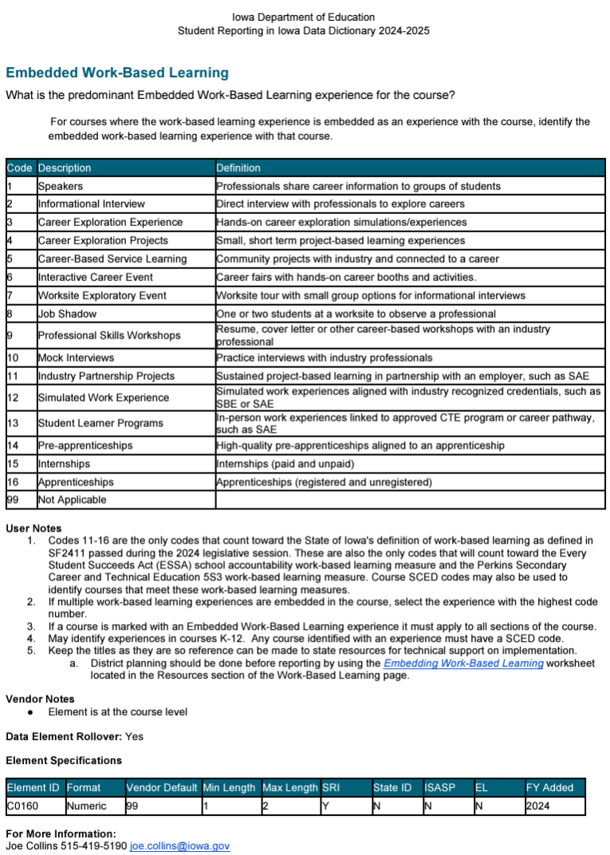
Embedded WBL Coding – SRI
Embedded Work-Based Learning Indicator was added to SRI and district SIS systems beginning with the 2023-2024 reporting cycle for use in reporting work-based learning happening in courses that may not be a dedicated WBL course.
Embedded WBL codes are outlined in the 2024-25 Student Reporting in Iowa (SRI) data dictionary (p. 111).
“User Notes” indicates which embed codes count toward the state’s new work-based learning definition and which do not.
It is desired ALL courses include this code, even dedicated WBL courses, since it adds a layer of specificity that does not exist with SCED codes.

Slide 13
Student Reporting in Iowa
Dates to Remember
December 2 – Cedar Connect and SRI opened for Winter collection (public and nonpublic)
December 2 – Dropout Verification Report opened (public and nonpublic having grades 7-12)
December 13 – Dropout Verification certification deadline (public and nonpublic having grades 7-12)
January 2 – Secondary CTE Reporting Application goes “live” – Winter SRI certification opens
January 29 – Courses in a program due in SCTERA & Winter SRI certification deadline

Slide 14
SRI is the foundation for… Secondary CTE Reporting Application (SCTERA)
The SRI system is the basis for extracting CTE data into the Secondary CTE Reporting Application (SCTERA) system (another EdInfo Application)
A EdInfo Application within the Iowa Education Portal
The information from SCTERA is used for ensuring that school districts comply with state and federal career and technical education requirements.
SCTERA information is also used to develop data required for the annual consolidated annual report (CAR) and reporting performance on the Federal Perkins accountability performance indicators.
Secondary CTE Reporting Application
One-way Data Connection
Student Reporting in Iowa (SRI)

Slide 15
Secondary CTE Reporting Application (SCTERA)
Log in to the Iowa Department of Education Portal
IDE recommends using the Google Chrome web browser
Access to the Secondary CTE Reporting Application (SCTERA) is through the Iowa Education Portal: https://portal.ed.iowa.gov
Under A&A Account, select “Sign-In” - Enter your e-mail and the password on the sign-in screen.

Slide 16
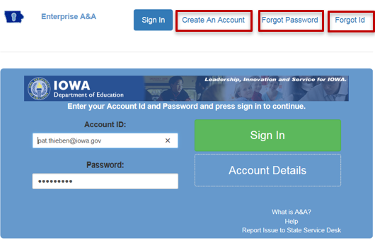
Secondary CTE Reporting Application (SCTERA)
You can reset your password by clicking the Forgot Password button at the top of the page on the log in page.
If you do not have an A&A account, click on Create an Account at the top. Your district A&A Administrator will give you permission to the CTE application.

Slide 17
Secondary CTE Reporting Application (SCTERA)
After successfully logging into the Iowa Education Portal –
Navigate to the dropdown menus in blue
Click on “EdInfo”
Select Secondary CTE Reporting Application
Need assistance with the Iowa Education Portal?
Need assistance with access to SRI and/or SCTERA applications?
Please contact ed.portal@iowa.gov or 515-725-2040

Slide 18
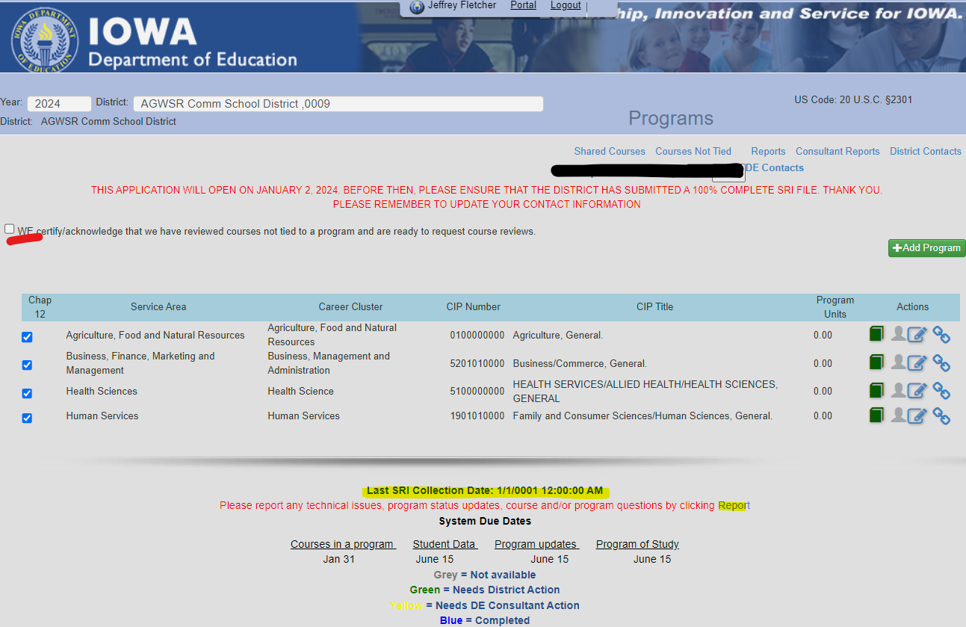
Secondary CTE Reporting Application (SCTERA)
Notes:
Check to make sure SRI is uploaded, timestamp is circled in RED in screenshot — nothing can be completed until school districts SRI file is uploaded/submitted AND 100% complete.
If the school district needs to re-upload/re-submit, it is important to be very cognizant of what the changes were so they can re-do/update a CTE program if CTE data changed.
Check (4) programs under the Chapter 12 column; the check-marks are about compliance for offer and teach accreditation; not that these are the only ones that will be documented.
Pick programs with 3.0 or more units of school district classes - unless they are a district that has under 600 students, then they can use CC classes in ONE program (if they have at least 5 students in the course or courses) and they would not lose supplemental weighting.

Slide 19
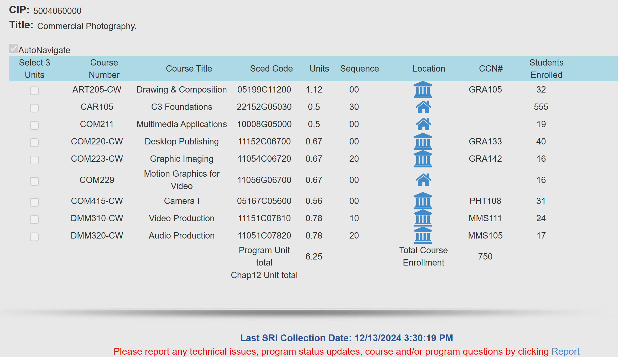
Secondary CTE Reporting Application (SCTERA)
Notes:
Be sure to include ALL Community College CTE courses associated with a CIP/CTE Program. We also need to count all CTE students. It can make a difference.
If there is more than (1) CIP/CTE Program within a Service Area, ensure that the courses are unique/specific to each CIP.
If CIP/CTE Program was checked for Chapter 12 – boxes for each course will be available; select courses until reaching 3.0 units. Note: If supplemental weighted courses are checked for the offer and teach requirement, the supplemental weighting is lost. Try to check local courses when and if possible. Any course(s) not marked as meeting the Offer and Teach requirement is/are eligible for supplemental weighting.

Slide 20
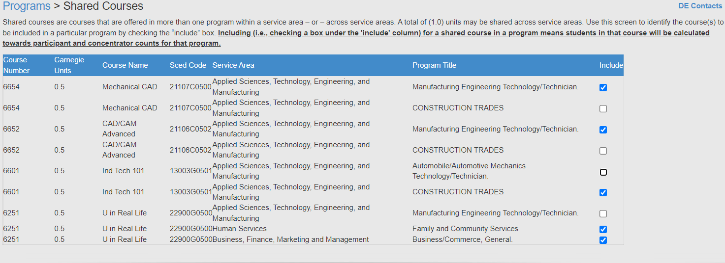
Shared Courses
Once all programs are completed, click on the “Shared Courses” link at the top of the Program screen.
SCTERA Short Takes Video: Shared Courses and "INCLUDE" (3:59)
Notes:
Shared courses are courses that are offered in more than one program within a service area or across service areas.
A TOTAL of 1.0 units may be shared across service areas.
There is no limit on sharing units within the same service area, however, the courses should relate to the CIP/CTE Program and show how the programs are unique. If needed, discuss with a service area DE consultant.
For shared courses – for each course, check the box if it should be counted in the program’s student counts.

Slide 21
Course NOT Tied to a Program
This is a frequent action item that comes up in a DE review and can result in additional attention and actions required by the district.
SCTERA Short Takes Video: Courses NOT Tied to a Program (5:37)
INSTRUCTIONS: Please review the list of "courses not tied" to a program: a) Whether a secondary or concurrent enrollment course, does it fit into an existing program? b) Whether secondary or concurrent enrollment courses - are there 3.0 units of sequential courses to create a new program? Please contact a service area consultant. c) If scenario A or B is not applicable, then the course may remain in in "course not tied" list.
Notes:
Courses Not Tied To A Program Report – It is possible or plausible to have an additional program if less than 2.0 units but shared with another course tied to a program. There are scenarios where a district may or may not want to consider. It is advised to speak with a Service Area DE Consultant.

Slide 22
Secondary CTE Reporting Application (SCTERA)
After adding courses to a program is complete, click on green “student head icon” and then click “Request Course Review” button.
Repeat step 1 for each program.
Congratulations, 2024 Winter SCTERA Collection is complete!
Certify SRI file in EdInfo SRI application.

Slide 23
Jeffrey Fletcher, PhD, MPA
Education Program Consultant
Jeffrey.Fletcher@iowa.gov
515-321-7309
Bureau of Community Colleges & Postsecondary Readiness
Division of Community Colleges and Workforce Preparation
Iowa Department of Education

Slide 24
Appendix – Compiled Resources
SRI 2024-2025 Data Dictionary
Reporting Assistance for HF 2465
Accreditation program area code ’11’ – CTE (ASTEM) & Mathematics
Accreditation program area code ‘12’ – CTE (AG) & Science
Student Reporting in Iowa Tutorials
Framework of SCED for Secondary Level Courses (12-2024)
Career Academy Minutes and SCED Codes (8-22-24)
Complete List of Non-Secondary Course Codes (8-24-21)
SCED v12
SCED Codes and Contact Minutes for Community College Courses (8-2024)
Compare PSEO and Contracted Courses
SCTERA APPLICATION HANDBOOK (12-12-24)
SCTERA Webinar FAQs
SCTERA Short Takes Video: Shared Courses and "INCLUDE" (3:59)
SCTERA Short Takes Video: Courses NOT Tied to a Program (5:37)
Iowa Approved CTE CIP Codes
Coding & Reporting Work-Based Learning Experiences

Slide 25
Appendix
According to Ch. 46 Career and Technical Education, ALL secondary CTE programs are required to be approved by the Director of the Department of Education. This is done through the self-study process as outlined in Ch. 46. The Department tracks operational programs subject to approval through the state CTE reporting system (SCTERA). Therefore, if a district wishes to offer a CTE program, it must be reported annually through the CTE reporting system.

