Slide 1
Shortened School Day: Smart Use in Special Education
Policy & Practice Webinar
December 11, 2024

Slide 2
Welcome
Please post your questions in the Q&A
Slides and resources will be posted on the DE website after the webinar
Policy & Practice Webinar Series & Recordings

Slide 3
Policy
Rachel Bosovich, Attorney II
Ivan Gentry, Regional Special Education Director - Green Hills

Slide 4
Participants will understand:
Appropriate and inappropriate uses of a shortened school day for learners in special education
How to use provided checklists to help guide their thinking for learners with medical versus behavioral needs to help IEP teams make decisions about shortened school days and homebound instruction
How to access and utilize ACHIEVE data to make data-driven decisions about systems and learners in special education

Slide 5
School Day:
IA Admin Code
281-41.11(2)
“School day” means any day, including a partial day, when children are in attendance at school for instructional purposes. School day has the same meaning for all children in school, including children with and without disabilities.
The length of the school day for an eligible individual shall be the same as that determined by the local educational agency’s board of directors for all other individuals, unless a shorter day or longer day is prescribed in the eligible individual’s individualized education program.

Slide 6
Least Restrictive Environment
IAC 281—41.114(2)
To the maximum extent appropriate, children with disabilities, including children in public or private institutions or other care facilities, are educated with children who are nondisabled;
Special classes, separate schooling, or other removal of children with disabilities from the general education environment occurs only if the nature or severity of the disability is such that education in regular classes with the use of supplementary aids and services cannot be achieved satisfactorily.

Slide 7
Least Restrictive Environment
-taken from i3
The least restrictive environment (LRE) is the educational environment that enables learners with disabilities, including those in public and private institutions and care facilities, to receive appropriate education and provides the learners with maximum opportunities for interaction with peers without disabilities.

Slide 8
Continuum of Alternative Services and Placements
IAC 281—41.115
Each public agency must ensure that a continuum of alternative services and placements is available to meet the needs of children with disabilities for special education and related services.
A district's continuum of services and placements includes the implementation of special education services in:
General education setting
Special classes
Special schools
Home instruction
Instruction in hospitals and institutions

Slide 9
Placements
IAC 281- 41.116
The placement decision shall be made:
(1) By a group of persons, including the parents and other persons knowledgeable about the child, the meaning of the evaluation data, and the placement options; and
(2) In conformity with the LRE provisions of this chapter, including rules 281—41.114

Slide 10
Placements (con’t)
IAC 281- 41.116
The child’s placement shall be:
(1) Determined at least annually;
(2) Based on the child’s IEP; and
(3) Located as close as possible to the child’s home;
c. Unless the IEP of a child with a disability requires some other arrangement, the child shall be educated in the school that he or she would attend if nondisabled;
d. In selecting the LRE, the agency shall consider any potential harmful effect on the child or on the quality of services that he or she needs; and
e. A child with a disability shall not be removed from education in age-appropriate regular classrooms solely because of needed modifications in the general education curriculum.

Slide 11
Determining the LRE
IAC 41.116(4) Special considerations.
When making placement decisions the IEP team must take into account:
The accommodations, modifications, and adaptations an individual may require to be successful in a general education environment
Potential barriers to providing these accommodations, modifications, and adaptations within the general education environment
The supports needed to assist the teacher and other personnel in providing accommodations, modifications, and adaptations
The impact on the individual provided special education services and activities in the general education environment
The impact on other learners when providing special education services and activities in the general education environment

Slide 12
Checklists to Support IEP Team Conversations
The checklists below are intended to help IEP teams gather data and information to help the team before, during, and after the IEP team meeting to discuss these topics.
There is no “one size fits all” approach to these conversations. The checklists are tools that can guide and support, but the focus remains on ensuring FAPE for the individual learner, and the IEP Team making the final determination.
Checklists Developed:
Shortened School Day
Medically Necessary Shortened School Day
Homebound Instruction

Slide 13
Red Flags & Missteps

Slide 14
Documentation
🚩 Insufficient Documentation
Documentation must include:
The reasons why the student requires a shortened school day to receive FAPE;
The team’s consideration of other services, supports and placements;
The reasons why those other options were rejected; and
The plan for reintegration.
Mora Independent Sch. Dist., 124 LRP 8387 (SEA NM 2024): In defending against the parent’s allegation that the district violated the IDEA by shortening the student’s school day, the district offered several reasons for the reduction. However, the district had not documented the reasons, considerations, or any plan for reintegration and was therefore found in violation of the IDEA.
In re: Student with a Disability, 121 LRP 7039 (SEA WI 2021): The IEP team determined the student’s school day should be shortened and gradually increased to help build the student’s stamina. While this would have been a reasonable decision, the district failed to document when and how decisions regarding increasing the student’s day would be made and therefore violated the IDEA.

Slide 15
Administrative Concerns
🚩Making decisions that impact the length of a student’s school day based on convenience, availability of resources, blanket policies, etc.
Staff schedules
Osseo Area Schs., Indep. Sch. Dist. v. A.J.T., 96 F.4 1062 (8th Cir. 2024): Student’s inability to attend school in the mornings due to seizures did not justify an only 3 hour school day when student was able to learn until 6:00 pm. The district prioritized “maintain[ing] the regular hours of the school’s faculty” over the student’s needs and was order to provide 495 hours of compensatory education and at home instruction from 4:30 to 6:00 every day.
Transportation
Cassia Sch. Dist., 67 IDELR 162 (SEA ID 2016): District violated IDEA by having student leave school 15 - 20 minutes early every day due to bus availability.
Blanket Policies
Seminole Cnty. Pub. Schs., 68 IDELR 23 (OCR 2016) - OCR found the district denied a student FAPE when it rejected a parent’s request for a shortened school day based on its mandatory attendance policy.

Slide 16
Behavior
Shortening a student’s school day due to behavior is a flag in and of itself…Proceed with caution.
🚩Shortening a student’s school day as a behavior management tool or discipline.
Behavior Management:
Plainville Board of Education v. R.N., 58 IDELR 257 (D. Conn. 2012): Student required intensive direct instruction is several areas and exhibited significant behaviors, including physical aggression and violence towards himself and others. After student was temporarily hospitalized due to a psychiatric episode, the IEP team shortened student’s school day thereby reducing student’s instructional time and counseling services. In finding the district violated the IDEA, the court explained, “the measures taken were simply stopgaps designed to manage his behavior rather than provide him educational benefit.” The court then ordered the district to reimburse the parent for costs of the residential program.
In re: Student with a Disability, 123 LRP 30509 (SEA WI 2023): The IEP team shortened the students school day due to an increase in behaviors and safety concerns. As the student’s behaviors continued and increased, the student’s school day was shortened further. The state noted, “it is not clear that the district considered how shortening the student's day met the student's unique, disability-related needs” and found the district violated the IDEA. (See Reynolds v. George Cnty. Sch. Dist., 81 IDELR 828 (S.D. Miss. 2022) in which the district was ordered to pay $56,454 in attorneys fees.)
“Earn your way back”:
Columbus Collegiate Academy, 123 LRP 25009 (SEA OH 2023): The student’s IEP team shortened the student’s school day due to the student’s behavior. The team did not implement the use of additional supports or strategies to work toward increasing the student’s school day, but instead implemented a “behavior plan” which allowed the student to “earn back” time in school through demonstrating “appropriate behavior”. The district was found in violation of the IDEA.

Slide 17
Resources
IAC Links
I3 Website Links
281—41.11(256B,34CFR300) Day; business day; school day
281—41.114 (256B,34CFR300) Least restrictive environment (LRE)
281—41.115 (256B,34CFR300) Continuum of alternative services and placements
281—41.116 (256B,34CFR300) Placements
281—41.320 (256B,34CFR300) Definition of individualized education program
281—41.321 (256B,34CFR300) IEP team
281—41.324 (256B,34CFR300) Development, review, and revision of IEP
Components of an IEP
Descriptions of Goals, Supports, Services, Activities, LRE, ESY, and more
Social Emotional Behavior in an IEP
Discipline in an IEP

Slide 18
Practice: IEP Team Practices and Administrative Monitoring
Brittany Beverage, Education Program Consultant
Betsy Lin, Bureau Chief of Student Instruction, Evaluation, and Services

Slide 19
IEP Team Decision: Shortened School Day (SSD)
Prior to Making Shortened School Day Determination
IEP Team Checklists (to come)
Shortened School Day - Non-Medical
Shortened School Day - Medical
Homebound Instructional Checklist
Preparing for the IEP Meeting
Gather documentation and data
Specifies the need, condition, limitations, expected duration, and recommendations for the shortened school day.
Convene the IEP team
Consider the participation of relevant stakeholders
Consider meaningful parent participation

Slide 20
IEP Team Decision: Shortened School Day (SSD)
IEP Meeting Conversation Points
Review Procedural Safeguards
Discussion Questions
What data is the IEP team utilizing to make Shortened School Day decisions?
Review
Interview
Observe
Test
A convergence of data indicates…
What does FAPE include for this student?
What are the reasons the student can not participate in a full-day of school?
Evaluate the impact of the shortened school day on the student's ability to access the general education curriculum and meet academic and functional goals. Explore alternative strategies or accommodations.
What are the continuum of placements and services for the student?

Slide 21
Consideration of Services Before SSD
Least Restrictive Environment?
Least Restrictive
Most Restrictive
Option 1 | Option 2 | Option 3 | Option 4
Describe the details included within this option, including relevant supports, accommodations, modifications, etc… | Describe the details included within this option, including relevant supports, accommodations, modifications, etc… | Describe the details included within this option, including relevant supports, accommodations, modifications, etc… | Describe the details included within this option, including relevant supports, accommodations, modifications, etc…

Slide 22
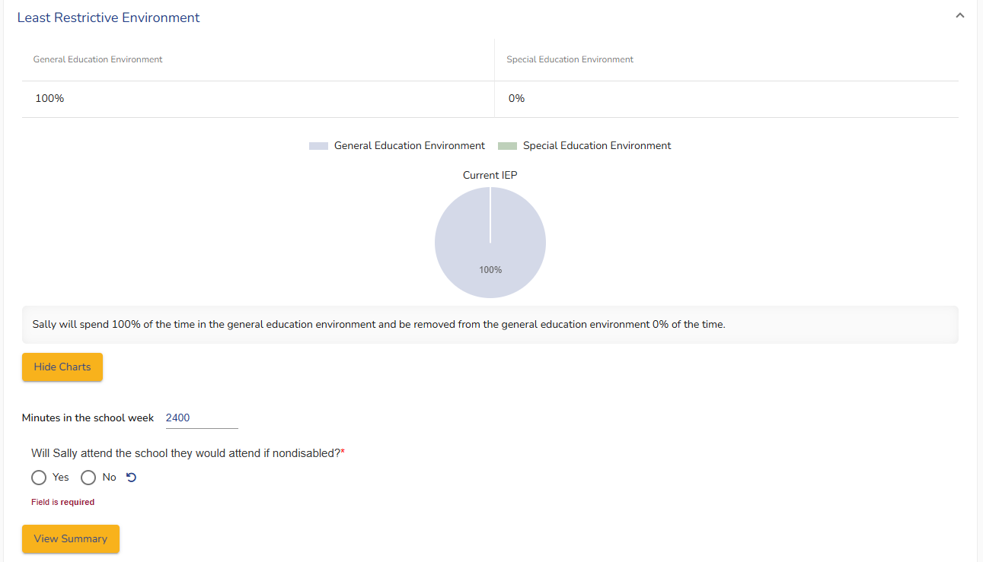
IEP Team Planning
IEP Team Work After the Decision
Complete Appropriate IEP Documentation
Determine appropriate IEP type
Review
Amendment
Interim
30 days of implementation
Re-evaluation
Trial placement
Manifestation Determination
Go to LRE and adjust minutes in the school day
If a teacher believes minutes inaccurate, reach out to Data Lead
Adjust relevant IEP items - the PLAAFP, Goals, Services +, and other parts of the IEP impacted by the IEP team’s decision
Complete a Prior Written Notice (PWN)
Include the reason for the shortened school day and the other options that were considered but rejected

Slide 23
IEP Team Planning
REVIEW DATE
Data gathered (Consider RIOT)
IEP Team Work After the Decision
Write a Reintegration Plan
Based upon data related to the individual’s IEP or IEP team knowledge
Considerations: Timeframe, data indicators including progress monitoring, varying levels of reintegration as appropriate
Revisit the reintegration plan regularly (Determined by the IEP team)
Discuss when the IEP team will reconvene
Meeting considerations
IEP-Type
Reasonable frequency
Measure and determine progress
Data description/Criterion:
Reintegration details including timeline:
REVIEW
DATE
Data gathered (Consider RIOT)
Data description/Criterion:
Reintegration details including timeline:
REVIEW
DATE
Data gathered (Consider RIOT)
Data description/Criterion:
Reintegration details including timeline:
REVIEW
DATE
Data gathered (Consider RIOT)
Data description/Criterion:
Reintegration details including timeline:

Slide 24
Report Information
Administrative Monitoring
Where is the report?
Practice
Screenshot Handout Guide
How do I generate the report?
Practice
Screenshot Handout Guide
How do I/can I sort the data?
Practice
Screenshot Handout Guide

Slide 25
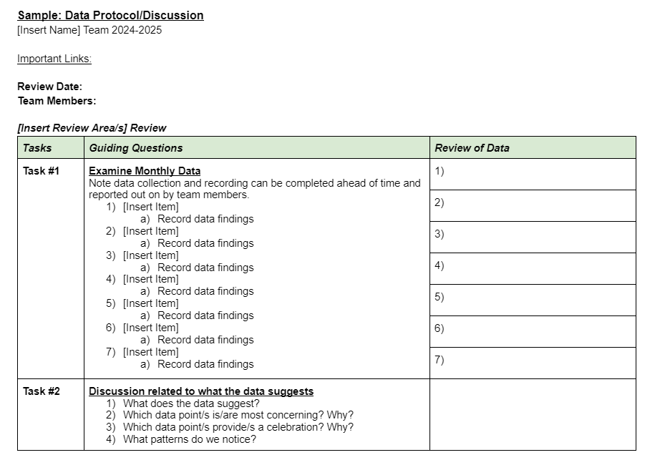
Report Information
Administrative Monitoring
Sample Data Protocol
Data pull
Discussion/Questions around data
Action steps
Focus on the Questions
What do you notice?
What additional or continued questions do we have?
Are corrective actions needed?
What decisions or actions need to occur based upon the data?
Who do I need to share this information with?

Slide 26
Recap of Considerations
Actions to Avoid
Using SSD to respond to disciplinary action
Making a unilateral decision outside of the IEP team
Using SSD due to lack of personnel, resources, etc…
Using SSD out of convenience
Considerations
Student’s access to transportation
Explain and support why SSD is the clearest option when reviewing the Consideration of Services
Sending a student home is a removal (10 days - Manifestation Determination)
Proactive IEP meetings
Reference: Special Ed Connection

Slide 27
What questions do you have for our presenter panel?

Slide 28
Future Policy and Practice Webinars
January 15 - General Supervision
February 12 - Functional Behavioral Assessments and Behavior Intervention Plans
April 9 - Least Restrictive Environment
May 14 - FAPE Considerations

Slide 29
“Our greatest weakness lies in giving up. The most certain way to succeed is always to try just one more time.”
Thomas Edison

Slide 30
Thank You!!

