Slide 1
Federal Programs Compliance Review and
Monitoring Plan
Teresa García
Bureau of Federal Programs

Slide 2
Overview
Introduction
Compliance Review
Rubric
Monitoring and Non-Compliance
Resources
Contact

Slide 3
Introduction
The Bureau of Federal Programs (Bureau) monitors the activities of recipients of federal funds under the Every Student Succeeds Act (ESSA), which amended and reauthorized the Elementary and Secondary Education Act of 1965 (ESEA).
Purpose of monitoring
Assess compliance with state and federal requirements,
Determine program effectiveness and improvement, and
Identify information needed for strategic planning.
The Bureau’s two-fold approach to monitoring
Monitor various data sources on an ongoing basis, which helps determine technical assistance needs of Local Education Agencies (LEAs), or districts, for fiscal and programmatic planning and implementation of title program services.
Additional monitoring determined by annual risk assessment

Slide 4
Compliance
The Iowa Department of Education (Department) must…
Evaluate each subrecipient's risk of noncompliance with a subaward to determine the appropriate subrecipient monitoring, and
Monitor the activities of a subrecipient to ensure compliance with statutes, regulations, and the terms and conditions of the subaward.
(CFR § 200.332)
Assessing risk refers to the possibility that a subrecipient may not comply with applicable rules.
High risk does not necessarily mean an LEA failed to comply
Low risk does not necessarily mean an LEA is compliant with all rules
Risk level can change from year to year.

Slide 5
Rubric
Risk factors may include, but are not limited to prior experience, previous audits, and personnel changes.
Rubric includes 12 criteria across five categories:
Data sources
Prior year data available through CASA
Other reports
1. Expenditures | 80% of possible risk points (16 of 20 total possible points)
2. Compliance
3. Staffing
4. Size
5. Performance | 20% of possible risk points (4 of 20 total possible points)

Slide 6
Risk Assessment Criteria: Expenditures
Criteria | Measure | Risk
1. Expenditures | Subrecipient claimed less than 50% of the current year allocation by the end of the third quarter. | Low reimbursement levels may reflect lack of expenditures and the possibility that program activities are not being fully implemented.
2. Carryover | Subrecipient forfeited funds that were carried forward from the previous year but remained unspent. | The loss of carryover funds despite having additional time to expend the resources may indicate program activities are not being sufficiently implemented.

Slide 7
Risk Assessment Criteria: Compliance
Criteria | Measure | Risk
3. Citations | Subrecipient had one or more citations for noncompliance with federal program requirements. | History of citations for noncompliance with federal program requirements poses a risk of continued noncompliance.
4. Unresolved citations | Subrecipient had one or more unresolved citations for noncompliance with federal program requirements. | Lack of adherence to state guidance on resolving citations poses a risk of continued noncompliance.
5. Application and report submissions | Subrecipient did not meet a deadline for submitting required reports, data, or applications or received more than two action required. | History of noncompliance with submission deadlines and/or inaccuracies in reports, data, and applications may reflect insufficient grant compliance oversight and poses a risk of continued noncompliance.
6. Claims submissions | Subrecipient failed to submit a claim or received more than two action required notices for claims across all programs. | History of noncompliance with submission deadlines and/or inaccuracies in claims may reflect insufficient grant compliance oversight and poses a risk of continued noncompliance.
7. Nonpublic consultation | Subrecipient did not meet the deadline for submitting non-public consulting agreement(s) and/or all equitable shares were not used. | The potential impact on Iowa learners and opportunities for error increase with the additional requirements of timely and meaningful consultation and equitable services for nonpublic schools.

Slide 8
Risk Assessment Criteria: Staffing
Criteria | Measure | Risk
8. Personnel (administration) | Subrecipient’s superintendent or school business official changed from the previous year. | The loss of institutional knowledge, continuity, and understanding of local initiatives may jeopardize effective federal grant management.
9. Personnel (Title programs) | Subrecipient’s designee for the consolidated application or one or more title programs changed from the previous year. | Lack of prior experience serving as designee for the consolidated application or title programs increases the possible risk of error due to loss of institutional knowledge, continuity, and/or understanding of local initiatives.

Slide 9
Risk Assessment Criteria: Size
Criteria | Measure | Risk
10. Award amount | Subrecipient allocation is a) <$50,000, b) $50,000-250,000, or c) >$250,000. | The more federal funds there are to manage, the greater the potential fiscal impact if the funds are mismanaged or otherwise compromised.
11. Grant programs | Total number of program grants awarded to Subrecipient is a) <4, b) 4-6, or c) >6. | The number of compliance requirements increases with the number of federal program awards, thereby also increasing opportunities for error.

Slide 10
Risk Assessment Criteria: Performance
Criteria | Measure | Risk
12. Needs improvement/ Priority | A school rating of Needs Improvement or Priority was assigned to one or more of Subrecipient’s schools. | Needs Improvement and Priority ratings may indicate the capacity to effectively manage support for student learning is compromised.

Slide 11
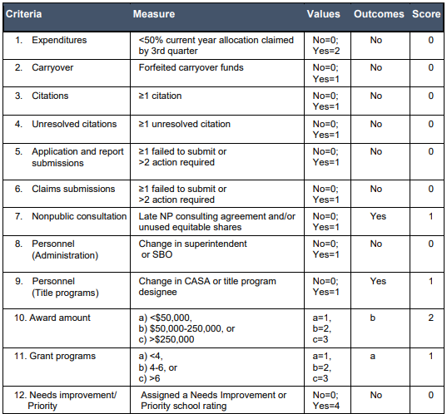
Sample Risk assessment Rubric
Subtotal 1-2: Expenditures | 0
Subtotal 3-7: Compliance | 1
Subtotal 8-9: Staffing | 1
Subtotal 10-11: Size | 3
Subtotal 12: Performance | 0
TOTAL | 5

Slide 12
Risk Levels and Monitoring Strategies
Risk Level | Score (0-20) | Monitoring Strategy
Tier 1: Low Risk | 0-7 points | No additional monitoring
Tier 2: Moderate Risk | 8-14 points | Technical assistance
Tier 3: High Risk | 15-20 points | Enhanced technical assistance

Slide 13
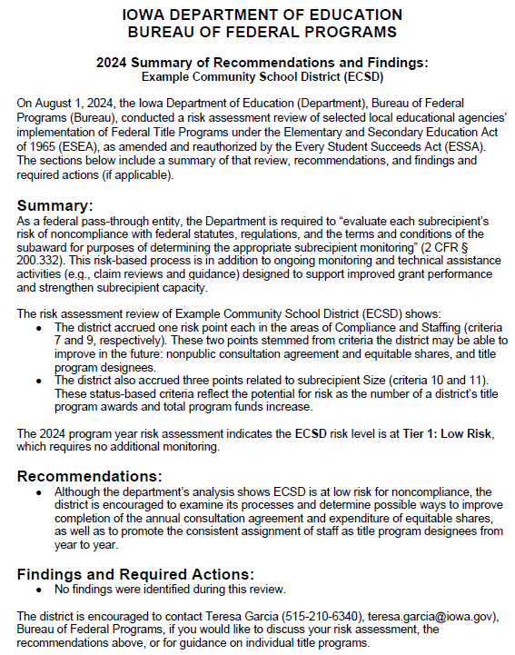
Summary of Recommendations and Findings
Summary
Summarizes risk assessment and outcome (tier level)
Recommendations
Lists recommended actions for LEA
Findings and Required Actions
Lists findings of noncompliance and required next steps

Slide 14
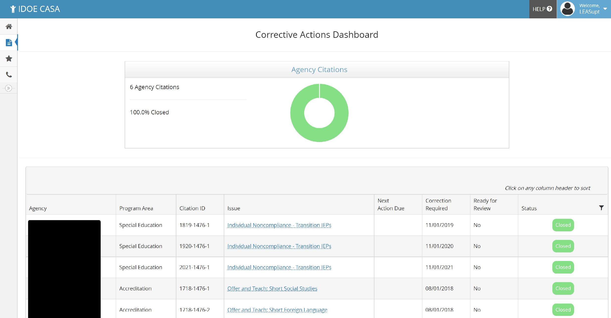
Noncompliance
Findings of noncompliance will be documented as citations in CASA: Corrective Actions
Subrecipient will be required to complete corrective action to address the issue(s).
Additional monitoring may be necessary depending on the nature of the noncompliance.
Citations will be considered resolved when Department receives sufficient evidence that noncompliance has been corrected.
Sample Corrective Actions Dashboard

Slide 15
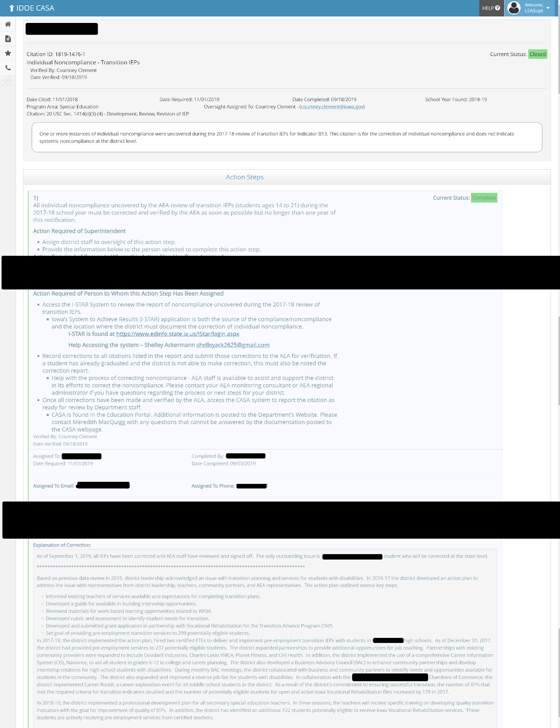
Noncompliance
Findings of noncompliance will be documented as citations in CASA: Corrective Actions
Sample Action Steps

Slide 16
Timeline
Timeline for implementing the annual risk analysis and monitoring process:
October | Bureau conducts risk assessment using prior year data.
November | Subrecipients are notified of risk assessment results and next steps.
January | Bureau begins follow-up monitoring activities as determined by risk assessment.
May | Bureau reviews previous monitoring cycle to determine possible improvements to risk assessment and monitoring process.
Notes:
You will need to mention during the webinar that this is the specific timeline starting in 2025-2026 and that we did not follow the timeline this year because of the delay in ESSA plan revisions and waiting for the new designations to be released.

Slide 17
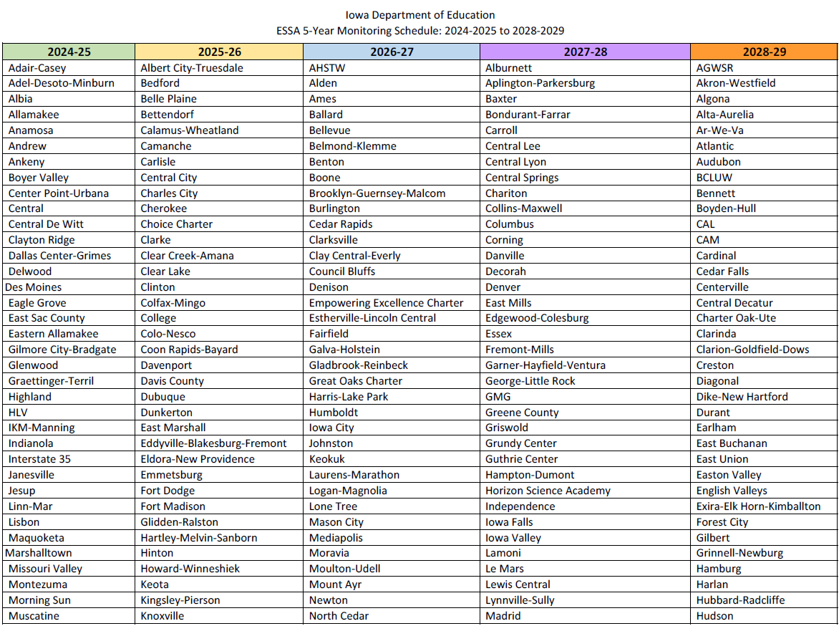
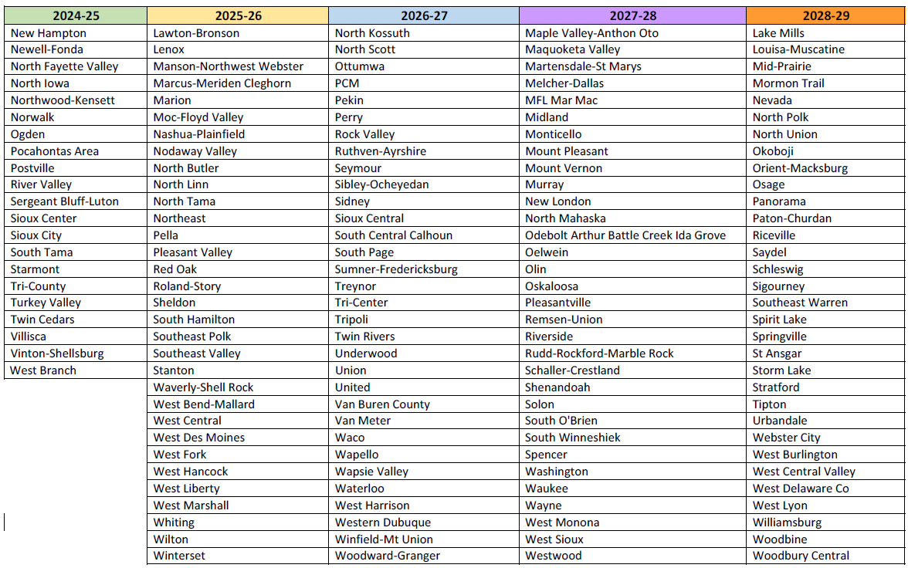
Monitoring Cycle
Five-year cycle
Each year selected subrecipients will participate in appropriate monitoring activities as determined by the annual risk assessment.
Subrecipients will have access to the risk assessment results during off-cycle years so they can take steps to improve their scores by the next cycle.
Adjustments to the schedule may be necessary in future years.
◄ Page 1
▼ Page 2

Slide 18
Resources
Iowa Department of Education Federal Programs Webpage -ESSA Guidance & Allocations - ESSA Guidance & Allocations
Federal Programs Compliance Review and Monitoring Plan
ESSA 5-Year Monitoring Schedule: 2024-2025 to 2028-2029
Example School District Risk Assessment Results
Example School District Summary of Recommendations and Findings
Sources of Authority for Monitoring
Every Student Succeeds Act (ESSA)
2 CFR 200 Uniform Administrative Requirements, Cost Principles, and Audit Requirements for Federal Awards

Slide 19
Contact
Teresa García, JD, PhD
Education Program Consultant
Bureau of Federal Programs
teresa.garcia@iowa.gov
(515) 210-6340

