Slide 1
Considerations for Exiting:
One data point is not enough.
Policy & Practice Webinar
October 30, 2024

Slide 2
Policy
Rachel Bosovich, Attorney II
Seth Piro, Regional Special Education Director — Northwest

Slide 3
Participants will understand:
1. Appropriate exit policies and practices;
2. Decisions regarding whether a child is, or continues to be, an eligible individual under the IDEA must be based on multiple sources of information;
3. A learner who demonstrates proficiency on an assessment may still be eligible for special education services.

Slide 4
Congratulations, a learner you are working with has reached a proficiency target or a goal!
Now what?
Wesley Jarnigan celebrates with Iowa state football team after a touchdown in the Victory Day at Jack Trice Stadium on Friday, Aug. 23, 2024, in Ames, Iowa.
Nirmalendu Majumdar/Ames Tribune

Slide 5
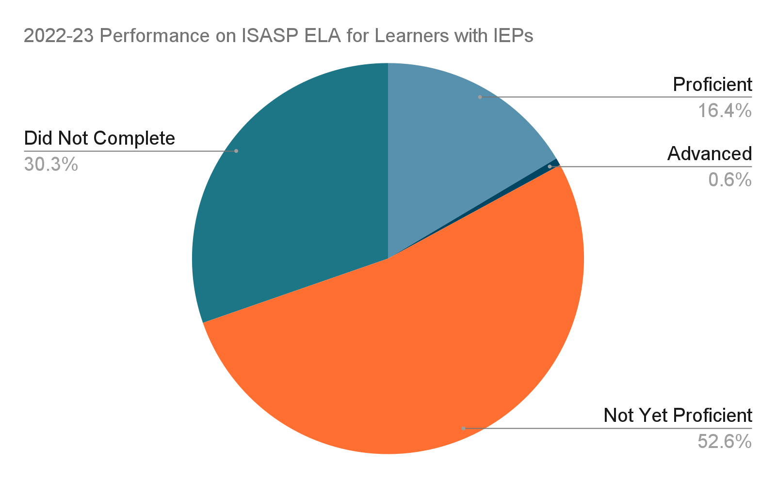
How many learners with IEPs were proficient on ISASP ELA in 2022-23?

Slide 6
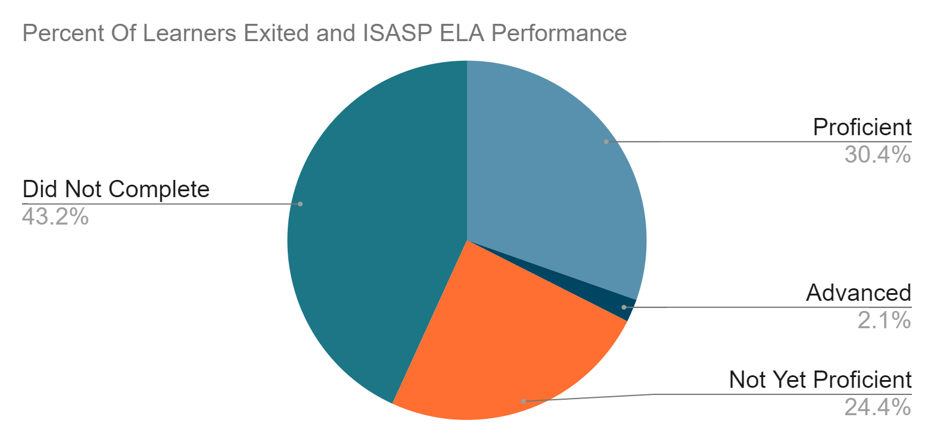
Does proficiency align with exit data?

Slide 7
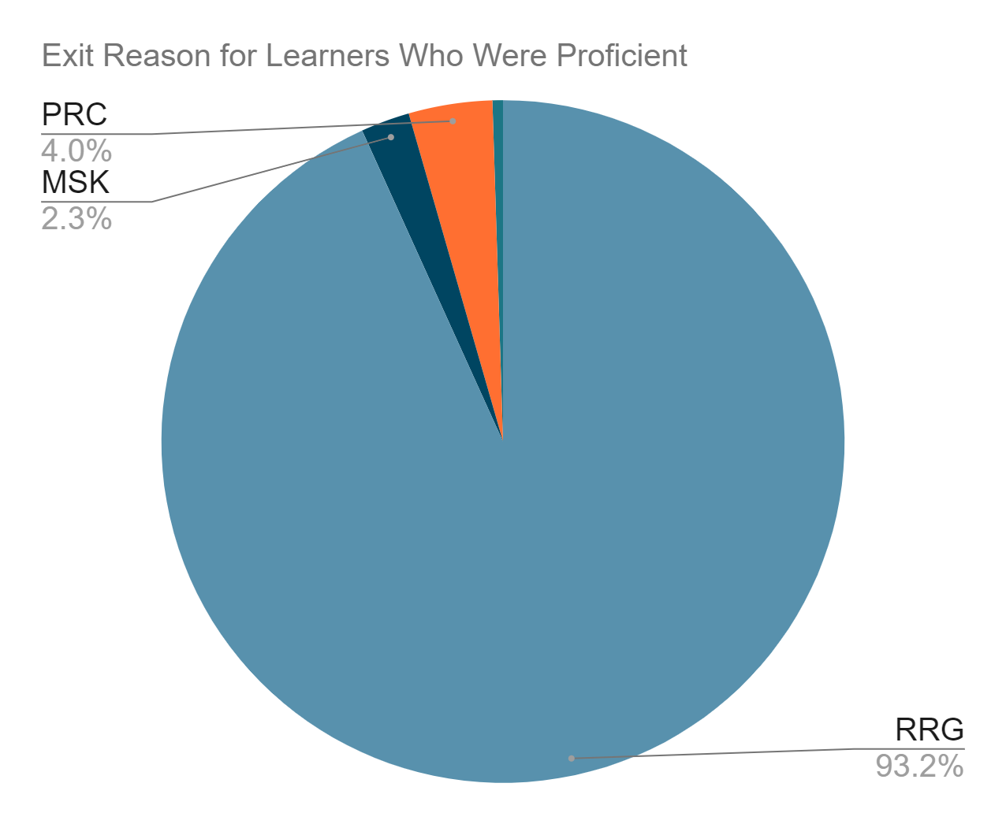
What code was used when learners who were proficient were exited from special education?
UNK = 0.5%

Slide 8
Yes.
A child may be eligible for special education if they are performing adequately in academics such as reading and math.

Slide 9
Eligibility & Proficiency
Overarching Rule: A "student with a disability" is eligible under the IDEA regardless of the student's academic success when the student otherwise meets the eligibility criteria.
Intellectually Gifted Students: The fact that a student is intellectuality gifted does not disqualify the student from eligibility for special education and related services under the IDEA.
Letter to Anonymous, 55 IDELR 172 (OSEP 2010) - (stating that a gifted student with Asperger syndrome could be eligible and require services to address behavioral or social challenges). See also Memorandum to State Dirs. of Special Educ., 65 IDELR 181 (OSEP 2015) (high cognition is not a bar to eligibility).
Williamson County Bd. of Educ. v. C.K., (M.D. Tenn. 2009) - Court held despite a 143 IQ and passing grades, the student's ADHD adversely impacted his educational performance, qualifying the student for special education.
R.B. and S.R.B. v. North East Indep. Sch. Dist. (W.D. Tex. 2022) - Court held although a gifted student excelled in academics, the student’s increasing anxiety, depression, unusual behavior, and excessive absences triggered the district's duty to evaluate.

Slide 10
Evaluation Required
No single measure/assessment may be the sole criterion for determining eligibility
IAC § 300.305(5)(a) a public agency must evaluate a child with a disability in accordance with [§§ 300.304 through 300.311] before determining that the child is no longer a child with a disability.
Example: Urbana City School District, (SEA OH 07/17/19) - Finding district violated the IDEA by failing to review and collect sufficient data to comprehensively evaluate a student with autism before exiting the student.

Slide 11
This point was reinforced by Administrative Law Judge Scase’s decision in A.W. vs Urbandale C.S.D., HAEA, IDOE, 2018:
“A determination that a student is eligible for special education cannot be based on “any single measure or assessment as the sole criterion for determining whether a child is [eligible].” 34 CFR § 300.304(b)(3).” ( p. 54)

Slide 12
Considerations
There are a number of important considerations that are frequently overlooked by teams when evaluating students for eligibility, or continued eligibility, who have demonstrated proficiency or adequate academic performance. Courts have found districts violated the IDEA by failing to include these considerations in evaluations.

Slide 13
Ability
Ability: Teams should consider academic abilities, in comparison to academic achievement, when assessing the need for specialized instruction.
Example: Special Sch. Dist. of St. Louis County (SEA MO 2019) - Finding teacher observations and records demonstrating that the student was capable of better grades supported the conclusion that the student was eligible.

Slide 14
Absences
Absences: Teams should consider factors like frequent absences and the student's ability to access the general education curriculum.
Example: Independent School District v. E.M.D.H., 960 F.3d 1073, (8th Cir. 2020) - District was aware student's absences stemmed from mental illness and resulted in student earning very few credits; but argued student did not have a need for special education given student’s above-average standardized test scores and high-level performance on the days student attended school. The court found the district denied FAPE.
Example: Rose Tree Media Sch. Dist. v. M.J., (E.D. Pa. 2019) - Court found the district failed its obligations when it "seemingly made no effort to explore a causal relationship" between a student's emotional function and attendance because the student earned "almost exclusively" A's and demonstrated advanced performance on classroom-based assessments and standardized tests.

Slide 15
Result of Services
Teams should consider whether a student's educational improvements resulted from the student receiving services.
Example: L.J. v. Pittsburg Unified Sch. Dist., 68 IDELR 121 (9th Cir. 2016) - Finding that the student made educational progress (with specially designed mental health services, a one-to-one behavioral aide, and accommodations that were not provided to his classmates) because of the specialized services he received, the court held that the district erred in finding the child ineligible.

Slide 16
Ask:
“Does this single data point align with the constellation of data we have for this learner?”

Slide 17
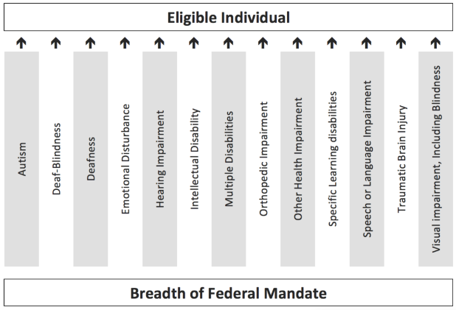
Ask:
“Does the learner continue to have a disability?”

Slide 18
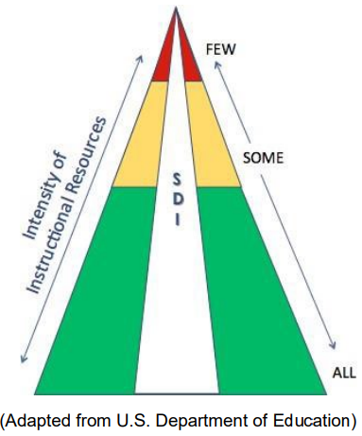
Ask:
“Does the learner continue to need specially designed instruction (adaptations to content, methodology or delivery) to meet their disability-related needs?”

Slide 19
Ask:
“Are there any outside factors that may be contributing to the child’s achievement?”
“How does the child’s independence generalize into other settings?”

Slide 20
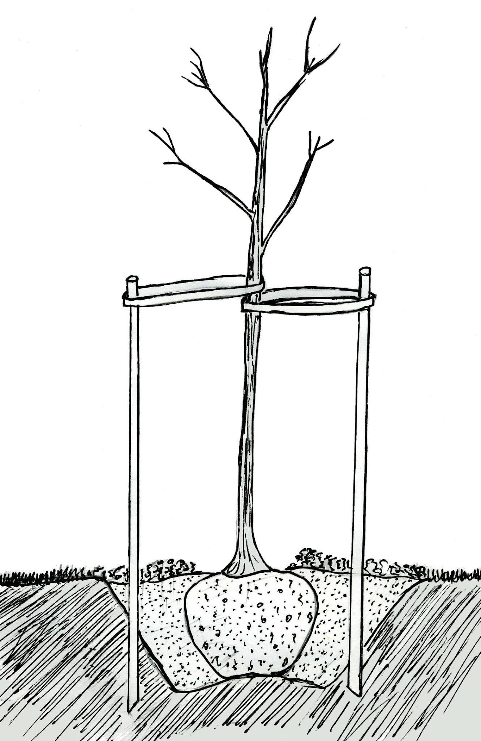
Ask:
“Does the learner continue to need specially designed instruction (adaptations to content, methodology or delivery) to meet their disability-related needs?”

Slide 21
Ask:
“Will the learner sustain proficiency without special education services?”

Slide 22
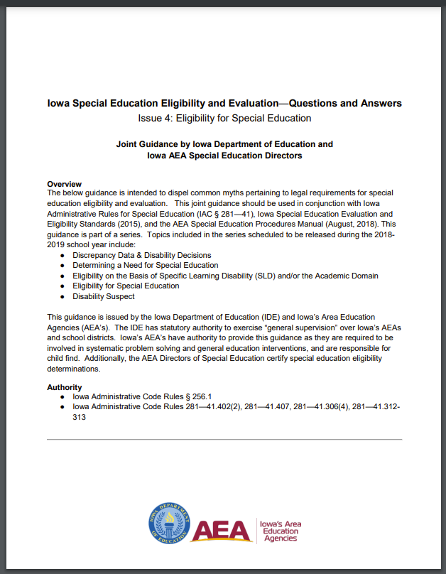
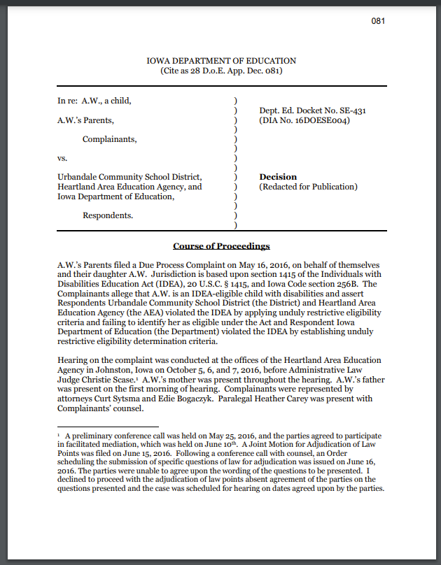
Resources
Iowa’s Eligibility and Evaluation Standards
Iowa IDEA Information: Defining a Disability and Exiting Special Education
Questions and Answers Issue 4: Eligibility for Special Education (April 9, 2019)
A.W. vs Urbandale C.S.D., HAEA, IDOE, 2018

Slide 23
Practice: Exiting Students from Special Education
A focus on accessing and analyzing data

Slide 24
Practice
Amy Thoms-Starr, Regional Special Education Director - Central Rivers
Brittany Beverage, Education Program Consultant

Slide 25
Step One: Review the What and Why
What is the data going to tell me? What question/s are going to be answered as a result?
How many children/students have been exited
Which grade level/s or age have students been exited
What are the reasons why students have been exited
Why is this information important?
Ongoing knowledge of the number of students being served
Roster impacts
Celebrations
Student
Teacher
Building
Department
Understanding of trends
Connections to instruction?
Areas of concern, correction, or growth

Slide 26
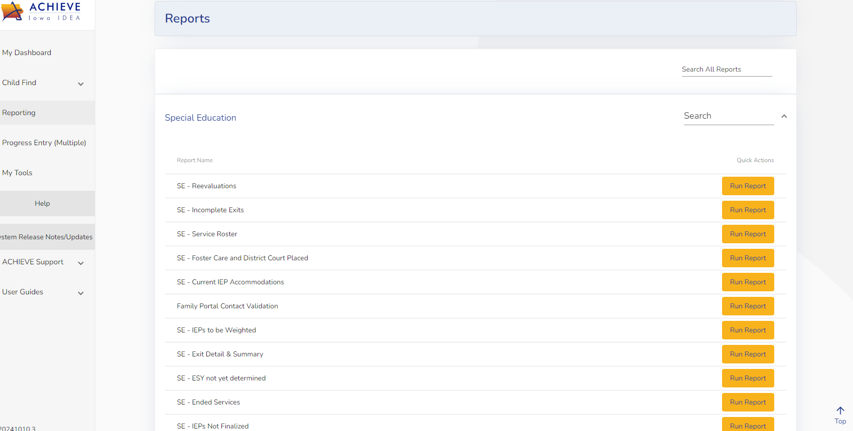
Step Two: Accessing the Data
Where is the report?
Practice
Screenshot Handout Guide
How do I generate the report?
Practice
Screenshot Handout Guide
How do I/can I sort the data?
Practice
Screenshot Handout Guide
Detailed Exit Information
For detailed exit description information, visit i3 Iowa’s IDEA Hub
For a summary of Exit Codes, visit Exit Resources on i3

Slide 27
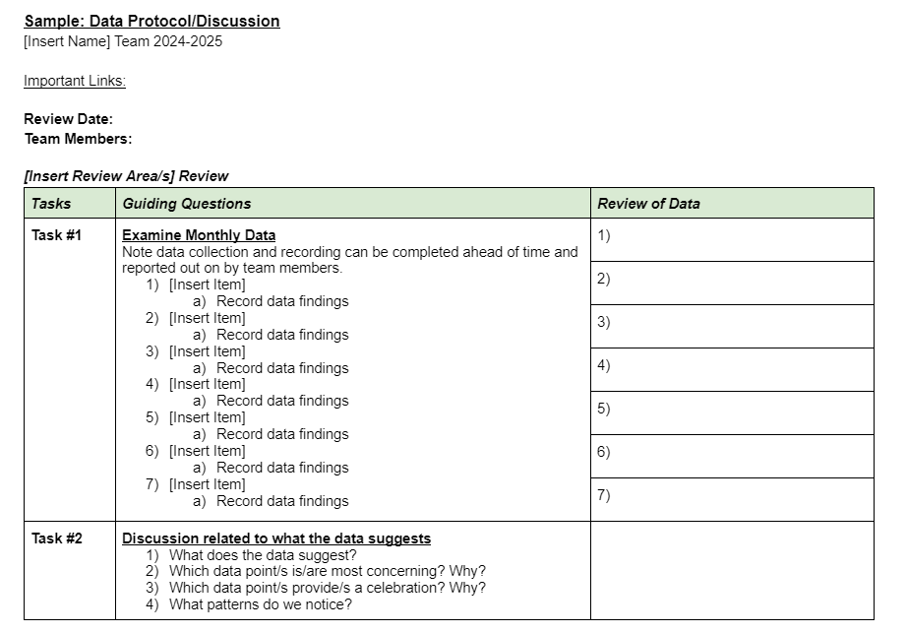
Step Three: Analyzing the Data
Sample Data Protocol
Data pull
Discussion/Questions around data
Action steps
Focus on the Questions
What can we celebrate?
What additional or continued questions do we have?
Are corrective actions needed?
What decisions need to be made as a result of this data?
Who do I need to share this information with?

Slide 28
Step Four: Establish Context
“Without context, a piece of information is just a dot. It floats in your brain with a lot of other dots. . . . Knowledge is information-in-context–connecting the dots.” –Michael Ventura
Consider the whole picture (environment)
Corroborate with other data sources
Use Review, Observe, Interview, and Test (RIOT) to assist
What are other sources of data you have access to that may impact exiting?
Who could you interview in order to get additional information (families, teachers, administrators)?
Is an exit survey necessary?
Requirement when students exit services
Reason why the student exited services
Data used to determine
When services end
How do we continue to monitor students who have exited from services?
Schedule times to revisit as an admin, team?
How do we communicate with staff when exits occur?

Slide 29
Thank You!!

