Slide 1
First Application for an Initial CTE Authorization
Iowa Bureau of Educational Examiners

Slide 2
Career and Technical Authorization
Qualification for the CTE authorization is one of the options below:
6,000 hours of recent and relevant experience
4,000 hours of recent and relevant experience if the applicant holds a BA/BS degree
3,000 hours of recent and relevant experience if the applicant holds an AA/AS degree in the teaching endorsement area sought, if such a degree is considered terminal for that field of instruction
Hold a BA or graduate degree or closely related degree in the teaching endorsement area sought; or
Hold a BA degree in any area of study if at least 18 of the credit hours were completed in the teaching endorsement area sought

Slide 3
Educator Licensure Landing Page
Start on the Educator Licensure landing page:
https://educate.iowa.gov/educator-licensure
Next select Apply for an Educator License or Authorization
Then choose one of the following:
Create a New Account – For new users to the online application system since March 28, 2019
Log In – If you have an account

Slide 4
If you already hold a Substitute or Coaching Authorization, you will choose “Yes”
If you do not remember your folder number, you may look it up here by Clicking on “Iowa BoEE License Search.”
You will NEED your folder number to complete the application.

Slide 5
Existing folder Number “Yes” Enter email that you will use as a login user name for this account and folder number Click “Sign Up” (Skip to Slide 8)

Slide 6
An email will be sent to the address provided.
Click the link in the email to setup your new password and start your account.

Slide 7
Password A request for a password will be sent to the email provided. Remember this password for future use.

Slide 8
Logging in with existing account Use the email you used to set up your account previously If you forgot your Password & click on “forgot you password,” an email will be sent to the username email originally used to set up the account

Slide 9
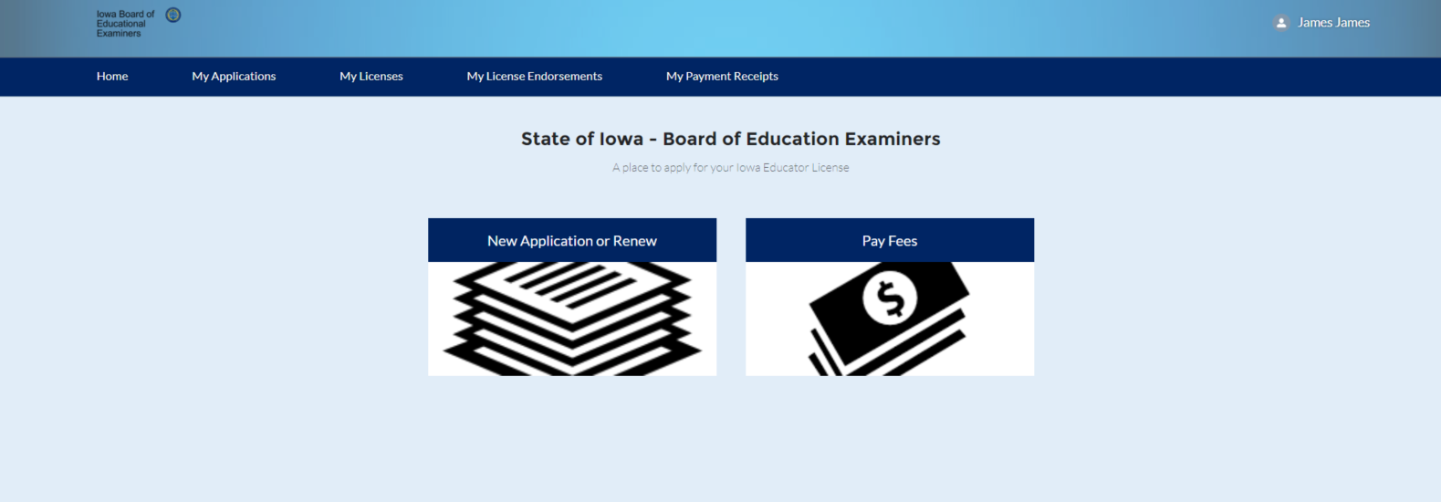
You are now logged in to the application system.
Click the “New application or renew” to start an application.

Slide 10
You will have a few screens of verifying your demographic information. If all is correct, click on the “Next Button.” This should all be ok if this is your first application ever.

Slide 11
If you need to make a change, click the “No” radio button and make the appropriate changes.

Slide 12
You now need to choose what you will be applying for. Select the “Apply for a new license” option. Then click “Next”

Slide 13
Use the pull down menu to choose the “Authorizations” option, then click “Next”

Slide 14
Use the pull down menu to choose your “First Career and Technical Authorization.” and click “Next”

Slide 15
Your application has been Created, click “Finish” to complete the setup and begin the application.

Slide 16
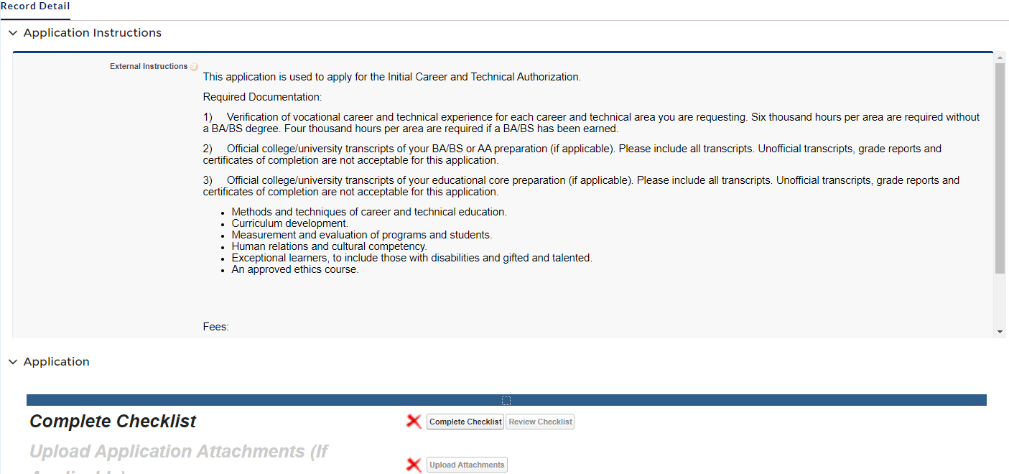
You will see general requirements, and necessary fees: $85 for the processing, $35 for a Background check, and $3 for credit card fee. Scroll down to the “Application” section and click on the “Complete Checklist” button.

Slide 17
As you respond to each checklist question, click the “Save & Next” button and you will advance to the next section.

Slide 18
This page notifies you of the required courses you must take during the 3 years of your Initial CTE Auth. Please check ‘No’ to all the questions unless you have taken a comparable course.

Slide 19
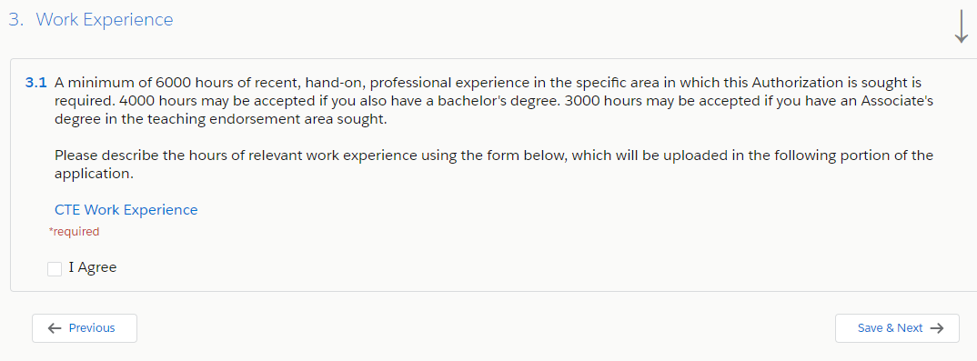
A form verifying your vocational experience will need to be downloaded, by Clicking on the Blue “CTE Work Experience” link Highlighted below. After you have completed the form, it will be uploaded in Step 2: Upload- Attachments. Then Click the box “I agree.” You may Also upload a copy of your official transcripts. We do not accept Unofficial transcripts.

Slide 20
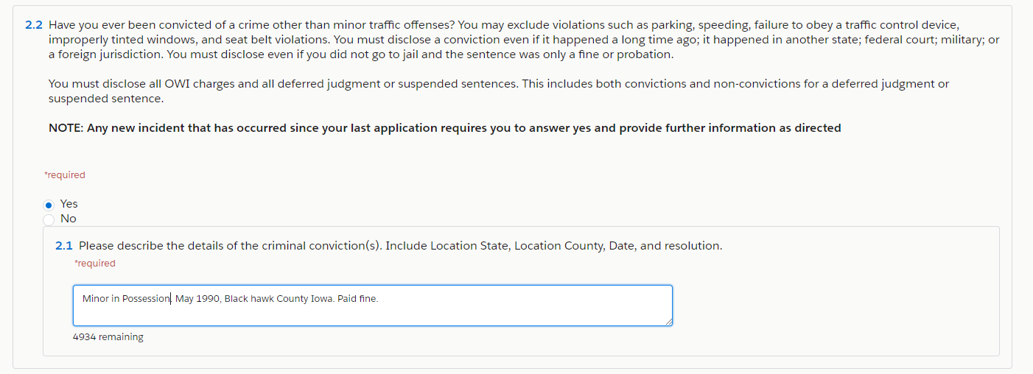
In some sections, your response may open another text box for you to provide more information. Many of these are freeform text boxes. Just type the information requested. In the case of past convictions, please list all and be specific. Failure to do so, may delay the processing of your application.

Slide 21
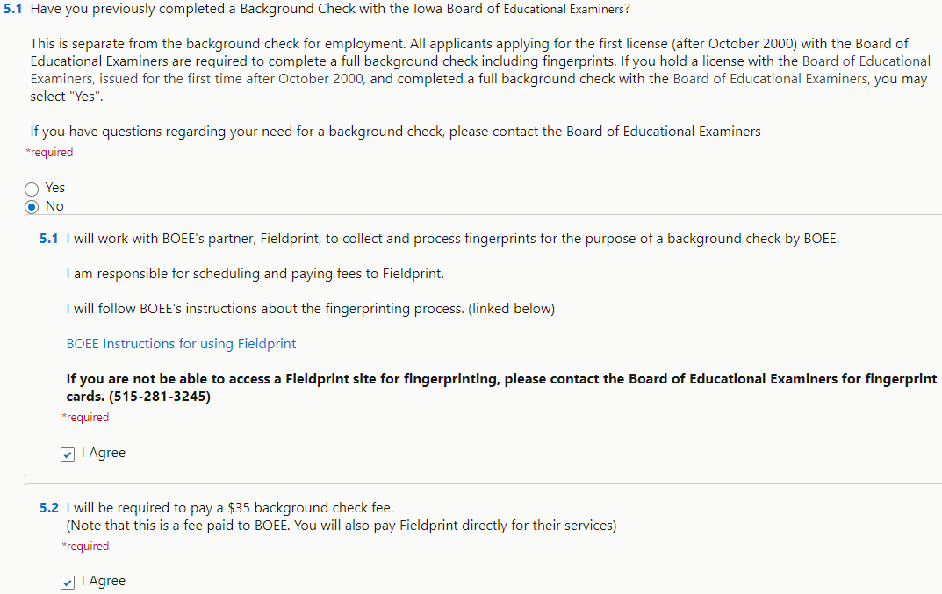
If you have not held a Substitute or Coaching Authorization, you will need to answer the question in Section 5: “No” and then select your preferred method to complete fingerprinting for your Iowa background check.

Slide 22
Reciprocity of the CTE Authorization
If you have held a CTE Auth./license from another State, you may qualify for Reciprocity of your license. If so, check the Box to verify this. If not, click on ‘Save & Next’ to move to the next page:

Slide 23
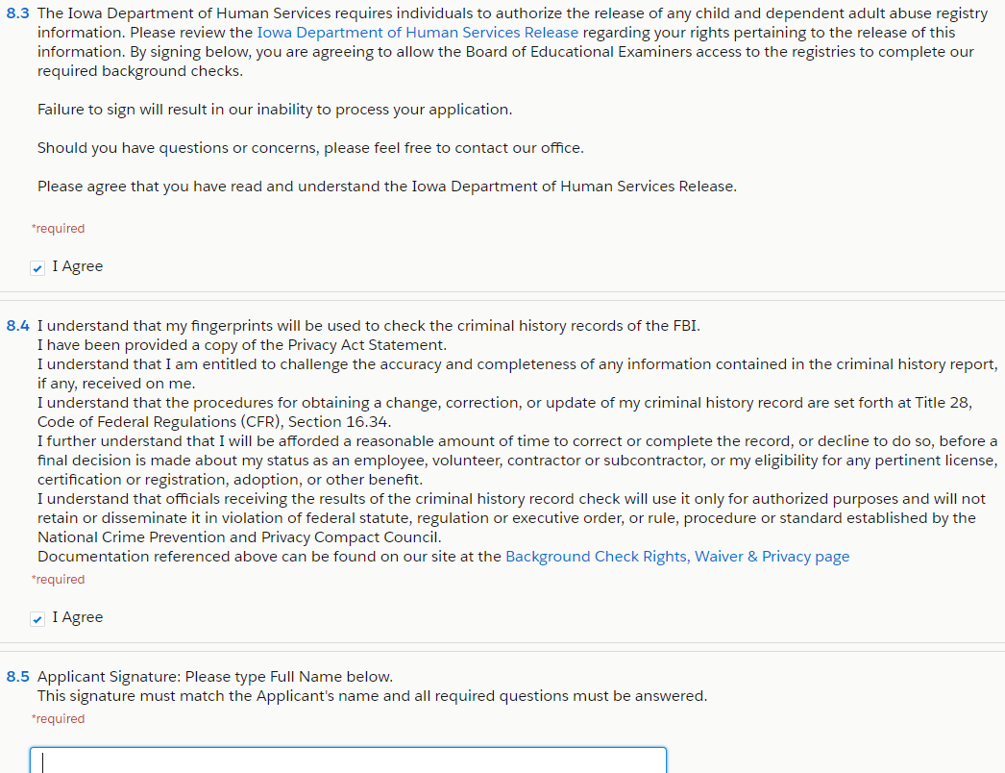
There are several other pages with questions about payment, release of information and fraud questions. Then electronically sign your name in the blank Textbox at the bottom:

Slide 24
The Attachments Section is where you will upload a PDF of the forms, and Official transcripts (IF applicable). Click on “Upload Attachments” to access the next page.

Slide 25
Click the ”Upload file” button to attach the CTE work Experience Form and Transcripts or other Documents can be added by clicking on the “Add More” button.

Slide 26
Next, make sure you have all the required boxes checked and documents needed. If so you can click on the “Pay Fees” box to proceed to that step.

Slide 27
Choose the fees you are wanting to pay. All fees for a specific application must be paid for the application to be submitted. You may pay with A credit card online now, or select the option to print an invoice and mail in a check.

Slide 28
You are now ready to pay fees and submit your application.

Slide 29
Please note, Federal background checks take 3-5 weeks to clear. You will get A PDF by email of your CTE Authorization when it is processed.
Once all steps have been completed, your application will be submitted to the Bureau of Educational Examiners for evaluation and issuance.
Please email if you have any problems or questions: David.Wempen@iowa.gov

