Slide 1
Educational Stability for Children & Youth in Foster Care
Elisa Koler, Education Program Consultant

Slide 2
Education of Children in Foster Care: Overview
The goal: Students in foster care should remain in their school of origin whenever this is in their best interest.
Purpose: To ensure school stability for children in foster care.
Why does school stability matter? Children in foster care experience unusually high levels of mobility. These unplanned school changes may be disruptive to a student’s progress and performance, both emotionally and academically.
What is a “school of origin”? The school that the student attended most recently, either with their primary caregiver before entering foster care or their most recent foster care placement.

Slide 3
What is foster care, exactly?
Any child who was removed from their primary caregivers by the courts and is in legal custody of the Department of Health and Human Services (HHS).
24-hour substitute care.
HHS is responsible for placement and care.
Notes:
Unfortunately students in JCS custody are excluded from these protections.
Explain that districts often misunderstand safety plans.

Slide 4
Most Common Types of Foster Care
Type | Description
Family Foster Care | A family or individual with no previous relationship to the child, licensed by the state to care for children and youth in the foster care system.
Relative Care | Care provided by a relative, who is not required to be licensed as a foster family (although they can be).
Qualified Residential Treatment Program (QRTP) | A type of group care that provides supervision and support to children and youth in foster care who need additional structure.
Notes:
Confusion about relative care and QRTPs.

Slide 5
Less Common Types of Foster Care
Type | Description
Non-Relative Placement | Also known as a “Fictive Kin Placement.” Care provided by a family or individual with a previous relationship with the child.
Pre-Adoptive Placement | A child or youth living with an individual or family while their adoption is finalized.
Shelter Care | Also known as a Neglected Facility. A group care placement for children and youth awaiting a permanent foster care placement.
Supervised Apartment Living (SAL) | Apartments for youth aging out of foster care, with access to additional services and supports to prepare them for independent living.
Psychiatric Medical Institute for Children (PMIC) | A psychiatric treatment facility for children. Not all children in these facilities are in foster care, but some are.

Slide 6
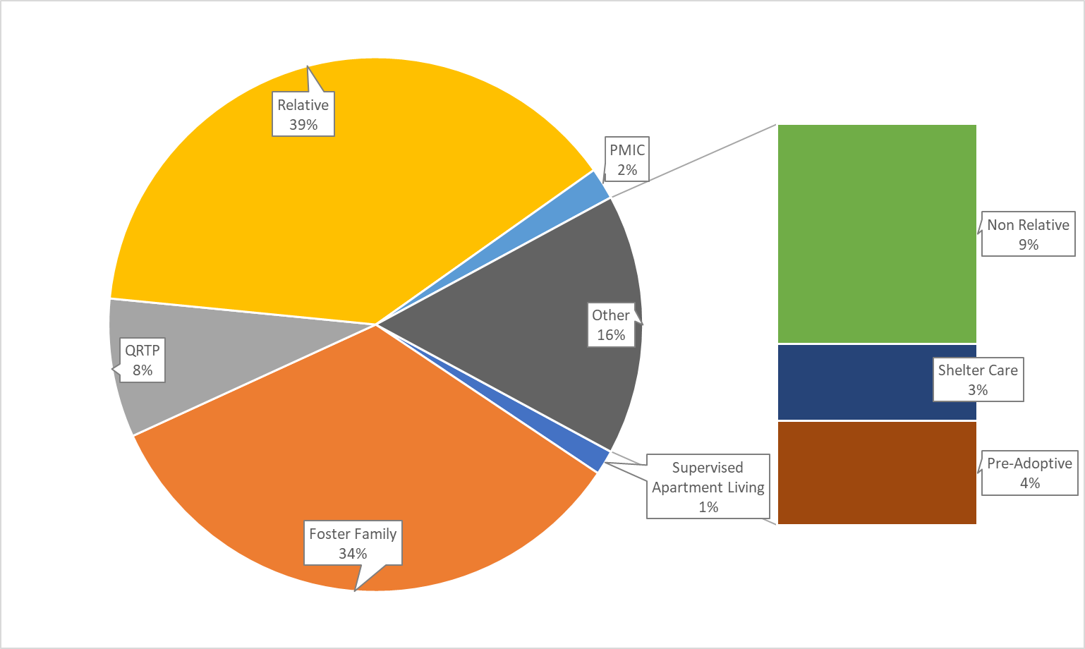
Type of Foster Care Placement
Notes:
Most questions are about QRTP, PMIC and shelter kiddos.

Slide 7
Important Note about Group Care
For a child or youth in a QRTP placement, if their school of origin is not an option, the local school district must provide these students with immediate and appropriate enrollment.
For children and youth in foster care who are placed in a PMIC setting, children and youth may attend school in the local community on a case by case basis. An LEA may not refuse enrollment to a youth if their care team determines that a community school setting is appropriate.
Notes:
This is in the QRTP contract, that the local school is responsible for education.
If you encounter any resistance, it is better to contact me right away rather than wait for a child to be out of school for weeks.

Slide 8
Foster Care is Not:
Homelessness
Staying with a friend or family member temporarily (unless this placement occurred with a court order)
Legal guardianship

Slide 9
“We don’t have any foster kids in our county.”

Slide 10
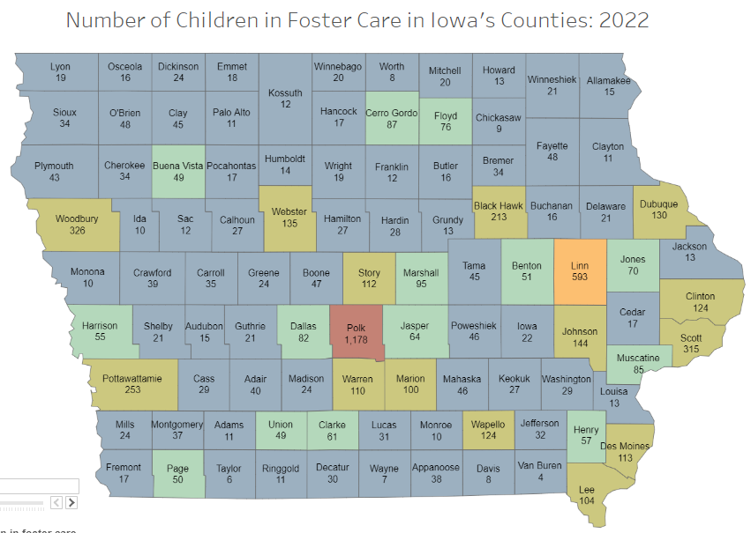
Yes, You Do.
2023 data is not available yet, but will be soon.

Slide 11
How do I know if a student is in foster care?
If a family discloses that their student is in foster care, ask for a copy of the court order that placed the student in the custody of HHS, often called a CINA order.
It’s OK if some information is redacted.
Some families are receiving guidance and support from HHS, but the children are not in foster care.
HHS is not able to give details.
Contact the Foster Care State Coordinator at the Iowa Department of Education to verify a student’s status.
Contact the HHS Community Liaison for your region.

Slide 12
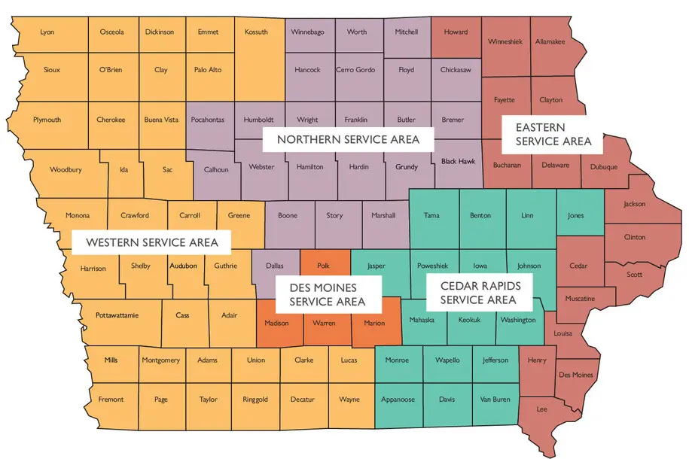
HHS Community Liaisons
Each HHS service area has one or more social workers who serve as the main point of contact with education professionals. Check the Department website for the latest contact information.

Slide 13
Applicable Law
Fostering Connections Act of 2008
Keep children with their family of origin whenever possible.
Focus on keeping siblings together and placing with people they already know.
Support youth transitioning out of foster care.
Guidance available here.
Uninterrupted Scholars Act
Schools may enroll a foster child even if full educational records are not yet received.
HHS can request educational records without parent permission.
Immediate and appropriate enrollment is required.
Guidance available here.

Slide 14
What does the law mean for us?
Children and youth in foster care remain in their school of origin, unless it is determined that it is not in their best interest to do so.
If students need to change schools, they shall be immediately enrolled, even if they do not have the required documentation.
Transportation must be provided when appropriate, regardless of cost or convenience.
HHS and educators are required to work together for the educational stability of children and youth in foster care.

Slide 15
ESSA
The Every Student Succeeds Act (ESSA) is the law that governs K–12 public education policy.
Similar guidance to Fostering Connections
Ensures “best interest determinations” be made in collaborative meetings
Presumption is that children remain in their school of origin
Requires transportation infrastructure
Points of Contact (POC) in both child welfare and education

Slide 16
Terms to Know, Part 1
Term | Definition
CINA | “Child in Need of Assistance” as determined by the courts.
Family of Origin | The primary caregivers of a child in foster care prior to removal. This term is preferred to “biological parents.”
School of Origin | The school where a child in foster care was last enrolled, either when the child entered foster care or at the child’s most recent placement. The focus should be on where the child has established relationships and an established educational plan.

Slide 17
Terms to Know, Part 2
Term | Definition
Neglected Facility | A public or private residential facility, other than a foster home, that is operated for the care of children who have been committed to the institution or voluntarily placed in the institution under applicable State law, due to abandonment, neglect, or death of their parents or guardians.
Fictive Kin | Friends, neighbors etc. who share a meaningful relationship with a child, but are not biologically related.
Best Interest Determination | The process of determining whether a child will remain in their school of origin, or if it is in their best interest to be enrolled elsewhere.
Guardian ad litem | An attorney representing a child, who advocates for the child’s safety and well-being.
Notes:
Students in Neglected facilities can continue at their school of origin if they have one.
If they do not, the team should decide what educational placement is in the youth’s best interest. Local LEA? LEA where Mom lives if youth will be reunified soon?

Slide 18
Annual Foster Care Assurances in CASA

Slide 19
Assurance 1
The local education agency assures it will designate a single point of contact for foster care matters in the Title IA program dashboard and make that individual’s contact information publicly available, including online and in annual notices to families. This information must be updated any time the point of contact changes. The identified individual must have sufficient capacity to fulfill the following duties:
Coordinating student information and services between HHS and the local education agency;
Initiating meetings to determine whether a student can remain in their school of origin or what educational placement will be in the student’s best interest if not in their school of origin;
Facilitating immediate and appropriate enrollment and transfer of records;
Facilitating data sharing between HHS and the local education agency and addressing any data obstacles;
Facilitating implementation of transportation procedures;
Preventing and resolving best interest and transportation disputes; and
Monitoring attendance and enrollment of students in foster care.

Slide 20
Foster Care Points of Contact
Every district is required to identify a Foster Care Point of Contact (POC) as part of the Title I Part A application in CASA, both during the Selection of Schools process every spring and the Title funding application every fall.
However, the name and contact information for the POC for foster care can be updated any time there is a changes in these responsibilities.

Slide 21
POC Duties
Foster Care POCs are responsible for:
Fielding calls from HHS regarding students in foster care
Convening Best Interest Determination meetings
Ensuring timely enrollment and the transfer of school records
Arranging transportation when needed
Determining the means of transportation
Coordinating and implementing transportation
Coordinating transportation reimbursement
Notes:
Talk about IV-E penetration.

Slide 22
Assurances 2-4
The local education agency assures it will provide any information to HHS that it deems necessary to incorporate educational needs and concerns into the case plan or other plan for each student in foster care.
The local education agency assures it will protect confidential information regarding students in foster care and will not disclose information regarding student foster care status unless specifically authorized by state and federal law.
The local education agency assures it will report unauthorized releases of exchanged data to the Department and cooperate in taking appropriate corrective action.

Slide 23
Assurance 5
The local education agency assures that all students in foster care will remain in their school of origin, unless their best interests require otherwise. When making this determination, the local education agency assures that it will:
Continue the student’s enrollment at their school of origin, including providing transportation, until the Best Interest Determination has been made.
Collaborate with all appropriate parties to determine what educational placement is in the student’s best interest.
Consider all relevant factors and information, including ensuring compliance with the relevant federal and state laws and rules. In the case of:
A student with a disability, such a determination must consider compliance with the Individuals with Disabilities Education Act, Section 504 of the Rehabilitation Act of 1973, and other relevant state laws and rules.
A student who is an English learner, such a determination must consider compliance with the Title VI of the Civil Rights Act of 1964, the Equal Educational Opportunities Act of 1974 (EEOA), and relevant state laws and rules.
Prioritize educational stability for the student. The potential cost and/or convenience to the local education agency must not be the sole rationale for the decision.
Notes:
If the receiving LEA does not have an appropriate special education program THEY ARE RESPONSIBLE FOR FINDING ONE.

Slide 24
Assurances 6-7
The local education agency assures that when a child’s best interest is not to attend the school of origin, the student is entitled to immediate and appropriate enrollment. For purposes of this agreement, “immediate” means as soon as the best interest determination has been made, and without regard to whether records, forms, tuition, fees, or costs typically associated with school enrollment have been provided. If the student is under long-term suspension or expulsion from the school of origin, compliance with Iowa Code section 282.4 is required before enrollment in a new school.
The local education agency assures that it will provide, arrange, and fund transportation for students who are to remain in their school of origin. The local education agency assures that it will establish the most effective means of transportation available. The local point of contact in the local education agency of origin must coordinate the transportation of the student between the school of origin and the foster placement. Transportation under this agreement must be provided in a “cost-effective manner and in accordance with section 475(4)(A) of the Social Security Act.” The local education agency hereby agrees to waive any local policy, practice, or procedure that would serve as a barrier to providing transportation pursuant to this paragraph, such as restrictions on its vehicles entering other LEAs’ boundaries.

Slide 25
Assurances 8-9
If the local education agency and local HHS cannot agree on the student's best interest for school placement after making every effort to reach agreement, both should review the rules or guidelines provided by the Department and HHS for support in resolving their dispute. If the disagreement regarding school placement continues, the state level points of contact for HHS and the Department must be given latitude to evaluate the decision and make a final determination.
The local education agency accepts that HHS is not permitted to share certain facts related to the child protective case and therefore will give deference to HHS decisions regarding appropriate services and placement.

Slide 26
School Fee Waiver per IAC 281—18.3 (256)
Children in foster care are eligible for free and reduced lunch and waived student fees:
Textbooks
School supplies
Summer school programs
Transportation fees for resident students who are not otherwise entitled to free transportation
Driver education programs
Eye protective devices
Ear protective devices
School meals
Non-resident student tuition
Notes:
Foster families do not need to provide FRL paperwork.
If there is property damage, lost laptops, etc. and all other avenues have failed, decat funds may be used.

Slide 27
High School Credits per Iowa Code § 280.29
“In order to facilitate the educational stability of children [...] receiving foster care services, a school district, upon notification by an agency of the state that a child [...] receiving foster care services is transferring to and enrolling in the school district, shall provide for the immediate and appropriate enrollment of the child. The school district shall do the following: [...]
Develop procedures for awarding credit for coursework, including electives, completed by a child [...] receiving foster care services while enrolled at another school.
Credits and grades earned and offered for acceptance shall be based on official transcripts and shall be accepted without validation unless required under the receiving school district’s accreditation requirements. [...]
Establish procedures to lessen the adverse impact of the enrollment transfer of a child [...] receiving foster care services to another school.”

Slide 28
Special Education
For most children and youth in foster care, special education funding is sourced from their reported District of Residence–meaning, the location where their family of origin is living and paying taxes. This is frequently different from where that child or youth is living while in foster care.
This does NOT mean that the district where the student is living is not responsible for providing the child with special education services. This is only about billing, not services.
If a child’s parental rights have been terminated, the district where they have been placed by the courts becomes their District of Residence. Special education funding is paid from the general fund.
The family of origin must be invited to all IEP meetings, and only the family of origin can revoke consent for special education services unless rights have been terminated.
Notes:
District of Residence = where family of origin was IN OCTOBER. Does not update until the following October.

Slide 29
What We Want for All Children in Foster Care
School stability
Appropriate education
Disability accommodations & IEP services
Adults with trauma sensitive practices
Records transferred timely
Full participation in school
Effective communication between child welfare and education
Support and infrastructure for transportation

Slide 30
Additional Resources
Education of Children in Foster Care | Iowa Department of Education
Best Interest Determination Conversation/Worksheet | Iowa Department of Education
ESSA – Children in Foster Care
Students in Foster Care - Office of Elementary and Secondary Education
Notes:
ADD updated POC list here
ADD updated HHS liaison list here

Slide 31
Contact Information:
elisa.koler@iowa.gov
515-669-4052

