Slide 1
Homeless Education in Iowa
Tyler Navin
Homeless Education Program Consultant
Federal Programs Bureau
Iowa Department of Education

Slide 2
Overview
McKinney Vento Act
Definitions
Eligibility
Unaccompanied Homeless Youth
Potential Causes of Homelessness
School Stability
Transportation
Homeless Liaison Responsibilities
Data
Requirements and Allowability
Funding
Title I, A homeless set-aside
McKinney Vento Competitive Subgrants
ARP-HCY
Resources

Slide 3
Purpose
The McKinney-Vento program is designed to address the barriers that children and youth experiencing homelessness have faced in enrolling, attending, and succeeding in school.

Slide 4
McKinney-Vento Act
Subtitle VII-B of The McKinney-Vento Homeless Assistance Act authorizes the federal Education for Homeless Children and Youth (EHCY) Program and is the primary piece of federal legislation related to the education of children and youth experiencing homelessness. It was reauthorized in December 2015 by Title IX, Part A, of the Every Student Succeeds Act (ESSA).
View the full text of the McKinney-Vento Homeless Assistance Act (Title IX, Part A of ESSA).
Education for Homeless Children and Youths Program: Non-Regulatory Guidance
Notes:
The McKinney–Vento Homeless Assistance Act of 1987 is a United States federal law that provides federal money for homeless shelter programs.^{[1][2]} It was the first significant federal legislative response to homelessness,^{[3]} and was passed by the 100th United States Congress and signed into law by President Ronald Reagan on July 22, 1987.^{[4]} The act has been reauthorized several times over the years.^{[5]}
It was most recently reauthorized in 2015 as part of the Every Student Succeeds Act.
I’ve included the full text of the McKinney Vento Act as well as the non-regulatory guidance that was put out by the US Department of Education

Slide 5
Definitions and Eligibility

Slide 6
Definition of Homeless under McKinney-Vento
Subtitle VII-B of the McKinney-Vento Homeless Assistance Act (per Title IX, Part A of the Elementary and Secondary Education Act, as amended by the Every Student Succeeds Act) defines homeless as follows:
The term “homeless children and youths”–
(A) means individuals who lack a fixed, regular, and adequate nighttime residence (within the meaning of section 103(a)(1)); and (B) includes–
(i) children and youths who are sharing the housing of other persons due to loss of housing, economic hardship, or a similar reason; are living in motels, hotels, trailer parks, or camping grounds due to the lack of alternative adequate accommodations; are living in emergency or transitional shelters; or are abandoned in hospitals;*
(ii) children and youths who have a primary nighttime residence that is a public or private place not designed for or ordinarily used as a regular sleeping accommodation for human beings (within the meaning of section 103(a)(2)(C));
(iii) children and youths who are living in cars, parks, public spaces, abandoned buildings, substandard housing, bus or train stations, or similar settings; and
(iv) migratory children (as such term is defined in section 1309 of the Elementary and Secondary Education Act of 1965) who qualify as homeless for the purposes of this subtitle because the children are living in circumstances described in clauses (i) through (iii).
*Per Title IX, Part A of the Every Student Succeeds Act, “awaiting foster care placement” was removed from the definition of homeless on December 10, 2016; the only exception to his removal is that “covered states” have until December 10, 2017 to remove “awaiting foster care placement” from their definition of homeless.
Notes:
Students experiencing homelessness are provided rights and protections through McKinney-Vento, federal legislation.
This slide has the legal definition of homelessness under the McKinney Vento Act
You can see that the key language here is that individuals who lack a fixed, regular, and adequate nighttime residence with one of the following situations:
(i) children and youths who are sharing the housing of other persons due to loss of housing, economic hardship, or a similar reason; are living in motels, hotels, trailer parks, or camping grounds due to the lack of alternative adequate accommodations; are living in emergency or transitional shelters; or are abandoned in hospitals;*
(ii) children and youths who have a primary nighttime residence that is a public or private place not designed for or ordinarily used as a regular sleeping accommodation for human beings (within the meaning of section 103(a)(2)(C));
(iii) children and youths who are living in cars, parks, public spaces, abandoned buildings, substandard housing, bus or train stations, or similar settings; and
(iv) migratory children (as such term is defined in section 1309 of the Elementary and Secondary Education Act of 1965) who qualify as homeless for the purposes of this subtitle because the children are living in circumstances described in clauses (i) through (iii).

Slide 7
Eligibility
The term “homeless children and youth” (HCY) means:
Individuals who lack a fixed, regular, and adequate nighttime residence
What exactly is fixed, regular and adequate nighttime residence?
Fixed = stationary, permanent, not subject to change
Regular = used on a predictable, routine, consistent basis and considered the relative permanence
Adequate = lawfully and reasonably sufficient for meeting the physical and psychological needs typically met in a home environment
Question to ask: Can the student go to the SAME PLACE (fixed) EVERY NIGHT (regular) to sleep in a SAFE AND SUFFICIENT SPACE (adequate)?
Notes:
Living situations are complex and oftentimes sensitive in nature. It is easy to get “lost in the weeds” in making a determination. The information provided may not always be the complete picture. A solid question to refer back to each and every time is “Can the student go to the same place every night to sleep in a safe and sufficient space?” If the answers is no, then the student likely qualifies as homeless as defined by McKinney-Vento.

Slide 8
Eligibility
A homeless youth may be sleeping at night in -
A house belonging to others due to loss of housing, economic hardship, or similar reason (doubled up)
Hotel/motel
Trailer parks or camping grounds due to lack of adequate alternative accommodation
Emergency or transitional shelter
A public or private place not designed for ordinary use as a regular sleeping accommodation (cars, parks, bus or train station, abandoned buildings, etc)
Notes:
When someone envisions a person experiencing homelessness, they likely picture an individual living in a park, their car, or a homeless shelter. Although those situations are considered homeless living situations as defined by McKinney-Vento, those are not the only living situations that qualify as homeless and are also not the most common.
About 75% of students identified as homeless nationwide and in the state of Iowa are in doubled up living situations. Not all doubled up living situations are considered homeless. When families or students lose their housing as a result of eviction, fire, domestic violence, etc, and become doubled up with another family, they would be considered homeless as defined by McKinney-Vento.
If two siblings decide to move into a home together and share financial responsibilities and provide each other help in caring for their children, in a planned, long term living arrangement, that would likely not be considered homeless as defined by McKinney-Vento.

Slide 9
Eligibility Resources
Confirming Eligibility for McKinney-Vento Rights and Services
Determining Eligibility for McKinney-Vento Rights and Services
Eligibility Flowchart
Notes:
Here are some MV eligibility resources including a flowchart.

Slide 10
Unaccompanied Homeless Youth
“Unaccompanied homeless youth” (UHY) meet the definition of homeless AND are not in the physical custody of a parent or guardian (i.e. youth living with relatives on an emergency basis, youth living with a friend or as a runaway).
Definition of Unaccompanied Homeless Youth
Unaccompanied Youth Eligibility Flowchart
Notes:
This is frequently seen at a high school level. A high school student might run from home due to abuse and be bouncing between friends’ homes. This isn’t unique to high school students, however.
There are times when there is not enough space for a family to stay together as a unit when they become displaced. Mom and baby might be staying with an aunt while the two older children stay with grandma, for example. The two other children are experiencing homelessness and also not currently in the physical care of their parent or legal guardian.
Sometimes, family or friends are willing to allow the children to stay with them but not the parents, so the parents might be sleeping in their car or in a homeless shelter without their kids.

Slide 11
Potential Causes of Homelessness
Loss or change in employment
Eviction
Fleeing domestic violence or abuse
Substance use disorder
Health, including mental health
Natural disasters
Lack of affordable housing
Notes:
It is important to note that homelessness can happen to anyone at any time, regardless of income level. A loss of job can create a great deal of instability for a family. A natural disaster, such as a tornado or derecho, can impact the housing of anyone, regardless of income level, and create displacement.

Slide 12
School Stability
Students experiencing homelessness are eligible to continue to attend their school of origin, if determined in their best interest, through the end of the school year in which the student becomes permanently housed, or the student is eligible for immediate enrollment in their school of residence.
Definitions -
School of origin
The school the student last attended
The school the student attended when last in stable housing
School of residence - any public school that students in stable housing living where the student is living are eligible to attend
Determining best interest -
Presume keeping the student in the school of origin is in their best interest
Give priority to the parent/guardian’s or unaccompanied youth’s request
Consider student-centered factors
School Selection and Best Interest Brief
Notes:
When a student is displaced as a result of homelessness, the student is entitled to continue in their school of origin or immediate enrollment in the school of residence. The student has a right to continue in their school of origin, even if they have been displaced outside of the district. Preschool is considered a school of origin.
Feeder schools are considered school of origin if a student completes the last grade level served by their school of origin. There could be 2 different schools of origin in addition to the new school of residence. It is also possible the student becomes homeless and is still residing within the boundaries of the school of origin.
The school of origin is presume to be for the best interest of the student, unless contrary to the wishes of the parent or guardian or the unaccompanied youth.
When determining best interest, districts should consider the continuity of instruction, anticipated length of stay, academic strength, student’s need for special instruction and other student-centered factors.

Slide 13
Transportation

Slide 14
Transportation
Districts must provide transportation to students experiencing homelessness for the duration of their homelessness, including through the remainder of the year in which the student becomes permanently housed.
If the student is residing outside the district of origin, the district of residence and the district of origin must decide how to share transportation responsibilities and costs.
If an agreement cannot be reached, the responsibilities and costs are to be split equally.
Transportation must be arranged promptly to ensure immediate enrollment and to prevent any barriers to attendance and academic access.
Transportation can take various modes, including but not limited to, school bus or van, mileage reimbursement, gas assistance, or public transportation.
Transporting Children and Youth Experiencing Homelessness
Notes:
As the homeless liaison, it is important to develop a close working relationship with the district’s transportation department. Districts are encouraged to create informal and formal agreements with neighboring districts where students experiencing homelessness often cross boundaries. If public transportation is being utilized, support can be provided to parents who are traveling with younger students.

Slide 15
Homeless Liaisons Responsibilities

Slide 16
LEA Homeless Liaison
What are Key Legal Requirements for McKinney-Vento Liaisons?
Local educational agencies (LEA) must designate an appropriate staff person, able to carry out the duties described in paragraph (6) subparagraph (A) in 42 USC Chapter 119, Subchapter VI, Part B: Education for Homeless Children and Youths, who may also be a coordinator for other Federal programs, as the LEA liaison for homeless children and youths.
Homeless Liaison Toolkit
Guidelines for Designating LEA-Level and Building-Level McKinney-Vento Liaisons
Notes:
Per McKinney-Vento, all school districts are required to designate a homeless liaison. Some districts employee one or more staff who devote their entire job to supporting students and families experiencing homelessness. Not all districts experience that level of need. However, all districts must ensure that the homeless liaison has the capacity to carry out their responsibilities, which we will talk about in the next couple of slides.

Slide 17
Responsibilities of the Homeless Liaison
Ensure HCY are identified in coordination with others
Ensure immediate enrollment & access to services
Includes enrollment in the school of origin or school of residence
Provide information about rights & opportunities
Includes meaningful opportunities for parents to participate in their children’s education
Includes transportation, school meals, & other programs
Ensure disputes are mediated
May affirm for Housing and Urban Development programs that HCY meet MV eligibility criteria
Notes:
The homeless liaison within a district is responsible for ensuring students experiencing homelessness are identified. This is not a task that can be accomplished alone. The liaison is responsible for providing professional development with all district staff, as students and families interact with staff in various roles.
The bus driver may be the first to notice a sign of homelessness - all of a families belongings on the curb following an eviction - and it is important that the bus driver recognize that sign and know who to contact within the district to provide that student support.
A student may mention to a food and nutrition staff that their parent has been unable to put money into their lunch account due to the parent losing their job and the family getting kicked out of their home.
A parent or student might confide in their teacher or counselor. Each staff within a school needs to have an understanding of homelessness and next steps for accessing support for the student.
In addition, access to education is vital. Students experiencing homelessness are entitled to immediate enrollment in their new neighborhood school or continued enrollment in their school of origin. If a student is enrolling in the school of residence, enrollment cannot be delayed due to lack of immunization records, transcripts, proof of residency or other enrollment documents. The student should be immediately enrolled and the homeless liaison should work with the family to obtain any necessary documentation.
The homeless liaison or a designated building point of contact is tasked with providing information to students and families regarding their McKinney-Vento rights and how to access services.
If there is a dispute, such as school selection, the liaison is responsible for ensuring the dispute is mediated.

Slide 18
Responsibilities of the Homeless Liaison Continued
Support UHY in school selection & dispute resolution
Ensure UHY are provided verification of their status for FAFSA purposes
Provide training & other support for school personnel
Provide referrals to services in the community
Collaborate & coordinate services with State Coordinators, community and school personnel
Collecting & reporting data
Homeless Liaison Responsibilities
Iowa's 2022-23 LEA Homeless Liaisons
Notes:
Students identified as unaccompanied homeless youth qualify as independent for FAFSA. They do not have to provide parent income information, which oftentimes presents a barrier to complete the FAFSA.
One of the responsibilities of the homeless liaison is to connect students and families to resources within the district as well as community resources, including food pantries, shelters, clothing closets, Iowa Legal Aid, and other resources needed for the students to succeed.
The list of liaisons for each school district is posted to the DE website and updated multiple times a year. It is linked on the bottom of the slide. You are encouraged to reach out to other liaisons to brainstorm resources, eligibility determinations, make transportation arrangements or communicate when a family is transferring districts.

Slide 19
Data

Slide 20
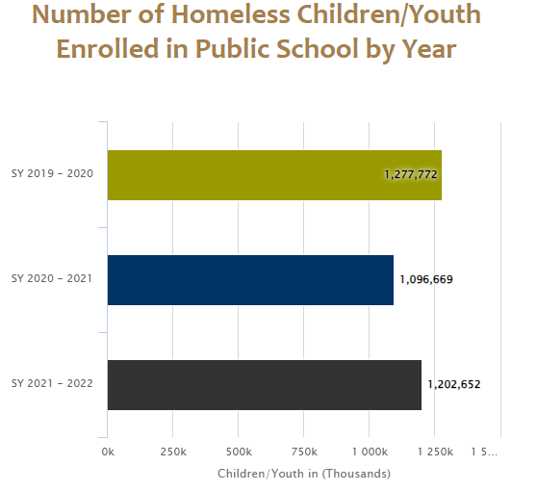
National Homeless Data
Source: National Center for Homeless Education
Notes:
I wanted to take you through some homeless data.
This slide starts with the National Homeless data for the number of homeless children and youth enrolled 2019-2022.
You can see a noticeable dip during the 2020-21 school year due to the lack of reporting while most schools were virtual during the height of the covid pandemic.
You can see this number rebounded the following year as students began going back to school and we expect this number to continue to spike as we recover from the pandemic.

Slide 21
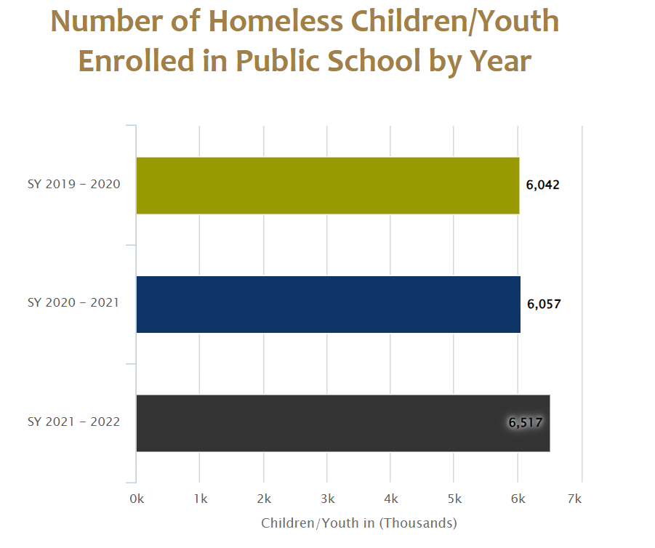
Number of Students Identified as Homeless
Source: National Center for Homeless Education
Notes:
This slide shows our homeless numbers enrolled. You can see the spike in 2021-22 that correlates with the national numbers. We expect this spike to continue as we continue to recover from the pandemic.

Slide 22
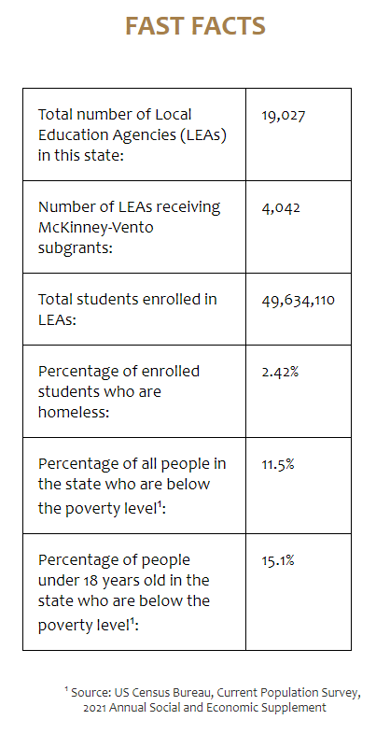
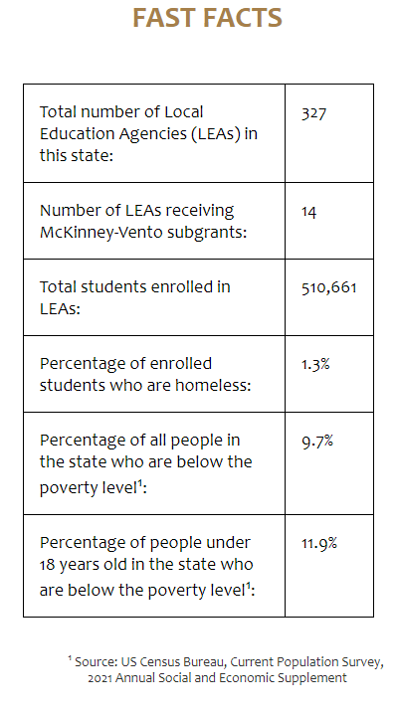
National and Iowa Snapshots
Notes:
This slide shows some fast fact in Iowa compared to national numbers. We are still below the national average for most of these percentages of our enrolled students.

Slide 23
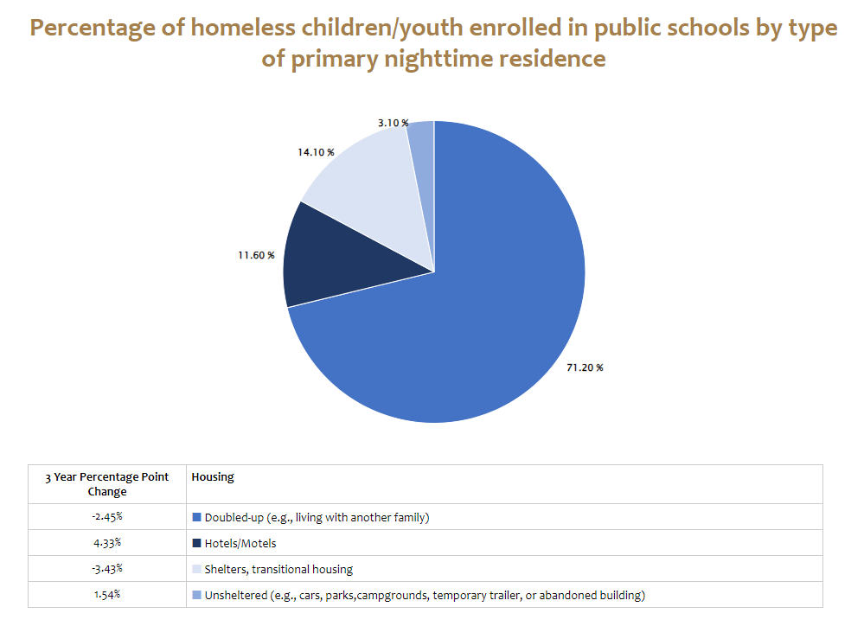
Iowa Primary Nighttime Residence 2021-22
Notes:
This slide shows the primary nighttime residence stats in Iowa.
You can see that our largest subgroup of homeless students by far are labeled as “doubled up”
One of the concerns here is the increase in unshleted students. These are some of our most at-risk students and we do not like seeing this number grow.

Slide 24
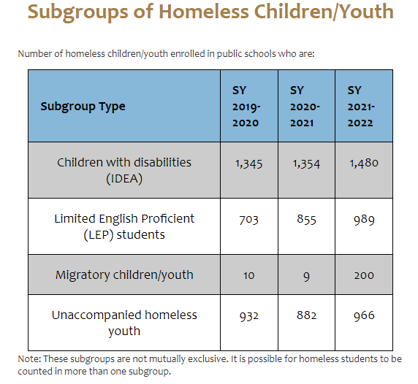
Subgroups of Homeless Children/Youth in Iowa
Notes:
This slide breaks down some of the subgroup numbers in our state. You can see that all numbers increased significantly in SY 2021-22. We expect that upward trend to continue.

Slide 25
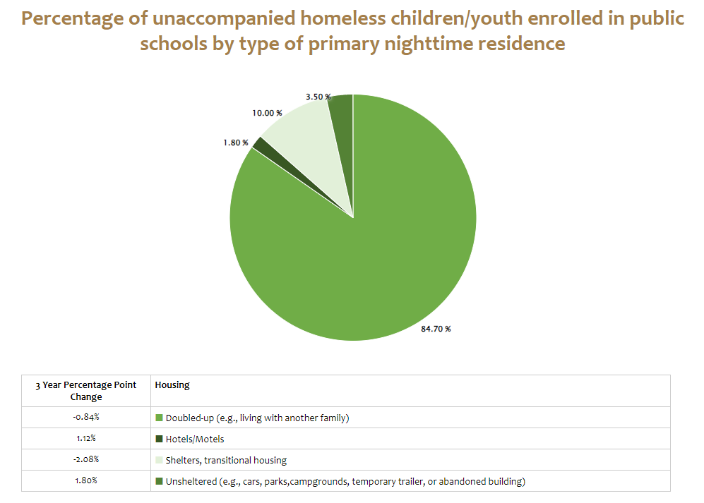
Iowa Unaccompanied Homeless Youth Primary Nighttime Residence 2021-22
Notes:
This slide indicates our number of unaccompanied homeless youth by nighttime residence. Again you can see the increase in the number of unsheltered students and that is concerning.

Slide 26
Requirements and Allowability

Slide 27
Funding
McKinney-Vento Subgrant
2022-23 state allocation of $697,160
Competitive subgrant on 3 year cycle
14 current subgrant recipients
Next application process will open Spring 2024 in CASA
American Rescue Plan Homeless Children and Youth
Iowa received approximately $5 million in ARP-HCY funds.
ARP I (25%) approximately $1.3 million disbursed in April 2021 to MV existing subgrantees.
ARP II (75%) approximately $3.8 million disbursed on formula basis.
223 districts receiving funding
Funding period ends September 30, 2024
Notes:
The McKinney-Vento competitive subgrant is currently in its third year of a 3 year cycle. A new application cycle will be opening in early 2024 for the 2024-2027 cycle. More information will be sent to districts regarding application requirements and deadlines.
Iowa saw an incredible increase in funding for students experiencing homelessness when relief funds were awarded. ARP HCY funds are specifically devoted to students experiencing homelessness. All districts qualified for some level of funding. 223 districts accepted that funding, with the remaining districts declining the funding. Many of the 223 districts have utilized all of the ARP HCY funds. Those that have not yet utilized all of the funds have until September of 2024 to obligate funds.

Slide 28
McKinney-Vento Subgrant Cycle 2024-27
For the upcoming MV subgrant cycle, the application will be completed in the Consolidated Accountability & Support Application (CASA) system.
Approximately $400,000 is available statewide for the first year to supplement existing services and/or to start new services. Amount will vary per year depending on allocation from the US Department of Education. Since funds are extremely limited, subgrants are expected to be awarded in the following ranges:
Tier 1: 10-50 homeless students – Subgrants may range up to $10,000 for each subgrant year.
Tier 2: 51 or more homeless students – Subgrants may range up to $25,000 for each subgrant year.
Annual requests for continuation during the 3-year subgrant period will be directed and coordinated by the Department and based on the availability of federal funds.
For the LEA to be eligible to apply for a McKinney-Vento subgrant, the LEA must have identified and reported a minimum of 10 students experiencing homelessness in Student Reporting in Iowa (SRI) in their spring 22-23 submission.

Slide 29
Title I, Part A Federally Required Set-Aside
Each local education agency must reserve funds to provide comparable services for eligible homeless children who do not attend participating schools, including providing educationally related support services to children in shelters and other locations where children may live (ESEA Sec. 1113 (c) (3)(A)).
Two guiding principles:
1. The services must be reasonable and necessary to assist students experiencing homelessness to take advantage of educational opportunities (ESEA section 1113(c)(3)(A); 2 CFR § 200.403(a)).
2. The funds must be used only as a last resort when funds or services are not available from other public or private sources (p. 41 Education for Homeless Children and Youths Programs Non-Regulatory Guidance.)
Notes:
All students experiencing homelessness are eligible for Title I supports, even if the student does not attend a Title I building.
When determining whether Title IA funds can be utilized for a given purpose, the two guiding principles must be considered. All expenses are on a case by case basis.

Slide 30
Title IA Set-Aside and McKinney Vento Subgrant Allowable Activities
Tutoring services (remedial or accelerated instruction), especially in shelters or other locations where homeless students live
Before-school/after-school, and/or summer programs
Services to enable students to enroll in, attend, and succeed in school
Personal school supplies such as backpacks and notebooks
Items of clothing to meet a school’s dress or uniform requirements
Shoes necessary to participate in physical education classes
Student fees necessary to participate in the general education program
Graduation cap and gown, graduation fees
Notes:
This slide and the next provide a list of examples of allowable expenses utilizing the Title IA set aside funds or the McKinney-Vento subgrant. Again, each expense must be evaluated utilizing the two guiding principles - reasonable and necessary as well as used as a last resort.

Slide 31
Examples of Allowable Activities Continued
Birth certificates necessary to enroll in school
Counseling services/domestic violence counseling services
Parental involvement specifically oriented to reaching out to parents of homeless students
Research-based programs that benefit highly mobile students
Fees for SAT/ACT testing if not waived by college or university
Cost of HiSET for an unaccompanied homeless youth
Health related services may be allowed if funds are not reasonably available from public or private sources (as a last resort, health, nutrition, other services such as eyeglasses and hearing aids, immunizations, and dental needs).
Defray the excess cost of transportation
Notes:
These are more examples of allowable activities

Slide 32
ARP-HCY Allowable Activities, Part 1
ARP-HCY allowable activities include all allowable McKinney-Vento subgrant and Title IA activities, plus -
Providing wraparound services (which could be provided in collaboration with and/or through contracts with community-based organizations, and could include academic supports, trauma-informed care, social-emotional support, and mental health services);
Purchasing cell phones or other technological devices for unaccompanied youth to enable the youth to attend and fully participate in school activities;
Providing access to reliable, high-speed internet for students through the purchase of internet-connected devices/equipment, mobile hotspots, wireless service plans, or installation of Community Wi-Fi Hotspots (e.g., at homeless shelters), especially in underserved communities;
Notes:
Any expense that would be considered allowable under Title IA homeless set aside or the McKinney-Vento subgrant would be considered allowable under ARP HCY. ARP HCY allows for expanded opportunities. Districts must determine the needs in their district and how to best utilize their funds to support students experiencing homelessness.

Slide 33
ARP-HCY Allowable Activities, Part 2
ARP-HCY allowable activities include all allowable McKinney-Vento subgrant and Title IA activities, plus -
Paying for short-term, temporary housing (e.g., a few days in a motel) when such emergency housing is the only reasonable option for COVID-safe temporary housing and when necessary to enable the homeless child or youth to attend school and participate fully in school activities (including summer school); and
Providing store cards/prepaid debit cards to purchase materials necessary for students to participate in school activities.

Slide 34
Resources
2022-23 District Homeless Liaison List
IDoE McKinney-Vento Resources
IDoE ESSA Guidance and Allocations
National Center for Homeless Education - NCHE
US Department of Education - Education for Homeless Children and Youth
SchoolHouse Connection
The National Association for the Education of Homeless Children and Youth
Education for Homeless Children and Youths Non-Regulatory Guidance
Notes:
Here are some resources to help you in your role as homeless liaison. Many of these resource links will take you to additional resources. NCHE is the national technical assistance center for homeless education and is truly an amazing resource. Please don’t hesitate to reach out to us at the Department with questions as they arise.
For assistance with an issue related to the education of a child or youth experiencing homelessness, contact the NCHE homeless education helpline toll-free at (800) 308-2145 or homeless@serve.org.

Slide 35
Resources Continued
Confirming Eligibility for McKinney-Vento Rights and Services
Determining Eligibility for McKinney-Vento Rights and Services
Eligibility Flowchart
Unaccompanied Youth Eligibility Flowchart
Definition of Unaccompanied Homeless Youth

Slide 36
Contact
Tyler Navin
Homeless Education Program Consultant
Iowa Department of Education
tyler.navin@iowa.gov
515-669-8622
Notes:
This is me and my contact information. Please reach out if you have any questions.

