Slide 1
Title I, Part C
Education of Migratory Children
Rachel Pettigrew
Education Program Consultant
Federal Programs Bureau

Slide 2
Overview
Slides 1-36
Purpose of Title I, Part C
Designations, Definitions, and Acronyms
ESSA Requirements
Documentation and Reporting
Local Operating Agencies (LOAs)
Slides 37-74
Service Delivery Plan (SDP)
Goal Area #1: School Readiness
Goal Area #2: English Language Arts and Mathematics
Goal Area #3: High School Graduation / Services to OSY
Goal Area #4: Non-Instructional Support Services
Resources
Contact Information

Slide 3
Purpose (ESEA § 1301)
To assist states in supporting high-quality and comprehensive educational programs and services during the school year and, as applicable, during summer or intersession periods, that address the unique educational needs of migratory children.
To ensure that migratory children who move among the states are not penalized in any manner by disparities among the states in curriculum, graduation requirements, and challenging State academic standards.
To ensure that migratory children receive full and appropriate opportunities to meet the same challenging state academic standards that all children are expected to meet.
To help migratory children overcome educational disruption, cultural and language barriers, social isolation, various health-related problems, and other factors that inhibit the ability of such children to succeed in school.
To help migratory children benefit from State and local systemic reforms.

Slide 4
Designations, Definitions, and Acronyms
CLARIFYING COMMON WORDS AND PHRASES

Slide 5
Designation
Distinctions
English
Learners
Immigrant
Students
Migratory
Children

Slide 6
Migratory
Child
(ESEA § 1309(3))
The term “migratory child” means a child or youth who made a qualifying move in the preceding 36 months—
as a migratory agricultural worker or a migratory fisher; or
with, or to join, a parent or spouse who is a migratory agricultural worker or a migratory fisher.

Slide 7
Migratory Agricultural Worker (ESEA § 1309(2))
The term “migratory agricultural worker'' means an individual who made a qualifying move in the preceding 36 months and, after doing so, engaged in new temporary or seasonal employment or personal subsistence in agriculture, which may be dairy work or the initial processing of raw agricultural products.
If an individual did not engage in such new employment soon after a qualifying move, such individual may be considered a migratory agricultural worker if the individual actively sought such new employment and has a recent history of moves for temporary or seasonal agricultural employment.

Slide 8
Qualifying
Move
(ESEA § 1309(5))
The term “qualifying move” means a move due to economic necessity—
from one residence to another residence; and
from one school district to another school district, except—
in the case of a State that is comprised of a single school district, wherein a qualifying move is from one administrative area to another within such district; or
in the case of a school district of more than 15,000 square miles, wherein a qualifying move is a distance of 20 miles or more to a temporary residence.

Slide 9
Local Operating
Agency
(LOA)
(ESEA § 1309(1))
The term “local operating agency” means—
a local educational agency to which a State educational agency makes a subgrant under this part;
a public or private agency with which a State educational agency or the Secretary makes an arrangement to carry out a project under this part; or
a State educational agency, if the State educational agency operates the State’s migrant education program or projects directly.

Slide 10
Priority For Services
(PFS)
(ESEA § 1304(d))
In providing services with funds received under this part, each recipient of such funds shall give priority to migratory children who have made a qualifying move within the previous 1-year period and who—
are failing, or most at risk of failing, to meet the challenging State academic standards; or
have dropped out of school.

Slide 11
Out-of-School Youth
(OSY)
(ESEA § 1304(d))
Age 16-21
Has not yet obtained a high school diploma or equivalency
Has dropped out of high school or
Has never attended high school
Is working as a migratory agricultural worker or
Moved with a migratory agricultural worker

Slide 12
Acronyms
COE - Certificate of Eligibility
CNA - Comprehensive Needs Assessment
ID&R - Identification and Recruitment
LOA - Local Operating Agency
MAW - Migratory Agricultural Worker
MEP - Migratory Education Program
MPO - Measurable Program Objective
MSIX - Migrant Student Information Exchange
OME - Office of Migrant Education
OSY - Out-of-School Youth
PFS - Priority for Services
QAD - Qualifying Arrival Date
SDP - Service Delivery Plan

Slide 13
Migratory Liaisons
RESPONSIBILITIES OF ALL SCHOOL DISTRICTS IN IOWA

Slide 14
All public school districts and nonpublic schools
Refer potentially migratory students to the MEP ID&R Coordinator.
Maintain records of the determination of child eligibility.
Coordinate with food service staff so that eligible migratory students receive free lunch.
Refer migratory students with unique educational needs to the appropriate area education agency (AEA) or Early ACCESS staff (IDEA Part C).

Slide 15
All public school districts and nonpublic schools
Ensure migratory liaisons or staff, as appropriate, speak to migratory parents about issues (e.g., graduation requirements, postsecondary options) within 90 days of their child's enrollment.
Coordinate and provide support for migratory students to meet the same challenging state academic standards that all students in Iowa are expected to meet.

Slide 16
Documentation and Reporting
RECORD KEEPING FOR ALL SCHOOL DISTRICTS IN IOWA

Slide 17
Initial
Eligibility Indicator
Migratory liaisons ensure that schools:
Identify children and families who may potentially be eligible to receive services under Title I, Part C.
Incorporate the MEP Parent Form into the school registration process.
MEP Parent Form (English)
MEP Parent Form (Spanish)
Refer potentially eligible migratory children to the MEP ID&R Coordinator.

Slide 18
Eligibility Determination Interviews
Regional MEP Identification Specialists conduct interviews with potentially eligible families to make the determination if children meet qualifications to be eligible for services under Title I, Part C.
When eligibility for services is determined, the national Certificate of Eligibility (COE) is written and approved by the Iowa MEP.

Slide 19
Approved COE and
Lunch Letter
The approved Certificate of Eligibility (COE) and Lunch Letter are sent through a secure email from our MEP Data Specialist to the Migratory Liaison.
All Migratory Liaisons in Iowa:
Forward the Lunch Letter to the district’s food service department as official documentation of eligibility for free lunch.
File the approved COE and Lunch Letter in the student’s cumulative file.
File the approved COE and Lunch Letter in the district’s records of migratory children.

Slide 20
MEP
Withdrawal Form
All school districts in Iowa:
Submit the completed MEP Withdrawal Form via secure email to the MEP Data Specialist within 10 days of when an eligible migratory student leaves the district and enrollment is terminated (moved, graduated, dropped out).
Include information related to services/support provided while the student was in the district, and provide any details if known of where the student is going (new city/school name).
For students who drop out, provide student contact information, reason for dropping out, school counselor contact information - any details that would be helpful as we reach out to the student and potentially serve as an Out of School Youth (OSY) within the MEP.

Slide 21
MEP
Residency Verification
Eligibility within the MEP is 36 months from the Qualifying Arrival Date. We are required to verify that every eligible child in our program has lived in Iowa at least one day on or after September 1 of the reporting period.
All Migratory Liaisons in Iowa:
Respond to the secure email sent in October from the MEP Data Specialist, asking you to verify if each eligible child has attended school at least one day on/after September 1.
If the answer is no, provide additional information related to when they withdrew and the circumstances (moved, graduated, dropped out).
If the answer is yes, we can verify their residency for the current reporting period.

Slide 22
Migrant Student Information Exchange (MSIX)
MSIX is a national electronic exchange developed to link existing State migrant student record systems to collect, consolidate, and make critical education and health data available to authorized personnel.
MSIX greatly benefits students by effectively tracking their credit accrual towards graduation requirements, allowing them to earn their degrees in a timely manner. MSIX provides useful data to assist stakeholders in making meaningful decisions regarding migrant students.
MSIX enables States to notify one another when a migrant student is moving to a different State. This helps improve the timeliness of school enrollments, improve the appropriateness of grade and course level placement, and reduces the incidences of unnecessary immunizations for migrant students.
MSIX is used primarily by local guidance counselors, school registrars, and MEP specialists throughout the nation who need migrant student data to make decisions on enrollment, grade or course placement, and accrual of credits.

Slide 23
Local Operating Agencies (LOAs)
RESPONSIBILITIES OF ALL SCHOOL DISTRICTS IN IOWA RECEIVING TITLE I, PART C

Slide 24
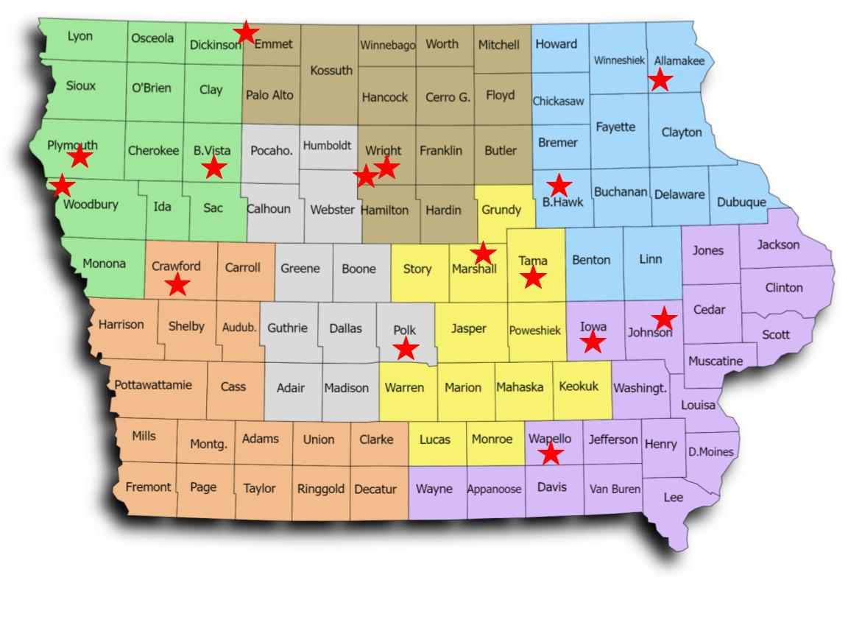
Local Operating Agencies
LOAs 2024-25
Clarion Denison Des Moines Eagle Grove Estherville Iowa City Le Mars Marshalltown Ottumwa Postville Sioux City South Tama Storm Lake Waterloo Williamsburg

Slide 25
Monthly
Eligibility List
Reconciliation
LOAs only:
Reconcile your district list of eligible MEP children with the Monthly Eligibility Report sent to you by the MEP Data Specialist, noting any differences in the following details:
Child name
Birthdate
State ID
Grade level
Facility name
Enrollment status

Slide 26
LOA
Year-End Reports
LOAs only:
Submit Year-End Reports to the MEP Data Specialist:
Regular School Year
Regular Year-end Reports (Due: June 1)
Summer Term
Summer Year-end Reports (Due: September 1)
MEP Important Dates and Reporting Requirements
Reporting Period: September 1 – August 31

Slide 27
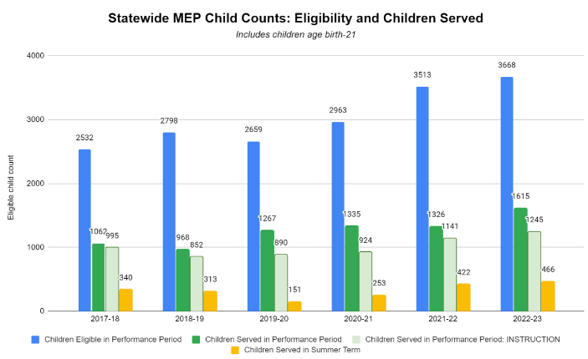
Migratory Children and Services Provided in Iowa

Slide 28
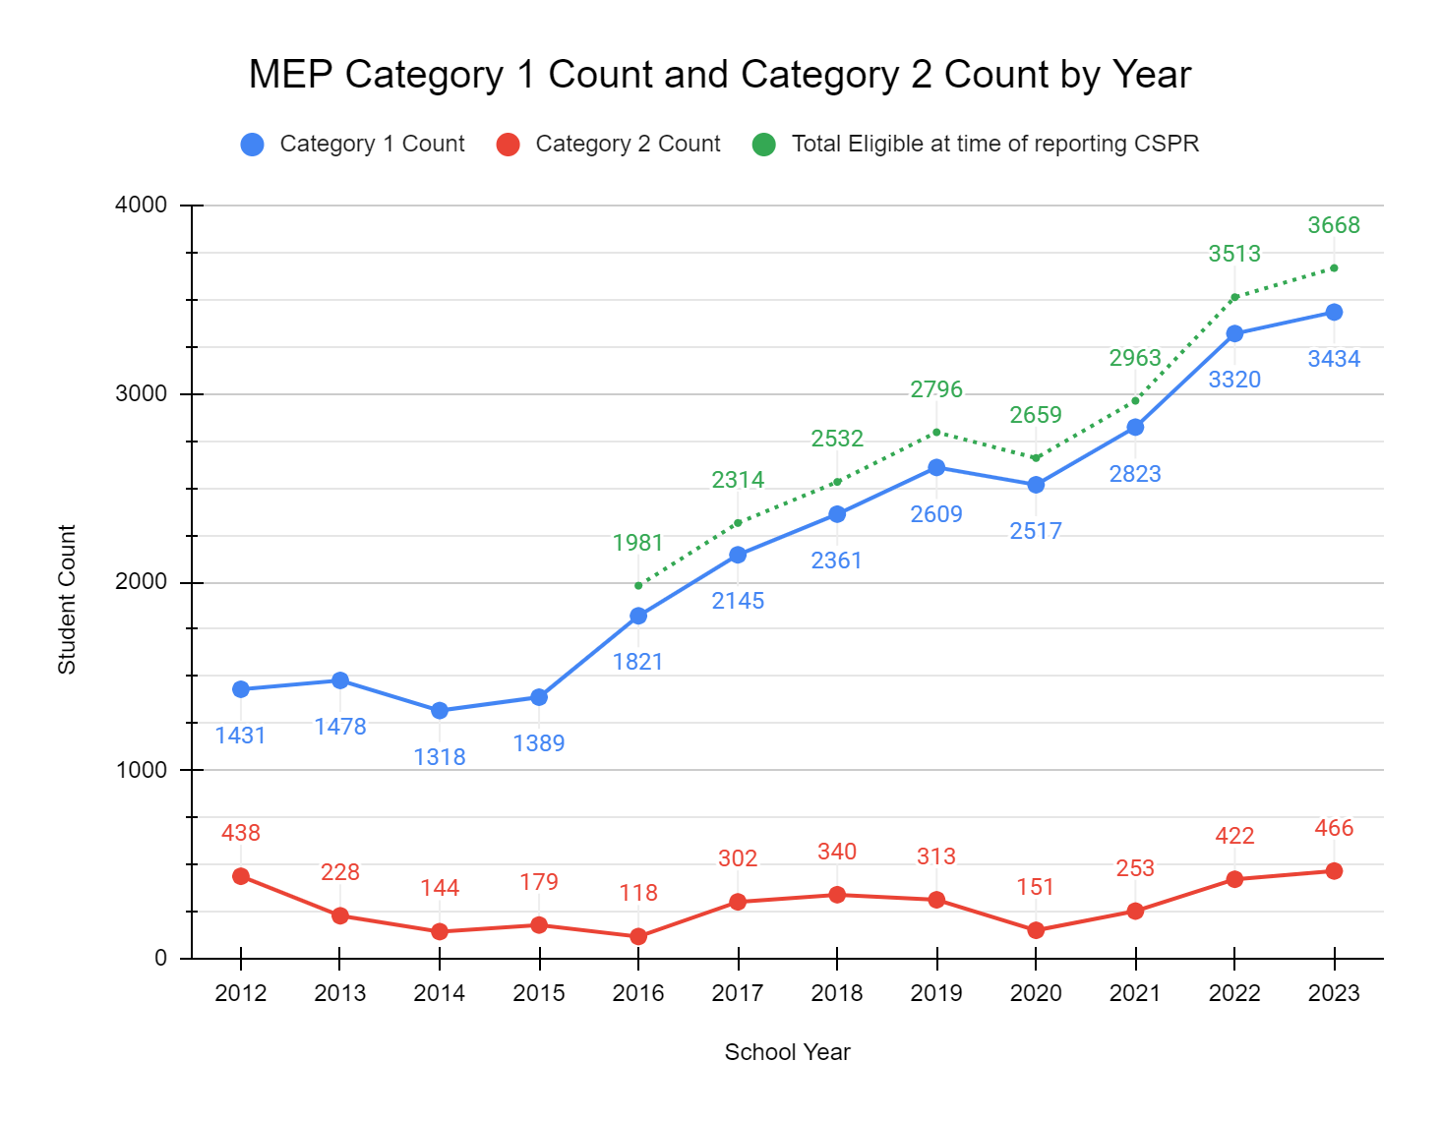
Migratory Children and Services Provided in Iowa

Slide 29
Supplement
Not Supplant
(ESEA § 3115(g))
Federal funds made available under this subpart shall be used so as to supplement the level of Federal, State, and local public funds that, in the absence of such availability, would have been expended for programs for English learners and immigrant children and youth and in no case to supplant such Federal, State, and local public funds.

Slide 30
Civil Rights
All students
Regulations Existed previously
If yes, it is supplanting and is NOT allowable:
Is it required under Civil Rights?
Is it offered to all students?
Is it required by federal, state, or local regulations?
Did it exist previously through other federal, state, or local funds?

Slide 31
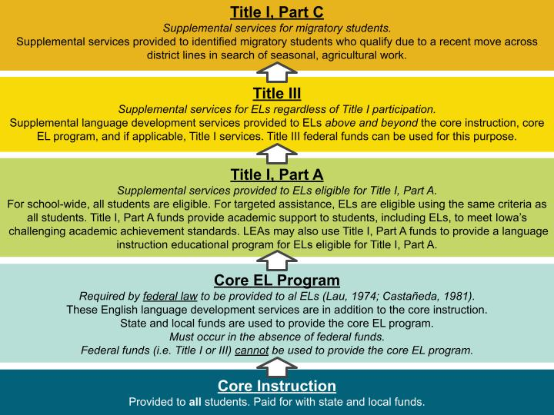
Funding
Distinctions

Slide 32
Allocation Formula for Title I, Part C
Total Weighting
Average of Eligible Students Served
(1.0) P3-OSY eligible
(1.0) Priority for services
(0.1) English learner
(1.0) Served during regular year
(0.5) Served during summer
Students served during regular year
Total P3-OSY eligible
Students served during summer
Total P3-OSY eligible
(10.0) LOAs not yet generating $40,000 for Title III-English Learners

Slide 33
Service Delivery Plan (SDP)
RESPONSIBILITIES OF THE STATE TO IMPLEMENT PROJECTS THROUGH
A COMPREHENSIVE NEEDS ASSESSMENT AND
A COMPREHENSIVE STATE PLAN FOR SERVICE DELIVERY

Slide 34
Required Components of the State SDP
(ESEA § 1306)
State Performance Targets
Comprehensive Needs Assessment
Measurable Program Outcomes
Service Delivery Strategies
Evaluation

Slide 35
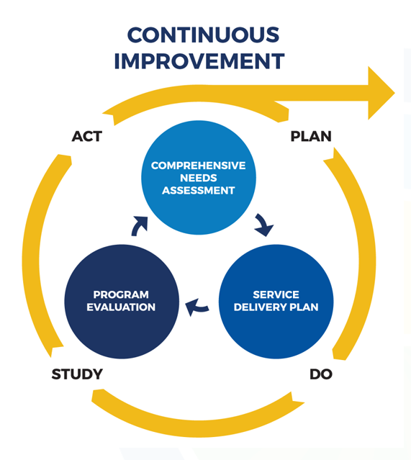
Office of Migrant Education (OME)

Slide 36
Four Goal Areas of Iowa’s MEP Service Delivery Plan
School Readiness
English Language Arts and Mathematics
High School Graduation/Services to OSY
Non-Instructional Support Services

Slide 37
School Readiness
GOAL AREA #1

Slide 38
Need Statement of Goal Area #1:
School Readiness
The percentage of migratory parents receiving resources and opportunities to understand child development needs to increase.
The percentage of eligible migratory children ages 3-5 who receive instructional or support services from the MEP needs to increase.

Slide 39
Strategy 1.1
Coordinate/provide parents of migratory children before school age with information and strategies on child development.
Coordinate/provide parents of migratory children before school age with access to local preschool resources.

Slide 40
Ideas for Implementation of Strategy 1.1
Collaborate with health/nutrition services.
Coordinate with the state level early childhood system to ensure inclusion of migratory children as an underserved population.
Coordinate with local early childhood systems to provide access to local resources.
Explore access/usage of online/virtual programming to provide information and ideas on how to support learning at home (e.g., Ready Rosie).
Provide learning opportunities to parents about resources and instructional services.
Provide school readiness tools and resources for children and parents (e.g., books in a backpack, pre-literacy and pre-numeracy learning kits).
Support parents as first teachers by helping parents with activities to do at home (e.g., Parents as Teachers).

Slide 41
Strategy 1.2
Coordinate with local preschool/childcare programs to ensure migratory children before school age receive instructional services.

Slide 42
Ideas for Implementation of Strategy 1.2
Coordinate access to community services like libraries.
Coordinate with the state level early childhood system to ensure inclusion of migratory children as an underserved population.
Coordinate with local early childhood systems to provide access to local resources.
Coordinate services in the language spoken at home.
Coordinate services based on needs (half day, full day).
Coordinate access to existing childcare and preschool services and programs.
Identify early childhood programs across the state.

Slide 43
Strategy 1.3
Coordinate/provide instructional and support services to migratory children before school age to support school readiness and transition to kindergarten.

Slide 44
Ideas for Implementation of Strategy 1.3
Coordinate/provide early reading and math services in the native language of the child.
Coordinate/provide support for writing/reading and math at home.
Coordinate/provide transition to kindergarten services.
Provide books in native language.
Provide interventions to prepare 3-5 year olds entering kindergarten using a Multi-Tiered System of Support (MTSS) approach.
Provide resources/materials and professional learning opportunities to support reading and math readiness content.

Slide 45
English Language Arts and Mathematics
GOAL AREA #2

Slide 46
Need Statement of Goal Area #2:
ELA and Math
To eliminate the achievement gap between migratory and non-migratory students, the percentage of migratory students scoring proficient or above on State assessments needs to increase by
37.4 percentage points (38.4 percentage points for PFS students) in ELA, and
33.0 percentage points (38.5 percentage points for PFS students) in math

Slide 47
Strategy 2.1
Coordinate/provide needs-based supplemental instruction in ELA and math to migratory students in grades K-12 during the regular school year.

Slide 48
Ideas for Implementation of Strategy 2.1
Regular Year
Before and after-school tutoring.
Coordinated student schedules (academic support happens outside of school and outside of activity/practice).
Literary and math backpacks (checkout and return).
Literacy nights.
Online platforms (e.g., Duolingo, Unite for Literacy, BookFlix, TrueFlix, Khan Academy, Prodigy, Dreamscape).
Partner with colleges for tutoring support.
Project-based learning (e.g., hands-on activities, building trades, cooking, health care, child development, STEAM, robotics, gardening, greenhouse work, agriculture).
Provide professional development on ELA and math instruction to staff serving migratory students.

Slide 49
Strategy 2.2
Coordinate/provide needs-based supplemental instruction in ELA and math to migratory students in grades K-12 during the summer.

Slide 50
Ideas for Implementation of Strategy 2.2
Summer
Back-to-school night–provide books.
ESL classes.
Field trips/excursions.
Literacy nights.
MEP-funded summer school.
Online platforms (e.g., Duolingo, Unite for Literacy, BookFlix, TrueFlix, Khan Academy, Prodigy, Dreamscape).
Partner with libraries, 4-H, ISU Extension offices, and other community organizations.
Project-based learning (e.g., hands-on activities, building trades, cooking, health care, child development, STEAM, robotics, gardening, greenhouse work, agriculture).
Provide credit-bearing courses/help.
Solicit support from local businesses to sponsor middle/high school students interested in a summer business venture.
Summer reading program.
Writer’s workshops.

Slide 51
High School Graduation and
Services to OSY
GOAL AREA #3

Slide 52
Need Statement of Goal Area #3: High School Graduation and Services to OSY
Need Statement
The migratory student graduation rate needs to increase by 15.4 percentage points (26.6 percentage points for PFS students) to eliminate the gap between migratory and non-migratory students.

Slide 53
Strategy 3.1
Coordinate/partner/provide supportive systems for migratory high school students to obtain credits for prompt high school graduation.

Slide 54
Ideas for Implementation of Strategy 3.1
Communicate with prior school to obtain records.
Expand statewide partnership and network to provide engaging supplementary supports for high school credit acquisition.
Offer credit recovery.
Online schools.
Open enrollment.
Partner with institutions of higher education.
Provide 1:1 tutoring.
Provide hybrid learning opportunities with in-person support.
Provide job-based schedules and earn credits for school from work experiences.
Provide on-demand tutoring (e.g., phone, online).
Provide opportunities to accrue credits focused on prompt graduation.
Provide virtual, online learning (asynchronous).
Provide/coordinate avenues for flexibility for credit accrual of high school (including transfer of credit).
School counselors/MEP staff meet with students to access credits and history to award credits.
Seamless credits.
Texas Migrant Interstate Project (TMIP) for assessing Texas-based student credit needs.

Slide 55
Strategy 3.2
Coordinate/partner/provide migratory high school students and OSY with culturally relevant information/services and access to college/career readiness and post-secondary education.

Slide 56
Ideas for Implementation of Strategy 3.2
Coordinate with other states.
coordinate with High School Equivalency Program (HEP) and College Assistance Migrant Program (CAMP).
Host career fairs.
Host meetings for students and families with motivational speakers.
Offer college readiness workshops.
Offer FAFSA/college nights.
Provide college visits.
Provide culturally relevant trips and experiences.
Provide opportunities for stackable certificates.
Provide seminars and webinars on how to access post-secondary education.
Provide support for non-FAFSA-eligible students.
Provide visits to vocational/technical schools.

Slide 57
Strategy 3.3
Coordinate/partner/provide instructional and support services to migratory OSY.

Slide 58
Ideas for Implementation of Strategy 3.3
Contract with agencies and community resources to provide social services for OSY.
Coordinate services for OSY.
Coordinate with trade/technical schools.
Create resource guides for services available for OSY.
Provide online and in-person ESL opportunities for OSY residing in rural areas.

Slide 59
Strategy 3.4
Coordinate/partner/provide migratory high school students and OSY with needs-based culturally relevant summer services.

Slide 60
Ideas for Implementation of Strategy 3.4
Coordinate with agencies/companies to provide soft skills/job skills (i.e., Junior Achievement).
Coordinate with Al Exito University.
Coordinate/provide more vocational support (i.e., Job Corps).
Offer classes for credentials that can be obtained short-term.
Partner with 4-H.
Provide a leadership camp at Western Iowa Tech (WIT) Community College.
Provide camps that are fun and engaging.
Provide life skills training for H2A workers (i.e., iSOSY lessons).
Send student to leadership camps out-of-state (e.g., DC, Nebraska).

Slide 61
Non-Instructional Support Services
GOAL AREA #4

Slide 62
Need Statement of Goal Area #4: Non-Instructional Support Services
The percentage of migratory children, youth, and families receiving MEP support services needs to increase.

Slide 63
Strategy 4.1
Coordinate/provide needs-based non-instructional support services to migratory children, youth, and families.

Slide 64
Ideas for Implementation of Strategy 4.1
Add student service provider positions to LOAs.
Coordinate and secure basic needs services for migratory families.
Coordinate with Department to establish a coalition of different programs (e.g., Title IA, Homeless).
Coordinate with other programs (e.g., Head Start, Title I, Homeless) to streamline services.
Establish a referral process.
Gather and provide a regional/district-level list of resources for families for basic needs (e.g., housing, transportation, nutrition).
Identify and/or designate a service provider for migratory families (i.e., liaison to support and help navigate resources based on needs)
Parents as Teachers.
Partner/collaborate with local/state/community organizations. Provide administrators and service providers with PD on allowable use of MEP funds.
Provide meaningful/purposeful OSY bags and materials.
Provide PD to LOAs about how to maximize federal program resources and investments to meet the basic needs of migratory children and youth.
Provide support through social worker positions.
Use the “I do, we do, you do” model and the “Goldilocks” approach.

Slide 65
Strategy 4.2
Coordinate/provide targeted professional development to staff who serve migratory children, youth, and families.

Slide 66
Ideas for Implementation of Strategy 4.2
Host a statewide MEP conference.
Provide MEP staff training on non-instructional support services.
Provide MEP staff training to build their skills to support the educational and support services needs of migratory students.
Provide MEP staff with definitions for, and examples of, non-instruction support services.
Provide opportunities for staff to network and share best practices.
provide PD on allowable use of MEP funds.
Provide PD on appropriate enrollment/placement of students.
Provide PD on appropriate record keeping and recording of services provided.
Provide PD on data collection and reporting.
Provide regional PD opportunities.
Provide school staff with trauma sensitive PD to help them handle secondary trauma and empathy-based training.
Provide statewide awareness of the MEP.

Slide 67
Strategy 4.3
Coordinate/provide migratory families with strategies to help them support their children.

Slide 68
Ideas for Implementation of Strategy 4.3
Communicate/coordinate with other school programs.
Coordinate with housing developments.
Coordinate with large companies to take social action.
Establish childcare partnerships.
Host family events.
Parents as Teachers training programs.
Provide school resources that match the home and culture of migratory students and their families.
Provide support for extracurricular events.
Solicit legislative advocacy.
Use marketing to tell positive stories about migratory children and their families.

Slide 69
Strategy 4.4
Coordinate/provide culturally responsive support and resources to migratory children and youth to build awareness and nurture their social-emotional well-being.

Slide 70
Ideas for Implementation of Strategy 4.4
Coordinate support through DHS for cultural awareness.
Coordinate/provide family support for appropriate discipline techniques.
Offer access to family recreational activities.
Offer college access training.
Offer training/webinars that support mental well-being.
Provide access to mental health services.
Provide access to non-traditional educational activities.
Provide access to successful adults who share similar stories.
Provide mentoring/cultural ambassador opportunities.

Slide 71
Resources
Iowa Department of Education
ESSA Guidance & Allocations Webpage
Iowa Migratory Education Webpage
U.S. Department of Education
Office of Migrant Education

Slide 72
Contact Information
Rachel Pettigrew
rachel.pettigrew@iowa.gov
515-380-5115

