Slide 1
Credentials for Child Care Careers
(C4) Grant
Orientation Webinar
Notes:
Introductions

Slide 2
Awarded Districts
Congratulations on receiving a C4 Grant award!
Awarded districts include:
Council Bluffs CSD
MMCRU CSD
Sioux Central CSD
Starmont CSD
Woodbine CSD

Slide 3
Grant Expectations
Awarded districts will:
Provide a Family and Consumer Science (FCS) course series in which students may earn a Child Development Associate (CDA™) Credential.
AND
Partner with a licensed child care center to provide service/practice hours to participating Career and Technical Education (CTE) students.

Slide 4
Grant Expectations - Curriculum
Awarded districts will:
Receive a Department-approved early childhood curriculum aligned to the Child Development Associate (CDA™) Credential.
AND
Use the approved curriculum paired with hands-on service hours to support students in completing the requirements for a CDA Credential.
AND
Ensure Iowa HHS Child Care Licensing Requirements are incorporated into the district’s course of study and completed within the first 3 months of child care center employment.

Slide 5
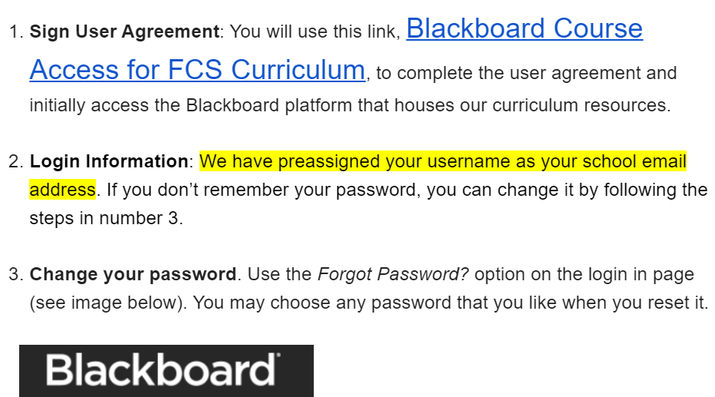
Curriculum
A user account and login is needed to access the curriculum. Each awarded grantee will receive the below detailed instructions from Texas Tech.
Notes:
Contact information has been provided to Texas Tech who will send access information (similar to what is shown on this slide).

Slide 6
Curriculum Overview
(Zoom link to be provided.)
Notes:
The name and contact information of the instructor/individual who will deliver the curriculum has been provided to the conference organizers who will send a zoom link for awarded districts to join a conference session related to the curriculum. This conference will be held June 19-20. The session is scheduled for Thursday, June 20th, 9:50 - 10:35 am.

Slide 7
Iowa HHS Child Care Licensing Requirements
Awarded districts will:
Ensure Iowa HHS Child Care Licensing Requirements are infused into the district’s course of study to ensure participants are immediately eligible for employment at a child care center.
HHS required professional development is completed separate from the state-approved curriculum.
Awarded districts must embed the requirements into coursework.

Slide 8
Iowa HHS Child Care Licensing Requirements
Ensure accordance with Iowa Administrative Rules for Child Care Centers, 441.109(7):
First Semester Course must include HHS required professional development; must be completed within the first 3 months of child care center employment (online, self-paced):
a. Account set up in Iowa’s Professional Development and Workforce Registry (i-PoWeR)
b. Child Care Preservice/Essentials Series: 12 hours
c. Mandatory Reporter: 2 hours
d. Universal Precautions: 1 hour
Ensure students have access and complete certification in first-aid and hands-on skills assessment certification for CPR within the first 3 months of child care center employment.
Approved trainings and training organizations can be found in i-PoWeR

Slide 9
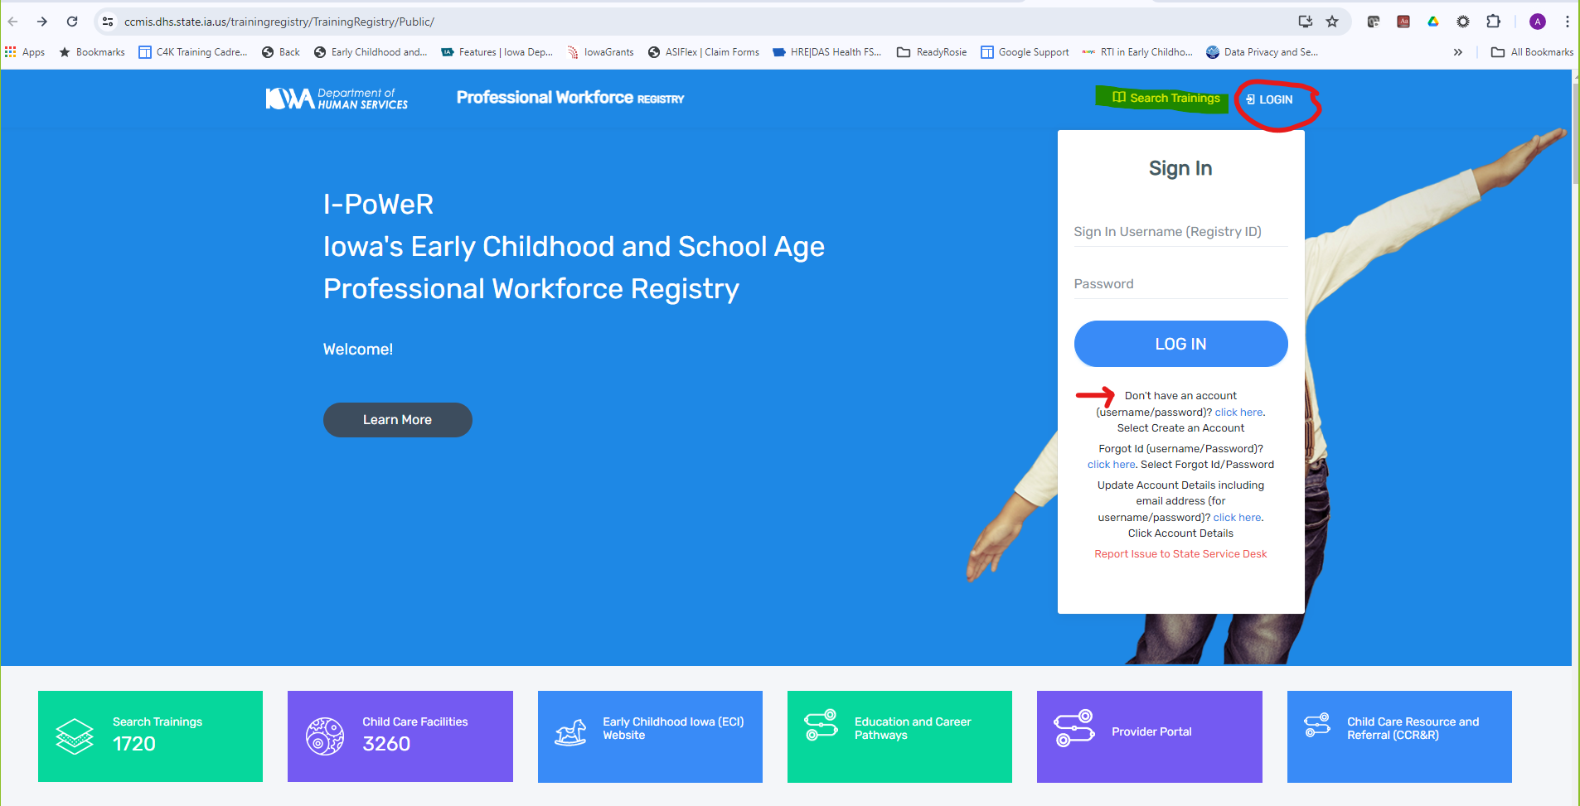
HHS Required Trainings in i-PoWeR
Notes:
Link to i-PoWeR is available in the title. Create an account and search for required trainings.

Slide 10
Funding
Budgets were submitted and approved within the application and are to cover grant-related expenses across two years: 2024-25 and 2025-26.
Grant funds may only be used to support the expenses outlined in the approved budget.
If budget adjustments are needed, (e.g. move funds from one category to another) notify the Department and submit budget adjustments for approval in IowaGrants.
Grant funds will be available for expenditures starting July 1, 2024.

Slide 11
Payment Methodology
Year One:
July 2024: Up to $7500 available for reimbursement of expenses
January 2025: Up to $7500 available contingent upon approval of the Year One mid-year report
Year Two:
July 2025: Up to $7500 available for reimbursement of expenses contingent upon approval of the Year One end-of-year report
January 2026: Remaining funds available contingent upon approval of the Year Two mid-year report
Grantees should submit claims for reimbursement within IowaGrants on at least a quarterly basis.
Notes:
Claims may be processed on a monthly basis; grantees should submit claims at least quarterly.

Slide 12
Reporting Timeline
Project Start Date | July 1, 2024
Year 1 Claims Submitted Quarterly | September 2024, December 2024, March 2025, June 2025
Year 1 Mid-Year Report Submitted | January 2025 via IowaGrants
Year 1 End-of-Year Report Submitted | July 2025
Year 2 Claims Submitted Quarterly | September 2025, December 2025, March 2026, June 2026
Year 2 Mid-Year Report Submitted | January 2026 via IowaGrants
Year 2 End-of-Year Report Submitted | July 2026
Project End Date | June 30, 2026
Notes:
Claims must be submitted at least quarterly but can be submitted on a more frequent basis. Claims will be processed on a monthly basis.

Slide 13
Mid-Year Reporting Requirements
The Grantee will submit a mid-year report to the Department for each grant year on or about January of the respective year.
The mid-year report will include:
● Activities completed during reporting period
● Description/Summary of expenditures
● Number of CTE student participants
● Number of partnerships with licensed child care centers

Slide 14
End-of-Year Reporting Requirements
The Grantee will submit an end-of-year report to the Department for each grant year no later than July 31 of the respective year.
The end-of-year report will include:
● Activities completed during reporting period
● Description/Summary of expenditures
● Number of CTE student participants
● Number of partnerships with licensed child care centers
● Average number of practice work hours completed within reporting period
● Number of participants completing 3-semester program (Year 2 data element)
● Number of participants attaining CDA credential (Year 2 data element)

Slide 15
Support and Resources
Available Resources:
One Page Overview of C4 Grant
Integrating Child Development Associate (CDA) Credential™- Aligned Programs in Iowa High Schools: A Handbook
Council for Professional Recognition is the entity that grants the CDA. Their website includes high school specific resources.
CDA Process Overview Flyer offers a quick view of the full process to obtain a CDA.
What other supports or resources would be helpful?
Contact list of other awarded districts
Develop a group for potential thought partners (district or teacher level)
Scheduled check-ins
Additional webinars on a particular topic

Slide 16
Questions
Grant Questions:
Jeanette Thomas, jeanette.thomas@iowa.gov
Dennis Harden, dennis.harden@iowa.gov
Mary Breyfogle, mary.breyfogle@iowa.gov
IowaGrants Questions:
Amy Stegeman, amy.stegeman@iowa.gov

Slide 17
Questions?

