Slide 1
Title I Part D: Prevention And Intervention Programs For Children And Youth Who Are Neglected, Delinquent, Or At Risk
Elisa Koler, Education Program Consultant

Slide 2
Overview
Overview of Title I Part D
Federal Funding
Federal Reporting
Annual Application
Claims and Expenditures

Slide 3
Purpose of the Title I Part D Program: Education
To improve educational services for children and youth in local, tribal, and State institutions for neglected or delinquent children and youth.
To ensure that children and youth have the opportunity to meet the same challenging State academic standards that all children in the State are expected to meet.
Source: 20 U.S.C. §1401

Slide 4
Purpose of the Title I Part D Program: Student Success
To provide children and youth with the services needed to make a successful transition from institutionalization to further schooling or employment.
To prevent at-risk youth from dropping out of school
To provide dropouts, and children and youth returning from correctional facilities or institutions for neglected or delinquent children and youth, with a support system to ensure their continued education and the involvement of their families and communities.
Source: 20 U.S.C. §1401

Slide 5
Subpart 1
Operated by a State Agency such as the Department of Corrections (DOC) or Department of Health and Human Services (HHS).
DOC: Adult Prisons and Penitentiaries.
9 facilities statewide.
HHS: State Training School for Boys.
Notes:
County jails and halfway houses are not state operated, so they would not qualify.

Slide 6
Subpart 2
Operated by an Area Education Agency (AEA) or Local Education Agency (LEA).
AEAs oversee the Juvenile Homes: shelters and juvenile detention centers.
LEAs oversee supervised group homes and apartment programs for Neglected youth, and residential treatment programs for Delinquent children and youth.

Slide 7
Neglected vs. Delinquent
Neglected | Delinquent
A student who is “committed to an institution (other than a foster home) or voluntarily placed under applicable State law due to abandonment, neglect, or death of his or her parents or guardians.” | A student who “resides in a public or private residential facility other than a foster home that is operated for the care of children and youth who have been adjudicated delinquent or in need of supervision.”

Slide 8
Neglected Facilities in Iowa
Juvenile Home–Shelter under Chapter 63 for children and youth awaiting foster care placement.
Qualified Residential Treatment Program (QRTP) for children and youth in foster care who require additional support in a homelike setting. A group home licensed with HHS.
Supervised Apartment Living (SAL) provides supervised, semi-independent transitional housing for youth aging out of foster care.

Slide 9
Delinquent Facilities in Iowa
Juvenile Home–Juvenile Detention Center under Chapter 63 provides short term care for children and youth awaiting further adjudication.
Long Term Secure Juvenile Facility provides long term care for children and youth adjudicated delinquent by the Juvenile Courts.
Adult Corrections includes state operated prisons and penitentiaries for adults or youth tried as adults.
Residential Treatment Center for Delinquent Youth provides secure care for children and youth who require an individually planned treatment program. This program must primarily serve children and youth in the custody of Juvenile Court Services (JCS).

Slide 10
Not all residential facilities are N&D Facilities!
Although some residential facilities have been identified as N&D in the past, many were found not to meet the federal definitions. Other types of residential facilities include:
Hospitals
Psychiatric hospitals
Short term crisis stabilization facilities
Shelters for homeless families
Domestic violence safety shelters
Residential consortium schools
Iowa School for the Deaf
Treatment centers for substance use disorders
Treatment centers for sexually problematized behaviors
Intermediate Care Facilities for Individuals with Intellectual Disabilities
4+ residential programs for disabled youth and young adults

Slide 11
Title 1 Part D
Federal Funding

Slide 12
October Count
Every fall, all N&D facilities must submit a student count number.
This process is different for Subpart 1 (State agency operated) and Subpart 2 (local agency operated).
This count number generates federal funding for the following year. For example, the count collected in October 2024 will generate the funding for the 2025-2026 school year.
This is entirely separate from the Certified Enrollment Count that generates State funding.

Slide 13
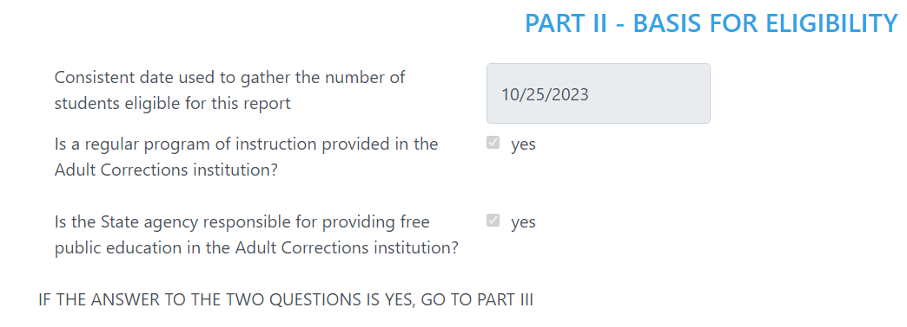
October Count: Subpart 1 Report Date
This process only applies to State agencies who operate N&D educational programs, namely, the DOC and HHS.
The DOC and HHS must choose a consistent date in October to submit a count of all students in the facility 20 year old or younger who are participating in an educational program.
For an agency with multiple facilities, every facility must use the same count date.

Slide 14
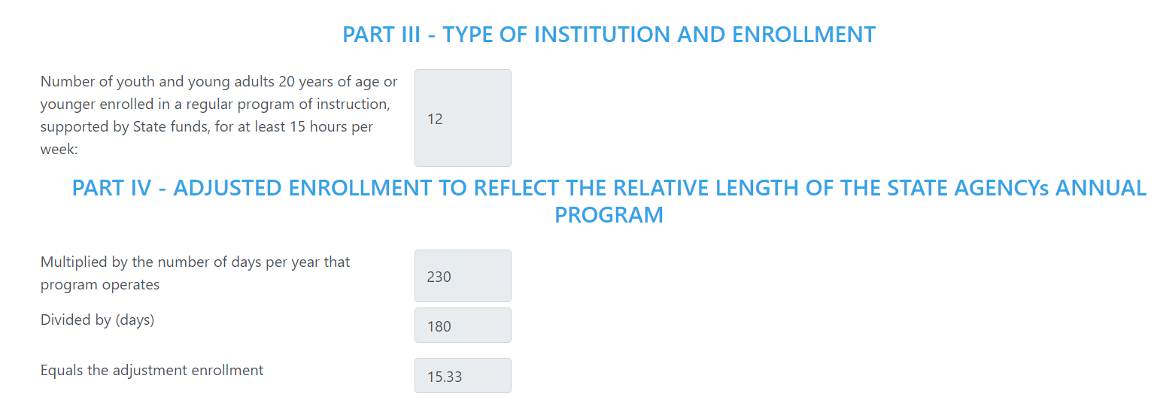
October Count: Subpart 1 Calculations

Slide 15
October Count: Subpart 2
Every fall, all N&D facilities operated by an AEA or LEA must submit their student count number for a 30 day period.
The subgrantee and facility will collaborate to set the dates for their 30-day count period. At least one date of this 30-day period must be in October.
During this 30-day period, all students who are present for one day or more in the facility are counted towards the total.
If a student exits the facility and then returns, that student must be counted twice.

Slide 16
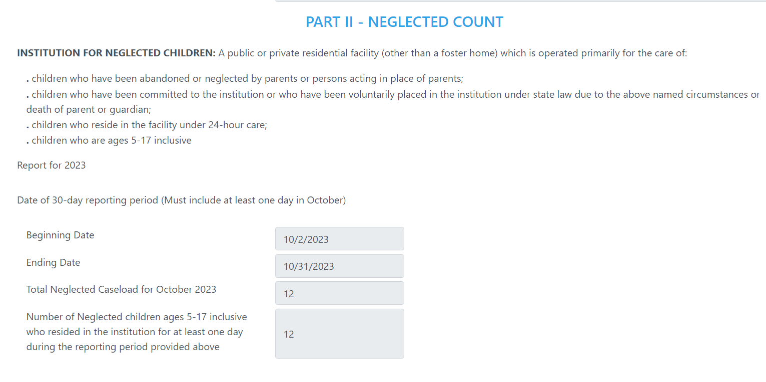
October Count: Subpart 2 Report Date

Slide 17
Title 1 Part D
Federal Reporting

Slide 18
Consolidated State Performance Report (CSPR)
CSPR data is collected during the fiscal year and is collated and send to the federal government after the Fiscal Year has concluded (June 30).
The CSPR collects demographic data, as well as academic and vocational outcomes.
Remember, Neglected facilities operating under Title I Part A are not required to participate in this process.

Slide 19
Demographic Data
For each participating student, the Department collects:
Last Name
First Name
State ID (Department of Education ID preferred)
Date of Birth
Whether they received Title services
Gender (Male, Female, Other)
Race (American Indian or Alaska Native, Asian, Black or African American, Native Hawaiian or other Pacific Islander, Two or More Races, White)
Whether the student had a High School Diploma or HiSET upon entrance
Comments, if needed (this is where an “Other” gender will be specified)

Slide 20
Demographic Data
For each participating student, the Iowa Department reports to the USED:
Total number of participating students
Total number of students in the facility for 90 days or more (“Long Term Students”)
Total number of students who received Title services
Total disaggregated by gender (Male, Female, Other)
Total disaggregated by race (American Indian or Alaska Native, Asian, Black or African American, Native Hawaiian or other Pacific Islander, Two or More Races, White)
Total disaggregated by age

Slide 21
Facility Data
For each participating facility, the Department collects and reports to the USED:
The facility name
The subgrantee (SEA, AEA, LEA)
The program type
Adult Corrections
Juvenile Detention Centers
Residential Treatment Centers
Long-term Secure Juvenile Facilities
The average length of stay
The average number of days served

Slide 22
Educational and Academic Data
For each participating student, the Department collects and reports to the USED:
Total number of students with IEPs
Total number of students who were identified as English Language Learners
Total number of students determined to be “proficient” on a State assessment
Total number of students determined to be “not yet proficient” on a State assessment

Slide 23
Academic and Vocational Outcomes
For each long term student, the Department collects and reports to the USED answers to the following questions. The facility will indicate which metrics were met during the student’s time in the facility, and the student’s immediate plans during the first 90 days after they have exited the facility.
Did the student enroll in their local school district? (Post 90 days only)
Did the student earn course credits? (High School only)
Did the student enroll in a HiSET program? (formally GED)
Did the student earn their HiSET?
Did the student obtain their high school diploma?
Was the student accepted or enrolled in a post-secondary program?
Did the student enroll in job training program?
Meaning “vocational training, on-the-job training or other recognized job readiness training programs focused on the acquisition of knowledge and skills that prepare a student for employment.”
Did the student obtain employment?

Slide 24
Federal Funding and Reporting
Facility Type | Application & Claims | October Count? | TID CSPR?
State-Operated Delinquent | Title I Part D Subpart 1 | Yes | Yes
Local Neglected | Title I Part A | Yes | No
Local Delinquent | Title I Part D Subpart 2 | Yes | Yes

Slide 25
Neglected and Delinquent
Annual Applications

Slide 26
Fall Funding Applications in CASA: Program Questions Program Assurances

Slide 27
Fall Funding Applications in CASA: Comprehensive Needs Assessment
This will be implemented beginning in the 2024-2025 School Year (FY 2025) for both Title I Part A Neglected programs and Title I Part D Delinquent programs.
Gather a team of professionals who can provide information about the program.
Gather information to understand what the existing program looks like.
Gather information to describe the student population and the services they need.
Gather information on the types of programming that currently exist to meet the needs of this population.
Review the most recent performance data.
Identify additional services that could support students. Discuss whether these services are successful and readily available.
20 U.S.C. 6434

Slide 28
Fall Funding Applications in CASA: Comprehensive Needs Assessment
Discuss the current teaching staff, and what support they need.
Discuss whether additional teaching staff are needed.
Discuss the strengths and needs of the current relationship between the facility, program and agencies.
Discuss the current policies and procedures regarding information sharing between the facility, program and agencies.
What are the overall strengths of the existing program?
What are the overall needs of the existing program?
20 U.S.C. 6434

Slide 29
Fall Funding Applications in CASA: Budget
100% of the carryover and current year allocation must be budgeted.
The budget must reflect the needs identified in the Comprehensive Needs Assessment.
The budget must align with the answers to the program questions within the application.
Title I Part D Subpart 1 subgrantees ONLY (DOC and HHS) must reserve at least 15% of their budget for transition-related programs and services (20 U.S.C. 6438).
Always explain any use of the “Other” line item and budget code.

Slide 30
Fall Funding Applications in CASA: Budget Categories

Slide 31
Fall Funding Applications in CASA: Budget Categories

Slide 32
Fall Funding Applications in CASA: Program Questions, Subpart 1

Slide 33
Program Questions for Subpart 1, Questions 1-3
Describe the procedures to be used, consistent with the state plan under section 1111, to assess the educational needs of the children, youth, and young adults to be served under Title ID1 and, to the extent practicable, provide for such assessment upon entry into a facility. (Limited to 500 characters)
Describe the supplemental education program that will be provided with Title ID1 funds. (Limited to 500 characters)
Describe how the program will meet the following student outcomes, as approved in the ESSA state plan:
Students will earn passing grades for 80% of the classes taken;
Students will complete 80% of the courses started while in the facility; and
Annually, 25% of students between the ages of 17-21 will complete their high school diploma or its recognized equivalent. (Limited to 500 characters)

Slide 34
Program Questions for Subpart 1, Questions 4-5
Will the state agency operate an institution-wide program? (Yes /No)
Indicate how the state agency will consult with experts and provide the necessary training for appropriate staff to ensure that the planning and operation of institution-wide projects under section 1416 are of high quality. (Check all that apply)
❑ Facility staff will work closely with experts to provide necessary training for the staff.
❑ Professional development is provided on an ongoing basis based on the needs of staff as aligned with the comprehensive needs assessment results.
❑ Other (Limited to 150 characters)
Describe how the state agency will use the results of the most recent evaluation under section 8601 to plan and improve the program. (Limited to 500 characters)

Slide 35
Program Questions for Subpart 1, Questions 4-6
Indicate how the programs will be coordinated with other appropriate state and federal programs, such as programs under Title I of the Workforce Innovation and Opportunity Act, career and technical education programs, state and local dropout prevention programs, and special education programs. (Check all that apply)
❑ Work jointly with outside agencies to assist students and specific needs for college/career readiness.
❑ Ensure that all students have access to career and technical programs.
❑ Ensure that students have access to staff from Iowa Workforce Development and Iowa Vocational
Rehabilitation.
❑ Other (Limited to 150 characters)

Slide 36
Program Questions for Subpart 1, Question 7
Indicate how the state agency will encourage facilities receiving Title ID1 funds to coordinate with local educational agencies or alternative education programs attended by children, youth, and young adults before and after their time in congregate care to ensure that student assessments and appropriate academic records are shared jointly between the correctional facility and the local educational agency or alternative education program in order to facilitate the transition of such children, youth, and young adults between the correctional facility and the local educational agency or alternative education program. (Check all that apply)
❑ The program has a dedicated staff member as the transition coordinator/liaison to coordinate with local educational agencies or alternative education programs attended by children, youth, and young adults prior to and after their time in congregate care to ensure that student assessments and appropriate academic records are shared jointly.
❑ The program has policies and procedures for the transition process.
❑ The program uses standardized assessments (Iowa Delinquency Assessment or IDA) and/or intake
and discharge forms created by the Juvenile Reentry Systems Grant (JRes) teams.
❑ The program uses the Youth Transition Decision-Making (YTDM) model and completes the transition
interview protocol for preparing to return to the local community.
❑ Other (Limited to 150 characters)

Slide 37
Program Questions for Subpart 1, Questions 8-9
Indicate how facilities will follow the Iowa Department of Education's professional development model while training staff in the following areas? (Check all that apply)
❑ Professional learning communities
❑ Universal design of instruction
❑ Evidenced-based intervention instructional strategies
❑ Special education strategies
❑ Transitions
❑ Other (Limited to 150 characters)
Name the person at each correctional facility or institution for neglected or delinquent children and youth responsible for issues relating to the transition of such children and youth between such facility or institution and locally-operated programs.

Slide 38
Fall Funding Applications in CASA: Program Questions, Subpart 2

Slide 39
Program Questions for Subpart 2, Questions 1-4
Briefly describe the supplemental education program that will be provided to students with Title ID2 funds. (Limited to 500 characters)
Describe, as appropriate, how participating schools will coordinate with neglected and delinquent facilities to ensure that students are participating in an education program comparable to one operating in the local school these students would attend, including high-quality academics, state-aligned curriculum and instructional time as would be provided in a traditional public school. (Limited to 500 characters)
Describe how the school will coordinate existing educational programs to meet the unique educational needs of such students . (Limited to 500 characters)
Describe the efforts participating schools will make to ensure neglected and delinquent facilities working with students are aware of a student’s existing individualized education program. (Limited to 500 characters)

Slide 40
Program Questions for Subpart 2, Questions 5-8
Describe the characteristics (including learning difficulties, substance use disorders, and other special needs) of the students who will be residing in neglected and delinquent facilities and, as appropriate, other at-risk students expected to be served by the program. (Limited to 500 characters)
Describe, as appropriate, how the program will involve parents and family members in efforts to improve the educational achievement of their children, assist in dropout prevention activities, and prevent the involvement of their children in delinquent activities. (Limited to 500 characters)
Describe how the program under this subpart will be coordinated with other Federal, State, and local programs, such as programs under Title I of the Workforce Innovation and Opportunity Act and career and technical education programs serving at-risk children and youth. (Limited to 500 characters)
Describe the program operated by participating schools to facilitate the successful transition of students returning from neglected and delinquent facilities and, as appropriate, the types of services that such schools will provide them and other at-risk students. (Limited to 500 characters)

Slide 41
Program Questions for Subpart 2, Question 9
The facility will coordinate and/or partner with which of the following to meet the needs of students returning from neglected and delinquent facilities? (Check all that apply)
❑ Local/county social, health, and other services
❑ Prenatal health care and nutrition services
❑ Parenting and child development classes
❑ Child care
❑ Targeted reentry and outreach programs
❑ Medicaid
❑ Iowa Aftercare/Supervised Apartment Living
❑ Referrals to community resources
❑ Other

Slide 42
Program Questions for Subpart 2, Question 10
The facility will coordinate and/or partner with which of the following to meet the needs of students returning from neglected and delinquent facilities? (Check all that apply)
❑ Local/county social, health, and other services
❑ Prenatal health care and nutrition services
❑ Parenting and child development classes
❑ Child care
❑ Targeted reentry and outreach programs
❑ Medicaid
❑ Iowa Aftercare/Supervised Apartment Living
❑ Referrals to community resources
❑ Other

Slide 43
Title 1 Part D
Claims and Expenditures

Slide 44
Appropriate Use of Funds
Instructional
Non-Instructional
Career and Technical Education
Dropout prevention programs
Entrepreneurship curriculum
Guidance counseling/college prep
Supplementary instructional materials
Daycare for parenting teens
Drug and alcohol counseling
Mentoring
Peer mediation
Transition services/coordinator

Slide 45
Most Common Claim Errors and How to Avoid Them
Claim Error | Solution
Staffing is being coded in one bucket (e.g. “Detention Center Staffing”) instead of by object codes (100s, 200s). | Code Neglected and Delinquent staff like any other LEA staff, unless they are contracted workers.
Large expenditures labeled as “supplies” with no additional information. | Proactively identify in claim’s Communications section how supplies, textbooks and assessment materials will be used to supplement ( and not supplant) other funds.
Claiming expenses already required by law, such as CPR training and teacher licensure fees. | The “supplement not supplant” rule requires that any expense required by State or Federal law must be paid for out of other funds. Title I funds must go beyond required expenses/services.

Slide 46
Supplement, Not Supplant
Supplant 🖓 | Supplement 🖒
Nonfiction books required by the ELA curriculum. | Additional high interest books to support nonfiction reading skills.
Assessment software used to monitor the progress of all students. | Assessment software to collect additional academic performance data for students who are more than one year behind in credits.
A brand new social emotional curriculum to implement schoolwide. | Curriculum intended to teach safe dating behaviors to students who have experienced domestic violence.

Slide 47
Additional Resources
ESSA Guidance & Allocations | Department of Education (Subpart 1)
ESSA Guidance & Allocations | Department of Education (Subpart 2)
NDTAC technical assistance center for Title I Part D
Neglected, Delinquent, or At-Risk – Title I, Part D - Office of Elementary and Secondary Education
Office of Juvenile Justice and Delinquency Prevention
Education of Children in Foster Care | Iowa Department of Education

Slide 48
Contact Information:
elisa.koler@iowa.gov
515-669-4052

