Slide 1
LEA User Manager
June 3, 2024

Slide 2
Background: General Supervision Tools
ACHIEVE General Supervision (Phase 2) Tools
What are they and what is their purpose?
Continuous Improvement
Data Collection
Focused Monitoring
Dispute Resolution
Where are they in ACHIEVE?
Who should have access to these tools?
Let’s take a peek!

Slide 3
ACHIEVE LEA User Manager
What is the purpose of the LEA User Manager?
What knowledge and skills does the LEA User Manager need to have to oversee this work?
What is the time commitment for the LEA User Manager to manage the roles and permissions?
What will the LEA User Manager be responsible for?
LEA User Manager Info

Slide 4
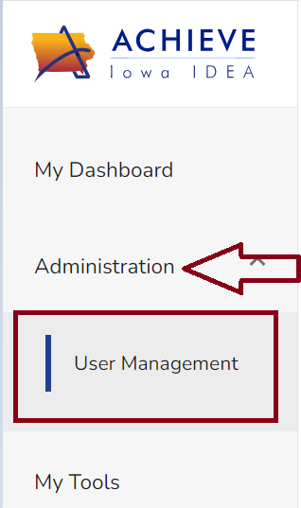
Administration/User Management
LEA User Manager Role Assignment
Assigned by ACHIEVE Super Admin or Data Lead
Locationally defined (district OR individual buildings)
The LEA User Manager will have access to Administration/Learner Management section of ACHIEVE to assign LEA staff within their location General Supervision User Roles.

Slide 5
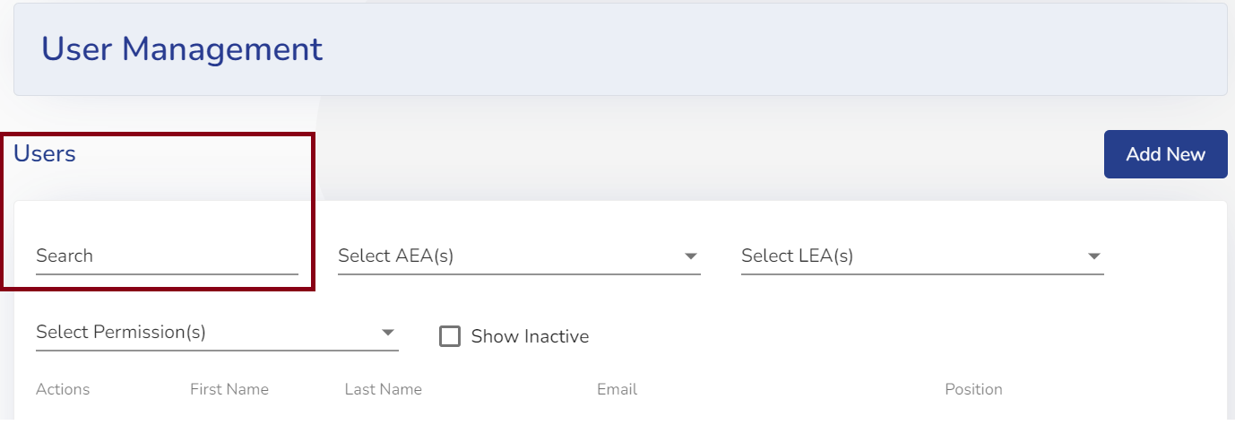
Ability to Search/Add Users
Search ‘all’ ACHIEVE users (training will include searching prior to adding new users)
Filter down by AEA, LEA or Permissions
View inactive users

Slide 6
Add Users
Add new users.
Note: User’s name, phone number, email address, position and location information does not come over to ACHIEVE from Student Information Systems (SIS)
Note: training will include that the flag in the SIS system for ACHIEVE must be set and the email address between ACHIEVE and SIS must be an exact match in order for users to gain access to ACHIEVE via EdPortal.

Slide 7
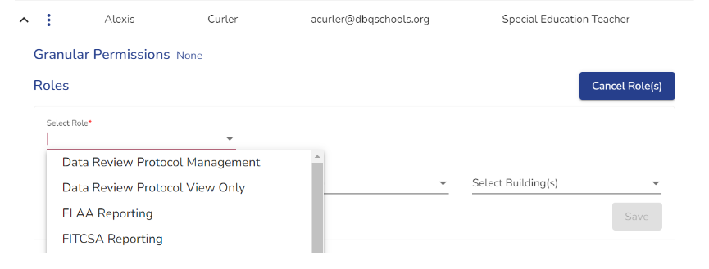
Add a GS Role to ACHIEVE User
LEA User Manager will select ‘add role(s)’. They will then choose the role that they need to assign (only General Supervision Roles will display to assign).

Slide 8
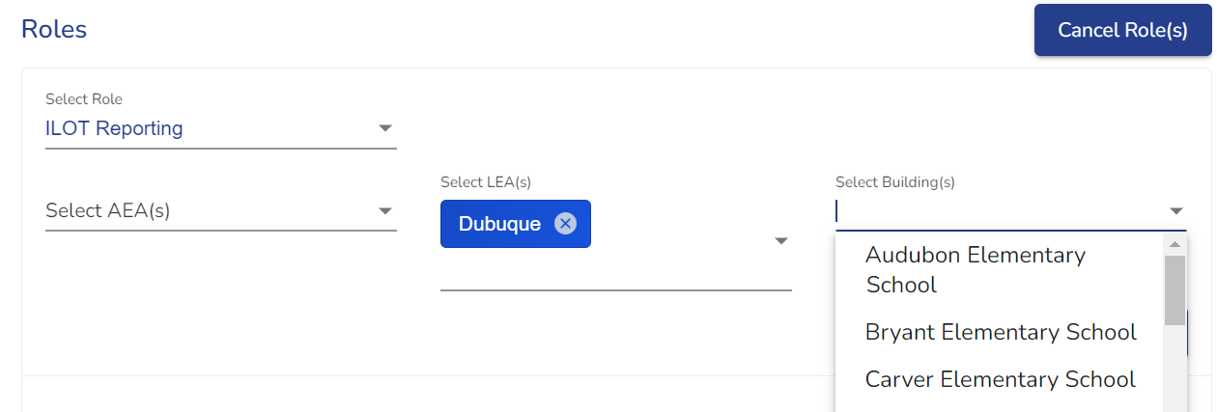
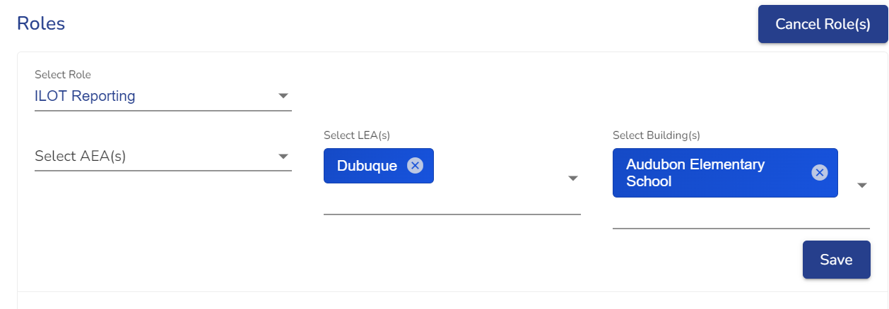
Continued Add a GS Role to ACHIEVE User
LEA User Manager will select location (district and/or building) for the user and click save to assign the role.

Slide 9
LEA User Manager - Next Steps
Next Steps
District Administrator should identify your LEA User Manager in CASA
Due by August 1, 2024
Training for LEA User Managers provided by Iowa Department of Education
Recording for training purposes (Ready by August 1, 2024)
Demo of General Supervision Tools / User guides
Demo of assigning General Supervision Access
Managing internal communication / documentation
Processes for reporting technical issues
LEA User Managers identified in CASA will receive the above training materials in August via email

Slide 10
Q & A

Slide 11
ACHIEVE Contacts
Lisa Lohman, ACHIEVE Technical & Support Specialist
lisa.lohman@iowa.gov
Shannon Grundmeier, ACHIEVE Project Manager shannon.grundmeier@iowa.gov

Slide 12
Thank you!

