Slide 1
Credentials to Careers
Industry Recognized Credentials Award
May 29, 2024
Allowable Use of Funds, Budget Amendments, and Reimbursements
Amy Vybiral, Dennis Harden, & Jeff Fletcher

Slide 2
Agenda May 29, 2024
Period Of Performance
Common Issues
Eligible Purchases
Google Form
Revised Completion Dates
Student Credentials and Reporting
IRC Claim Template Demo
Invoice and receipt attachment demo
Iowa Grants – Instructions
FAQ – Source, Project, & Object Codes
CTC FAQs

Slide 3
Period Of Performance
Round One March 29, 2024 through September 30, 2024
Round two May 1, 2024 through September 30, 2024
All Purchases must be completed by September 30 with an invoice or receipt dated on or before September 30, 2024..
Sufficient Documentation
Invoices and receipts
Date
Item description (eligibility)
Receipt of item or service
Insufficient Documentation –
Claim will be denied
Orders
Purchase orders
Emails
Requisitions, RFQs, estimates
Credit card or bank statements
General ledgers

Slide 4
Credentials to Careers
Revised Completion Dates
Purchase | Purchased (on or before) | Completed or Received (on or before) | Claimed (on or before)
Instructor Training | September 30, 2024 | December 31, 2024 | October 31, 2024
Student Assessments | September 30, 2024 | December 31, 2024 | October 31, 2024
Iowa Grants (all other eligible purchases in the budget form AND application) | September 30, 2024 | September 30, 2024 | October 31, 2024
Travel is ineligible. Contact amy.Vybiral@iowa.gov for funding options.

Slide 5
Credentials to Careers
Eligible Purchases
Eligible
Purchases that support approved Industry Recognized Credentials (IRC)
46 Approved Credentials
Purchases that support IRCs Pending Approval (Submitted at the time of application)
42 Pending Approval
Ineligible
Purchases that support IRCs not on the approved list and not submitted for approval at the time of application.

Slide 6
Credentials to Careers
Google Form
Purpose:
Collect standardized information
IRC to be awarded
Approved or Pending Approval
Change or update IRC(s).
Purchases that accompany IRC
Change or update budgets to align with eligible IRCs.
Projected Credentials Awarded
Change or update credentials or number of credentials awarded.

Slide 7
Credentials to Careers
Google Form
Eligible
Purchases that accompany approved Industry Recognized Credentials (IRC)
46 Approved Credentials
Purchases that accompany IRCs Pending Approval (Submitted at the time of application)
42 Pending Approval
Ineligible
IRCs not on the approved list and not submitted for approval at the time of application.
IRC Ineligible Expenditures (prohibited by federal administrative regulation)
Student transportation
Travel expenses for instructor training
Stipends, salaries, benefits for instructor training.

Slide 8
Student Assessments, Credentials and Reporting
Assessments must be purchased on or before September 30, 2024.
Assessments must be claimed on or before October 31, 2024.
Credential Reporting:
December 31, 2024
March 31, 2025
June 30, 2024
Credential reporting update, Fall 2024

Slide 9
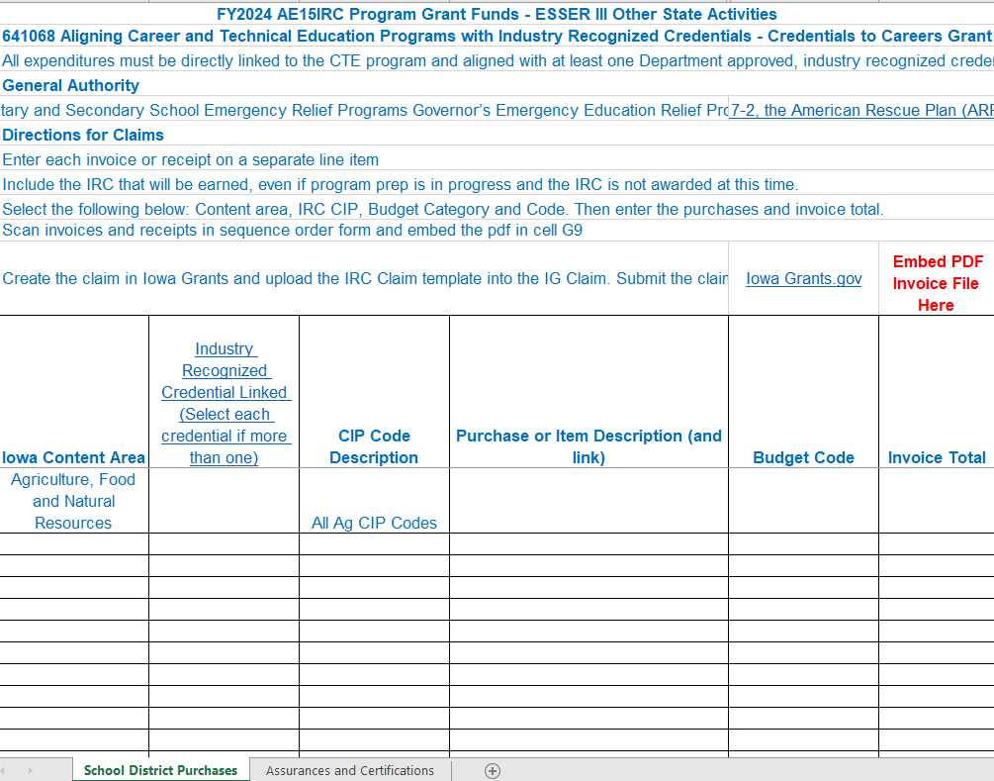
IRC Claim Template

Slide 10
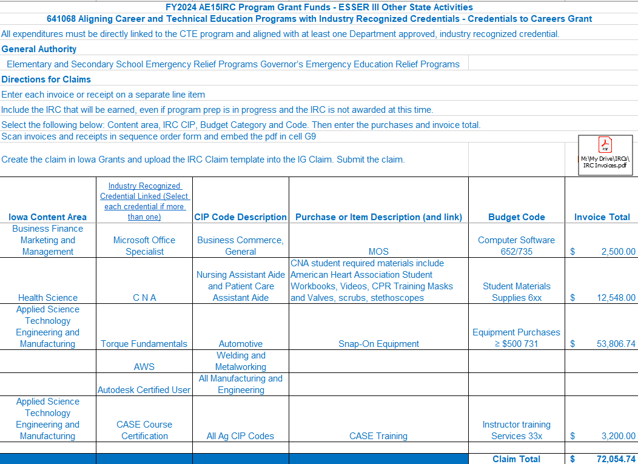
Completed Claim Template with Documentation

Slide 11
Credentials to Careers Updates
Source, Project, and Object Codes
Question 1: What is the source/project code for the Credential to Careers grant?
Districts will use Source/Project 4057 for this grant
See Slide 14 for setting up separate accounts if districts received multiple awards.
Question 2: How long does the district have to spend the grant funds?
Districts will have until September 30, 2024.
Invoices dated after September 30 will not be reimbursed. See the timeline below:
Purchased items must be received by September 30, 2024.
Services must be rendered/completed by September 30, 2024
Instructor training must be completed by September 30, 2024.
Student assessments must be administered/completed by December 31, 2024. Credential reporting for this grant goes through June 30, 2025.

Slide 12
Credentials to Careers Updates
Frequently Asked Questions (FAQs)
Question 3: What can the district purchase in each budget code and what are the applicable object codes?
Computer Hardware Object 734
Computers, Promethean interactive panels, touchscreen monitors
Network equipment, PCs, tablets, peripheral devices
Computer Software Object 652/735
Equipment Purchases ≥ $500.00 Object 731
Lathe, 3D printers, auto lifts, laser engravers, air compressors,
air tools, auto creepers & stools, automotive diagnostic tools,
lifting systems, etc.
Equipment Rentals Object 442
Installation Costs Object 43X
Non-capital expenditures
Instructional Supplies ≤ $499.00 Object 6XX
Reusable kits, supplies, textbooks and workbooks
Computer charging cart, Nasco culinary demonstration table
parts washers, auto tools

Slide 13
Credentials to Careers Updates
Frequently Asked Questions (FAQs)
Question 3: What can the district purchase in each budget code and what are the applicable object codes? (cont.)
Instructor Training Services Object 33X
Professional development
Training required by third party credentialing vendor
Travel expenses are ineligible.
Instructor stipends are ineligible.
Internet Service Object 536
Student Assessment Fees Object 325
Certified Nurse Aide Assessment
Certified Nurse Aide Written Exam
Student Required Material (Supplies) Object 6XX
CPR training masks, valves, scrubs, stethoscopes
Auto tool kits, welding jackets, gloves, helmets, masks
Supplemental Curriculum Object 6XX
Basic life support textbooks
Vendor specific curriculum (ProStart, Snap-On, AWS, Microsoft Office)

Slide 14
Credentials to Careers Updates
Frequently Asked Questions (FAQs)
Question 4: If the district received multiple awards under the Credential to Careers grant, how does the district account for them separately?
District will use the applicable program codes below.
310 Agriculture, Food & Natural Sciences
315 Architecture & Construction
320 Arts, A/V Technology and Communications
325 Business, Management, and Administration
330 Education and Training
335 Finance
345 Health Science
350 Hospitality and Tourism
355 Human Services
360 Information Technology
365 Law, Public Safety & Security
370 Manufacturing
375 Marketing
385 Transportation, Distribution and Logistics

Slide 15
Credentials to Careers Updates
Frequently Asked Questions (FAQs)
Account Code Contact Information
Department Contacts:
Program and claim questions may be directed to Amy Vybiral at amy.vybiral@iowa.gov.
Account coding questions may be directed to Jina Brincks at jina.brincks@iowa.gov or Song Luong at song.luong1@iowa.gov.

Slide 16
Credentials to Careers Updates
Frequently Asked Questions (FAQs)
Are we cleared to order now?
Yes.
We are purchasing equipment for a commercial kitchen that requires remodeling, rewiring, plumbing, and flooring and won’t have the space fully in use by September 30. Are we in compliance?
As long as all invoices are dated on or before September 30 and equipment is received and purchased services are completed by September 30, compliance is met.

Slide 17
Credentials to Careers Updates
Frequently Asked Questions (FAQs)
There is no budget category for travel. May I use IRC funds to travel for professional development?
No. Grant funds may only be used for the cost to train and certify instructors.
May I spend Perkins for travel to instructor training for implementation of the IRC into the curriculum?
Yes. Perkins may be used for mileage, parking, airfare, baggage, hotel, meals, and ground transportation.

Slide 18
Credentials to Careers Updates
Frequently Asked Questions (FAQs)
How long do we have to complete student assessments and award student credentials.
Students must be assessed by December 31, 2024, however, assessment may continue through June 30, 2025 as final credential reporting will be collected through June 30, 2025.
Note: Credential award data will be collected:
September 30, 2024
December 31, 2024
March 31, 2024
June 30, 2024
What if we do not use all of the CTC purchased assessments?
Continue to use all IRC assessments with career and technical students.
Reporting updates will be sent when available.
Note: Continue to purchase the same assessments with Perkins funds to avoid supplanting issues in future years. Once non-Federal funds are used to purchase assessments for IRCs, federal funds may not be used in future program years.
Are there any tests that cannot be claimed with Perkins after September 30, 2024?
No. Every credential on the is Perkins eligible

Slide 19
Credentials to Careers Updates
Frequently Asked Questions (FAQs)
We have quotes that have higher prices than the quotes submitted with
the application. Can we still order these at the higher prices if we don’t
exceed the allocation?
Yes.
Can 2024 graduates enroll in IRC summer classes?
Yes, all high school CTE students, including academic year 2024 graduates reported in SCTERA are eligible to receive IRC training.

Slide 20
Contact Information
Dennis Harden - 515-314-7852
Allowable use of funds
Credentials to Careers/IRC Questions
Amy Vybiral - 515-339-4520
Filing Claims in Iowa Grants
IRC Claim Template
Prior approval
Iowa Industry-Recognized Credentials website
Credentials to Careers slide deck & recording
Listed under “May 29 Recording”
Jeff Fletcher - 515-321-7309
Iowa Grants Technical Assistance

